Slide 1
Challenge 4
        6 x 7 = 2 x 7 =
        12 x 9 = 8 x 7 =
        7 x 9 = 3 x 7 =
        1 x 9 = 11 x 7 =
        12 x 6 = 3 x 9 =
        10 x 6 = 8 x 9 =

Slide 2
Year 4 | Week 11 | Day 5

Slide 3
L.O. - To find the area of rectilinear shapes by counting squares.
SOME WILL EVEN: Use two clues and an image of Shape A to compare and find the possible area of Shae B on a grid; Draw a rectilinear shape, with a smaller or bigger area than a given value.
SOME WILL: Compare the area of rectilinear shapes where some parts of the shapes take up a half, quarter or three-quarters of a grid square.
MOST WILL: Compare the area of rectilinear shapes.
ALL WILL: Compare the area of squares and rectangles.

Slide 4
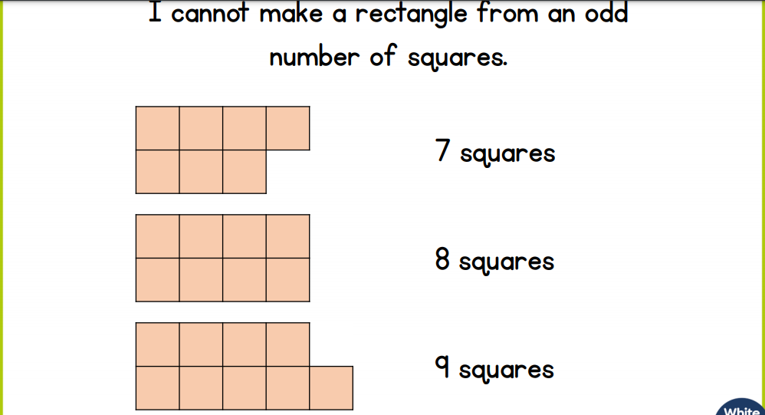
True or false:

Slide 5
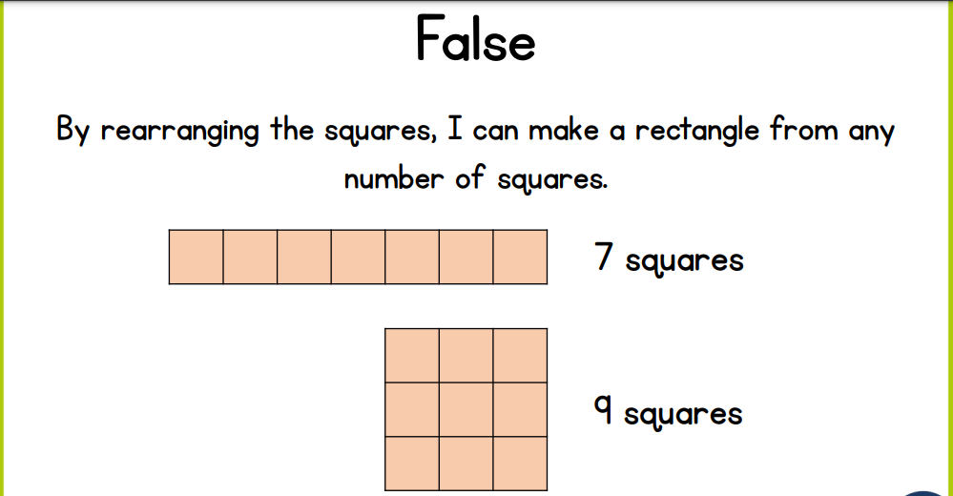
True or false:

Slide 6
GUIDED PRACTICE:

Slide 7


Introduction
Find the area of the shapes below.
A
B
C
© Classroom Secrets Limited 2019

Slide 8
Introduction
Find the area of the shapes below.
A
B
C
14 squares
10 squares
12 squares
© Classroom Secrets Limited 2019

Slide 9
Varied Fluency 1
Circle the shape with the largest area.
 | A |  |  |  |  |  | B
© Classroom Secrets Limited 2019

Slide 10
Varied Fluency 1
Circle the shape with the largest area.
 | A |  |  |  |  |  | B
© Classroom Secrets Limited 2019

Slide 11
Varied Fluency 2
Insert <, > or = to correctly compare the shapes below.
A |  |  |  | B
 | A |  |  |  |  |  | B
© Classroom Secrets Limited 2019

Slide 12
Varied Fluency 2
Insert <, > or = to correctly compare the shapes below.
A |  | < |  | B
 | A |  |  |  |  |  | B
© Classroom Secrets Limited 2019

Slide 13
Varied Fluency 3
Compare the shapes below.
Which statement is incorrect?
A has an area smaller than B.
The area of A is 4 squares smaller than B.
B has an area of 14 squares.
 | A |  |  |  |  | B
© Classroom Secrets Limited 2019

Slide 14
Varied Fluency 3
Compare the shapes below.
Which statement is incorrect?
A has an area smaller than B.
The area of A is 4 squares smaller than B.
B has an area of 14 squares. (B = 13 squares)
 | A |  |  |  |  | B
© Classroom Secrets Limited 2019

Slide 15

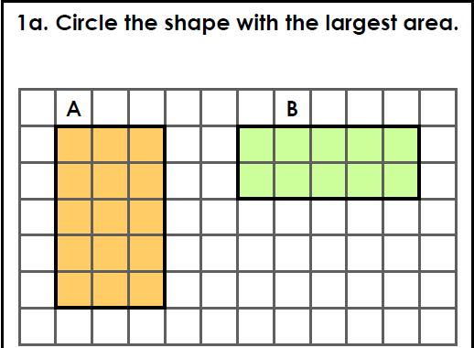
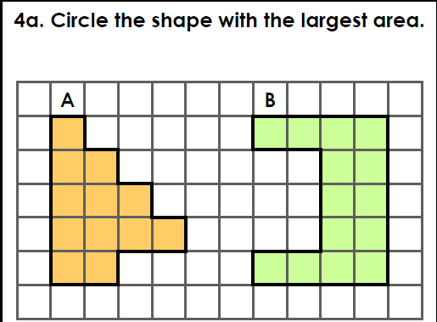
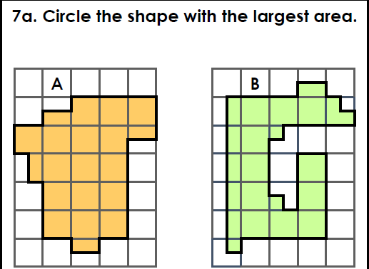
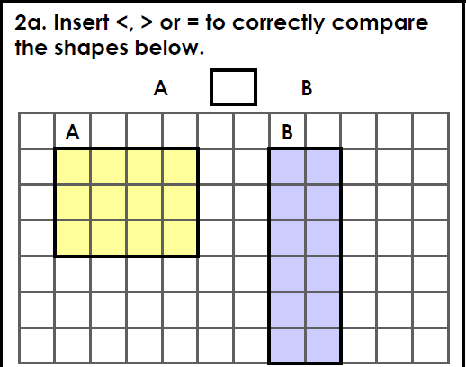
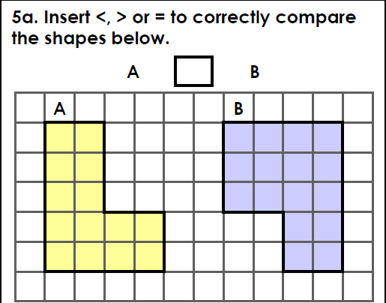
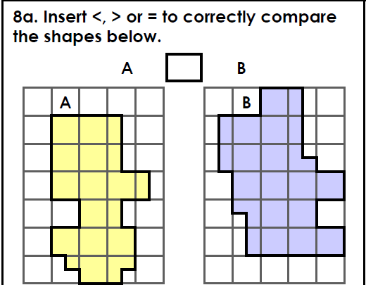
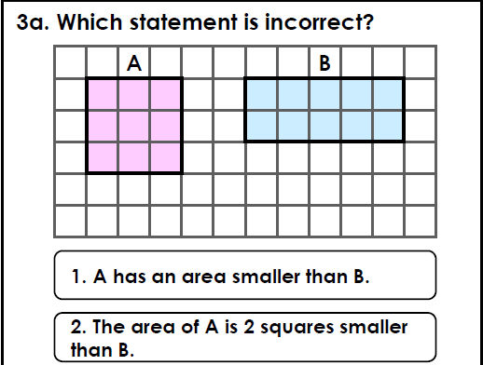
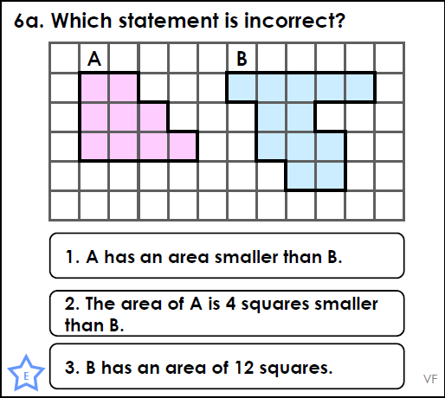
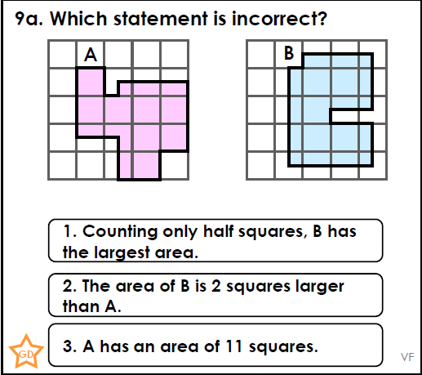
Intelligent Practice

Slide 16

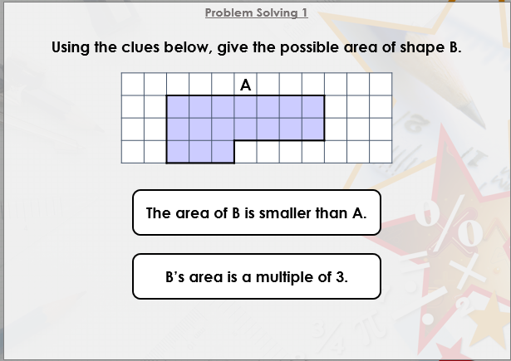


Slide 17

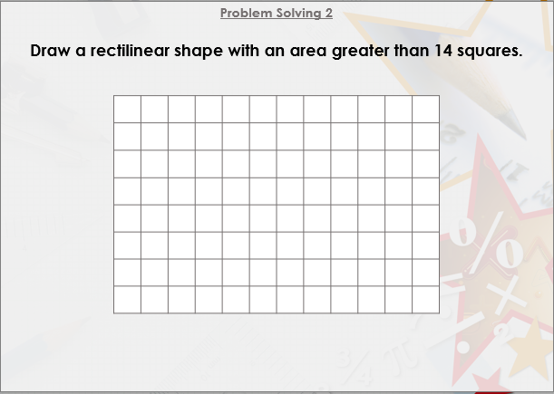

Slide 18

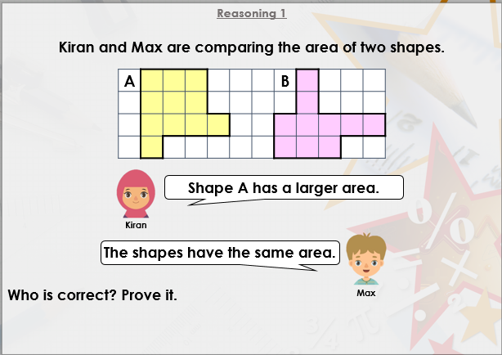
DIVE DEEPER 3

Slide 19
A | B | A
A = B | A < B | A < B
2 is incorrect because the area of A is 1 square smaller than B. | 2 is incorrect because the area of B is 3 squares smaller than A. | 2 is incorrect because both shapes have an equal area.
Intelligent Practice

Slide 20
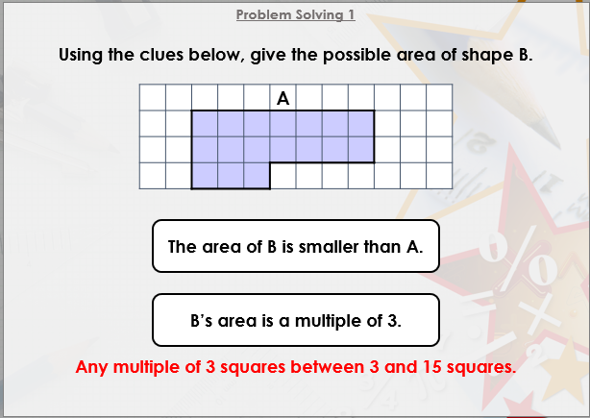

Slide 21
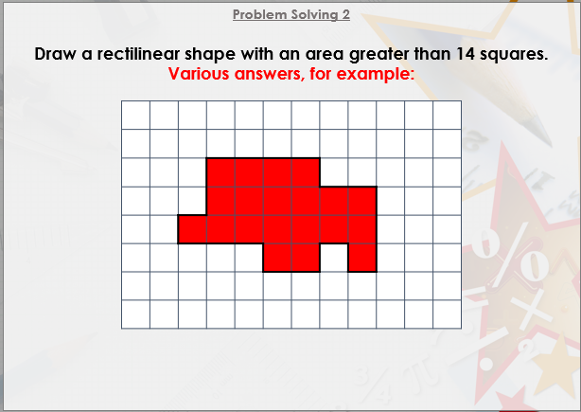

Slide 22
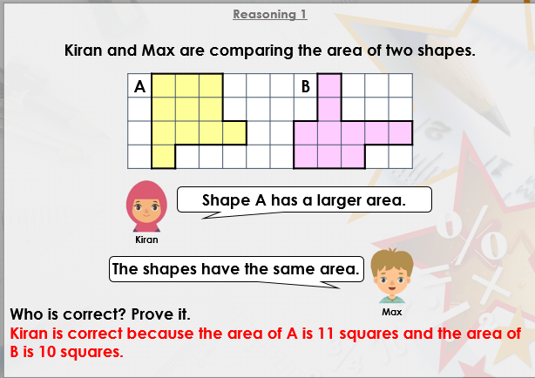
DIVE DEEPER 3

