Slide 1
Challenge 3
        4 x 6 = 9 x 9 =
        2 x 6 = 4 x 9 =
        7 x 7 = 7 x 6 =
        12 x 7 = 8 x 6 =
        11 x 7= 9 x 7 =
        2 x 9 = 10 x 7 =

Slide 2
Year 4 | Week 11 | Day 4

Slide 3
L.O. - to find the area of rectilinear shapes by counting squares
SOME WILL EVEN: Determine whether the given statement about making shapes is correct; Draw three possible rectilinear shapes to match a given area; Complete a rectilinear shape on a grid using squares and half squares.
SOME WILL: Make rectilinear shapes using squares and half squares and then counting the area.
MOST WILL: Make rectilinear shapes using squares and then counting the area.
ALL WILL: Make squares and rectangles and then count the area.

Slide 4
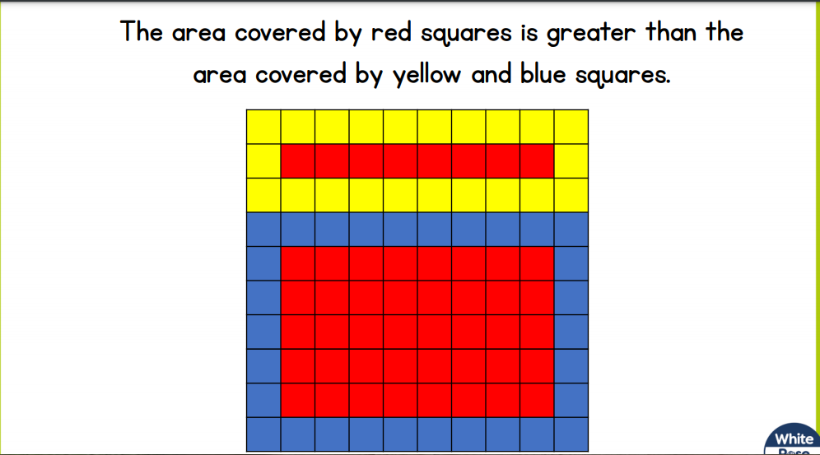
True or false:

Slide 5
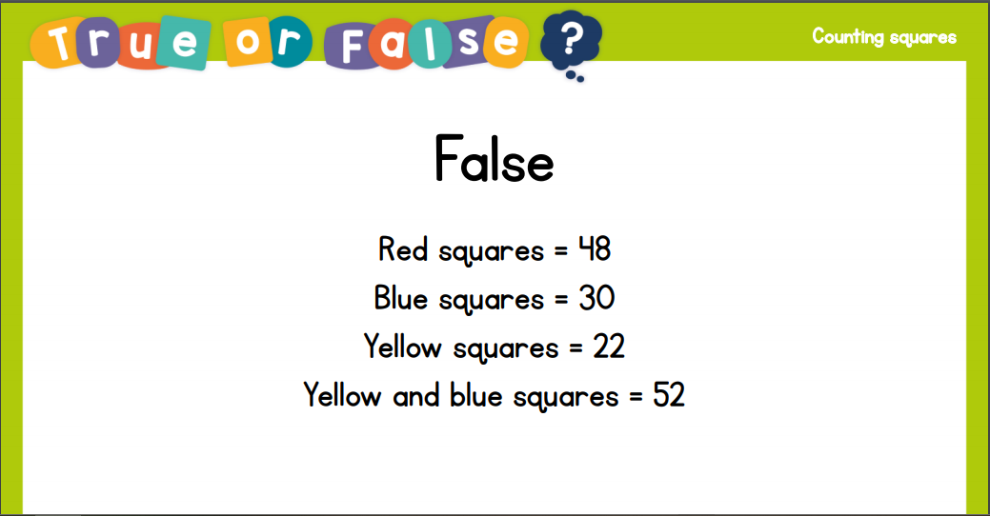
True or false:

Slide 6
GUIDED PRACTICE:

Slide 7


Introduction
What is the area of each shape below?
A.
B.
C.
D.
E.
© Classroom Secrets Limited 2018

Slide 8
Introduction
What is the area of each shape below?
A.
B.
C.
9 squares
12 squares
8 squares
D.
E.
14 squares
15 squares
© Classroom Secrets Limited 2018

Slide 9
Varied Fluency 1
Justin has made this shape using six identical square tiles.
Rearrange the tiles to make a different 8-sided shape.
© Classroom Secrets Limited 2018

Slide 10
Varied Fluency 1
Justin has made this shape using six identical square tiles.
Rearrange the tiles to make a different 8-sided shape.
Various answers, for example:
© Classroom Secrets Limited 2018

Slide 11
Varied Fluency 2
Create a rectilinear shape to make the inequality statement correct.
>
© Classroom Secrets Limited 2018

Slide 12
Varied Fluency 2
Create a rectilinear shape to make the inequality statement correct.
Shape must be fewer than 12 squares.
Various answers, example shown above.
>
© Classroom Secrets Limited 2018

Slide 13
Varied Fluency 3
True or false?
You can make a 6-sided shape with 6 square tiles.
© Classroom Secrets Limited 2018

Slide 14
Varied Fluency 3
True or false?
True.
You can make a 6-sided shape with 6 square tiles.
© Classroom Secrets Limited 2018

Slide 15
Varied Fluency 4
Jemima wants to create three different rectilinear shapes using 24 square tiles. She has completed two. Create a shape with the remaining tiles.
© Classroom Secrets Limited 2018

Slide 16
Varied Fluency 4
Jemima wants to create three different rectilinear shapes using 24 square tiles. She has completed two. Create a shape with the remaining tiles.
Shape must be made up of 9 squares, example shown above.
© Classroom Secrets Limited 2018

Slide 17

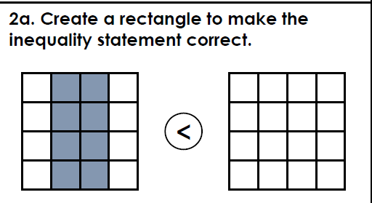
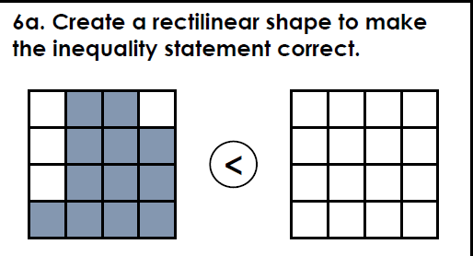
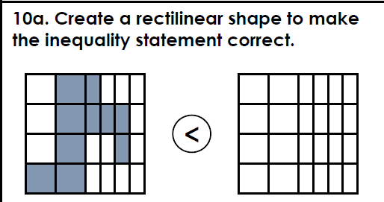
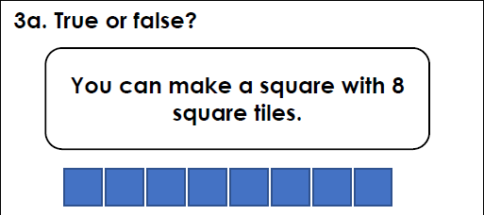
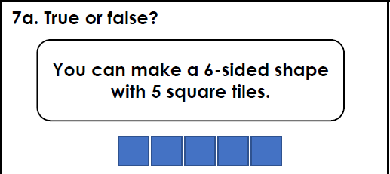
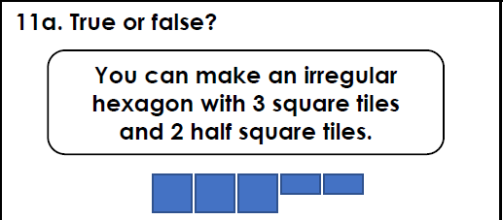
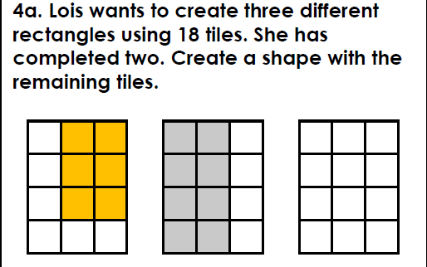
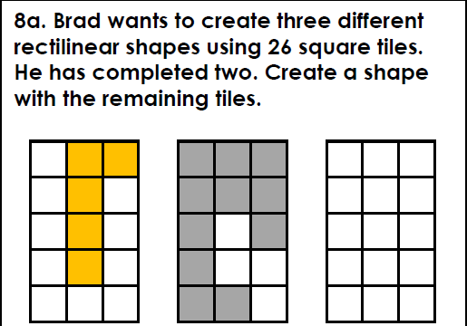
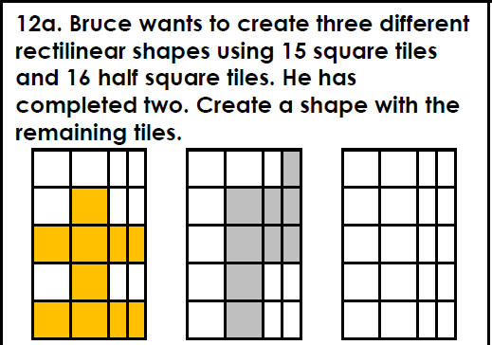
Intelligent Practice

Slide 18

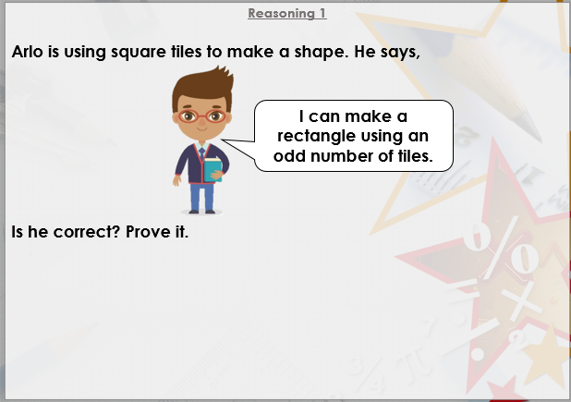


Slide 19

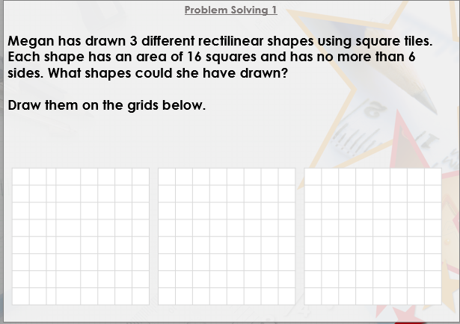

Slide 20

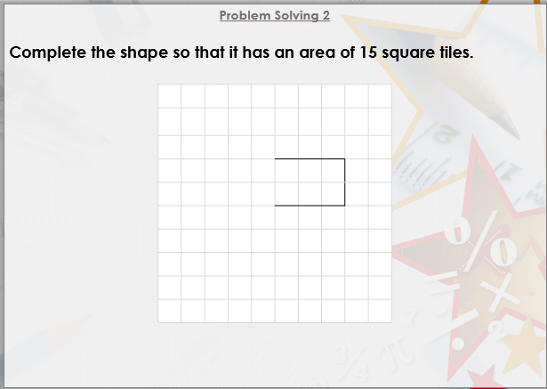
DIVE DEEPER 3

Slide 21


Any rectangle with an area of 8 squares or more. | Any shape with an area of 13 squares or more. | Any shape with an area of more than 7 and a half squares.
False. Only a rectangle can be made with 8 squares. | True: | True:
Any shape with an area of 4 squares. | Any shape with an area of 10 squares. | Any shape with an area of 5 squares and 7 half squares.
Intelligent Practice

Slide 22
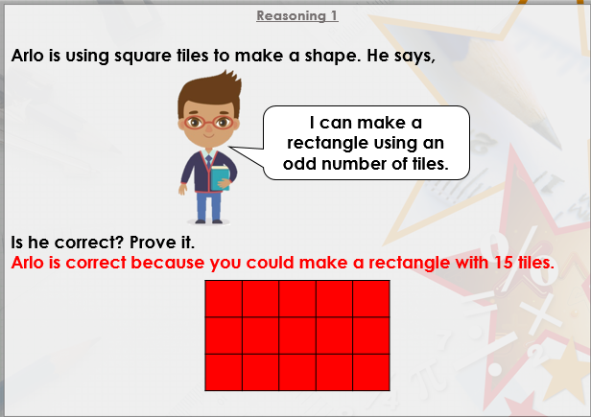

Slide 23
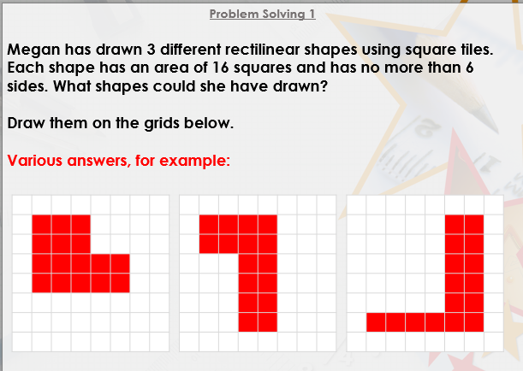

Slide 24
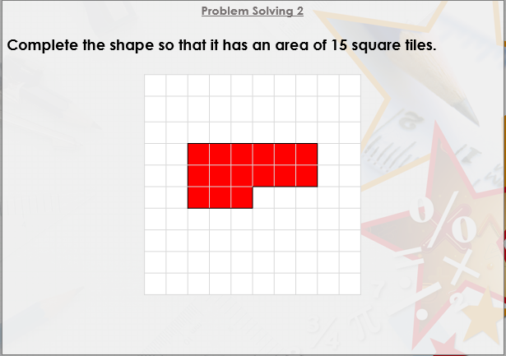
DIVE DEEPER 3

Slide 25

Intelligent Practice

