Slide 1
Challenge 2
        8 x 7 = 11 x 7 =
        3 x 9 = 9 x 7 =
        10 x 9 = 6 x 7 =
        9 x 9 = 12 x 9 =
        12 x 6 = 4 x 9 =
        11 x 6 = 7 x 9 =

Slide 2
Year 4 | Week 11 | Day 3

Slide 3
L.O. - To find areas of rectilinear shapes by counting squares
SOME WILL EVEN: Calculate the number of squares in a repeated pattern when a shape is made larger; Count the area of a rectilinear shape up to 8 sides to explain whether there are enough squares to complete a pattern.
SOME WILL: To find the area of rectilinear shapes with up to 8 sides by counting squares.
MOST WILL: To find the area of squares and rectilinear shapes with up to 6 sides by counting squares.
ALL WILL: To find the area of squares and rectangles by counting squares.

Slide 4
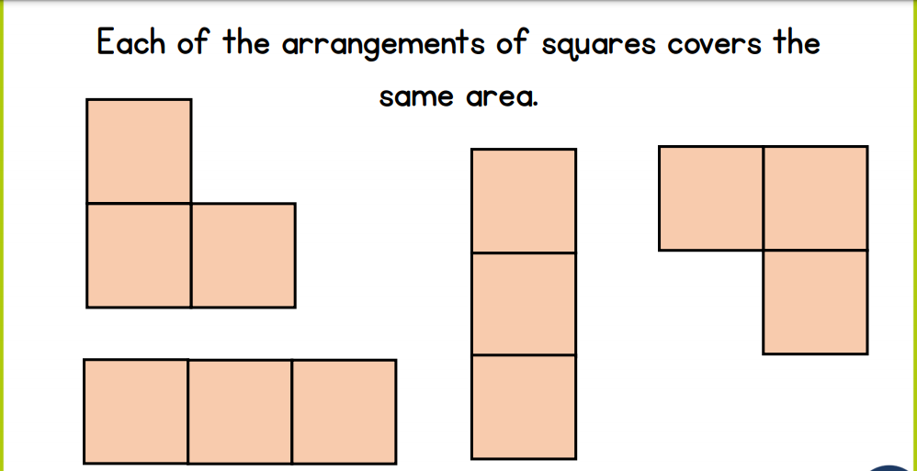
recall:

Slide 5
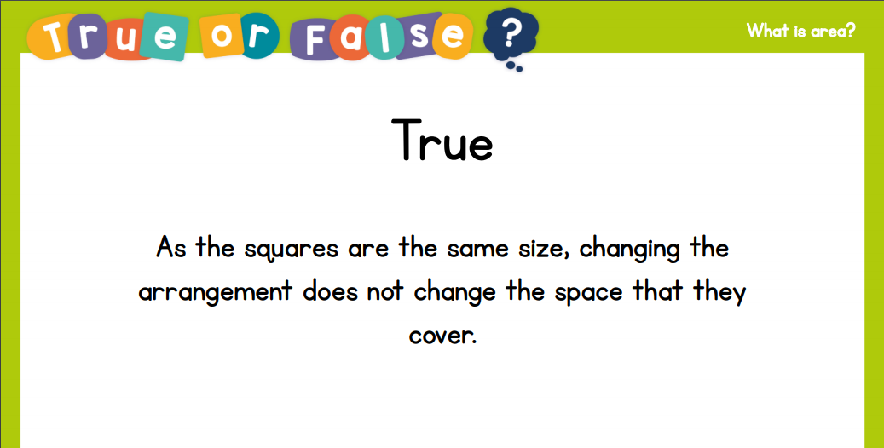
recall:

Slide 6
GUIDED PRACTICE:

Slide 7


Introduction
Estimate the area of the shapes below. Use the reference square to help you.
A
B
© Classroom Secrets Limited 2018

Slide 8
Introduction
Estimate the area of the shapes below. Use the reference square to help you.
A = 17 squares
A = 16 squares
© Classroom Secrets Limited 2018

Slide 9
Varied Fluency 1
Circle the correct area for the shape below.
15 squares |  | 17 squares |  | 19 squares
© Classroom Secrets Limited 2018

Slide 10
Varied Fluency 1
Circle the correct area for the shape below.
15 squares |  | 17 squares |  | 19 squares
© Classroom Secrets Limited 2018

Slide 11
Varied Fluency 2
Match the shape to the correct number sentences.
A.
20 squares
5 x 4 = 20 squares
B.
14 squares
2 x 4 and 2 x 3 = 14 squares
© Classroom Secrets Limited 2018

Slide 12
Varied Fluency 2
Match the shape to the correct number sentences.
A.
20 squares
5 x 4 = 20 squares
B.
14 squares
2 x 4 and 2 x 3 = 14 squares
© Classroom Secrets Limited 2018

Slide 13
Varied Fluency 3
Calculate the area of this shape.
 | squares
© Classroom Secrets Limited 2018

Slide 14
Varied Fluency 3
Calculate the area of this shape.
18 | squares
© Classroom Secrets Limited 2018

Slide 15
Varied Fluency 4
Complete the inequality statement.
© Classroom Secrets Limited 2018

Slide 16
Varied Fluency 4
Complete the inequality statement.
<
17 squares
21 squares
© Classroom Secrets Limited 2018

Slide 17

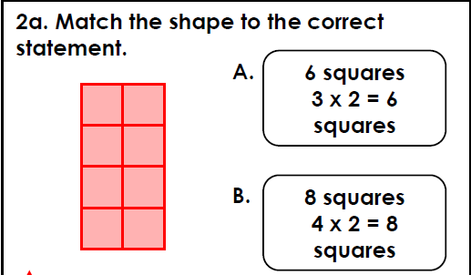
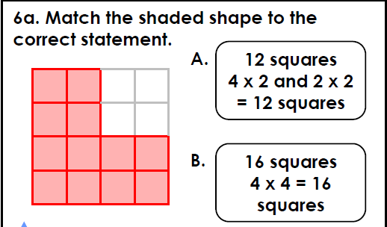
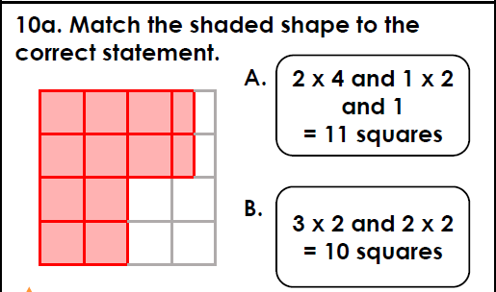
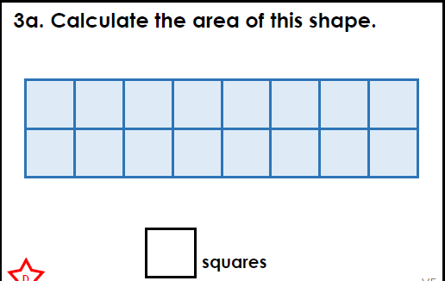
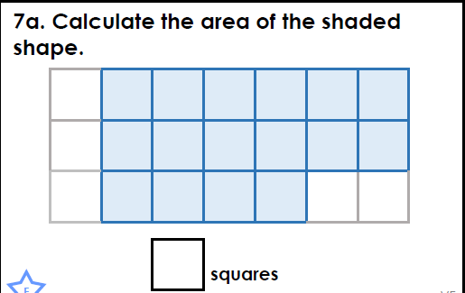
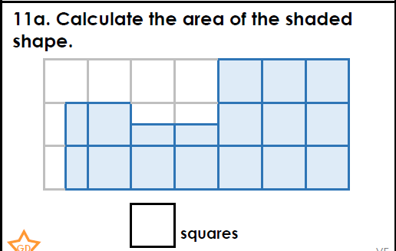
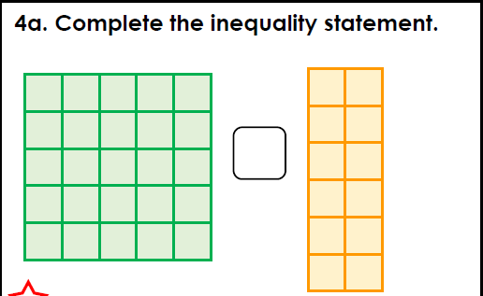
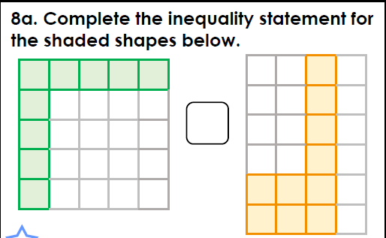
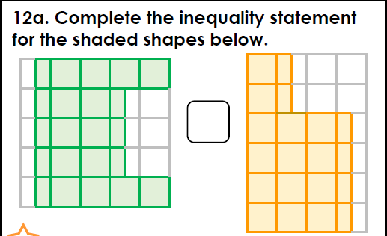
Intelligent Practice

Slide 18

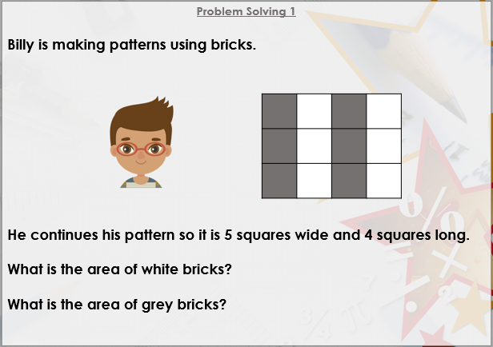


Slide 19

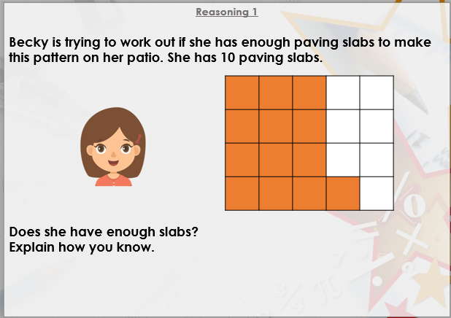

Slide 20

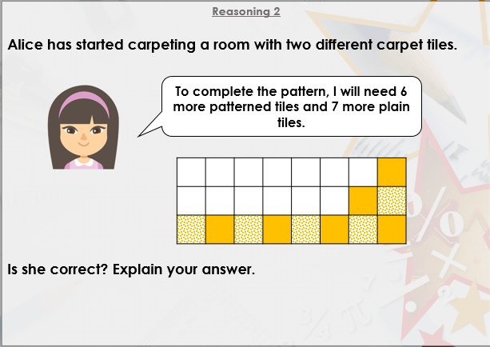
DIVE DEEPER 3

Slide 21
B | A | A
16 squares | 16 squares | 15 squares
> | < | >
Intelligent Practice

Slide 22
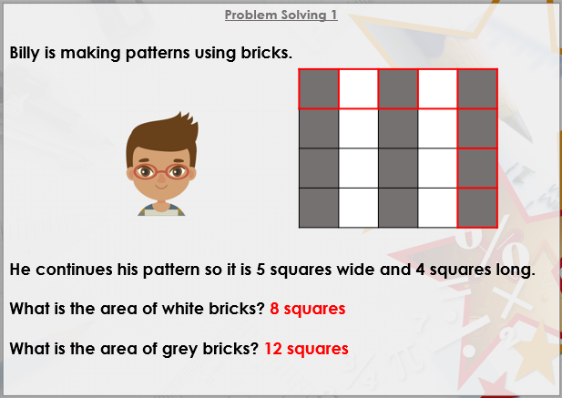

Slide 23
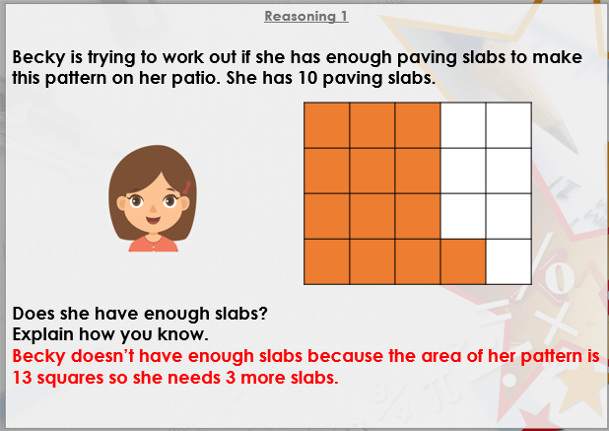

Slide 24
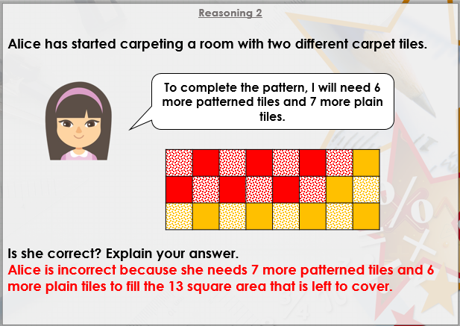
DIVE DEEPER 3

Slide 25

Intelligent Practice

