Slide 1
Challenge 1
        3 x 6 = 2 x 9 =
        9 x 6 = 5 x 9 =
        2 x 7 = 7 x 6 =
        3 x 7 = 4 x 6 =
        1 x 7 = 5 x 7 =
        6 x 9 = 12 x 7 =

Slide 2
Year 4 | Week 11 | Day 2

Slide 3
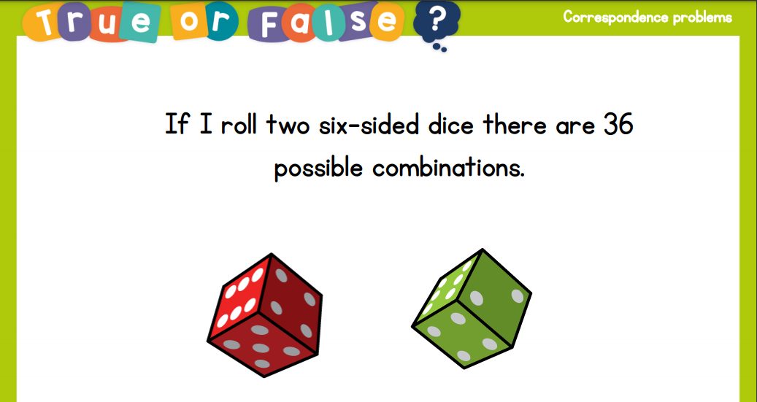
True or false:

Slide 4
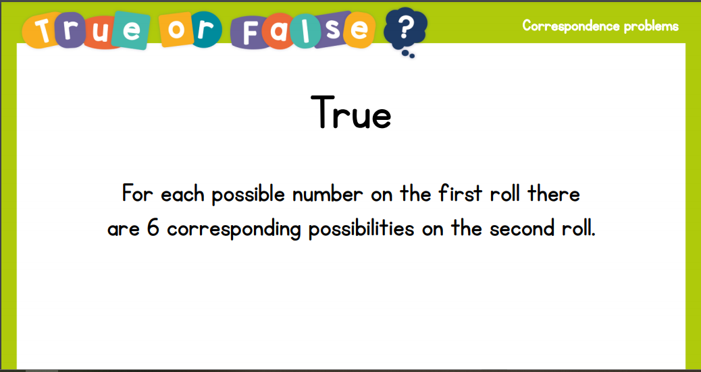
True or false:

Slide 5
L.O. - To find the area of rectilinear shapes by counting squares
SOME WILL EVEN: Explain which shape is best for covering the area of a rectilinear shape; Use the square and half square to create a shape which meets the set parameters; Explain which is the odd one out.
SOME WILL: Use rectilinear shapes with up to 8 sides to support the understanding of area.
MOST WILL: Use rectilinear shapes with up to 6 sides to support the understanding of area.
ALL WILL: Use squares and rectangles to support the understanding of area.

Slide 6
GUIDED PRACTICE:

Slide 7


Introduction
Joe is trying to measure the area of the top of his table. He has chosen to use paper plates. Do you think this is a good idea?
© Classroom Secrets Limited 2018

Slide 8
Introduction
Joe is trying to measure the area of the top of his table. He has chosen to use paper plates. Do you think this is a good idea?
No, there are gaps between the circles.
© Classroom Secrets Limited 2018

Slide 9
Varied Fluency 1
How many squares cover the surface of the shape below?
The surface of the shape is covered by ___ squares.
reference square
© Classroom Secrets Limited 2018

Slide 10
Varied Fluency 1
How many squares cover the surface of the shape below?
The surface of the shape is covered by ___ squares.
reference square
11
© Classroom Secrets Limited 2018

Slide 11
Varied Fluency 2
Order these shapes from smallest area to largest area using the square as a reference point.
reference square
A.
B.
C.
© Classroom Secrets Limited 2018

Slide 12
Varied Fluency 2
Order these shapes from smallest area to largest area using the square as a reference point.
A, C, B
reference square
A.
B.
C.
© Classroom Secrets Limited 2018

Slide 13
Varied Fluency 3
Estimate how many of each square would cover the shape below.
A.
B.
© Classroom Secrets Limited 2018

Slide 14
Varied Fluency 3
Estimate how many of each square would cover the shape below.
A.
B.
5 squares
20 squares
© Classroom Secrets Limited 2018

Slide 15
Varied Fluency 4
Compare the area of these shapes using the reference square and the symbols <, > or =.
reference square
___ squares
___ squares
© Classroom Secrets Limited 2018

Slide 16
Varied Fluency 4
Compare the area of these shapes using the reference square and the symbols <, > or =.
reference square
<
9 squares
10 squares
© Classroom Secrets Limited 2018

Slide 17

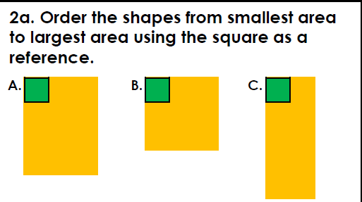
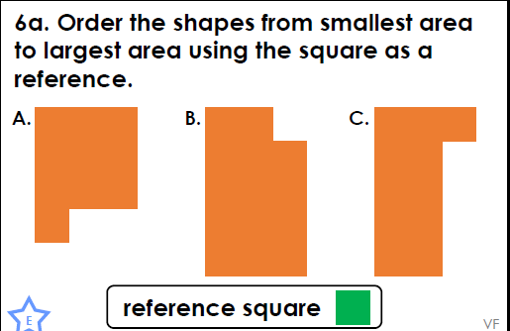
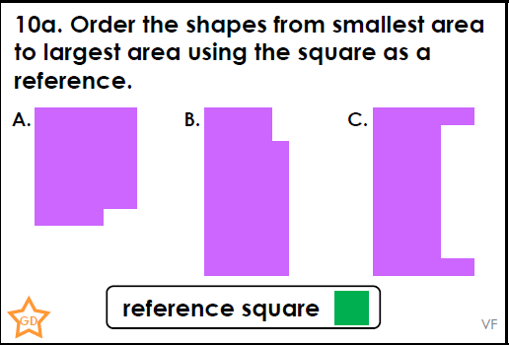
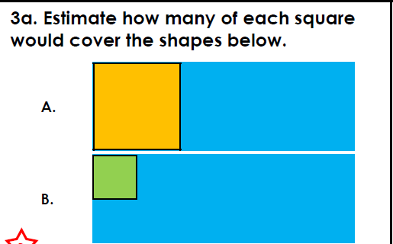
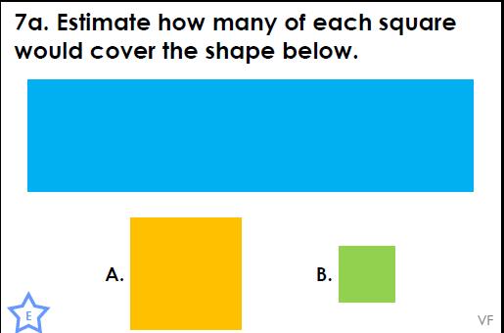
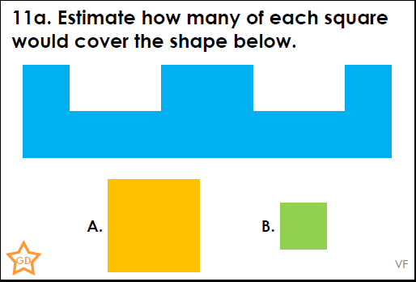
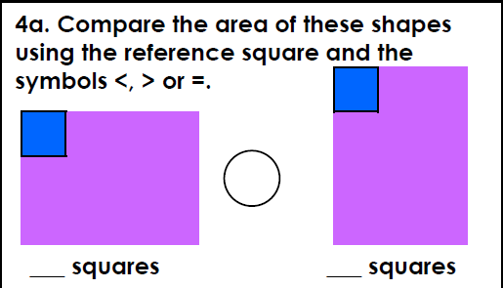
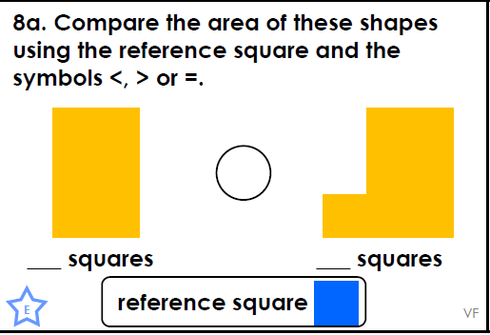
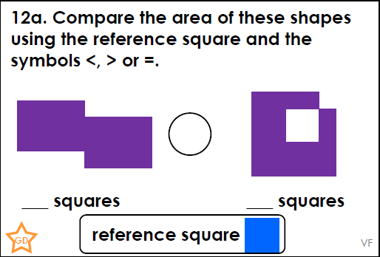
Intelligent Practice

Slide 18

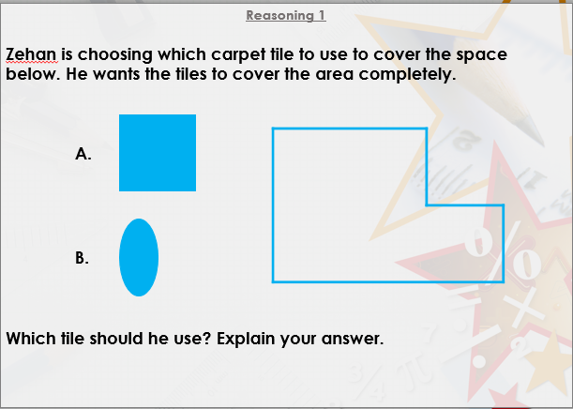


Slide 19

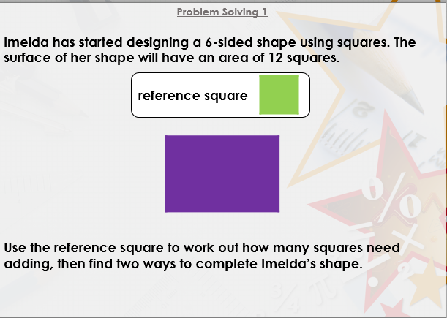

Slide 20

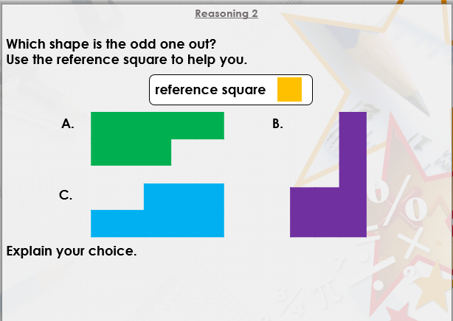
DIVE DEEPER 3

Slide 21
B, C, A | A, C, B | B, C, A
A. 3 squares; B. 12 squares | A. 4 squares; B. 16 squares | A. 3 squares; B. 12 squares
= | < | >
Intelligent Practice

Slide 22
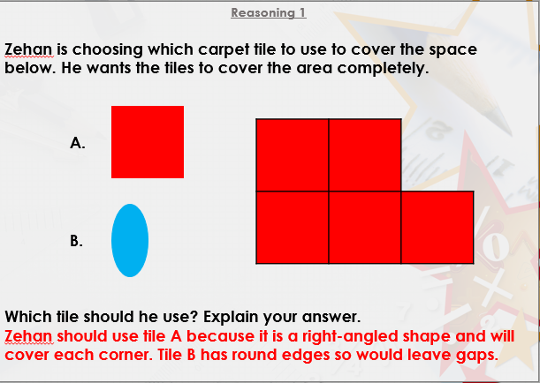

Slide 23
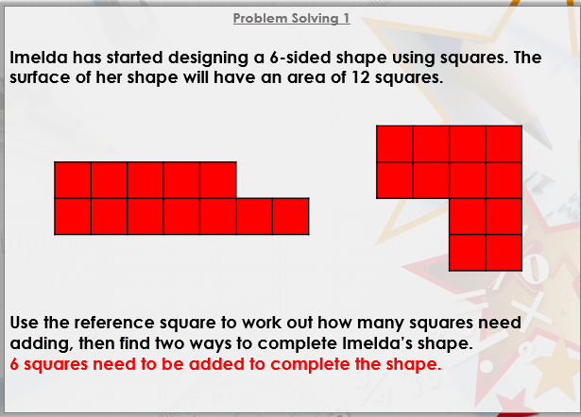

Slide 24
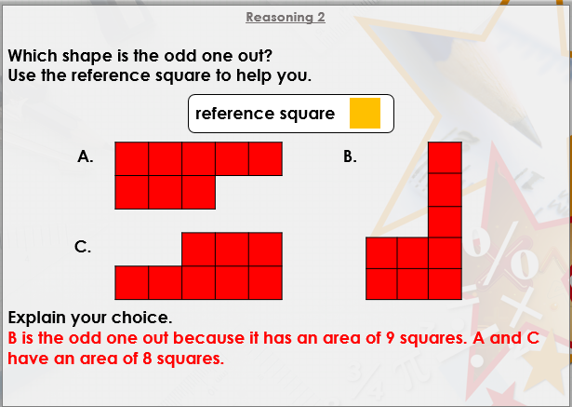
DIVE DEEPER 3

Slide 25

Intelligent Practice

