Slide 1
Challenge 7
        4 x 6 = 9 x 9 =
        12 x 6 = 8 x 7 =
        4 x 9 = 6 x 9 =
        10 x 7 = 7 x 7 =
        5 x 7 = 2 x 6 =
        6 x 6 = 10 x 9 =

Slide 2
Year 4 | Week 11 | Day 1

Slide 3
L.O. - to understand multiplication and division correspondence problems
SOME WILL EVEN: Identify and explain missing values by identifying the correspondence between ‘n’ objects and ‘m’ objects; Calculate the possible combinations of values by identifying the correspondence between ‘n’ objects and ‘m’ objects.
SOME WILL: Identify the correspondence between ‘n’ objects and ‘m’ objects; all table facts with no pictorial support.
MOST WILL: Identify the correspondence between ‘n’ objects and ‘m’ objects; all table facts with some pictorial support.
ALL WILL: Identify the correspondence between ‘n’ objects and ‘m’ objects; includes 2,3,4,5 and 8 times tables with some pictorial support.

Slide 4
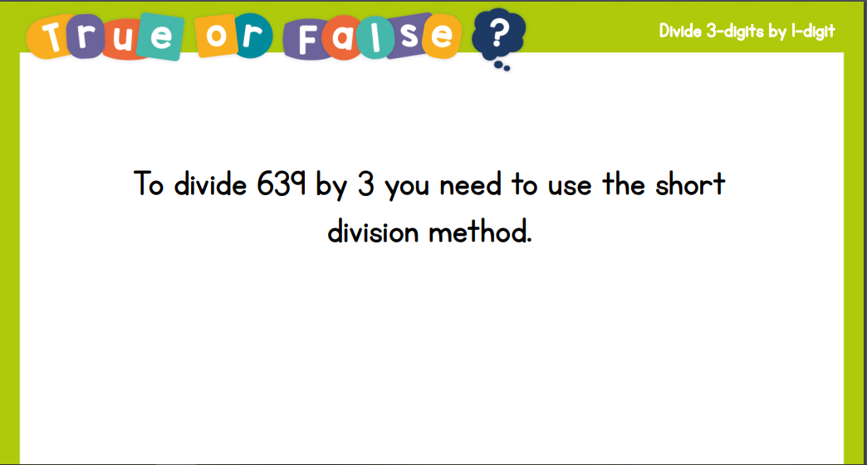
Recall:

Slide 5
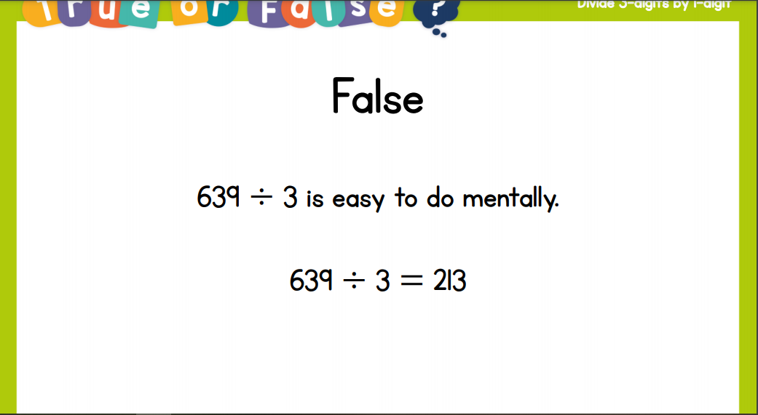
Recall:

Slide 6
GUIDED PRACTICE:

Slide 7


Introduction
Complete the calculations.
 |  |  | Total
2 x 5 = | + | 4 x 3 =
4 x 6 = | + | 3 x 3 =
6 x 2 = | + | 5 x 4 =
8 x 5 = | + | 9 x 1 =
10 x 10 = | + | 2 x 6 =
© Classroom Secrets Limited 2019

Slide 8
Introduction
Complete the calculations.
 |  |  | Total
2 x 5 = 10 | + | 4 x 3 = 12 | 22
4 x 6 = 24 | + | 3 x 3 = 9 | 33
6 x 2 = 12 | + | 5 x 4 = 20 | 32
8 x 5 = 40 | + | 9 x 1 = 9 | 49
10 x 10 = 100 | + | 2 x 6 = 12 | 112
© Classroom Secrets Limited 2019

Slide 9
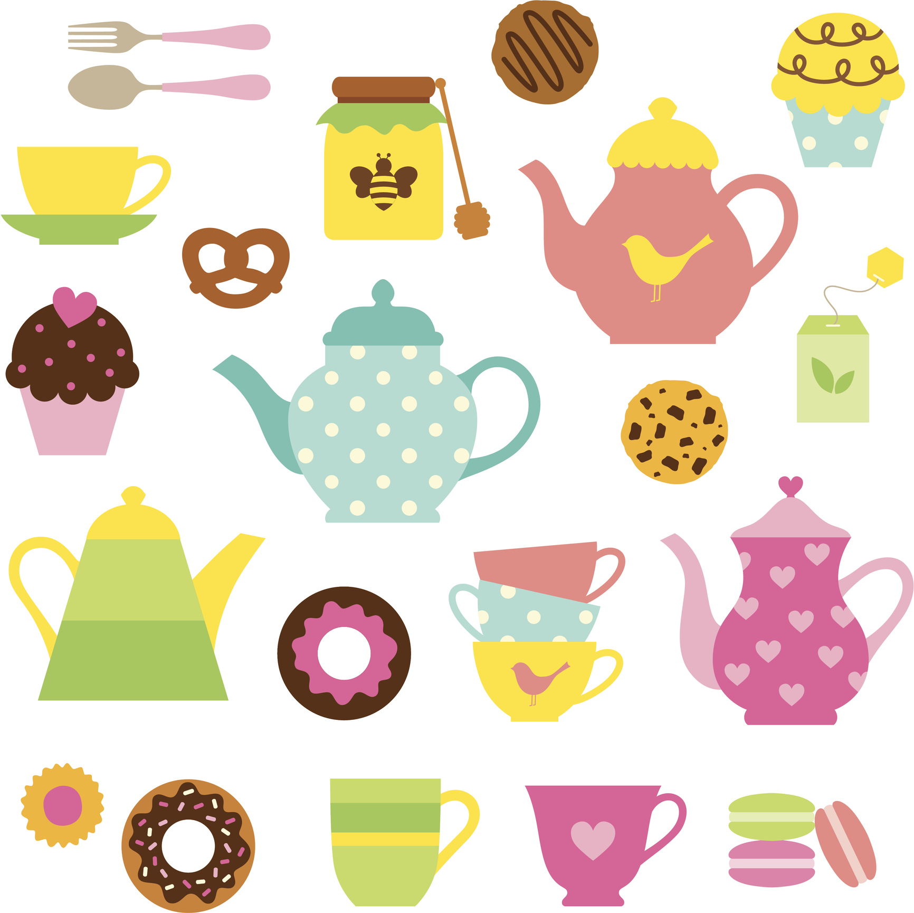
Varied Fluency 1
One box contains 5 different forks and a variety of shaped spoons. There are 35 possible combinations of forks and spoons.
Circle the number of spoons in the box.
6 |  | 8 |  | 7
© Classroom Secrets Limited 2019

Slide 10
Varied Fluency 1
One box contains 5 different forks and a variety of shaped spoons. There are 35 possible combinations of forks and spoons.
Circle the number of spoons in the box.
6 |  | 8 |  | 7
© Classroom Secrets Limited 2019

Slide 11
Varied Fluency 2
True or false?
There are 18 combinations of cake flavours and toppings. Show your working.
Cake flavour | Toppings
vanilla chocolate | milk chocolate chips white chocolate chips sprinkles sweets strawberries cherry blueberries
© Classroom Secrets Limited 2019

Slide 12
Varied Fluency 2
True or false?
There are 18 combinations of cake flavours and toppings. Show your working.
False, there are 14 combinations (2 x 7 = 14)
Cake flavour | Toppings
vanilla chocolate | milk chocolate chips white chocolate chips sprinkles sweets strawberries cherry blueberries
© Classroom Secrets Limited 2019

Slide 13
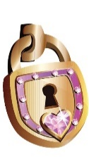

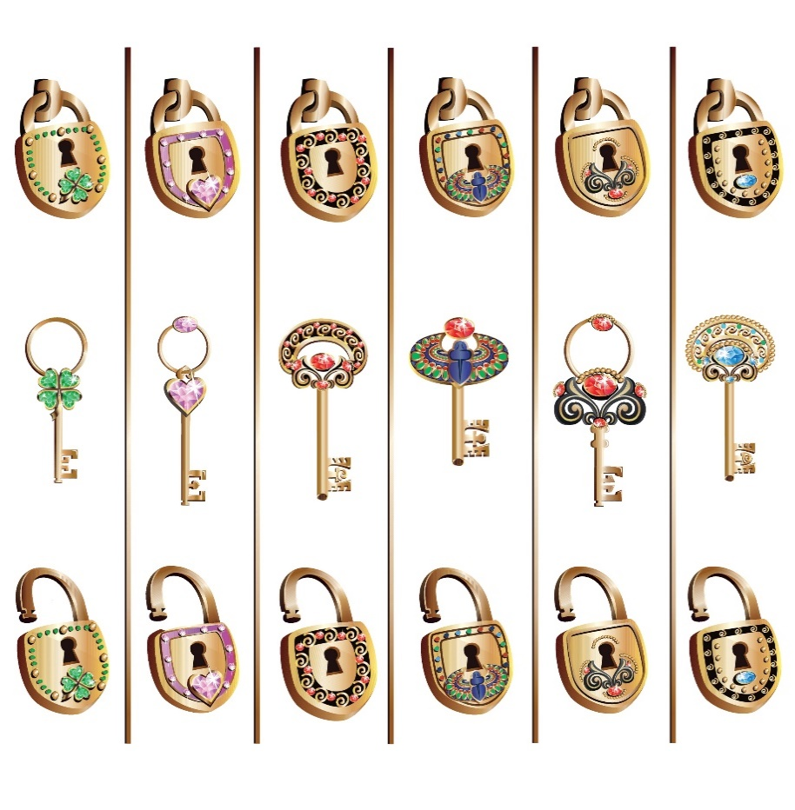


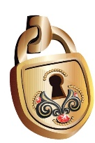


Varied Fluency 3
There are two groups of keys and locks.
How many combinations of lock and key can be made?
Complete the calculation below to show the total number of combinations.
A.
B.
 |  | x |  |  |  | =
© Classroom Secrets Limited 2019

Slide 14
Varied Fluency 3
There are two groups of keys and locks.
How many combinations of lock and key can be made?
Complete the calculation below to show the total number of combinations.
A.
B.
5 |  | x |  | 4 |  | = |  | 20
© Classroom Secrets Limited 2019

Slide 15
Varied Fluency 4
Tick the correct number of possible combinations.
Shelf 1 | Shelf 2
tetra guppy catfish angel fish goldfish blue tang mollies | tetra guppy catfish angel fish neon tetra
28
30
35
© Classroom Secrets Limited 2019

Slide 16
Varied Fluency 4
Tick the correct number of possible combinations.
Shelf 1 | Shelf 2
tetra guppy catfish angel fish goldfish blue tang mollies | tetra guppy catfish angel fish neon tetra
✓
28
30
35
© Classroom Secrets Limited 2019

Slide 17

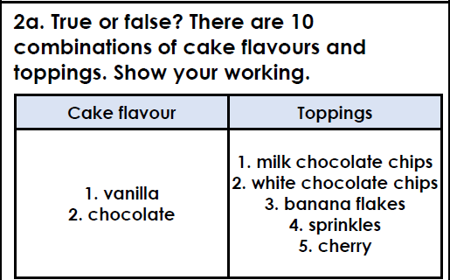
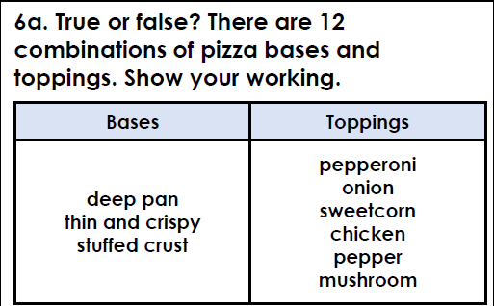
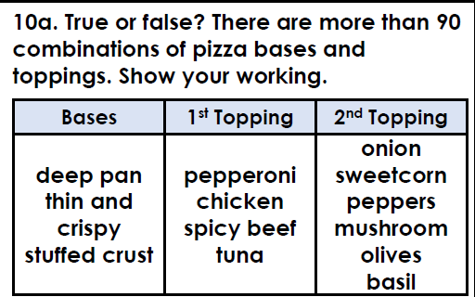
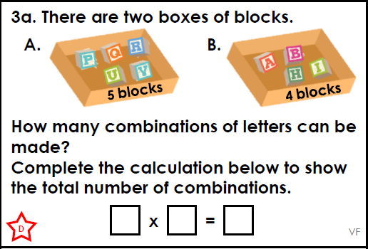
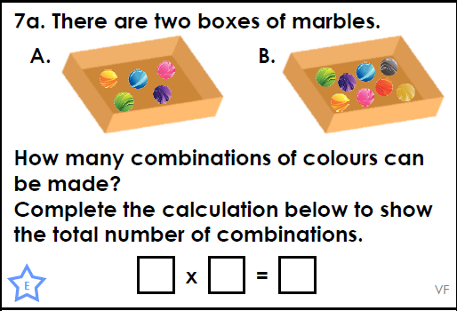
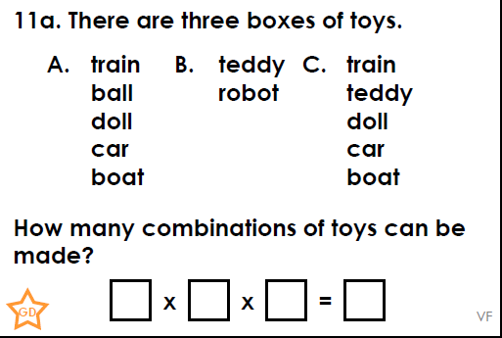
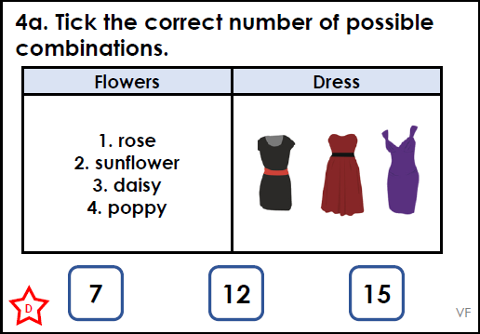
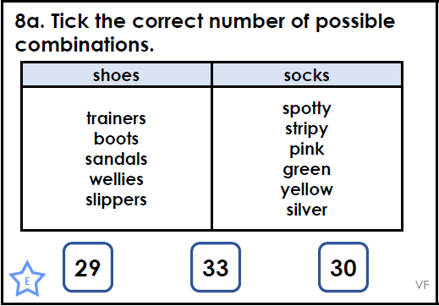
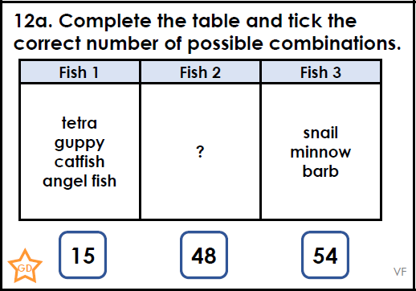
Intelligent Practice

Slide 18

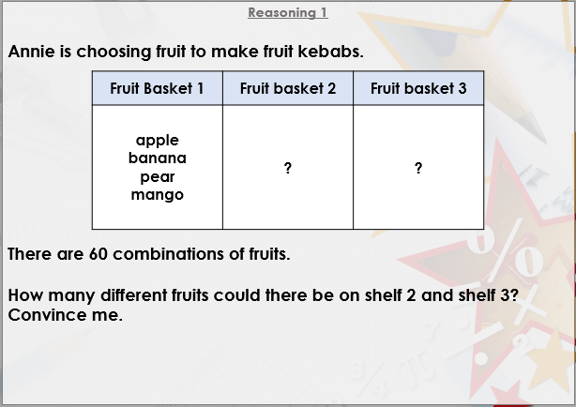


Slide 19

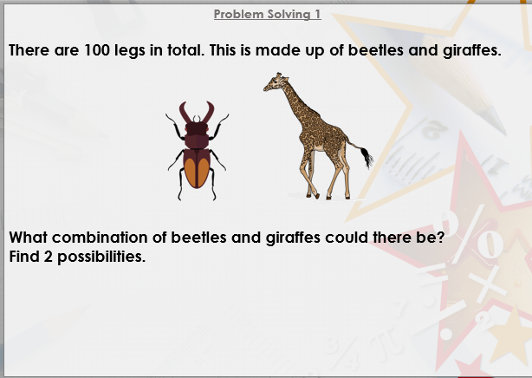

Slide 20

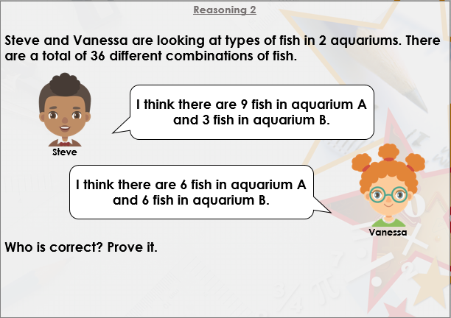
DIVE DEEPER 3

Slide 21
True: 2 x 5 = 10 combinations | False: 3 x 6 = 18 combinations, not 12 | True: 4 x 4 x 6 = 96 combinations
5 x 4 = 20 combinations | 5 x 8 = 40 combinations | 5 x 2 x 5 = 50 combinations
12 combinations | 30 combinations | There are 4 fish missing from column 2. The correct number of combinations is 48
Intelligent Practice

Slide 22
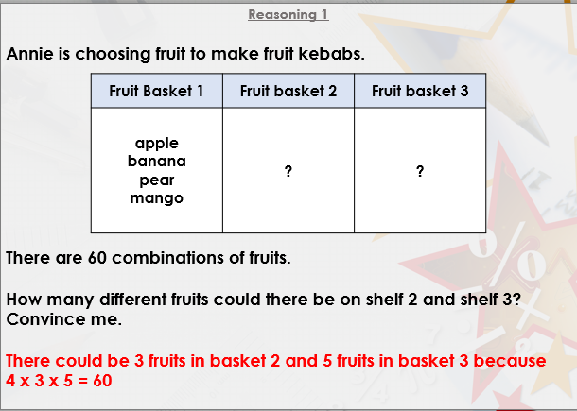

Slide 23
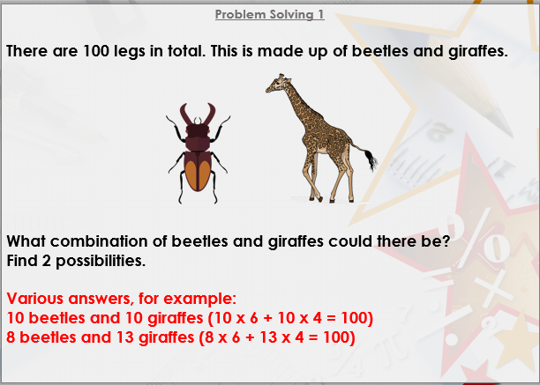

Slide 24
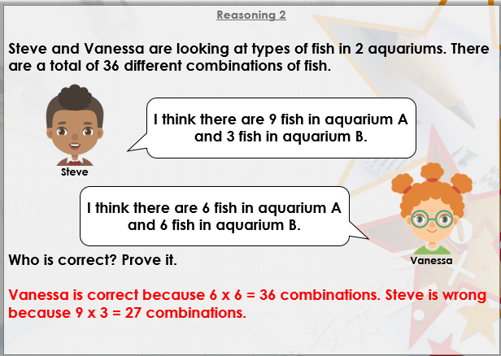
DIVE DEEPER 3

Slide 25

Intelligent Practice

