Slide 1
Challenge 6
        3 x 6 = 6 x 6 =
        12 x 9 = 11 x 9 =
        2 x 9 = 12 x 6 =
        8 x 9 = 5 x 7 =
        11 x 6 = 8 x 6 =
        9 x 7 = 17 x 5 =

Slide 2
Year 4 | Week 10 | Day 5

Slide 3
L.O. - divide 3-digits by 1-digit
SOME WILL EVEN: Find the missing numbers when dividing 3-digits by 1-digit without pictorial support; Use the counters to find two solutions to the calculations; Prove whether a statement is correct by dividing 3-digits by 1-digit.
SOME WILL: Divide 3-digits by 1-digit without pictorial support, with exchanging with remainders.
MOST WILL: Divide 3-digits 2,3,4,5,6,7,8 and 9 with some pictorial support; some exchanging, no remainders.
ALL WILL: Divide 3-digits by 2,3,4,5 and 8 with pictorial support, without exchanging, no remainders.

Slide 4
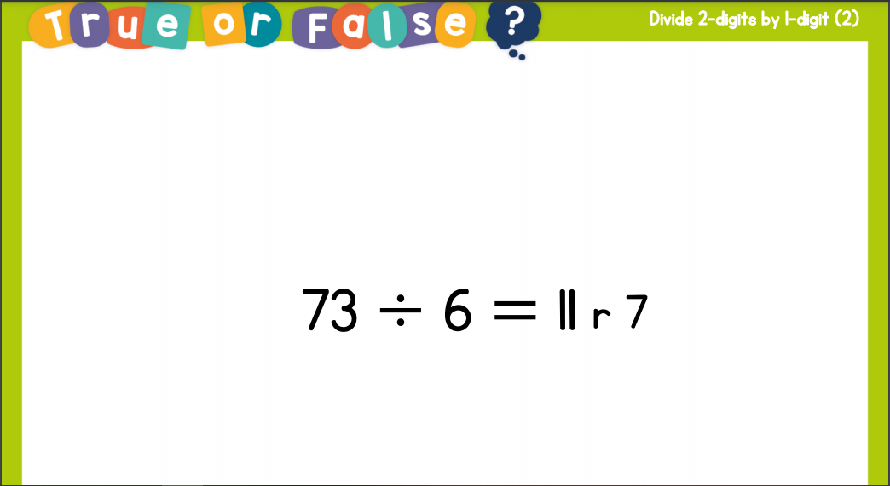
Recall:

Slide 5
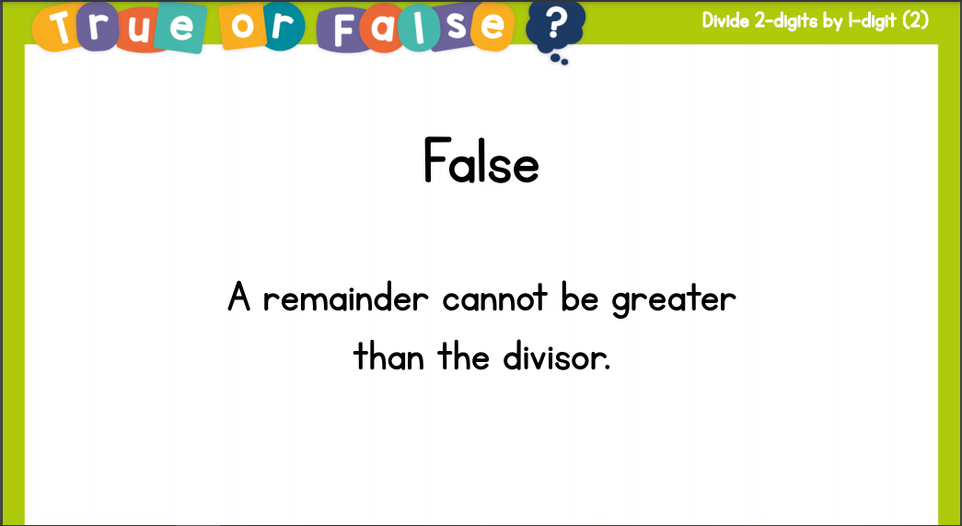
Recall:

Slide 6
GUIDED PRACTICE:

Slide 7


Introduction
Match the calculation to the answer.
85 ÷ 5
13
84 ÷ 3
17
64 ÷ 4
28
91 ÷ 7
16
© Classroom Secrets Limited 2018

Slide 8
Introduction
Match the calculation to the answer.
85 ÷ 5
13
84 ÷ 3
17
64 ÷ 4
28
91 ÷ 7
16
© Classroom Secrets Limited 2018

Slide 9
Varied Fluency 1
Use place value counters to divide the amount below by 5.
Record your calculations using the short division method.
H | T | O
100
100
10
10
1
1
10
10
1
1
100
100
1
100
10
10
© Classroom Secrets Limited 2018

Slide 10
Varied Fluency 1
Use place value counters to divide the amount below by 5.
Record your calculations using the short division method.
H | T | O
100
100
10
10
1
1
1
1
 | 1 | 1 | 3
5 | 5 | 6 | 5
100
100
10
10
1
1
100
10
10
1
1
1
1
1
1
1
1
1
1
© Classroom Secrets Limited 2018

Slide 11
Varied Fluency 2
Draw the place value counters to divide five hundred and sixty eight by four.
Use short division to show your calculations.
H | T | O
© Classroom Secrets Limited 2018

Slide 12
Varied Fluency 2
Draw the place value counters to divide five hundred and sixty eight by four.
Use short division to show your calculations.
H | T | O
100
100
10
10
10
1
1
 | 1 | 4 | 2
4 | 5 | 6 | 8
10
10
10
1
1
100
100
1
10
10
1
1
100
10
10
10
10
1
1
10
10
10
10
© Classroom Secrets Limited 2018

Slide 13
Varied Fluency 3
True or false?
232 ÷ 4 = 51
Partition the number to support your calculations.
232
÷ 4
© Classroom Secrets Limited 2018

Slide 14
Varied Fluency 3
True or false?
232 ÷ 4 = 51
Partition the number to support your calculations.
232
200
32
÷ 4
50
8
50 + 8 = 58
© Classroom Secrets Limited 2018

Slide 15
Varied Fluency 4
Add the symbol <, > or = to make the following statement correct.
627 ÷ 3
763 ÷ 7
© Classroom Secrets Limited 2018

Slide 16
Varied Fluency 4
Add the symbol <, > or = to make the following statement correct.
627 ÷ 3
>
763 ÷ 7
© Classroom Secrets Limited 2018

Slide 17

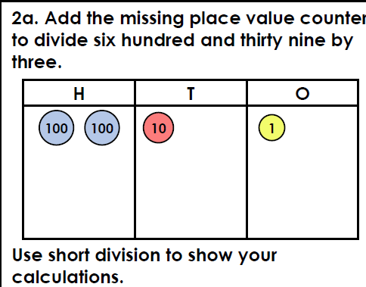
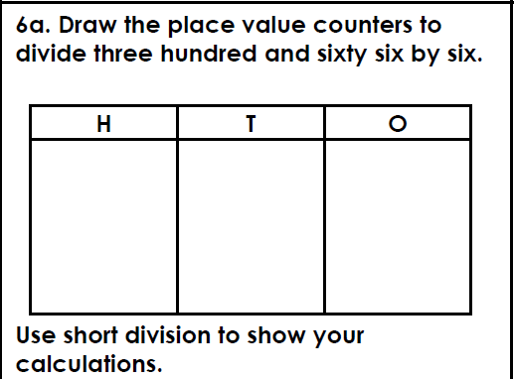
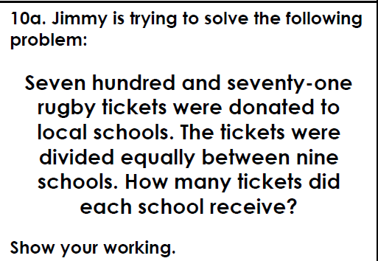
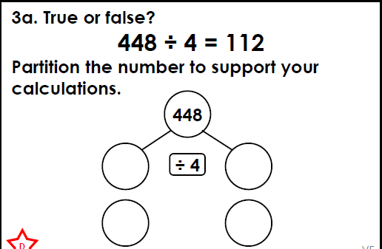
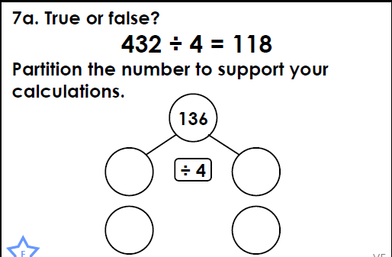
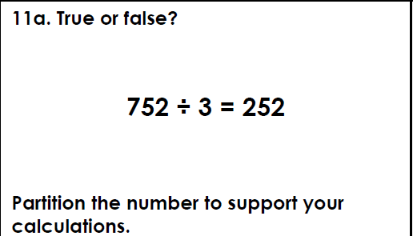
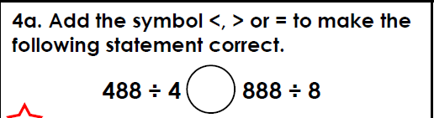
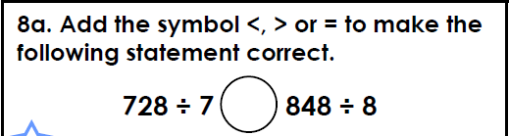
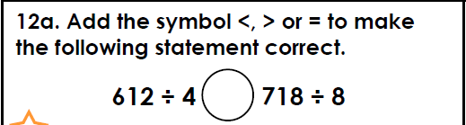
Intelligent Practice

Slide 18

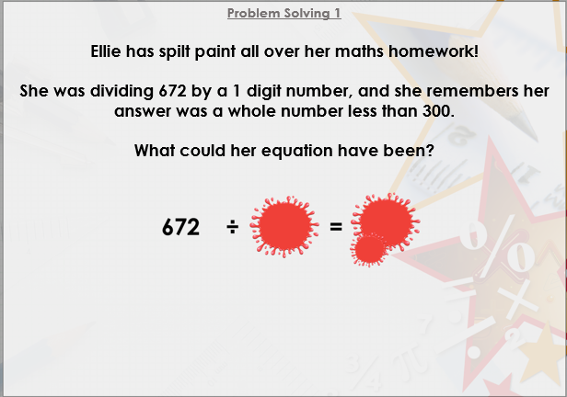


Slide 19

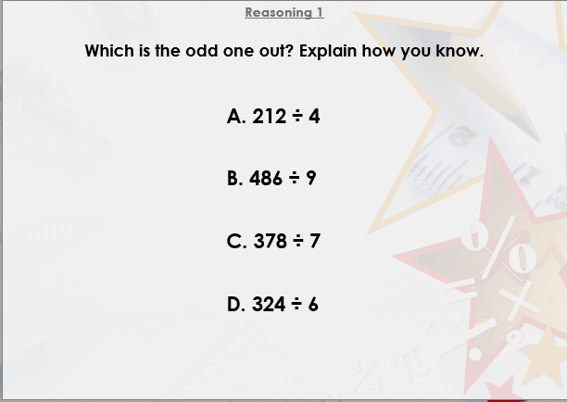

Slide 20

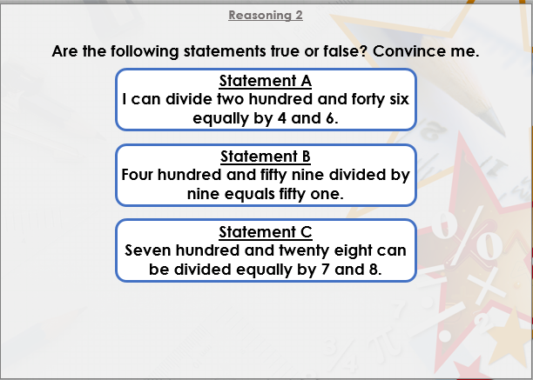
DIVE DEEPER 3

Slide 21
639÷3 = 213 | 366÷6 = 61 | 771÷9 = 85 Each school received 85 tickets and there were 6 left over.
True | False, the correct answer is 108 | False, the correct answer is 250 remainder 2.
> | < | >
Intelligent Practice

Slide 22
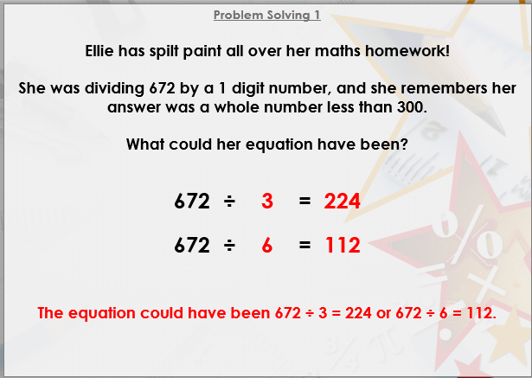

Slide 23
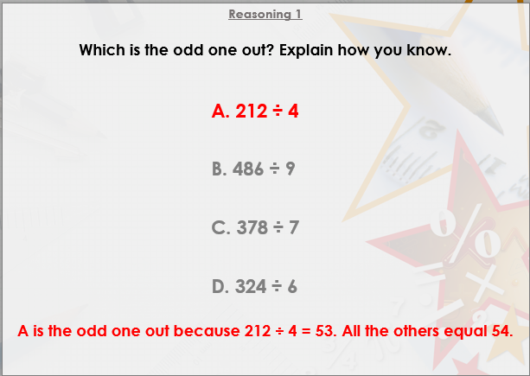

Slide 24
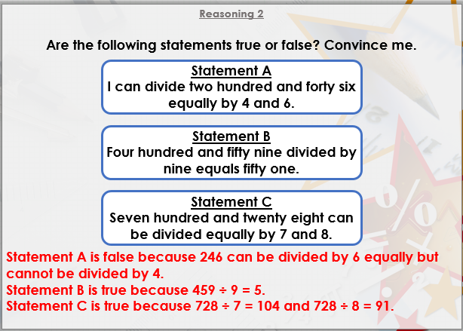
DIVE DEEPER 3

Slide 25

Intelligent Practice

