Slide 1
Challenge 5
        5 x 6 = 8 x 7 =
        7 x 7 = 10 x 6 =
        4 x 9 = 2 x 7 =
        4 x 7 = 5 x 9 =
        12 x 7 = 10 x 9 =
        7 x 6 = 1 x 9 =

Slide 2
Year 4 | Week 10 | Day 4

Slide 3
L.O. - To divide 2-digits by 1-digit
SOME WILL EVEN: Solve a two-step problem using addition and division of 2 digits by 1 digit; Identify and explain errors when dividing 2-digits by 1 digit; Order calculations by their numbers of remainders when dividing 2-digits by 1-digit.
SOME WILL: Divide 2-digit numbers by a 1-digit number without pictorial support and exchanges including remainders.
MOST WILL: Divide 2-digit numbers by a 1-digit number with pictorial support with some exchanges including remainders.
ALL WILL: Divide 2-digit numbers by a 1-digit number with pictorial support and no exchanges including remainders.

Slide 4
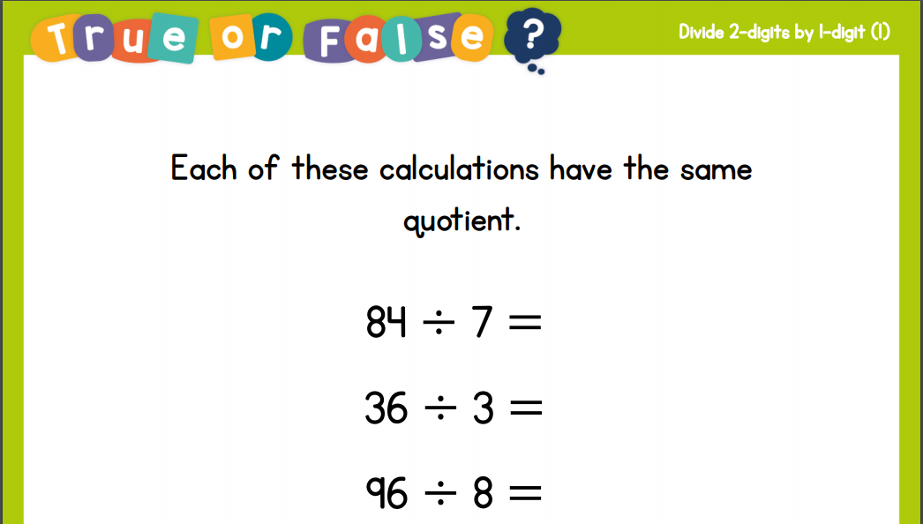
Recall:

Slide 5
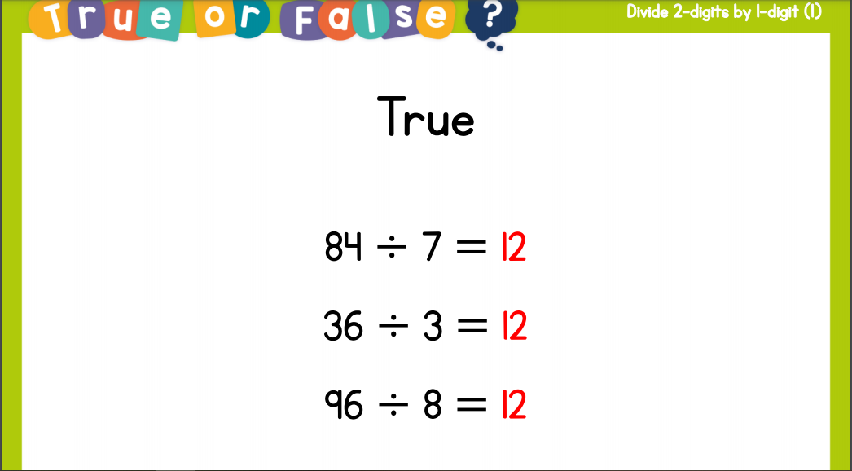
Recall:

Slide 6
GUIDED PRACTICE:

Slide 7


Introduction
Sort the numbers into the Venn diagram.
Multiples of 3
Multiples of 7
21
49
14
70
36
28
9
18
© Classroom Secrets Limited 2018

Slide 8
Introduction
Sort the numbers into the Venn diagram.
Multiples of 3
Multiples of 7
9
18
14
21
70
36
28
49
© Classroom Secrets Limited 2018

Slide 9
Varied Fluency 1
True or false? 65 ÷ 6 = 11 r1
65 | ÷ | 6 | =
10
1
10
1
10
1
10
1
10
1
10
© Classroom Secrets Limited 2018

Slide 10
Varied Fluency 1
True or false? 65 ÷ 6 = 11 r1
False
65 | ÷ | 6 | = | 10 r5
10
1
10
1
10
1
10
1
10
1
10
© Classroom Secrets Limited 2018

Slide 11
Varied Fluency 2
Complete the calculation.
74 | ÷ | 6 | =
Tens | Ones
10
1
1
1
10
1
1
1
10
1
1
10
1
1
10
1
1
10
1
1
10
Exchanged for 10 ones and shared equally.
© Classroom Secrets Limited 2018

Slide 12
Varied Fluency 2
Complete the calculation.
74 | ÷ | 6 | = | 12 r2
Tens | Ones
10
1
1
1
10
1
1
1
10
1
1
10
1
1
10
1
1
10
1
1
10
Exchanged for 10 ones and shared equally.
© Classroom Secrets Limited 2018

Slide 13
Varied Fluency 3
Match the division number sentences to the correct answer cards.
64 ÷ 5
51 ÷ 4
Tens | Ones
Tens | Ones
10
1
1
1
10
1
1
1
10
1
1
1
10
1
1
1
10
1
1
1
10
1
1
1
10
1
1
1
10
1
1
10
1
1
10
Exchanged for 10 ones and shared equally.
10
Exchanged for 10 ones and shared equally.
12 r3
12 r4
© Classroom Secrets Limited 2018

Slide 14
Varied Fluency 3
Match the division number sentences to the correct answer cards.
64 ÷ 5
12 r4
51 ÷ 4
12 r3
Tens | Ones
Tens | Ones
10
1
1
1
10
1
1
1
10
1
1
1
10
1
1
1
10
1
1
1
10
1
1
1
10
1
1
1
10
1
1
10
1
1
10
Exchanged for 10 ones and shared equally.
10
Exchanged for 10 ones and shared equally.
© Classroom Secrets Limited 2018

Slide 15

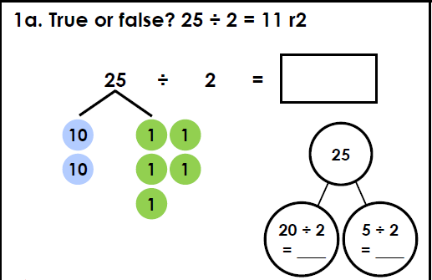
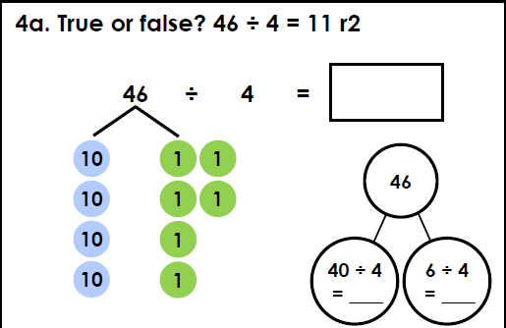
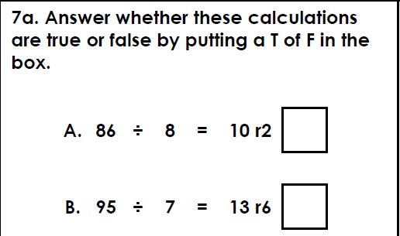
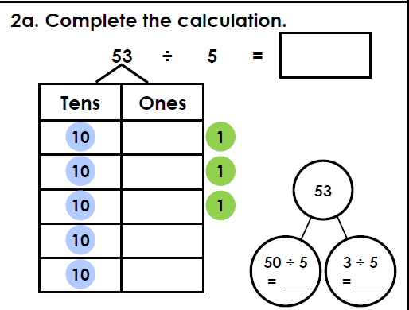
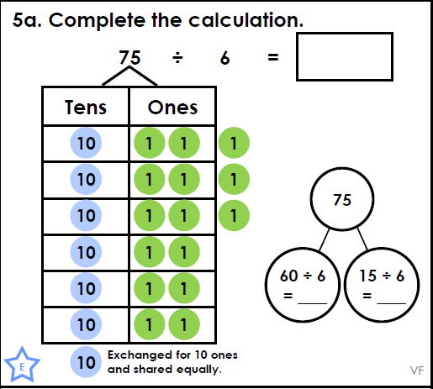
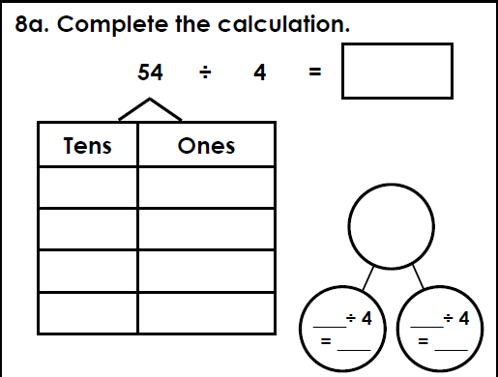
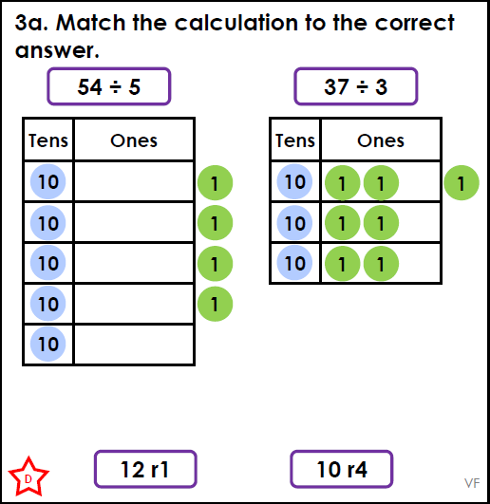
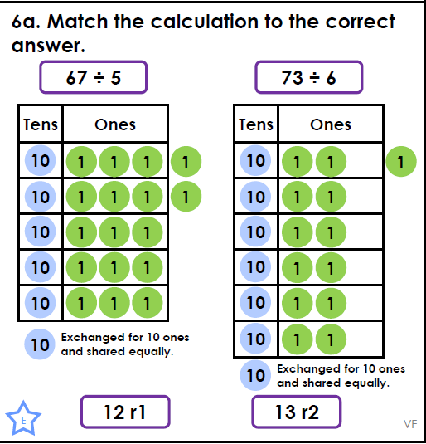
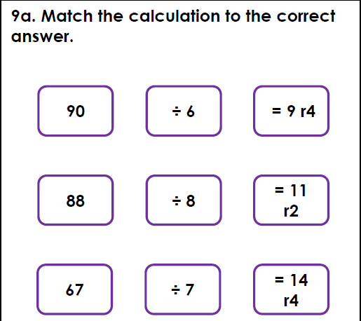
Intelligent Practice

Slide 16

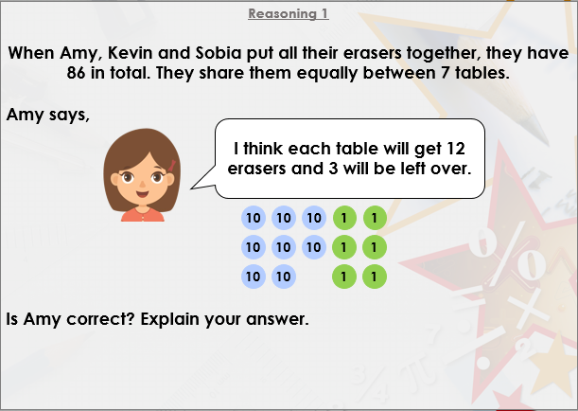


Slide 17

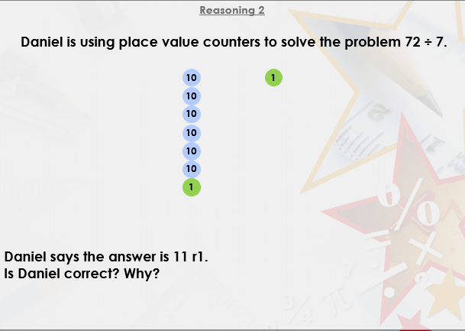

Slide 18

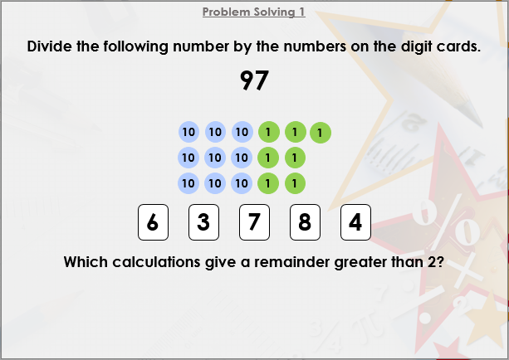
DIVE DEEPER 3

Slide 19
False, 25 ÷2 = 12 r1 part-whole model: 20 ÷2 = 10, 5 ÷2 = 2 r1 | True part-whole model: 40 ÷4 = 10, 6 ÷4 = 1 r2 | A. False, 86 ÷8 = 10 r6; B. False, 95 ÷7 = 13 r4
10 r3 part-whole model: 50 ÷5 = 10, 5 ÷3 = 0 r3 | 12 r3 part-whole model: 60 ÷6 = 10, 15 ÷6 = 2 r3 | 54 ÷4 = 13 r2 part-whole model: 54; 40 ÷4 = 10, 14 ÷4 = 3 r2
54 ÷5 = 10 r4; 37 ÷3 = 12 r1 | 67 ÷5 = 13 r2; 73 ÷6 = 12 r1 | 90 ÷8 = 11 r2; 88 ÷6 = 14 r4; 67 ÷7 = 9 r4
Intelligent Practice

Slide 20
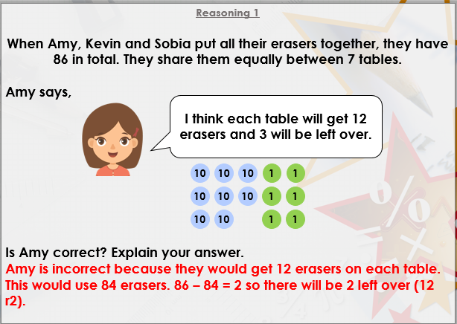

Slide 21
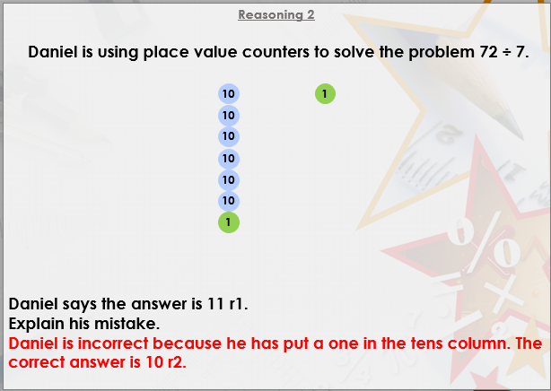

Slide 22
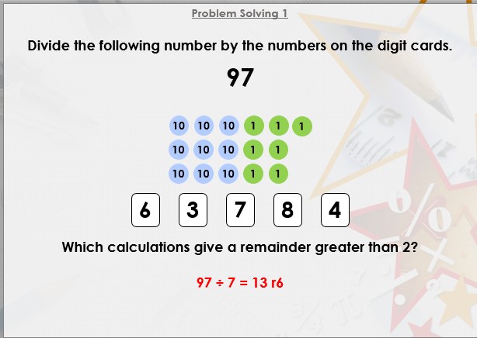
DIVE DEEPER 3

Slide 23

Intelligent Practice

