Slide 1
Challenge 4
        6 x 7 = 2 x 7 =
        12 x 9 = 8 x 7 =
        7 x 9 = 3 x 7 =
        1 x 9 = 11 x 7 =
        12 x 6 = 3 x 9 =
        10 x 6 = 8 x 9 =

Slide 2
Year 4 | Week 10 | Day 3

Slide 3
L.O. - to divide 2 digits by 1 digit
SOME WILL EVEN: Identify the correct missing digit using division with exchanges; Create three calculations to make two given statement true; Complete calculations so that they match given statements using division with exchanges.
SOME WILL: Divide 2-digit numbers by a 1-digit number with exchanges and multi-step calculations.
MOST WILL: Divide 2-digit numbers by a 1-digit number with some exchanges and pictorial support.
ALL WILL: Divide 2-digit numbers by a 1-digit number with no exchanges and pictorial representation.

Slide 4
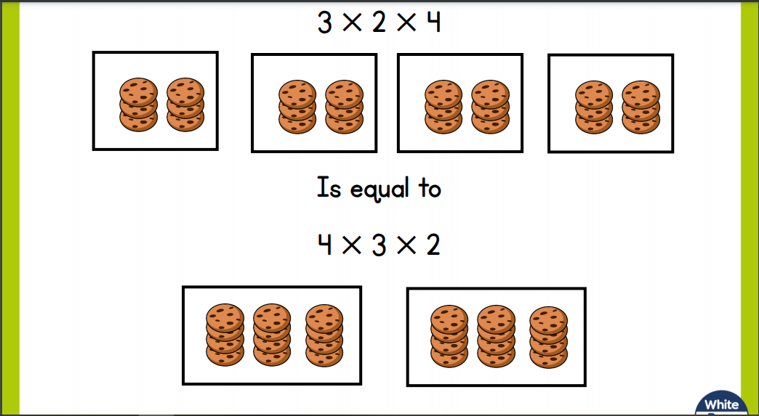
Recall:

Slide 5
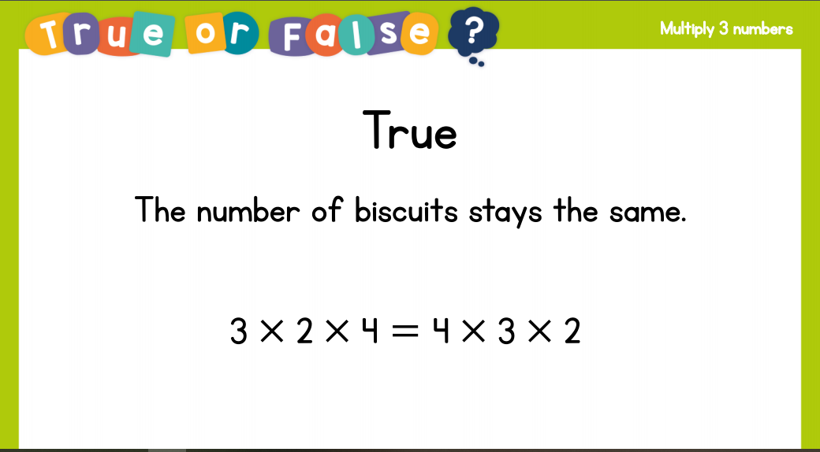
Recall:

Slide 6
GUIDED PRACTICE:

Slide 7


Introduction
Partition the following 2-digit numbers.
35 |  | 84 |  | 27
© Classroom Secrets Limited 2018

Slide 8
Introduction
Partition the following 2-digit numbers.
35 |  | 84 |  | 27
30 |  | 5 |  | 80 |  | 4 |  | 20 |  | 7
© Classroom Secrets Limited 2018

Slide 9
Varied Fluency 1
True or false? The answer is 24.
75 | ÷ | 3 | =
10
10
10
1
1
10
10
1
1
10
10
1
© Classroom Secrets Limited 2018

Slide 10
Varied Fluency 1
True or false? The answer is 24.
False; 75 ÷ 3 = 25
75 | ÷ | 3 | =
10
10
10
1
1
10
10
1
1
10
10
1
© Classroom Secrets Limited 2018

Slide 11
Varied Fluency 2
Use the bar model to solve the following calculation.
 | 4 | ÷ | 4 | =
80
4
10
10
10
10
10
10
10
10
1
1
1
1
© Classroom Secrets Limited 2018

Slide 12
Varied Fluency 2
Use the bar model to solve the following calculation.
8 | 4 | ÷ | 4 | = | 21
80
4
10
10
10
10
10
10
10
10
1
1
1
1
© Classroom Secrets Limited 2018

Slide 13
Varied Fluency 3
Use the counters to solve the calculation.
72 | ÷ | 4 | =
10
10
1
1
1
1
1
1
1
10
10
10
1
1
1
1
1
1
1
10
10
1
1
10
1
1
1
1
10
1
1
1
1
1
1
10
1
1
1
1
1
1
© Classroom Secrets Limited 2018

Slide 14
Varied Fluency 3
Use the counters to solve the calculation.
72 | ÷ | 4 | = | 18
10
10
1
1
1
1
1
1
1
10
10
10
1
1
1
1
1
1
1
10
10
1
1
10
1
1
1
1
10
1
1
1
1
1
1
10
1
1
1
1
1
1
© Classroom Secrets Limited 2018

Slide 15
Varied Fluency 4
Complete the part-whole model.
78 ÷ 6 = 13
10
1
1
10
10
1
1
60 ÷ 6 = 10
18 ÷ 6 = 3
10
10
1
1
10
10
1
1
© Classroom Secrets Limited 2018

Slide 16
Varied Fluency 4
Complete the part-whole model.
78 ÷ 6 = 13
10
1
1
10
10
1
1
60 ÷ 6 = 10
18 ÷ 6 = 3
10
10
1
1
10
10
1
1
© Classroom Secrets Limited 2018

Slide 17

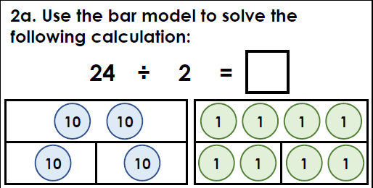
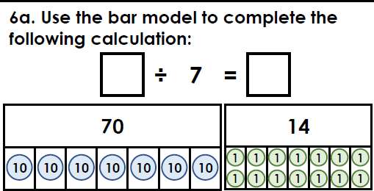
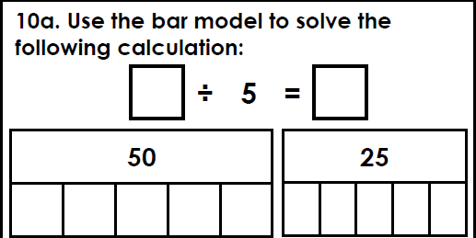
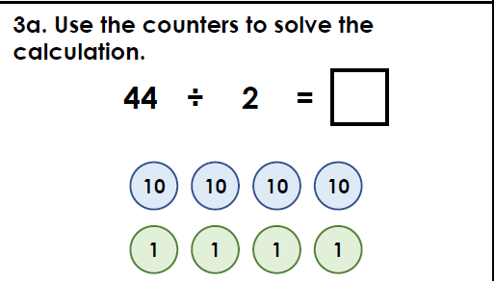
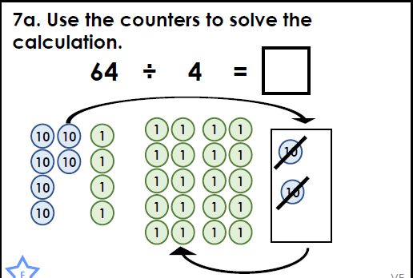
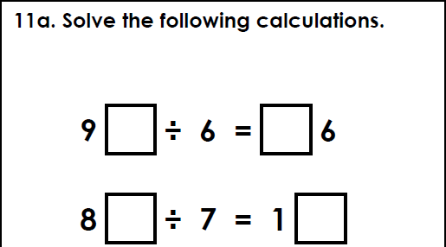
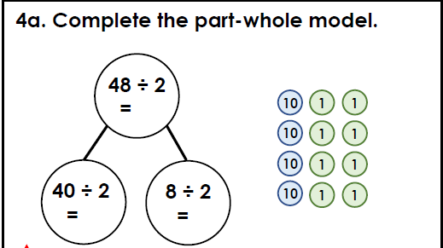
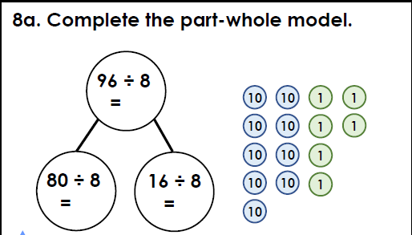
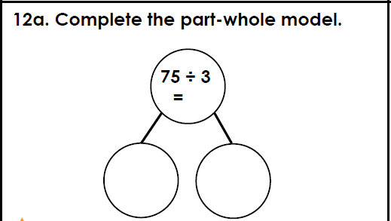
Intelligent Practice

Slide 18

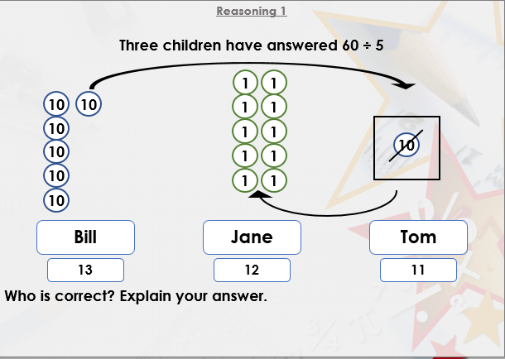


Slide 19

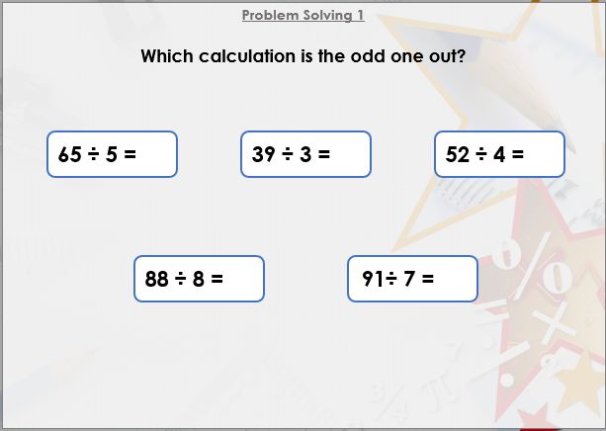

Slide 20

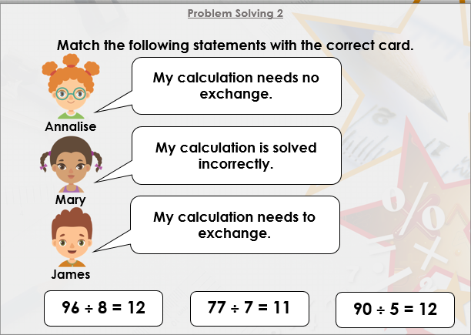
DIVE DEEPER 3

Slide 21
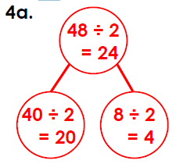
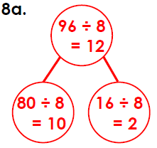
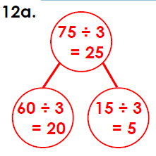
12 | 84÷7 = 12 | 75÷5 = 15
22 | 16 | 96÷6 = 16; 84÷7 = 12
Intelligent Practice

Slide 22
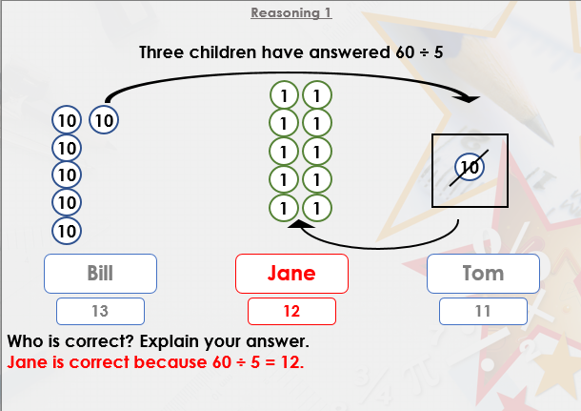

Slide 23
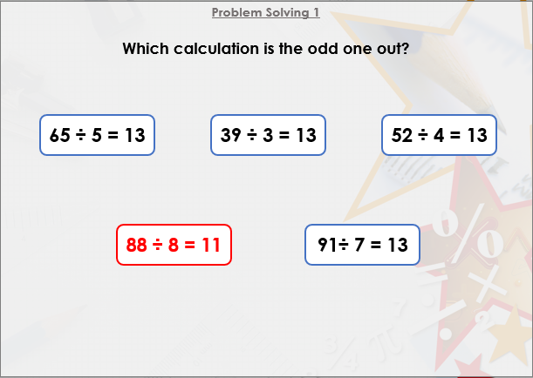

Slide 24
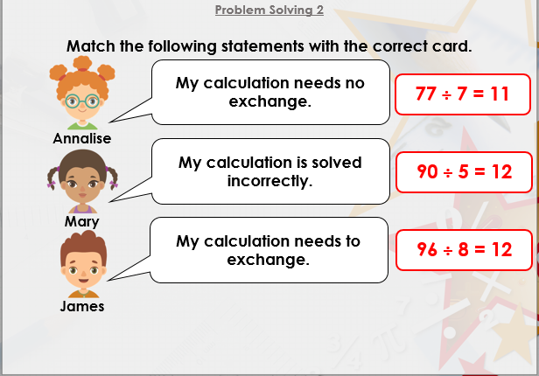
DIVE DEEPER 3

Slide 25

Intelligent Practice

