Slide 1
Challenge 3
        4 x 6 = 9 x 9 =
        2 x 6 = 4 x 9 =
        7 x 7 = 7 x 6 =
        12 x 7 = 8 x 6 =
        11 x 7= 9 x 7 =
        2 x 9 = 10 x 7 =

Slide 2
Year 4 | Week 10 | Day 2

Slide 3
L.O. To multiply 3-digit by 1-digit numbers
SOME WILL EVEN: Match the numbers to make a given product; Add the missing digits to the multiplication calculation; Prove if a statement is correct.
SOME WILL: Multiply 3-digit by 1-digit numbers using short written up to three exchanges.
MOST WILL: Multiply 3-digit by 1-digit numbers using short written method up to two exchanges.
ALL WILL: Multiply 3-digit by 1-digit numbers using expanded form only and up to one exchange.

Slide 4
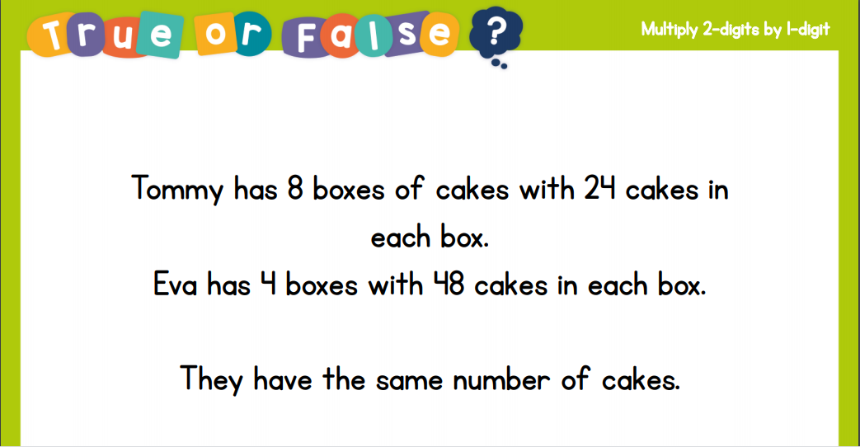
Recall:

Slide 5
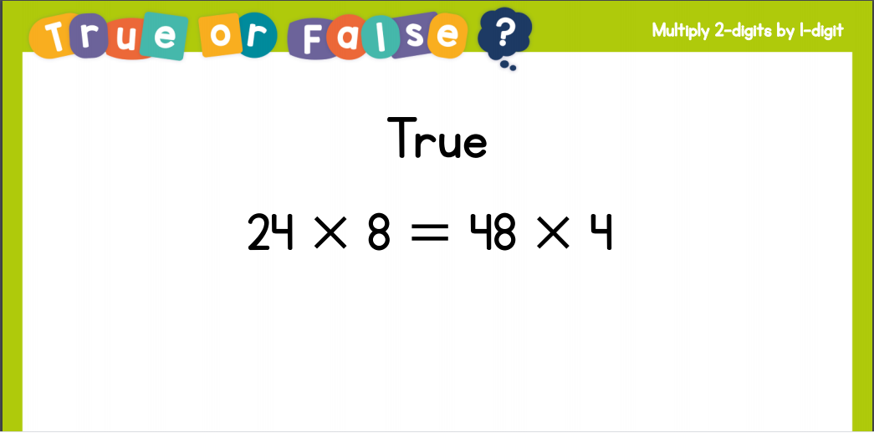
Recall:

Slide 6
GUIDED PRACTICE:

Slide 7


Introduction
Which multiplication sentences match this image?
6 x 5
8 x 4
2 x 8
12 x 3
1 x 22
5 x 6
14 x 2
3 x 9
© Classroom Secrets Limited 2018

Slide 8
Introduction
Which multiplication sentences match this image?
6 x 5
8 x 4
2 x 8
12 x 3
1 x 22
5 x 6
14 x 2
3 x 9
© Classroom Secrets Limited 2018

Slide 9
Varied Fluency 1
True or false? The calculation below has been worked out correctly.
Hundreds | Tens | Ones
 | 3 | 0 | 5
x |  |  | 3
 | 6 | 1 | 5
© Classroom Secrets Limited 2018

Slide 10
Varied Fluency 1
True or false? The calculation below has been worked out correctly.
False, 300 x 3 = 900, not 600. The answer should be 915.
Hundreds | Tens | Ones
 | 3 | 0 | 5
x |  |  | 3
 | 6 | 1 | 5
© Classroom Secrets Limited 2018

Slide 11
Varied Fluency 2
Circle the correct answer to the calculation below.
Hundreds | Tens | Ones
 | 4 | 2 | 0
x |  |  | 4
1,608
1,860
1,680
© Classroom Secrets Limited 2018

Slide 12
Varied Fluency 2
Circle the correct answer to the calculation below.
Hundreds | Tens | Ones
 | 4 | 2 | 0
x |  |  | 4
1 | 6 | 8 | 0
1,608
1,860
1,680
© Classroom Secrets Limited 2018

Slide 13
Varied Fluency 3
Complete the calculation.
Hundreds | Tens | Ones
 | 5 | 2 | 3
x |  |  | 6
© Classroom Secrets Limited 2018

Slide 14
Varied Fluency 3
Complete the calculation.
Hundreds | Tens | Ones
 | 5 | 2 | 3
x |  |  | 6
3 | 1 | 3 | 8
1
1
© Classroom Secrets Limited 2018

Slide 15

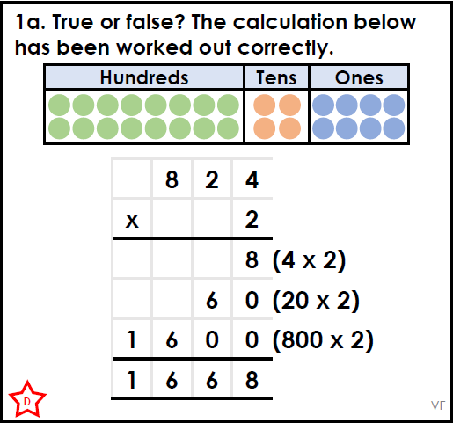
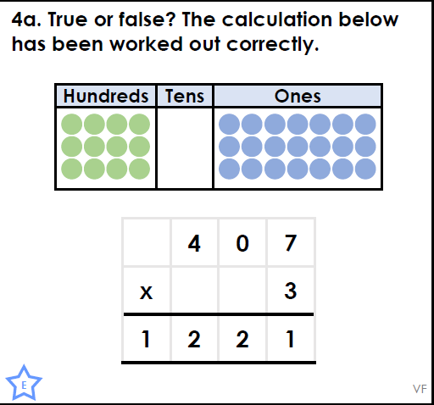
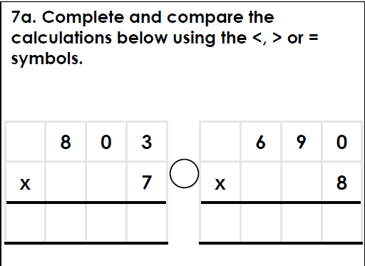
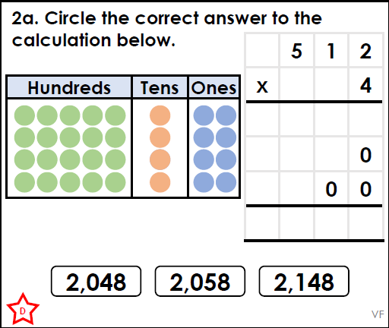
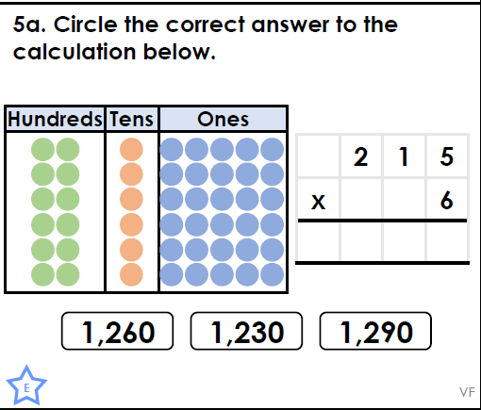
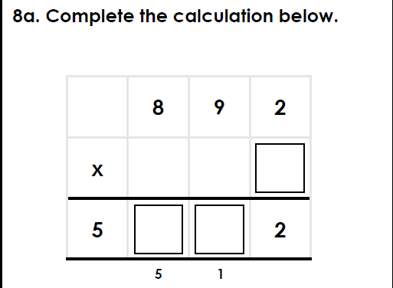
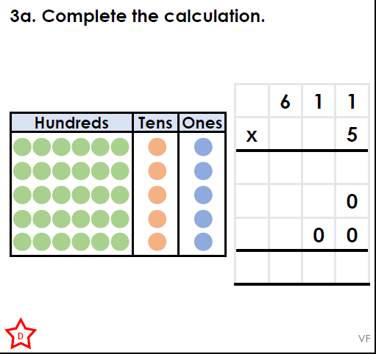
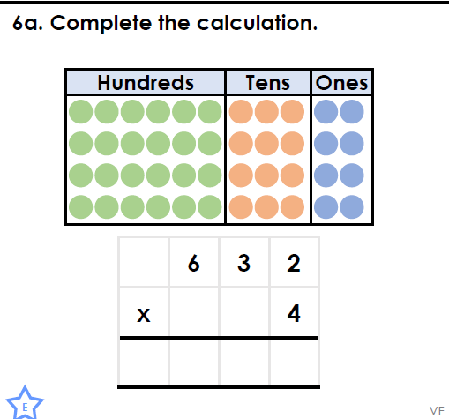
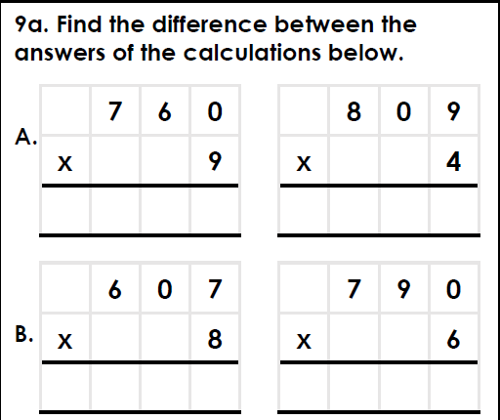
Intelligent Practice

Slide 16

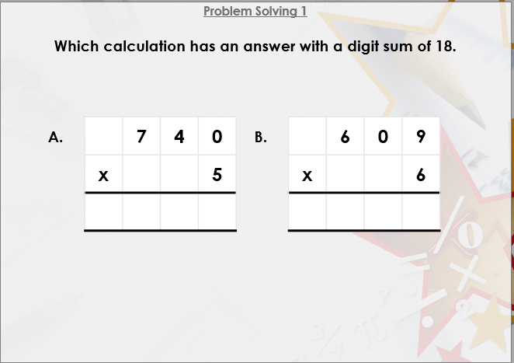


Slide 17

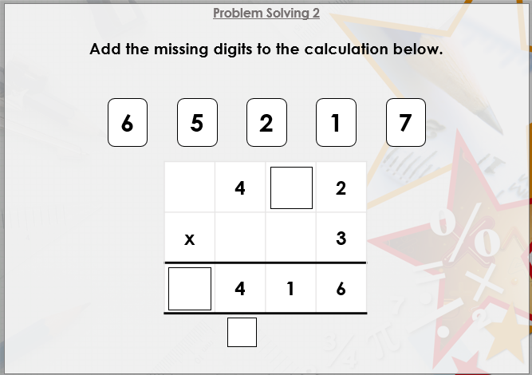

Slide 18

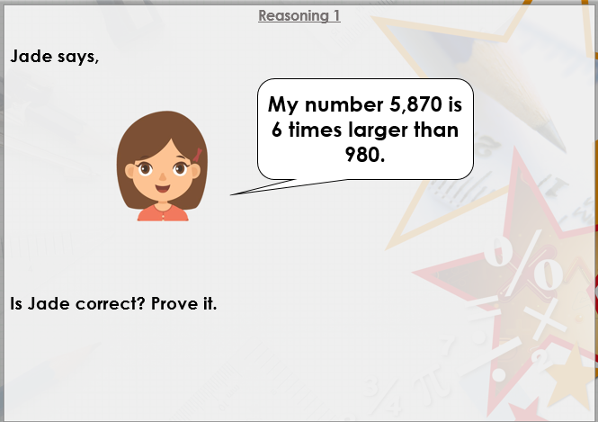
DIVE DEEPER 3

Slide 19
False, 20 x 2 = 40, not 60. The answer should be 1,648. | True | 5,621 >5,520
2,048 | 1,290 | 892 x 6= 5,352
3,055 | 2,528 | A: 6,840 –3,236 = 3,604, B: 4,856 –4,740 = 116
Intelligent Practice

Slide 20
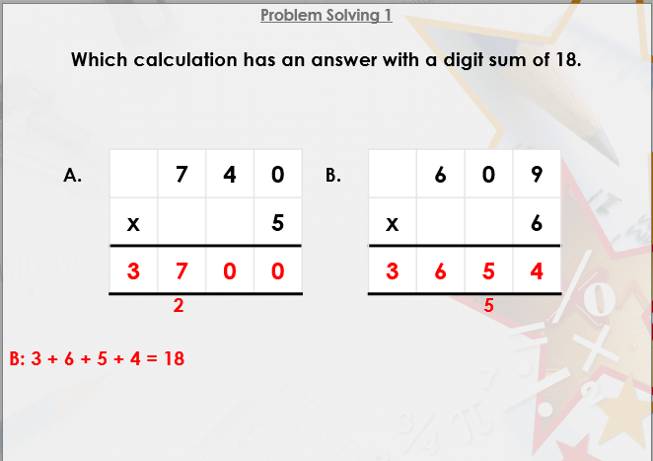

Slide 21
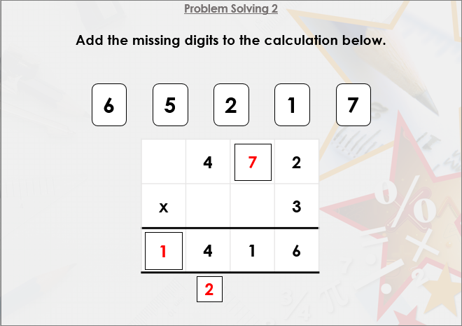

Slide 22
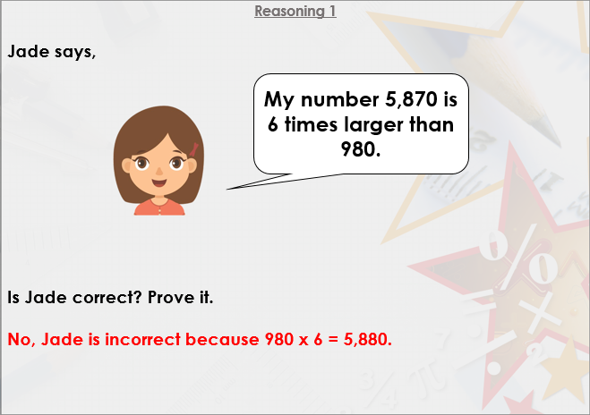
DIVE DEEPER 3

