Slide 1
Challenge 2
        8 x 7 = 11 x 7 =
        3 x 9 = 9 x 7 =
        10 x 9 = 6 x 7 =
        9 x 9 = 12 x 9 =
        12 x 6 = 4 x 9 =
        11 x 6 = 7 x 9 =

Slide 2
Year 4 | Week 10 | Day 1
1

Slide 3
L.O. To multiply 2 digits by 1 digit.
SOME WILL EVEN: Solve the word problem; Use digit cards to complete the calculations; Identify who has solved the calculations incorrectly and explain you answer.
SOME WILL: Multiply 2 digits by 1 digit using short
MOST WILL: Multiply 2 digits by 1 digits starting with expanded form and moving to short written method with exchanges.
ALL WILL: Multiply 2 digits by 1 digits using expanded form only with no exchanges.

Slide 4
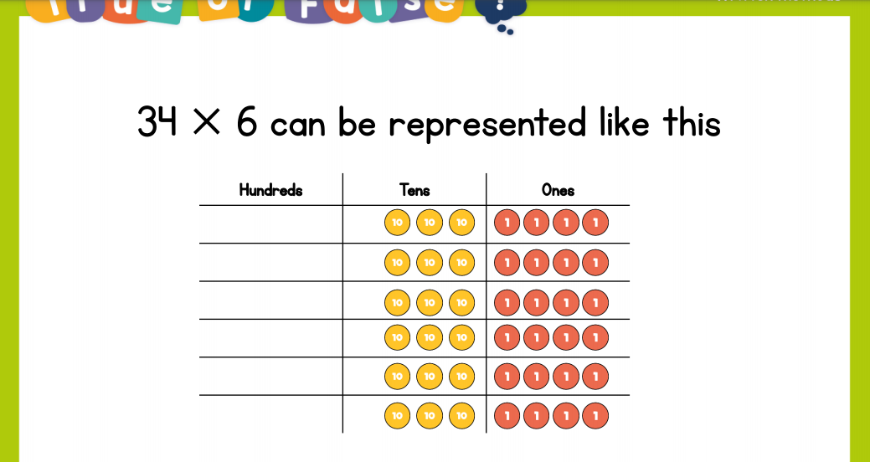
Recall:

Slide 5
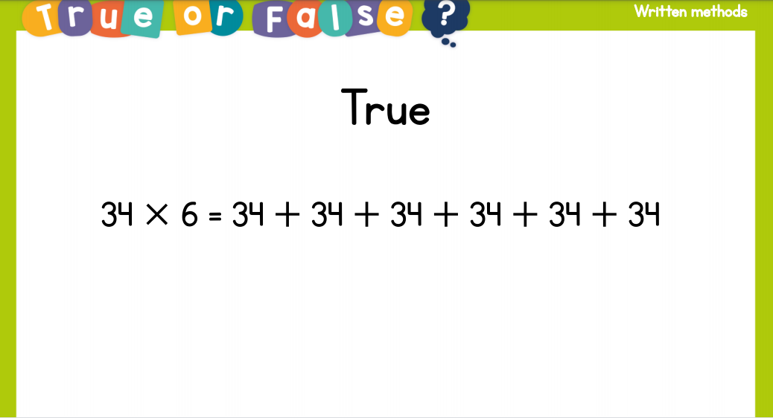
Recall:

Slide 6
GUIDED PRACTICE:

Slide 7


Introduction
Identify the answer using the part-whole model.
18 x 4
10 x 4
8 x 4
© Classroom Secrets Limited 2018

Slide 8
Introduction
Identify the answer using the part-whole model.
18 x 4
72
10 x 4
40
8 x 4
32
© Classroom Secrets Limited 2018

Slide 9
Varied Fluency 1
Which calculation matches the number sentence?
A.
 | 2 | 4
x |  | 4
 | 1 | 6
 | 8 | 0
 | 9 | 6
B.
 | 2 | 4
x |  | 4
 | 1 | 6
 | 8 | 0
 | 9 | 0
(4 x 4)
(4 x 4)
(4 x 20)
(4 x 20)
24 x 4
© Classroom Secrets Limited 2018

Slide 10
Varied Fluency 1
Which calculation matches the number sentence?
A.
 | 2 | 4
x |  | 4
 | 1 | 6
 | 8 | 0
 | 9 | 6
B.
 | 2 | 4
x |  | 4
 | 1 | 6
 | 8 | 0
 | 9 | 0
(4 x 4)
(4 x 4)
(4 x 20)
(4 x 20)
24 x 4 = 96
© Classroom Secrets Limited 2018

Slide 11
Varied Fluency 2
True or false?
 | 3 | 3
x |  | 7
 | 2 | 1
2 | 0 | 0
2 | 2 | 1
(7 x 3)
(7 x 30)
© Classroom Secrets Limited 2018

Slide 12
Varied Fluency 2
True or false?
False: 33 x 7 = 231
 | 3 | 3
x |  | 7
 | 2 | 1
2 | 1 | 0
2 | 3 | 1
(7 x 3)
(7 x 30)
© Classroom Secrets Limited 2018

Slide 13
Varied Fluency 3
Solve the calculation.
10
10
10
10
1
1
1
1
1
1
x
10
10
10
10
1
1
1
1
1
1
10
10
10
10
1
1
1
1
1
1
10
10
10
10
1
1
1
1
1
1
 | x | 4 | =
© Classroom Secrets Limited 2018

Slide 14
Varied Fluency 3
Solve the calculation.
10
10
10
10
1
1
1
1
1
1
 | 4 | 6
x |  | 4
1 | 8 | 4
 | ²
10
10
10
10
1
1
1
1
1
1
10
10
10
10
1
1
1
1
1
1
10
10
10
10
1
1
1
1
1
1
46 | x | 4 | = | 184
© Classroom Secrets Limited 2018

Slide 15
Varied Fluency 4
Match the calculation to the correct answer.
10
10
10
1
1
1
1
1
1
1
 | 3 | 7
x |  | 4
10
10
10
1
1
1
1
1
1
1
10
10
10
1
1
1
1
1
1
1
10
10
10
1
1
1
1
1
1
1
146
158
148
© Classroom Secrets Limited 2018

Slide 16
Varied Fluency 4
Match the calculation to the correct answer.
10
10
10
1
1
1
1
1
1
1
 | 3 | 7
x |  | 4
1 | 4 | 8
 | ²
10
10
10
1
1
1
1
1
1
1
10
10
10
1
1
1
1
1
1
1
10
10
10
1
1
1
1
1
1
1
146
158
148
© Classroom Secrets Limited 2018

Slide 17

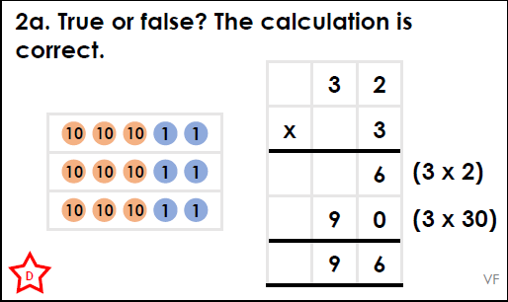
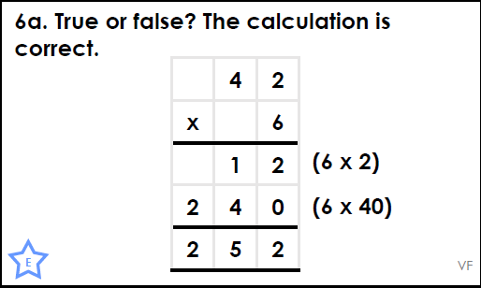
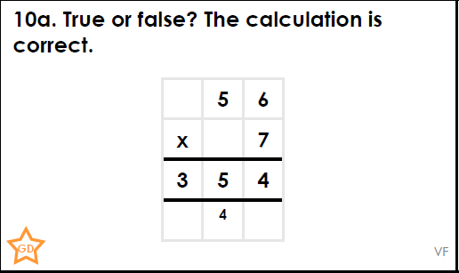
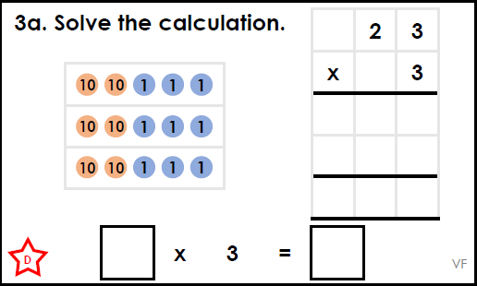
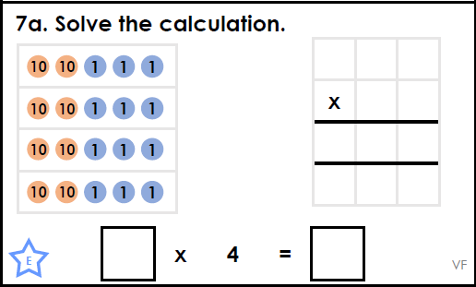
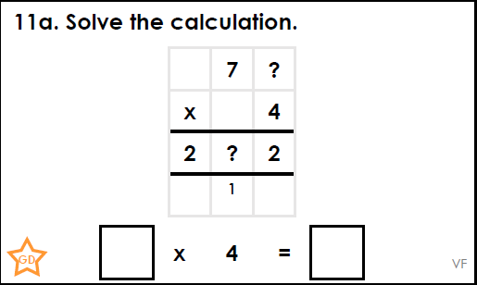
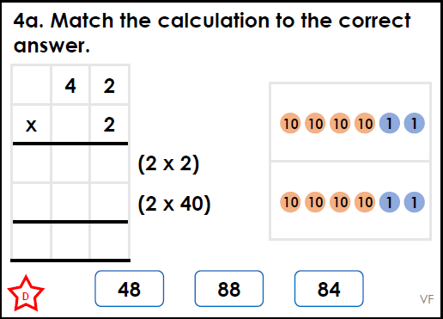
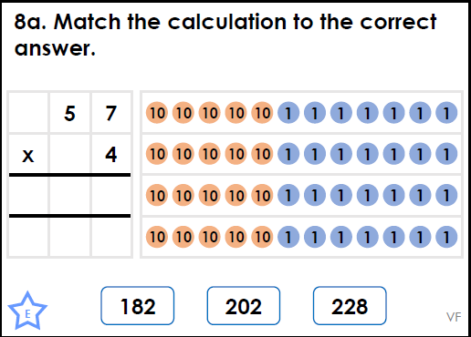
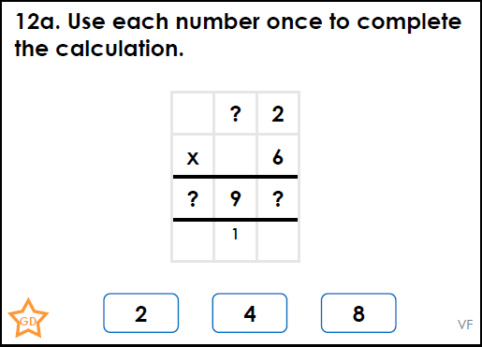
 | .
Intelligent Practice

Slide 18

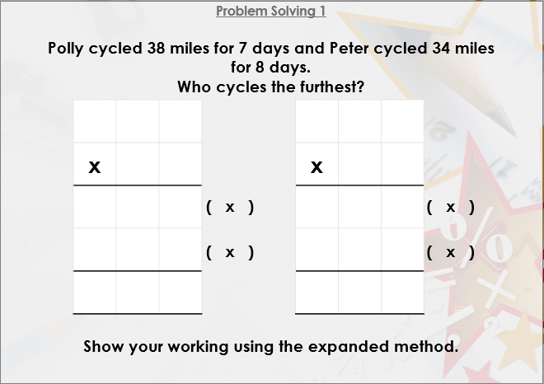


Slide 19

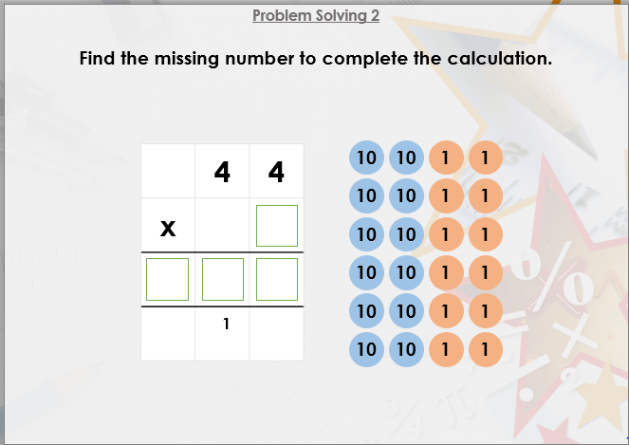

Slide 20

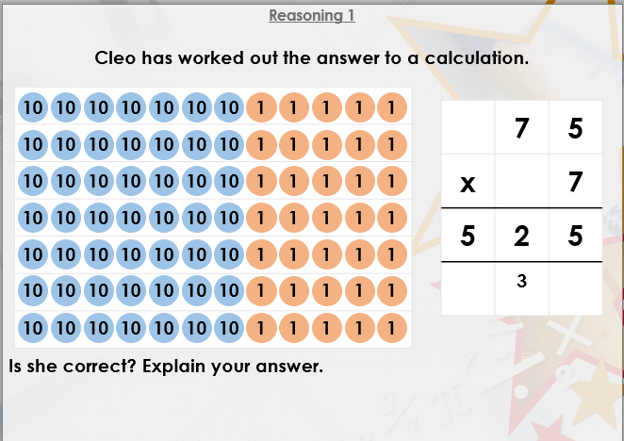
DIVE DEEPER 3

Slide 21
True: 32 x 3 = 96 | True: 42 x 6 = 252 | False: 56 x 7 = 392
23 x 3 = 69 | 23 x 4 = 92 | 73 x 4 = 292
84 | 228 | 82 x 6 = 492
Intelligent Practice

Slide 22
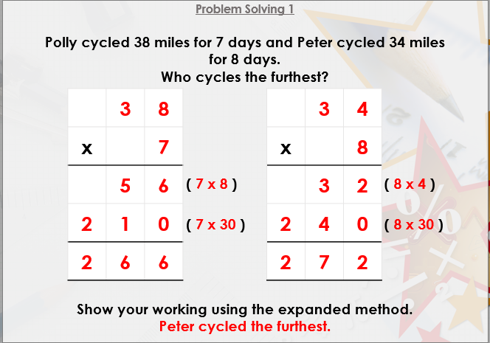

Slide 23
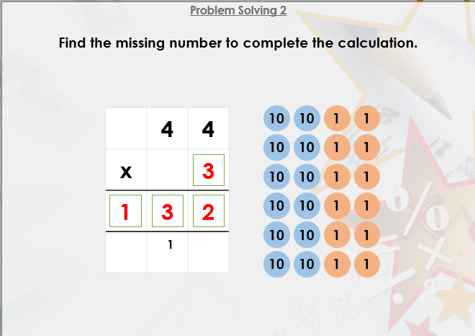

Slide 24
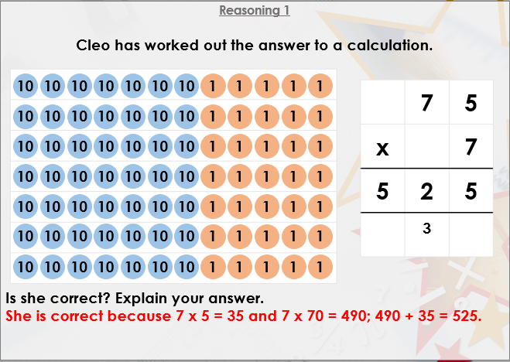
DIVE DEEPER 3

