Slide 1
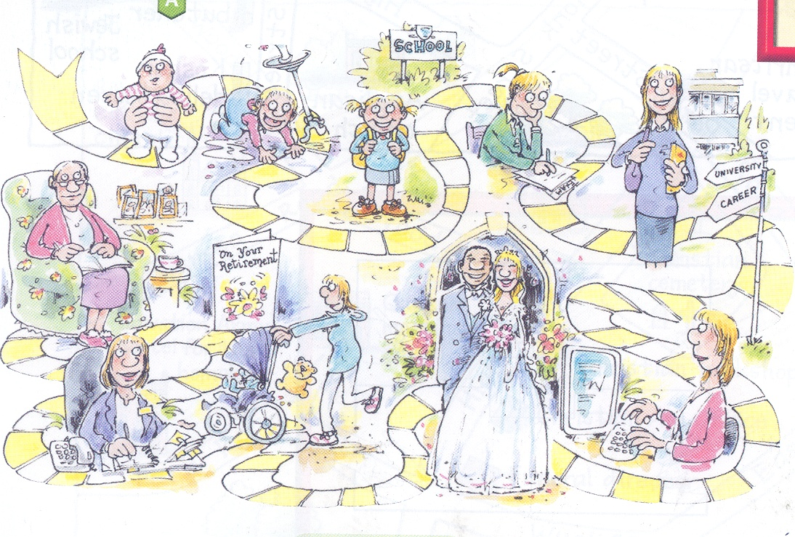

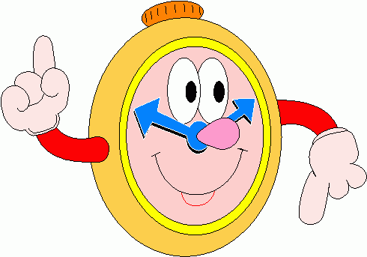
Before we begin…
Activating Prior Knowledge
On your post it notes write down what you think this picture shows.
5 minutes

Slide 2
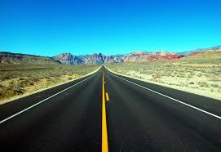
The Journey of
Life
‘’Life is a journey and only you hold the map.’’
‘’Life is a journey not a destination.’’

Slide 3
Lesson Objectives:
1) To understand what the ‘Journey of life’ means.
2) To create your own Journey of life map and consider your choices and influences.

Slide 4


So, what is the ‘Journey of Life’…?
http://youtu.be/jYOsWWKHZVw

Slide 5
The journey of life shows your path through life. You start your journey when you are born, travel through life achieving religious (christening, marriage) and secular (first day at school) milestones and achievements. You end your journey when you die.
OR DO YOU?!

Slide 6
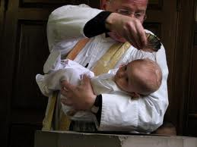
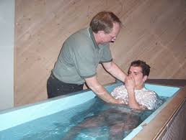
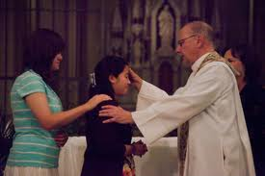
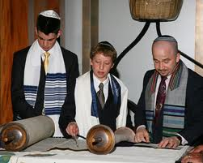
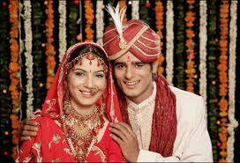
Religious milestones and achievements:

Slide 7
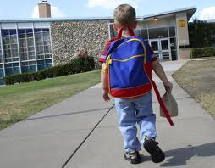
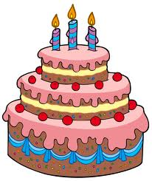

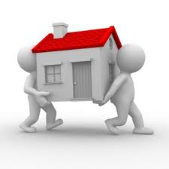
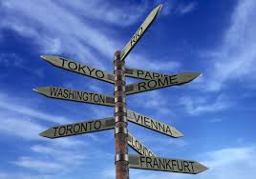
Secular milestones and
achievements:

Slide 8
In your exercise books… Fill in the blank spaces!
The _____ of life shows your path through ____. You ____ your journey when you are ____, travel through life achieving ______ (christening, marriage) and ______ (first day at school) milestones and achievements. You ____ your journey when you die.

Slide 9

Lesson Objectives:
1) To understand what the ‘Journey of life’ means.
2) To create our own Journey of life map and consider our choices and influences .

Slide 10
TASK
Look again at the picture from the beginning of the lesson.
Create your own ‘Journey of Life’ map
2) Include at least 3 important milestones or achievements you have experienced in your life so far or may have to experience in the future as you go through life.
3) Explain your choices; Who or what has influenced you. For example, did you have a choice of which secondary school to attend?

Slide 11
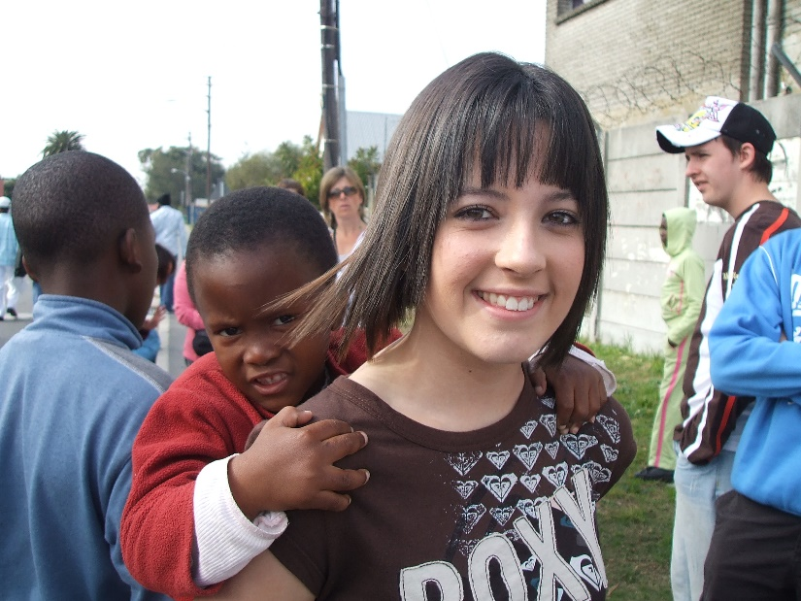
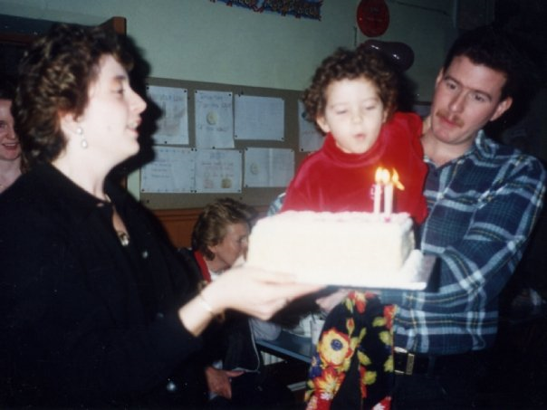
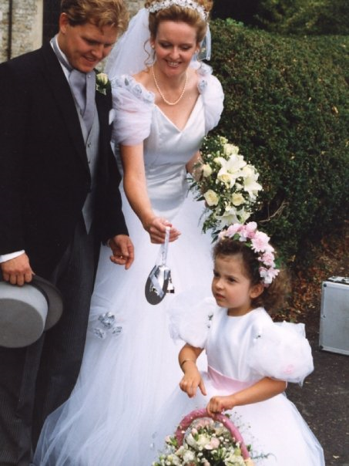
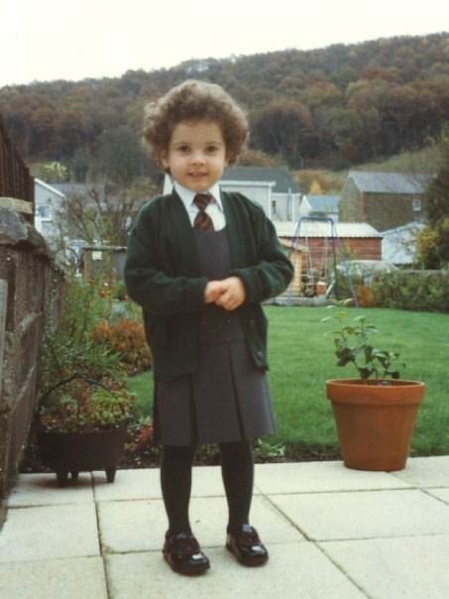
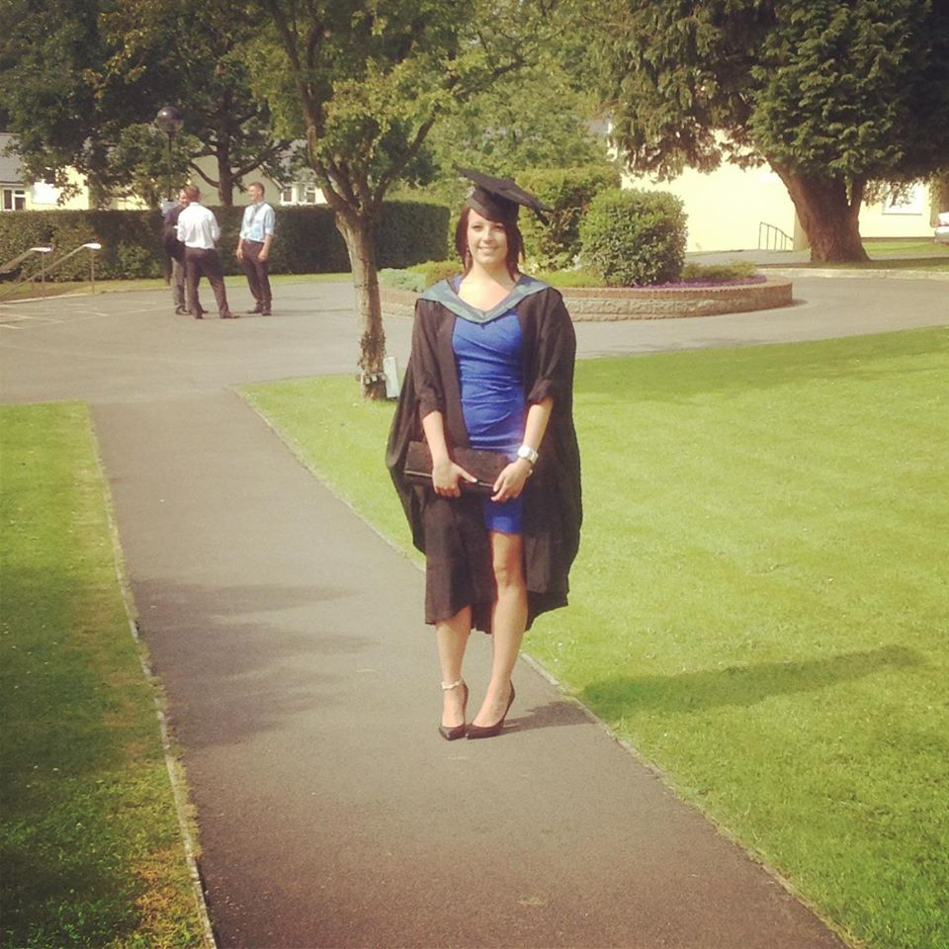

Slide 13
Lesson Objectives:
1) To understand what the ‘Journey of life’ means.
2) To create our own Journey of life map and consider our choices and influences .

Slide 14

PLENARY
What have you learnt this lesson?
Thumbs up or down to the following words……….

Slide 15
Journey of Life
Religious
Secular
Achievement
Milestone

