Slide 1
Challenge 4
        72 ÷ 6 = 9 x 6 =
        36 ÷ 6 = 2 x 6 =
        18 ÷ 6 = 30 ÷ 6 =
        66 ÷ 6 = 6 ÷ 6 =
        3 x 6 = 42 ÷ 6 =
        6 x 6 = 48 ÷ 6 =

Slide 2
Year 4 | Week 8 | Day 4

Slide 3
L.O. - to recognise 7 times table multiplication and division facts
SOME WILL EVEN: Use the given digit cards to create two fact families for the 7 times tables; Explain whether calculations of money are correct or not using known facts of the 7 times table.
SOME WILL: Solve calculations using known facts of the 7 times tables to find division facts using non-standard multiples.
MOST WILL: Solve calculation using known facts of the 7 times table to find division facts using multiples of 10 and 100.
ALL WILL: Solve calculations using known facts of the 7 times tables with pictorial support.

Slide 4
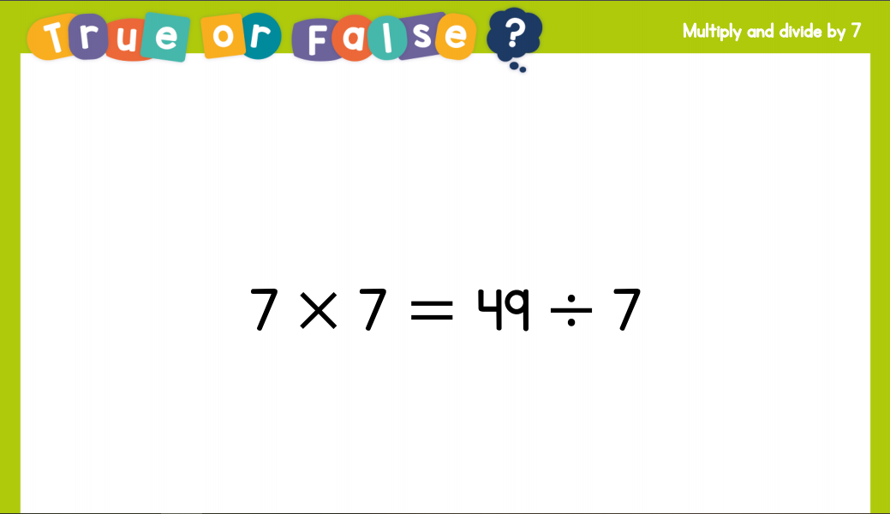
Recall:

Slide 5
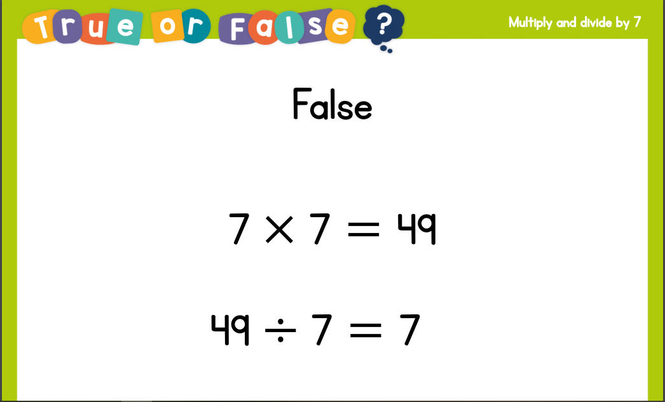
Recall:

Slide 6
GUIDED PRACTICE:

Slide 7


Introduction
Use your knowledge of the 7 times table to answer the questions as quickly possible.
5 x 7 =
8 x 7 =
1 x 7 =
6 x 7 =
11 x 7 =
2 x 7 =
21 ÷ 7 =
63 ÷ 7 =
28 ÷ 7 =
49 ÷ 7 =
84 ÷ 7 =
70 ÷ 7 =
© Classroom Secrets Limited 2018

Slide 8
Introduction
Use your knowledge of the 7 times table to answer the questions as quickly possible.
5 x 7 = | 35
8 x 7 = | 56
1 x 7 = | 7
6 x 7 = | 42
11 x 7 = | 77
2 x 7 = | 14
21 ÷ 7 = | 3
63 ÷ 7 = | 9
28 ÷ 7 = | 4
49 ÷ 7 = | 7
84 ÷ 7 = | 12
70 ÷ 7 = | 10
© Classroom Secrets Limited 2018

Slide 9
Varied Fluency 1
Complete the calculations below.
5 x 7 =
A.
50 x 7 =
B.
500 x 7 =
C.
© Classroom Secrets Limited 2018

Slide 10
Varied Fluency 1
Complete the calculations below.
5 x 7 =
35
A.
50 x 7 =
350
B.
500 x 7 =
3,500
C.
© Classroom Secrets Limited 2018

Slide 11
Varied Fluency 2
Match the calculations to the correct answers.
A. |  | 12 | x | 7 | = |  | 840
B. |  | 120 | x | 7 | = |  | 8,400
C. |  | 1,200 | x | 7 | = |  | 84
© Classroom Secrets Limited 2018

Slide 12
Varied Fluency 2
Match the calculations to the correct answers.
A. |  | 12 | x | 7 | = |  | 840
B. |  | 120 | x | 7 | = |  | 8,400
C. |  | 1,200 | x | 7 | = |  | 84
© Classroom Secrets Limited 2018

Slide 13
Varied Fluency 3
Tick the number sentences that can be solved using the information in the bar model.
28
7 | 7 | 7 | 7
4 | x | 7 | = | 28
28 | ÷ | 4 | = | 7
28 | x | 7 | = | 4
280 | ÷ | 7 | = | 40
© Classroom Secrets Limited 2018

Slide 14
Varied Fluency 3
Tick the number sentences that can be solved using the information in the bar model.
28
7 | 7 | 7 | 7
4 | x | 7 | = | 28
28 | ÷ | 4 | = | 7
28 | x | 7 | = | 4
280 | ÷ | 7 | = | 40
✓
✓
✓
© Classroom Secrets Limited 2018

Slide 15

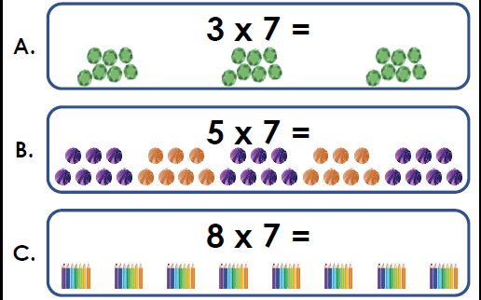
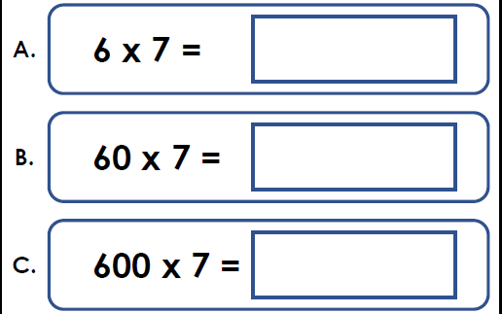
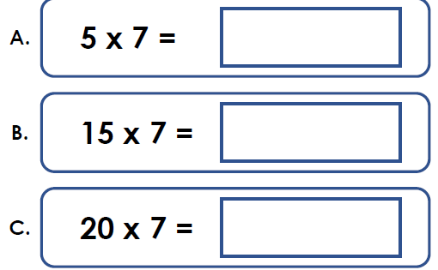
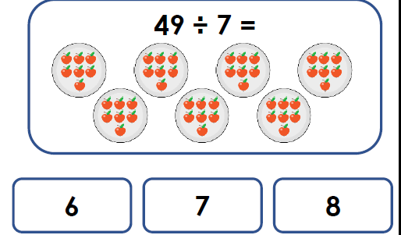
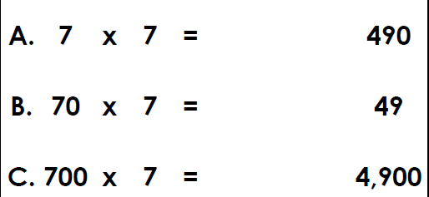
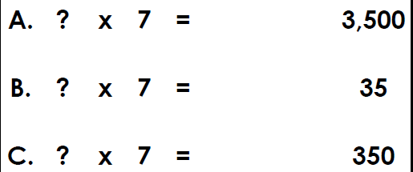
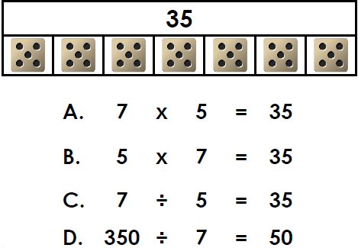
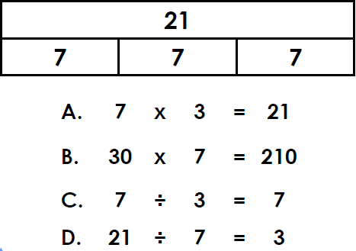
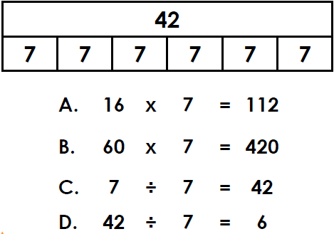
Complete the calculations below. | Complete the calculations below. | Complete the calculations below.
Match the calculation below to the correct answer. | Match the calculation below to the correct answer. | Complete the calculation and match to the answer.
Which number sentences that can be solved using in the bar model below | Which number sentences that can be solved using in the bar model below | Which number sentences that can be solved using in the bar model below
Intelligent Practice

Slide 16

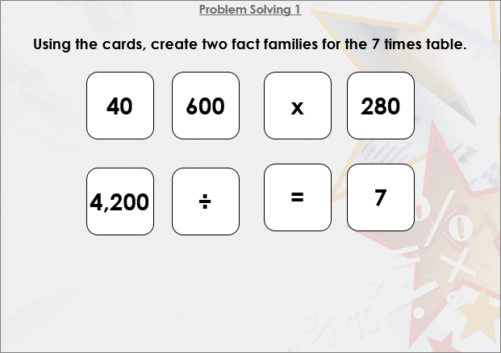


Slide 17

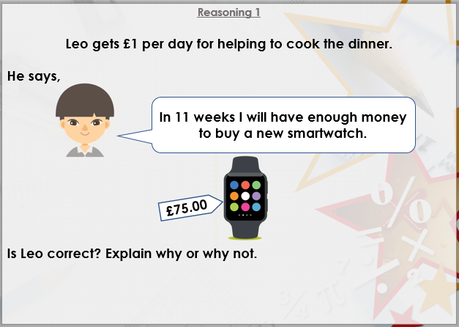

Slide 18

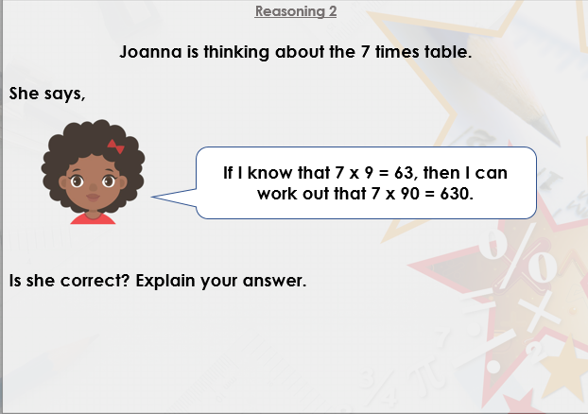
DIVE DEEPER 3

Slide 19
Complete the calculations below. | Complete the calculations below. | Complete the calculations below.
A = 21, B = 35, C 56 | A = 42, B = 420, C = 4,200 | A = 35, B = 105, C 140
Match the calculation below to the correct answer. | Match the calculation below to the correct answer. | Complete the calculation and match to the answer.
7 | A = 49, B = 490, C = 4,900 | A = 5 x 7 = 35, B = 50 x 7 = 350, C 500 x 7 = 3,500
Which number sentences that can be solved using in the bar model below | Which number sentences that can be solved using in the bar model below | Which number sentences that can be solved using in the bar model below
A, B and D | A, B, and D should be ticked | B and D should be ticked
Intelligent Practice

Slide 20
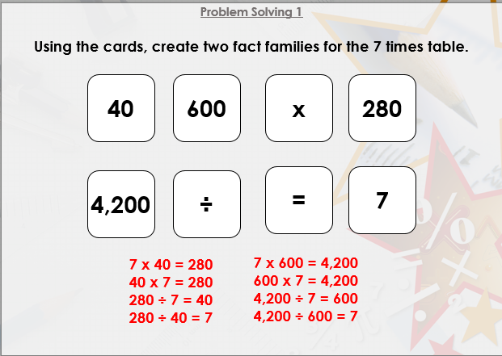

Slide 21
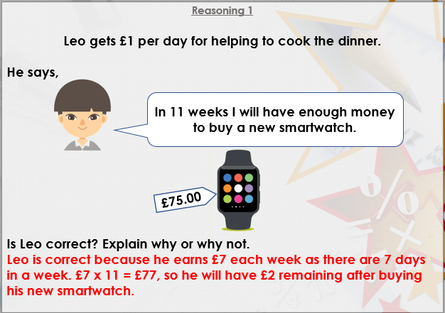

Slide 22
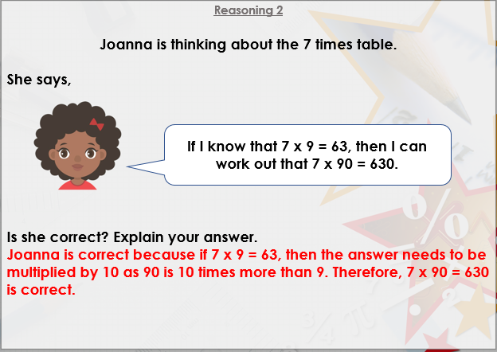
DIVE DEEPER 3

Slide 23

Intelligent Practice

