Slide 1
Year 4 | Week 9 | Day 5

Slide 2
L.O. - to use written methods to solve 2 digits x 1 digit
SOME WILL EVEN: Use the most efficient method to solve a multiplication calculation; Use digit cards to create a multiplication calculation; Explain whether the multiplication has been calculated correctly.
SOME WILL: Use informal written methods to multiply 2-digits by a 1-digit number including some incomplete calculations.
MOST WILL: Use informal written methods to multiply 2-digit numbers and 1-digit numbers support by pictorial support and some incomplete calculations.
ALL WILL: Use informal written methods to multiply 2-digits by a 1-digit number with pictorial support and scaffolding.

Slide 3
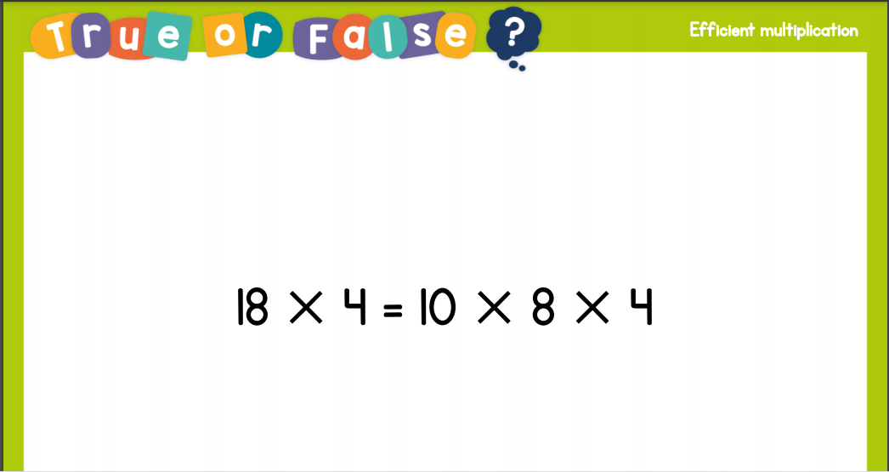
Recall:

Slide 4
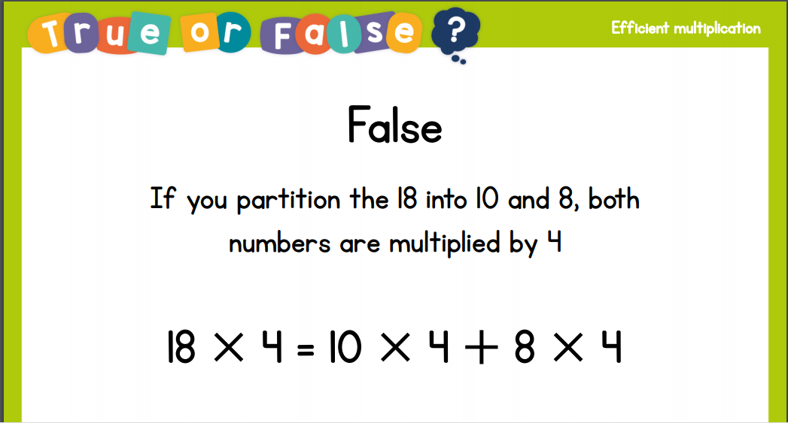
Recall:

Slide 5
GUIDED PRACTICE:

Slide 6


Introduction
Which multiplication sentences do not match this image?
6 x 4
8 x 3
3 x 8
24 x 1
1 x 22
4 x 6
14 x 2
3 x 9
© Classroom Secrets Limited 2018

Slide 7
Introduction
Which multiplication sentences do not match this image?
6 x 4
8 x 3
3 x 8
24 x 1
1 x 22
4 x 6
14 x 2
3 x 9
© Classroom Secrets Limited 2018

Slide 8
Varied Fluency 1
Complete the calculation to match the pictorial representation and solve it.
10
10
10
1
1
1
1
1
1
1
10
10
10
1
1
1
1
1
1
1
10
10
10
1
1
1
1
1
1
1
10
10
10
1
1
1
1
1
1
1
10
10
10
1
1
1
1
1
1
1
10
10
10
1
1
1
1
1
1
1
 | x | 6 | =
© Classroom Secrets Limited 2018

Slide 9
Varied Fluency 1
Complete the calculation to match the pictorial representation and solve it.
10
10
10
1
1
1
1
1
1
1
10
10
10
1
1
1
1
1
1
1
10
10
10
1
1
1
1
1
1
1
10
10
10
1
1
1
1
1
1
1
10
10
10
1
1
1
1
1
1
1
10
10
10
1
1
1
1
1
1
1
37 | x | 6 | = | 222
© Classroom Secrets Limited 2018

Slide 10
Varied Fluency 2
Complete the pictorial representation and the calculation.
10
10
10
10
1
1
1
1
1
10
10
10
10
 | x | 3 | =
© Classroom Secrets Limited 2018

Slide 11
Varied Fluency 2
Complete the pictorial representation and the calculation.
10
10
10
10
1
1
1
1
1
10
10
10
10
1
1
1
1
1
10
10
10
10
1
1
1
1
1
45 | x | 3 | = | 135
© Classroom Secrets Limited 2018

Slide 12
Varied Fluency 3
Complete the number line to work out the answer to 34 x 7.
10 x 7 =
10 x 7 =
10 x 7 =
4 x 7 =
140
© Classroom Secrets Limited 2018

Slide 13
Varied Fluency 3
Complete the number line to work out the answer to 34 x 7.
34 x 7 = 238
10 x 7 = 70
10 x 7 = 70
10 x 7 = 70
4 x 7 = 28
70
140
210
238
© Classroom Secrets Limited 2018

Slide 14
Varied Fluency 4
True or false?
A part-whole model is an efficient way to calculate
35 x 4.
Use the part-whole model to work out the answer.
35 x 4
30 x 4
5 x 4
© Classroom Secrets Limited 2018

Slide 15
Varied Fluency 4
True or false?
A part-whole model is an efficient way to calculate
35 x 4.
Use the part-whole model to work out the answer.
True
35 x 4
140
30 x 4
120
5 x 4
20
© Classroom Secrets Limited 2018

Slide 16

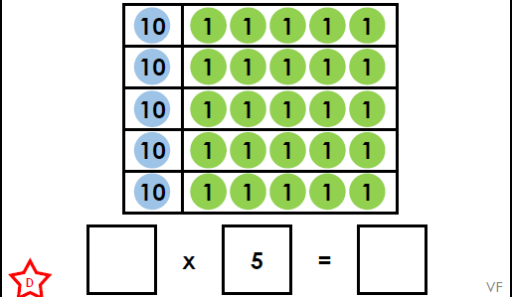
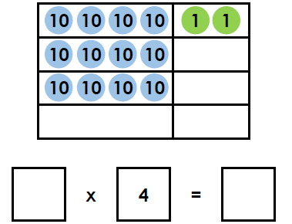
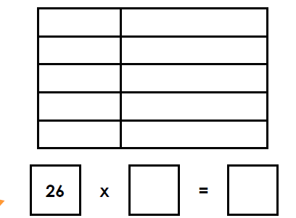
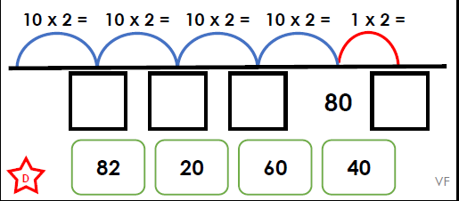
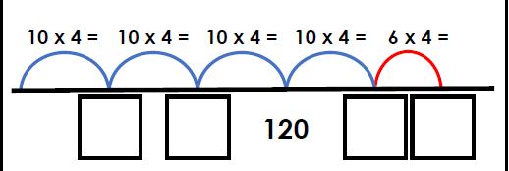
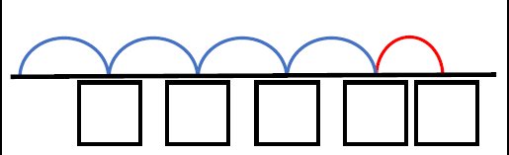
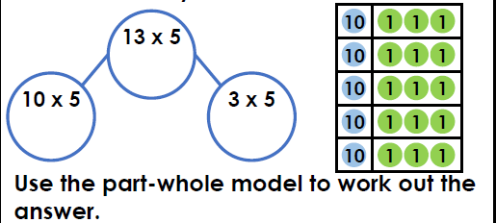
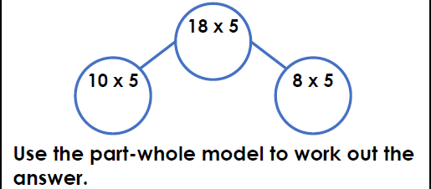
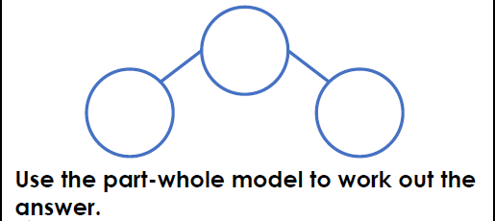
Complete the pictorial representation and the calculation. | Complete the pictorial representation and the calculation. | Complete the pictorial representation and the calculation.
Complete the numberline to work out the answer to 41 x 2 | Complete the numberline to work out the answer to 46 x 4 | Complete the calculation and match to the answer to 46 x 7.
True or false? A part-whole model is an efficient way to calculate 13 x 5 | True or false? A part-whole model is an efficient way to calculate 18 x 5 | True or false? A part-whole model is an efficient way to calculate 47 x 5.
Intelligent Practice

Slide 17

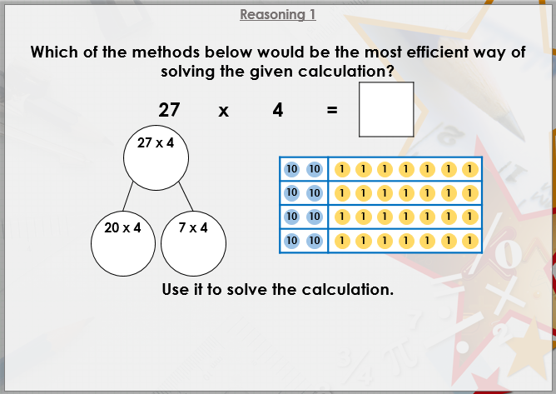


Slide 18

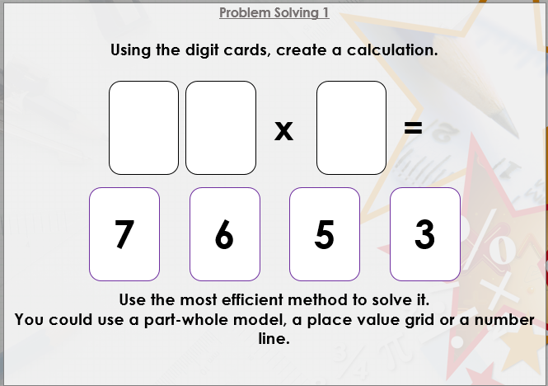

Slide 19

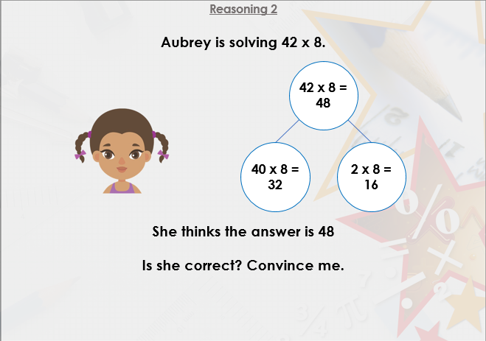
DIVE DEEPER 3

Slide 20
Complete the pictorial representation and the calculation. | Complete the pictorial representation and the calculation. | Complete the pictorial representation and the calculation.
15 x 5 = 75 | 42 x 4 = 168 | 26 x 5 = 130
Complete the numberline to work out the answer to 41 x 2 | Complete the numberline to work out the answer to 46 x 4 | Complete the calculation and match to the answer to 46 x 7.
41 x 2 = 82 | 46 x 4 = 184 | 46 x 7 = 322
True or false? A part-whole model is an efficient way to calculate 13 x 5 | True or false? A part-whole model is an efficient way to calculate 18 x 5 | True or false? A part-whole model is an efficient way to calculate 47 x 5.
True, but allow for varied opinion. 13 x 5 = 65 | True, but allow for varied opinion. 18 x 5 = 90 | True, but allow for varied opinion. 47 x 5 = 235
Intelligent Practice

Slide 21
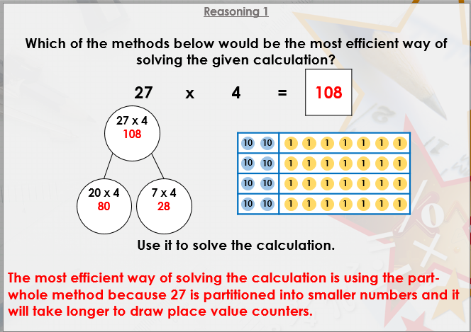

Slide 22
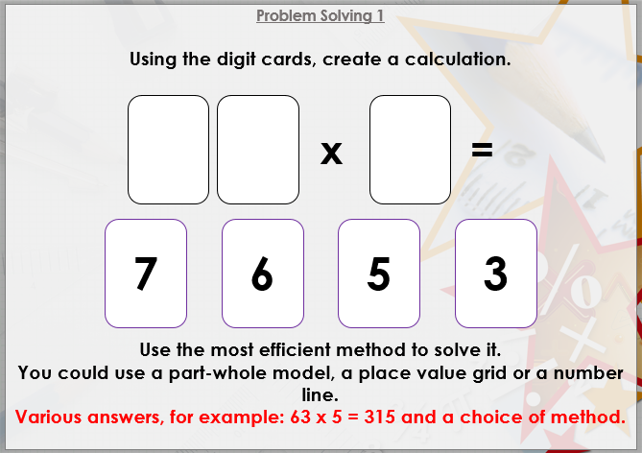

Slide 23
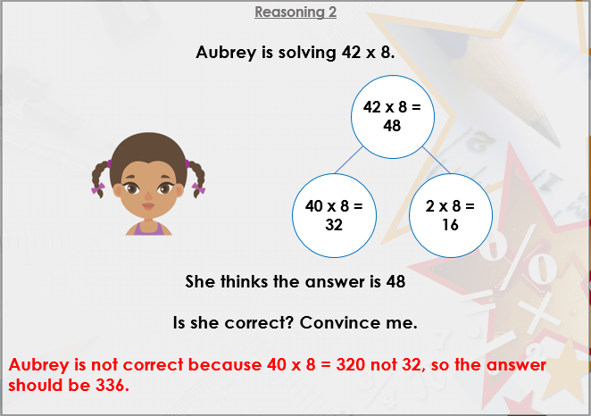
DIVE DEEPER 3

