Slide 1
Year 4 | Week 9 | Day 4

Slide 2
L.O. - To multiply efficiently
SOME WILL EVEN: Decide whether or not a calculation has been solved efficiently; Solve a given calculation using factor pairs, or doubling and halving.
SOME WILL: Use factors, partitioning, addition and subtraction, doubling and halving to effectively multiply 2-digit numbers.
MOST WILL: Use factors, partitioning, addition and subtraction to multiply 2-digit numbers.
ALL WILL: Use partitioning and addition to efficiently multiply 2-digit numbers using all 12 times tables.

Slide 3
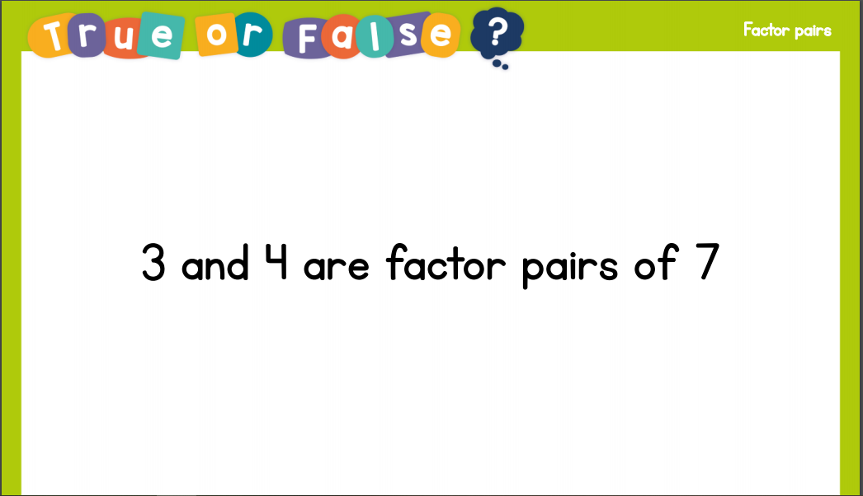
Recall:

Slide 4
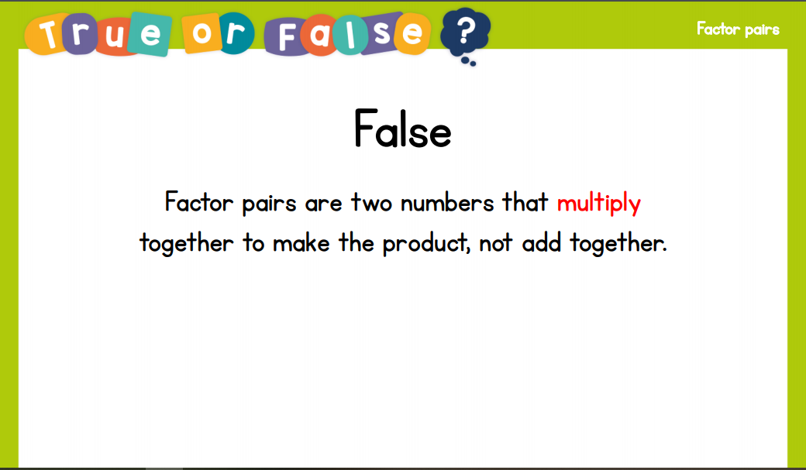
Recall:

Slide 5
GUIDED PRACTICE:

Slide 6


Introduction
Circle all of the factor pairs of 48 below.
6 x 8 |  | 3 x 16 |  | 5 x 8
 | 4 x 12 |  | 8 x 7
2 x 24 |  | 9 x 6 |  | 1 x 48
© Classroom Secrets Limited 2018

Slide 7
Introduction
Circle all of the factor pairs of 48 below.
6 x 8 |  | 3 x 16 |  | 5 x 8
 | 4 x 12 |  | 8 x 7
2 x 24 |  | 9 x 6 |  | 1 x 48
© Classroom Secrets Limited 2018

Slide 8
Varied Fluency 1
Sam has started to work out 42 x 6.
Complete his calculation.
42 x 6
40 | x |  | =
 | x | 6 | =
 |  |  | =
© Classroom Secrets Limited 2018

Slide 9
Varied Fluency 1
Sam has started to work out 42 x 6.
Complete his calculation.
42 x 6
40 | x | 6 | = | 240
2 | x | 6 | = | 12
40 x 6
2 x 6
240 | + | 12 | = | 252
© Classroom Secrets Limited 2018

Slide 10
Varied Fluency 2
Sheila is calculating 38 x 9 efficiently.
Sheila is correct. True or false?
50 | x | 9 | = | 450
2 | x | 9 | = | 18
450 | – | 18 | = | 432
© Classroom Secrets Limited 2018

Slide 11
Varied Fluency 2
Sheila is calculating 38 x 9 efficiently.
Sheila is correct. True or false?
False. 38 x 9 = 342, not 432. 40 x 9 = 360, 2 x 9 = 18 and
360 – 18 = 342.
50 | x | 9 | = | 450
2 | x | 9 | = | 18
450 | – | 18 | = | 432
© Classroom Secrets Limited 2018

Slide 12
Varied Fluency 3
Thierry is using factors to solve 24 x 5.
Complete his method and circle the correct answer above.
24 | x | 5 | = |  | x |  | x | 5
24 | x | 5 | = | 6 | x
124 |  | 120 |  | 145
© Classroom Secrets Limited 2018

Slide 13
Varied Fluency 3
Thierry is using factors to solve 24 x 5.
Complete his method and circle the correct answer above.
24 | x | 5 | = | 6 | x | 4 | x | 5
24 | x | 5 | = | 6 | x | 20
124 |  | 120 |  | 145
© Classroom Secrets Limited 2018

Slide 14

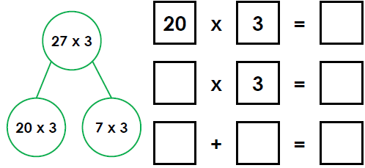
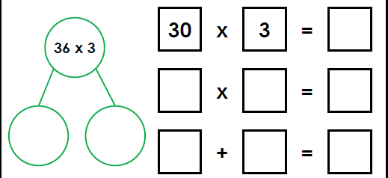
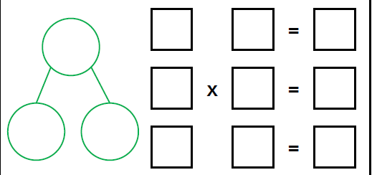
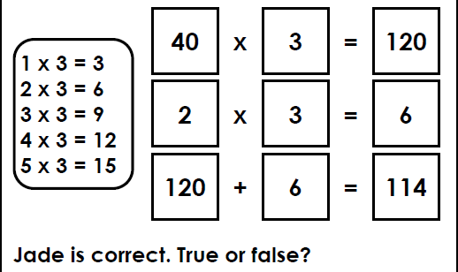
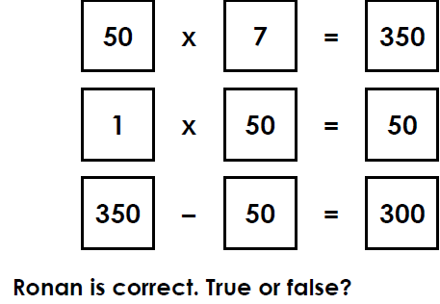
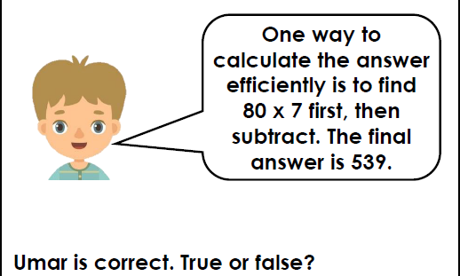
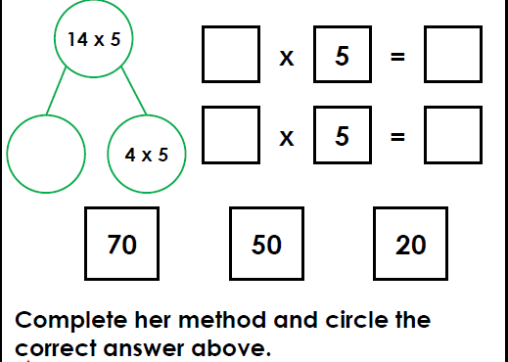
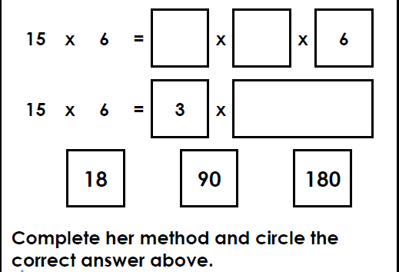
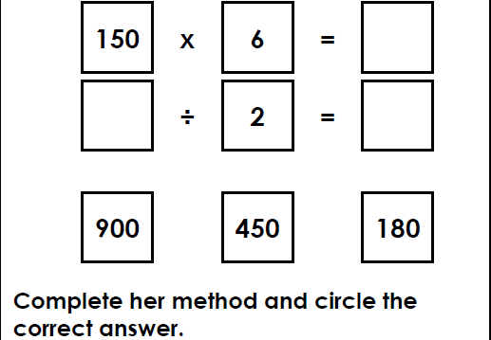
Kyle has started to work out 27 x 3. Complete his calculation. | Ruby has started to work out 36 x 3. Complete her calculation. | Belinda has started to work out 64 x 9. Complete her calculation.
Jade is calculating 43 x 2 efficiently. | Ronan is calculating 49 x 7 efficiently. | Umar is calculating 47 x 7 efficiently
Alicia is efficiently solving 14 x 5 | Ellan is using factors to solve 15 x 6 | Kiera is efficiently solving 75 x 6
Intelligent Practice

Slide 15

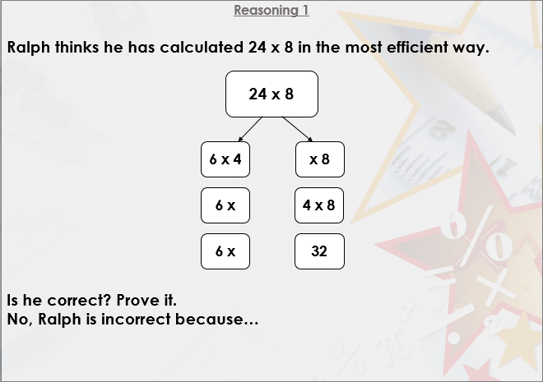


Slide 16

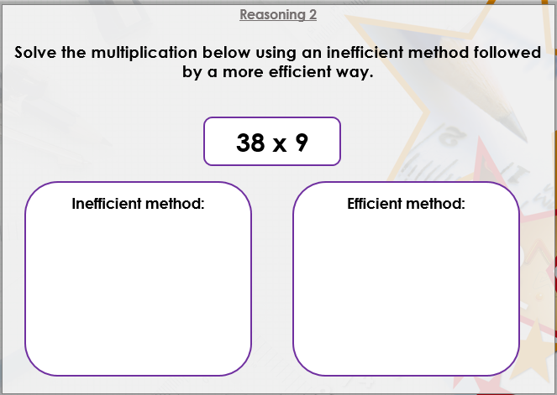

Slide 17

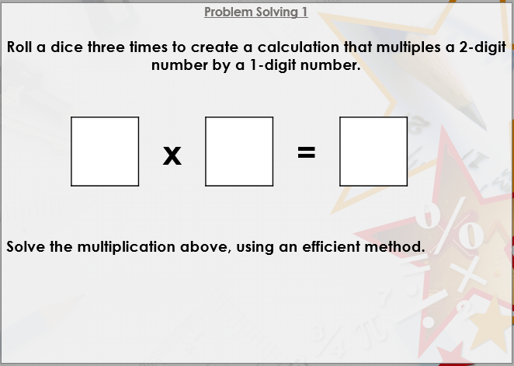
DIVE DEEPER 3

Slide 18
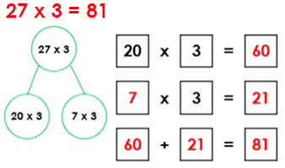
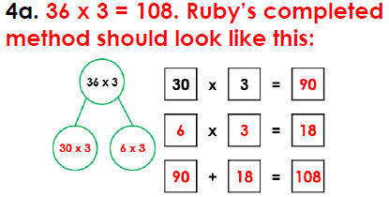
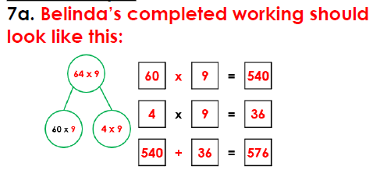
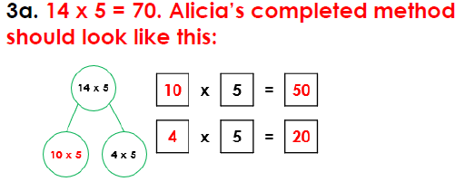
Kyle has started to work out 27 x 3. Complete his calculation. | Ruby has started to work out 36 x 3. Complete her calculation. | Belinda has started to work out 64 x 9. Complete her calculation.
Jade is calculating 43 x 2 efficiently. | Ronan is calculating 49 x 7 efficiently. | Umar is calculating 47 x 7 efficiently
False because 42 x 3 = 126, not 114. 40 x 3 = 120, 2 x 3 = 6 and 120 + 6 = 126. | False because 49 x 7 = 343, not 300. 50 x 7 = 350, 1 x 7 = 7 and 350 –7 = 343 | True
Alicia is efficiently solving 14 x 5 | Ellan is using factors to solve 15 x 6 | Kiera is efficiently solving 75 x 6
 | 15 x 6 = 90. 15 x 6 = 3 x 5 x 6 15 x 6 = 3 x 30; 15 x 6 = 90 | 75 x 6 = 450. 150 x 6 = 900; 900 ÷2 = 450.
Intelligent Practice

Slide 19
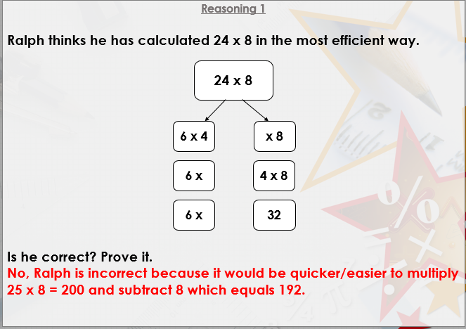

Slide 20
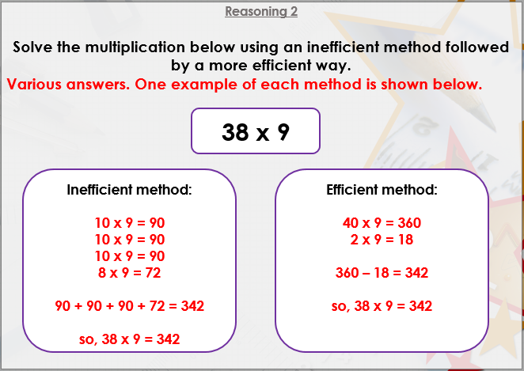

Slide 21
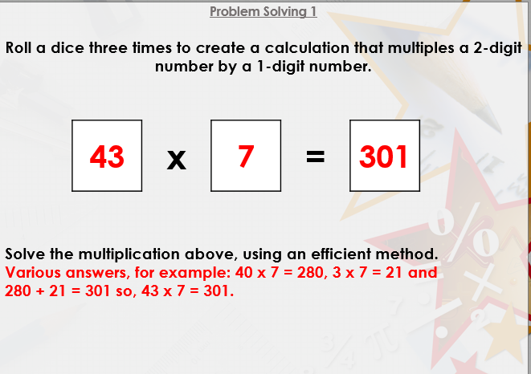
DIVE DEEPER 3

