Slide 1
Year 4 | Week 9 | Day 1
6 cm

Slide 2
L.O. - to understand 11 and 12 multiplication and division facts
SOME WILL EVEN: Use knowledge of 11 and 12 times tables to write related number sentences; Use knowledge of 11 and 12 times tables to calculate the required quantity of each ingredient.
SOME WILL: Show an understanding of the 11 and 12 time table without pictorial support.
MOST WILL: Use pictorial support and scaffolding to support the understanding of 11 and 12 time tables.
ALL WILL: Use base 10 to support the understanding of 11 and 12 time tables.

Slide 3
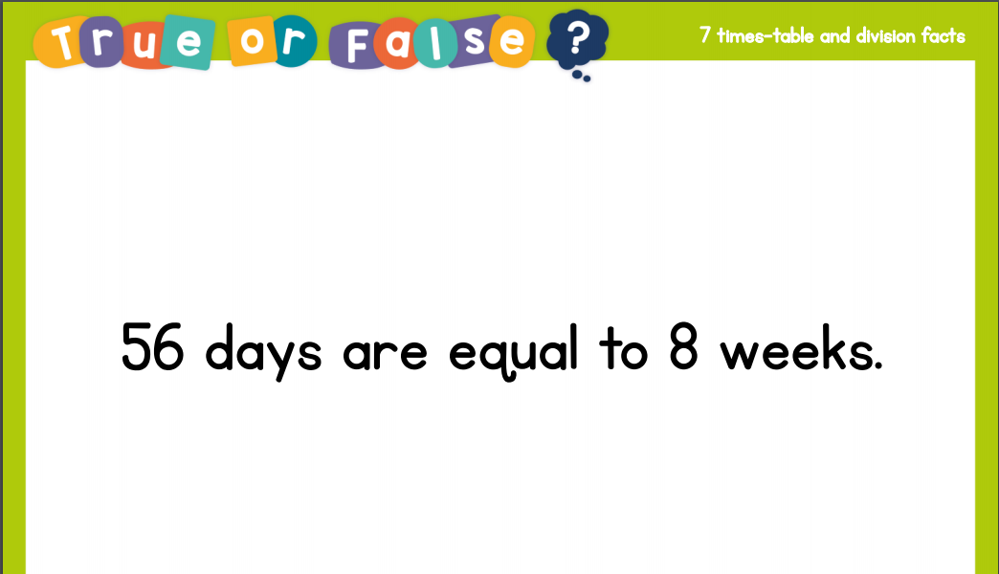
True or false:

Slide 4
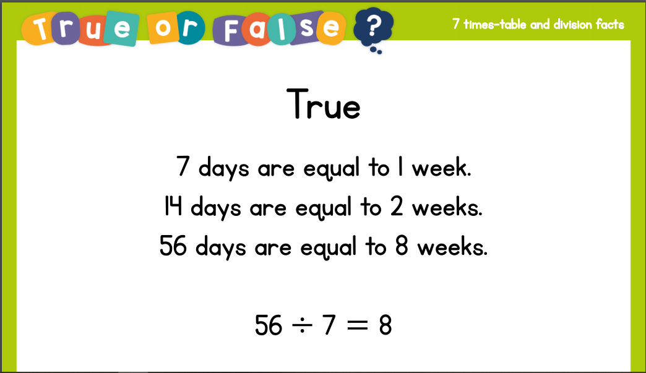
True or false:

Slide 5
GUIDED PRACTICE:

Slide 6


Introduction
Circle the incorrect multiplications below.
1 | x | 9 | = | 9
10 | x | 9 | = | 9
2 | x | 2 | = | 4
3 | x | 9 | = | 26
10 | x | 6 | = | 66
2 | x | 9 | = | 18
7 | x | 9 | = | 63
10 | x | 5 | = | 50
2 | x | 7 | = | 15
10 | x | 9 | = | 99
10 | x | 3 | = | 30
2 | x | 11 | = | 24
© Classroom Secrets Limited 2018

Slide 7
Introduction
Circle the incorrect multiplications below.
1 | x | 9 | = | 9
10 | x | 9 | = | 9
2 | x | 2 | = | 4
3 | x | 9 | = | 26
10 | x | 6 | = | 66
2 | x | 9 | = | 18
7 | x | 9 | = | 63
10 | x | 5 | = | 50
2 | x | 7 | = | 15
10 | x | 9 | = | 99
10 | x | 3 | = | 30
2 | x | 11 | = | 24
© Classroom Secrets Limited 2018

Slide 8
Varied Fluency 1
Complete 5 x 12, by partitioning it into tens and ones.
10
10
1
1
1
1
1
1
10
10
10
1
1
1
1
10
10
10
10
10
10 ones
 | + |  | =
© Classroom Secrets Limited 2018

Slide 9
Varied Fluency 1
Complete 5 x 12, by partitioning it into tens and ones.
10
10
1
1
1
1
1
1
10
10
10
1
1
1
1
10
10
10
10
10
10 ones
50 | + | 10 | = | 60
© Classroom Secrets Limited 2018

Slide 10
Varied Fluency 2
Fill in the grid to find the answer.
11 x 8 =
x | 10 | 1
8
© Classroom Secrets Limited 2018

Slide 11
Varied Fluency 2
Fill in the grid to find the answer.
11 x 8 =
x | 10 | 1
8 | 80 | 8
88
© Classroom Secrets Limited 2018

Slide 12
Varied Fluency 3
Use >, < or = to make each statement correct.
96 ÷ 12 |  | 88 ÷ 11
5 x 11 |  | 4 x 12
12 x 12 |  | 132 ÷ 11
© Classroom Secrets Limited 2018

Slide 13
Varied Fluency 3
Use >, < or = to make each statement correct.
96 ÷ 12 | = | 88 ÷ 11
5 x 11 | > | 4 x 12
12 x 12 | > | 132 ÷ 11
© Classroom Secrets Limited 2018

Slide 14
Varied Fluency 4
Complete the missing numbers.
A. |  |  | x | 12 | = | 24
B. |  | 11 | x | 9 | =
C. |  | 9 | = |  | ÷ | 11
D. |  |  | ÷ | 12 | = | 2
© Classroom Secrets Limited 2018

Slide 15
Varied Fluency 4
Complete the missing numbers.
A. |  | 2 | x | 12 | = | 24
B. |  | 11 | x | 9 | = | 99
C. |  | 9 | = | 99 | ÷ | 11
D. |  | 24 | ÷ | 12 | = | 2
© Classroom Secrets Limited 2018

Slide 16

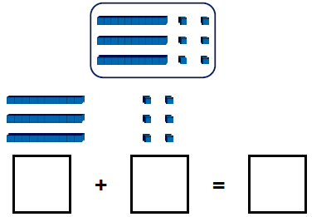
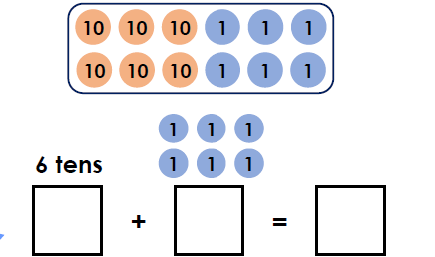
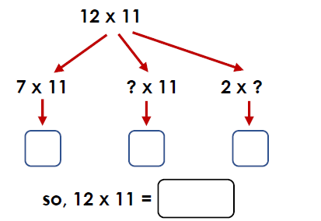
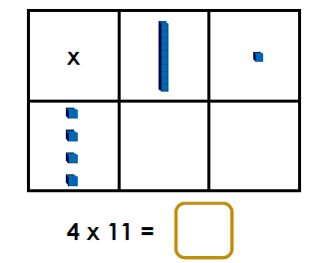
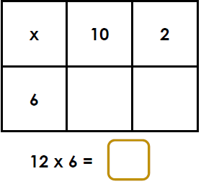
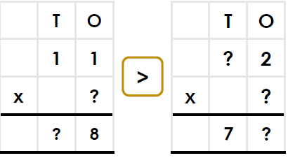
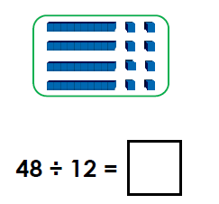
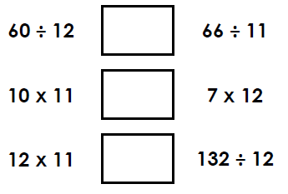
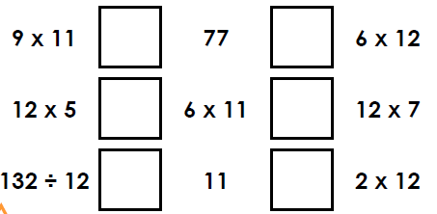
Complete 12 x 3, by partitioning it into tens and ones | Complete the calculations below. | Complete 12 x 11 using partitioning
Fill in the grid to find the answer. | Fill in the grid to find the answer. | Fill in the missing digits below to complete the multiplication puzzle
Draw the Base 10 into equal groups of 12 to solve the number sentence. | Use <, > or = to make each statement correct. | Use <, > or = to make each statement correct.
Intelligent Practice

Slide 17

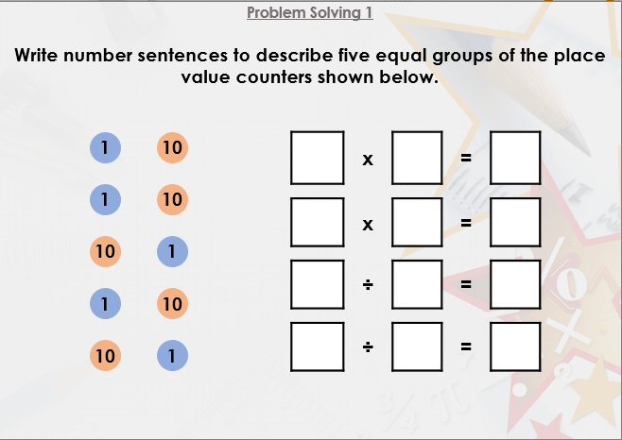


Slide 18

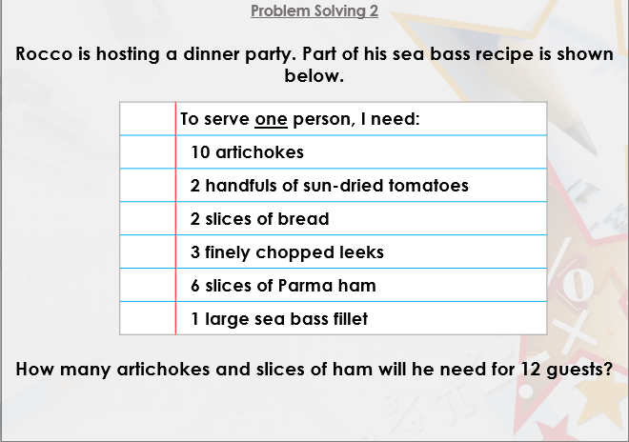

Slide 19

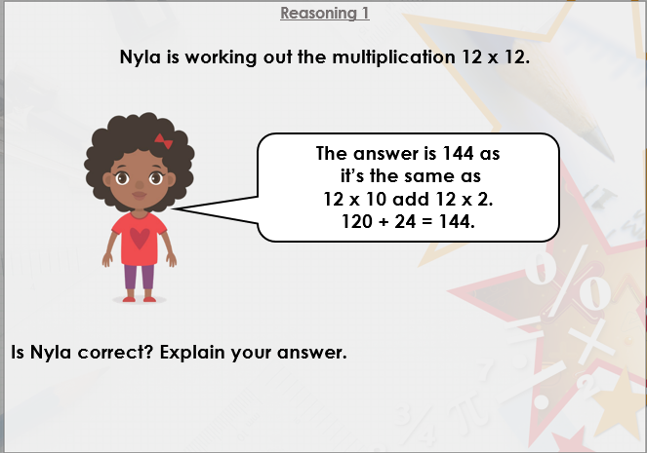
DIVE DEEPER 3

Slide 20
Complete 12 x 3, by partitioning it into tens and ones | Complete the calculations below. | Complete 12 x 11 using partitioning
30 + 6 = 36 | 60 + 6 = 66 | 7 x 11 = 77, 3x 11 = 33and 2 x 11= 2277 + 33 + 22 = 132, so 12 x 11 = 132
Fill in the grid to find the answer. | Fill in the grid to find the answer. | The missing digits are:
40 + 4 = 44 so 4 x 11 = 44 | 60 + 12 = 72
There should be four equal groups, as shown below. | Use <, > or = to make each statement correct. | Use <, > or = to make each statement correct.
 | <, > and > | > and >; < and <; = and <
Intelligent Practice

Slide 21
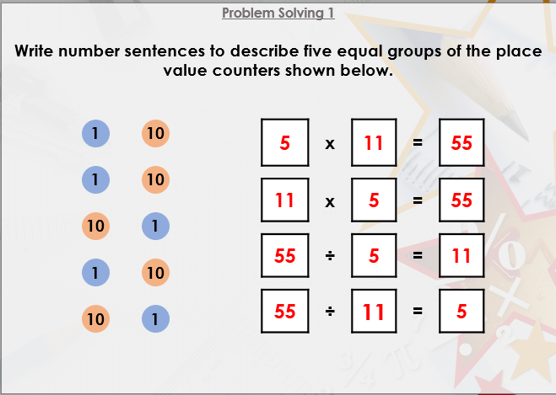

Slide 22
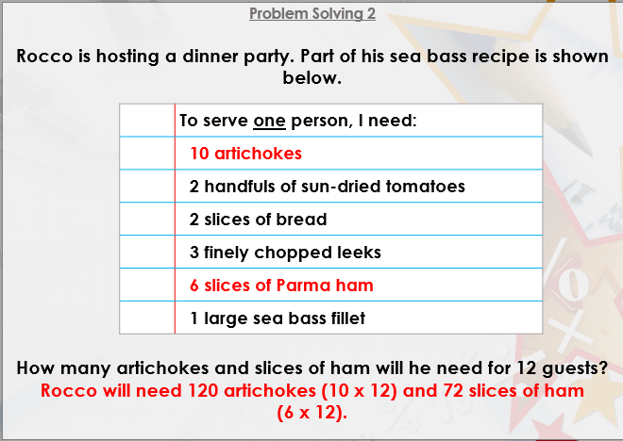

Slide 23
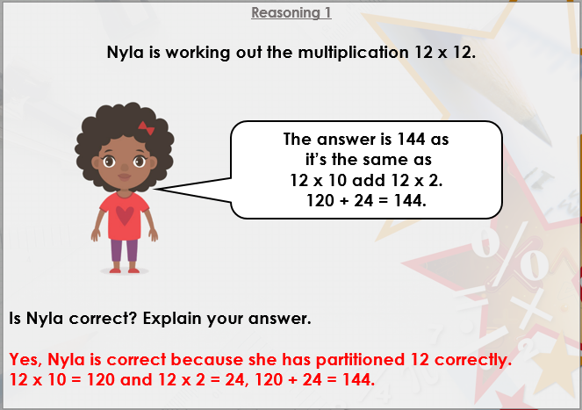
DIVE DEEPER 3

Slide 24

Intelligent Practice

