Slide 1
Year 4 | Week 9 | Day 3

Slide 2
L.O. to investigate factor pairs
SOME WILL EVEN: Find the missing numbers from a given factor and clues; Investigate whether numbers in a specific times tables will have an even number of factor pairs; Compare odd and even numbers in terms of number of factor pairs.
SOME WILL: Investigate systematic ways of recording and sorting factor pairs.
MOST WILL: Explore the systematic recording of factor pairs using knowledge of known times tables facts.
ALL WILL: Explore the systematic recordings of factor pairs including facts of the 3, 4, 6 and 8 times tables.

Slide 3
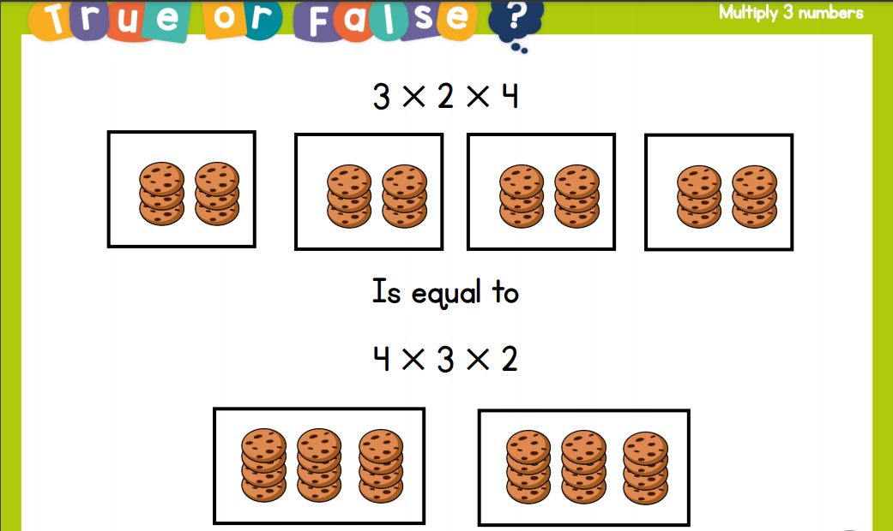
Recall:

Slide 4
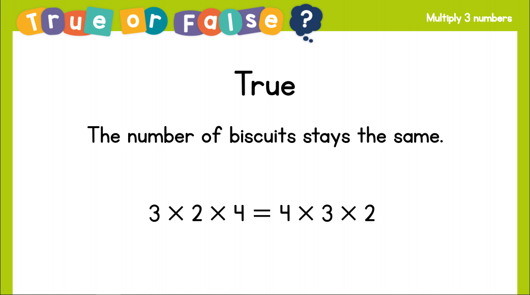
Recall:

Slide 5
GUIDED PRACTICE:

Slide 6


Introduction
Complete these questions about the 11 and 12 times table.
1 x 11 = |  |  | 12 ÷ 1 =
11 ÷ 1 = |  |  | 2 x 12 =
22 ÷ 2 = |  |  | 4 x 12 =
3 x 11 = |  |  | 108 ÷ 12 =
99 ÷ 11 = |  |  | 60 ÷ 12 =
© Classroom Secrets Limited 2018

Slide 7
Introduction
Complete these questions about the 11 and 12 times table.
1 x 11 = | 11 |  | 12 ÷ 1 = | 12
11 ÷ 1 = | 11 |  | 2 x 12 = | 24
22 ÷ 2 = | 11 |  | 4 x 12 = | 48
3 x 11 = | 33 |  | 108 ÷ 12 = | 9
99 ÷ 11 = | 9 |  | 60 ÷ 12 = | 5
© Classroom Secrets Limited 2018

Slide 8

Varied Fluency 1
Complete the factor crab.
1
16
2
8
4
4
© Classroom Secrets Limited 2018

Slide 9
Varied Fluency 1
Complete the factor crab.
1
16
2
8
16
4
4
© Classroom Secrets Limited 2018

Slide 10
Varied Fluency 2
Write the missing factors.
40
 | 1 |  |  | 40
A. |  |  |  | 20
 | 4 |  | C.
B. |  |  |  | 5
© Classroom Secrets Limited 2018

Slide 11
Varied Fluency 2
Write the missing factors.
A = 2; B = 8; C = 10
40
 | 1 |  |  | 40
A. | 2 |  |  | 20
 | 4 |  | C. | 10
B. | 8 |  |  | 5
© Classroom Secrets Limited 2018

Slide 12
Varied Fluency 3
Draw lines to match the factor pairs.
Factor pairs of 30
1 | 7 | 2 | 5 | 10
3 | 6 | 9 | 30 | 15
© Classroom Secrets Limited 2018

Slide 13
Varied Fluency 3
Draw lines to match the factor pairs.
Factor pairs of 30
1 | 7 | 2 | 5 | 10
3 | 6 | 9 | 30 | 15
© Classroom Secrets Limited 2018

Slide 14
Varied Fluency 4
Circle all the factor pairs of 50.
14 x 3 |  | 2 x 25 |  | 20 x 3
 | 1 x 50 |  | 21 x 2 |  | 18 x 3
12 x 6 |  | 17 x 3 |  | 10 x 5
© Classroom Secrets Limited 2018

Slide 15
Varied Fluency 4
Circle all the factor pairs of 50.
14 x 3 |  | 2 x 25 |  | 20 x 3
 | 1 x 50 |  | 21 x 2 |  | 18 x 3
12 x 6 |  | 17 x 3 |  | 10 x 5
© Classroom Secrets Limited 2018

Slide 16

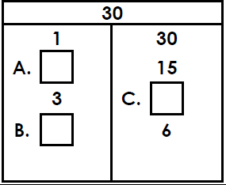
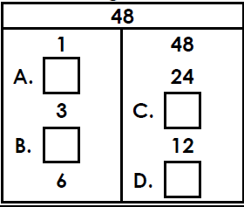
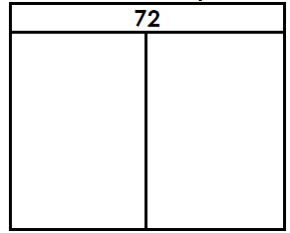
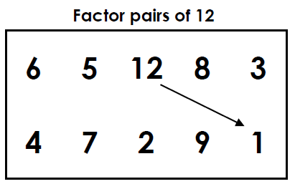
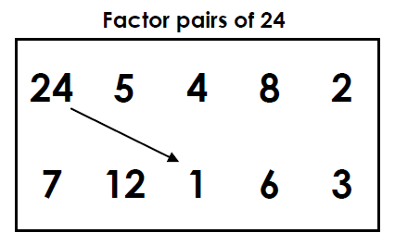
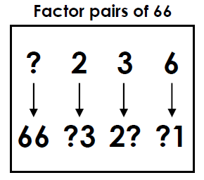
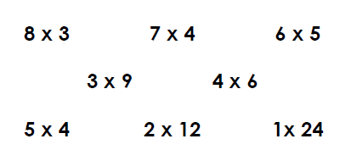
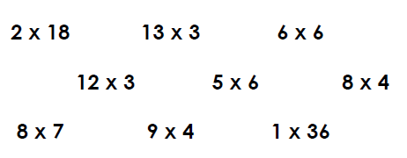
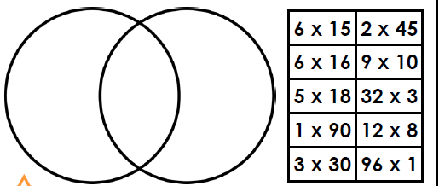
Write the missing factors. | Write the missing factors | Explore methodically the factors of 72.
Match the factor pairs. | Match the factor pairs. | Complete the factor pairs
Write down the factor pairs for 24. | Write down the factor pairs for 36 | Sort the factor pairs below into the venn diagram. Label the diagram.
Intelligent Practice

Slide 17

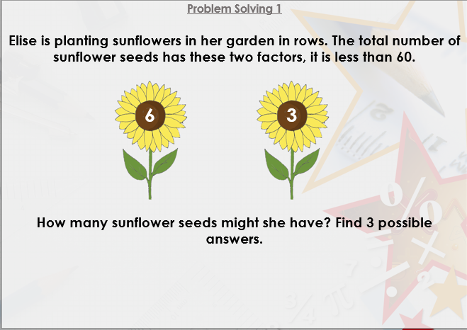


Slide 18

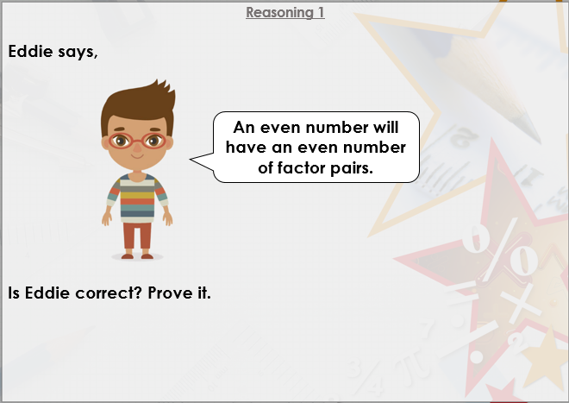

Slide 19

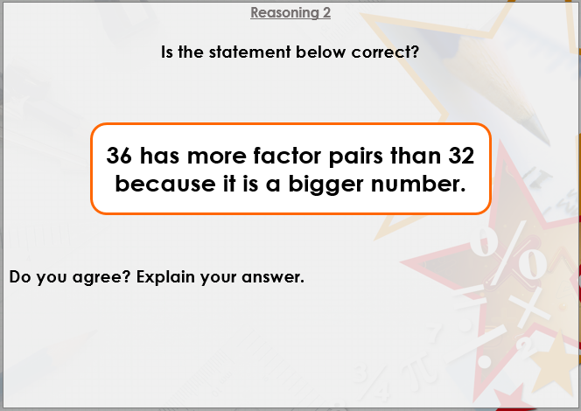
DIVE DEEPER 3

Slide 20
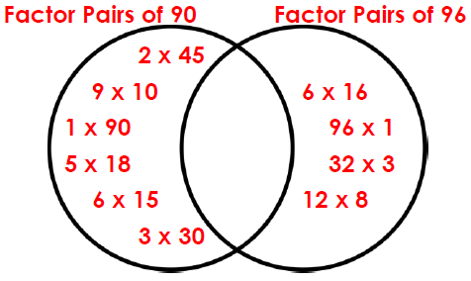
Write the missing factors. | Write the missing factors | Explore methodically the factors of 72.
A = 2; B = 5; C = 10 | A = 2; B = 4; C = 16; D = 8 | 1 x 72; 2 x 36; 3 x 24; 4 x 18; 6 x 12; 8 x 9
Match the factor pairs. | Match the factor pairs. | Complete the factor pairs
1 x 12; 2 x 6; 3 x 4 | 1 x 24; 2 x 12; 3 x 8; 4 x 6 | 66 = 1 x 66; 2 x 33; 3 x 22; 6 x 11
Write down the factor pairs for 24. | Write down the factor pairs for 36 | Sort the factor pairs below into the venn diagram. Label the diagram.
1 x 24; 2 x 12; 4 x 6; 8 x 3 | 1 x 36; 2 x 18; 3 x 12; 6 x 6; 9 x 4; 12 x 3
Intelligent Practice

Slide 21
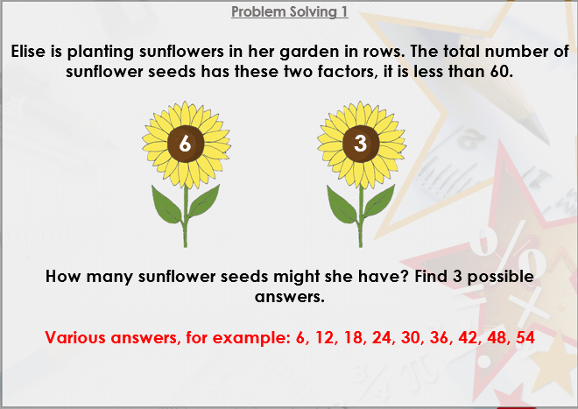

Slide 22
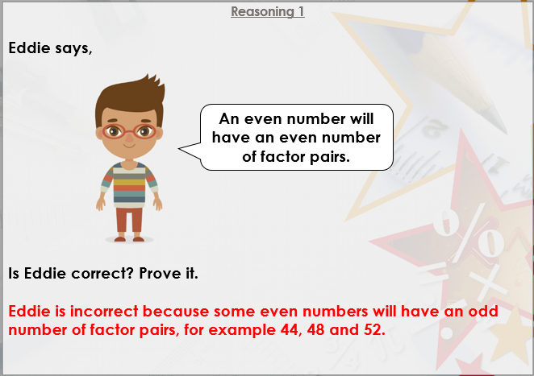

Slide 23
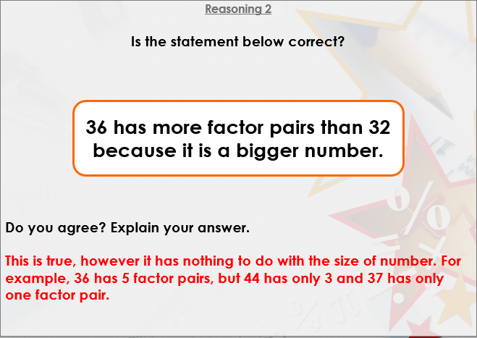
DIVE DEEPER 3

Slide 24

Intelligent Practice

