Slide 1
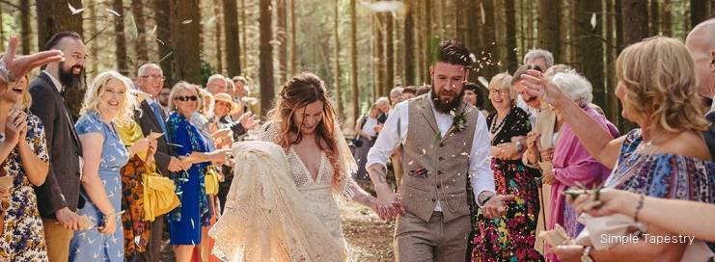
Humanist Marriage Ceremony

Slide 2
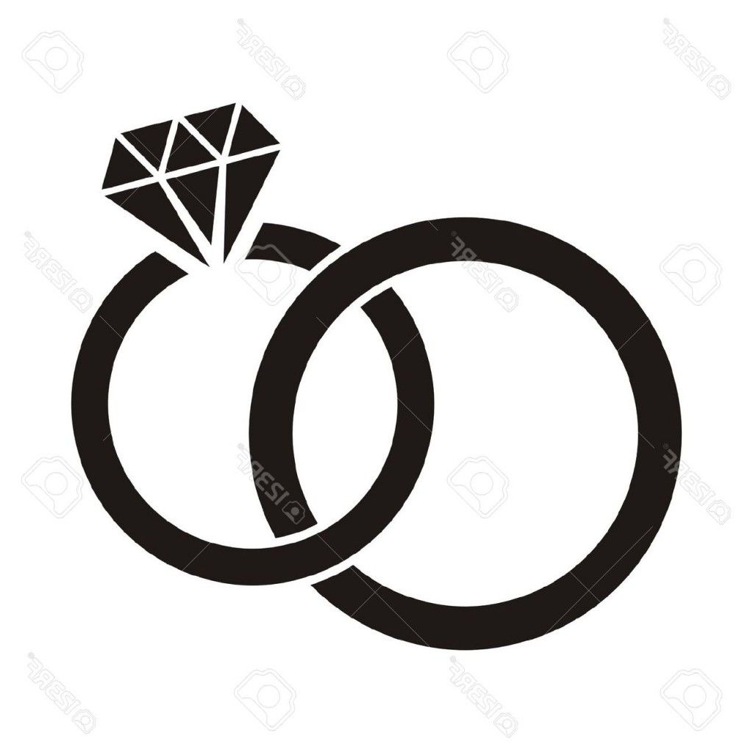
A non-religious wedding marks the commitment of two people to share their lives together just as much as does a religious wedding.
A non-religious marriage is founded on the efforts and relationship of the couple. There is no place in the marriage or the wedding for a supernatural power.

Slide 3
Humanist wedding ceremonies allow for far greater personalisation than religious ceremonies, which must inevitably follow the directions of a particular church or institution. This allows the ceremony to incorporate words and rituals from a wide range of cultures.
Humanist wedding rituals often emphasise the equality of the partners.
The ceremony will reflect the Humanist idea that the marriage depends solely on the efforts and relationship of the couple.

Slide 4
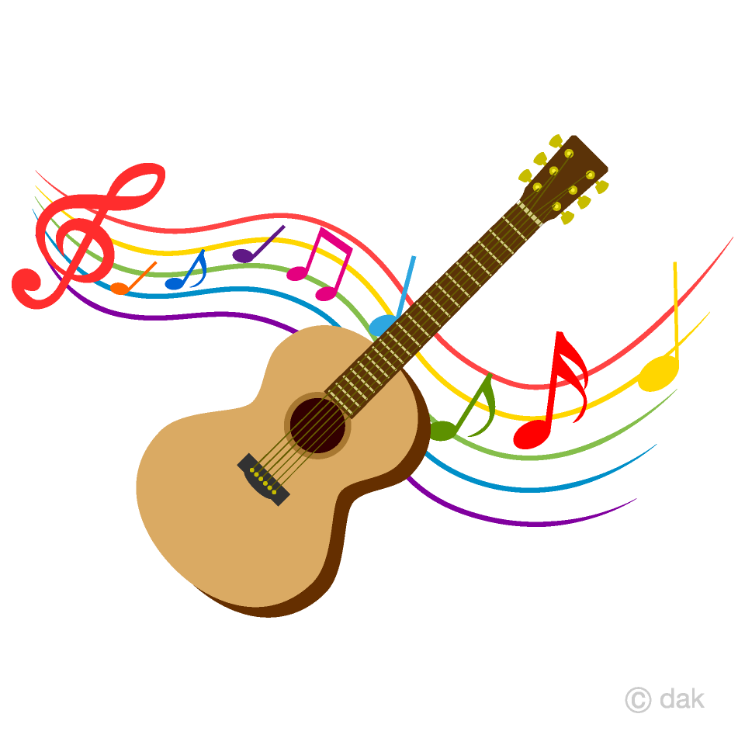
Humanist wedding ceremonies may include:
Music
An introduction that sets out the nature, purpose, and importance of marriage
Readings:
  A ritual of commitment for the bride and groom
Ritual actions:
  These will include an exchange of rings, and perhaps an embrace, candle-lighting, a wine cup ritual or a hand-fasting ritual
Formal words pronouncing the couple married
A non-religious blessing of the marriage

