Slide 1
Year 4 | Week 9 | Day 2

Slide 2
L.O. - to multiply 3 numbers
SOME WILL EVEN: Group numbers and explain why this is the most efficient grouping; Choose cards and identify the missing numbers; Find 3 numbers which can be multiplied to make a given product.
SOME WILL: Multiply three 1-digit numbers with no pictorial support or scaffolding.
MOST WILL: Multiply three 1-digit numbers with some pictorial support or scaffolding.
ALL WILL: Multiply three 1-digit numbers with pictorial support.

Slide 3
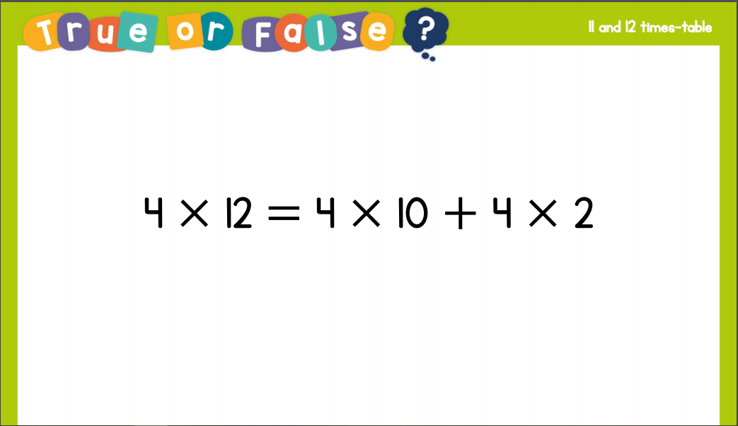
Recall:

Slide 4
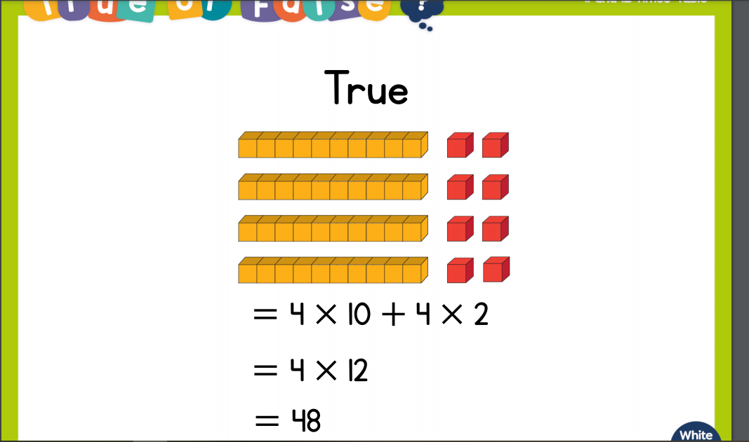
Recall:

Slide 5
GUIDED PRACTICE:

Slide 6

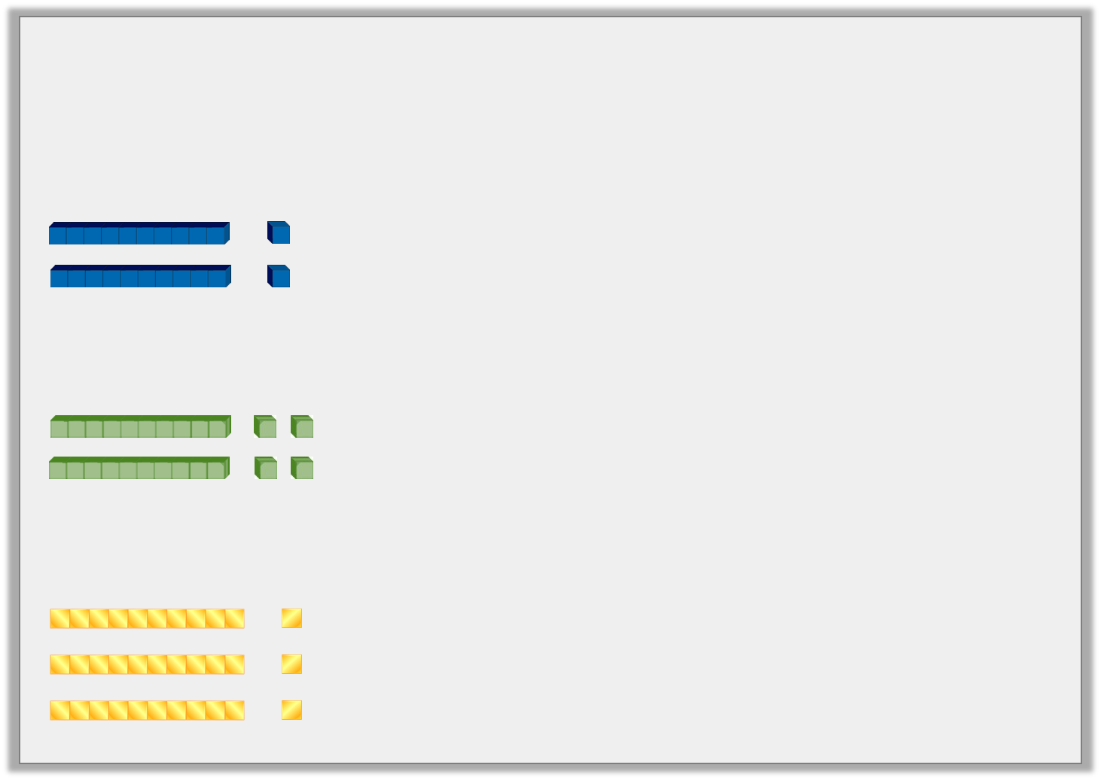

Introduction
Match the picture to the correct sentence.
3 lots of 10 + 3 lots of 1 is the same as 3 lots of 11
2 lots of 10 + 2 lots of 2 is the same as 2 lots of 12
2 lots of 10 + 2 lots of 1 is the same as 2 lots of 11
© Classroom Secrets Limited 2018

Slide 7
Introduction
Match the picture to the correct sentence.
3 lots of 10 + 3 lots of 1 is the same as 3 lots of 11
2 lots of 10 + 2 lots of 2 is the same as 2 lots of 12
2 lots of 10 + 2 lots of 1 is the same as 2 lots of 11
© Classroom Secrets Limited 2018

Slide 8
Varied Fluency 1
Complete the calculations below.
9 | x | 5 | x | 2 | =
3 | x | 8 | x | 3 | =
© Classroom Secrets Limited 2018

Slide 9
Varied Fluency 1
Complete the calculations below.
9 | x | 5 | x | 2 | = | 90
3 | x | 8 | x | 3 | = | 72
© Classroom Secrets Limited 2018

Slide 10
Varied Fluency 2
True or false?
6 | x | 9 | x | 2 | = | 99
© Classroom Secrets Limited 2018

Slide 11
Varied Fluency 2
True or false?
False; 6 x 9 x 2 = 108
6 | x | 9 | x | 2 | = | 99
© Classroom Secrets Limited 2018

Slide 12
Varied Fluency 3
Complete the calculation. Write three different multiplication calculations using all of the numbers below.
7 | x | 3 | x | 6 | =
© Classroom Secrets Limited 2018

Slide 13
Varied Fluency 3
Complete the calculation. Write three different multiplication calculations using all of the numbers below.
Various answers, for example:
3 x 7 x 6; 6 x 7 x 3; 6 x 3 x 7
7 | x | 3 | x | 6 | = | 126
© Classroom Secrets Limited 2018

Slide 14
Varied Fluency 4
Tick the calculation that is correct.
A. |  | 5 | x | 3 | x | 6 | = | 80
B. |  | 7 | x | 5 | x | 4 | = | 140
C. |  | 4 | x | 8 | x | 4 | = | 120
© Classroom Secrets Limited 2018

Slide 15
Varied Fluency 4
Tick the calculation that is correct.
A. |  | 5 | x | 3 | x | 6 | = | 80
B. |  | 7 | x | 5 | x | 4 | = | 140 |  | 
C. |  | 4 | x | 8 | x | 4 | = | 120
© Classroom Secrets Limited 2018

Slide 16

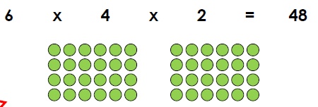
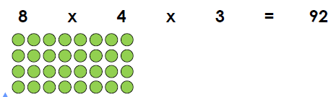
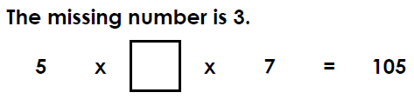
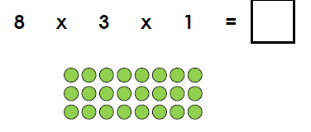
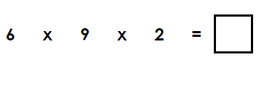

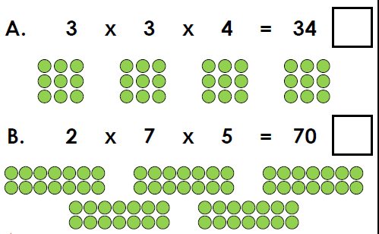
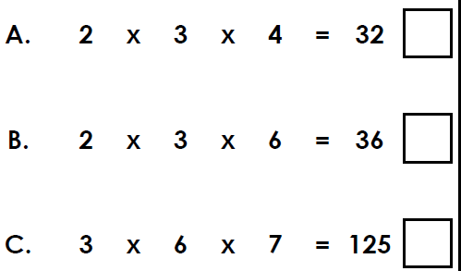
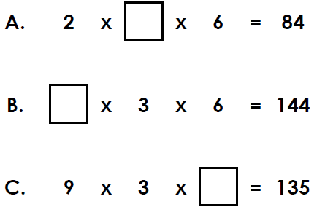
True or false? | True or false? | True or false?
Complete the calculation. Write three different multiplication calculations using all the numbers below. | Complete the calculation. Write three different multiplication calculations using all the numbers below. | Complete the calculation. Write three different multiplication calculations using all the numbers below.
Which calculation is correct? | Which calculation is correct? | Which calculation is correct
Intelligent Practice

Slide 17

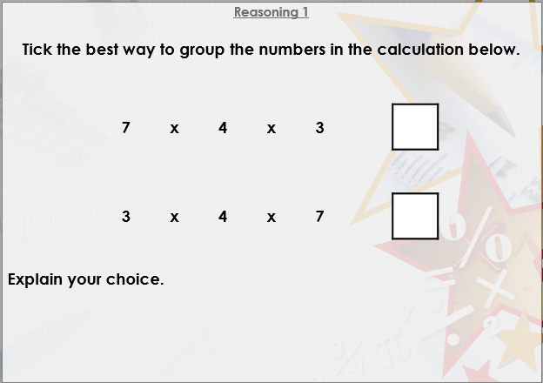


Slide 18

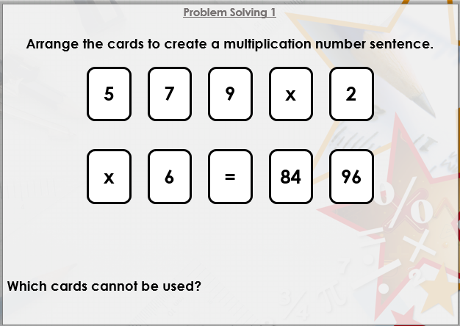

Slide 19

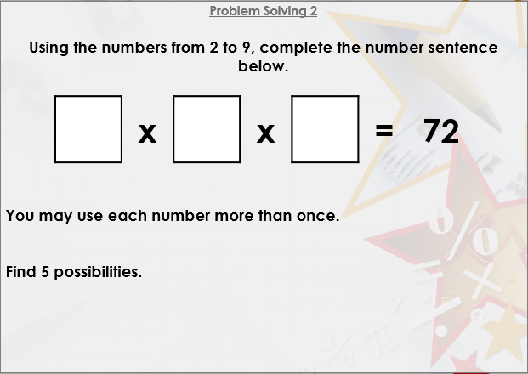
DIVE DEEPER 3

Slide 20
True or false? | True or false? | True or false?
True | False; 8 x 4 x 3 = 96 | True; 5 x 3 x 7 = 105
Complete the calculation. Write three different multiplication calculations using all the numbers below. | Complete the calculation. Write three different multiplication calculations using all the numbers below. | Complete the calculation. Write three different multiplication calculations using all the numbers below.
The missing number is 24. Various answers, for example: 3 x 8 x 1 = 24, 3 x 1 x 8 = 24, 8 x 3 x 1 = 24 | The missing number is 108. Various answers, for example: 6 x 9 x 2 = 108, 6 x 2 x 9 = 108, 9 x 6 x 2 = 108 | 7 x 7 x 4 = 196, 4 x 7 x 7 = 196, 7 x 4 x 7 = 196 12a. A: 7, B: 8, C: 5
Which calculation is correct? | Which calculation is correct? | Which calculation is correct
B | B | A: 7, B: 8, C: 5
Intelligent Practice

Slide 21
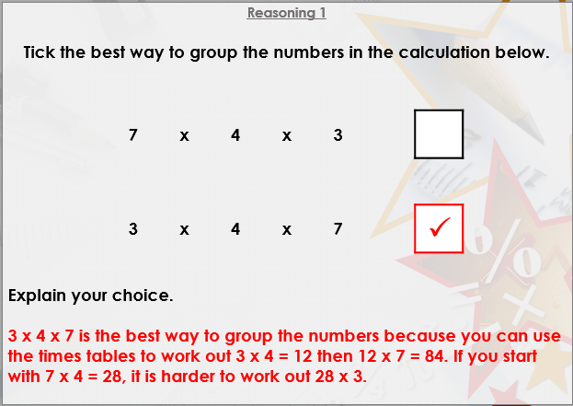

Slide 22
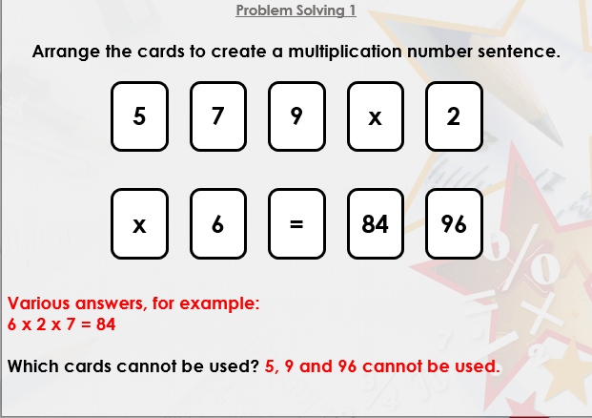

Slide 23
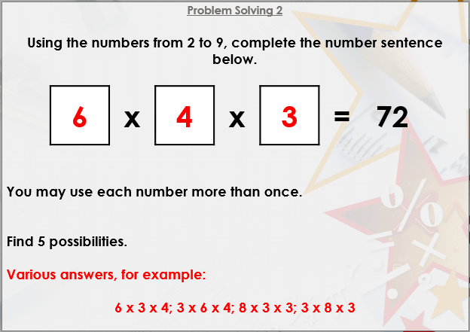
DIVE DEEPER 3

Slide 24

Intelligent Practice

