Slide 1
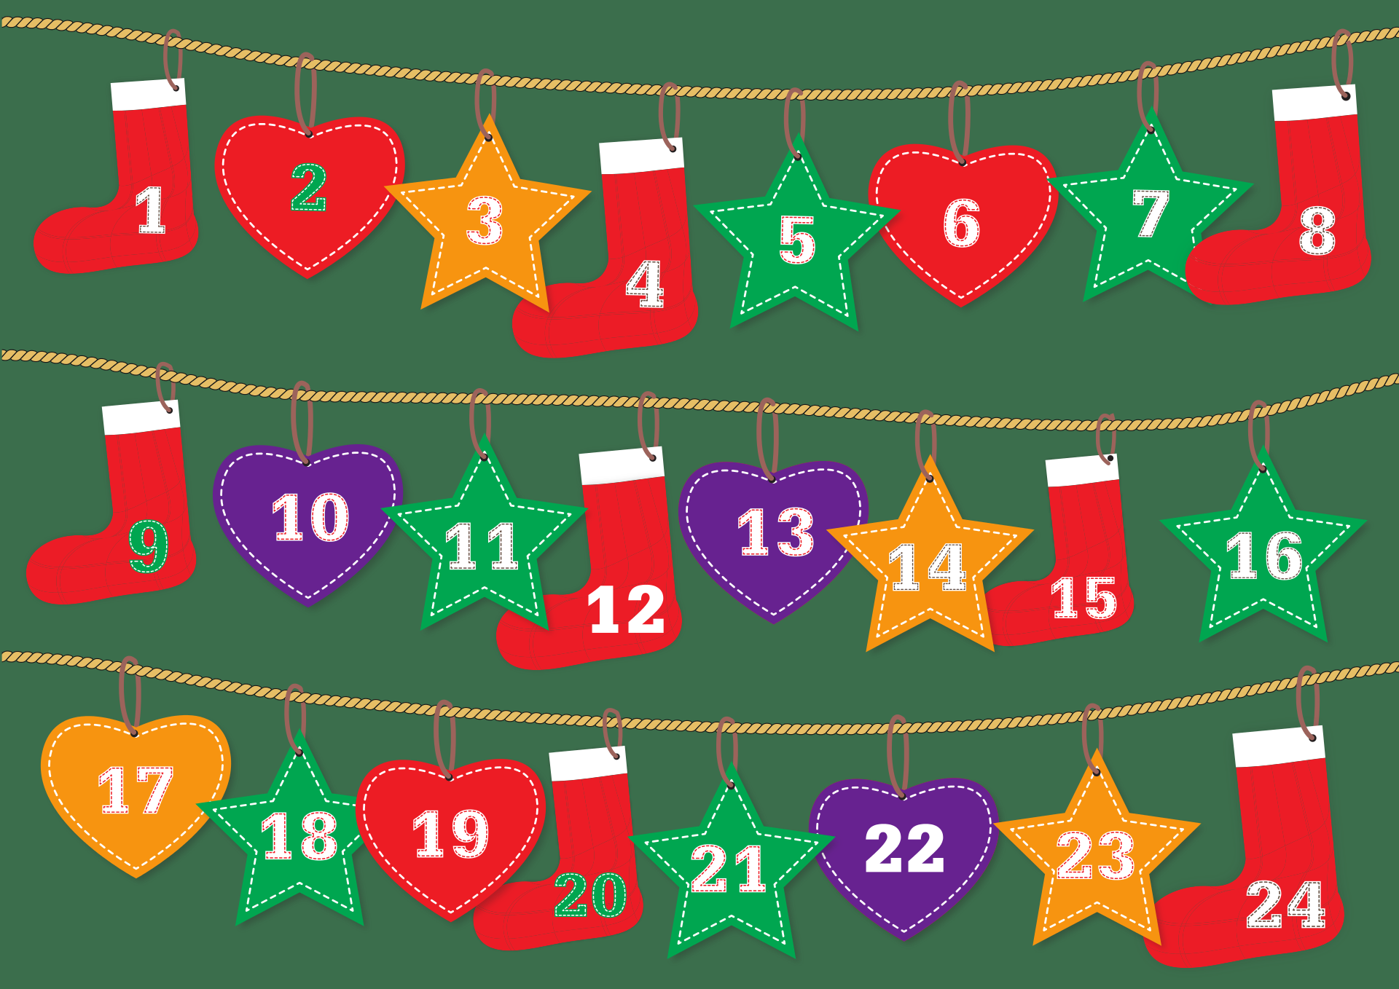

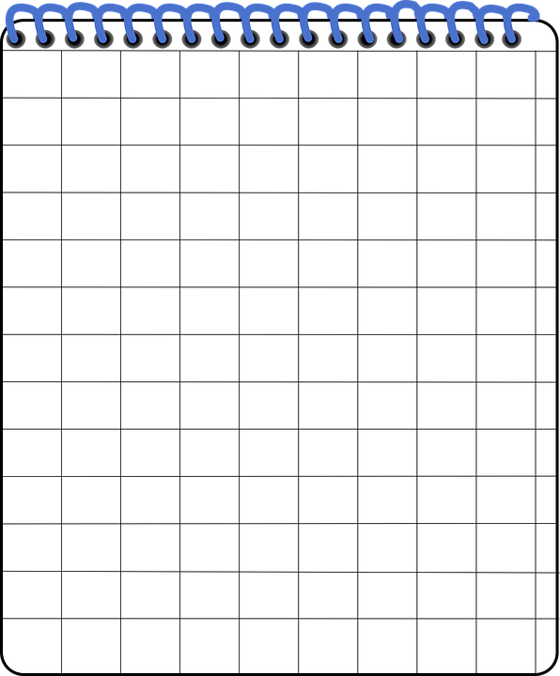
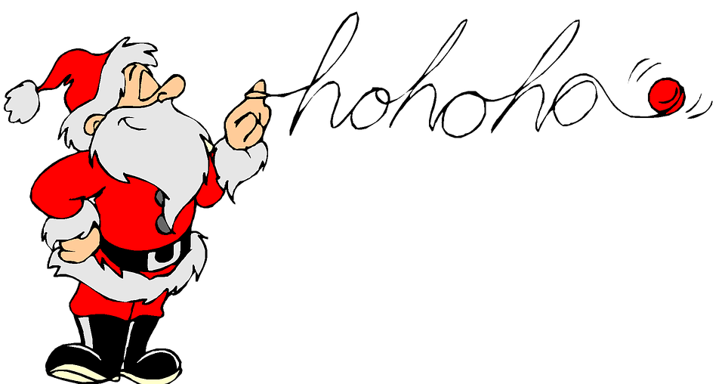

SATS Revision Christmas Countdown!
Click on one picture every day to reveal a hidden SATS question
Great for introductions, plenaries and early morning activities
Click the to return to the calendar screen
Ask children to demonstrate their workings using Santa’s Scratch Pad!
We hope you have a wonderful Christmas break!
Share your experiences via our social media following…

Slide 3


1st December
35 x 8 =
1 mark

Slide 4

2nd December
Santa needs to order new shoes for the elves. There are 135 elves in total.
There are 15 pairs of shoes in each box.
How many boxes does Santa need to order?
Santa’s Scratch Pad

Slide 5
3rd December
Which sentence uses capital letters correctly?
Tick one
The christmas lights in London are impressive.
The Christmas lights in London are impressive.
The christmas lights in london are impressive.
The Christmas lights in london are impressive.

Slide 6
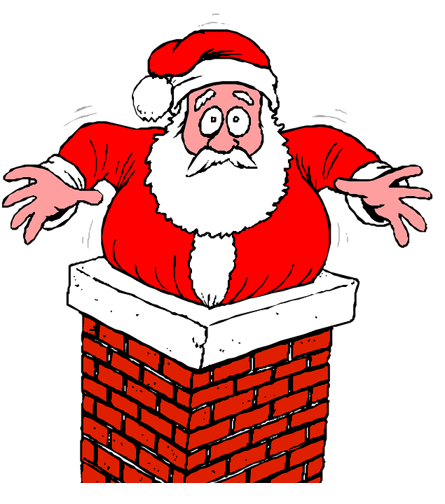
4th December
41,949 + 2,174 =
1 mark

Slide 7



5th December
Write the missing numbers to make this multiplication grid correct
x
7
28
12
96
Santa’s Scratch Pad

Slide 8
6th December
Tick the sentence that must end with a question mark.
Tick one
What ever the magic elf touched, turned to gold
How Santa could fit down the chimney was a mystery
Why Rudolph wouldn’t fly was anyone’s guess.
When do the toys need to be ready

Slide 9
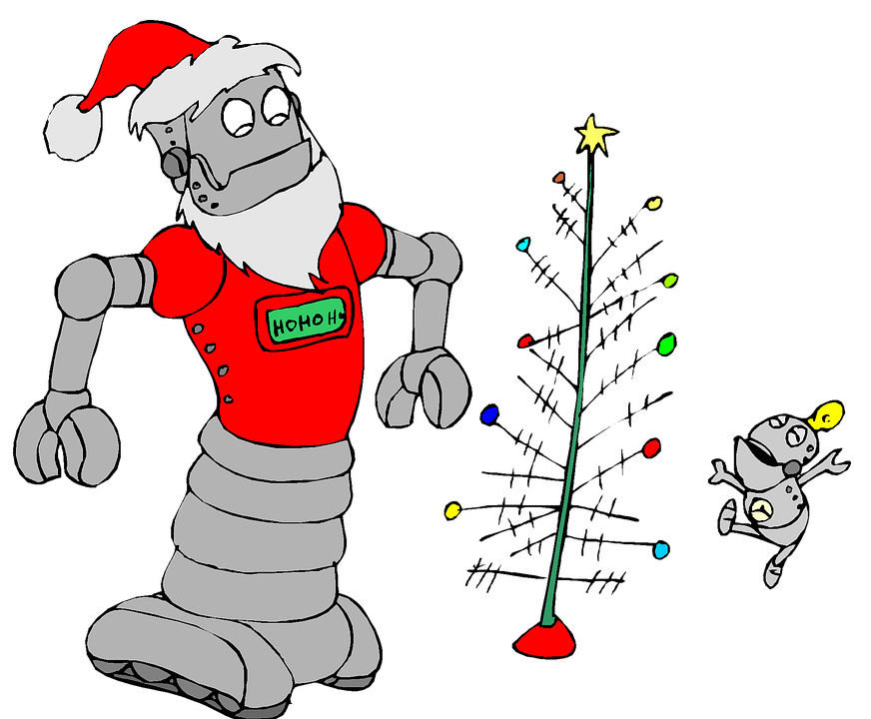


7th December
$$\frac{3}{5}$$
$$\frac{7}{8}$$
x
=

Slide 10
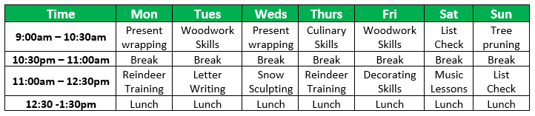
8th December
Here is the morning timetable for Santa’s elves to follow during the months of November and December.
What is the total number of hours for ‘Present Wrapping’ on this timetable?
hours
How many minutes do the elves spend ‘Reindeer Training’ and ‘Decorating’ together?
minutes
Santa’s Scratch Pad

Slide 11
9th December
Tick one box in each row to show how the modal verb affects the meaning of the sentence.
Sentence
Modal verb indicates certainty
Modal verb indicates possibility
If it snows, we can get the sledge out.
You may be on Santa’s ‘naughty’ list!
The elves have been working hard all year.
There might be a chocolate inside the door of your advent calendar.

Slide 12
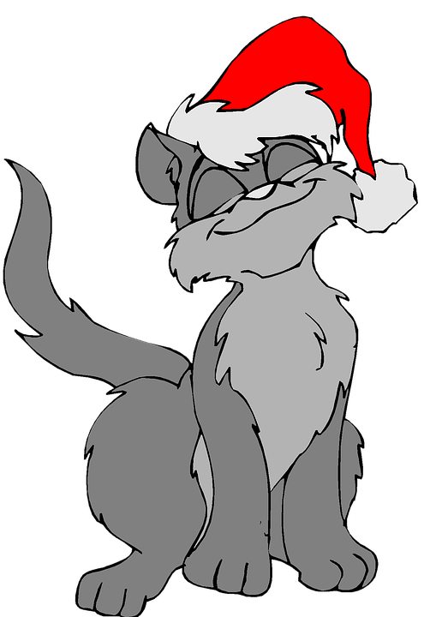
10th December
9.2 – 1.692 =

Slide 13

11th December
Lucy’s Christmas present was in the shape of a cuboid.
6cm
9cm
7cm
Calculate the volume of Lucy’s Christmas present.
cm³
Santa’s Scratch Pad

Slide 14
12th December
Rewrite the underlined verbs in the sentence below so that they are in the present progressive form.
Eddie the elf hates tidying up. He makes all of the other elves do it instead!.
­­­

Slide 15

13th December
13,000 – 165 =

Slide 16
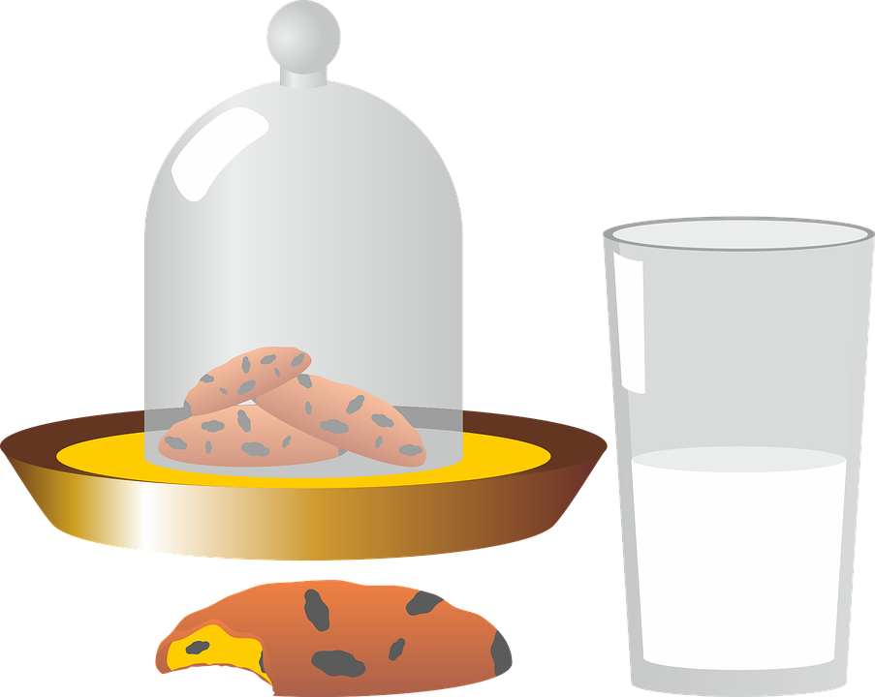
14th December
Santa is given lots of drinks at each house on his Christmas Eve, global delivery run.
At No. 42 Fleet Street, Greta Sanderson has left him half a litre of warm milk.
Santa drinks 120ml of it and gives 175ml to his reindeer, on the rooftop.
How many millilitres did Santa leave behind?
ml
Santa’s Scratch Pad

Slide 17
15th December
Which sentence is an exclamation?
Tick one
When will the family arrive
David and Olivia helped to stuff the turkey
That is the best Christmas tree I’ve ever seen
Ed opened day 15 on his advent calendar

Slide 18



16th December
$$\frac{2}{3}$$
$$\frac{7}{12}$$
+
=
Write your answer as a mixed number and in its lowest form

Slide 19
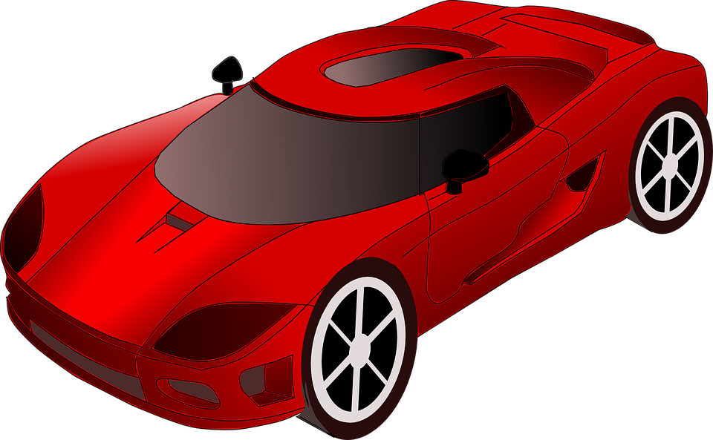
17th December
Archie wanted a remote controlled car for Christmas. It was in the shop for £68.
The shop had a sale and reduced the price by 20%.
What is the new price of the car?
Show your method
£

Slide 20

18th December
Draw a line to match each prefix to the correct word so that it makes a new word.
im
organise
il
definitely
non
logical
re
essential
in
patient

Slide 21
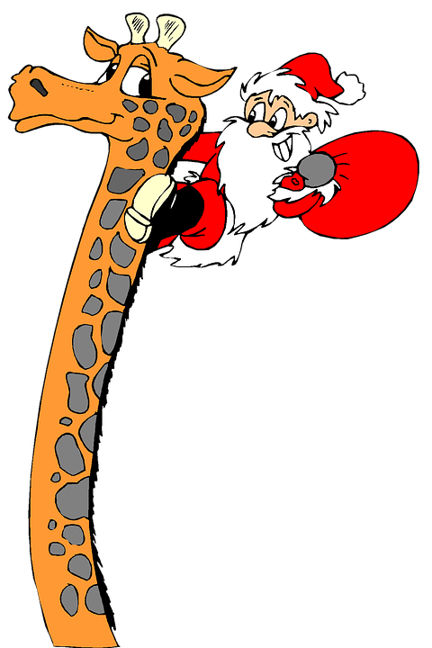
19th December
75% of 380 =

Slide 22
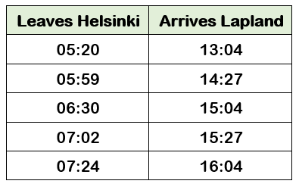
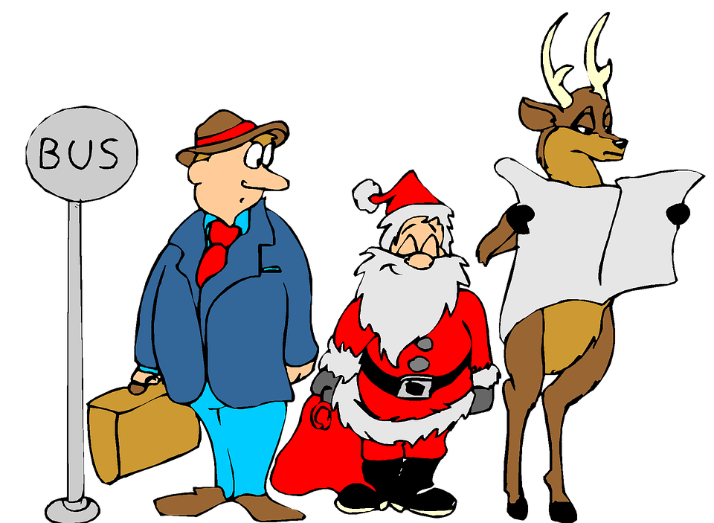
20th December
Frank is waiting for the bus from Helsinki to Lapland.
He needs to arrive in Lapland by 3:45 pm.
Circle the latest time that Frank can leave Helsinki.

Slide 23
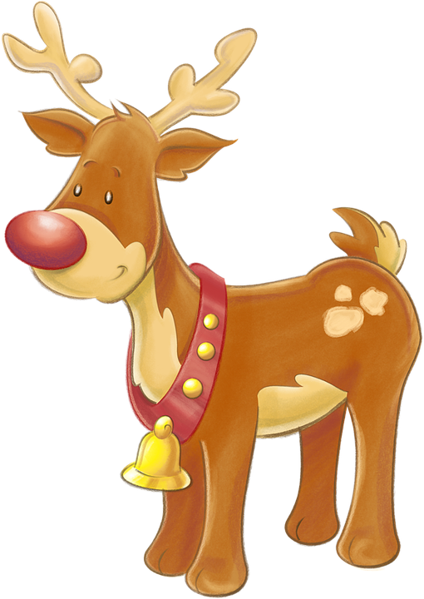
21st December
Complete the sentence below with a noun formed from the verb create.
The __________________ of the new reindeer training ground will be of great benefit to Rudolph and his friends.

Slide 24

22nd December
1
8
x
6
4
Show your method

Slide 25


23rd December
Santa’s Christmas wreath has a diameter of 48cm.
What is the radius of Santa’s Christmas wreath?
Santa’s Scratch Pad

Slide 26
24th December
Which sentence is punctuated correctly?
Tick one
“Yes Its Christmas Eve!” exclaimed Charlie.
Yes! “It’s Christmas Eve,” exclaimed Charlie.
“Yes! It’s Christmas Eve!” exclaimed Charlie.
.
“Yes. It’s Christmas Eve”! exclaimed Charlie.

Slide 27
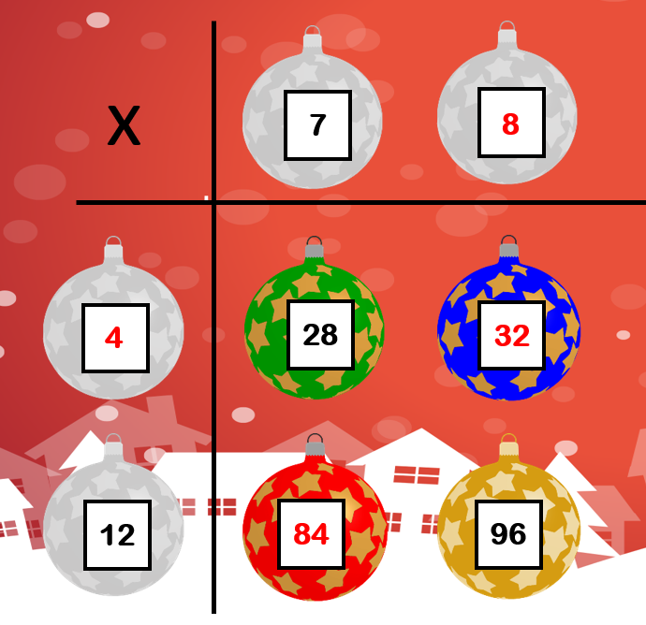
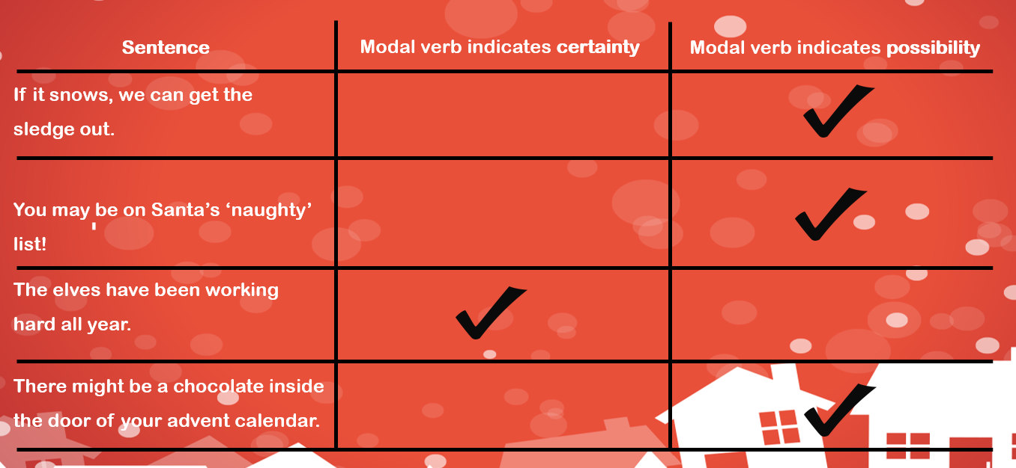
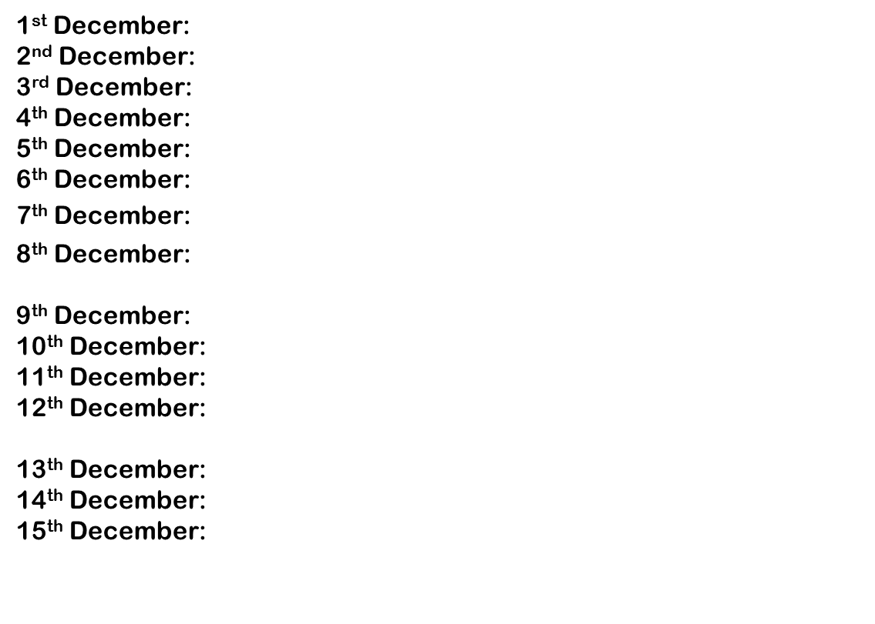
Answers
A
1st December: 280
2nd December: 9 Boxes
3rd December: The Christmas lights in London are impressive
4th December: 44,123
5th December: Picture A
6th December: When do the toys need to be ready?
7th December: $\frac{21}{40}$
8th December: Present wrapping = 3 hours. Reindeer Training & Decorating = 270 minutes
9th December: Picture B
10th December: 7.508
11th December: 378cm³
12th December: Eddie the elf is hating tidying up. He is making all of the other elves do it instead!
13th December: 12,835
14th December: 205ml
15th December: That is the best Christmas tree I’ve ever seen!
B

Slide 28
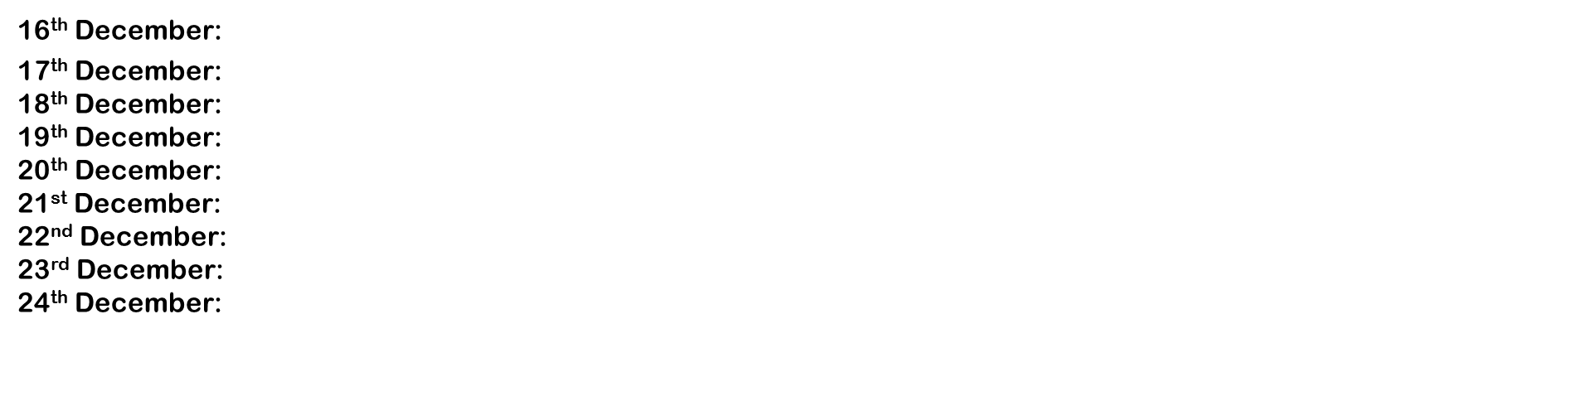
Answers Continued…
16th December: 1 $\frac{1}{4}$
17th December: £54.40
18th December: impatient, illogical, nonessential, reorganise & indefinitely
19th December: 285
20th December: 07:02
21st December: The creation of the new reindeer training ground will be of great benefit to Rudolph and his friends.
22nd December: 1,152
23rd December: 24cm
24th December: “Yes! It’s Christmas Eve!” exclaimed Charlie.
Did you find these questions useful?
Visit our resources shop for our full Y6 SATS Christmas Revision Booklet.
‘The Twelve Days of Christmas’
On our website and in our TES shop
Merry Christmas!
From Tutortastic

