Slide 1
Monday 4th October

Slide 2
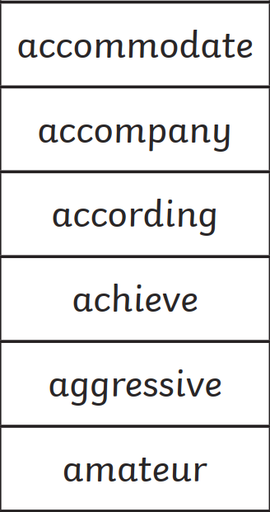
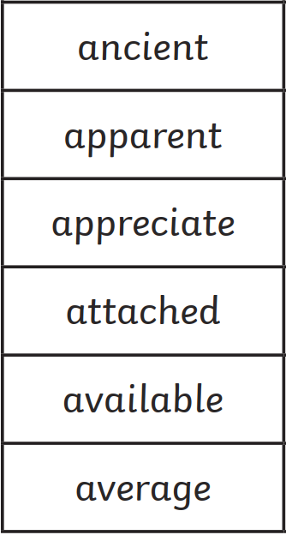
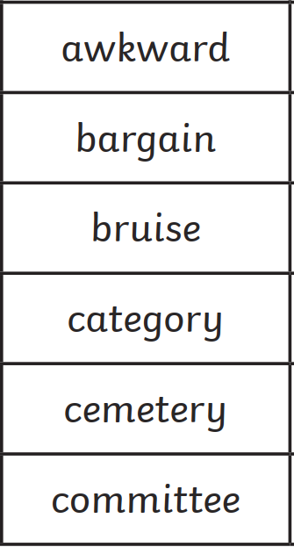
Spellings
Good Morning
You have practised 18 of the year 5/6 spellings. Now try the quiz!
If you’re at home, practise the ones that you find tricky.

Slide 3

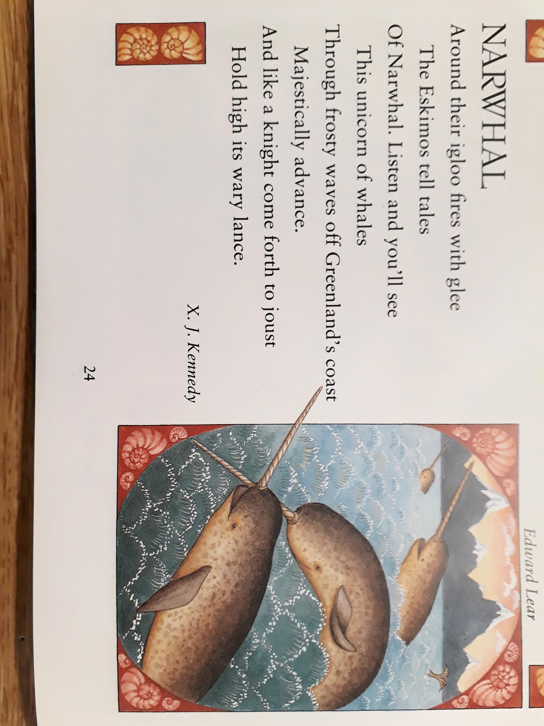


Poem: Narwhal (By Kennedy)
Where are the narwhal seen?
(1)
How are the narwhal like:
A unicorn of whales
A knight come forth to joust?
(2)
Comment on the author’s opinion of narwhal, and how you know this.
(2)
Mastery:
Create and answer your own R.I.C questions.

Slide 4

Displace
What does it say?
What could it mean?

Slide 5
Displace
What does it say?
What could it mean?
To move something from its proper or usual position.
The war has displaced thousands of people.
The hurricane displaced most of the town's residents.

Slide 6
Recall
 | Simple present | Present Progressive | Present Perfect
I have eaten all of my dinner.
I walk the dog every morning.
I am writing in my journal.
He is enjoying the film.
She has injured her knee.

Slide 7
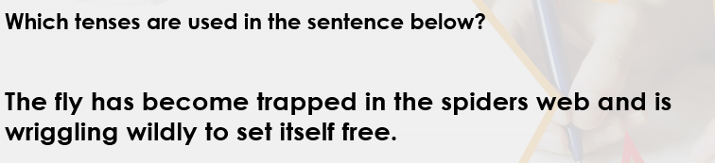
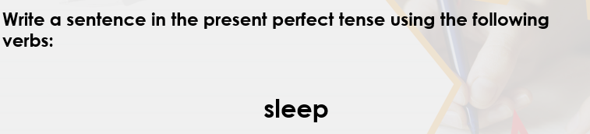

Slide 8
Monday 4th October
To learn how to use forms of the past tense
Some will even change a sentence from one verb form to another.
Some will write a sentence using each of the verb forms.
Most will recognise simple past, past progressive and past perfect.
All explain what the past tense is.

Slide 9
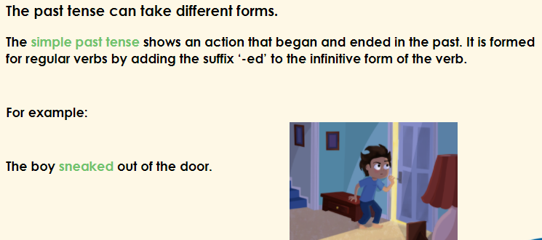

Slide 10
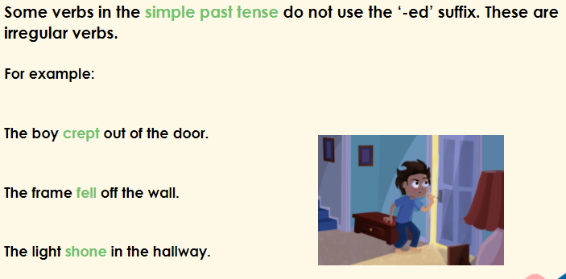

Slide 11
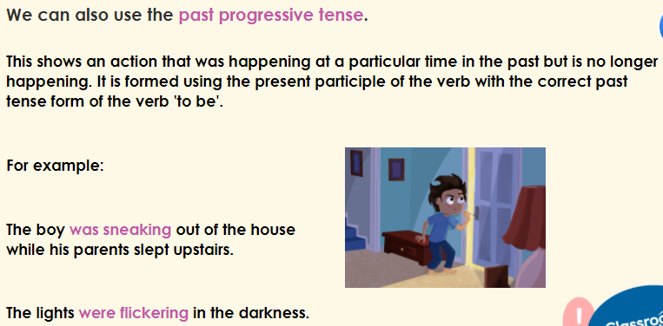
To be
I was
He/she was
It was
They were
We were
You were

Slide 12
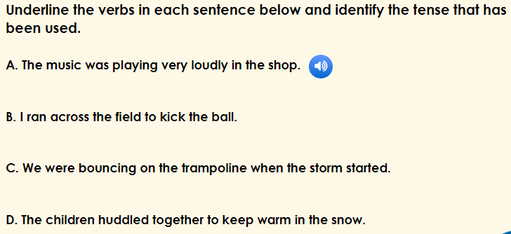

Slide 13
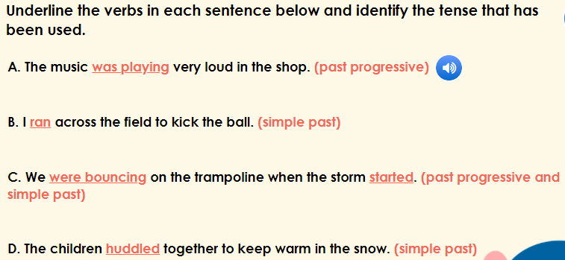

Slide 14
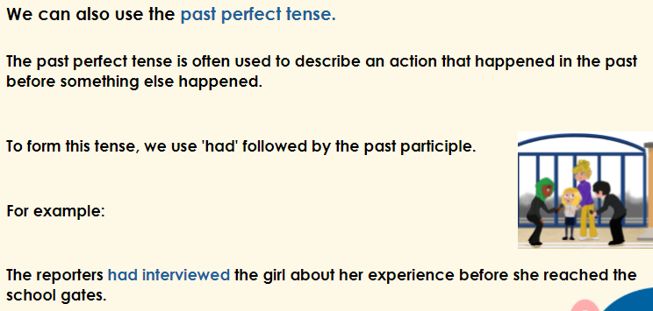

Slide 15
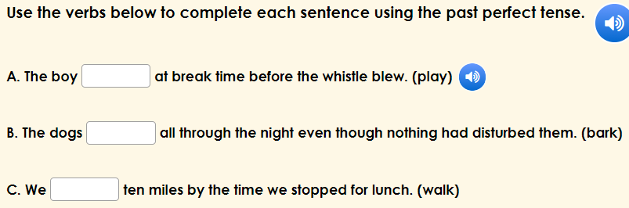

Slide 16
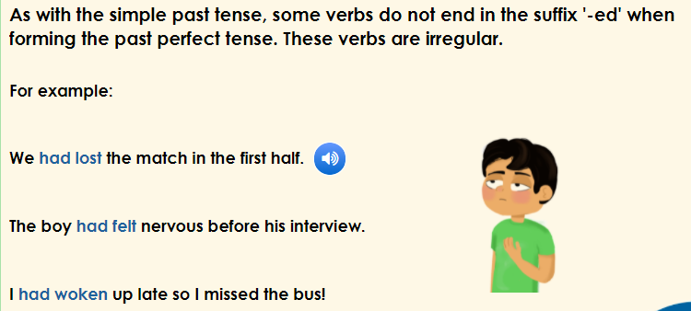

Slide 17
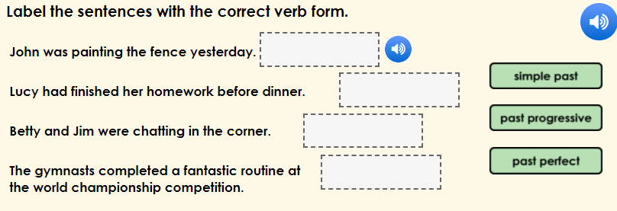

Slide 18
choose
Write a sentence in each of the past tenses using the above verb.
Simple Past Past Progressive Past Perfect
(walked) (was walking) (had walked)

Slide 19
Independent Task
Use the following verbs:
Bring
Find
Write two more sentences for each type of past tense in your book.
Simple Present
1.
2.
Simple Progressive
1.
2.
Simple Perfect
1.
2.

Slide 20
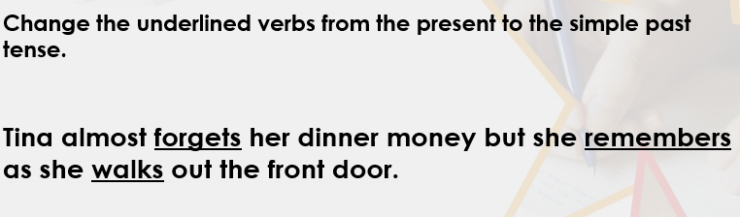
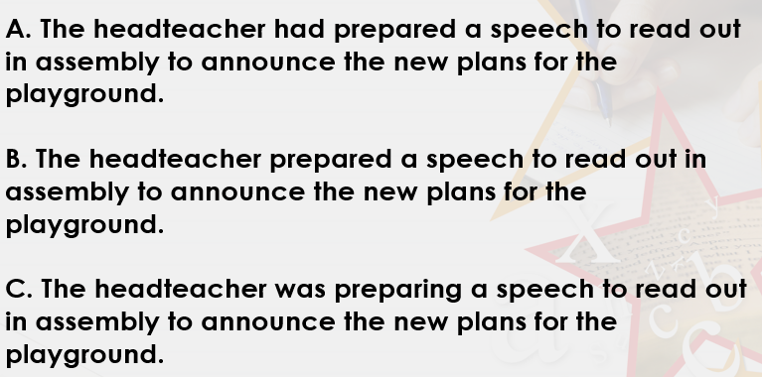
Extension
A- change to simple past
B- change to past progressive
C- Change to past perfect

Slide 21

retreat

Slide 22
What could it mean?
retreat
She felt the urge to retreat to her room and stay there.
We must retreat or risk falling into an ambush.

Slide 23
SAY IT AND FEEL THE SYLLABLES
SAY IT IN A SQUEAKY VOICE
SAY IT TO SOMEONE ON ANOTHER TABLE
WHISPER IT TO MRS SILK
SAY IT TO YOUR BOOK
REPEAT IT AFTER ME
SAY IT TO THE WINDOW
WHISPER IT TO A WALL
retreat

Slide 24
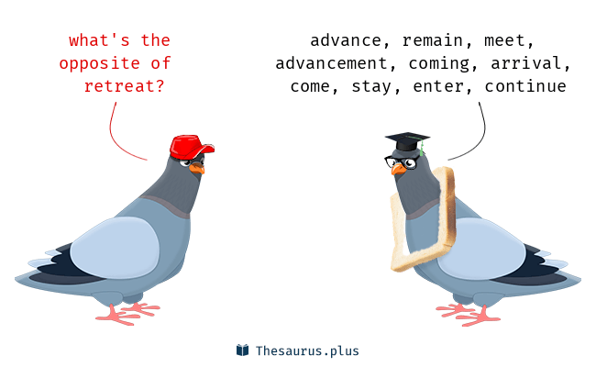
retreat

Slide 25
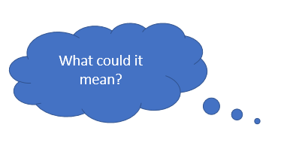
retreat
Verb
To move back or withdraw.

Slide 26
L.O. divide numbers confidently.
Some will even solve calculations involving decimals.
Some will solve calculations with remainders
Most will solve calculations without remainders
All will use the bus stop method to divide

Slide 27
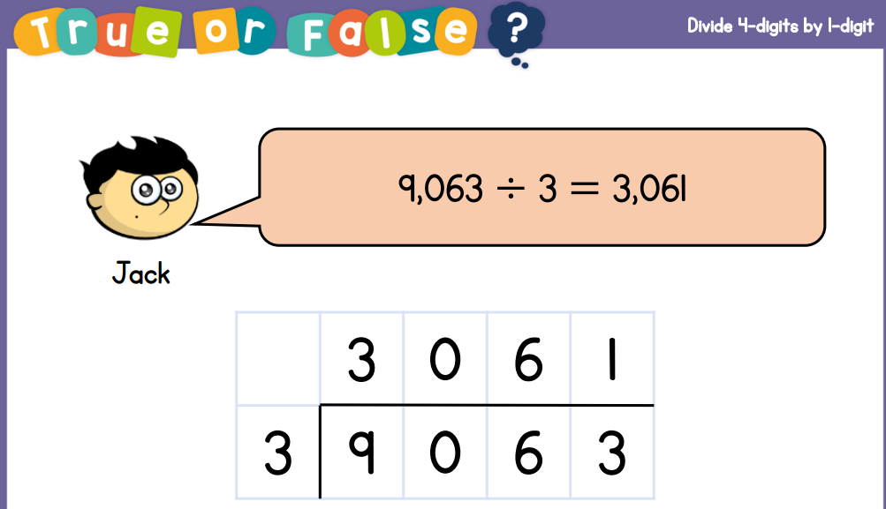
Guided practice

Slide 28
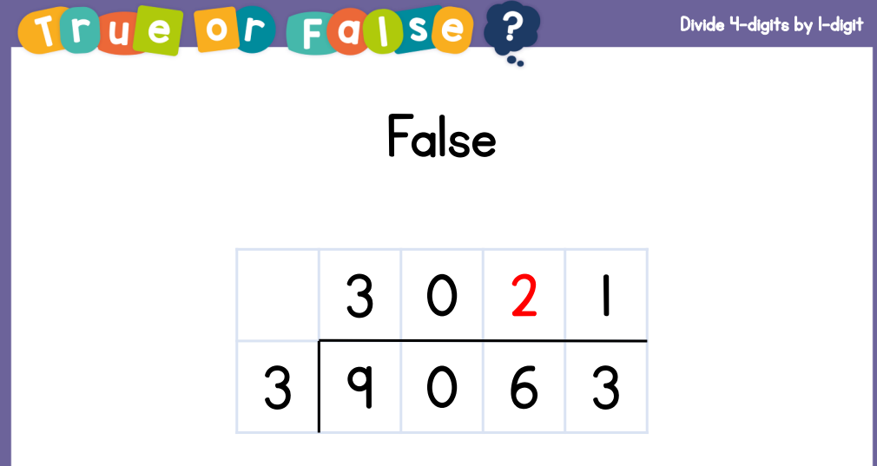

Slide 29
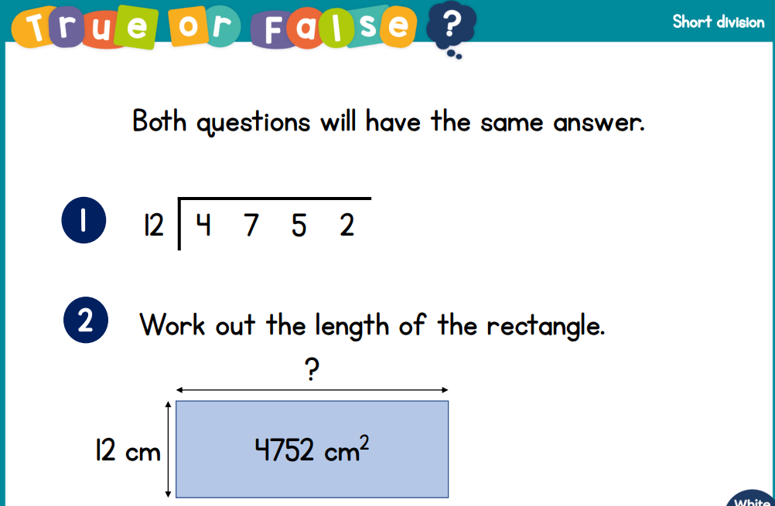

Slide 30
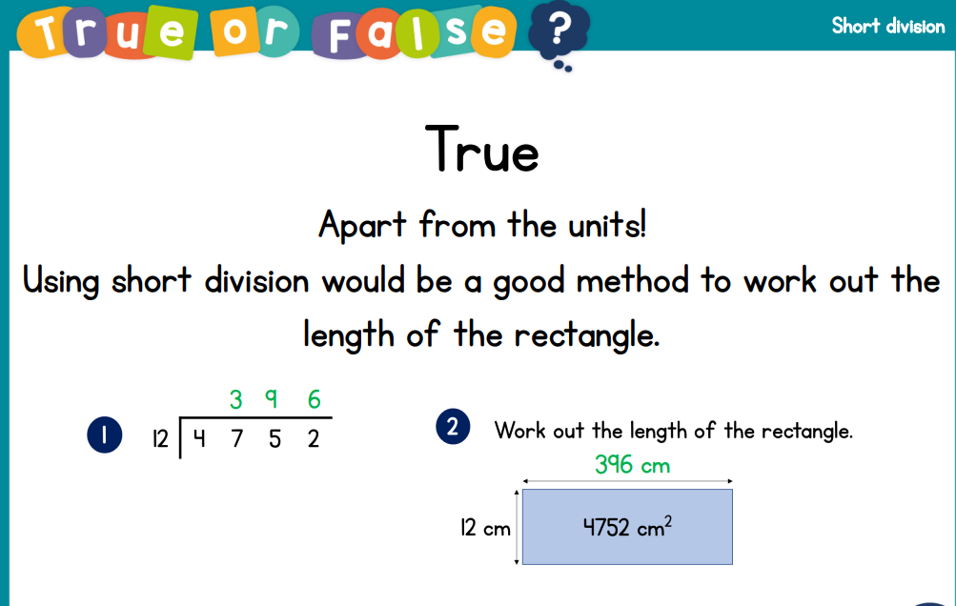

Slide 31
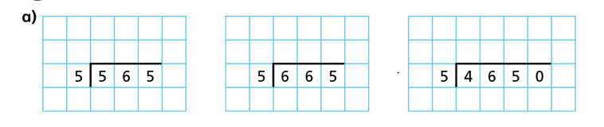

Slide 32

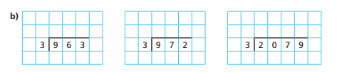
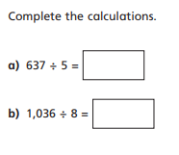
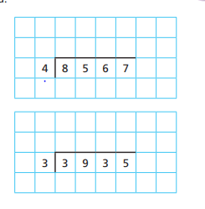
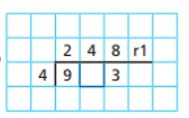


Intelligent Practice

Slide 33

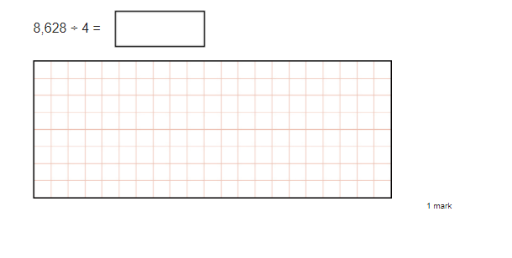
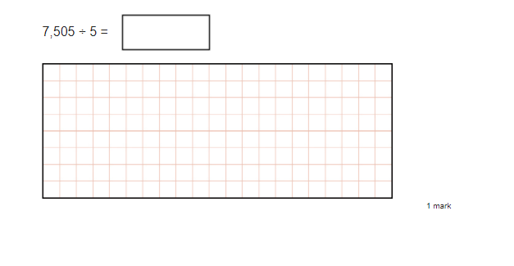

Slide 34
2157
1501

Slide 35



4 =
98.31
134.3
6 =

Slide 36
4 =
24.57 r 3
98.31
134.3
6 =
22.3 r 5

Slide 37
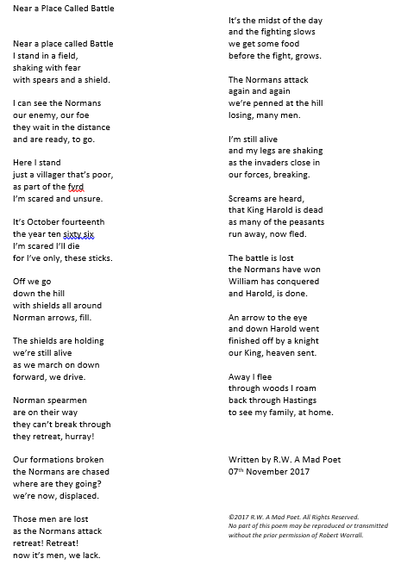
Who is the speaker in the poem?
Draw a timeline of what happens
At each stage of the battle.
Whole Class Reading

Slide 38
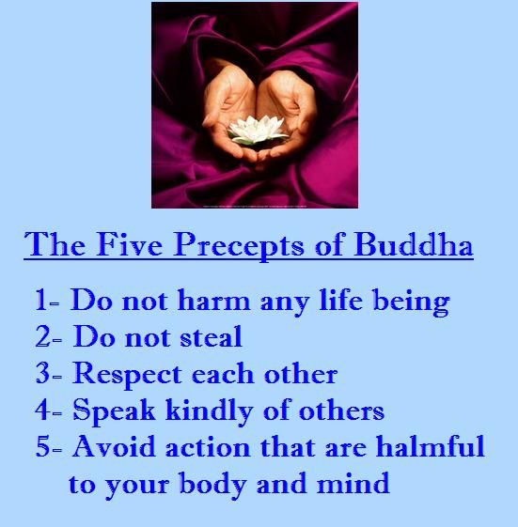
Monday 4th October
To consider moral codes expressing ideas about what is right and wrong.

Slide 39


Slide 40
The 5 Precepts and The 10 Commandments are the moral codes of Buddhism and Christianity
Organise each of the points from the 5 precepts of Buddhism and The 10 Commandments into the venn diagram.
What do you notice?

Slide 41
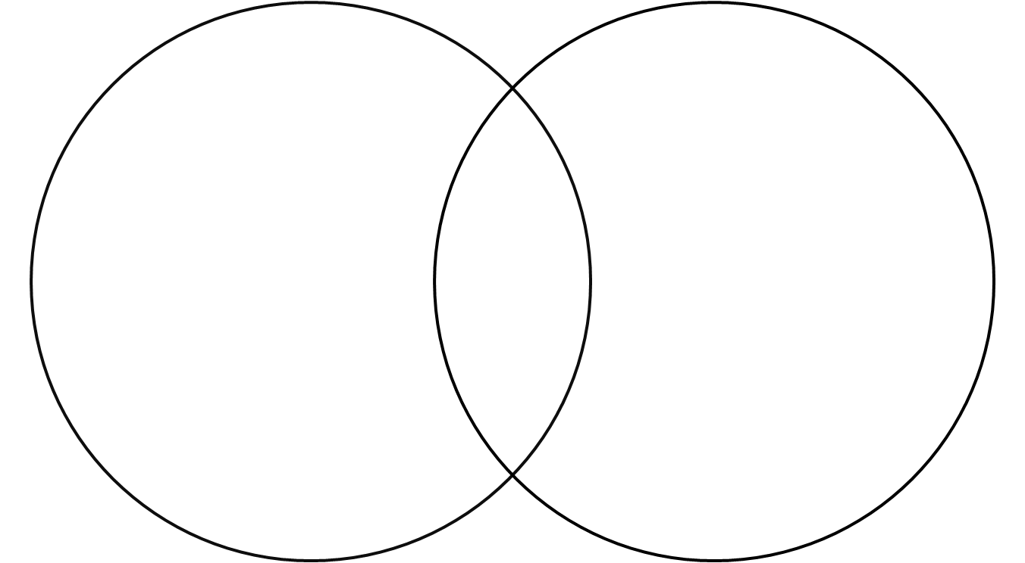
5 precepts of Buddhism
10 Commandments

Slide 42
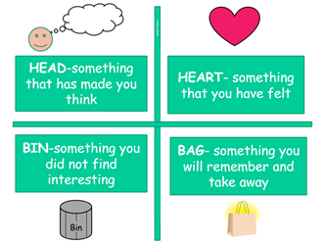
Write a sentence for
each quarter about the
5 precepts and 10
Commandments.
Head
Heart
Bin
Bag
E.G The moral codes made me think that the messages of both religions were very similar.

Slide 43

Monday 4th October
To understand that you have a responsibility to use mobile phones respectfully and take other people’s feelings into account.
Read the comic strip and the scenario cards.
Create a poster to teach other children about how to be
respectful when using mobile phones

