Slide 1
Monday 31st January

Slide 2
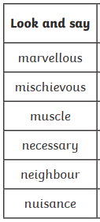
Spellings
Complete the next page of your
spelling booklet

Slide 3




Poem: The Oak Chest
Explain why the poet has said
‘The room feels empty now’.
Darkness. Can you see anything?
The room feels empty now.
Wait. There’s a great oak chest
in the corner. You saw it
yesterday, late. Come on. Your hand.
Feel these carvings. A forest, a king
lying under trees, an arrow,
remember? A shield, a date.
And inside? Shall we open it?
I said, Shall we open it?
Fred Sedgwick
What is carved into the chest?
What do you think may be in the chest? Why do you think that?
Comment on the poet’s layout choices (rhyme, regular or irregular, use of punctuation, stanzas)
Mastery:
Create and answer your own R.I.C questions.

Slide 4

multitude
What does it say?
What could it mean?

Slide 5
multitude
What does it say?
What could it mean?
Adjective
A large number of people or things.
Out there in the woods lay a multitude of plants she wanted to see, and no slithering reptile was going to stand in her way.

Slide 6
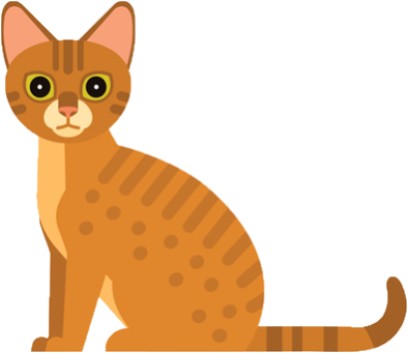

RECALL
When a sentence is in the active form, the subject is performing the action.
The sentence uses the active verb.
For example:
The cat saw the mouse.
The cat (subject) is performing the action of seeing.

Slide 7
When a sentence is in the passive form, the subject is having the action performed to it.
Our sentence changes from
The cat saw the mouse.
to
The mouse was seen by the cat.
The mouse (subject) is having the action done to it.

Slide 8
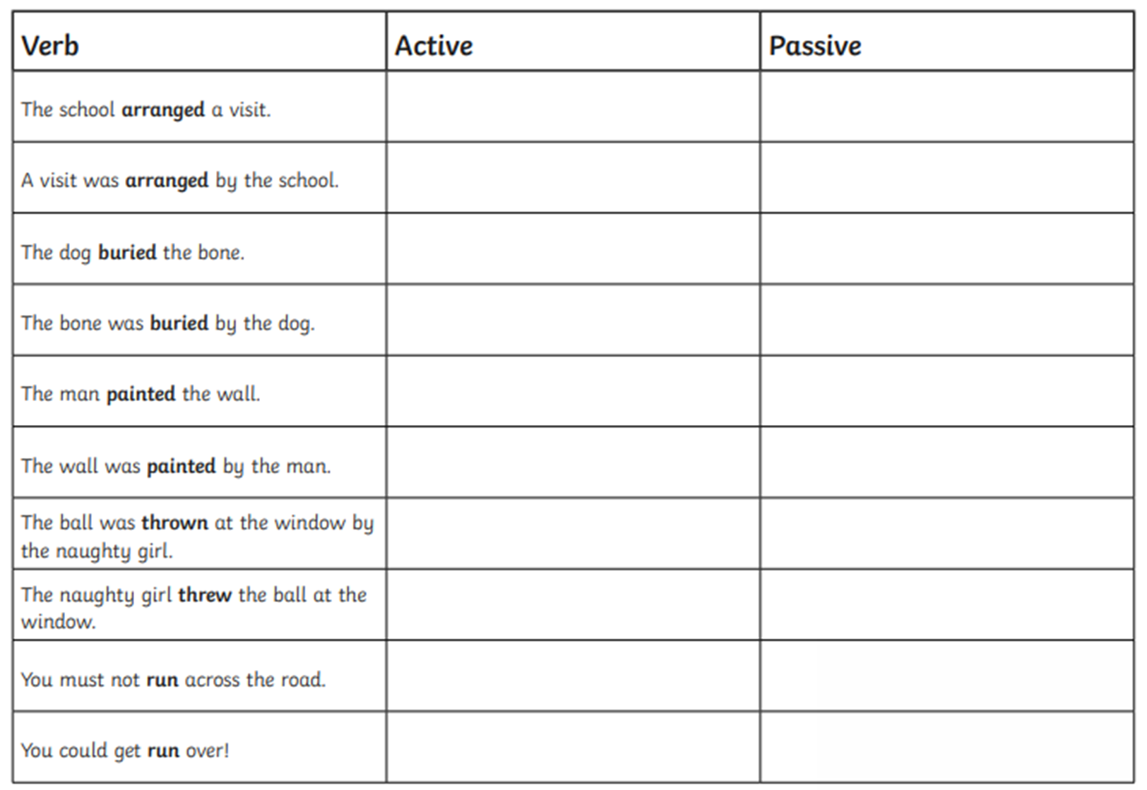
RECALL

Slide 9


Confident
George
Daniella
Alfie
Nick
Cheri
Lola T
Lente
Archie
Seren
Liam P
Darcie
Jamie Lee
Ikjot
Jaylyn
Morgan
Jack
Ben
Writers of the Day
Tristan
Notes:
Lesson 5
feedforward

Slide 10

Lexi- why didn’t you complete the work?
Liam- was/were
Written by not wrote by
Holly
Elliott
Lola T
Seren
Jamie Lee
Morgan
Jack
Hidden by not hid by
Lowenna
Jamie Lee
Jaylyn
Lola N
Archie- bitten by not bit by.
Lola T-capital letters
Ella see me for a bit of help.
Oops…missing things to look for…
Presentation Watch
Alfie
Holly
Please take care with your handwriting
Common spelling mistakes…!
Please make sure when you copy tricky spellings, that you copy them correctly.
Notes:
feedforward

Slide 11
Monday 31st January
To learn how to recognise vocabulary and structures that
are appropriate for formal speech and writing.
Some will even change a paragraph to formal language.
Some will Re-write sentences in formal language.
Most will recognise the when a piece of writing is formal or informal.
All will explain when formal and informal writing should be used.

Slide 12
Blue Whale
https://www.naturalcurriculum.co.uk/grammar/year-6-grammar-lessons/formal-language/fin-whale/screen-1/
With a tongue that can weigh as much as an elephant and a heart the size of a small car, the blue whale is the largest animal ever known to have lived on Earth. Something so large couldn’t possibly live on land as it would crush itself under its own weight. Yet, despite its mind-boggling dimensions, the blue whale is a gentle giant that spends much of its time in the the depths of the ocean, filtering krill (a tiny shrimp-like animal) from huge gulps of sea water. To satisfy its enormous appetite, at certain times of the year, it must consume 4 tonnes of krill each day – a weight greater than a rhinoceros!
In this fascinating clip, Sir David Attenborough walks us through a computer-generated model of a blue whale, whilst reeling off incredible facts about the blue whale’s size. For example, we learn that the whale’s heart pumps blood through a million miles of blood vessels. Incredibly, we also learn about the distant relatives of the blue whale. You’ll be surprised to hear that they are land-dwelling creatures that exist on the planet today. What do you think they are? Watch the clip to find out.

Slide 13

When you interact with your family and friends, you will most likely be using an informal speaking (or writing) style. However, there will be times in your life when you will need to adopt a more formal style in the way that you communicate your thoughts and ideas. With your talk partner, discuss when you might need to use a formal writing style and informal writing style.
Formal
Informal

Slide 14
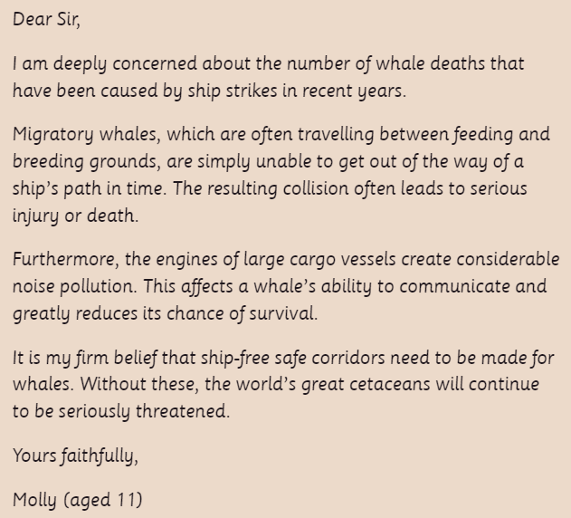
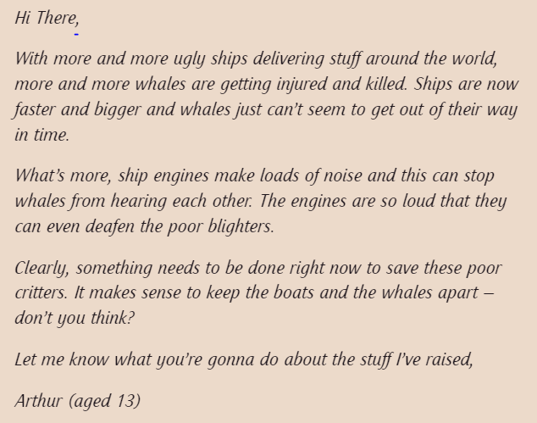
Formal or informal?
How do you know? Text mark with your partner.

Slide 15

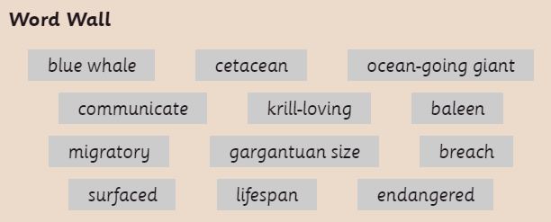
Re-write the sentence so that it is written in formal style.
Use words form the word wall to help you.

Slide 16


Rewrite the second sentence so that it is in a formal style, using some of the words from the Word Wall. Make sure that you don’t directly address the reader and that there are no abbreviations or contractions in your writing.

Slide 17

Write a short paragraph for Molly’s letter that explains why the blue whale is such an impressive creature. Try to include some of the technical words from the Word Wall and use a formal writing style.

Slide 18
Convert the following paragraph to formal language
If you’re ‘whaley’ mad about whales, you’ll love the blue whale. It’s such an awesome critter. You’ll be impressed by its size, as it really is a whopper! I bet you didn’t know that they’re the biggest animal that has ever lived on Earth? Except for the Arctic, they can be found in loads of oceans and seas around our awesome planet. Guess why it’s called the blue whale? It’s coz its body appears blue underwater, though when it pops up for air, it’s more of a spotty blue-grey colour.
You gotta feel sorry for these guys though, as they have had a tough time in the wild. In the 19th Century they were nearly wiped out completing due to whaling, when they were killed for their blubber and other body bits ‘n’ bobs. Though whaling isn’t so much of a problem for them these days, life still ain’t easy for these poor guys. They sometimes get stuck in fishing nets and hit by ships. Did I mention the fact that they are also affected by global warming and plastic pollution? It’s not rocket science – more needs to be done to help these awesome ocean giants.
Make sure you do not have any of the following
Abbreviations
Contractions
Vague language
Slang and idioms
Direct address to the reader

Slide 19
Plenary
Share examples

Slide 20
Times tables
X8 loop cards

Slide 21
Confident
Archie
Elliott
Lente
Darcie
Nick
Holly
Seren
Tristan
Mathematician of the Day
Lola T
Notes:
Lesson 5
feedforward

Slide 22
30.11.20
Lola N- simplify fractions please.
Oops…missing things to look for…
Presentation Watch
George and please ensure you write the calculations not just the answers.
Alfie- ruler
Ben- ruler
Notes:
feedforward

Slide 23


RECALL

Slide 24
L.O. To divide fractions by integers and fractions.
Some will even solve problems involving dividing fractions.
Some find missing numerators and denominators
Most- divide a fraction by a fraction
All- Divide a fraction by a integer

Slide 25
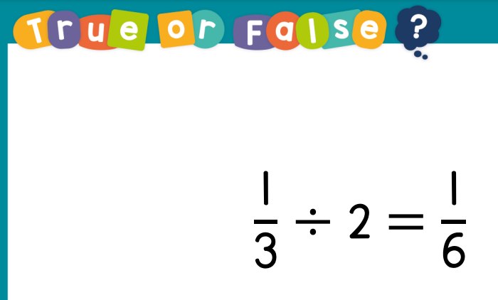
Guided Practice

Slide 26
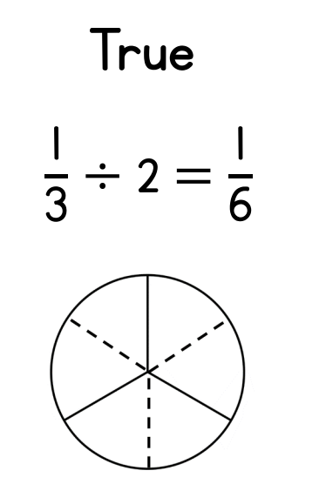
K F C
KFC

Slide 27
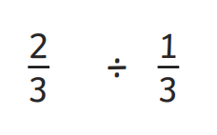

=

Slide 28

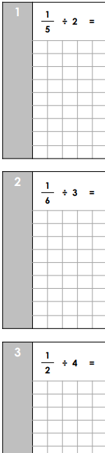
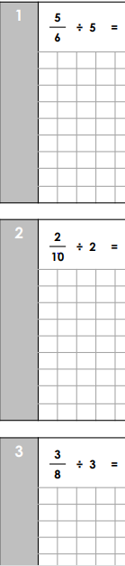

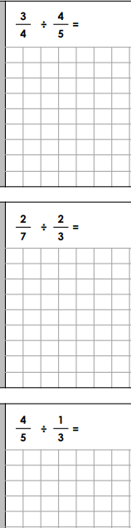



Intelligent Practice

Slide 29

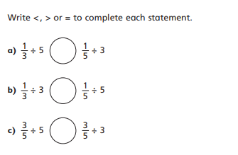

Slide 30
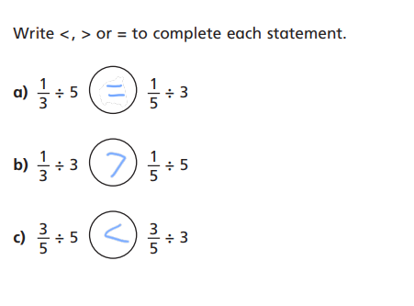

Slide 31
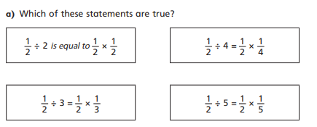
2

Slide 32
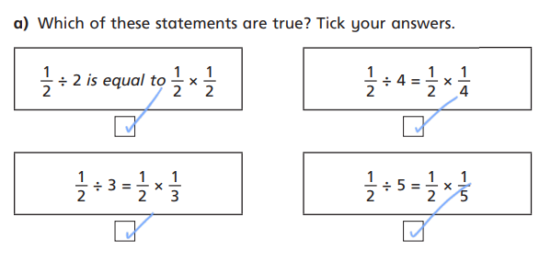
2

Slide 33
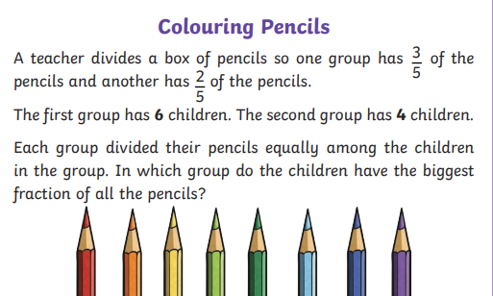
3

Slide 34
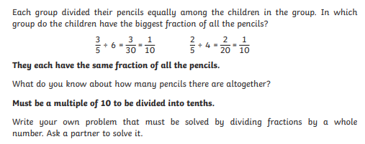
3

Slide 35
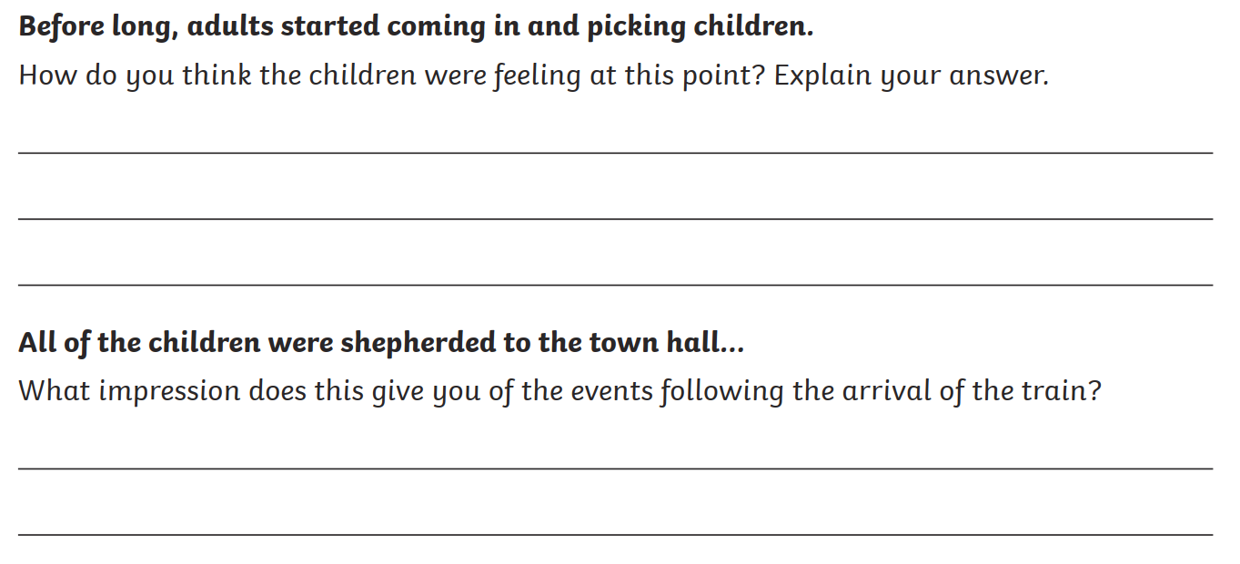
Whole Class Reading

Slide 36

queasy

Slide 37
What could it mean?
queasy
The boat ride made me a little queasy.
She complained of a queasy stomach.
He feels queasy about taking the test.
She had the queasy feeling that she was being watched.

Slide 38
SAY IT AND FEEL THE SYLLABLES
SAY IT IN A SQUEAKY VOICE
SAY IT TO SOMEONE ON ANOTHER TABLE
WHISPER IT TO MRS SILK
SAY IT TO YOUR BOOK
REPEAT IT AFTER ME
SAY IT TO THE WINDOW
WHISPER IT TO A WALL
queasy

Slide 39
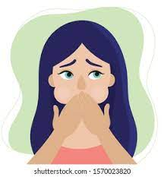
queasy

Slide 40

queasy
Adjective
Nauseous or feeling sick.

Slide 41
Confident
Ella Mai
Holly
Lola N
Elliott
Daniella
Cheri
Morgan
Darcie
Archie
Lente
Jack
Lola
Excellent RE
Ikjot
Notes:
Lesson 5
feedforward

Slide 42

30.11.20
Remember to think about the question- why were those items in a
Church so important?
Oops…missing things to look for…
Presentation Watch
All ensure you write a date and title and underline it with a ruler
Vicar
Notes:
feedforward

Slide 43
RE
Monday 31st January
To develop the our understanding of the difference that believing and worshipping makes to the lives of religious people.
How does worship makes a difference to Hindus?
Building
Services
Links to the community
Artefacts/symbols used

Slide 44


Slide 45
Describe 3 things in a Mandir and how they help a Hindu worship
Item | How does it help worship?

Slide 46
Monday 31st January
PSHE QUIZ
To understand how democracy works in the UK: at a local, regional and national level

Slide 47

Where Is the UK Parliament?
The Houses of Parliament, also known as the Palace of Westminster, is in the centre of London.
It is one of the most iconic buildings in the world and includes the green-coloured benches in the House of Commons Chamber and the red-coloured benches in the House of Lords Chamber. It also includes the famous clock tower, popularly known as Big Ben.

Slide 48
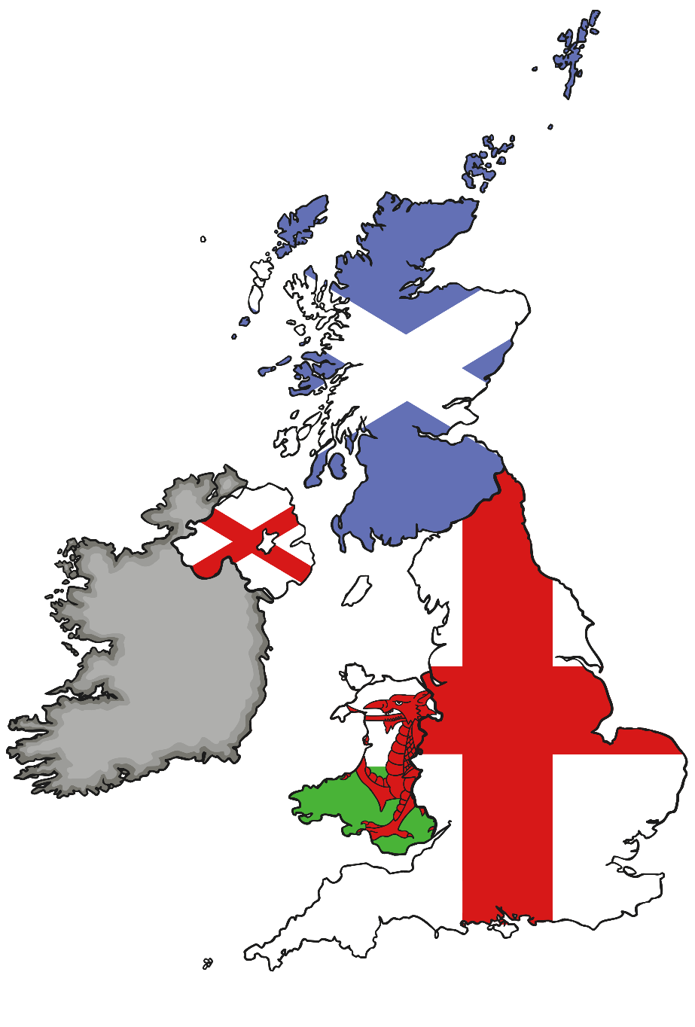
Where Is the UK Parliament?
To give the people of Scotland, Wales and Northern Ireland more say over what happens in their countries, the UK Parliament has devolved (given away) some of its powers to other national and regional bodies.
For example, in Scotland there is a Scottish Parliament, which has elected members who make some decisions for Scotland. There is also the National Assembly for Wales and the Northern Ireland Assembly.

Slide 49
What Is the UK Parliament?
Parliament is made up of three parts: the House of Commons, the House of Lords and the king or queen – known as the Monarch.
The House of Commons is made up of Members of Parliament (MPs). MPs are elected to represent our views in the House of Commons.
In the House of Lords, members are appointed from inside and outside of Parliament, based on their special experience and knowledge, to check and challenge the work of the Government.
The role of the Monarch is mainly ceremonial these days. The Monarch meets the Prime Minister once a week to hear what’s going on in Parliament, signs new laws (gives Royal Assent) and attends the State Opening of Parliament.

Slide 50
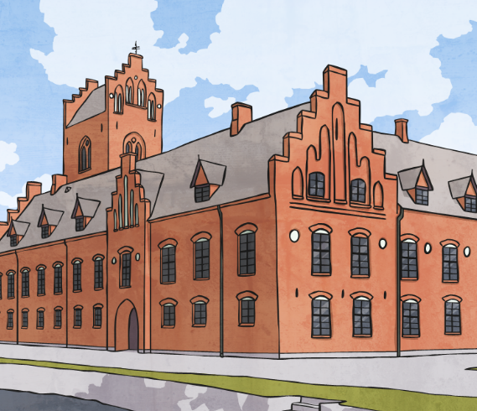
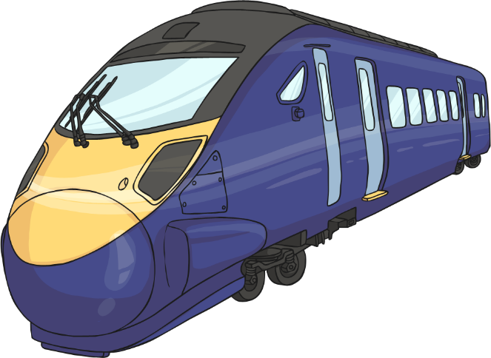
What Does Parliament Do?
The main work of Parliament is to:
check and challenge the work of the Government;
make and change laws;
debate the important issues of the day.
The issues discussed in Parliament affect us all and include health, the environment, transport, jobs, schools and crime.

Slide 51
Is Parliament Different from the Government?
Yes! The Government’s job is to run the country.
Parliament’s job is to check and challenge what the Government does.
The UK usually holds a general election every five years. After the election, the party with the most MPs can then form the Government.
The leader of the winning party becomes the Prime Minister and chooses a team of MPs and members of the House of Lords to form the Government.
MPs and Lords who are not part of the winning party become the Opposition. They check and challenge the ideas of the Government through debates
and questions.
There are also many Lords who are not members of either the Government or the Opposition. They don’t belong to any political party. They are called ‘crossbenchers’ as they sit across the middle of the House of Lords Chamber.

Slide 52

How Can I Get Involved?
The UK Parliament is your Parliament and your thoughts and ideas matter!
If you feel seriously about an issue, something in the news or an idea for a law that Parliament is talking about, then you can get involved.
Let’s see how some young people are getting involved…

Slide 53
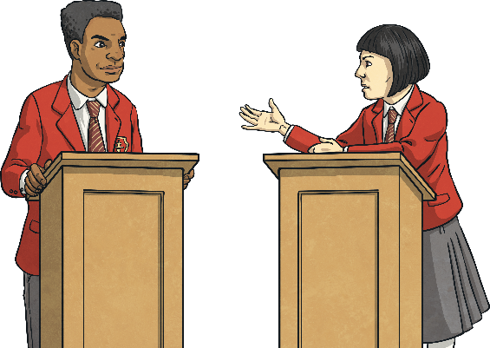
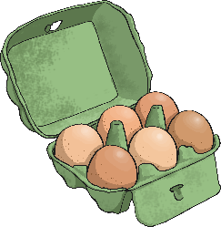
How Can I Get Involved?
Debating…
Alex Rukin was just nine years old when he became the youngest person to give his opinion to a House of Commons Select Committee in Parliament. He gave his opinion about plans for a new rail link near his home.
Speaking Up…
If you are between 11 and 18 years old, you can become a member of the UK Youth Parliament, which comes to the House of Commons every year to hold a debate about issues that are important to them.
Every year, young people from around the UK also take part in a House of Lords Chamber event where they debate big issues, such as freedom of speech or climate change.
Gaining Support…
Lucy Gavaghan started a petition when she was 14 to ban supermarkets selling eggs laid by hens in cages. Her petition got so much support that supermarkets made a promise to stop selling eggs from caged hens by 2015.
We’ll be learning more about how you can get involved with Parliament throughout the week!

Slide 54
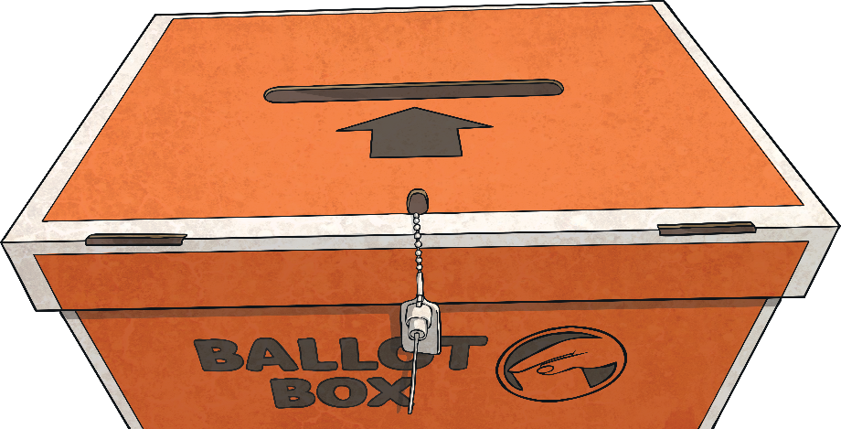
What Is Parliament Week?
UK Parliament Week is a festival which takes place every year.
It engages people from across the country with the work of the UK Parliament, explores what Parliament means to them and empowers them to get involved.
Organisations from across the country run events and activities all about Parliament – just like your school is doing now!
Events from last year’s UK Parliament Week included lunches with politicians, special film screenings in cinemas, community debates and quizzes.

