Slide 2
Monday 31st January

Slide 3
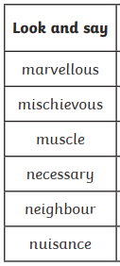
Spellings
Complete the next page of your
spelling booklet

Slide 4




Poem: The Oak Chest
Explain why the poet has said
‘The room feels empty now’.
Darkness. Can you see anything?
The room feels empty now.
Wait. There’s a great oak chest
in the corner. You saw it
yesterday, late. Come on. Your hand.
Feel these carvings. A forest, a king
lying under trees, an arrow,
remember? A shield, a date.
And inside? Shall we open it?
I said, Shall we open it?
Fred Sedgwick
What is carved into the chest?
What do you think may be in the chest? Why do you think that?
Comment on the poet’s layout choices (rhyme, regular or irregular, use of punctuation, stanzas)
Mastery:
Create and answer your own R.I.C questions.

