Slide 2
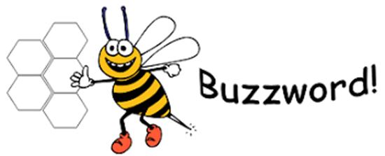
multitude
What does it say?
What could it mean?

Slide 3
multitude
What does it say?
What could it mean?
Adjective
A large number of people or things.
Out there in the woods lay a multitude of plants she wanted to see, and no slithering reptile was going to stand in her way.

Slide 4
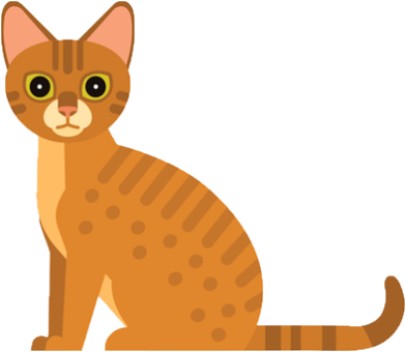

RECALL
When a sentence is in the active form, the subject is performing the action.
The sentence uses the active verb.
For example:
The cat saw the mouse.
The cat (subject) is performing the action of seeing.

Slide 5
When a sentence is in the passive form, the subject is having the action performed to it.
Our sentence changes from
The cat saw the mouse.
to
The mouse was seen by the cat.
The mouse (subject) is having the action done to it.

Slide 6
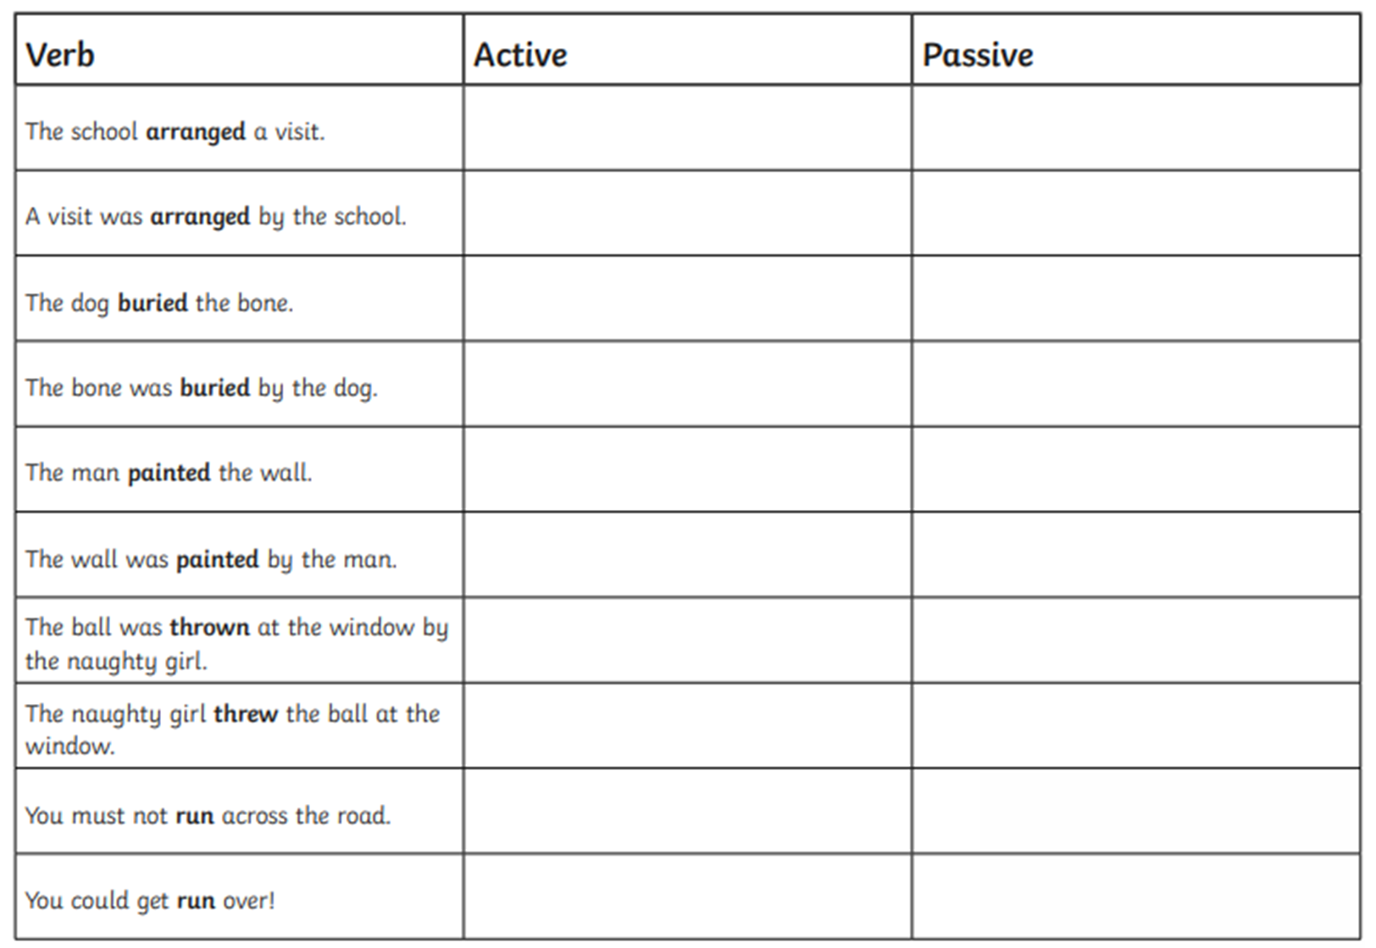
RECALL

Slide 7


Confident
George
Daniella
Alfie
Nick
Cheri
Lola T
Lente
Archie
Seren
Liam P
Darcie
Jamie Lee
Ikjot
Jaylyn
Morgan
Jack
Ben
Writers of the Day
Tristan
Notes:
Lesson 5
feedforward

Slide 8

Lexi- why didn’t you complete the work?
Liam- was/were
Written by not wrote by
Holly
Elliott
Lola T
Seren
Jamie Lee
Morgan
Jack
Hidden by not hid by
Lowenna
Jamie Lee
Jaylyn
Lola N
Archie- bitten by not bit by.
Lola T-capital letters
Ella see me for a bit of help.
Oops…missing things to look for…
Presentation Watch
Alfie
Holly
Please take care with your handwriting
Common spelling mistakes…!
Please make sure when you copy tricky spellings, that you copy them correctly.
Notes:
feedforward

Slide 9
Monday 31st January
To learn how to recognise vocabulary and structures that
are appropriate for formal speech and writing.
Some will even change a paragraph to formal language.
Some will Re-write sentences in formal language.
Most will recognise the when a piece of writing is formal or informal.
All will explain when formal and informal writing should be used.

Slide 10
Blue Whale
https://www.naturalcurriculum.co.uk/grammar/year-6-grammar-lessons/formal-language/fin-whale/screen-1/
With a tongue that can weigh as much as an elephant and a heart the size of a small car, the blue whale is the largest animal ever known to have lived on Earth. Something so large couldn’t possibly live on land as it would crush itself under its own weight. Yet, despite its mind-boggling dimensions, the blue whale is a gentle giant that spends much of its time in the the depths of the ocean, filtering krill (a tiny shrimp-like animal) from huge gulps of sea water. To satisfy its enormous appetite, at certain times of the year, it must consume 4 tonnes of krill each day – a weight greater than a rhinoceros!
In this fascinating clip, Sir David Attenborough walks us through a computer-generated model of a blue whale, whilst reeling off incredible facts about the blue whale’s size. For example, we learn that the whale’s heart pumps blood through a million miles of blood vessels. Incredibly, we also learn about the distant relatives of the blue whale. You’ll be surprised to hear that they are land-dwelling creatures that exist on the planet today. What do you think they are? Watch the clip to find out.

Slide 11
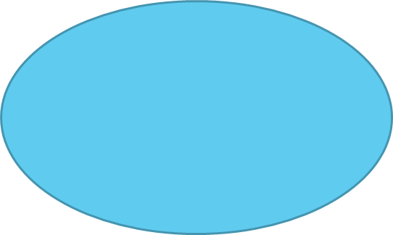
When you interact with your family and friends, you will most likely be using an informal speaking (or writing) style. However, there will be times in your life when you will need to adopt a more formal style in the way that you communicate your thoughts and ideas. With your talk partner, discuss when you might need to use a formal writing style and informal writing style.
Formal
Informal

Slide 12
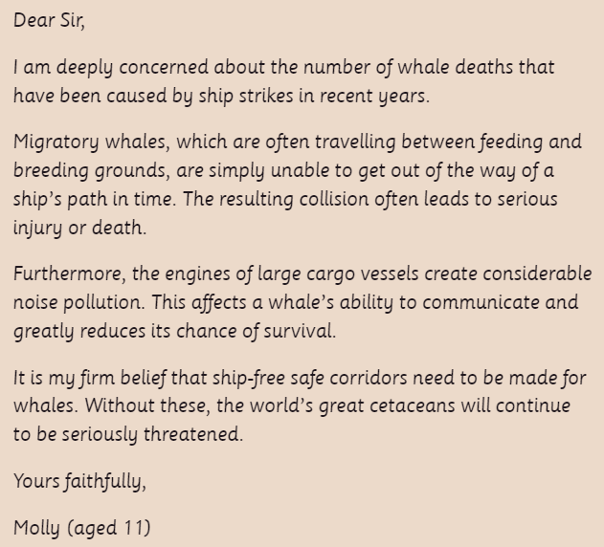
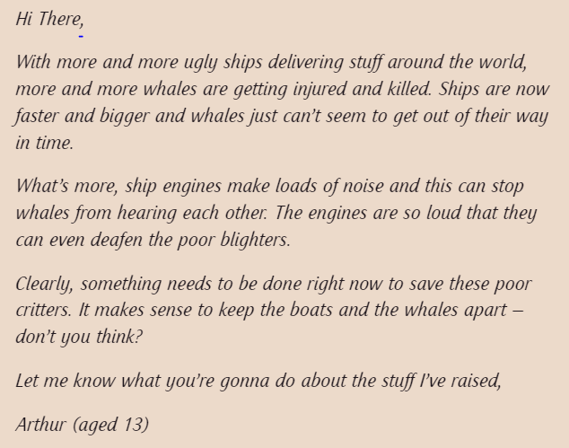
Formal or informal?
How do you know? Text mark with your partner.

Slide 13

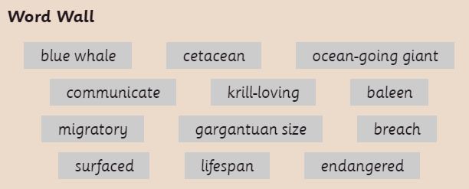
Re-write the sentence so that it is written in formal style.
Use words form the word wall to help you.

Slide 14


Rewrite the second sentence so that it is in a formal style, using some of the words from the Word Wall. Make sure that you don’t directly address the reader and that there are no abbreviations or contractions in your writing.

Slide 15

Write a short paragraph for Molly’s letter that explains why the blue whale is such an impressive creature. Try to include some of the technical words from the Word Wall and use a formal writing style.

Slide 16
Convert the following paragraph to formal language
If you’re ‘whaley’ mad about whales, you’ll love the blue whale. It’s such an awesome critter. You’ll be impressed by its size, as it really is a whopper! I bet you didn’t know that they’re the biggest animal that has ever lived on Earth? Except for the Arctic, they can be found in loads of oceans and seas around our awesome planet. Guess why it’s called the blue whale? It’s coz its body appears blue underwater, though when it pops up for air, it’s more of a spotty blue-grey colour.
You gotta feel sorry for these guys though, as they have had a tough time in the wild. In the 19th Century they were nearly wiped out completing due to whaling, when they were killed for their blubber and other body bits ‘n’ bobs. Though whaling isn’t so much of a problem for them these days, life still ain’t easy for these poor guys. They sometimes get stuck in fishing nets and hit by ships. Did I mention the fact that they are also affected by global warming and plastic pollution? It’s not rocket science – more needs to be done to help these awesome ocean giants.
Make sure you do not have any of the following
Abbreviations
Contractions
Vague language
Slang and idioms
Direct address to the reader

Slide 17
Plenary
Share examples

