Slide 2


Confident
Ella Mai
Holly
Lola N
Elliott
Daniella
Cheri
Morgan
Darcie
Archie
Lente
Jack
Lola
Excellent RE
Ikjot
Notes:
Lesson 5
feedforward

Slide 3


30.11.20
Remember to think about the question- why were those items in a
Church so important?
Oops…missing things to look for…
Presentation Watch
All ensure you write a date and title and underline it with a ruler
Vicar
Notes:
feedforward

Slide 4
RE
Monday 31st January
To develop the our understanding of the difference that believing and worshipping makes to the lives of religious people.
How does worship makes a difference to Hindus?
Building
Services
Links to the community
Artefacts/symbols used

Slide 5


Slide 6
Describe 3 things in a Mandir and how they help a Hindu worship
Item | How does it help worship?

Slide 7
Monday 31st January
PSHE QUIZ
To understand how democracy works in the UK: at a local, regional and national level

Slide 8

Where Is the UK Parliament?
The Houses of Parliament, also known as the Palace of Westminster, is in the centre of London.
It is one of the most iconic buildings in the world and includes the green-coloured benches in the House of Commons Chamber and the red-coloured benches in the House of Lords Chamber. It also includes the famous clock tower, popularly known as Big Ben.

Slide 9
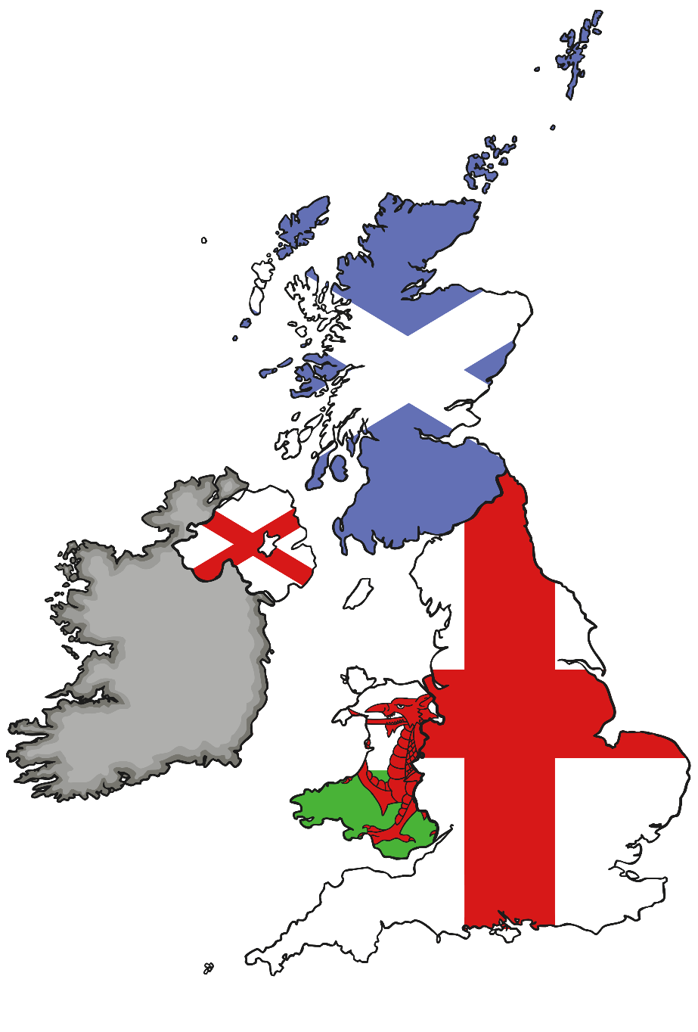
Where Is the UK Parliament?
To give the people of Scotland, Wales and Northern Ireland more say over what happens in their countries, the UK Parliament has devolved (given away) some of its powers to other national and regional bodies.
For example, in Scotland there is a Scottish Parliament, which has elected members who make some decisions for Scotland. There is also the National Assembly for Wales and the Northern Ireland Assembly.

Slide 10
What Is the UK Parliament?
Parliament is made up of three parts: the House of Commons, the House of Lords and the king or queen – known as the Monarch.
The House of Commons is made up of Members of Parliament (MPs). MPs are elected to represent our views in the House of Commons.
In the House of Lords, members are appointed from inside and outside of Parliament, based on their special experience and knowledge, to check and challenge the work of the Government.
The role of the Monarch is mainly ceremonial these days. The Monarch meets the Prime Minister once a week to hear what’s going on in Parliament, signs new laws (gives Royal Assent) and attends the State Opening of Parliament.

Slide 11
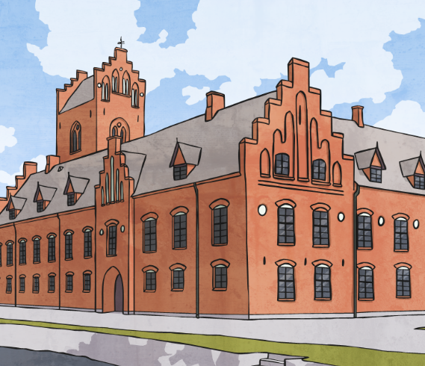
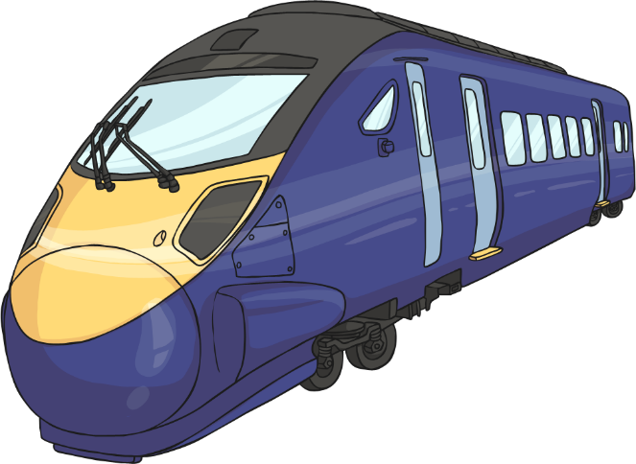
What Does Parliament Do?
The main work of Parliament is to:
check and challenge the work of the Government;
make and change laws;
debate the important issues of the day.
The issues discussed in Parliament affect us all and include health, the environment, transport, jobs, schools and crime.

Slide 12
Is Parliament Different from the Government?
Yes! The Government’s job is to run the country.
Parliament’s job is to check and challenge what the Government does.
The UK usually holds a general election every five years. After the election, the party with the most MPs can then form the Government.
The leader of the winning party becomes the Prime Minister and chooses a team of MPs and members of the House of Lords to form the Government.
MPs and Lords who are not part of the winning party become the Opposition. They check and challenge the ideas of the Government through debates
and questions.
There are also many Lords who are not members of either the Government or the Opposition. They don’t belong to any political party. They are called ‘crossbenchers’ as they sit across the middle of the House of Lords Chamber.

Slide 13

How Can I Get Involved?
The UK Parliament is your Parliament and your thoughts and ideas matter!
If you feel seriously about an issue, something in the news or an idea for a law that Parliament is talking about, then you can get involved.
Let’s see how some young people are getting involved…

Slide 14
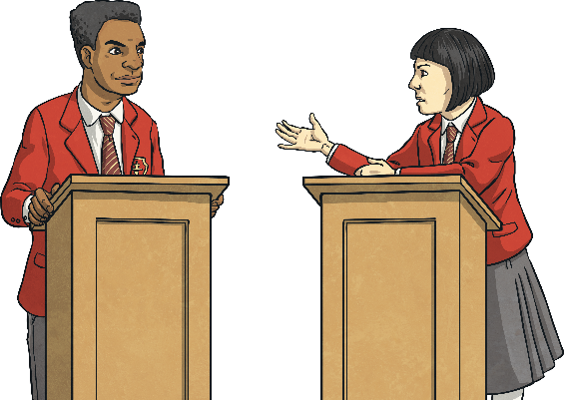
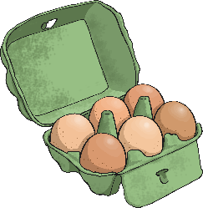
How Can I Get Involved?
Debating…
Alex Rukin was just nine years old when he became the youngest person to give his opinion to a House of Commons Select Committee in Parliament. He gave his opinion about plans for a new rail link near his home.
Speaking Up…
If you are between 11 and 18 years old, you can become a member of the UK Youth Parliament, which comes to the House of Commons every year to hold a debate about issues that are important to them.
Every year, young people from around the UK also take part in a House of Lords Chamber event where they debate big issues, such as freedom of speech or climate change.
Gaining Support…
Lucy Gavaghan started a petition when she was 14 to ban supermarkets selling eggs laid by hens in cages. Her petition got so much support that supermarkets made a promise to stop selling eggs from caged hens by 2015.
We’ll be learning more about how you can get involved with Parliament throughout the week!

Slide 15
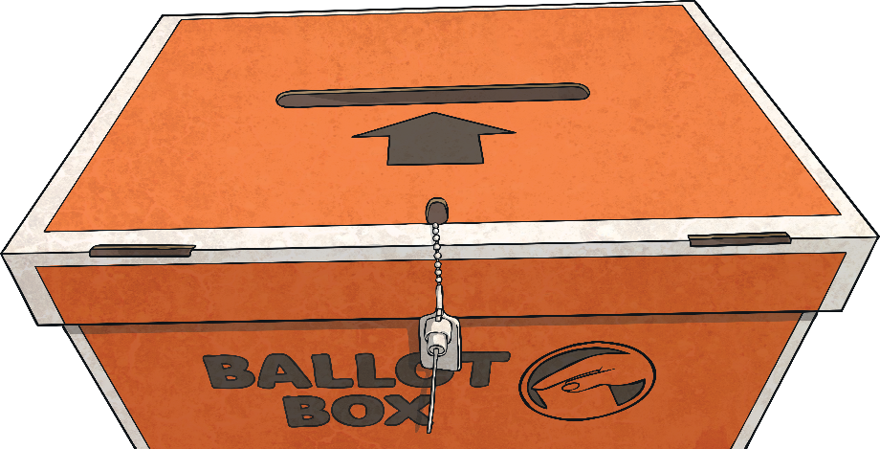
What Is Parliament Week?
UK Parliament Week is a festival which takes place every year.
It engages people from across the country with the work of the UK Parliament, explores what Parliament means to them and empowers them to get involved.
Organisations from across the country run events and activities all about Parliament – just like your school is doing now!
Events from last year’s UK Parliament Week included lunches with politicians, special film screenings in cinemas, community debates and quizzes.

