Slide 2
Times tables
X8 loop cards

Slide 3


Confident
Archie
Elliott
Lente
Darcie
Nick
Holly
Seren
Tristan
Mathematician of the Day
Lola T
Notes:
Lesson 5
feedforward

Slide 4

30.11.20
Lola N- simplify fractions please.
Oops…missing things to look for…
Presentation Watch
George and please ensure you write the calculations not just the answers.
Alfie- ruler
Ben- ruler
Notes:
feedforward

Slide 5


RECALL

Slide 6
L.O. To divide fractions by integers and fractions.
Some will even solve problems involving dividing fractions.
Some find missing numerators and denominators
Most- divide a fraction by a fraction
All- Divide a fraction by a integer

Slide 7
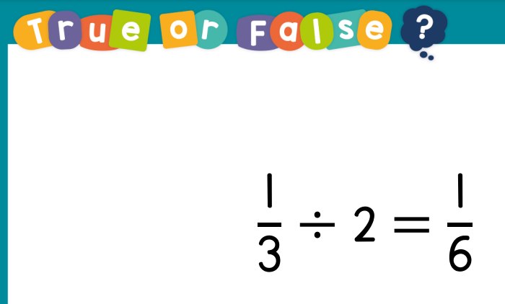
Guided Practice

Slide 8
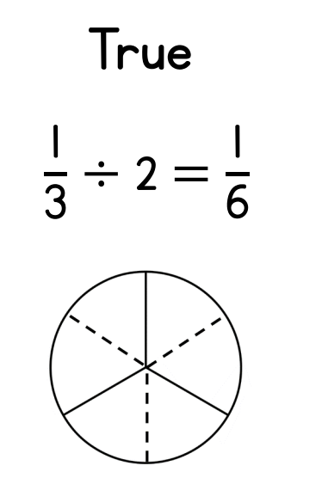

K F C
KFC

Slide 9
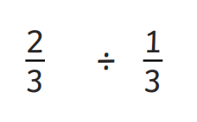
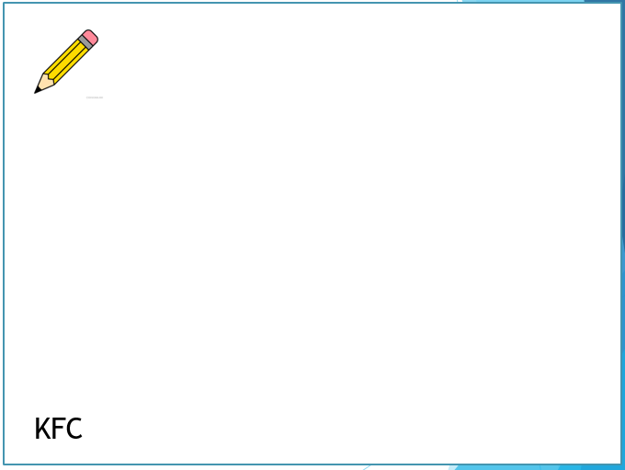
=

Slide 10

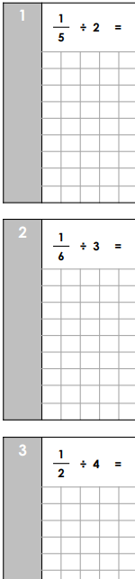
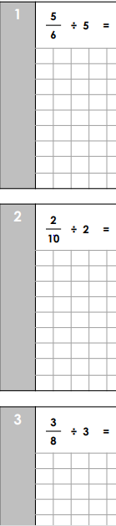

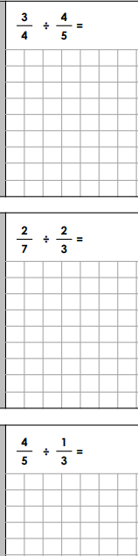



Intelligent Practice

Slide 11

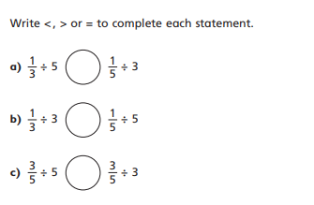

Slide 12
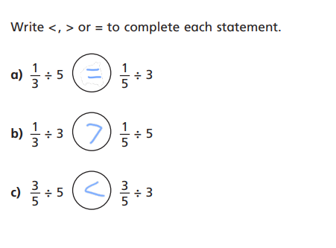

Slide 13
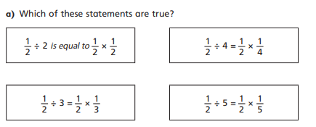
2

Slide 14
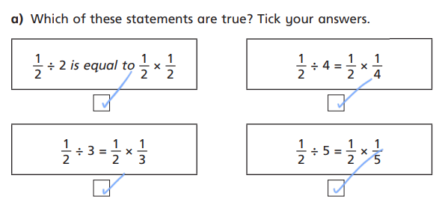
2

Slide 15
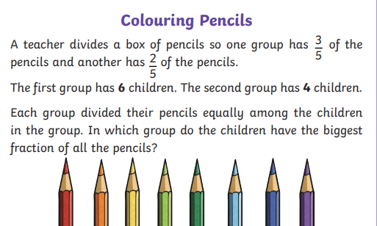
3

Slide 16
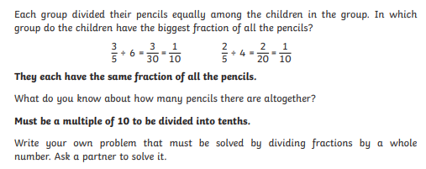
3

