Slide 2
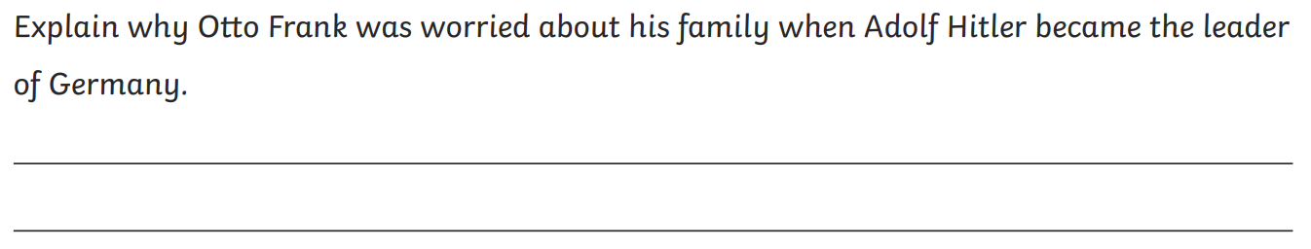
Whole Class Reading
Explain why Jewish people were forced to wear a yellow star.

Slide 3

despise

Slide 4
What could it mean?
despise
I despise anyone who is cruel to animals.

Slide 5
SAY IT AND FEEL THE SYLLABLES
SAY IT IN A SQUEAKY VOICE
SAY IT TO SOMEONE ON ANOTHER TABLE
WHISPER IT TO MRS SILK
SAY IT TO YOUR BOOK
REPEAT IT AFTER ME
SAY IT TO THE WINDOW
WHISPER IT TO A WALL
despise

Slide 6
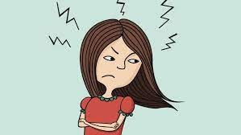
despise

Slide 7
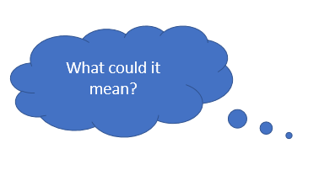
despise
Verb
To feel contempt for.

