Slide 2
Monday 24th January

Slide 3
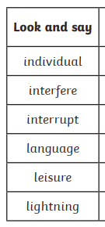
Spellings
Complete the next page of your
spelling booklet

Slide 4

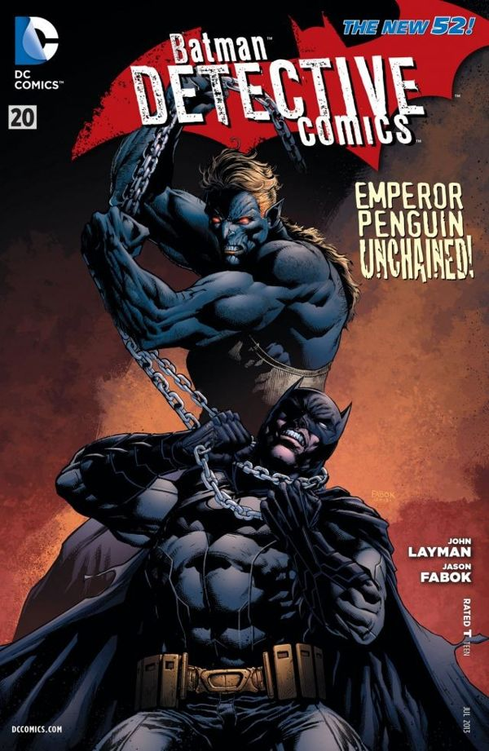


Comic book cover: Batman
Describe what the illustration shows.
(1)
What clues are there that this is not the first time that Emperor Penguin and Batman have fought each other.
(2)
“Emperor Penguin Unchained!” Comment on how the illustrator has made the illustration echo the exclamation.
(2)
Mastery:
Create and answer your own R.I.C questions.

Slide 5

vivacious
What does it say?
What could it mean?

Slide 6
vivacious
What does it say?
What could it mean?
Adjective
Lively and animated
When the vivacious child came through the school’s door on her first day of nursery, she spoke with every student and volunteered to do every activity.

