Slide 2
L.O. To multiply a fractions by fraction
Some will even find different ways to complete a calculation
Some find missing numerators and denominators
Most- multiply a mixed number by a mixed number
All- multiply a fraction by a fraction

Slide 3
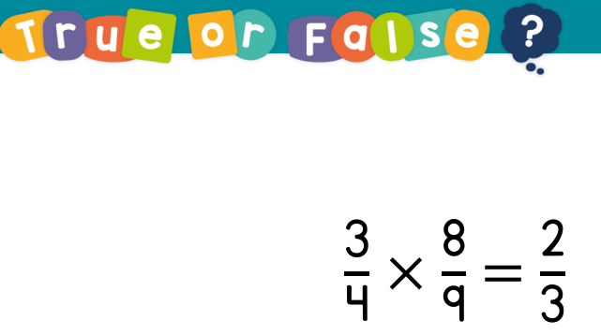
Guided Practice

Slide 4
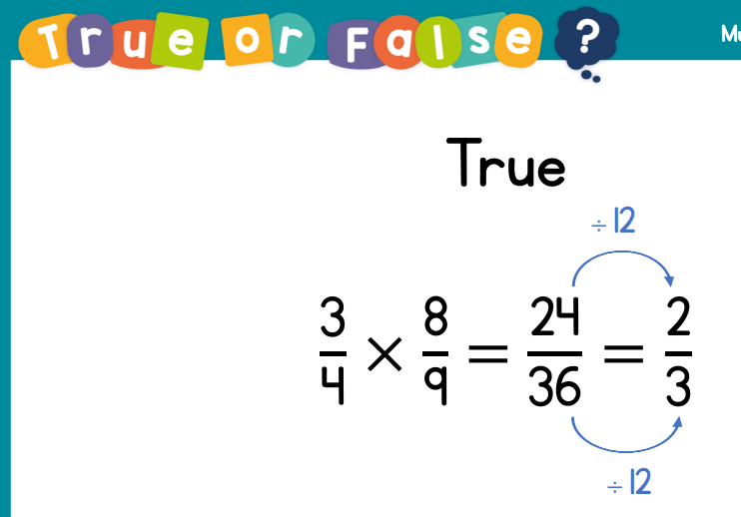

Slide 5
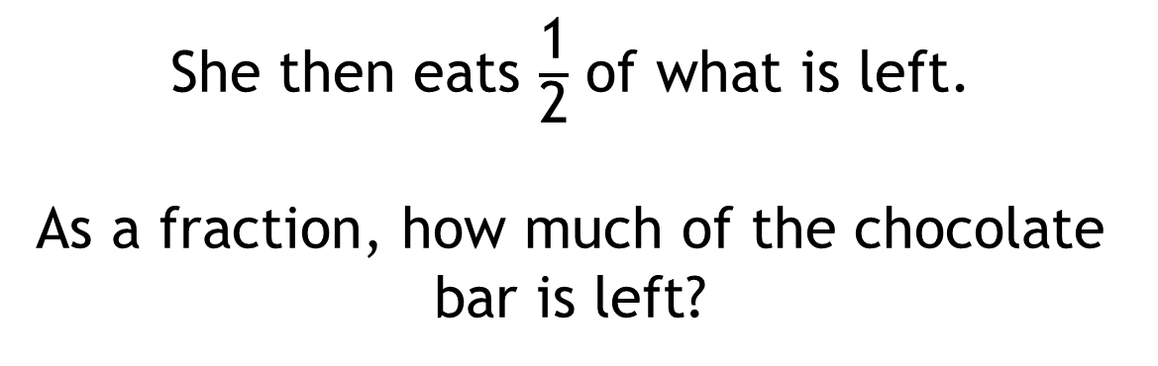

Sally eats $\frac{\text{1}}{\text{2}}$ of the chocolate bar.
She then eats $\frac{\text{1}}{\text{2}}$ of what is left.
As a fraction, how much of the chocolate bar is left?

Slide 6

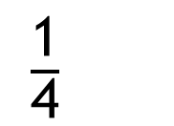
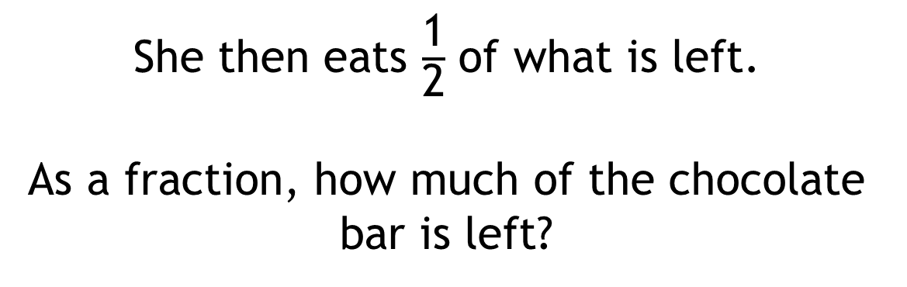
$\frac{\text{1}}{\text{4}}$
Sally eats $\frac{\text{1}}{\text{2}}$ of the chocolate bar.
She then eats $\frac{\text{1}}{\text{2}}$ of what is left.
As a fraction, how much of the chocolate bar is left?

Slide 7






$$\frac{\text{1}}{\text{2}}×\text{1}$$
$$=\frac{\text{1}}{\text{2}}$$
$$\frac{\text{1}}{\text{2}}×\frac{\text{1}}{\text{2}}$$
$$=\frac{\text{1}}{\text{4}}$$
$$=\frac{\text{1}}{\text{2}}$$
$$=\frac{\text{1}}{\text{4}}$$
Half of 1
Half of a half

Slide 8
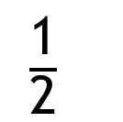


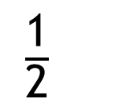
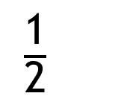

$$\frac{\text{1}}{\text{2}} × \frac{\text{1}}{\text{2}}$$
$$=\frac{\text{1}}{\text{4}}$$
$\frac{\text{1}}{\text{2}}$
$\frac{\text{1}}{\text{2}}$
$\frac{\text{1}}{\text{2}}$
$\frac{\text{1}}{\text{2}}$

Slide 9


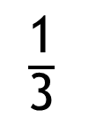
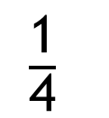
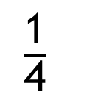
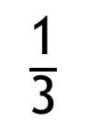
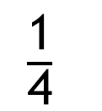
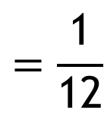
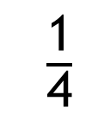
$$=\frac{\text{1}}{\text{12}}$$
$$\frac{\text{1}}{\text{4}}×\frac{\text{1}}{\text{3}}$$
$\frac{\text{1}}{\text{4}}$
$\frac{\text{1}}{\text{4}}$
$\frac{\text{1}}{\text{4}}$
$\frac{\text{1}}{\text{4}}$
$\frac{\text{1}}{\text{3}}$
$\frac{\text{1}}{\text{3}}$
$\frac{\text{1}}{\text{3}}$

Slide 10

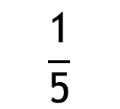







Have a think
$$\frac{\text{1}}{\text{2}}$$
$$\frac{\text{1}}{\text{3}}$$
$$\frac{\text{1}}{\text{5}}$$
$$\frac{\text{1}}{\text{5}}$$
$$\frac{\text{1}}{\text{2}}×\frac{\text{1}}{\text{5}}$$
$$\frac{\text{1}}{\text{3}}×\frac{\text{1}}{\text{5}}$$
$$=\frac{\text{1}}{\text{10}}$$
$$=\frac{\text{1}}{\text{15}}$$

Slide 11








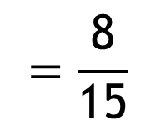

$$=\frac{\text{8}}{\text{15}}$$
$$\frac{\text{4}}{\text{5}}×\frac{\text{2}}{\text{3}}$$
$$\frac{\text{1}}{\text{3}}$$
$$\frac{\text{1}}{\text{3}}$$
$$\frac{\text{1}}{\text{3}}$$
$$\frac{\text{1}}{\text{5}}$$
$$\frac{\text{1}}{\text{5}}$$
$$\frac{\text{1}}{\text{5}}$$
$$\frac{\text{1}}{\text{5}}$$
$$\frac{\text{1}}{\text{5}}$$

Slide 12






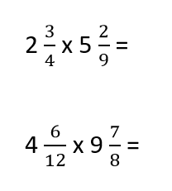


Intelligent Practice

Slide 13

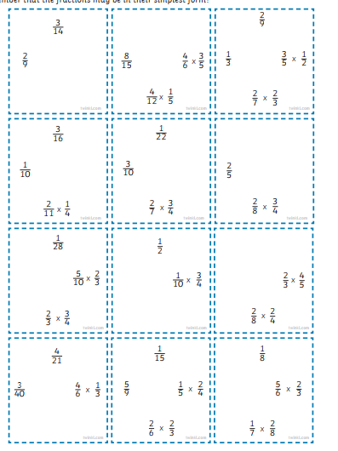
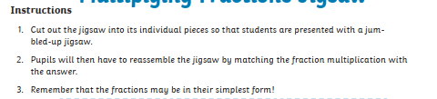

Slide 14
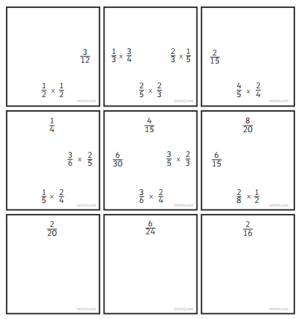

Slide 15
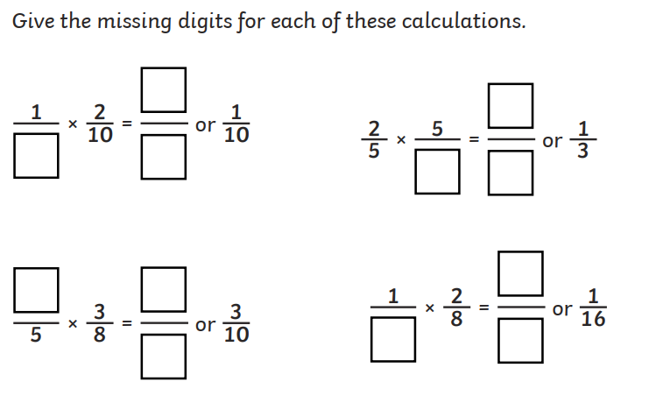
2

Slide 16
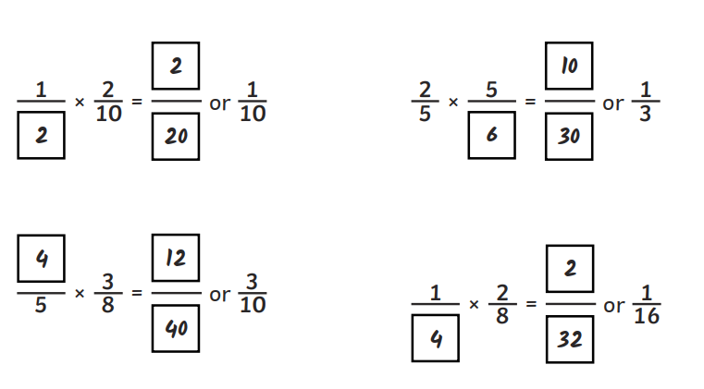
2

Slide 17
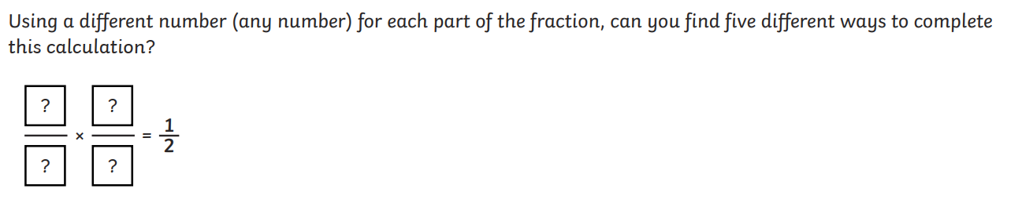
3

Slide 18
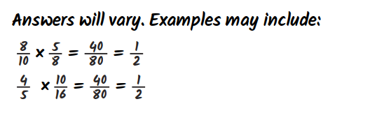

Slide 19
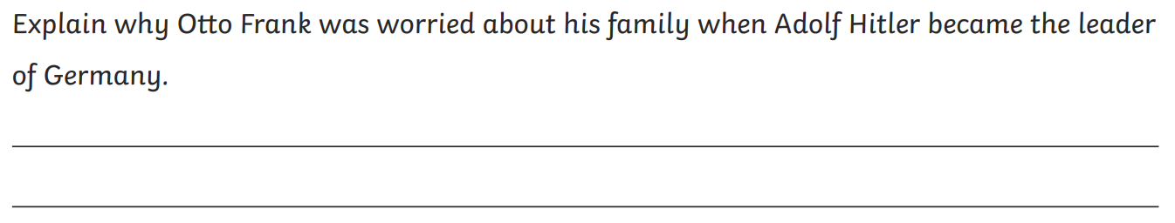
Whole Class Reading
Explain why Jewish people were forced to wear a yellow star.

