Slide 1
Good Morning
Friday 5th March

Slide 2

Harry’s Mad - Part 3
As an Olympic athlete, a jumper perhaps, stand poised, breathing deeply, swaying gently back and forth, tensing himself for that indefinable moment when he knows he is exactly ready to make the attempt, Harry stood at the head of the stairs. His feet were neatly together on the edge of the top step, his hands rammed deep into his trouser pockets, his eyes wide, as though to photograph his mind the other thirteen steps stretching away below him. Seven jumps to make. Harry shut his eyes.
Evidence
Retrieve
Interpret
Choice
What does poised mean?
having a composed and self-assured manner
Looking really nervous
Looking angry and upset.
How many steps were there altogether?
What was Harry getting ready to do?
Do you think Harry will succeed?

Slide 3
Spelling Test

Slide 4
Maths – Year 4 Catch Up
Read the slides and do the activities

Slide 5
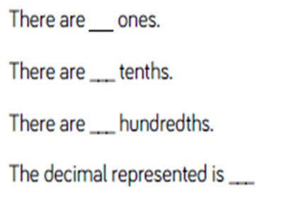
RECALL AD
TP: Complete the stem sentence for 5.93
TP: Draw a part-whole model to partition:
0.73
TP: Make a partition calculation for:
8.35
TP: Can you partition this using a different way?
TP: How many different ways can you think of?

Slide 6
LO: To be able to divide 1 or 2-digits by 100 AD
Top Down | Self Assessment
Some of us will even: I can problem solve and reason when required to divide 1 or 2-digit numbers by 100
Some of us will: I can use the inverse operation to find what number was divided by 100
Most of us will: I can divide a 2-digit number by 100
All of us will: I can divide a 1-digit number by 100

Slide 7
LO: To be able to divide 1 or 2-digits by 100 AD
Get your place value mats.
TP: What does each column represent?
TP: What happens to the value of the number as we go up the place value mat?
TP: What happens to the value of the number as we go down the place value mat?

Slide 8
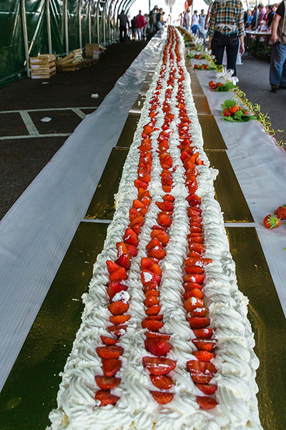
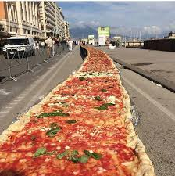
LO: To be able to divide 1 or 2-digits by 100 AD
Longest Food Competition: 100 guests
Jaylyn says:
“I have measured the pizza. It is 3m long.”
Jamie-Lee says:
“I have measured the cake. It is 12m long.”
TP: The pizza is cut so it can be shared out to the 100 guests. How long is each pizza? What calculation do we have to do?
TP: The cake is then shared out to the 100 guests. How long is each piece of cake? What calculation do we have to do?

Slide 9
LO: To be able to divide 1 or 2-digits by 100 AD
Longest Food Competition: 100 guests
Jaylyn says:
“I have measured the pizza. It is 3m long.”
Jamie-Lee says:
“I have measured the cake. It is 12m long.”
TP: The pizza is cut so it can be shared out to the 100 guests. How long is each pizza? What calculation do we have to do?
TP: The cake is then shared out to the 100 guests. How long is each piece of cake? What calculation do we have to do?
Let us do these calculations on the calculator.

Slide 10
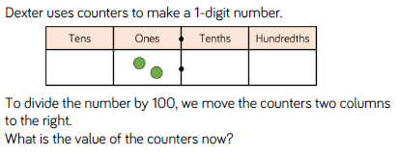
LO: To be able to divide 1 or 2-digits by 100 ES
TP: Why is 0 important when dividing a one or two
digit number by 100?

Slide 11
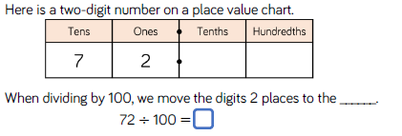

LO: To be able to divide 1 or 2-digits by 100 ES
TP: Why is the 0 important here?
TP: How did you solve the last one? What mathematical knowledge did you need to recall?

Slide 12
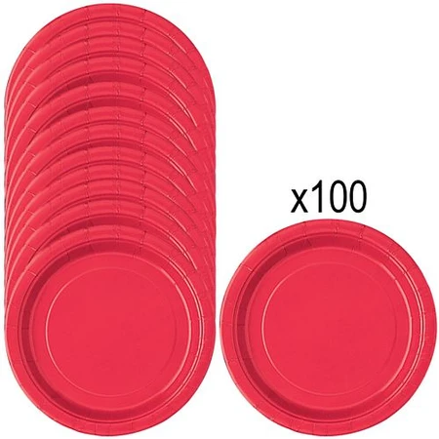
LO: To be able to divide 1 or 2-digits by 100 ES
100 of these red plates has a mass of 4kg.
TP: What is the mass of each plate?

Slide 13
LO: To be able to divide 1 or 2-digits by 100 ES
Q: A 2-digit number divided by 100 is 0.16.
TP: What is the starting number?
TP: What mathematical knowledge do you need to use?
Q: 60 ÷ 10 = 6
TP: How can this help us to calculate:
60 ÷ 100?

Slide 14
LO: To be able to divide 1 or 2-digits by 100 ES
TP: Three children have tried to complete different calculations. What is the answer to Elliot’s question?
Nick – 1 ÷ 100 = 0.01
Cheri – 13 ÷ 100 = 0.13
Elliot – 145 ÷ 100 = ?
Elliot’s question is a new question. Does he still use the same method?
TP: Can you see a pattern?

Slide 15
LO: To be able to divide 1 or 2-digits by 100
Chilli 1 | Chilli 2 | Chilli 3
1 ÷ 100 = 2 ÷ 100 = 3 ÷ 100 = 4 ÷ 100 = 5 ÷ 100 = | 1. 11 ÷ 100 = 2. 12 ÷ 100 = 3. 13 ÷ 100 = 4. 14 ÷ 100 = 5. 15 ÷ 100 = | 1. ? ÷ 100 = 0.06 2. ? ÷ 100 = 0.07 3. ? ÷ 100 = 0.08 4. ? ÷ 100 = 0.16 5. ? ÷ 100 = 0.17 6. ? ÷ 100 = 0.18

Slide 16
LO: To be able to divide 1 or 2-digits by 100
Chilli 1 | Chilli 2 | Chilli 3
1 ÷ 100 = 0.01 2 ÷ 100 = 0.02 3 ÷ 100 = 0.03 4 ÷ 100 = 0.04 5 ÷ 100 = 0.05 | 1. 11 ÷ 100 = 0.11 2. 12 ÷ 100 = 0.12 3. 13 ÷ 100 = 0.13 4. 14 ÷ 100 = 0.14 5. 15 ÷ 100 = 0.15 | 1. 6 ÷ 100 = 0.06 2. 7 ÷ 100 = 0.07 3. 8 ÷ 100 = 0.08 4. 16 ÷ 100 = 0.16 5. 17 ÷ 100 = 0.17 6. 18 ÷ 100 = 0.18

Slide 17
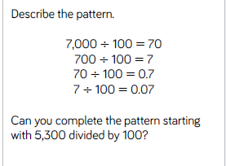
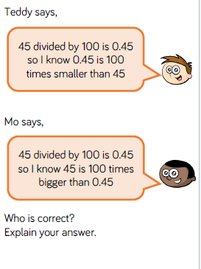
LO: To be able to divide 1 or 2-digits by 100
Q1
Are the following statements true or false? Write you answer in the table.
When you divide by 100:
Q2
If I divide 45 by 100, what will the value of the 5 digit be in the answer?
Complete this statement.
The value of the digit 5 in the answer is _________
b. If I find 1/100 of 59, what will the value of the digit 9 be in the answer?
Complete this statement.
The value of the digit 9 in the answer is ________
 | True or False?
The digits change
Any digit in the ones column moves to the tenth column.
Any digit in the tens column moves to the tenth column.
Each digit becomes 1/100 of the value

Slide 18
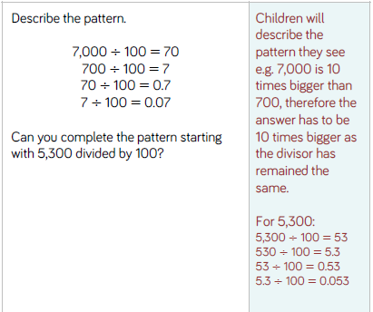
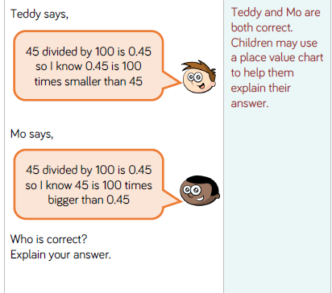
LO: To be able to divide 1 or 2-digits by 100

Slide 19
LO: To be able to divide 1 or 2-digits by 100
Top Down | Self Assessment
Some of us will even: I can problem solve and reason when required to divide 1 or 2-digit numbers by 100
Some of us will: I can use the inverse operation to find what number was divided by 100
Most of us will: I can divide a 2-digit number by 100
All of us will: I can divide a 1-digit number by 100

Slide 20
REFLECTION - LO: To be able to divide 1 or 2-digits by 100
SELF ASSESSMENT

Slide 21
Break

Slide 22
Independent Write Continued

Slide 23
Introduction
Traditional tales are stories that have been told and retold for many years. Often they are passed down through generations. Therefore, they become a story that many people know. There are often lots of different versions of the same story.
Traditional tales are also known as fairy stories or fairy tales.

Slide 24
Introduction
Traditional Tales
Core Features
A simple beginning, series of events in the middle leading to a predictable outcome
Details and descriptions support the plot
The story is for telling and re-telling

Slide 25
Introduction
Language Features
• A simple traditional opening e.g. one day, once upon a time, Long, long ago
• A simple traditional ending e.g. And they lived happily ever after, always keep your promises
• Evil Characters.
• Characters are often foolish or play tricks
• Animals have human attributes
• People are stereotyped e.g. princesses are pretty
• The number 3 is important e.g. three bears
• Magical or supernatural forces e.g. fairies
• Clear values e.g. honesty
• Literal description e.g. red riding hood had a red cloak

Slide 26
LO: To plan, write and edit a story in the style of a traditional tale
We have read a range of traditional stories over this fortnight.
Your task is to plan, write and edit a traditional tale.
You can choose to retell a traditional tale
OR
You can choose to use a traditional tale and change the characters, setting, etc.

Slide 27
LO: To be able to describe settings, characters and atmosphere and integrating dialogue to convey character and advance the action in the style of a Traditional Tale
Checklist
Checklist
Parenthesis
Direct speech
Reported Speech
Expanded Noun Phrases
5 senses
Figurative Language – Simile
Figurative Language - Personification
Figurative Language - Metaphor
Fronted Adverbials
Complex sentences (main and subordinate clause)
Relative Clauses
Statements
Questions
Exclamations
Commands

Slide 28
LO: To plan, write and edit a story in the style of a traditional tale
ACTIVITY
Children to plan, write and edit a traditional tale independently

Slide 29

Chapter 6 – The Swimming Lesson
Lesson 16
LO: To be able to identify how narrative content is related and contributes to meaning as a whole (2f)
What does tirade mean ?

Slide 30
Chapter 6 – The Swimming Lesson
Lesson 16
LO: To be able to identify how narrative content is related and contributes to meaning as a whole (2f)
What does tirade mean ?
Noun - a long, angry speech expressing strong disapproval

Slide 31
LO: To be able to identify how narrative content is related and contributes to meaning as a whole (2f)
Read Pages 48 – 56.
P1 – Why was Elliot able to sleep knowing that Virgo would not sell his family’s silver?
P3 – Why was it strange that Virgo was watching the TV?
P7 – What is a Gorgon?
P9 – Why do you think Elliot was going to take Virgo to the police station? (2d)
P14 – Why did Elliot begin to feel guilty? (2d)

Slide 32
LO: To be able to identify how narrative content is related and contributes to meaning as a whole (2f)
Read p55-56 (paragraph 23)
Elliot is beginning to panic about Virgo.
Highlight some evidence in the text to show how the author has portrayed his panic.

Slide 33
Lunch

Slide 34
Take 5

Slide 35
Story

Slide 36
Handwriting

Slide 37

conspiracy

Slide 38
conspiracy
What could it mean?
“Oh, don’t start, Charon,” Virgo huffed. “Not everything is a conspiracy.”

Slide 39
conspiracy
SAY IT AND FEEL THE SYLLABLES
SAY IT TO THE BIN
SAY IT TO SOMEONE ON ANOTHER TABLE
WHISPER IT TO THE FLOOR
SAY IT TO YOUR BOOK
REPEAT IT AFTER ME
SAY IT TO THE WINDOW
WHISPER IT TO A WALL

Slide 40
conspiracy
Noun. the activity of secretly planning with other people to do something bad or illegal

Slide 41
conspiracy
The three men are accused of conspiracy.
She has been charged with conspiracy to murder.
I think there was a conspiracy to keep me off the committee.
Some people believe that Covid is just one conspiracy set up by the world’s leaders.

Slide 42
conspiracy
In your books, write the word, the definition and use it in a sentence/draw a picture.

Slide 43
conspiracy
Noun. the activity of secretly planning with other people to do something bad or illegal

Slide 44
LO: To investigate which materials are electrical conductors and which are electrical insulators
TP: Ask your partner your questions from the previous lessons.
Quiz 3
TP: What is a conductor? What is an insulator?

Slide 45
LO: To investigate which materials are electrical conductors and which are electrical insulators
Conductors - a substance that electricity or heat will go through
Insulators - a material or covering that electricity, heat, or sound cannot go through

Slide 46
LO: To investigate which materials are electrical conductors and which are electrical insulators
Electricity can travel easily through electrical conductors, but some materials do not let electricity pass through them. These are known as electrical insulators.
https://www.bbc.co.uk/bitesize/topics/z2882hv/articles/zxv482p

Slide 47
LO: To investigate which materials are electrical conductors and which are electrical insulators
Some conductors make it easier for electricity to pass through them than others.
All materials have some electrical resistance.
Resistance is the opposition to the flow of electricity through a material.
Electrical insulators have a very high resistance and it is very hard for electricity to travel through these objects.
Electrical conductors have very low resistance and it is very easy for electricity to pass through them.
Different conductors have different levels of resistance, so even through they can all conduct electricity, some allow electricity to flow through easier than others.

Slide 48
LO: To investigate which materials are electrical conductors and which are electrical insulators
Which materials are electrical conductors and which are electrical insulators?
You are going to conduct an experiment to find which materials are electrical conductors and which are electrical insulators.
The materials you will use are:
Plastic Ruler
Wooden Pencil
Pencil led
Paper Clip
Paper
String
Cork

Slide 49
LO: To investigate which materials are electrical conductors and which are electrical insulators
Which materials are electrical conductors and which are electrical insulators?
You are going to conduct an experiment to find which materials are electrical conductors and which are electrical insulators.
You will have:
Light bulb and Bulb Holder
3 wires
Cell

Slide 50
LO: To investigate which materials are electrical conductors and which are electrical insulators
Which materials are electrical conductors and which are electrical insulators?
You are going to conduct an experiment to find which materials are electrical conductors and which are electrical insulators.
TP: How will you use these things to conduct the experiment?
TP: What do we need to remember about what we did in Electricity last year?
TP: What is a variable?
TP: What is a independent, dependent and controlled variable?

Slide 51
LO: To investigate which materials are electrical conductors and which are electrical insulators
Which materials are electrical conductors and which are electrical insulators?
You are going to conduct an experiment to find which materials are electrical conductors and which are electrical insulators.
A variable is any factor or condition that will change or can be changed in the investigation.
Independent - The independent variable is the thing that the scientist purposefully changes or alters throughout the investigation.
TP: What is your independent variable?
Dependent - The dependent variable is the thing that is measured or observed, and changes as a result of the changes to the independent variable.
TP: What will you dependent variable be?
Controlled - All the other things in the investigation should remain the same throughout, and are called controlled variables.

Slide 52
LO: To investigate which materials are electrical conductors and which are electrical insulators
Which materials are electrical conductors and which are electrical insulators?
You are going to conduct an experiment to find which materials are electrical conductors and which are electrical insulators.
TP: How can we show our results?

Slide 53
LO: To investigate which materials are electrical conductors and which are electrical insulators
ACTIVITY
Children to make predictions and complete the section of how they will conduct the experiment. To then work in groups of 4 to conduct the experiment and to show their results and write their conclusions.
LA: Teacher Support – TH, JLJ, RC, LT, LT, BB, JB
MA: TS/SS Support - JW, GS, DRL, LN, EW, EMA, IB, AW, AB, AM, LS, LL, MB, CH, LP, CM.
HA: Independent - LW, JM, EB, DW, EB, CW, NP, SC

Slide 54
REFLECTION - LO: To investigate which materials are electrical conductors and which are electrical insulators
TP: What did you find?
Let us take a test. Are these things electrical conductors or electrical insulators?

Slide 55
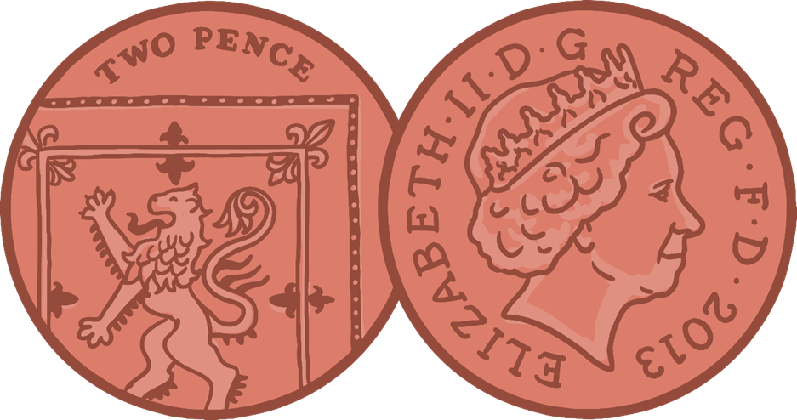
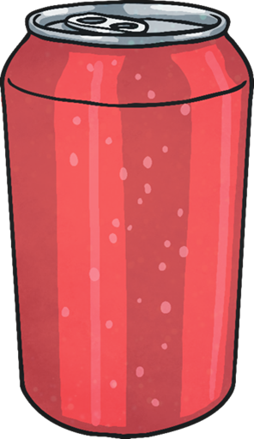




REFLECTION - LO: To investigate which materials are electrical conductors and which are electrical insulators

Slide 56
LO: To investigate which materials are electrical conductors and which are electrical insulators
Quiz 3
Using your fact file and what you have learnt in the lesson, what questions could you ask your partner?

