Slide 1
Good Morning
Thursday 4th March

Slide 2

Harry’s Mad – Part 2
Some were comparatively simple – sliding down the bannisters for example, or rolling down the stairs, or hopping down but missing every other step was a good deal more difficult, and could be made harder still by doing it with hands in pockets, or even – the real test – with hands in pockets and eyes shut.
Harry only attempted this last combination when something told him it was going to be a very special sort of day. On this particular morning something told him.
Evidence
Retrieve
Interpret
Choice
What does comparatively mean?
Totally
to a moderate degree as compared to something else
Not at all
What was the hardest way Harry could think of to go down the stairs?
Do you think Harry thought the hardest way to go down the stairs was dangerous?
What ‘special’ thing do you think will happen to Harry?

Slide 3
Spelling – Look/Cover/Spell/Check
Lente/Alicia/Elliot/Jack
Rest
audience
autumn
beautiful
beginning
believe
beneath
buried
business
caught
chocolate
accompany
according
achieve
aggressive
amateur
answer
appear
arrive
believe
Bicycle

Slide 4
Maths
Read the slides and do the activities

Slide 5
RECALL
TP: What are equivalent fractions?
TP: How do I convert:
½ to ?/10
TP: How do I convert
5/15 to ?/3
TP: Convert these fractions:
4/12 = 8/?
3/6 = ?/24
5/15 = ?/3
10/15 = 2/?

Slide 6
LO: To be able to compare numbers less than 1
Top Down | Self Assessment
Some of us will even: I can problem solve and reason when comparing numbers less than 1
Some of us will: I can order fractions by making the denominators the same or drawing bar models so I can compare them
Most of us will: I can compare fractions by making the denominator the same so I can compare them.
All of us will: I can draw bar models so I can compare fractions

Slide 7
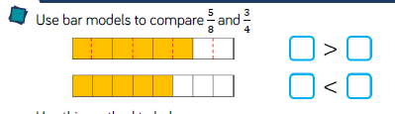
LO: To be able to compare numbers less than 1
TP: How does a bar model help us to visualise fractions?
TP: Should both of our bars be the same size? Why? What does it show us?
TP: Solve the problem

Slide 8

LO: To be able to compare numbers less than 1

Slide 9
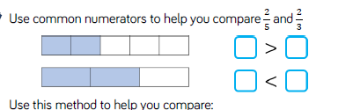
LO: To be able to compare numbers less than 1
TP: How does a bar model help us to visualise fractions?
TP: Should both of our bars be the same size? Why? What does it show us?
TP: Solve the problem

Slide 10

LO: To be able to compare numbers less than 1

Slide 11
LO: To be able to compare numbers less than 1
Type of Bool | Science Fiction | Non-Fiction | Mystery Fiction | Comic
Fraction of children who liked this type | 5 8 | 3 5 | 3 8 | 3 4
TP: Do more children like Science Fiction or mystery books? How did you work this out?
Q: Do more children like Science Fiction or Comic books?
TP: What is the problem?
TP: How are we going to work it out?
TP: What knowledge can we use other than drawing diagrams that will help us compare the fractions?
TP: Solve it.

Slide 12
LO: To be able to compare numbers less than 1
Type of Bool | Science Fiction | Non-Fiction | Mystery Fiction | Comic
Fraction of children who liked this type | 5 8 | 3 5 | 3 8 | 3 4
Q: Do more children like non-fiction or mystery fiction?
TP: What is the problem? Any suggestions on what we need to do?

Slide 13
LO: To be able to compare numbers less than 1
Type of Bool | Science Fiction | Non-Fiction | Mystery Fiction | Comic
Fraction of children who liked this type | 5 8 | 3 5 | 3 8 | 3 4
Q: Do more children like non-fiction or mystery fiction?
3/5 3/8
TP: What can we use to help us compare these fractions? When we use these, what do we need to remember to do?
TP: Does anyone know another way?

Slide 14
LO: To be able to compare numbers less than 1
2/6
2/3
5/12
5/6
3/6
1/6
Q: Put these cards in order from smallest to biggest.
TP: Which ones can we order at first?
TP: What is the problem with some of the fractions?
TP: How can we solve this?
TP: Solve it.

Slide 15
LO: To be able to compare numbers less than 1
5/9 > ?/18
?/6 < 12/18
George says,
“I think one of these has more solutions than the other.” Do you agree? Explain your answer.
TP: How would you solve it?

Slide 16
LO: To be able to compare numbers less than 1
Chilli 1 | Chilli 2 | Chilli 3
Draw bar models to compare these fractions. ½ and 1/8 ½ and ¼ ½ and 3/8 ½ and 2/4 ½ and 5/8 ½ and ¾ | Make the denominators the same so you can compare them. ¾ and 1/8 ¾ and 2/8 ¾ and 3/8 ¾ and 4/8 ¾ and 5/8 | Put these fractions in order smallest to largest. ¾, 3/8, 7/8 ½, 5/6, 5/12 ¾, 7/10, 17/20, 4/5

Slide 17
LO: To be able to compare numbers less than 1
Chilli 1 | Chilli 2 | Chilli 3
Draw bar models to compare these fractions. ½ > 1/8 ½ > ¼ ½ > 3/8 ½ = 2/4 ½ < 5/8 ½ < ¾ | Make the denominators the same so you can compare them. ¾ (6/8) > 1/8 ¾ (6/8) > 2/8 ¾ (6/8 > ) 3/8 ¾ (6/8) > 4/8 ¾ (6/8) > 5/8 | Put these fractions in order smallest to largest. ¾ (6/8), 3/8, 7/8 3/8, ¾, 7/8 2. ½ (6/12), 5/6 (10/12, 5/12 5/12, ½, 5/6 ¾ (15/20), 7/10 (14/20), 17/20, 4/5 (16/20) 7/10, ¾, 4/5, 17/20

Slide 18
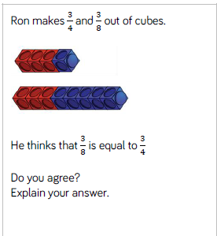
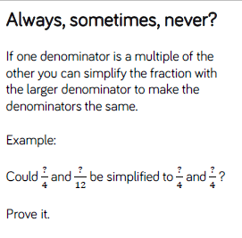
LO: To be able to compare numbers less than 1

Slide 19
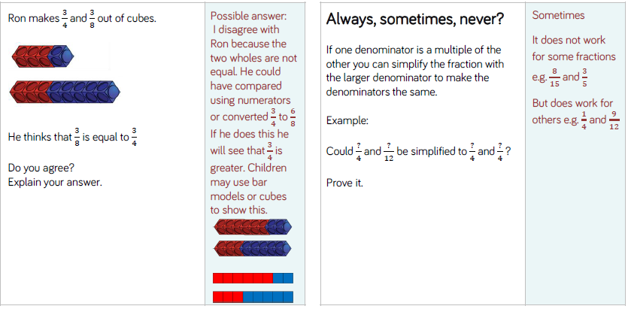
LO: To be able to compare numbers less than 1

Slide 20
REFLECTION - LO: To be able to compare numbers less than 1
Top Down | Self Assessment
Some of us will even: I can problem solve and reason when comparing numbers less than 1
Some of us will: I can order fractions by making the denominators the same or drawing bar models so I can compare them
Most of us will: I can compare fractions by making the denominator the same so I can compare them.
All of us will: I can draw bar models so I can compare fractions

Slide 21
REFLECTION - LO: To be able to compare numbers less than 1
SELF ASSESSMENT

Slide 22
Break

Slide 23
P.E.

Slide 24
English – Traditional Tales – Independent Write
Read the Slides and do the activities

Slide 25
LO: To be able to identify the features of a traditions tale
Traditional tales are stories that have been told and retold for many years. Often they are passed down through generations. Therefore, they become a story that many people know. There are often lots of different versions of the same story.
Traditional tales are also known as fairy stories or fairy tales.

Slide 26
LO: To be able to identify the features of a traditions tale
Traditional Tales
Core Features
A simple beginning, series of events in the middle leading to a predictable outcome
Details and descriptions support the plot
The story is for telling and re-telling

Slide 27
LO: To be able to identify the features of a traditions tale
Language Features
• A simple traditional opening e.g. one day, once upon a time, Long, long ago
• A simple traditional ending e.g. And they lived happily ever after, always keep your promises
• Evil Characters.
• Characters are often foolish or play tricks
• Animals have human attributes
• People are stereotyped e.g. princesses are pretty
• The number 3 is important e.g. three bears
• Magical or supernatural forces e.g. fairies
• Clear values e.g. honesty
• Literal description e.g. red riding hood had a red cloak

Slide 28
LO: To plan, write and edit a story in the style of a traditional tale
We have read a range of traditional stories over this fortnight.
Your task is to plan, write and edit a traditional tale.
You can choose to retell a traditional tale
OR
You can choose to use a traditional tale and change the characters, setting, etc.

Slide 29
LO: To be able to describe settings, characters and atmosphere and integrating dialogue to convey character and advance the action in the style of a Traditional Tale
Checklist
Checklist
Parenthesis
Direct speech
Reported Speech
Expanded Noun Phrases
5 senses
Figurative Language – Simile
Figurative Language - Personification
Figurative Language - Metaphor
Fronted Adverbials
Complex sentences (main and subordinate clause)
Relative Clauses
Statements
Questions
Exclamations
Commands

Slide 30
LO: To plan, write and edit a story in the style of a traditional tale
ACTIVITY
Children to plan, write and edit a traditional tale independently

Slide 31
Lunch

Slide 32
Take 5

Slide 33
Story

Slide 34
Handwriting

Slide 35
X Table Test

Slide 36

hectic

Slide 37
hectic
What could it mean?
It was a nice change of pace after a hectic morning.

Slide 38
hectic
SAY IT AND FEEL THE SYLLABLES
SAY IT TO THE BIN
SAY IT TO SOMEONE ON ANOTHER TABLE
WHISPER IT TO THE FLOOR
SAY IT TO YOUR BOOK
REPEAT IT AFTER ME
SAY IT TO THE WINDOW
WHISPER IT TO A WALL

Slide 39
hectic
Adj. full of activity, or very busy and fast

Slide 40
hectic
A teacher has had to follow a hectic schedule.
The area has become a haven for people tired of the hectic pace of city life.
A holiday slows down the hectic life of a working person.

Slide 41
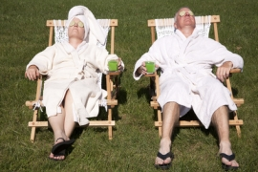
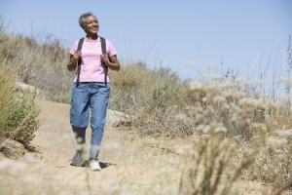

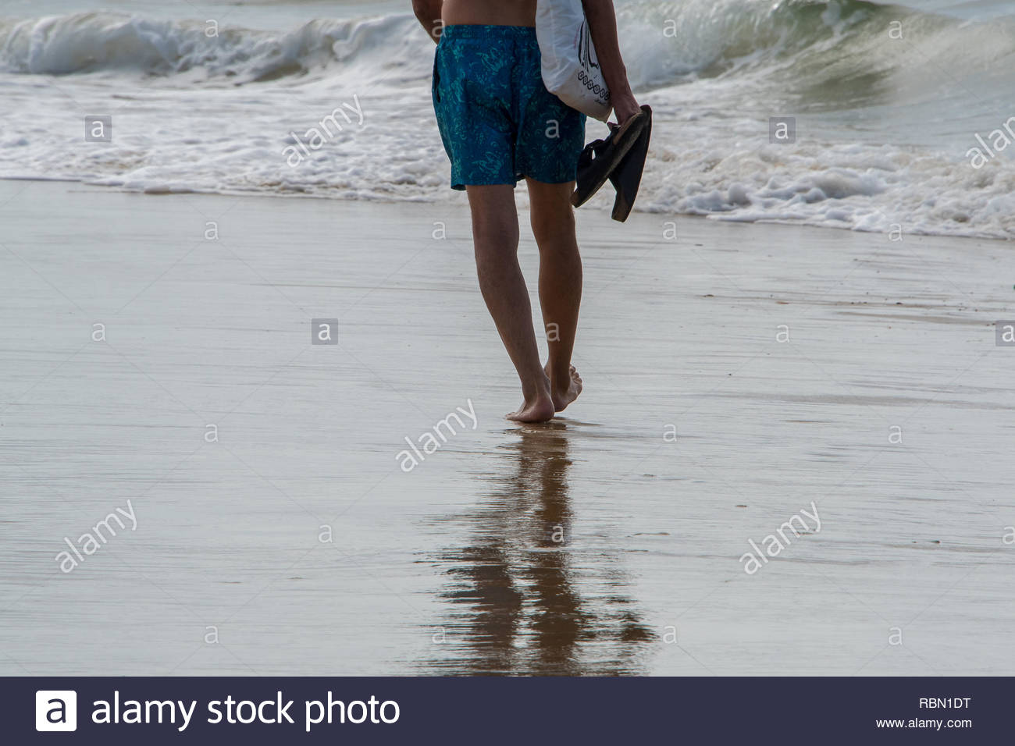

hectic
Say hectic if you see someone full of activity or very busy and fast.

Slide 42
hectic
Act it out!
Move around the classroom hectically.

Slide 43
hectic
In your books, write the word, the definition and use it in a sentence/draw a picture.

Slide 44
hectic
Adj. full of activity, or very busy and fast
Life is very hectic at school since
Life is very hectic at school while
Life is very hectic at school unless
Life is very hectic at school whenever

Slide 45

Chapter 5 – Stranger’s in the Night
Lesson 15
LO: To be able to make inferences from the text and explain and justify inferences with evidence from the text (2d)
What does elixir mean ?

Slide 46
Chapter 5 – Stranger’s in the Night
Lesson 15
LO: To be able to make inferences from the text and explain and justify inferences with evidence from the text (2d)
What does elixir mean ?
Noun - a substance, usually a liquid, with a magical power to cure, improve, or preserve something

Slide 47
LO: To read a text fluently
Read Page 44 to 47
What has happened so far from Elliot meeting Virgo? Note things down.
P19 – Why had Virgo’s clothes nearly made Elliot puke? (2d)
TP: How do we read fluently?
P20 – Work with your partner. To top of p46. Without the narration, how would they talk to one another?

Slide 48
LO: To investigate thermal conductors and insulators
TP: Ask your questions from the previous lesson.
Quiz 2
TP: What do these words mean?
Thermal
Conductors
Insulators

Slide 49
LO: To investigate thermal conductors and insulators
Thermal - connected with heat
Conductors - a substance that electricity or heat will go through
Insulators - a material or covering that electricity, heat, or sound cannot go through

Slide 50
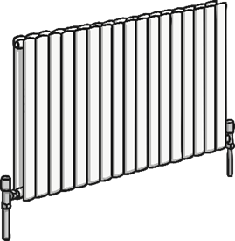
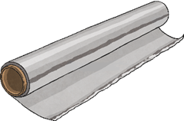
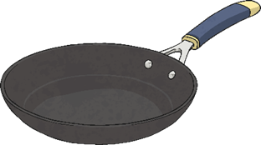

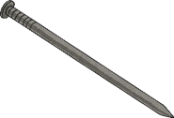
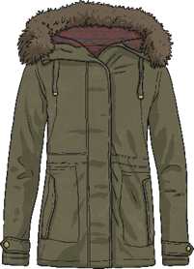
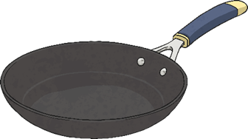


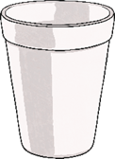
LO: To investigate thermal conductors and insulators
Miss Davison has sorted these materials into two groups.
TP: What can you see in each groups?
TP: Can you identify the two groups that he has sorted them into?

Slide 51
LO: To investigate thermal conductors and insulators
Miss Davison has sorted the materials into thermal conductors and insulators.

Slide 52
LO: To investigate thermal conductors and insulators
Thermal Conductors
Thermal Insulators
Heat can travel easily through thermal conductors.
Metals are good thermal conductors, as they allow heat to move through them.
Thermal conductors are used to make items that need heat to travel through them, like a pan or a radiator.
Thermal insulators do not let heat travel through them easily.
Some fabrics, wood and plastics are good thermal insulators.
Thermal insulators can keep heat out or in. For example, a vacuum flask stops heat from the air travelling through to the food or drink inside, keeping it cool. A coat stops the heat from your body travelling through to the air outside, keeping you warm.
https://www.youtube.com/watch?v=DGXHeRkhRgs

Slide 53
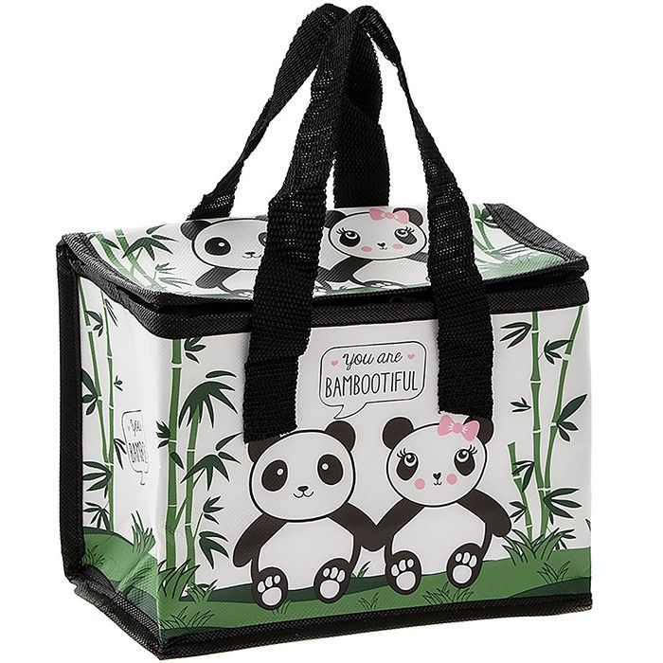
LO: To investigate thermal conductors and insulators
Design a new Lunch box.
The Brilliant Bags Company want to make a new lunch box for children to bring their packed lunches to school in.
Food will be stored in the lunch box for quite a long time – probably all morning.
They want to make sure the lunch box keeps the children’s lunches cool and fresh, so they need to think about the best material to use to make the inner lining of the lunch box

Slide 54
LO: To investigate thermal conductors and insulators
The company want you to help them choose the best material for the inner lining of the lunch box.
The lining will need to stop heat getting through from the air to the cool food inside.
TP: Will the lining need to be a good thermal conductor or a good thermal insulator?

Slide 55
LO: To investigate thermal conductors and insulators
You will need to find the best thermal insulator for the inner lining of the lunch box. Thermal conductors will let heat through and make the food warm up quickly.
Thermal insulators will stop the heat getting through and keep the food cool for longer. You will need to set up a comparative investigation to test the different materials to see if they conduct heat or insulate from it

Slide 56
LO: To investigate thermal conductors and insulators
TP: Can you test the thermal conductivity of the different materials?
You can use the following equipment:
Containers
Thermometer
Ice-cubes
Rulers
Stop Watches
Different materials

Slide 57
LO: To investigate thermal conductors and insulators
Testing Materials
You could wrap the different materials around the containers, and then fill them with the ice cubes.
By checking the temperature of the containers at intervals of time, you will be able to see which materials allow heat from the surroundings through easily. These materials will cause the ice to melt quicker. They are thermal conductors
Any material which stops heat from the outside getting through will keep the ice cubes solid for longer. These materials are thermal insulators

Slide 58
LO: To investigate thermal conductors and insulators
When setting up investigations, scientists have to consider the variables of each experiment. A variable is any factor or condition that will change or can be changed in the investigation.
There are 3 types of variable:
Independent - The independent variable is the thing that the scientist purposefully changes or alters throughout the investigation.
Dependent - The dependent variable is the thing that is measured or observed, and changes as a result of the changes to the independent variable.
Controlled - All the other things in the investigation should remain the same throughout, and are called controlled variables.

Slide 59
LO: To investigate thermal conductors and insulators
Independent - The independent variable is the thing that the scientist purposefully changes or alters throughout the investigation.
TP: What is your independent variable?
Dependent - The dependent variable is the thing that is measured or observed, and changes as a result of the changes to the independent variable.
TP: What will you dependent variable be?
Controlled - All the other things in the investigation should remain the same throughout, and are called controlled variables.
TP: What will your controlled variants be?

Slide 60
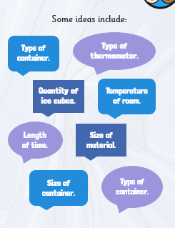
LO: To investigate thermal conductors and insulators
TP: Have we thought about these? Why must we think about them?

Slide 61
LO: To investigate thermal conductors and insulators
Activity
Children to make predictions and then to set up investigation to find the best material for the lunch box according to the instructions and to record their results on sheet. To conclude with report to company giving best material and why.
Materials – Paper, cloth, foil, card, cling film.
Children to be split into 5 groups, each using one of materials and then to share results with rest of class.
LA: LT, LT, BB, RC, JLJ, TH, JB – To have tips and variables to help predictions. For conclusion to have key words to put in reasons.
MA: JW, GS, DRL, LN, EW, EMA, IB, AW, AB, AM, LS, LL, MB, CH, LP, CM - To have tips for predictions. For conclusion to give best material, reason and any other material and to have key words to help them.
HA: LW, JM, EB, DW, EB, CW, NP, SC – Conclusion to give material and choice and other materials.
Children at home write the experiment up to the point of actually performing the experiment.

Slide 62
REFLECTION - LO: To investigate thermal conductors and insulators
TP: What did you find?
Quiz 2
Using your fact file and what you have learnt in the lesson, what questions could you ask your partner?

