Slide 1
Good Morning
Wednesday 3rd March

Slide 2

Harry’s Mad – Part 1
This is the opening of Dick King-Smith’s book ‘Harry’s Mad’.
Most people walk down stairs, putting one foot more or less carefully in front of the other and perhaps holding on to the banisters. Not Harry Holdsworth, oh no, not he!
Longs hours of practice had made Harry expert in unusual methods of getting from the upper to the ground flour of the Holdsworth’s house.
Evidence
Retrieve
Interpret
Choice
What does ‘expert’ mean?
A person who knows nothing about a subject.
A person who knows something about a subject.
a person who is very knowledgeable about or skilful in a particular area
What had practice made Harry an expert of?
What impression do you get of Harry from the introductory paragraph?
What ways do you think Harry uses to get from the upper to the ground floor of the house?

Slide 3
Spelling – Look/Cover/Spell/Check
Lente/Alicia/Elliot/Jack
Rest
audience
autumn
beautiful
beginning
believe
beneath
buried
business
caught
chocolate
accompany
according
achieve
aggressive
amateur
answer
appear
arrive
believe
Bicycle

Slide 4
Maths
Read the Slides and do the activities

Slide 6
RECALL
TP: What is a mixed number? Write an example of one.
12/5
TP: What is an improper fraction?
TP: How would you convert my mixed number into an improper fraction? 12/5
TP: Now convert your mixed number

Slide 7
RECALL
TP: Write an improper fraction
18/5
TP: How would I convert my improper fraction to a mixed number?
TP: Convert your improper fraction to a mixed number.

Slide 8
LO: To count in number sequences using mixed numbers and improper fractions
Top Down | Self Assessment
Some of us will even: I can problem solve and reason about number sequences
Some of us will: I can find missing numbers in a number sequence
Most of us will: I can continue number sequences
All of us will: I can say what steps a number sequence is going up or down in

Slide 9
LO: To count in number sequences using mixed numbers and improper fractions
Let us do some counting together. Lets us start with counting in proper and improper fractions.
Let us start at 0 and finish at 10
Let us count in ¼
Let us count in 1/3
Let us start at 10 and count backwards in:
1/4s
1/3s

Slide 10
LO: To count in number sequences using mixed numbers and improper fractions
Let us do some counting together. Let us count in mixed numbers
Let us start at 0 and finish at 10
Let us count in ¼
Let us count in 1/3
Let us start at 10 and count backwards in:
1/4s
1/3s
Let us start at 0 and finish at 10
Let us count in ¼
Let us count in 1/3
Let us start at 10 and count backwards in:
1/4s
1/3s

Slide 11
LO: To count in number sequences using mixed numbers and improper fractions
We are going to start a 4 and count backwards in mixed numbers to 0 in 1/3s
We are going to start at 1 and count in 2/3.

Slide 12
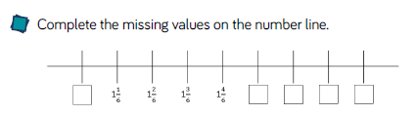
LO: To count in number sequences using mixed numbers and improper fractions
Q: Complete the missing values.
TP: What must we do first before we complete the task?
TP: Complete the missing values

Slide 13
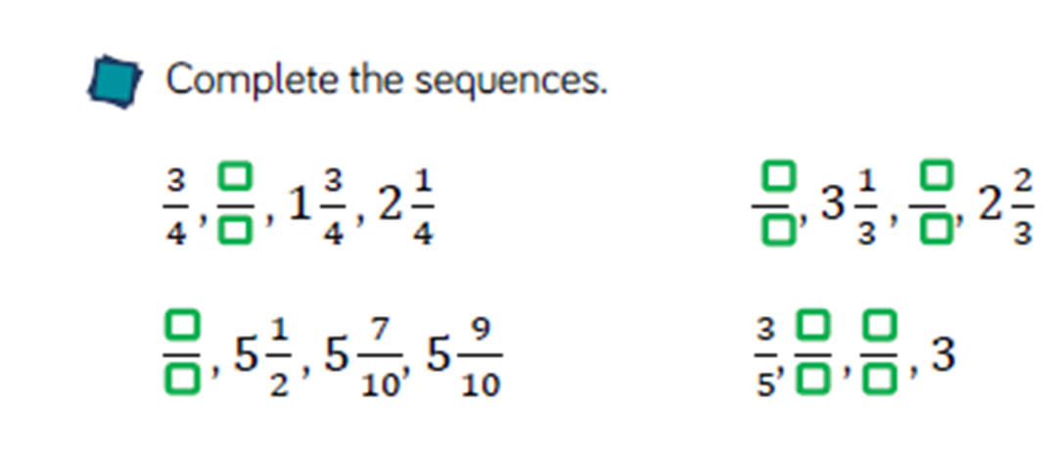
LO: To count in number sequences using mixed numbers and improper fractions
Q: Complete the missing values
TP: How will we solve these?
Are the values increasing or decreasing each time?
How much are they increasing or decreasing each time?
Can you convert them to improper fractions? Does this make it easier to solve the sequence?

Slide 14
LO: To count in number sequences using mixed numbers and improper fractions
½
1, ½
1
5/4
¾
1, ¾
1/4
Q: Order these cards to make a counting sequence.
TP: What could you use to help you to do this?
TP: Could you convert some of the cards?
TP: What order are they going up in? How do you know? What clue is there?
TP: Order them.

Slide 15
LO: To count in number sequences using mixed numbers and improper fractions
¼
½
¾
1
5/4
1, ½
1, ¾
Now you have ordered them.
Q: How many cards will the machine print in total until it reaches 5, ½
TP: What could you use to help you solve this?
TP: Solve it.

Slide 16
LO: To count in number sequences using mixed numbers and improper fractions
TP: Work out the rule of this sequence by finding the missing numbers
4 ? ? ? ? 5

Slide 17
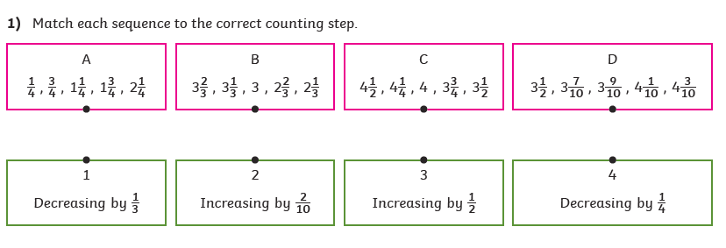
LO: To count in number sequences using mixed numbers and improper fractions
Chilli 2
Continue these number sequences by 3
8/4, 9/4, 10/4, 11/4, 12/4
15/3, 14/3, 13/3, 12/3, 11/3
9/2, 4, 7/2, 3,
2, 2 1/8, 2 ¼, 2 ½, 2 5/8, 2 ¾
Chilli 1
Chilli 3
Finding the missing number in the number sequence
2, ?, 2 ½ , 2 ¾, 3, ? , 3 ½
10, 9 ¾, ?, ?, 9, ?, ?, 8 ¼, 7
4 ½, ?, ?, 5 1/10, 5 3/10, 5 ½

Slide 18
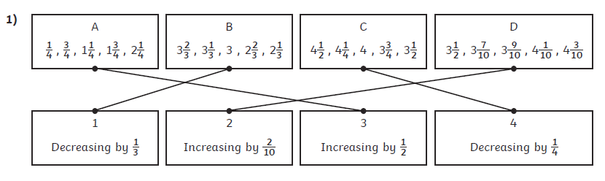
LO: To count in number sequences using mixed numbers and improper fractions
Chilli 2
Continue these number sequences by 3
8/4, 9/4, 10/4, 11/4, 12/4, 13/4, 14/4, 15/4
15/3, 14/3, 13/3, 12/3, 11/3, 10/3, 9/3, 8/3
9/2, 4, 7/2, 3, 5/2, 2, 3/2, 1
2, 2 1/8, 2 ¼, 2 ½, 2 5/8, 2 ¾, 2 7/8, 3, 3 1/8
Chilli 1
Chilli 3
Finding the missing number in the number sequence
2, 2 ¼ , 2 ½ , 2 ¾, 3, 3 ¼ , 3 ½
10, 9 ¾, 9 1/2, 9 1/4, 9, 8 ¾ , 8 ½ , 8 ¼, 7
4 ½, 4 7/10, 4 9/10, 5 1/10, 5 3/10, 5 ½

Slide 19
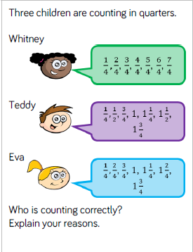
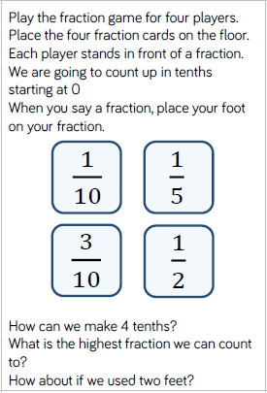
LO: To count in number sequences using mixed numbers and improper fractions

Slide 20
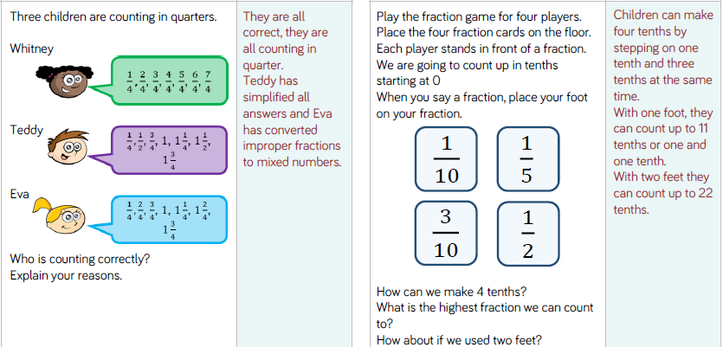
LO: To count in number sequences using mixed numbers and improper fractions

Slide 21
LO: To count in number sequences using mixed numbers and improper fractions
Top Down | Self Assessment
Some of us will even: I can problem solve and reason about number sequences
Some of us will: I can find missing numbers in a number sequence
Most of us will: I can continue number sequences
All of us will: I can say what steps a number sequence is going up or down in

Slide 22
REFLECTION - LO: To count in number sequences using mixed numbers and improper fractions

Slide 23
Break

Slide 24
English – Traditional Stories
Read the slides and do the activities

Slide 25
Introduction
The genre we will be focusing on for 2 weeks is Traditional Tales.
We will be focusing on the Traditional Tale of the ‘Firebird’.
We will be focusing on grammar of: Fronted adverbials, parenthesis, relative clauses, Inverted commas and complex sentences and descriptive/figurative language.
You will be asked to rewrite the story of ‘Firebird’.
Group A will change: Setting, characters, Firebird and main animal
Group B will change: Setting and characters
Group C will rewrite the story.

Slide 26
LO: To be able to identify the features of a traditions tale
Traditional tales are stories that have been told and retold for many years. Often they are passed down through generations. Therefore, they become a story that many people know. There are often lots of different versions of the same story.
Traditional tales are also known as fairy stories or fairy tales.

Slide 27
LO: To be able to identify the features of a traditions tale
Traditional Tales
Core Features
A simple beginning, series of events in the middle leading to a predictable outcome
Details and descriptions support the plot
The story is for telling and re-telling

Slide 28
LO: To be able to identify the features of a traditions tale
Language Features
• A simple traditional opening e.g. one day, once upon a time, Long, long ago
• A simple traditional ending e.g. And they lived happily ever after, always keep your promises
• Evil Characters.
• Characters are often foolish or play tricks
• Animals have human attributes
• People are stereotyped e.g. princesses are pretty
• The number 3 is important e.g. three bears
• Magical or supernatural forces e.g. fairies
• Clear values e.g. honesty
• Literal description e.g. red riding hood had a red cloak

Slide 29
LO: To be able to describe settings, characters and atmosphere and integrating dialogue to convey character and advance the action in the style of a Traditional Tale
Today, you are doing to complete your traditional stories.

Slide 30
LO: To be able to describe settings, characters and atmosphere and integrating dialogue to convey character and advance the action in the style of a Traditional Tale
Checklist
Checklist
Parenthesis
Direct speech
Reported Speech
Expanded Noun Phrases
5 senses
Figurative Language – Simile
Figurative Language - Personification
Figurative Language - Metaphor
Fronted Adverbials
Complex sentences (main and subordinate clause)
Relative Clauses
Statements
Questions
Exclamations
Commands

Slide 31
LO: To be able to describe settings, characters and atmosphere and integrating dialogue to convey character and advance the action in the style of a Traditional Tale
Child’s work
A – Using the checklist find one things that is good about this work.
B – Using the checklist, can you find other things that are good about this work?
C – Using the checklist, what have they missed out? Can you see where they could add these things?

Slide 32
LO: To be able to describe settings, characters and atmosphere and integrating dialogue to convey character and advance the action in the style of a Traditional Tale
ACTIVITY
Children to write their traditional tale on or based on ‘The Firebird’.
Teacher Support – CM, LL, IB, HP, LP
Student Support – RA, LT, LT, JW, JB
TA Support – TH, JLJ, RC, BB
.

Slide 33
REFLECTION - LO: To be able to describe settings, characters and atmosphere and integrating dialogue to convey character and advance the action in the style of a Traditional Tale
PEER ASSESSMENT
Read your partners work, using the checklist, tick off what they have used.
Recommend what they could add to it.

Slide 34

Chapter 5 – Mum’s the
Word
Lesson 14
LO: To be able to make inferences from the text and explain and justify inferences with evidence from the text (2d)
What does discreetly mean ?

Slide 35
Chapter 5 – Mum’s the
Word
Lesson 14
LO: To be able to make inferences from the text and explain and justify inferences with evidence from the text (2d)
What does discreetly mean ?
Adv. in a way that is careful not to cause embarrassment or attract too much attention, especially by keeping something secret

Slide 36
LO: To be able to make inferences from the text and explain and justify inferences with evidence from the text (2d)
Read from Page 38 – to break in Page 44
P4 - Why do you think Lady Bovinor did not answer? (2d)
P5 - Why did Virgo think this rude? (2d)
P10 – Who do you think is opening the door? (2e)
P13 – ‘His ragged breathing betraying his thumping heartbeat’ What does this phrase tell us how Elliot is feeling? (2g)
P16 – Why did Virgo spell it out ‘like she was talking to a half dead baboon? (2d)

Slide 37
LO: To be able to make inferences from the text and explain and justify inferences with evidence from the text (2d)
P44 ‘Someone else with problems. Just what he needed.’
What does Elliot mean?
2d

Slide 38
Lunch

Slide 39
Take 5

Slide 40
Story

Slide 41
Handwriting

Slide 42
X Table Test

Slide 43

pungent

Slide 44
pungent
What could it mean?
Elliot took his place on a narrow bench next to a particularly pungent sandwich.

Slide 45
pungent
SAY IT AND FEEL THE SYLLABLES
SAY IT TO THE BIN
SAY IT TO SOMEONE ON ANOTHER TABLE
WHISPER IT TO THE FLOOR
SAY IT TO YOUR BOOK
REPEAT IT AFTER ME
SAY IT TO THE WINDOW
WHISPER IT TO A WALL

Slide 46
pungent
Adj. smelling or tasting very strong and sharp

Slide 47
pungent
As I walked through the field, the pungent whiff of a goat invaded by nostrils.
I sat down to a cup of wonderfully pungent Turkish coffee.

Slide 48
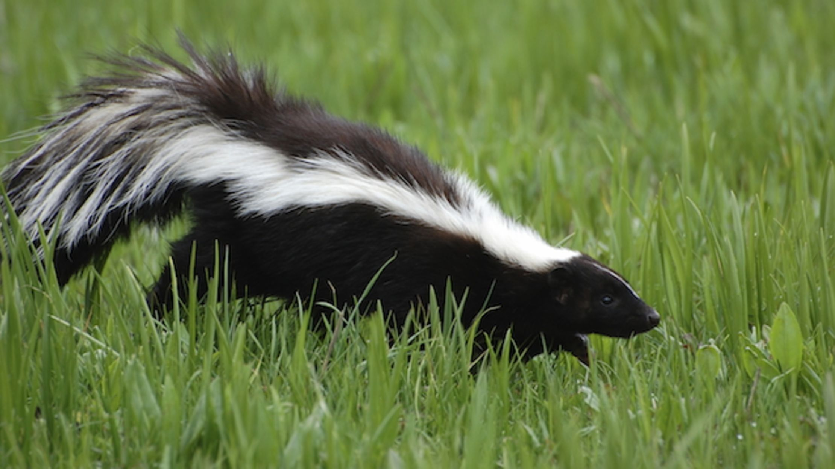

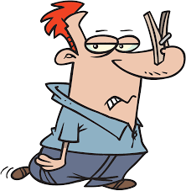
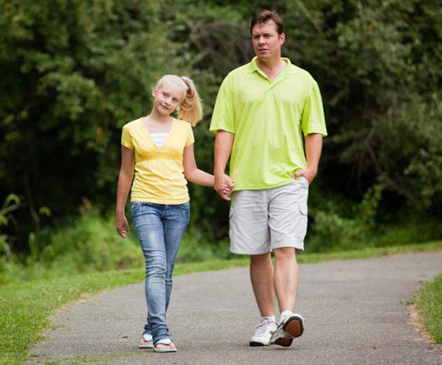
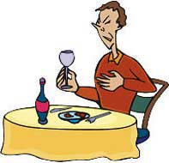
pungent
Say pungent if you see someone smelling something strong or sharp or could be pungent.

Slide 49
pungent
Act it out!
How would you behave if you had a waft of a pungent smell?

Slide 50
pungent
In your books, write the word, the definition and use it in a sentence/draw a picture.

Slide 51
pungent
Adj. smelling or tasting very strong and sharp
Because there was a rather pungent smell coming from the room,
After there was a pungent smell coming from the room,
If there was a pungent smell coming from the room,
When there was a pungent smell coming from the room,
Even though there was a pungent smell coming from the room,
Although there was a pungent smell coming from the room,

Slide 52
Lesson 1
LO: To be able to compare materials according to their properties

Slide 53
Introduction
Look at your fact file and the scientific language.

Slide 54
Introduction
TP: What is everything made up of?
TP: What are three states that everything exists in?
TP: What can you tell me about how these three states are formed by the particles? How do they behave?

Slide 55
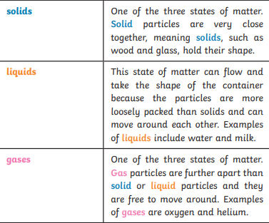
Introduction

Slide 56
Introduction
TP: What do these terms mean?
Condensing
Evaporating
Freezing
Melting

Slide 57
LO: To be able to compare materials according to their properties
Front Cover
Fact File
Quiz 1

Slide 58
LO: To be able to compare materials according to their properties
Any substance that is used to make something is a material.
Natural materials such as stone, wood and cotton are used or worked with in the way they are found in nature.
Synthetic or human-made materials are made from natural materials, but are altered with the help of heat or chemicals. Some examples include plastics,
polyester and Kevlar.

Slide 59
LO: To be able to compare materials according to their properties
TP: What materials can you see around the classroom?
TP: Think of words to describe each material, such as hard, soft, cold or rough.
TP: What materials can you see outside?
TP: Think of words to describe each material, such as hard, soft, cold or rough.

Slide 60
LO: To be able to compare materials according to their properties
The words used to describe a material are known as its properties.
Each material has its own set of properties.
These properties make different materials useful for
different purposes.

Slide 61
LO: To be able to compare materials according to their properties
TP: Use a dictionary to match these scientific definitions to their properties?
Magnetic
Reflective
Absorbent
Permeable
Translucent
Flexible
Hard
Flammable
Insulating
Transparent
Will allow liquids and gases to pass through.
Will stop energy such as electricity or heat from transferring through
Will bounce off its surface.
Easy to bend.
Objects are attracted to magnets.
Will easily catch fire and burn quickly.
Is able to soak up a liquid easily.
Difficult to scratch.
Will let light but not detailed shapes pass through them.
Light passes through easily and objects are clearly seen.

Slide 62
LO: To be able to compare materials according to their properties
TP: Why is it useful to know the properties of a material?

Slide 63
LO: To be able to compare materials according to their properties
TP: Why is it useful to know the properties of a material?
It is useful because if you know the properties of a material, you can then choose the best material for a purpose.
TP: Think again about the objects you have seen in the classroom and outside. Why was each material chosen to make these things?
https://www.bbc.co.uk/bitesize/topics/z4339j6/articles/zx8hhv4

Slide 64
LO: To be able to compare materials according to their properties
To find out which properties a material has, they have to be tested.
You are going to test several different materials to find their properties.
You will test for:
magnetism;
hardness;
transparency;
flexibility;
permeability.

Slide 65
LO: To be able to compare materials according to their properties
ACTIVITY
Materials to test: Paper, Wood , Plastic (ruler), steel (paper clip), Foil
MA/LA: To be given instructions on how to test whether a material is: magnetic, hard, transparent, Flexible or permeable. To choose 5 materials to test and then rate them according their property on a sheet.
BB, LT, LT, RC, TH, JLJ, RA, JB, LL, LP, CM, DRL, LN, GS, JW
TA/SS
MA/HA: To be given instructions on how to conduct test on Hard, Flexible and permeable but to suggest ways to conduct test on magnetic and transparency. To choose 5 material to test and rate them according to their property on a sheet.
TS: EW, EMA, IB, HP, AW,

Slide 66
REFLECTION - LO: To be able to compare materials according to their properties
TP: Thinking about what you have found in your experiment, why are plastic, paper, wood, steel and foil used?
QUIZ 1
Using your fact file and what you have learnt in the lesson, what questions could you ask your partner?

