Slide 1
Good Morning
Tuesday 2nd March

Slide 2

Getting Granny’s New Glasses – Part 4
“Well, my eyes are not too bad,” said Granny, looking for excuses. She did feel like going far from the village; in particular she did not want to be parted from Mani. He was eleven and quite capable of looking after himself, but Granny had brought him up ever since his mother had died when he was only a year old. She was his Nani (maternal grandmother) and had cared for boy and father, and cows and hens and household all these years, with great energy and devotion. Ever her failing eyesight hadn’t prevented her from milking cows and preparing meals and harvesting corn.
Evidence
Retrieve
Interpret
Choice
What does devotion mean?
Love and loyalty to a person
Hate and uncaring
Did not care one way
How old was Mani?
Why do you think Granny said, “My eyes are not too bad.”?
What do you think will happen next in the story?

Slide 3
Spelling – Look/Cover/Spell/Check
Lente/Alicia/Elliot/Jack
Rest
audience
autumn
beautiful
beginning
believe
beneath
buried
business
caught
chocolate
accompany
according
achieve
aggressive
amateur
answer
appear
arrive
believe
Bicycle

Slide 4
Maths
Read the slides and do the activities

Slide 5


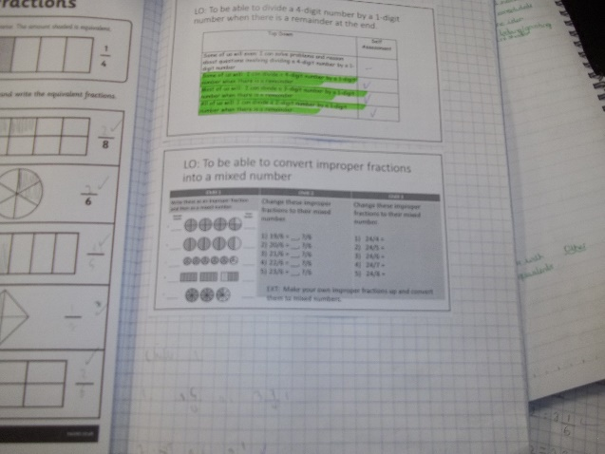
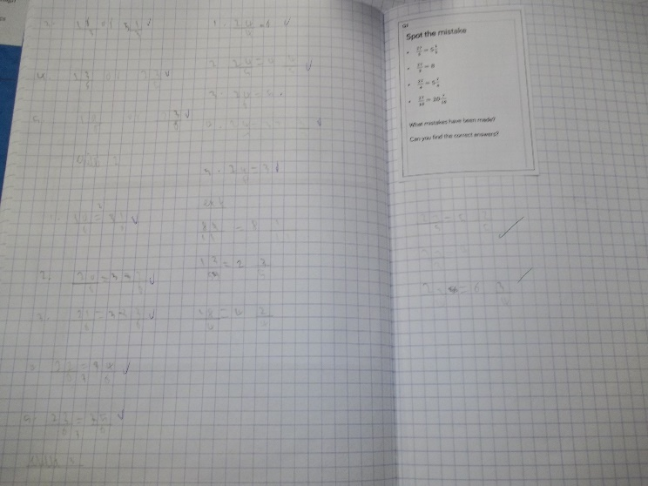
Ellie Bonser, Jack Manning, Ikjot Bachaal
Monday 1st Match
Mathematician of the Day
Elliot Barker

Slide 6

Oops…missing things to look for
Presentation Watch
Seren – Count carefully the amount shaded and what the shape is split into.
Lola – Make sure you put the correct denominator. Count carefully how many pieces a shape is split into.
Lola T – Concentrate on not using diagrams
Ella-Mae – Learn your tables and corresponding division facts and use your tables chart
Lola N – Learn your tables and corresponding division facts and use your tables chart
Lowenna T – Learn your tables and corresponding division facts and use your tables chart
Jamie-Lee – Learn your tables and corresponding division facts and use your tables chart
Ben – Learn your tables and corresponding division facts and use your tables chart
.
Alfie – Use a ruler
Finish your challenges…
Lola N – Do not leave a calculation half complete
Alfie W – Do not leave a calculation half complete
Ellie B – DO not leave a calculation incomplete

Slide 7
RECALL
TP: What is an improper fraction?
TP: What is a mixed number?

Slide 8
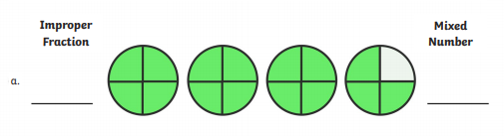
RECALL

Slide 9
RECALL
TP: Change this improper fraction to a mixed number. How did you do it?
20/6 = ____, ?/6
TP: Write this improper fraction as a mixed number.
23/3 =

Slide 10
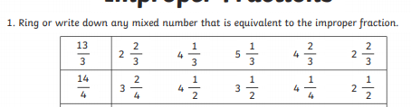
RECALL

Slide 11
LO: To convert mixed numbers to improper fractions
Top Down | Self Assessment
Some of us will even: I can solve problems and reason about converting mixed numbers into improper fractions
Some of us will: I can convert mixed numbers into improper fractions
Most of us will: I can convert mixed numbers into improper fractions using diagrams to help me
All of us will: I can colour the bar models to represent a mixed number and use these to convert it into an improper fraction

Slide 12
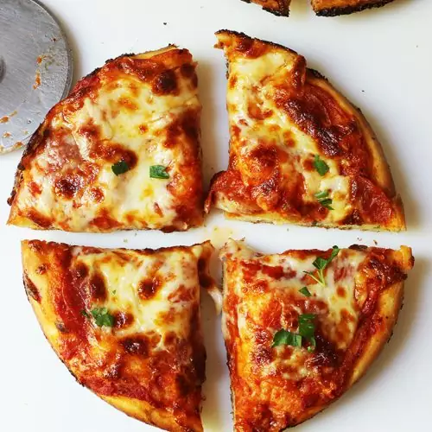


LO: To convert mixed numbers to improper fractions
Lente, Clayton, Elliot, Darcie, Jake and Jack are having a pizza party. They order 5 pizzas and cut each pizza into 4.
TP: What fraction have they split the pizza into?

Slide 13
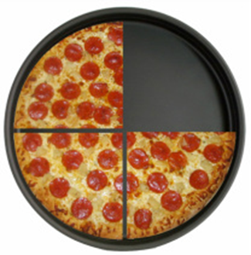
LO: To convert mixed numbers to improper fractions
Lente, Clayton, Elliot, Darcie, Jake and Jack are having a pizza party. They order 5 pizzas and cut each pizza into 4.
TP: Lente eats ¼ of the pizzas. Written as a mixed number, How much pizza is left?

Slide 14
LO: To convert mixed numbers to improper fractions
Lente, Clayton, Elliot, Darcie, Jake and Jack are having a pizza party. They order 5 pizzas and cut each pizza into 4.
TP: If 4, ¾ of the pizza is left. How many quarters are left to be eaten by the others? Write as an improper fraction.

Slide 15
LO: To convert mixed numbers to improper fractions
Lente, Clayton, Elliot, Darcie, Jake and Jack are having a pizza party. They order 5 pizzas and cut each pizza into 4.
4, ¾ = 19/4
TP: What mathematical knowledge can we use to find 19/4 using the mixed number 4, ¾?

Slide 16
LO: To convert mixed numbers to improper fractions
Lente, Clayton, Elliot, Darcie, Jake and Jack are having a pizza party. They order 5 pizzas and cut each pizza into 4.
4, ¾ = 19/4
First, we multiply the whole number by the denominator to tell us how many quarters are in 4 whole pizzas which equals 16
Then, we add on the numerator (which tells us how many pieces are left in the part that has been eaten) to the amount of whole quarters there are, in this case 16. So we get 16 + 3 = 19

Slide 17
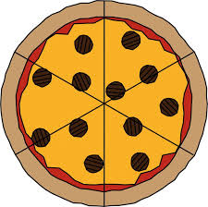
LO: To convert mixed numbers to improper fractions
TP: How much pizza is there this time? What fraction have they been cut into?

Slide 18
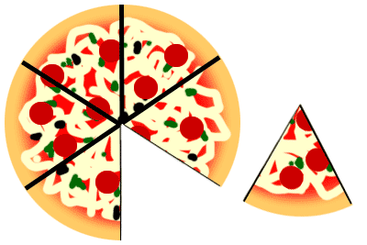
LO: To convert mixed numbers to improper fractions
TP: Oh dear! Somebody has taken a sneaky piece. As a mixed number how much is left?
TP: As an improper fraction, how much is left?

Slide 19
LO: To convert mixed numbers to improper fractions
3, 5/6 = 23/6
TP: How can we work this out without the pizzas?

Slide 20
LO: To convert mixed numbers to improper fractions
TP: Some of class 5 are having Chocolate cheesecake for lunch. There are 4 cheesecakes altogether. Each cheesecake is split into 5 pieces. What fraction is each cheesecake split into?
TP: Somebody has eaten 2 pieces of one of the cheesecakes. As a mixed number, what is left of the cheesecakes?
TP: Can you convert this to a mixed number so we know how many slices are left?

Slide 21
LO: To convert mixed numbers to improper fractions
TP: Convert these mixed numbers into improper fractions:
3, ½
2, 2/3
4, 1/5

Slide 22

LO: To convert mixed numbers to improper fractions
Q: Give three possible improper fractions that you could put in the empty box to make
this statement true.
TP: What does this statement say?
TP: What can we convert these mixed numbers so we could convert them?
TP: Convert and answer the questions.

Slide 23
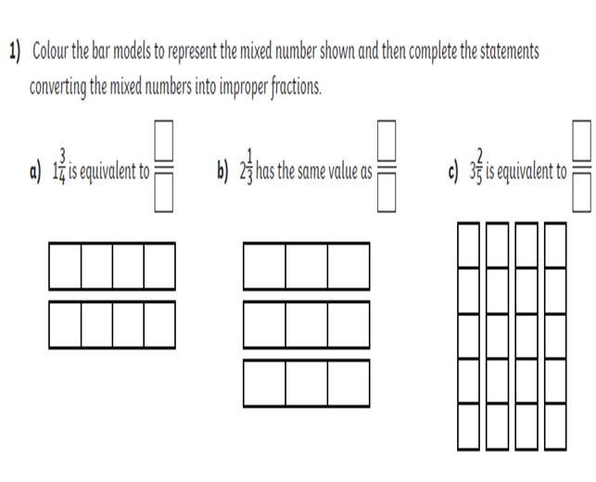
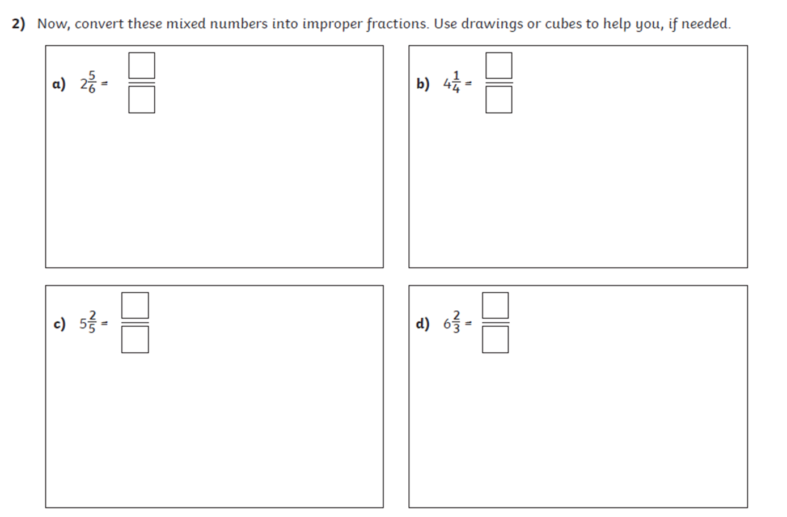
LO: To convert mixed numbers to improper fractions
Chilli 1
Chilli 2
Chilli 3 – Convert these mixed numbers into improper fractions
4, 1/6
4, 2/6
4, 3/6
4, 4/6
4, 5/6

Slide 24
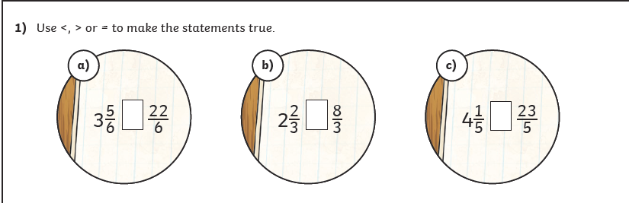
Extension

Slide 25
LO: To convert mixed numbers to improper fractions
7
4
7
3
17
5
Chilli 1
Chilli 2
Chilli 3 – Convert these mixed numbers into improper fractions
4, 1/6 = 25/6
4, 2/6 = 26/6
4, 3/6 = 27/6
4, 4/6 = 28/6
4, 5/6 = 29/6
17
4
17
6
27
5
20
3

Slide 26

Extension

Slide 27
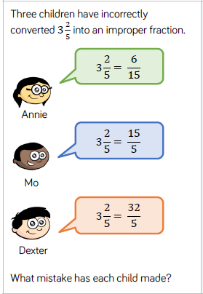
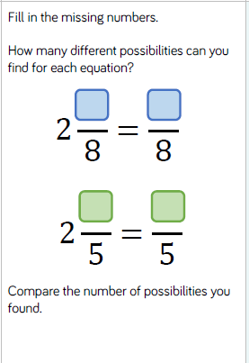
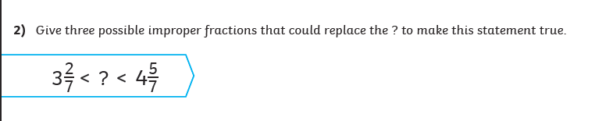
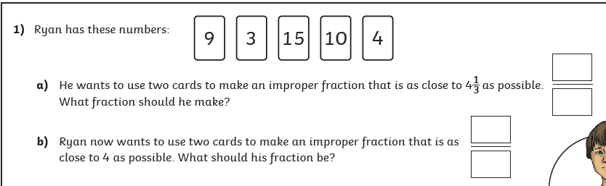
LO: To convert mixed numbers to improper fractions

Slide 28
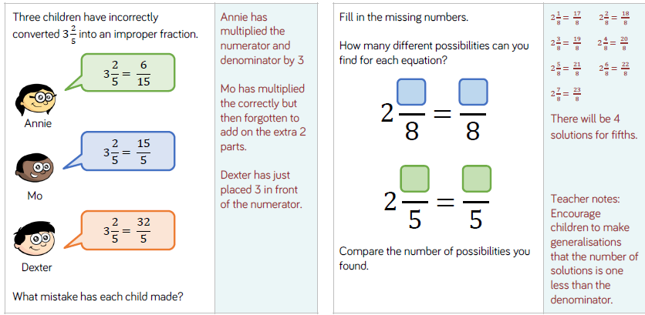
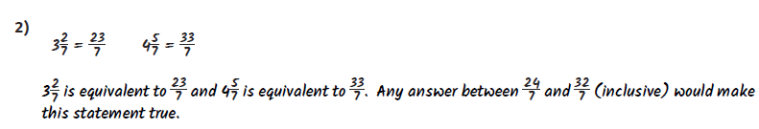
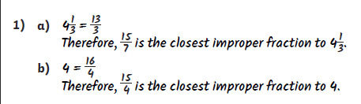
LO: To convert mixed numbers to improper fractions

Slide 29
LO: To convert mixed numbers to improper fractions
Top Down | Self Assessment
Some of us will even: I can solve problems and reason about converting mixed numbers into improper fractions
Some of us will: I can convert mixed numbers into improper fractions
Most of us will: I can convert mixed numbers into improper fractions using diagrams to help me
All of us will: I can colour the bar models to represent a mixed number and use these to convert it into an improper fraction

Slide 30
REFLECTION - LO: To convert mixed numbers to improper fractions
SELF ASSESSEMENT

Slide 31
Break

Slide 32
English – Traditional Stories
Read the slides and do the activities

Slide 33
Introduction
The genre we will be focusing on for 2 weeks is Traditional Tales.
We will be focusing on the Traditional Tale of the ‘Firebird’.
We will be focusing on grammar of: Fronted adverbials, parenthesis, relative clauses, Inverted commas and complex sentences and descriptive/figurative language.
You will be asked to rewrite the story of ‘Firebird’.
Group A will change: Setting, characters, Firebird and main animal
Group B will change: Setting and characters
Group C will rewrite the story.

Slide 34
LO: To be able to identify the features of a traditions tale
Traditional tales are stories that have been told and retold for many years. Often they are passed down through generations. Therefore, they become a story that many people know. There are often lots of different versions of the same story.
Traditional tales are also known as fairy stories or fairy tales.

Slide 35
LO: To be able to identify the features of a traditions tale
Traditional Tales
Core Features
A simple beginning, series of events in the middle leading to a predictable outcome
Details and descriptions support the plot
The story is for telling and re-telling

Slide 36
LO: To be able to identify the features of a traditions tale
Language Features
• A simple traditional opening e.g. one day, once upon a time, Long, long ago
• A simple traditional ending e.g. And they lived happily ever after, always keep your promises
• Evil Characters.
• Characters are often foolish or play tricks
• Animals have human attributes
• People are stereotyped e.g. princesses are pretty
• The number 3 is important e.g. three bears
• Magical or supernatural forces e.g. fairies
• Clear values e.g. honesty
• Literal description e.g. red riding hood had a red cloak

Slide 37
Fragments of a sentence
What should a sentence begin with?
What else needs to be in a sentence?

Slide 38
Fragments of a sentence
Ivan saw bright red, yellow, orange glowing feathers he heard. The firebird flapping his wings Through the dark night sky Ivan Touched a gleaming feather. Ivan could taste the dust from the firebird Ivan could smell hollow wind through his nose.

Slide 39

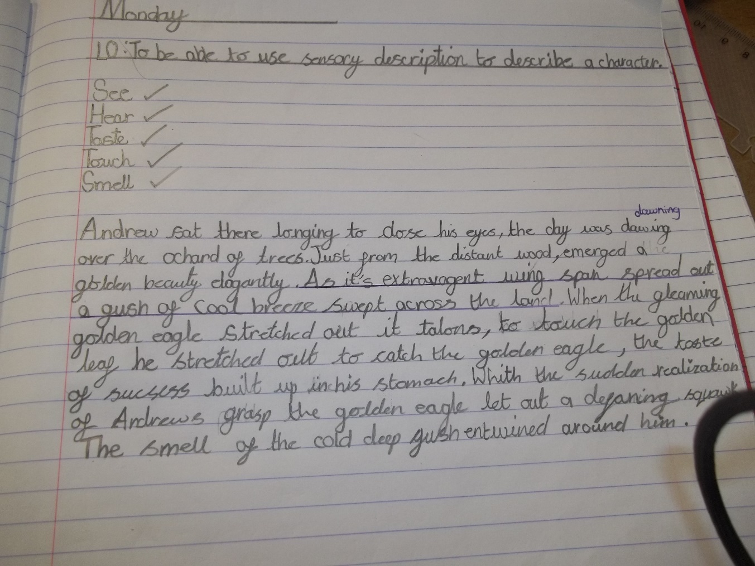
Jack Manning, Elliot Barker, Alfie Wadsworth
Writer of the Day
Seren Cavanagh

Slide 40
Oops…missing things to look for…
Presentation Watch
Liam P - You missed a sentence with hear. Add one in.
Lola N – You missed an opportunity with taste.
Liam P – You missed a sentence with smell.
Ben B - You missed a sentence with smell.
Rihanna - You missed a sentence with smell.
Lola N - You missed a sentence with smell.
Daniella – You missed an opportunity for touch.
Ben - You missed an opportunity for touch.
Rihanna - You missed an opportunity for touch.
All – How did the feather feel?
Common spelling mistakes… check your spelling of these words and
edit if you need to!
Firebird around eagle grabbed until

Slide 41
Edit

Slide 42
LO: To be able to describe settings, characters and atmosphere and integrating dialogue to convey character and advance the action in the style of a Traditional Tale
Today and tomorrow we are going to write our traditional tales about or based on the ‘Firebird’.

Slide 43
LO: To be able to describe settings, characters and atmosphere and integrating dialogue to convey character and advance the action in the style of a Traditional Tale
Checklist
Checklist
Parenthesis
Direct speech
Reported Speech
Expanded Noun Phrases
5 senses
Figurative Language – Simile
Figurative Language - Personification
Figurative Language - Metaphor
Fronted Adverbials
Complex sentences (main and subordinate clause)
Relative Clauses
Statements
Questions
Exclamations
Commands

Slide 44
LO: To be able to describe settings, characters and atmosphere and integrating dialogue to convey character and advance the action in the style of a Traditional Tale
SHARED WRITING (of the Firebird)
This is a traditional story. What shall we begin the story with?
Who lived there? What expanded noun phrase could we use to describe him?
What children did he have? What shall we tell them about the children? Can we add parenthesis to this sentence?
What did he have surrounding his palace? What was in it? Can we use expanded noun phrases, the senses and figurative language to describe this?

Slide 45
LO: To be able to describe settings, characters and atmosphere and integrating dialogue to convey character and advance the action in the style of a Traditional Tale
ACTIVITY
Children to write their traditional tale on or based on ‘The Firebird’.
Teacher Support – CM, LL, IB, HP, LP
Student Support – RA, LT, LT, JW, JB
TA Support – TH, JLJ, RC, BB
Groups working with adults to discuss how they will start it, what they are going to put in it, description they could add.

Slide 46
REFLECTION - LO: To be able to describe settings, characters and atmosphere and integrating dialogue to convey character and advance the action in the style of a Traditional Tale
PEER ASSESSMENT
Read your partners work, using the checklist, tick off what they have used.
Recommend what they could add to it.

Slide 47

Chapter 5 – Mum’s the
Word
Lesson 13
LO: To be able retrieve and record information, identifying key details (2b)
What does tailspin mean?

Slide 48
Chapter 5 – Mum’s the
Word
Lesson 13
LO: To be able retrieve and record information, identifying key details (2b)
What does tailspin mean?
Noun - a situation in which a plane turns round and round as it falls quickly towards the ground

Slide 49
LO: To be able retrieve and record information, identifying key details (2b)
Read Pages 36-37
How did Virgo fall to Earth?
What had made Virgo lose control and ‘knocked her into a tailspin’?
What were the ‘positive signs’ that Virgo had survived the fall?
What had broken Virgo’s fall?
What were Virgo’s nostrils ‘hit’ with?
Where was Virgo?
Where was the only light coming from?
As her eyes grew accustomed to the dark, what could she see?
Who is Taurus?
What was Taurus a stickler for?

Slide 50
LO: To be able retrieve and record information, identifying key details (2b)
Read Pages 36-37
How did Virgo fall to Earth? Damp, loud splat
What had made Virgo lose control and ‘knocked her into a tailspin’? A giant metal bird
What were the ‘positive signs’ that Virgo had survived the fall? She was thinking, she could feel her arms, she could move her legs.
What had broken Virgo’s fall? A squelchy substance
What were Virgo’s nostrils ‘hit’ with? A truly disgusting stench
Where was Virgo? A large, dark cavern that seemed to contain nothing but straw.
Where was the only light coming from? A hole in the roof
As her eyes grew accustomed to the dark, what could she see? A female Bovinor
Who is Taurus? A member of the Zodiac Council
What was Taurus a stickler for? Good Manners

Slide 51
Lunch

Slide 52
Take 5

Slide 53
Story

Slide 54
Handwriting

Slide 55

Proprietor

Slide 56
Proprietor
What could it mean?
“I’m Charon, proprietor of Quix Styx Cabs.”

Slide 57
Proprietor
SAY IT AND FEEL THE SYLLABLES
SAY IT TO THE BIN
SAY IT TO SOMEONE ON ANOTHER TABLE
WHISPER IT TO THE FLOOR
SAY IT TO YOUR BOOK
REPEAT IT AFTER ME
SAY IT TO THE WINDOW
WHISPER IT TO A WALL

Slide 58
Proprietor
Noun. a person who owns a particular type of business, especially a hotel, a shop, or a company that makes newspapers

Slide 59
Proprietor
He is the proprietor of one of the best hotels in Orlando.
Meet the new proprietor of your local shop.
The proprietor of the shop caught the thief red-handed.

Slide 60
Proprietor
In your books, write the word, the definition and use it in a sentence/draw a picture.

Slide 61
Proprietor
Noun. a person who owns a particular type of business, especially a hotel, a shop, or a company that makes newspapers

Slide 62
Arithmetic Test Week 12

Slide 63
LO: To understand what democracy is and how people take part in it
TP: What have we found out about democracy so far?

Slide 64
LO: To understand what democracy is and how people take part in it
Who makes the decisions?
A constitutional government is voted by the majority of citizens.
The Prime Minister appoints a ‘cabinet’ of about 20 ministers.
Each minister is put in charge of an area of government, e.g. children’s issues. One of the most important posts is that of the Chancellor of the Exchequer, who decides how the money collected through taxes will be spent.
The cabinet meets with the Prime Minister once a week at his home in 10 Downing Street.

Slide 65
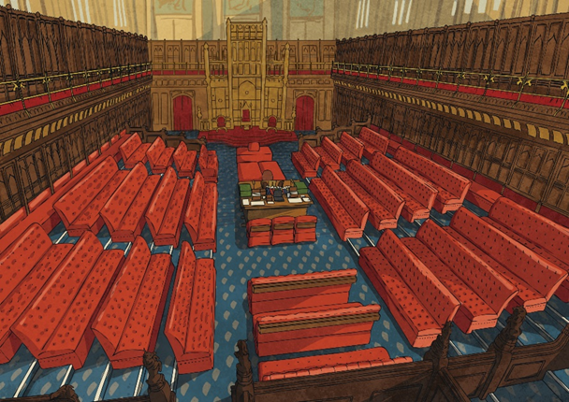
LO: To understand what democracy is and how people take part in it
The House of Lords
The House of Lords has 742 members who are appointed, not elected.
Members of the House of Lords scrutinise and debate bills which have
passed through the House of Commons and question government parts
they are concerned about.
They can stop a bill from passing into
law although the House of Commons
can overrule this after a certain
amount of time has passed.
TP: Why is it a good idea to check things through?

Slide 66
LO: To understand what democracy is and how people take part in it
The House of Commons
The House of Commons is the lower house of Parliament of the United Kingdom of Great Britain and Northern Ireland.
The House of Commons meets in the Palace of Westminster.
The House is an elected body, consisting of members known as members of parliament (MPs).
The UK public elects 650 members of parliament (MPs) to represent their interests and concerns in the House of Commons.
MPs consider and propose new laws and can scrutinise government policies by asking ministers questions about current issues either in the Commons Chamber or in Committees.

Slide 67
LO: To understand what democracy is and how people take part in it
TP: Why do we have laws?

Slide 68
LO: To understand what democracy is and how people take part in it
Why do we have laws?
Without laws, people would be able to do whatever they wanted to and might harm others. Laws protect our rights and ensure that we carry out our responsibilities.
Most people obey our laws. When people are suspected of breaking the law, they are taken to court. If they are found guilty, they are punished.
Sometimes laws seem unfair and need to be changed. Our governments are constantly changing and making new laws.

Slide 69
LO: To understand what democracy is and how people take part in it
TP: How Can We Participate in Democracy?

Slide 70
LO: To understand what democracy is and how people take part in it
How Can We Participate in Democracy?
Stand as a candidate.
Attend community meetings.
Join a trade union.
Petition the government.
Join protests and marches
Campaign for a political party or cause.

Slide 71
LO: To understand what democracy is and how people take part in it
Getting Involved Online
Until recently, the best way of contacting political representatives was by letter.
Now, you can report a pothole directly to your councillor by clicking on
http://www.fixmystreet.com/ or email your MP directly http://www.writetothem.com/.
People can contact the newspapers, radio or T.V. to share their views about what is happening in the community. However, it is the editor who decides what is printed or featured in their programmes.
Many people, including politicians, prefer to use websites like Twitter http://twitter.com/ to communicate with a wide group of people and stay up to date.

Slide 72
LO: To understand what democracy is and how people take part in it
In Our Democracy, Every Citizen Has Certain Basic Rights
No one can tell you what you must think, believe, say or not say.
Everyone is free to choose their own religion and to worship and practice their religion as they want to.
Every individual has the right to enjoy their own culture, along with other members of their group, even if their group is a minority.

Slide 73
LO: To understand what democracy is and how people take part in it
You can read, listen to and watch all kinds of news and opinion in the newspapers, on the radio and on television.
You have the right to join organisations, including trade unions.
You are free to travel around the country and to go abroad if you want to.
You have the right to gather with other people and to protest about what the government is doing.
However, everyone must exercise these rights peacefully, with respect for the law and the rights of others.

Slide 74
LO: To understand what democracy is and how people take part in it
Our Democracy Is a System of Rule by Laws, Not by Individuals
The rule of law protects the rights of citizens, maintains order and limits the power of government.
All citizens are equal under the law. No one may be discriminated against on the basis of their race, religion, ethnic group or gender. No one is above the law, not even the Queen or the Prime Minister.
No one can be arrested or imprisoned without reason.
If you are arrested, you have the right to know the charges against you and to be presumed innocent until proven guilty.
Anyone charged with a crime has the right to a fair, speedy and public trial by an impartial court independent of government. No minister, or political party can tell a judge how to decide a case.
People in office cannot use their power to make themselves
rich. The courts punish people who are corrupt.

Slide 75
LO: To understand what democracy is and how people take part in it
School Council and Democracy
All pupils in the school are involved in the school council.
It is pupil-led.
The staff and the children believe that it plays an important role.
It deals with significant issues.
It makes a difference.

Slide 76
LO: To understand what democracy is and how people take part in it
Different Elections for Different Governments
In our democracy, we are given the opportunity to elect representatives in different types of governments:
Central Government
Local Government
Their job is to talk for us and fight for the things we want changed or kept as they are.

Slide 77
LO: To understand what democracy is and how people take part in it
Central Government
The person we elect for our central government is called a member of parliament (or MP for short).
Elections to the House of Commons must take place at least every five years. The exact timing is decided by the leader of the biggest party, the Prime Minister.
Proposals for new laws, or proposals to change an existing law, are called bills. Bills are discussed and amended in the House of Commons and the House of Lords.
When the bill is agreed, the Queen is asked to give her approval (known as Royal Assent). Once Royal Assent is given, a bill becomes an Act of Parliament and is law.
Central Government is responsible for the welfare of all citizens and protects the most vulnerable in our society.
It looks after national matters, such as health, defence, foreign policy and the environment.
Every four years, people are asked to vote for local government representatives, called councillors.
Many councils elect a mayor, who chairs (keeps order) in full meetings of the council.

Slide 78
LO: To understand what democracy is and how people take part in it
Local Government (your council) is responsible for:
Roads
Education
Housing
Policing
The Fire Service
Waste Disposal/Street Cleaning
Roads
Education
Housing
Policing
The Fire Service
Waste Disposal/Street Cleaning

Slide 79
LO: To understand what democracy is and how people take part in it
Children and Democracy - What Can You Do?
Stand as a candidate and vote in your school council election.
Lobby your councillor and/or MP about local and national issues.
Find out about your rights and responsibilities.
Learn to see the difference between choices that affect you personally and those that affect others.
Improve your skills, for example public speaking.
Keep informed - watch and read the news regularly.

Slide 80
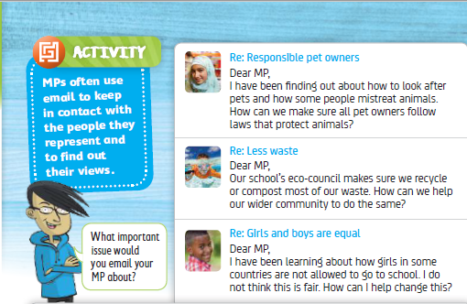
LO: To understand what democracy is and how people take part in it
ACTVITY

Slide 81
REFELCTION - LO: To understand what democracy is and how people take part in it
TP: What have we learnt about democracy?

