Slide 1
Good Morning
Monday 1st March

Slide 2

Getting Granny’s New Glasses – Part 3
“Well, you know we can’t get them in the village,” said Granny. Mani said,
“You’ll have to go to the eye-hospital in Mussoorie. That’s the nearest town.”
“But that is a two-day journey,” protested Granny. “First I’d have to walk to Nain market, twelve miles at least, spend the night there at your uncle’s place and then catch a bus for the rest of the Journey! You know how I hate buses. And its ten years since I walked all the way to Mussoorie. That was when I had these glasses made.”
“Well, it’s still there,” said Mani’s father.
“What is?”
“Mussoorie.”
“And the eye-hospital?”
“That too.”
Evidence
Retrieve
Interpret
Choice
What is a synonym for protested?
Object
Agree
Shout
Granny hated:
Her glasses
Buses
Mani
Walking
Do you think Mani and his family are wealthy? Why/Why not?
Explain why it is difficult for Granny to get new glasses.

Slide 3
Spelling – Look/Cover/Spell/Check
Lente/Alicia/Elliot/Jack
Rest
audience
autumn
beautiful
beginning
believe
beneath
buried
business
caught
chocolate
accompany
according
achieve
aggressive
amateur
answer
appear
arrive
believe
Bicycle

Slide 4
Maths
Read the slides and do the activities

Slide 5



RECALL
TP: What is an improper fraction?
TP: Here are 2 whole squares. Each square is divided into 4 parts? What fraction am I dealing with? What fraction are shaded? Write as an improper fraction.

Slide 6


RECALL
What fraction is shaded blue? Write as an improper fraction.

Slide 7
RECALL
TP: What is a mixed number?
TP: Here are 2 whole squares. Each square is divided into 4 parts? What fraction am I dealing with? What fraction are shaded? Write as a mixed number.

Slide 8
RECALL
What fraction is shaded blue? Write as a mixed number.

Slide 9
LO: To be able to convert improper fractions into a mixed number
Top Down | Self Assessment
Some of us will even: I can solve problems and reason about them when involving converting improper fractions into mixed numbers
Some of us will: I can convert an improper fraction into a mixed number
Most of us will: I can convert an improper fraction into a mixed number when the denominator is given
All of us will: I can convert an improper fraction into a mixed number using a diagram

Slide 10



LO: To be able to convert improper fractions into a mixed number
I have baked two cakes. I cut them into equal pieces.
TP: What fraction have I cut them into?
Some of the pieces I have iced blue and some red.
TP: What fraction of the cakes are iced blue?
Write as an improper fraction
Write as a mixed number.

Slide 11
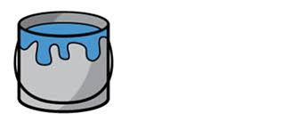
LO: To be able to convert improper fractions into a mixed number
Alfie is going to paint his bedroom blue. He has a look in his garage and finds 5 tins of paint. Each time of paint is half
full.
½ ½ ½ ½ ½
TP: How many halves of paint has Alfie found in the garage? How would we write this as a mixed faction?

Slide 12
LO: To be able to convert improper fractions into a mixed number
Alfie is going to paint his bedroom blue. He has a look in his garage and finds 5 tins of paint. Each time of paint is half
full.
½ + ½ + ½ + ½ + ½
2/2 3/2 4/2 5/2
TP: How many halves of paint has Alfie found in the garage? How would we write this as a mixed faction?

Slide 13
LO: To be able to convert improper fractions into a mixed number
Alfie is going to paint his bedroom blue. He has a look in his garage and finds 5 tins of paint. Each time of paint is half
full.
½ + ½ + ½ + ½ + ½
2/2 3/2 4/2 5/2
TP: How many halves of paint would make up 1 whole tin of paint?
TP: How many halves of paint would make up 2 whole tins?
TP: How much paint is left over?
TP: How would we write this as a mixed number?

Slide 14
LO: To be able to convert improper fractions into a mixed number
Alfie is going to paint his bedroom blue. He has a look in his garage and finds 5 tins of paint. Each time of paint is half
full.
½ + ½ + ½ + ½ + ½
2/2 3/2 4/2 5/2
5/2 = 2, ½
TP: Could we use a simple calculation to work this out?

Slide 15
LO: To be able to convert improper fractions into a mixed number
5 ÷ 2 =
5 ÷ 2 = 2 r1
BUT because we are working in halves we write the answer
2 ½

Slide 16
LO: To be able to convert improper fractions into a mixed number
TP: Can you convert these into a mixed number:
10/3 = ____ ?/3
5/4 = ____ ?/4
13/5 = _____ ?/5
15/6 = ___ ?/6
TP: For each of these calculations, what has stayed the same and what has changed?

Slide 17
LO: To be able to convert improper fractions into a mixed number
TP: Can you change these improper fractions into mixed numbers?
17/6
24/5
20/3

Slide 18
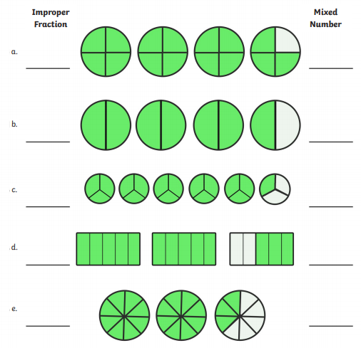
LO: To be able to convert improper fractions into a mixed number
Chilli 1 | Chilli 2 | Chilli 3
Write these as an improper fraction and then as a mixed number | Change these improper fractions to their mixed number. 19/6 = __, ?/6 20/6 = __, ?/6 21/6 = __, ?/6 22/6 = __, ?/6 23/6 = __, ?/6 | Change these improper fractions to their mixed number. 24/4 = 24/5 = 24/6 = 24/7 = 24/8 =
EXT: Make your own improper fractions up and convert them to mixed numbers.

Slide 19
LO: To be able to convert improper fractions into a mixed number
Chilli 1 | Chilli 2 | Chilli 3
Write these as an improper fraction and then as a mixed number 15/4 3, ¾ 7/2 3, 1/2 16/3 5, 1/3 13/5 2, 3/5 19/8 2, 3/8 | Change these improper fractions to their mixed number. 19/6 = 3, 1/6 20/6 = 3, 2/6 21/6 = 3, 3/6 22/6 = 3, 4/6 23/6 = 3, 5/6 | Change these improper fractions to their mixed number. 24/4 = 6 24/5 = 4, 4/5 24/6 = 4 24/7 = 3, 3/7 24/8 = 3

Slide 20
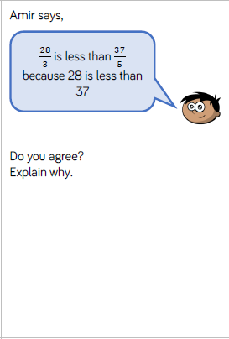
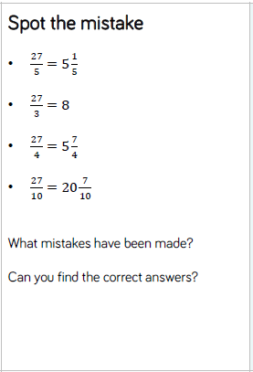
LO: To be able to convert improper fractions into a mixed number

Slide 21
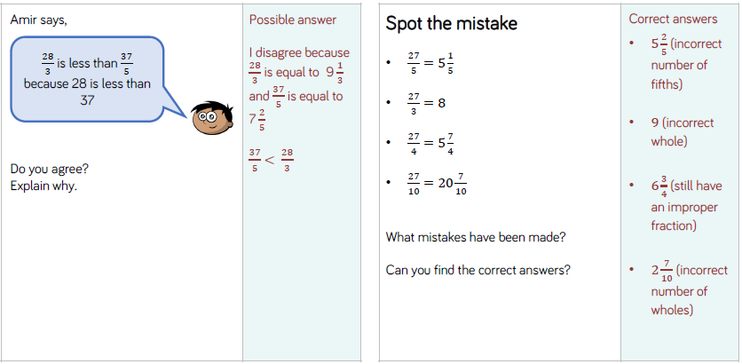
LO: To be able to convert improper fractions into a mixed number

Slide 22
LO: To be able to convert improper fractions into a mixed number
Top Down | Self Assessment
Some of us will even: I can solve problems and reason about them when involving converting improper fractions into mixed numbers
Some of us will: I can convert an improper fraction into a mixed number
Most of us will: I can convert an improper fraction into a mixed number when the denominator is given
All of us will: I can convert an improper fraction into a mixed number using a diagram

Slide 23
REFLECTION - LO: To be able to convert improper fractions into a mixed number
SELF ASSESSEMENT

Slide 24
Assembly and Break

Slide 25
English – Traditional Tales Lesson 6
LO: To be able to use sensory description to describe a character
Read the slides and do the activities

Slide 26
Introduction
The genre we will be focusing on for 2 weeks is Traditional Tales.
We will be focusing on the Traditional Tale of the ‘Firebird’.
We will be focusing on grammar of: Fronted adverbials, parenthesis, relative clauses, Inverted commas and complex sentences and descriptive/figurative language.
You will be asked to rewrite the story of ‘Firebird’.
Group A will change: Setting, characters, Firebird and main animal
Group B will change: Setting and characters
Group C will rewrite the story.

Slide 27
LO: To be able to identify the features of a traditions tale
Traditional tales are stories that have been told and retold for many years. Often they are passed down through generations. Therefore, they become a story that many people know. There are often lots of different versions of the same story.
Traditional tales are also known as fairy stories or fairy tales.

Slide 28
LO: To be able to identify the features of a traditions tale
Traditional Tales
Core Features
A simple beginning, series of events in the middle leading to a predictable outcome
Details and descriptions support the plot
The story is for telling and re-telling

Slide 29
LO: To be able to identify the features of a traditions tale
Language Features
• A simple traditional opening e.g. one day, once upon a time, Long, long ago
• A simple traditional ending e.g. And they lived happily ever after, always keep your promises
• Evil Characters.
• Characters are often foolish or play tricks
• Animals have human attributes
• People are stereotyped e.g. princesses are pretty
• The number 3 is important e.g. three bears
• Magical or supernatural forces e.g. fairies
• Clear values e.g. honesty
• Literal description e.g. red riding hood had a red cloak

Slide 30
LO: To be able to use sensory description to describe a character
TP: What are the 5 senses?

Slide 31
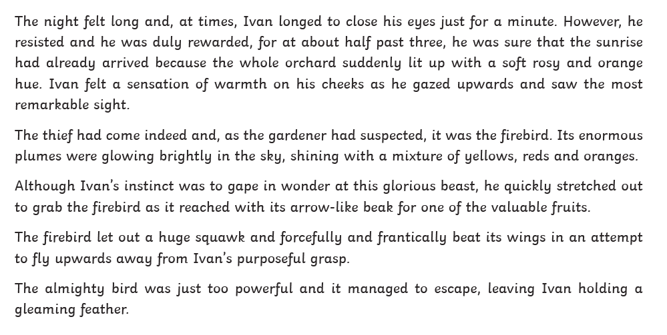
LO: To be able to use sensory description to describe a character

Slide 32
LO: To be able to use sensory description to describe a character
TP: With your partner, discuss and colour code to show where the 5 senses are referred to the story.

Slide 33
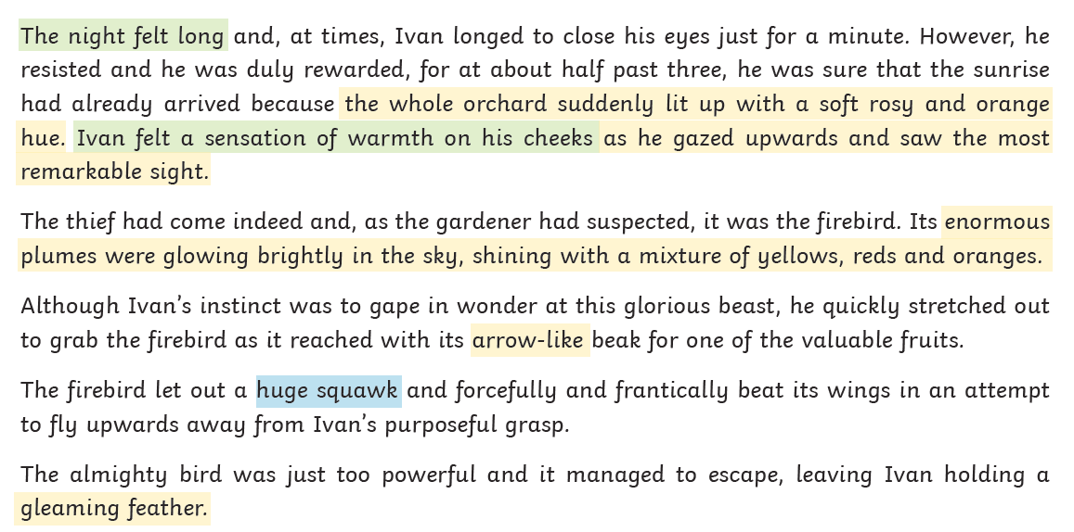
LO: To be able to use sensory description to describe a character
No taste or smell

Slide 34
Taste
You are going to write your own sensory description about the firebird.
You will be generating ideas to write about each of the senses.
Let’s start with a tricky one together.

Slide 35

Taste
Ivan is not eating when he sees the
firebird so what could he possibly taste?
success?
taste
excitement?
In these cases, can Ivan really taste anything?
No, figurative language is being used. The word ‘taste’ is used but in fact it is emotions that are being felt.

Slide 36
LO: To be able to use sensory description to describe a character
It might be that the character is smelling something and it feels like he is tasting it. Also, sometimes the air can have a taste to it
Ivan could taste the fresh night air.
TP: Have you any ideas for taste?

Slide 37
LO: To be able to use sensory description to describe a character
Feeling – Again it might not be actually what he feels but it can be used to give an emotion/feeling a person gets e.g.
Ivan felt the cold night air wrapping itself around his body.
This tells us how he is feeling. How is he feeling?
TP: Can you think of an example?

Slide 38
LO: To be able to use sensory description to describe a character
ACTIVITY
Children to think of words and phrases that would describe the firebird in the garden when Ivan first sees it and to put them into sentences. Some children will use the characters and animals that they have planned for. To use the sheets as a reference.

Slide 39
REFLECTION - LO: To be able to use sensory description to describe a character
PEER ASSESSMENT
Have they got a descriptive sentence for each sense? If not, help them create one.
What is your favourite sentence?

Slide 40

Chapter 4 – Mum’s the
Word
Lesson 12
LO: To be able to identify/explain how meaning is enhanced through choice of words and phrases
What does waffled mean?

Slide 41
Chapter 4 – Mum’s the
Word
Lesson 12
LO: To be able to identify/explain how meaning is enhanced through choice of words and phrases
What does waffled mean?
Verb. to talk or write a lot without giving any useful information or any clear answers

Slide 42
LO: To be able to identify/explain how meaning is enhanced through choice of words and phrases
What have we been told so far about Mum? Jot down ideas
Read from Page 29 to end of chapter
P14 – Why has the other put ‘borrowed’ in inverted commas?
P25 – Why had the house plunged into darkness?
End of chapter – Predict what is going to happen next.

Slide 43
Mum’s the word – What is an idiom?
LO: To be able to identify/explain how meaning is enhanced through choice of words and phrases
Why do you think the chapter is called this?
What does it mean?
2g

Slide 44
Lunch

Slide 45
Take 5

Slide 46
Story
Read a traditional story

Slide 47
Handwriting
Audience
Autumn
Accompany
according

Slide 48

chortled

Slide 49
chortled
What could it mean?
“All right, darling, you got me,” chortled Charon several octaves lower.

Slide 50
chortled
SAY IT AND FEEL THE SYLLABLES
SAY IT TO THE BIN
SAY IT TO SOMEONE ON ANOTHER TABLE
WHISPER IT TO THE FLOOR
SAY IT TO YOUR BOOK
REPEAT IT AFTER ME
SAY IT TO THE WINDOW
WHISPER IT TO A WALL

Slide 51
chortled
Verb. to laugh, showing pleasure and satisfaction

Slide 52
chortled
She chortled with glee at the news.
I thought I heard a chortle at the back of the room.
She suppressed an embarrassed chortle.

Slide 53
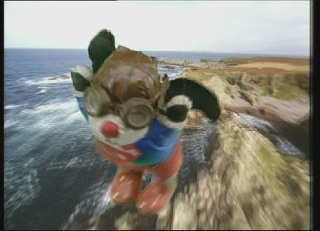
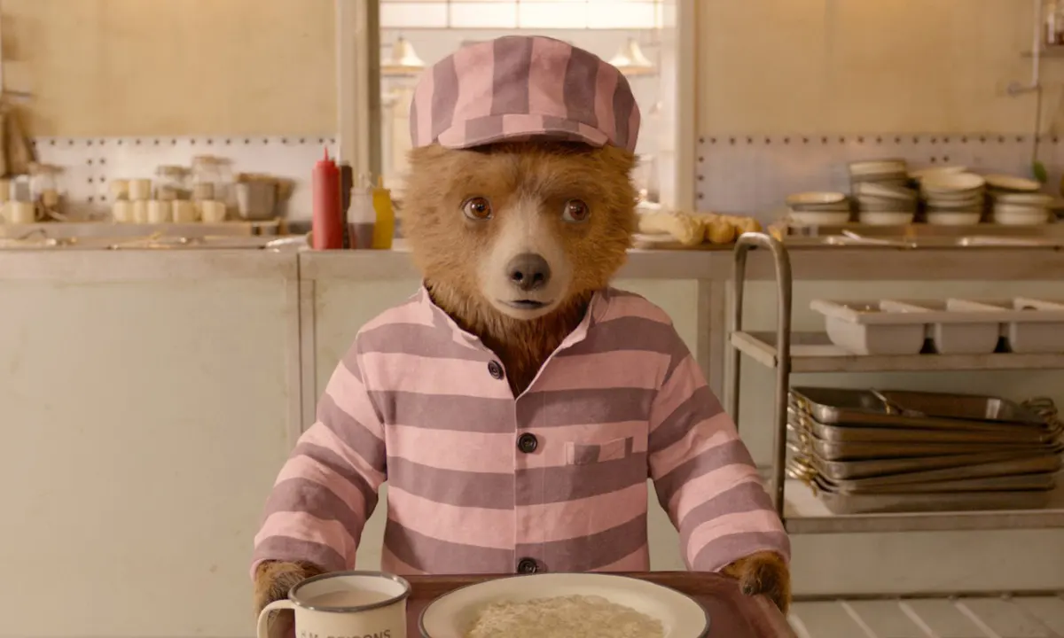
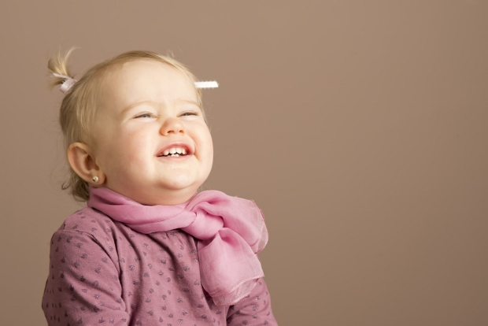
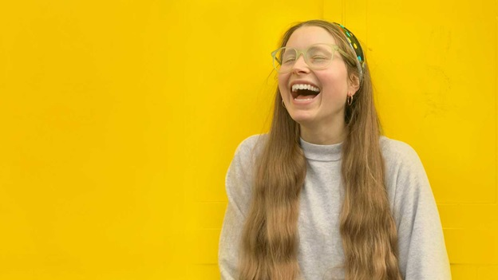
chortled
Say chortled if you see someone laughing, showing pleasure and satisfaction.

Slide 54
chortled
Act it out!
Can you chortle?

Slide 55
chortled
In your books, write the word, the definition and use it in a sentence/draw a picture.

Slide 56
chortled
Verb. to laugh, showing pleasure and satisfaction

Slide 57
D.T. Lesson 6
LO: To know how to plan and shop for a meal
Read the slides and do the activities
Use worksheet B

Slide 58
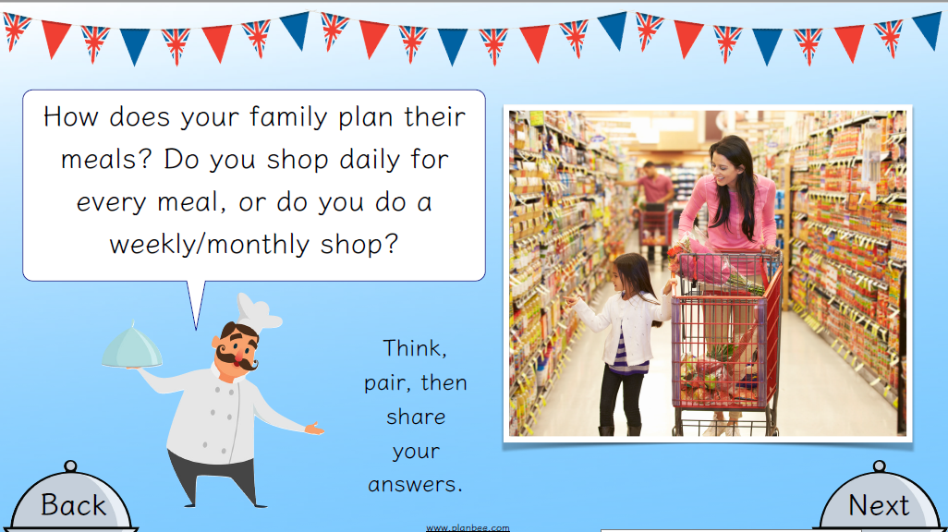
LO: To know how to plan and shop for a meal

Slide 59
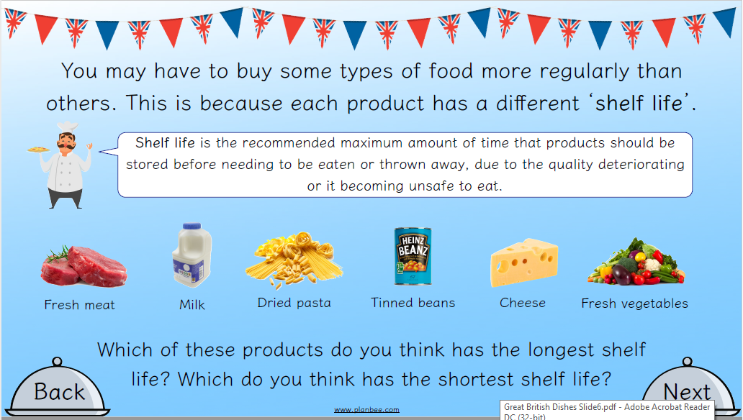
LO: To know how to plan and shop for a meal

Slide 60
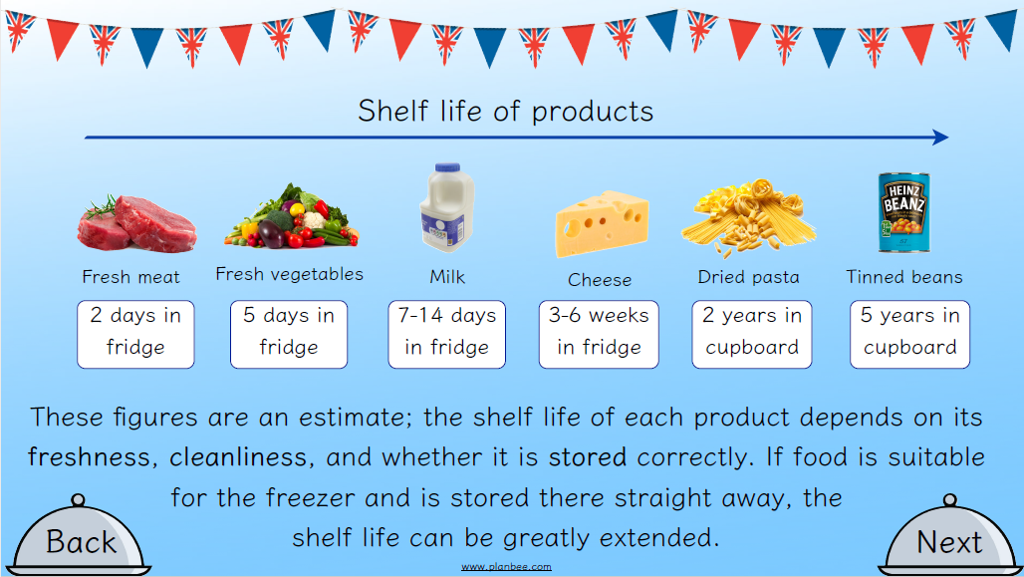
LO: To know how to plan and shop for a meal

Slide 61
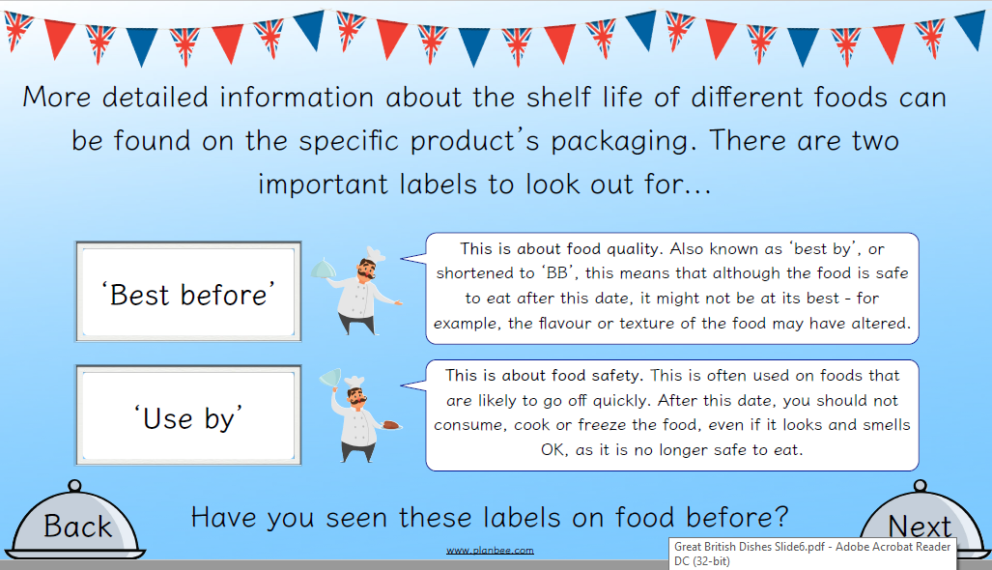
LO: To know how to plan and shop for a meal

Slide 62
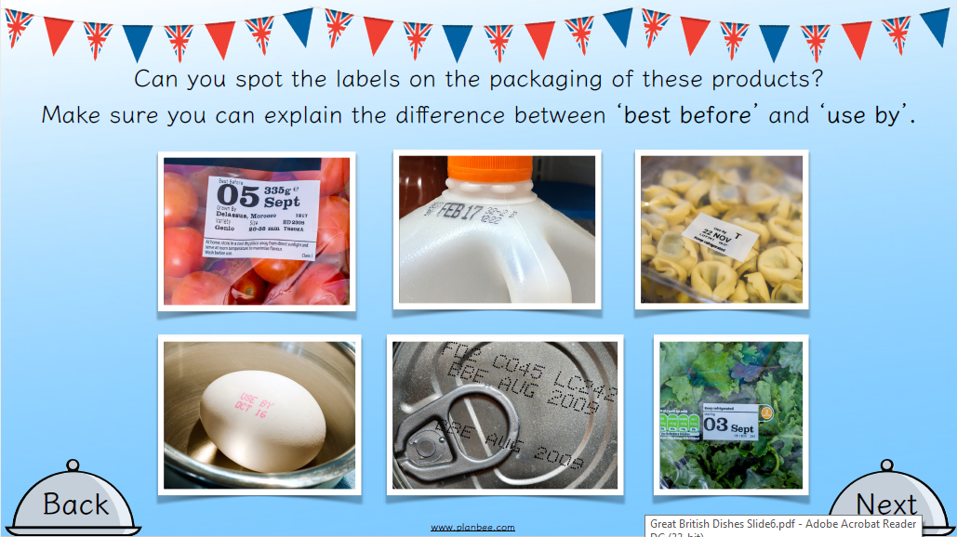
LO: To know how to plan and shop for a meal

Slide 63
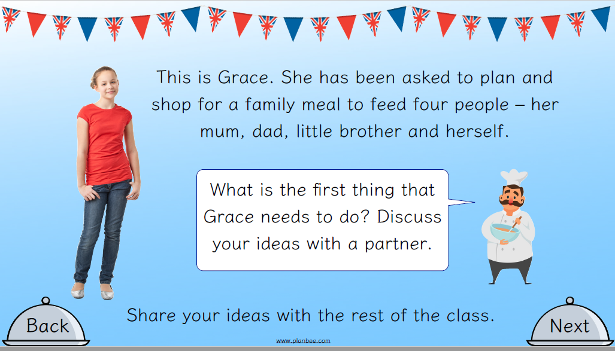
LO: To know how to plan and shop for a meal

Slide 64
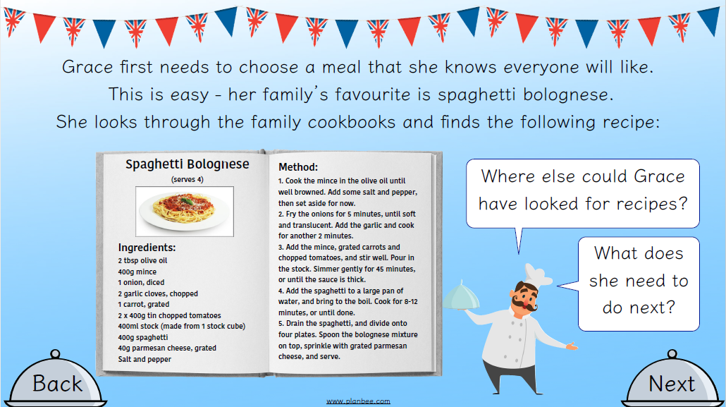
LO: To know how to plan and shop for a meal

Slide 65
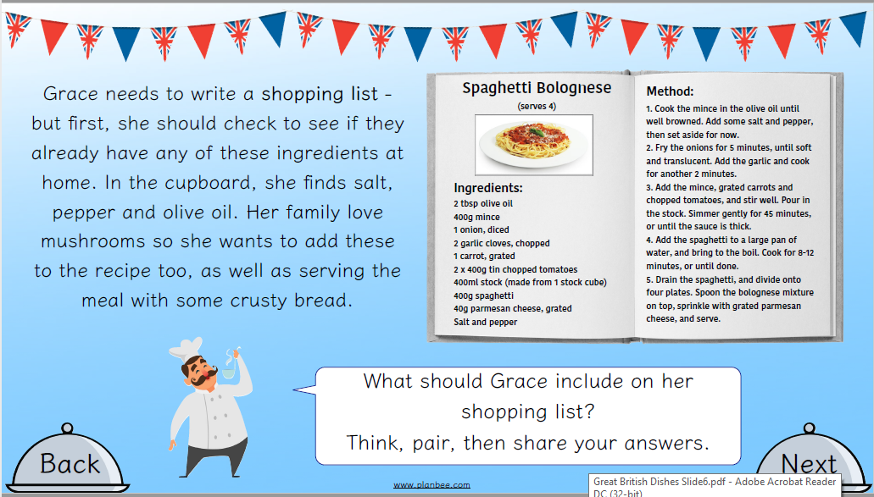
LO: To know how to plan and shop for a meal

Slide 66
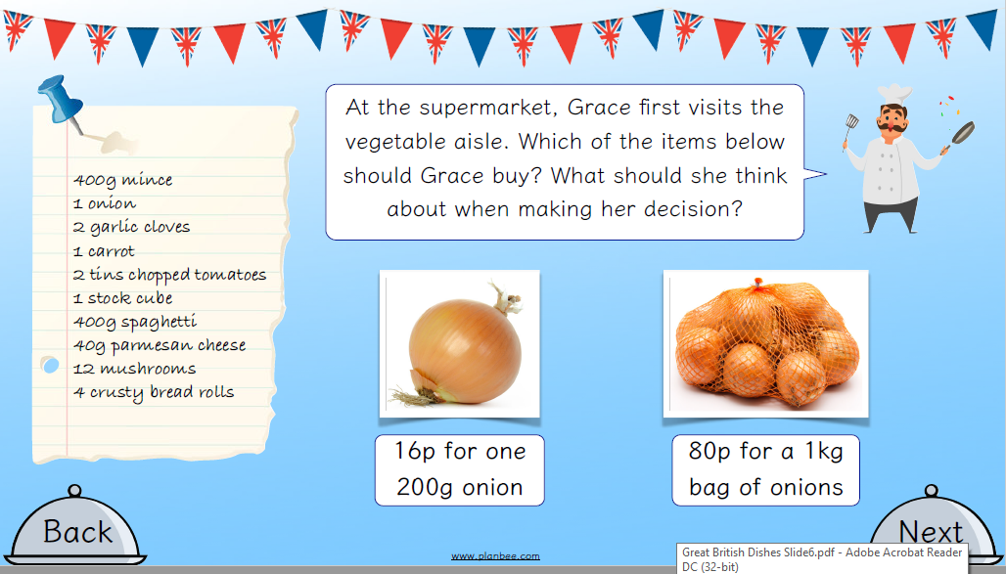
LO: To know how to plan and shop for a meal

Slide 67
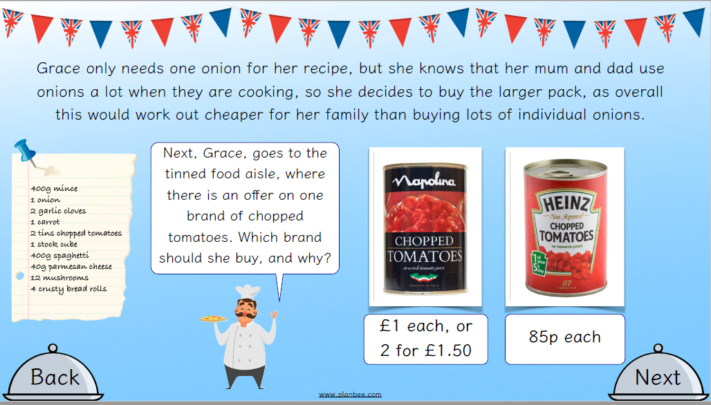
LO: To know how to plan and shop for a meal

Slide 68
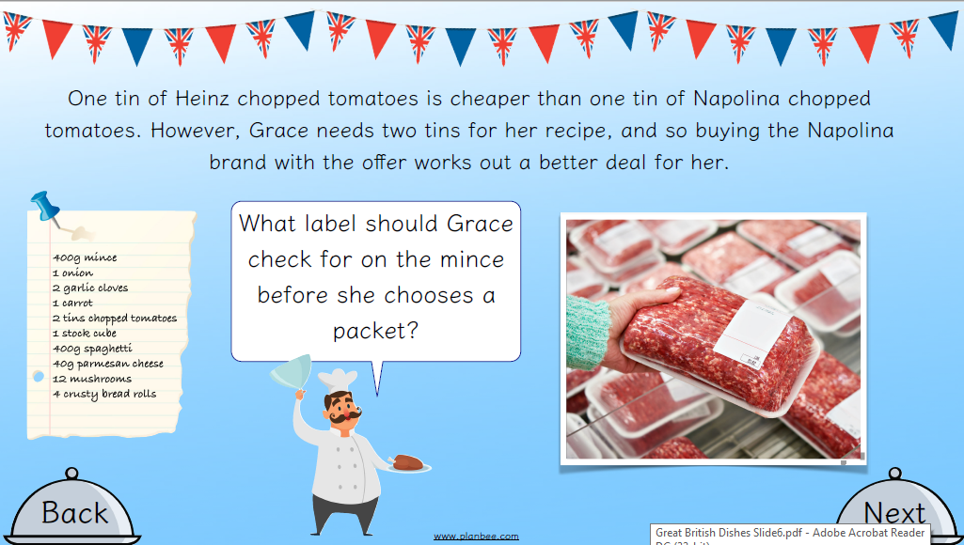
LO: To know how to plan and shop for a meal

Slide 69
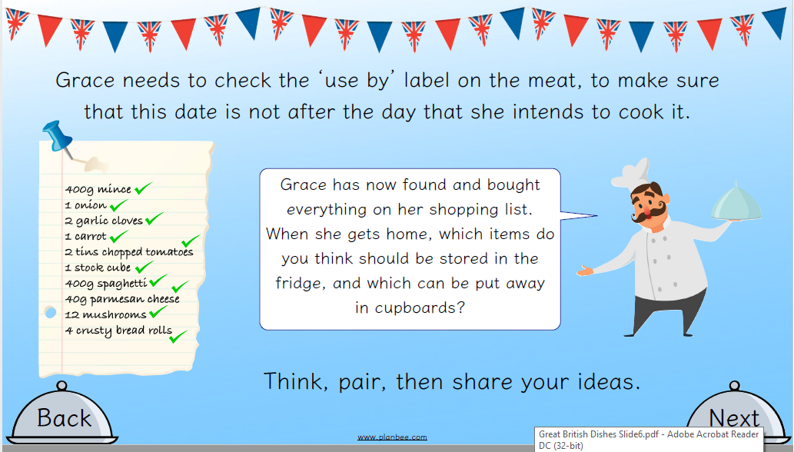
LO: To know how to plan and shop for a meal

Slide 70
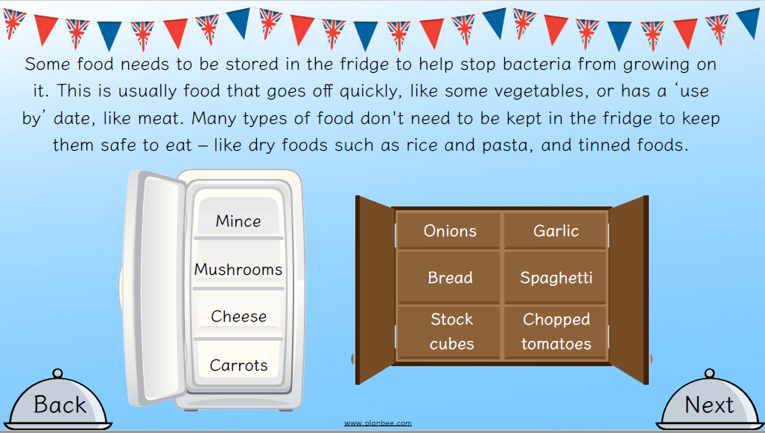
LO: To know how to plan and shop for a meal

Slide 71
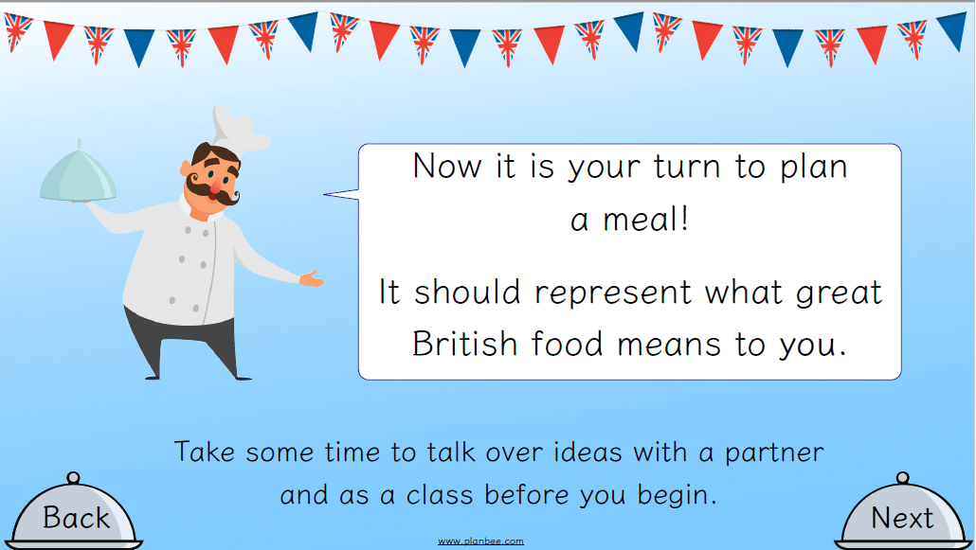
LO: To know how to plan and shop for a meal

Slide 72
LO: To know how to plan and shop for a meal
ACTIVITY
Children to plan a meal that they think represents great British food. They are to use cookery books or the internet to research their recipe, including the ingredients and cost. Children to write down and describe their meal and the reason for their choice. To say which ingredients need to go in the fridge and whether it is healthy and why. Sheet B

Slide 73
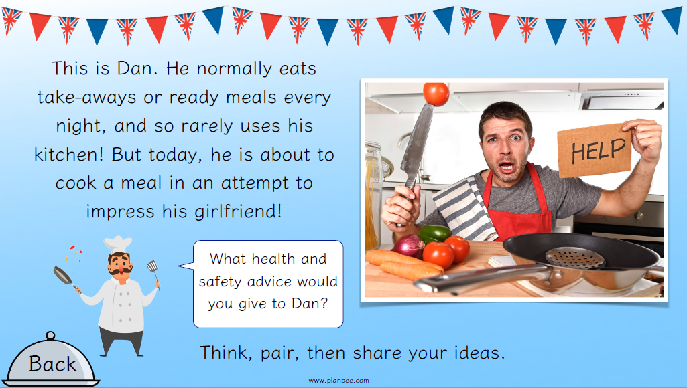
REFLECTION - LO: To know how to plan and shop for a meal

Slide 74
P.E.

