Slide 1
Good Morning
Thursday 25th February

Slide 2

Getting Granny’s New Glasses – Part 1
Granny needs new glasses but she lives at least two day’s journey from the nearest eye-hospital.
Granny could hear the distant roar of the river, and smell the pine needles beneath her feet, and feel the presence of her grandson, Mani; but she couldn’t see the river or the trees; and of her grandson she could only make out his fuzzy hair, and sometimes, when she was very close, his blackberry eyes and the gleam of his teeth when he smiled.
Evidence
Retrieve
Interpret
Choice
What is another word for eye-hospital?
What did Granny need?
Why did Granny put up with not being able to see her Grandson properly?
What do you think will happen in the rest of the story?

Slide 3
Spelling – Look/Cover/Spell/Check
Lente, Jack, Alicia and Elliot
Rest of class
accommodation
actually
alcohol
although
analyse
analysis
argument
assessment
atmosphere
audible
therefore
though
although
thought
through
various
weight
woman
women
accommodate

Slide 4
Maths
Read the slides and do the activities

Slide 5
RECALL
Write the decimal equivalent to:
1/100
2/100
3/100
4/100
5/100
6/100
7/100
8/100
9/100
10/100

Slide 6
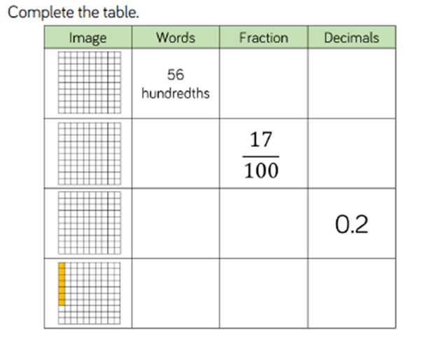
RECALL

Slide 7
LO: To be able to represent hundredths on a place value grid
Top Down | Self Assessment
Some of us will even: I can problem solve and reason about questions involving the place value of numbers hundredths
Some of us will: I can partition a number involving hundredths and represent it as a calculation
Most of us will: I can create a part-whole model to show the place value of each digit involving hundredths
All of us will: I can place counters on a place value grid showing the value of each digit involving hundredths

Slide 8
LO: To be able to represent hundredths on a place value grid
TP: What is a hundredth?
TP: What does equivalent mean?
TP: How many hundredths are equivalent to one tenth?

Slide 9

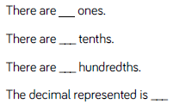
LO: To be able to represent hundredths on a place value grid
TP: Write the decimal represented in each place value grid by completing this sentence stem:
TP: If I was to make these place value counters, what digit/s do I need to write inside each of them?

Slide 10

LO: To be able to represent hundredths on a place value grid
TP: Write the decimal represented in each place value grid by completing this sentence stem:
TP: If I was to make these place value counters, what digit/s do I need to write inside each of them?

Slide 11



LO: To be able to represent hundredths on a place value grid
Ones | Tenths | Hundredths
TP: On you white boards draw this place value grid.
TP: Place these decimals on your place value grids in figures and underneath using place value counters.
TP: Complete the sentence stem for each.

Slide 12


LO: To be able to represent hundredths on a place value grid
Part-whole model
Riley has placed five 0.01 counters in the part-whole model to show the place value of the hundredths.
TP: What other counters does he need to make 0.35?
TP: What other ways could we represent the hundredth counters and the tenth counters?
0.35
0.01

Slide 13
LO: To be able to represent hundredths on a place value grid
Part-whole model
TP: What other ways could we represent the hundredth counters and the tenth counters?
We could:
Add all the 0.01 counters together and write 0.05
Change the 0.01 to 1/100
Add the five 1/100 together and write 5/100
0.35
0.01

Slide 14

LO: To be able to represent hundredths on a place value grid
Part-whole model
TP: Represent the decimals below on a part-whole model.
TP: How many different ways can you partition each number?

Slide 15
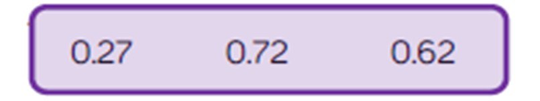
LO: To be able to represent hundredths on a place value grid
Look at the decimals you have represented on the place value grid and in the part whole models.
TP: What’s the same about the numbers? What’s different?

Slide 16
LO: To be able to represent hundredths on a place value grid
TP: 0.43. I want to make a partition calculation. For example,
_____ + _____ = 0.43
TP: What digits would I have to put into the blank spaces to make this partition calculation true?
TP: Can you do this another way?
TP: What is the same? What is different? About the calculations?
TP: How would I partition, using the above method 4.39?

Slide 17
LO: To be able to represent hundredths on a place value grid
How many different ways can be made by combining two of the following groups of counters?
TP: How would you go about solving this? How do you need to work?
TP: How would you present this?
Group 1
0.1, 0.1, 0.1
Group 2
0.01, 0.01, 0.01
Group 3
1/10, 1/10, 1/10, 1/10
Group 4
1/100, 1/100, 1/100, 1/100

Slide 18
LO: To be able to represent hundredths on a place value grid
Chilli 1 | Chilli 2 | Chilli 3
Complete the sentence stem for each of the numbers below: 0.08 0.34 2.67 3.82 7.72 | Draw a part-whole model and partition these numbers 0.28 0.63 0.43 0.83 0.37 | Partition these numbers 0.34 0.53 0.05 1.48 7.38
Extension – Can you write the above partitions in a different way?

Slide 19
LO: To be able to represent hundredths on a place value grid
Chilli 1 | Chilli 2 | Chilli 3
Complete the sentence stem for each of the numbers below: 0.08 0.34 2.67 3.82 7.72 | Draw a part-whole model and partition these numbers 0.28 0.63 0.43 0.83 0.37 | Partition these numbers as decimals 0.34 = 0 + 0.3 + 0.04 0.53 = 0 + 0.5 + 0.03 0.05 = 0 + 0 + 0.05 1.48 = 1 + 0.4 + 0.08 7.38 = 7 + 0.3 + 0.08
Extension – Can you write the above partitions in a different way?
0 + 3/10 + 4/100
0 + 5/10 + 3/100
0 + 0 + 5/100
1 + 4/10 + 8/100
7 + 3/10 + 8/100

Slide 20
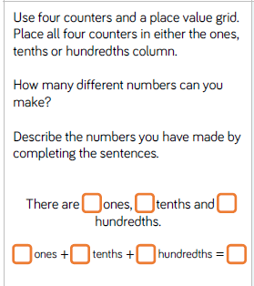
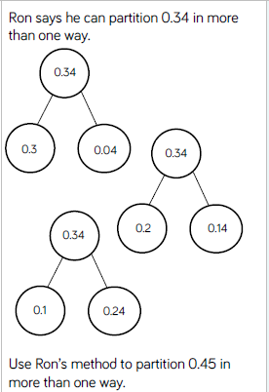
LO: To be able to represent hundredths on a place value grid
Q1
How many different ways can be made by combining two of the following groups of counters?
Group 1
0.1, 0.1, 0.1
Group 2
0.01, 0.01, 0.01
Group 3
1/10, 1/10, 1/10, 1/10
Group 4
1/100, 1/100, 1/100, 1/100
Q2
Luis writes the number of shaded squares on the grid as 0.5 of the hundredth grid.
Do you agree with Luis?
Complete this sentence
I agree/disagree because…….

Slide 21
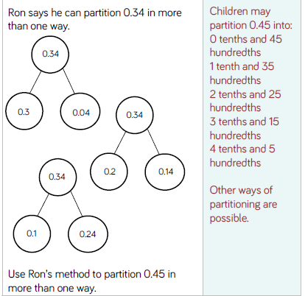
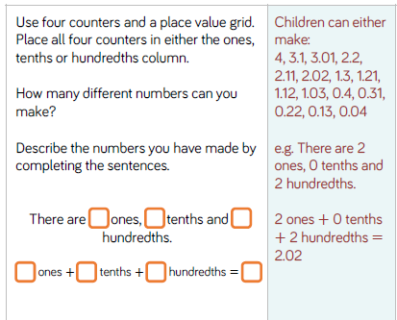
LO: To be able to represent hundredths on a place value grid

Slide 22
LO: To be able to represent hundredths on a place value grid
Top Down | Self Assessment
Some of us will even: I can problem solve and reason about questions involving the place value of numbers hundredths
Some of us will: I can partition a number involving hundredths and represent it as a calculation
Most of us will: I can create a part-whole model to show the place value of each digit involving hundredths
All of us will: I can place counters on a place value grid showing the value of each digit involving hundredths

Slide 23
REFLECTION - LO: To be able to represent hundredths on a place value grid
SELF ASSESSMENT

Slide 24
Break

Slide 25
PE for class
Reading for online learners

Slide 27
English – Traditional Tales Lesson 4
LO: To be able to use inverted commas and the correct punctuation to write a conversation between 2 or more characters to move the story forward.
Read the slides and do the activities

Slide 28
Introduction
The genre we will be focusing on for 2 weeks is Traditional Tales.
We will be focusing on the Traditional Tale of the ‘Firebird’.
We will be focusing on grammar of: Fronted adverbials, parenthesis, relative clauses, Inverted commas and complex sentences and descriptive/figurative language.
You will be asked to rewrite the story of ‘Firebird’.
Group A will change: Setting, characters, Firebird and main animal
Group B will change: Setting and characters
Group C will rewrite the story.

Slide 29
Introduction
Traditional tales are stories that have been told and retold for many years. Often they are passed down through generations. Therefore, they become a story that many people know. There are often lots of different versions of the same story.
Traditional tales are also known as fairy stories or fairy tales.

Slide 30
Introduction
Traditional Tales
Core Features
A simple beginning, series of events in the middle leading to a predictable outcome
Details and descriptions support the plot
The story is for telling and re-telling

Slide 31
Introduction
Language Features
• A simple traditional opening e.g. one day, once upon a time, Long, long ago
• A simple traditional ending e.g. And they lived happily ever after, always keep your promises
• Evil Characters.
• Characters are often foolish or play tricks
• Animals have human attributes
• People are stereotyped e.g. princesses are pretty
• The number 3 is important e.g. three bears
• Magical or supernatural forces e.g. fairies
• Clear values e.g. honesty
• Literal description e.g. red riding hood had a red cloak

Slide 32
Introduction
TP: Discuss with your partner what happened in ‘Firebird’ and any changes you have made to the story.

Slide 33
LO: To be able to use inverted commas and the correct punctuation to write a conversation between 2 or more characters to move the story forward
Top Down | Self Assessment
Some of us will even: I am able to sustain dialogue between two or more characters without losing the flow of the story (Y6)
Some of us will: I use a range of punctuation correctly . , ? ! “” (Y5)
Most of us will: I use reported speech (Y4)
All of us will 2: I use the correct punctuation before closing speech . , ? ! (Y4)
All of us will 1: I use speech marks to punctuate direct speech

Slide 34
LO: To be able to use inverted commas and the correct punctuation to write a conversation between 2 or more characters to move the story forward
TP: What are the rules of using inverted speech?

Slide 35
LO: To be able to use inverted commas and the correct punctuation to write a conversation between 2 or more characters to move the story forward
Rules
A “ when a person starts speaking.
A ” when a person has finished speaking.
A capital letter is needed after the “ for the first word.
A .,! or ? is needed before the ”.
Start a new line when there is a new speaker.
A ,! or ? when you are told who said something after they have said it.
A . ! or ? when you are told who said it before they say something. A comma is needed where we are told who is saying it.

Slide 36
LO: To be able to use inverted commas and the correct punctuation to write a conversation between 2 or more characters to move the story forward
TP: What is reported speech?

Slide 37
LO: To be able to use inverted commas and the correct punctuation to write a conversation between 2 or more characters to move the story forward
Reports what a person says

Slide 38
LO: To be able to use inverted commas and the correct punctuation to write a conversation between 2 or more characters to move the story forward
“Surely it is my turn now,” exclaimed Ivan, the youngest son, as he met his father later that day. “I should be allowed my chance to catch the thief.”
“I see no point, Ivan,” replied the tsar. “You are a good boy but you are still so young and foolish. Why would you be able to catch the thief when both your brother’s failed?”
“Well, I can assure you…” began the strong-willed prince, but his father was already waving him away, with a look of annoyance on his face.
Underline what is spoken.
Discuss what punctuation has been used and why.
Discuss why all of it has not used inverted commas.
Discuss why a new line has been used.
Can you turn the last bit of direct speech into reported speech?

Slide 39
LO: To be able to use inverted commas and the correct punctuation to write a conversation between 2 or more characters to move the story forward
Read Pages 16 and 17 where Ivan meets the wolf.
Can you write me an opening line that the wolf might say to Ivan? Or if you have changed the characters, what they might say to each other?

Slide 40
LO: To be able to use inverted commas and the correct punctuation to write a conversation between 2 or more characters to move the story forward
ACTIVITY
Children to use the conventions of reported speech or indirect speech to move the story forward through reported or direct speech when Ivan meets the Wolf. Group 1 and Group 2 to use the characters that they have changed to for the story.
*** Group – LW, JM, NP, EB to write the passage using some reported speech
** Group – To write the passage using all the conventions of indirect speech.
* Group – To write the passage using all the conventions of indirect speech.
Work with T (CM, LL, HP, IB, JB)
Work with ST (RA, JW, RA, LT)
Work with TA (BB, TH, JLJ, RC)

Slide 41
LO: To be able to use inverted commas and the correct punctuation to write a conversation between 2 or more characters to move the story forward

Slide 42
Lunch

Slide 43
Take 5

Slide 44
Story
Read a Traditional Tale

Slide 45
Handwriting
Argument
Assessment
Weight
woman

Slide 46

swathed

Slide 47
swathed
What could it mean?
His short figure was swathed in a rough brown robe, his dirty, veiny hands jutting from the sleeves.

Slide 48
swathed
SAY IT AND FEEL THE SYLLABLES
SAY IT TO THE BIN
SAY IT TO SOMEONE ON ANOTHER TABLE
WHISPER IT TO THE FLOOR
SAY IT TO YOUR BOOK
REPEAT IT AFTER ME
SAY IT TO THE WINDOW
WHISPER IT TO A WALL

Slide 49
swathed
Noun. a long strip of cloth OR are of land

Slide 50
swathed
Huge swathes of rainforest are being cleared for farming and mining.
His head was wrapped in swathes of bandages.
Her neck was swathed in jewels.
After the explosion at Chernobyl, huge swathes of land became radioactive.

Slide 51
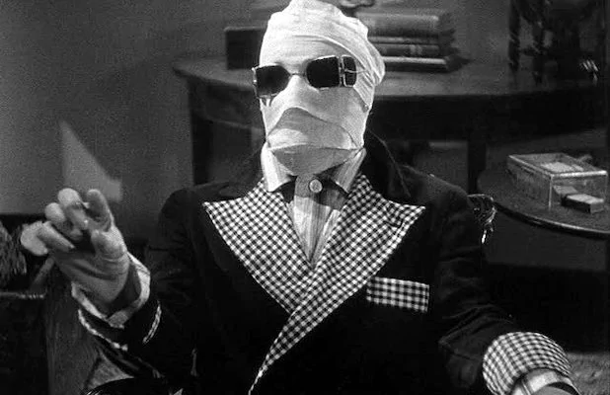
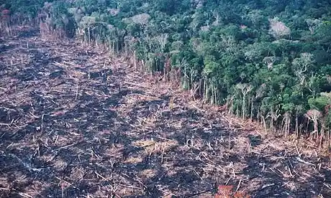
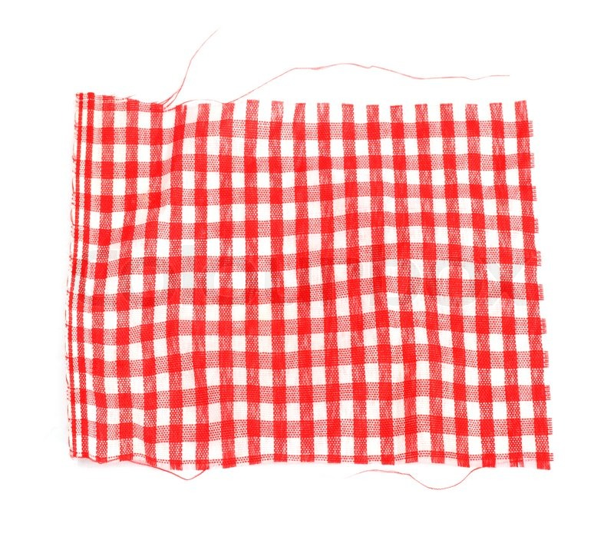
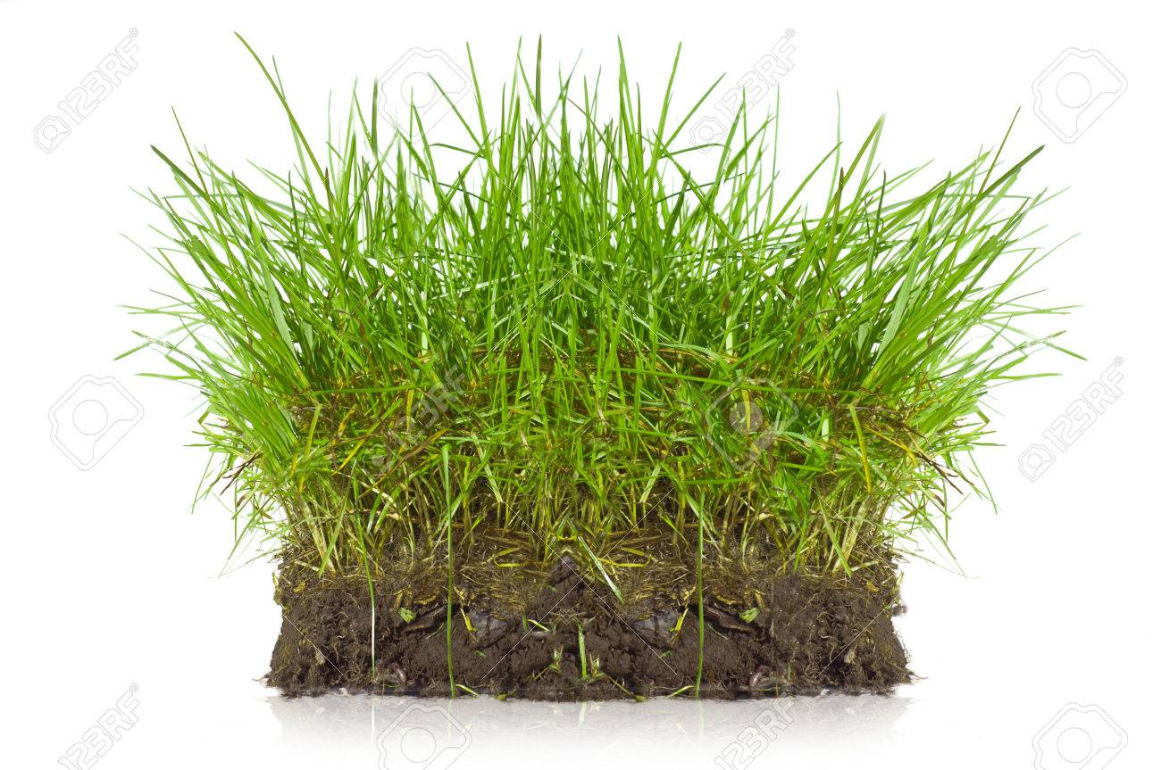
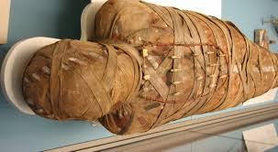
swathed
Say swathed if you see someone or something in a long strip.

Slide 52
swathed
In your books, write the word, the definition and use it in a sentence/draw a picture.

Slide 53
swathed
Noun. a long strip of cloth OR are of land
The Invisible Man was swathed in bandages because
The Invisible Man was swathed in bandages so
The Invisible Man was swathed in bandages but

Slide 54

Chapter 3 – A Star is Born
Lesson 10
LO: To be able retrieve and record information, identifying key details (2b)
LO: To be able to predict what might happen from details stated and implied (2e)
What does scuttling mean?

Slide 55
Chapter 3 – A Star is Born
Lesson 10
LO: To be able retrieve and record information, identifying key details (2b)
LO: To be able to predict what might happen from details stated and implied (2e)
What does scuttling mean?
Verb. to move quickly, with small, short steps, especially in order to escape

Slide 56
LO: To be able retrieve and record information, identifying key details (2b)
Read from Page 20 to end of chapter
P11 – What was Aries?
P12 – What was Taurus? What was he doing?
P12 – What was Capricorn? What was she doing? When did she do it?
P12 – What was cancer? When did he do it? What happened to him?
P12 – Who were the twins?
P13 – What did Scorpio do?
P13 – What did Aquarius do?
P13 – How did Cancer retaliate?
P13 – What was Sagittarius? What did he do?

Slide 57
The Zodiac Council Meeting
LO: To be able retrieve and record information, identifying key details (2b)
Council Member | Description | Action
Aries | Crab | Yell ‘Bog off!’
Taurus | Weighing scales | Threw his water jug
Cancer | Golden Ram | Gets a water jug thrown at him.
Gemini Twins | Half goat | Fires a banana from his bow
Scorpio | Centaur | Snorts with laughter at Virgo
Capricorn | Castor and Pollux | Nips Aries with her pincers
Libra | A bull | Crocheting a scarf
Aquarius | A Lion
Sagittarius | Water Bearer | Gets squashed fruit in his mane
Leo | A scorpion | Calls Libra a big drip
Match the councillor to their description and their actions.
Read p20-22

Slide 58
Foreshadowing
LO: To be able to predict what might happen from details stated and implied (2e)
…she could distinguish the tiny mortals scuttling around like ants below. What would it be like to meet one? She wondered. But, no-that was against the rules. And Virgo always obeyed the rules. Well. Nearly always.
Why has the author written this paragraph?
What is the purpose?
This technique is called foreshadowing and the author wants us to make predictions about future events.

Slide 59
D.T. - Lesson 3
LO: To make and learn about some national Scottish dishes
Read the slides and do the activities
For the activity – Use sheets 3 and 4 and if you can’t make them just design a topping on the sheet.

Slide 60
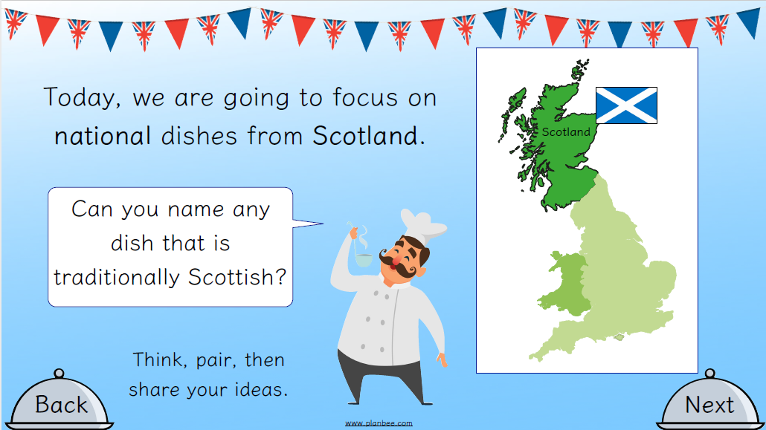
LO: To make and learn about some national Scottish dishes

Slide 61
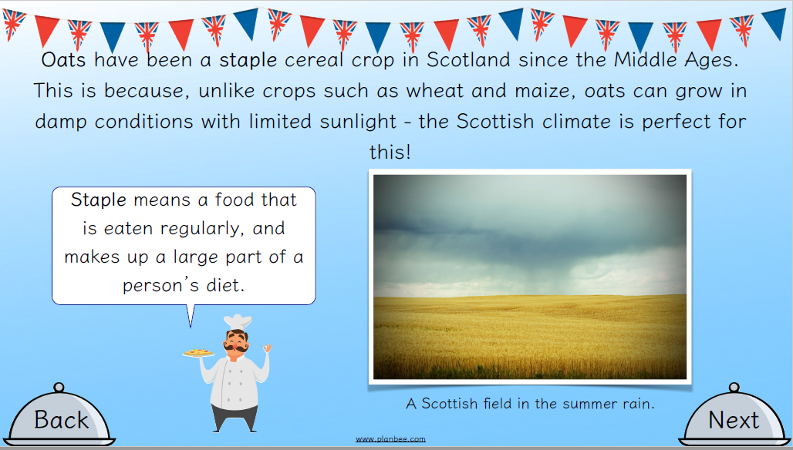
LO: To make and learn about some national Scottish dishes

Slide 62
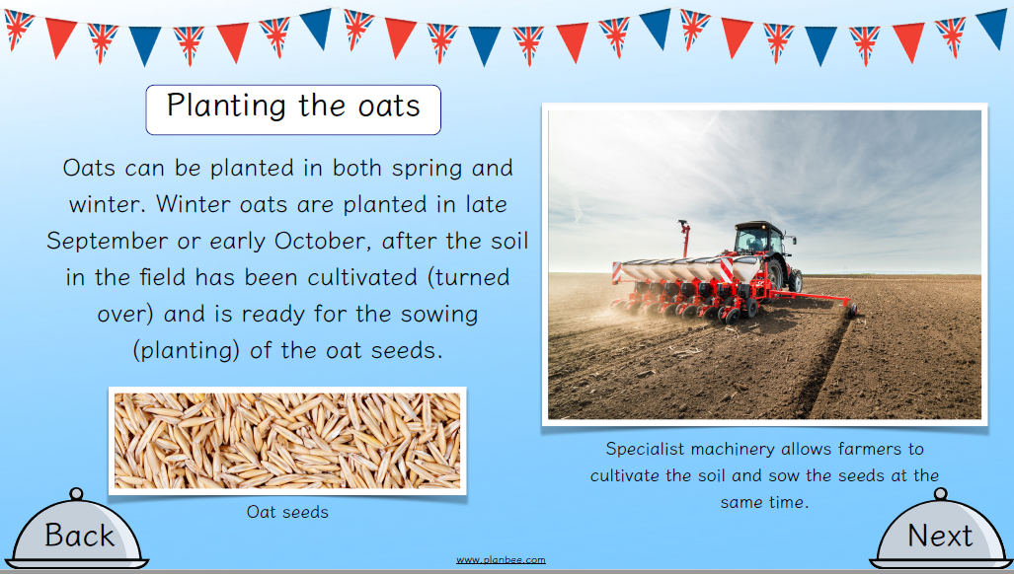
LO: To make and learn about some national Scottish dishes

Slide 63
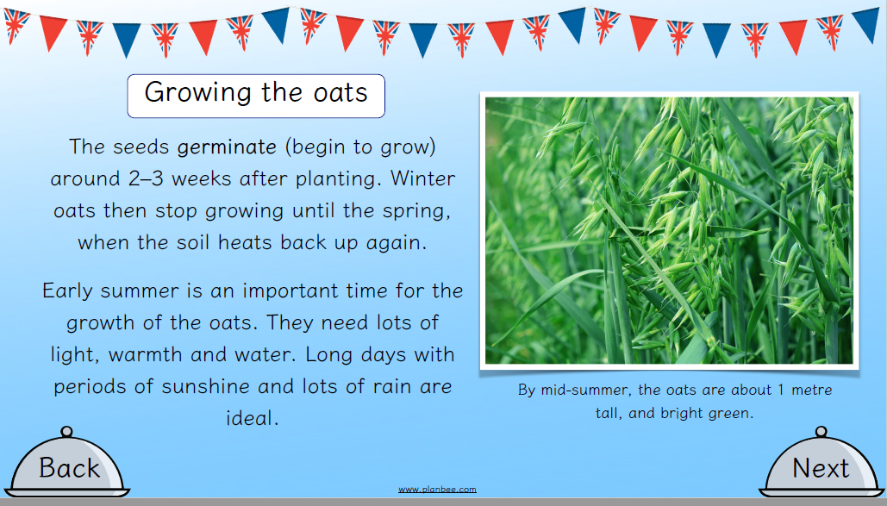
LO: To make and learn about some national Scottish dishes

Slide 64
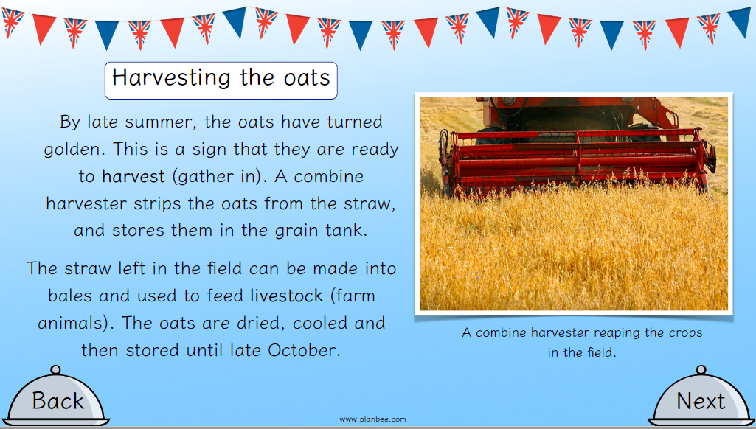
LO: To make and learn about some national Scottish dishes

Slide 65
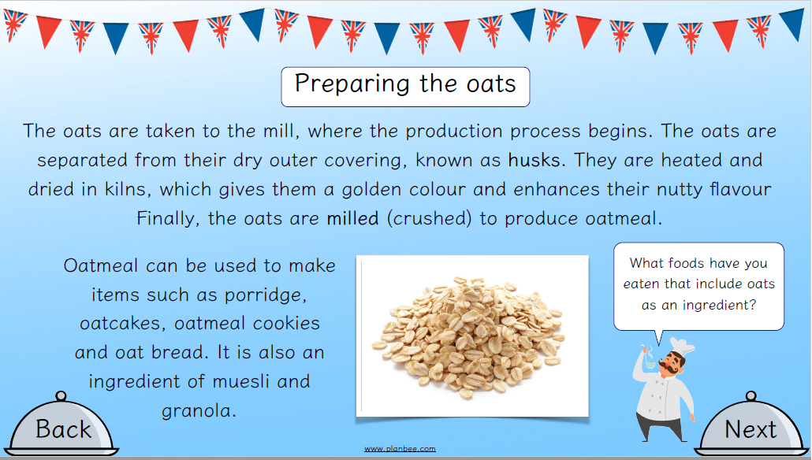
LO: To make and learn about some national Scottish dishes

Slide 66
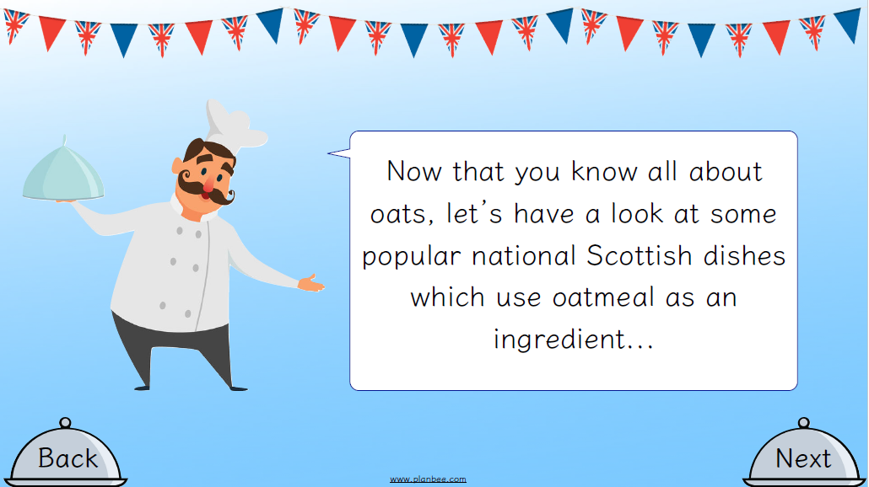
LO: To make and learn about some national Scottish dishes

Slide 67
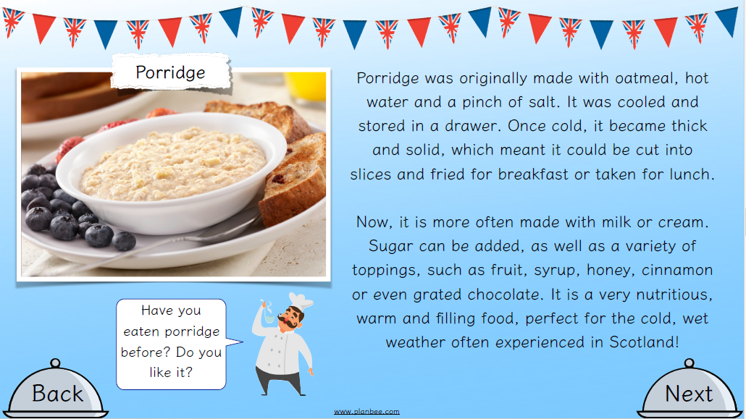
LO: To make and learn about some national Scottish dishes

Slide 68
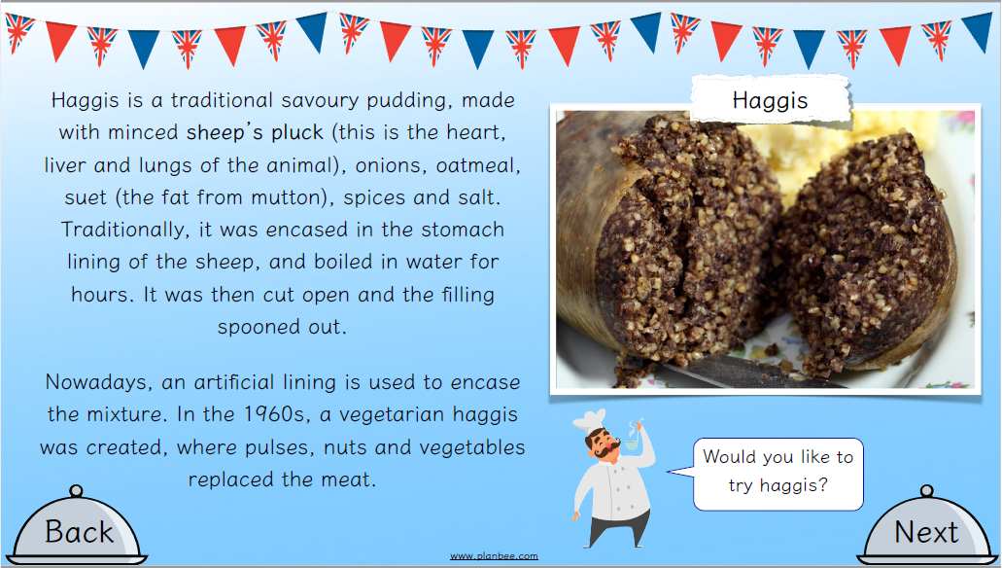
LO: To make and learn about some national Scottish dishes

Slide 69
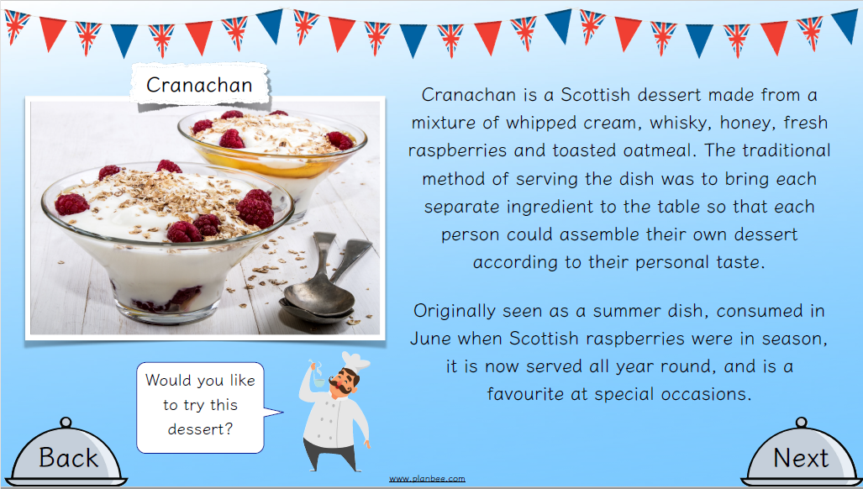
LO: To make and learn about some national Scottish dishes

Slide 70
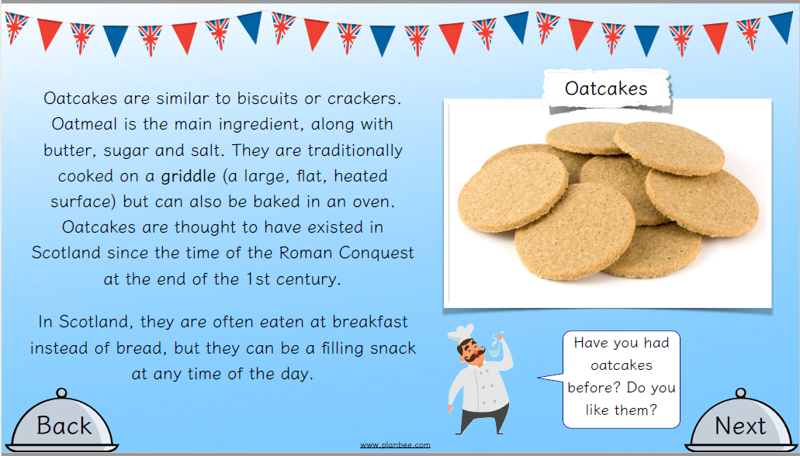
LO: To make and learn about some national Scottish dishes

Slide 71
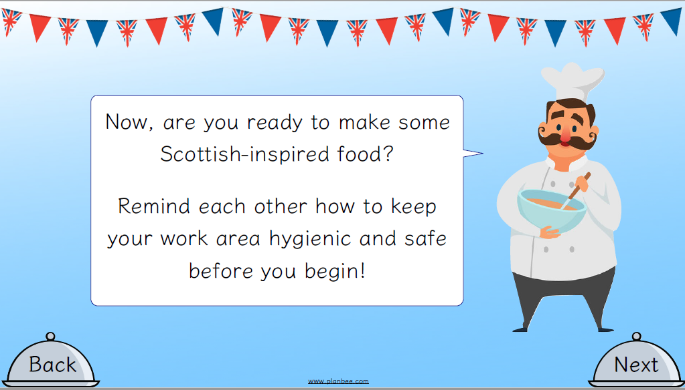
LO: To make and learn about some national Scottish dishes

Slide 72
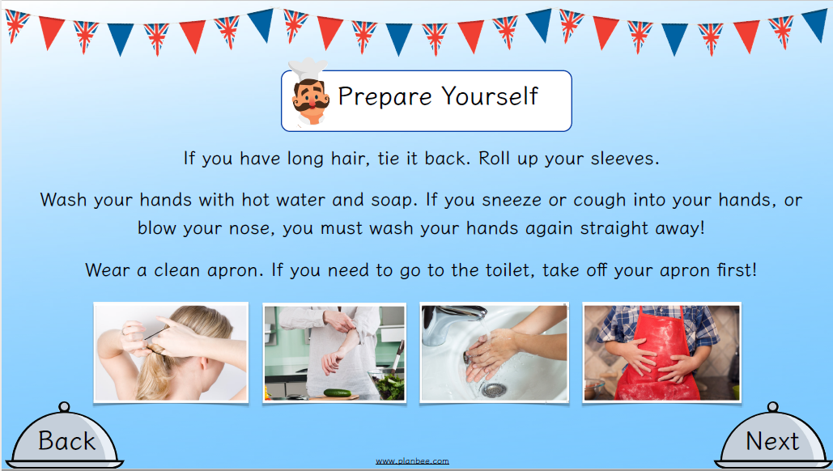
LO: To learn about and make some national English sweet dishes

Slide 73
LO: To make and learn about some national Scottish dishes
ACTIVITY
Children to use Worksheets B
Children to first design 3 toppings for Oakcakes that are savoury using the ingredients provided. To then make them, describe their appearance and taste. Then, to choose the topping they like the least and to the suggest ways to improve or change it.
Children repeat with 3 sweet toppings
HOME CHILDREN – If you are at home and can’t make the toppings, use sheet 3 and 4 and just design you savoury and sweet topping.

Slide 74
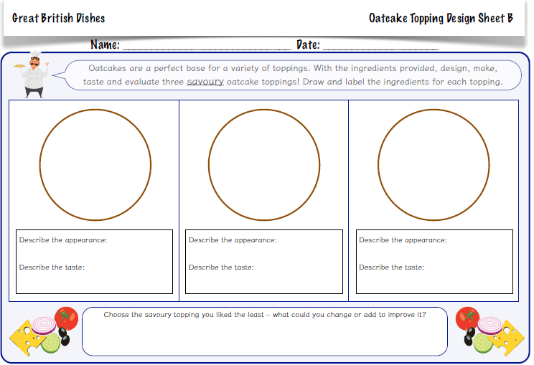
LO: To make and learn about some national Scottish dishes

Slide 75
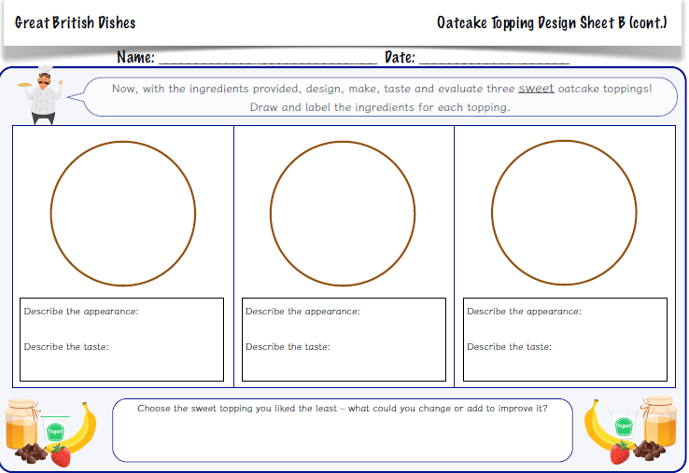
LO: To make and learn about some national Scottish dishes

Slide 76
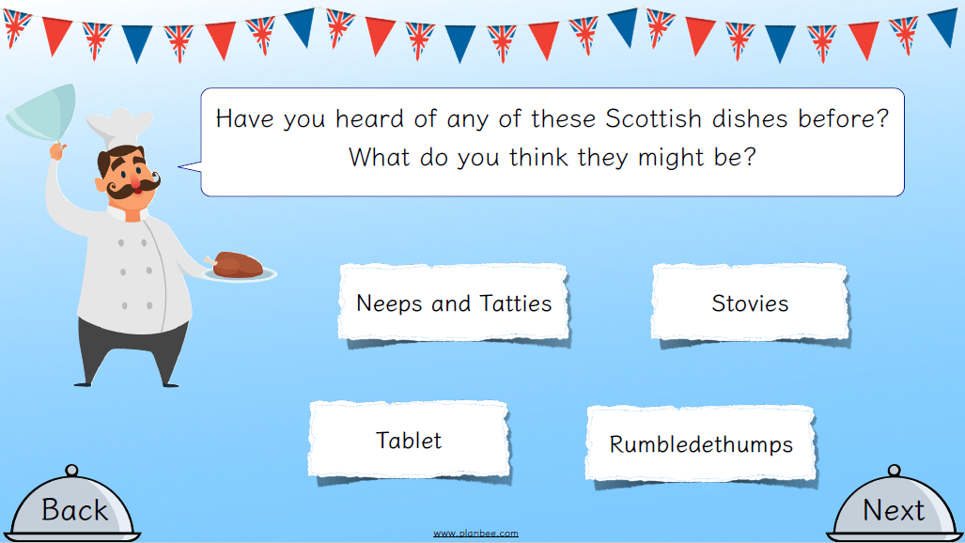
REFLECTION - LO: To make and learn about some national Scottish dishes

Slide 77
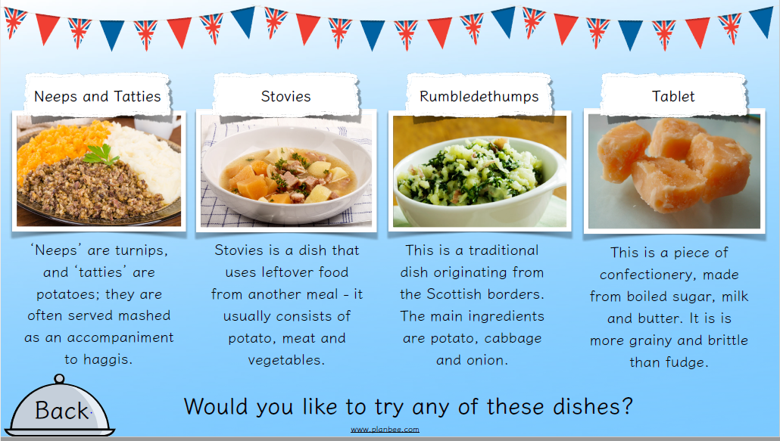
REFLECTION - LO: To make and learn about some national Scottish dishes

