Slide 1
Good Morning
Tuesday 23rd February

Slide 2
The Banana Machine – Part 2
Grandfather Michael looked his neighbour in the eye and nodded.
“I promise, and so I will,” he said. “I’ll be over at your place just after eight.”
And so it was that half the banana plantation was lost, and when it passed to Aunt Bat after Grandfather Michael died it was hardly large enough to keep one family.
Because the plantation was so small, Aunt Bat did most of the work, and she was helped by Patty and Mike. Patty and Mike had to go to school, though, and could only help afterwards. So everybody was always busy looking after the trees and trying to make sure the bananas grew as big and healthy as possible.
Retrieve
Interpret
Choice
How much of the banana plantation had Grandfather Michael lost through gambling?
What do you think it was like for Patty and Mike growing up?
What were the consequences of loosing half of the banana plantation?

Slide 3
Spelling – Look/Cover/Spell/Check
Lente, Jack, Alicia and Elliot
Rest of class
accommodation
actually
alcohol
although
analyse
analysis
argument
assessment
atmosphere
audible
therefore
though
although
thought
through
various
weight
woman
women
accommodate

Slide 4
Maths
Read the slides and do the activities

Slide 5
RECALL
Use the bus stop method to solve:
3642 ÷ 3 =
4896 ÷ 4 =
5590 ÷ 5 =

Slide 6
LO: To be able to divide a 4-digit number by a 1-digit number when there is a remainder at the end.
Top Down | Self Assessment
Some of us will even: I can solve problems and reason about questions involving dividing a 4-digit number by a 1-digit number
Some of us will: I can divide a 4-digit number by a 1-digit number when there is a remainder
Most of us will: I can divide a 3-digit number by a 1-digit number when there is a remainder
All of us will: I can divide a 2-digit number by a 1-digit number when there is a remainder

Slide 7
LO: To be able to divide a 4-digit number by a 1-digit number when there is a remainder at the end.
TP: Use the bus stop method to solve:
62 ÷ 4 =
TP: What do you notice? What is the problem? How do we write the answer?
TP: Solve 98 ÷ 5 using the bus stop method.

Slide 8
LO: To be able to divide a 4-digit number by a 1-digit number when there is a remainder at the end.
TP: How would you solve 457 ÷ 5 = using the bus stop method?
TP: Try 787 ÷ 6 =

Slide 9

LO: To be able to divide a 4-digit number by a 1-digit number when there is a remainder at the end.
TP: How would you solve 4894 ÷ 4 =?
TP: Now try:

Slide 10
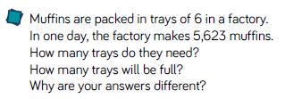
LO: To be able to divide a 4-digit number by a 1-digit number when there is a remainder at the end.

Slide 11

LO: To be able to divide a 4-digit number by a 1-digit number when there is a remainder at the end.

Slide 12
LO: To be able to divide a 4-digit number by a 1-digit number when there is a remainder at the end.
Will they all have remainders at the end?
Chilli 1 | Chilli 2 | Chilli 3
81 ÷ 5 = 82 ÷ 5 = 83 ÷ 5 = 84 ÷ 5 = 85 ÷ 5 = | 161 ÷ 4 = 162 ÷ 4 = 163 ÷ 4 = 164 ÷ 4 = 165 ÷ 4 = | 1940 ÷ 7 = 1941 ÷ 7 = 1942 ÷ 7 = 1943 ÷ 7 = 1944 ÷ 7 =
EXT: Look at chilli 3 and its pattern what is the next number that 7 will divide into that will not have a remainder at the end?

Slide 13
LO: To be able to divide a 4-digit number by a 1-digit number when there is a remainder at the end.
Will they all have remainders at the end?
Chilli 1 | Chilli 2 | Chilli 3
81 ÷ 5 = 16 r1 82 ÷ 5 = 16 r2 83 ÷ 5 = 16 r3 84 ÷ 5 = 16 r4 85 ÷ 5 = 17 | 161 ÷ 4 = 40 r1 162 ÷ 4 = 40 r2 163 ÷ 4 = 40 r3 164 ÷ 4 = 41 165 ÷ 4 = 41 r1 | 1940 ÷ 7 = 277 r1 1941 ÷ 7 = 277 r2 1942 ÷ 7 = 277 r3 1943 ÷ 7 = 277 r4 1944 ÷ 7 = 277 r5
EXT: Look at chilli 3 and its pattern what is the next number that 7 will divide into that will not have a remainder at the end? 1946 (There needs to be an example of the calculation to show this).

Slide 14
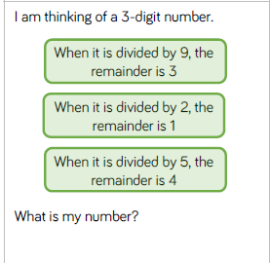
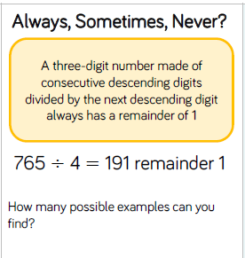
LO: To be able to divide a 4-digit number by a 1-digit number when there is a remainder at the end.

Slide 15
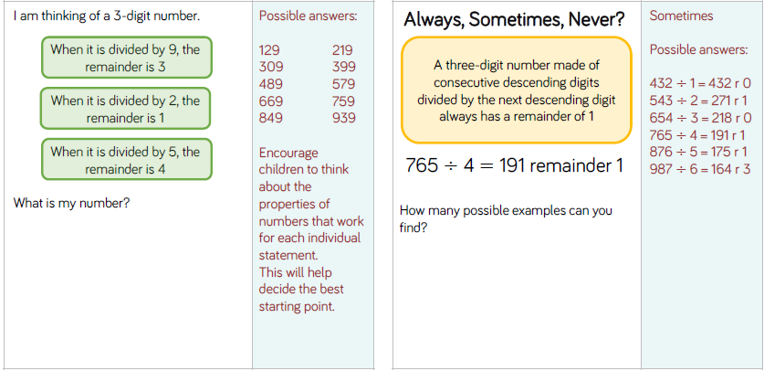
LO: To be able to divide a 4-digit number by a 1-digit number when there is a remainder at the end.

Slide 16
LO: To be able to divide a 4-digit number by a 1-digit number when there is a remainder at the end.
Top Down | Self Assessment
Some of us will even: I can solve problems and reason about questions involving dividing a 4-digit number by a 1-digit number
Some of us will: I can divide a 4-digit number by a 1-digit number when there is a remainder
Most of us will: I can divide a 3-digit number by a 1-digit number when there is a remainder
All of us will: I can divide a 2-digit number by a 1-digit number when there is a remainder

Slide 17
REFLECTION - LO: To be able to divide a 4-digit number by a 1-digit number when there is a remainder at the end.
SELF ASSESSMENT

Slide 18
Assembly and Break

Slide 19
English – Traditional Tales Lesson 2
LO: To be able to identify the features of a traditions tale
LO: To be able to use – and () correctly when using parenthesis to add meaning and interest to writing
Read the slides and do the activities

Slide 20
Introduction
The genre we will be focusing on for 2 weeks is Traditional Tales.
We will be focusing on the Traditional Tale of the ‘Firebird’.
We will be focusing on grammar of: Fronted adverbials, parenthesis, relative clauses, Inverted commas and complex sentences and descriptive/figurative language.
You will be asked to rewrite the story of ‘Firebird’.
Group A will change: Setting, characters, Firebird and main animal
Group B will change: Setting and characters
Group C will rewrite the story.

Slide 21
LO: To be able to identify the features of a traditions tale
Traditional tales are stories that have been told and retold for many years. Often they are passed down through generations. Therefore, they become a story that many people know. There are often lots of different versions of the same story.
Traditional tales are also known as fairy stories or fairy tales.

Slide 22
LO: To be able to identify the features of a traditions tale
Traditional Tales
Core Features
A simple beginning, series of events in the middle leading to a predictable outcome
Details and descriptions support the plot
The story is for telling and re-telling

Slide 23
LO: To be able to identify the features of a traditions tale
Language Features
• A simple traditional opening e.g. one day, once upon a time, Long, long ago
• A simple traditional ending e.g. And they lived happily ever after, always keep your promises
• Evil Characters.
• Characters are often foolish or play tricks
• Animals have human attributes
• People are stereotyped e.g. princesses are pretty
• The number 3 is important e.g. three bears
• Magical or supernatural forces e.g. fairies
• Clear values e.g. honesty
• Literal description e.g. red riding hood had a red cloak

Slide 24
LO: To be able to identify the features of a traditions tale
For the next to lessons we are going to read ‘Firebird’. We are going to identify the features of a traditional tale in this story and make notes and explain the features that we find.
You need to pay close attention to the story as over the next 2 weeks we will be either retelling the story in more detail OR basing our stories on this one.
First, we will read a page of the story.
Next, discuss any features there are.
Then, record these features in our grids.

Slide 25
LO: To be able to identify the features of a traditions tale
Feature | Chapter 1 | Chapter 2 | Chapter 2 | Chapter 4 | Chapter 5
A simple traditional opening
A simple traditional ending
Evil Characters.
Characters are often foolish or play tricks
Animals have human attributes
People are stereotyped
The number 3 is important
Magical or supernatural forces
Clear values

Slide 26
REFLECTION - LO: To be able to identify the features of a traditions tale
Which features did you find?

Slide 27
LO: To be able to use – and () correctly when using parenthesis to add meaning and interest to writing
Parenthesis
Means adding extra information in a sentence. We can use the comma, brackets or dashes to do this.

Slide 28
LO: To be able to use – and () correctly when using parenthesis to add meaning and interest to writing
Brackets ()
Brackets are used to separate information from the rest of the sentence.
Uncle Nigel (my dad’s brother) works on a farm.
Or
I don’t like white chocolate (it’s to sweet).
The bit is the brackets is the extra information. The rest of the sentence would still make sense without it.

Slide 29
LO: To be able to use – and () correctly when using parenthesis to add meaning and interest to writing
TP: Look at these sentences. Discuss was extra information (parenthesis) could go in these brackets.
Many years ago there was a Tsar ( ) who was rich and powerful.
The Tsar had 3 sons ( ) who we all very different.
When a golden apple fell to the ground, he allowed only his trusted, old gardener ( ) to pick them up.
The Tsar’s 2 oldest sons ( ) sniggered at the old Gardener.

Slide 30
LO: To be able to use – and () correctly when using parenthesis to add meaning and interest to writing
Now write out these sentences adding the extra information (parenthesis) using brackets to show this.
Many years ago there was a Tsar ( ) who was rich and powerful.
The Tsar had 3 sons ( ) who we all very different.
When a golden apple fell to the ground, he allowed only his trusted, old gardener ( ) to pick them up.
The Tsar’s 2 oldest sons ( ) sniggered at the old Gardener.

Slide 31

Chapter 2 – Home is Where the Farm is
Lesson 8
LO: To be able to make inferences from the text and explain and justify inferences with evidence from the text (2d)
What does tottering mean?

Slide 32
Chapter 2 – Home is Where the Farm is
Lesson 8
LO: To be able to make inferences from the text and explain and justify inferences with evidence from the text (2d)
What does tottering mean?
Verb. walking with difficulty in a way that looks as if you are about to fall:

Slide 33
LO: To be able to make inferences from the text and explain and justify inferences with evidence from the text (2d)
Read from Paragraph 11 to end of chapter
P11 – Does Elliot like Mrs Porshley-Plum? How do you know? (2d) Repeat question several times during paragraph
P11 – What does ample mean? (2a) If the shape of someone's body or a part of their body is ample, it is large
P12, 13, 14 – What was Mrs P trying to get the family to do? From this, what kind of a person is the author trying to portray Mrs P as? How?
P21 – ‘Elliot’s stomach tightened into a familiar knot. The back door was ajar. His heart plummeted.’ (2g). What does this phrase tell us about how Elliot is feeling?

Slide 34
Patricia Porshley-Plum…
LO: To be able to make inferences from the text and explain and justify inferences with evidence from the text (2d)
Elliot does not seem to like Mrs Porshley-Plum.
True/ False/ Both

Slide 35
Lunch

Slide 36
Take 5

Slide 37
Story
Read a traditional Tale

Slide 38

jeopardized

Slide 39
jeopardized
What could it mean?
“So if you could beam me back to my jeopardized mortal life, I’d be grateful.”

Slide 40
jeopardized
SAY IT AND FEEL THE SYLLABLES
SAY IT TO THE BIN
SAY IT TO SOMEONE ON ANOTHER TABLE
WHISPER IT TO THE FLOOR
SAY IT TO YOUR BOOK
REPEAT IT AFTER ME
SAY IT TO THE WINDOW
WHISPER IT TO A WALL

Slide 41
jeopardized
Verb. to put something such as a plan or system in danger of being harmed or damaged

Slide 42
jeopardized
She knew that by failing her finals she could jeopardize her whole future.
007 knew if he did not catch Spectre, the future of the whole world would be jeopardized.

Slide 43
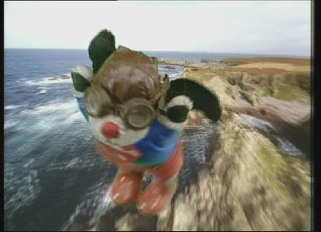
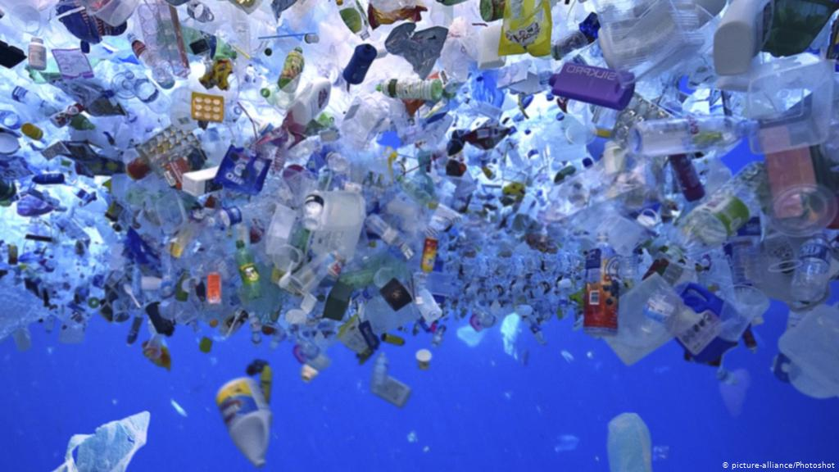
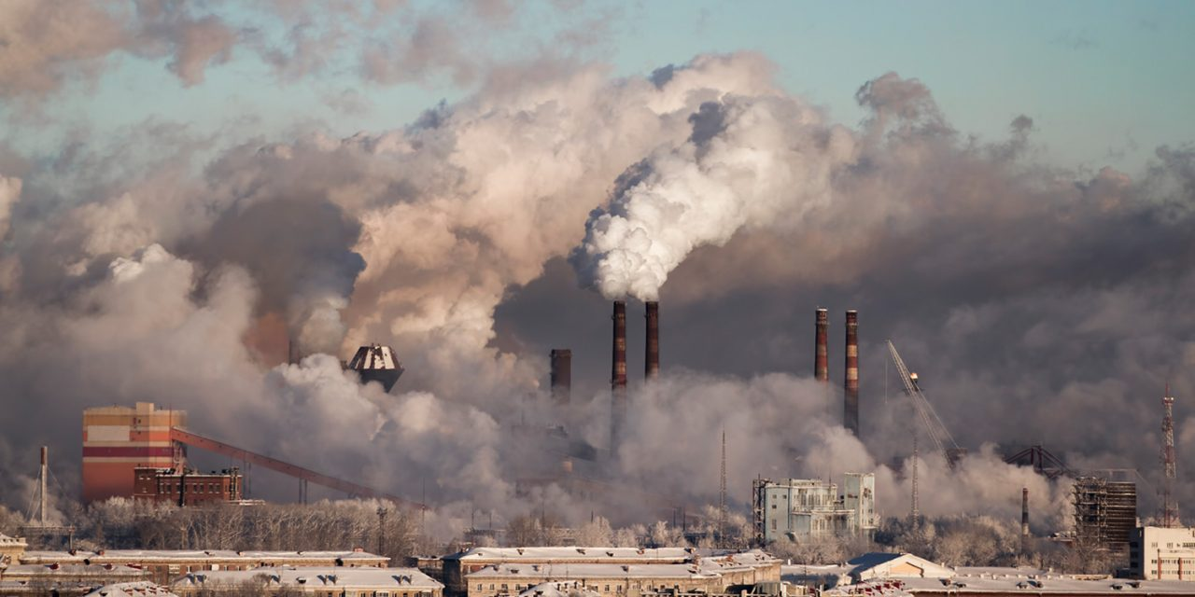


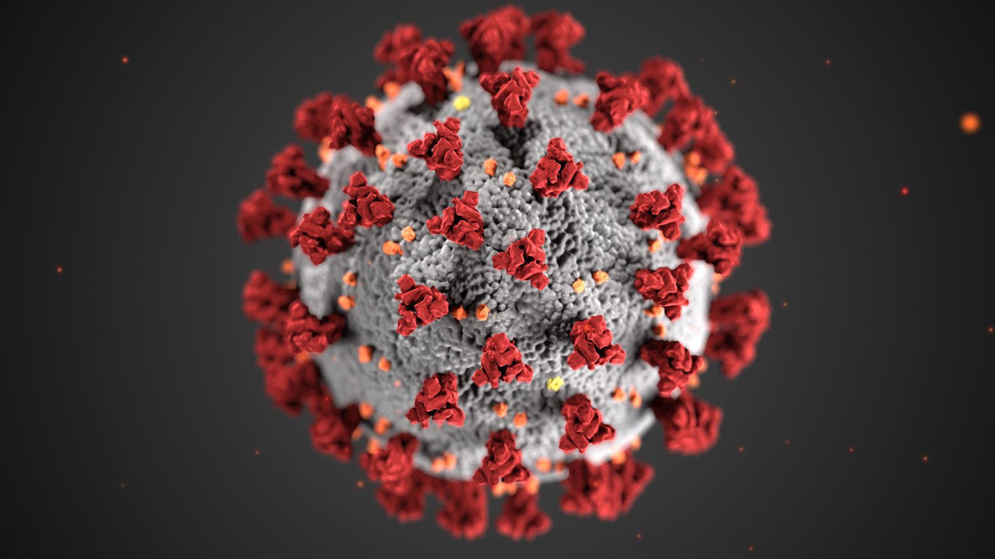
jeopardized
Say jeopardized if you see someone or something that could harm you or something.

Slide 44
jeopardized
In your books, write the word, the definition and use it in a sentence/draw a picture.

Slide 45
jeopardized
Verb. to put something such as a plan or system in danger of being harmed or damaged
Add parenthesis to these sentences with jeopardized in.
Plastic, , in the water jeopardizes the fate of many animals.
James Bond, , stopped Spectre’s plan that would jeopardize the whole world’s freedom.
Covid-19, , has jeopardized the lives of many people.

Slide 46
Handwriting
Alcohol
Although
Therefore
though

Slide 47
LO: Selected words from statutory spelling lists
Build a pyramid
A
Ac
Acc
Acco
Accom
Accomm
Accommo
Accommod
Accommoda
Accommodat
Accommodati
Accommodatio
accommodation

Slide 48
LO: Selected words from statutory spelling lists
accommodation
actually
alcohol
although
analyse
analysis
argument
assessment
atmosphere
audible
therefore
though
although
thought
through
various
weight
woman
Women
accommodate

Slide 49
Arithmetic Test

Slide 50
PSHE - Lesson 1
LO: To understand what democracy is and how people take part in it

Slide 51
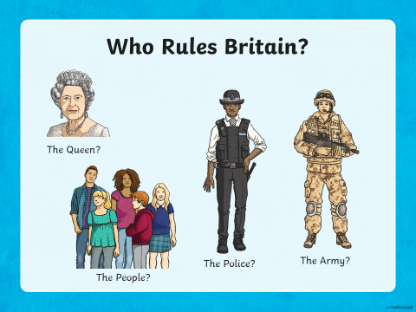
LO: To understand what democracy is and how people take part in it

Slide 52
What Does Democracy Mean?
We have a system of government called democracy.
Democracy means ‘rule by the people’. It comes from the Greek words Dêmos, which means people, and krátos which means rule or strength.
This is because the idea of democracy developed in Greece in about 507 BC.

Slide 53
LO: To understand what democracy is and how people take part in it
Watch:
https://www.youtube.com/watch?app=desktop&v=BmKrJdMwsks
TP: How can everybody rule? It would be chaos! Do you know how everybody does rule?

Slide 54
LO: To understand what democracy is and how people take part in it
We hold an election to choose someone to represent us.
Most candidates who ’stand’ for election belong to a political party – a group of people who share similar beliefs.
Together, people who belong to the party agree on changes they will make if they are elected. These are called policies.
TP: Can you name any political parties or their leaders?

Slide 55
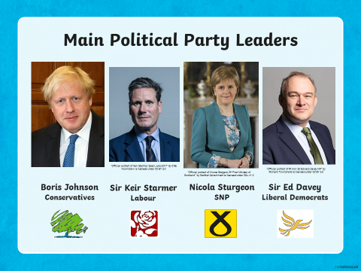
LO: To understand what democracy is and how people take part in it

Slide 56
LO: To understand what democracy is and how people take part in it
Our democracy is a system of government with four special features:
Allows people a way of choosing and replacing their representatives through free and fair elections.
Protects the human rights of all citizens.
Depends on laws, which apply equally to all citizens.
Encourages citizens to participate in politics and community life.

Slide 57
LO: To understand what democracy is and how people take part in it
Voting
Every citizen should listen to the views of the different parties and candidates and then make his or her own decision on whom to support.
A general election takes place around every five years although they can be held earlier if the party in government decide to hold one earlier.
People must be 18 or over in order to take part in an election.
Each person (voter) votes (‘casts a ballot’) for the candidate of his or her choice. S/he does this by putting a cross beside the person’s name on the ballot paper.
People cast their ballots in a booth so that no one can see who they are voting for. This is called a ‘secret ballot’.
At the end of the election day, the votes are added up and the candidate with the highest number of votes (the majority) is declared the winner

Slide 58
LO: To understand what democracy is and how people take part in it
TP: Do you think voting is necessary?
TP: Do you think 18 is the right age to allow people to vote? Why? If not, what age do you think people should be allowed to vote?

Slide 59




Elected Representatives
Elected representatives – MPs (Member of Parliament) in all forms of government should listen to the people and respond to their needs and suggestions.
People are free to criticise all their elected leaders and representatives and to look closely at how they govern.
Elected leaders and representatives hold power only temporarily.
I think you’re
wrong about
that.
I disagree.
That’s not very good.
I’m not happy
with that.

Slide 60
LO: To understand what democracy is and how people take part in it
ACTIVITY
Imagine you are running for election as an MP. How could you persuade people to vote for you? What do you think people want? Research an issue that is important to you and write about it telling the people what you would do.

Slide 61
REFLECTION - LO: To understand what democracy is and how people take part in it
What have you found out about democracy so far?

