Slide 1
Good Morning
Monday 22nd February

Slide 2

The Banana Machine – Part 1
Grandfather Michael has gambled away half of his banana plantation.
Now there were some neighbours who would have laughed and said:
“No worry. We’d never take away your land.” But the man who had won the land was not like that. He took up the piece of paper, folder it carefully, and put it in his pocket. Then he said,
“That’s just fine, then. Give me the deeds to the land tomorrow morning.”
Evidence
Retrieve
Interpret
Choice
What does plantation mean?
An estate where cars are made
An estate that people go and visit
An estate where crops are grown
What fruit did they grow on the plantation?
How do you think Grandfather Michael was feeling?
Why do you think the man who had won the land wanted the deeds of the land?

Slide 3
Spelling – Look/Cover/Spell/Check
Lente, Jack, Alicia and Elliot
Rest of class
accommodation
actually
alcohol
although
analyse
analysis
argument
assessment
atmosphere
audible
therefore
though
although
thought
through
various
weight
woman
women
accommodate

Slide 4
Maths
Read the slides and do the activities

Slide 5
RECALL
Use the bus stop method to solve:
3333 ÷ 3 =
3336 ÷ 3 =
3339 ÷ 3 =

Slide 6
LO: To be able to divide a 4-digit number by a 1-digit number with remainders within the questions
Top Down | Self Assessment
Some of us will even: I can solve problem solving and reasoning questions when dividing a 4-digit number by a 1-digit number
Some of us will: I can divide a 4-digit number by a 1-digit number when there are remainders within the question
Most of us will: I can divide a 3-digit number by a 1-digit number when there are remainders within the question
All of us will: I can divide a 2-digit number by a 1-digit number when there are remainders within the question

Slide 7
LO: To be able to divide a 4-digit number by a 1-digit number with remainders within the questions
4892 ÷ 4 =
TP: Discuss with your partner how you would solve this question. Are there any problems you will encounter?

Slide 8
LO: To be able to divide a 4-digit number by a 1-digit number with remainders within the questions
4892 ÷ 4 =
The problem you will encounter is when you get to the 9 tens.
4 does not divide into 9 tens without a remainder.
4 does divide into 8 tens twice but what do we do with the remaining 1 ten?
We exchange it over to the 2 ones to make it 12 ones. We put this remainder as a small 1 at the right hand top side of the 2.
4 does divide into 12 ones 3 times.

Slide 9

LO: To be able to divide a 4-digit number by a 1-digit number with remainders within the questions

Slide 10

LO: To be able to divide a 4-digit number by a 1-digit number with remainders within the questions
TP: What calculation must we use to solve this?
TP: Solve the problem

Slide 11
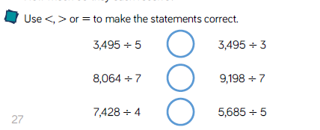
LO: To be able to divide a 4-digit number by a 1-digit number with remainders within the questions

Slide 12
LO: To be able to divide a 4-digit number by a 1-digit number with remainders within the questions
Chilli 1 | Chilli 2 | Chilli 3
76 ÷ 4 = 75 ÷ 5 = 75 ÷ 3 = | 565 ÷ 5 = 575 ÷ 5 = 585 ÷ 5 = 595 ÷ 5 = | 3642 ÷ 3 = 4896 ÷ 4 = 5590 ÷ 5 = 6696 ÷ 6 = 7798 ÷ 7 =
EXT: When do you know a number is divisible by 5?

Slide 13
LO: To be able to divide a 4-digit number by a 1-digit number with remainders within the questions
Chilli 1 | Chilli 2 | Chilli 3
76 ÷ 4 = 19 75 ÷ 5 = 15 75 ÷ 3 = 25 | 565 ÷ 5 = 113 575 ÷ 5 = 115 585 ÷ 5 = 117 595 ÷ 5 = 119 | 3642 ÷ 3 = 1214 4896 ÷ 4 = 1224 5590 ÷ 5 = 1198 6696 ÷ 6 = 1116 7798 ÷ 7 = 1114
EXT: When do you know a number is divisible by 5? If the number ends in 0 or 5

Slide 14
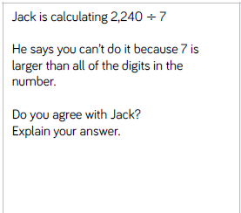
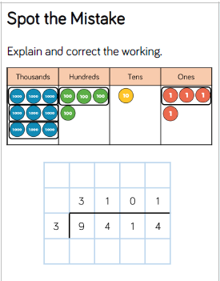
LO: To be able to divide a 4-digit number by a 1-digit number with remainders within the questions

Slide 15
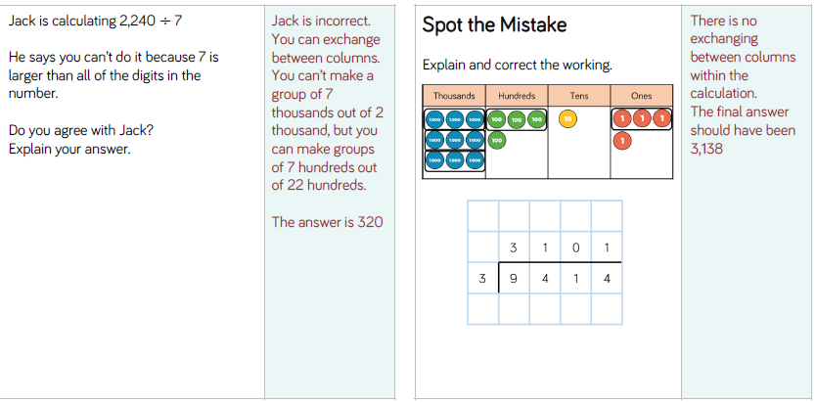
LO: To be able to divide a 4-digit number by a 1-digit number with remainders within the questions

Slide 16
LO: To be able to divide a 4-digit number by a 1-digit number with remainders within the questions
Top Down | Self Assessment
Some of us will even: I can solve problem solving and reasoning questions when dividing a 4-digit number by a 1-digit number
Some of us will: I can divide a 4-digit number by a 1-digit number when there are remainders within the question
Most of us will: I can divide a 3-digit number by a 1-digit number when there are remainders within the question
All of us will: I can divide a 2-digit number by a 1-digit number when there are remainders within the question

Slide 17
REFLECTION - LO: To be able to divide a 4-digit number by a 1-digit number with remainders within the questions
SELF ASSESSMENT

Slide 18
Assembly and Break

Slide 19
English
Read the slides and do the activities

Slide 20
LO: To be able to identify the features of a traditions tale
Traditional tales are stories that have been told and retold for many years. Often they are passed down through generations. Therefore, they become a story that many people know. There are often lots of different versions of the same story.
Traditional tales are also known as fairy stories or fairy tales.

Slide 21
LO: To be able to identify the features of a traditions tale
Traditional Tales
Core Features
A simple beginning, series of events in the middle leading to a predictable outcome
Details and descriptions support the plot
The story is for telling and re-telling

Slide 22
LO: To be able to identify the features of a traditions tale
Language Features
• A simple traditional opening e.g. one day, once upon a time, Long, long ago
• A simple traditional ending e.g. And they lived happily ever after, always keep your promises
• Evil Characters.
• Characters are often foolish or play tricks
• Animals have human attributes
• People are stereotyped e.g. princesses are pretty
• The number 3 is important e.g. three bears
• Magical or supernatural forces e.g. fairies
• Clear values e.g. honesty
• Literal description e.g. red riding hood had a red cloak

Slide 23
LO: To be able to identify the features of a traditions tale
For the next to lessons we are going to read ‘Firebird’. We are going to identify the features of a traditional tale in this story and make notes and explain the features that we find.
You need to pay close attention to the story as over the next 2 weeks we will be either retelling the story in more detail OR basing our stories on this one.
First, we will read a page of the story.
Next, discuss any features there are.
Then, record these features in our grids.

Slide 24
LO: To be able to identify the features of a traditions tale
Feature | Chapter 1 | Chapter 2 | Chapter 2 | Chapter 4 | Chapter 5
A simple traditional opening
A simple traditional ending
Evil Characters.
Characters are often foolish or play tricks
Animals have human attributes
People are stereotyped
The number 3 is important
Magical or supernatural forces
Clear values

Slide 25
REFLECTION - LO: To be able to identify the features of a traditions tale
Which features did you find?

Slide 26
Reading Comprehension
Who Let the God’s Out!

Slide 27

Chapter 2 – Home is Where the Farm is
Lesson 7
LO: To be able to make inferences from the text and explain and justify inferences with evidence from the text (2d)
What does irritating mean?

Slide 28
Chapter 2 – Home is Where the Farm is
Lesson 7
LO: To be able to make inferences from the text and explain and justify inferences with evidence from the text (2d)
What does irritating mean?
Adjective - making you feel annoyed

Slide 29
LO: To be able to make inferences from the text and explain and justify inferences with evidence from the text (2d)
Detectives
In Chapter 2 (P9-11), the author drops lots of clues about Elliot and his life.
TP: Read the text carefully noting the important clues.
TP: Discuss with your partner what you think they tell you as the reader.
What points are we told about the reader?
What does this tell us about the reader?
Can you summarise Elliot’s life before and after.
Model
Answer this question using PEE

Slide 30
LO: To be able to make inferences from the text and explain and justify inferences with evidence from the text (2d)
Detectives
In Chapter 2 (P9-11), the author drops lots of clues about Elliot and his life.
Read the text carefully noting the important clues.
Discuss what you think they tell you as the reader.
Point – What does it tell us about the reader.
Evidence – There are several points made. List them all.
Explanation – Explain what each points tell us about his life that supports your point.

Slide 31
LO: To be able to make inferences from the text and explain and justify inferences with evidence from the text (2d)
Detectives
In Chapter 2 (P9-11), the author drops lots of clues about Elliot and his life.
Read the text carefully noting the important clues.
Discuss what you think they tell you as the reader.
Point – What does it tell us about the reader.
Evidence – There are several points made. List them all.
Explanation – Explain what each points tell us about his life that supports your point.

Slide 32
Lunch

Slide 33
D.T. – Great British Dishes
Spring 2

Slide 34
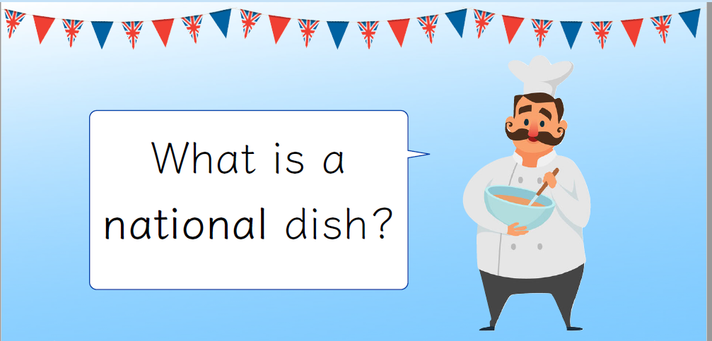
LO: To learn about and make some national English savoury dishes

Slide 35
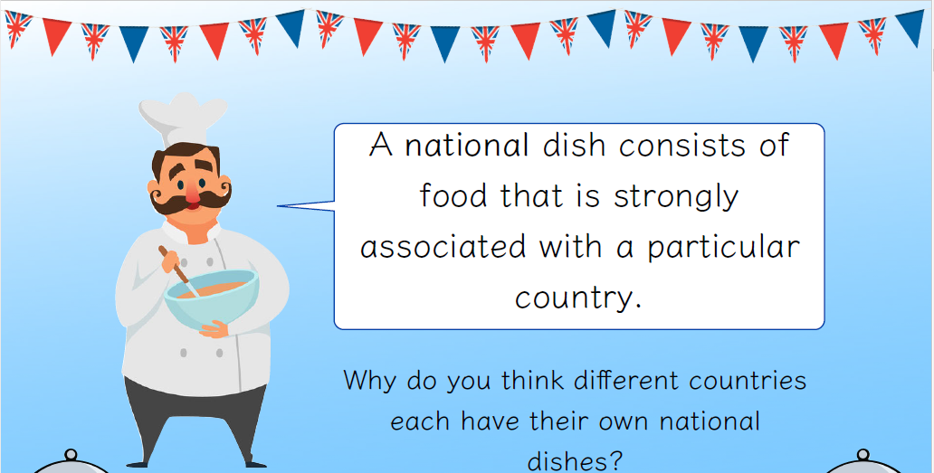
LO: To learn about and make some national English savoury dishes

Slide 36
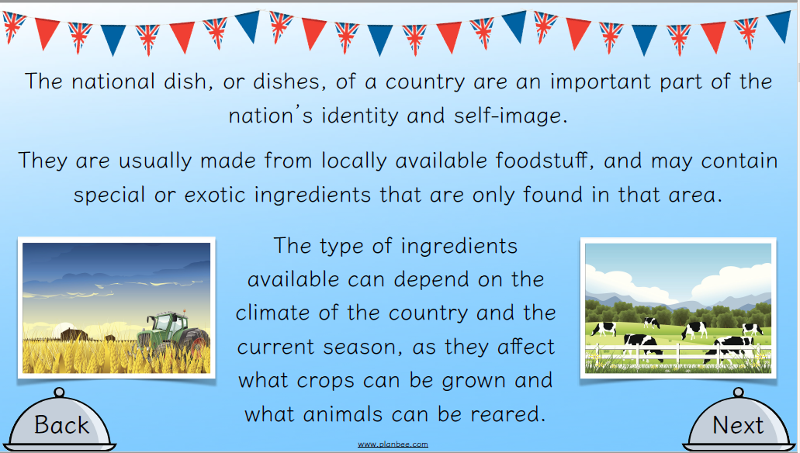
LO: To learn about and make some national English savoury dishes

Slide 37
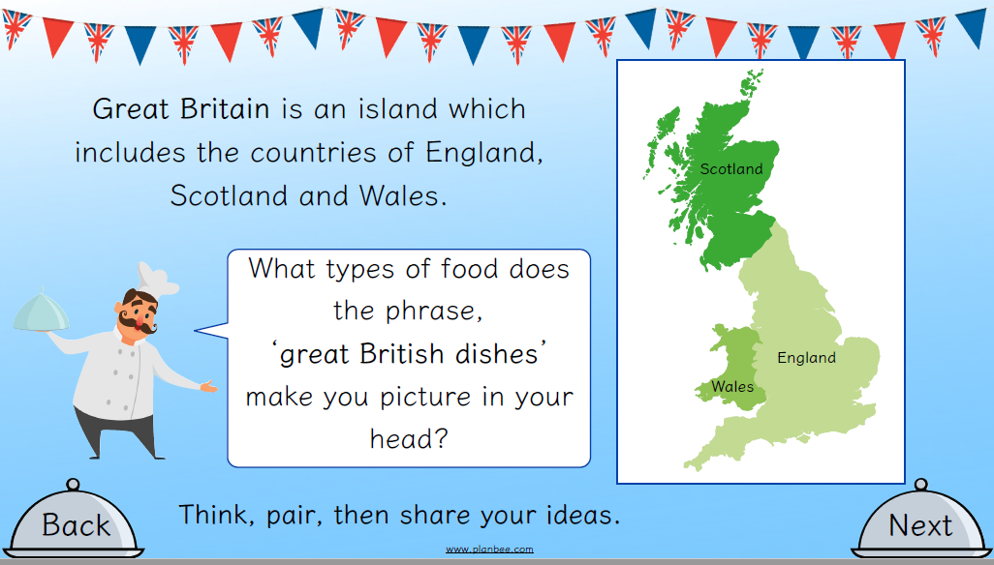
LO: To learn about and make some national English savoury dishes

Slide 38
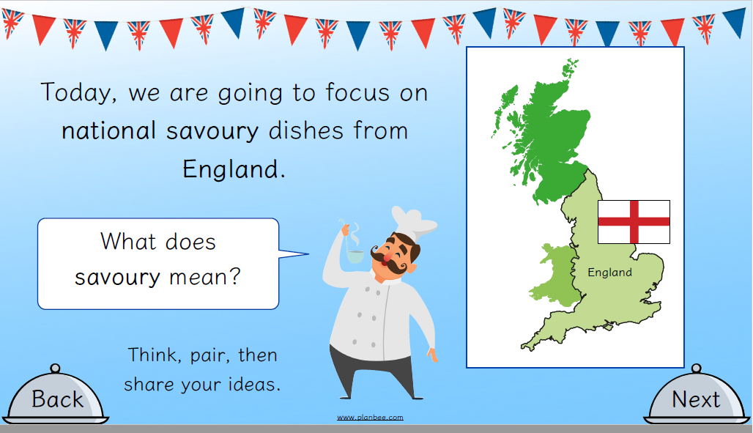
LO: To learn about and make some national English savoury dishes

Slide 39
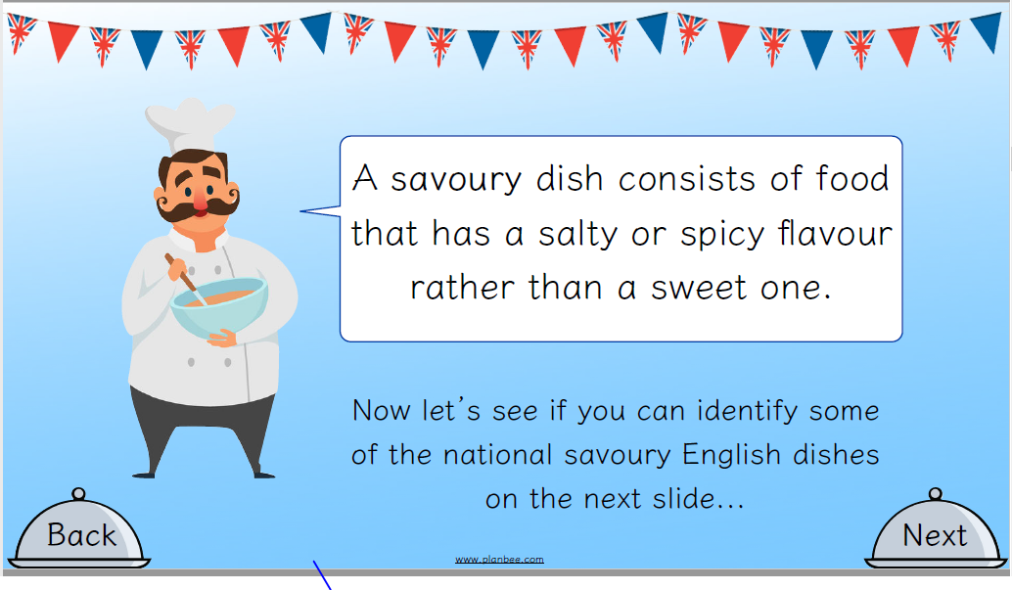
LO: To learn about and make some national English savoury dishes

Slide 40

LO: To learn about and make some national English savoury dishes

Slide 41
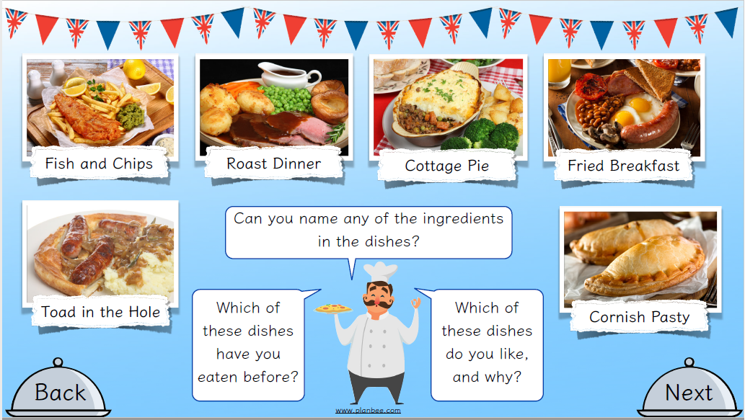
LO: To learn about and make some national English savoury dishes

Slide 42
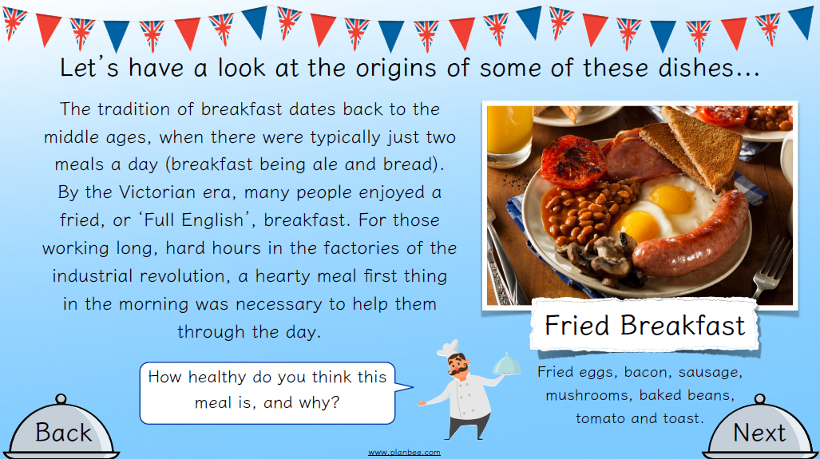
LO: To learn about and make some national English savoury dishes

Slide 43
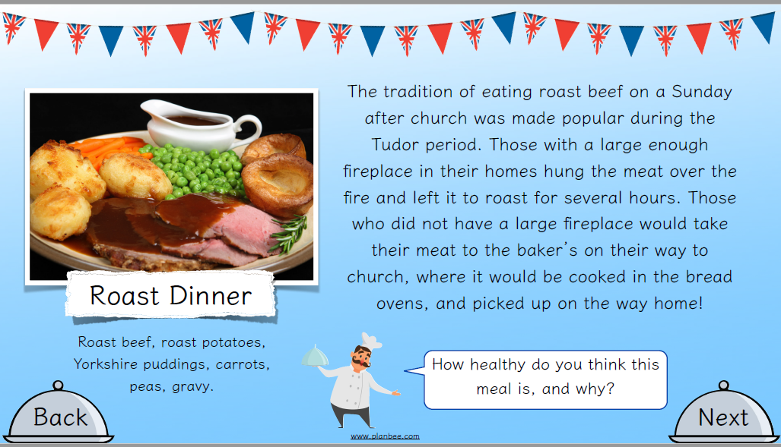
LO: To learn about and make some national English savoury dishes

Slide 44
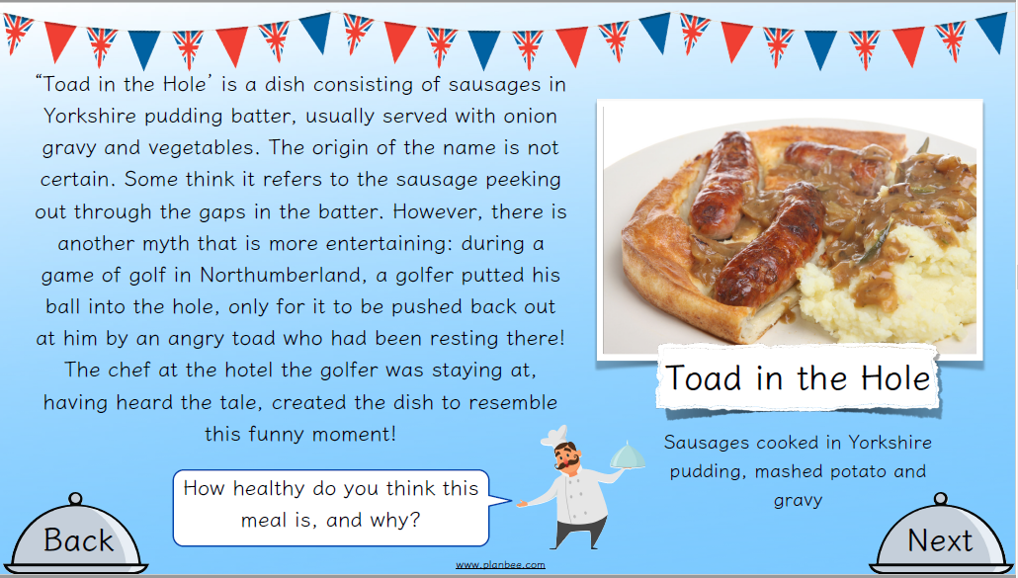
LO: To learn about and make some national English savoury dishes

Slide 45
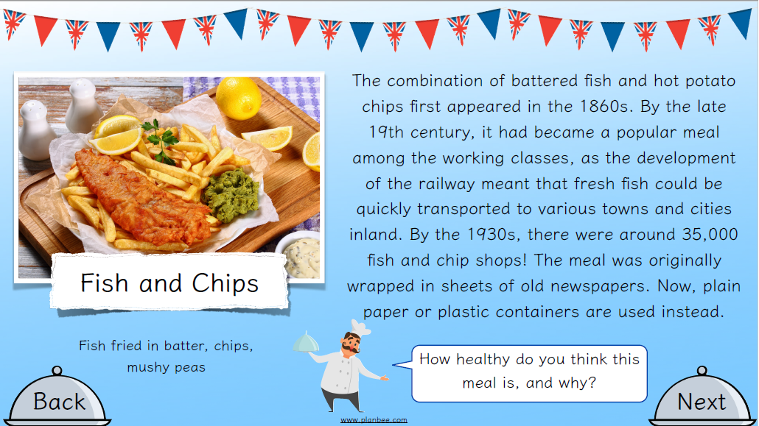
LO: To learn about and make some national English savoury dishes

Slide 46
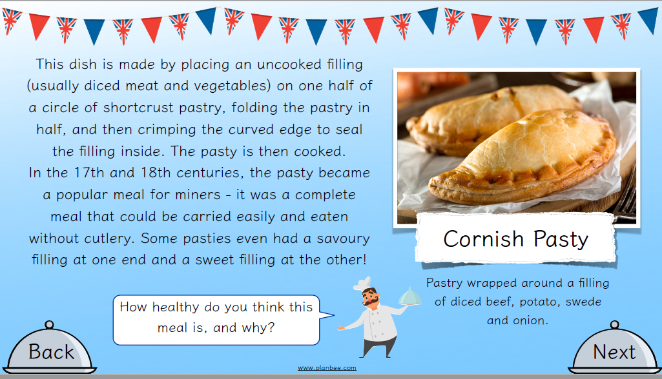
LO: To learn about and make some national English savoury dishes

Slide 47
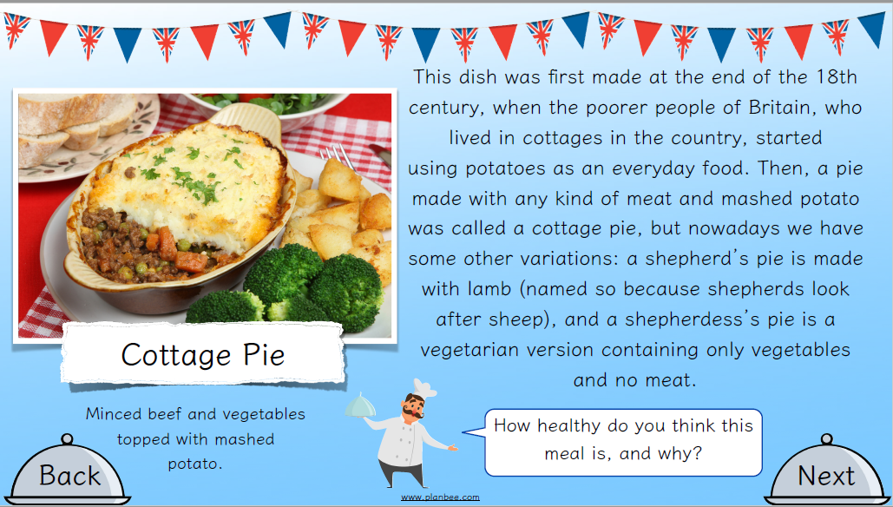
LO: To learn about and make some national English savoury dishes

Slide 48
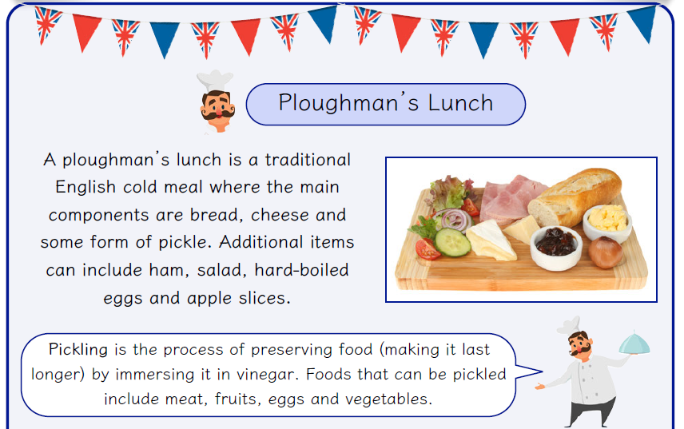
LO: To learn about and make some national English savoury dishes

Slide 49
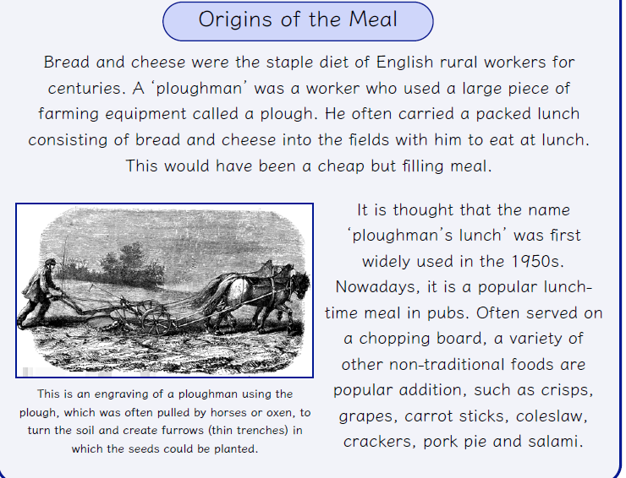
LO: To learn about and make some national English savoury dishes

Slide 50
LO: To learn about and make some national English savoury dishes
ACTIVITY
You are going to design your own version of a Ploughman’s Lunch. You can include additional food items to make your lunch tastier/more appealing.
First, you are going to taste different cheeses, breads and pickles. On your sheet you will fill in the name of the cheese/bread/pickle, make comments about its taste, texture and appearance and give it an overall score.
Then, using what you have found out you will design your own Ploughman’s Lunch labelling all the components.
People working from home, you will need pages 6 & 7.

Slide 51
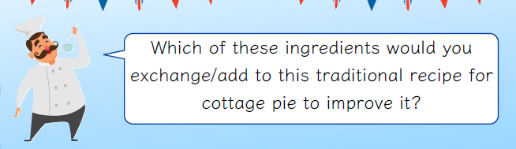
REFLECTION - LO: To learn about and make some national English savoury dishes
Ingredients
Bread
Cheese
Ham
Pickle
Lettuce
Tomato
Cucumber
Onion

