Slide 1
Good Morning
Friday 5th February

Slide 2

Theseus and the Minotaur – Part 4
Nine years passed very quickly. It was just about time for Athens to send seven boys and seven girls to Crete to be eaten by the Minotaur. Seven girls and six boys had taken their place to go to Crete. Everyone in Athens was upset. Prince Theseus, son of King Aegeus, knew the importance of keeping your word. However, he also knew that it was wrong for his father to send small children to Crete to be eaten by the Minotaur just to avoid a battle with King Minos. Theseus told his father that he was going to Crete as the seventh boy and swore he would kill the monster and end the terror.
Evidence
Retrieve
Interpret
Choice
Which word would sum up the phrase ‘the importance of keeping your word’.
Principal
Disloyal
Cheating
What was the relationship between Theseus and King Aegeus?
How would the children be feeling who were being sent to Crete?
What do you think King Aegeus should have done?

Slide 3
Spelling Test

Slide 4
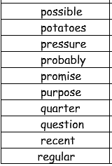
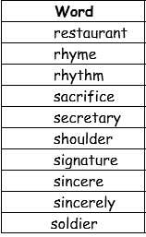
Spellings – Look/Cover/Spell/Check
Lente, Jack, Elliot, Alicia

Slide 5
Maths – Year 4 Catch Up
Read the Slides and do the activities

Slide 6
RECALL – Look at the diagrams. What fraction is highlighted red and what is its decimal equivalent?
1/10 | 1/10 | 1/10 | 1/10 | 1/10
1/10 | 1/10 | 1/10 | 1/10 | 1/10
Fraction =
Decimal fraction =

Slide 7
RECALL – Look at the diagrams. What fraction is highlighted red and what is its decimal equivalent?
1/10 | 1/10 | 1/10 | 1/10 | 1/10
1/10 | 1/10 | 1/10 | 1/10 | 1/10
Fraction =
Decimal fraction =

Slide 8
RECALL – Look at the diagrams. What fraction is highlighted red and what is its decimal equivalent?
1/10 | 1/10 | 1/10 | 1/10 | 1/10
1/10 | 1/10 | 1/10 | 1/10 | 1/10
Fraction =
Decimal fraction =

Slide 9
RECALL – Look at the diagrams. What fraction is highlighted red and what is its decimal equivalent?
1/10 | 1/10 | 1/10 | 1/10 | 1/10
1/10 | 1/10 | 1/10 | 1/10 | 1/10
Fraction =
Decimal fraction =

Slide 10
RECALL – Look at the diagrams. What fraction is highlighted red and what is its decimal equivalent?
1/10 | 1/10 | 1/10 | 1/10 | 1/10
1/10 | 1/10 | 1/10 | 1/10 | 1/10
Fraction =
Decimal fraction =
TP: Can you identify what the equivalent fraction in its simplest form will be?

Slide 11
LO: To recognise hundredths and that hundredths arise from dividing one whole into one hundred equal parts.
Top Down | Self Assessment
Some of us will even: I can problem solve and reason using my knowledge of hundredths
Some of us will: I know tenth and hundredth equivalents and can complete number sequences using this knowledge
Most of us will: I can complete number lines/sequences counting forward and backwards in hundredths
All of us will: I can shade fractions of a hundredth.

Slide 12
LO: To recognise hundredths and that hundredths arise from dividing one whole into one hundred equal parts.
TP: Here is one whole square. How equal parts has it been divided up into?
TP: What fraction is each square worth?

Slide 13
LO: To recognise hundredths and that hundredths arise from dividing one whole into one hundred equal parts.
TP: What fraction is shaded red?
TP: If I was to shade the next square red, what fraction would be shaded?
TP: And the next, and the next.
TP: Let us count in hundredths from….

Slide 14
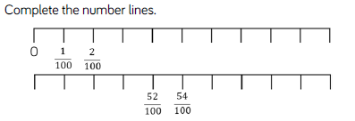
LO: To recognise hundredths and that hundredths arise from dividing one whole into one hundred equal parts.
TP: I did you complete the second number line?

Slide 15
LO: To recognise hundredths and that hundredths arise from dividing one whole into one hundred equal parts.
TP: On your whiteboards draw a hundredth grid (10 x 10)
TP: Shade:
1/100
2/100
3/100
4/100
5/100
6/100
7/100
8/100
9/100
10/100

Slide 16
LO: To recognise hundredths and that hundredths arise from dividing one whole into one hundred equal parts.
TP: What does equivalent mean?
TP: Divide your grid into 10 rows or tenths.
Do you notice any equivalent fractions?

Slide 17
LO: To recognise hundredths and that hundredths arise from dividing one whole into one hundred equal parts.
TP: Now shade 20/100
TP: How many tenths are equivalent?

Slide 18
LO: To recognise hundredths and that hundredths arise from dividing one whole into one hundred equal parts.
TP: Now shade 30/100
TP: How many tenths are equivalent?

Slide 19
LO: To recognise hundredths and that hundredths arise from dividing one whole into one hundred equal parts.
TP: Now shade 40/100
TP: How many tenths are equivalent?

Slide 20
LO: To recognise hundredths and that hundredths arise from dividing one whole into one hundred equal parts.
TP: Now shade 50/100
TP: How many tenths are equivalent?
TP: What other fraction is equivalent to this?

Slide 21
LO: To recognise hundredths and that hundredths arise from dividing one whole into one hundred equal parts.
TP: Now shade 60/100
TP: How many tenths are equivalent?

Slide 22
LO: To recognise hundredths and that hundredths arise from dividing one whole into one hundred equal parts.
TP: Now shade 70/100
TP: How many tenths are equivalent?

Slide 23
LO: To recognise hundredths and that hundredths arise from dividing one whole into one hundred equal parts.
TP: Now shade 80/100
TP: How many tenths are equivalent?

Slide 24
LO: To recognise hundredths and that hundredths arise from dividing one whole into one hundred equal parts.
TP: Now shade 90/100
TP: How many tenths are equivalent?

Slide 25
LO: To recognise hundredths and that hundredths arise from dividing one whole into one hundred equal parts.
TP: Now shade 100/100
TP: How many tenths are equivalent?
TP: What else is it equivalent to?

Slide 26
LO: To recognise hundredths and that hundredths arise from dividing one whole into one hundred equal parts.
WC: Let us count in 1/100ths except when we come to an equivalent 1/10th we say for example:
10/100 or 1/10

Slide 27
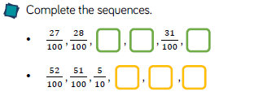
LO: To recognise hundredths and that hundredths arise from dividing one whole into one hundred equal parts.
TP: Complete the first number line. Is there more than one way to complete it? How?
TP: How would we complete the second number line?

Slide 28
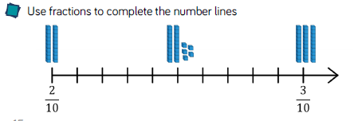
LO: To recognise hundredths and that hundredths arise from dividing one whole into one hundred equal parts.
TP: Look at this number line. There are numbers between 2/10 and 3/10. What fractions are inbetween? Think of you 100 grids.
TP: Look at your base 10. The ten stick represents 1/10. The 1 cubes represent 1/100. How could you change the 2/10 into 100ths? 3/10 into 100ths?
TP: How many 100th cubes will you need to make the next number on the line? How many hundredths is this?
TP: And the next? And the next?
TP: What number is represented by the base 10 on the number line?

Slide 29
LO: To recognise hundredths and that hundredths arise from dividing one whole into one hundred equal parts.
Clayton has a bag with 100 counters. Unfortunately, he drops the bag and looses some of the counters. To help himself find how many counters he has lost he lays them out on a hundred grid.
TP: How many counters has Clayton lost?
TP: How can we write this as a fraction?
TP: How can we write this in tenths and hundredths?

Slide 30
LO: To recognise hundredths and that hundredths arise from dividing one whole into one hundred equal parts.
Chilli 2
Fill in the missing numbers in these sequences counting in hundredths.
1/100 |  |  | 4/100 |  |  |  |  |  | 10/100
 |  | 33/100 |  |  | 36/100
Chilli 1
 | 56/100 | 58/100 |  |  |  | 66/100
48/100 |  |  | 45/100 | 44/100
95/100 | 90/100 |  |  | 75/100
Chilli 3
Fill in the missing numbers in these sequences counting in hundredths.
38/100 | 39/100 | 4/10 |  |  | 43/100
0 |  |  |  |  |  |  |  |  | 9/100
3/10 |  |  |  |  |  |  |  |  | 39/100
5/10 |  |  |  |  | 45/100 |  |  |  | 41/100
 |  |  |  |  | 8/10
What fraction is shaded:
Red
Red and Green
Red, green and purple
Red, green, purple and yellow
Red, green, purple, yellow and orange?
EXTENSION – Write in how many tenths and hundredths is
23/100
39/100
99/100

Slide 31
LO: To recognise hundredths and that hundredths arise from dividing one whole into one hundred equal parts.
Chilli 2
Fill in the missing numbers in these sequences counting in hundredths.
1/100 | 2/100 | 3/100 | 4/100 | 5/100 | 6/100 | 7/100 | 8/100 | 9/100 | 10/100
31/100 | 32/100 | 33/100 | 34/100 | 35/100 | 36/100 | 37/100 | 38/100 | 39/100 | 40/100
Chilli 1
54/100 | 56/100 | 58/100 | 60/100 | 62/100 | 63/100 | 66/100 | 67/100 | 68/100 | 69/100
48/100 | 47/100 | 46/100 | 45/100 | 44/100 | 43/100 | 42/100 | 41/100 | 40/100 | 39/100
95/100 | 90/100 | 85/100 | 80/100 | 75/100 | 70/100 | 65/100 | 60/100 | 55/100 | 50/100
Chilli 3
Fill in the missing numbers in these sequences counting in hundredths.
38/100 | 39/100 | 4/10 | 41/100 | 42/100 | 43/100 | 44/100 | 45/100 | 46/100 | 47/100
0 | 1/100 | 2/100 | 3/100 | 4/100 | 5/100 | 6/100 | 7/100 | 8/100 | 9/100
3/10 | 31/100 | 32/100 | 33/100 | 34/100 | 35/100 | 36/100 | 37/100 | 38/100 | 39/100
5/10 | 49/100 | 48/100 | 47/100 | 46/100 | 45/100 | 44/100 | 43/100 | 42/100 | 41/100
75/100 | 76/100 | 77/100 | 78/100 | 79/100 | 8/10 | 81/100 | 82/100 | 83/100 | 84/100
What fraction is shaded:
Red – 1/100
Red and Green – 20/100
Red, green and purple – 21/100
Red, green, purple and yellow – 22/100
Red, green, purple, yellow and orange – 23/100
EXTENSION – Write in how many tenths and hundredths is
23/100 – 2/10 and 3/100
39/100 – 3/10 and 9/100
99/100 – 9/10 and 9/100

Slide 32
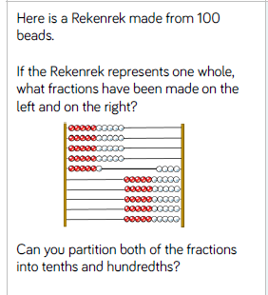
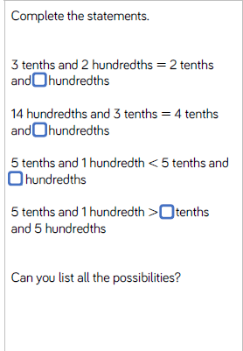
LO: To recognise hundredths and that hundredths arise from dividing one whole into one hundred equal parts.
Q1. How many different fractions can you make by combining two of the following groups? Work systematically.
Group 1
1/10, 1/10, 1/10
Group 2
1/100, 1/100, 1/100
Groups 3
1/10, 1/10, 1/10, 1/10
Group 4
1/100, 1/100, 1/100, 1/100
Q2.
Jack says he has shaded 2/10 of the grid. Is he correct? Explain your answer

Slide 33
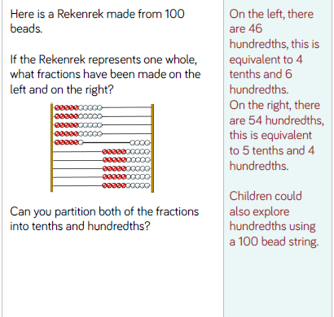
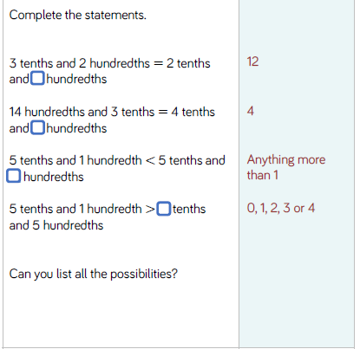
LO: To recognise hundredths and that hundredths arise from dividing one whole into one hundred equal parts.

Slide 34
LO: To recognise hundredths and that hundredths arise from dividing one whole into one hundred equal parts.
Top Down | Self Assessment
Some of us will even: I can problem solve and reason using my knowledge of hundredths
Some of us will: I know tenth and hundredth equivalents and can complete number sequences using this knowledge
Most of us will: I can complete number lines/sequences counting forward and backwards in hundredths
All of us will: I can shade fractions of a hundredth.

Slide 35
REFLECTION - LO: To recognise hundredths and that hundredths arise from dividing one whole into one hundred equal parts.
SELF ASSESSMENT

Slide 36
Break

Slide 37
English - Poetry
Read the slides and do the activities

Slide 38
Introduction
We are going to be concentrating on Narrative/Epic Poem that was first told in Anglo-Saxon/Viking times called ‘Beowulf’. We are going to find out what the poem is about, we are going to look at narrative poetry and then have a go at writing our own Narrative Poem about ‘Beowulf’. Finally, we perform our poems. These will be filmed and sent to parents and the school.

Slide 39
Introduction
A narrative poem is a type of poem that tells a story. Narrative poems tend to be quite long. They tell a story like in a novel and also use rhythm and rhyme, like in a poem.
https://www.bbc.co.uk/bitesize/topics/z4mmn39/articles/z3btrwx#:~:text=A%20narrative%20poem%20is%20a,rhyme%2C%20like%20in%20a%20poem.

Slide 40
Introduction
Today, we are going to look at writing our own first stanza of our narrative poems based on the epic story of Beowulf

Slide 41
LO: To create a narrative poem that choose the appropriate vocabulary to describe setting, characters and atmosphere
Q: What does rhyme mean?

Slide 42
LO: To create a narrative poem that choose the appropriate vocabulary to describe setting, characters and atmosphere
Q: What does rhyme mean?
The same sound at the end of a word.
Q: Find pairs of words that rhyme.
Q: What do we mean by rhyming pattern in a poem?

Slide 43
LO: To create a narrative poem that choose the appropriate vocabulary to describe setting, characters and atmosphere
Q: What does rhyme mean?
The same sound at the end of a word.
Q: Find pairs of words that rhyme.
Q: What do we mean by rhyming pattern in a poem?
Certain lines have the end words that make the same sound.
In poetry, do all lines have to rhyme?

Slide 44
LO: To create a narrative poem that choose the appropriate vocabulary to describe setting, characters and atmosphere
The story began when the King of the Danes, Hrothgar, built a mead-hall. He called the hall, Heorot, meaning hart.
Once Heorot was built, King Hrothgar and his people enjoyed feasts and celebrations there. The hall was filled with the sounds, sights and smells of happy gatherings.
This the first part of our story that we need to retell in our narrative poems and it sets the scene. We need to decide:
How many lines are going to be in the stanza.
Rhyming pattern
To help with rhyming patterns often finding/choosing key words and thinking of words that rhyme can help us
Q: What would you say are the key words in this part of the story
Q: What words can you think of that rhyme with them.

Slide 45
LO: To create a narrative poem that choose the appropriate vocabulary to describe setting, characters and atmosphere
The story began when the King of the Danes, Hrothgar, built a mead-hall. He called the hall, Heorot, meaning hart.
Once Heorot was built, King Hrothgar and his people enjoyed feasts and celebrations there. The hall was filled with the sounds, sights and smells of happy gatherings.
Q: What are the key things we want to put in our first stanza that will tell the story?
Q: Who are the key characters I want to introduce?
Q: What things do I need to mention to set the scene?
Q: What atmosphere do I want to create?
Q: What could I do at the end of the verse to infer that something is going to change this atmosphere?
Now, we can try and put these ideas together.

Slide 46
LO: To create a narrative poem that choose the appropriate vocabulary to describe setting, characters and atmosphere
The story began when the King of the Danes, Hrothgar, built a mead-hall. He called the hall, Heorot, meaning hart.
Once Heorot was built, King Hrothgar and his people enjoyed feasts and celebrations there. The hall was filled with the sounds, sights and smells of happy gatherings.
Our story begins with Hrothgar, King of the Danes
When he built Heorot, a mead-hall.
Which he wanted things to be celebrated in by all.
Oh how happy those people were
And what magnificent feasts!
But they were unaware of an angry beast.

Slide 47
LO: To create a narrative poem that choose the appropriate vocabulary to describe setting, characters and atmosphere
Q: How many lines are in my first stanza?
Q: Which words rhyme? What is the rhyming pattern?
Our story begins with Hrothgar, King of the Danes
When he built Heorot, a mead-hall.
Which he wanted things to be celebrated in by all.
Oh how happy those people were
And what magnificent feasts!
But they were unaware of an angry beast.

Slide 48
LO: To create a narrative poem that choose the appropriate vocabulary to describe setting, characters and atmosphere
ACTIVITY
Write the first stanza (verse) of their Narrative poem that retells the poem of Beowulf using the first part of story in their plans. The poem must have the same amount of lines in each stanza (verse), it must have some lines that rhyme and for future verses try to keep the same rhyming pattern. Before the write the stanza, to think of the key things they want to put in the stanza and think of key words and words that rhyme with them.

Slide 49
REFLECTION - LO: To create a narrative poem that choose the appropriate vocabulary to describe setting, characters and atmosphere
Let us listen to some of the stanzas and see if we can pick the rhyming pattern out.

Slide 50
Reading - Poetry
Read through the slides and do the activities
LO: To be able to retrieve information from a poem and comment on the author’s use of language

Slide 51
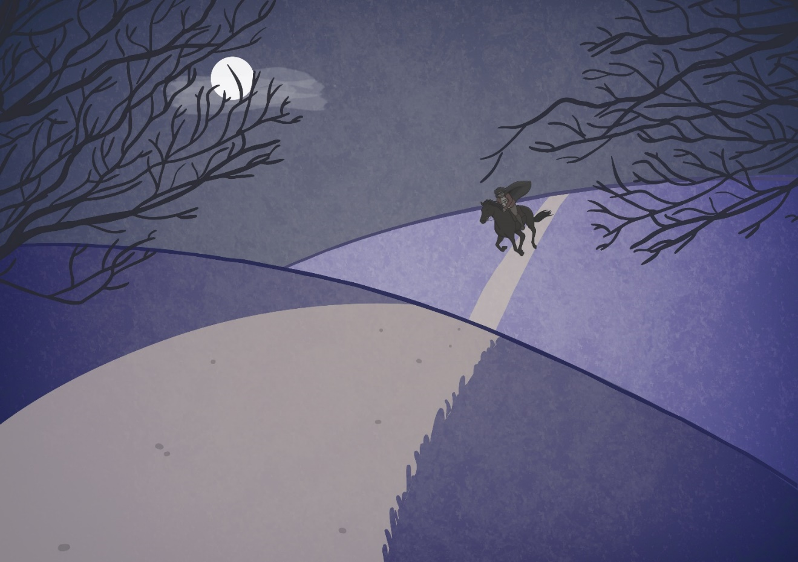

The wind was a torrent of darkness among the gusty trees,
The moon was a ghostly galleon tossed upon cloudy seas,
The road was a ribbon of moonlight over the purple moor,
And the highwayman came riding-
Riding- riding-
The highwayman came riding, up to the old inn door.

Slide 52

The wind was a torrent of darkness among the gusty trees,
The moon was a ghostly galleon tossed upon cloudy seas,
The road was a ribbon of moonlight over the purple moor,
And the highwayman came riding-
Riding- riding-
The highwayman came riding, up to the old inn door.

Slide 53
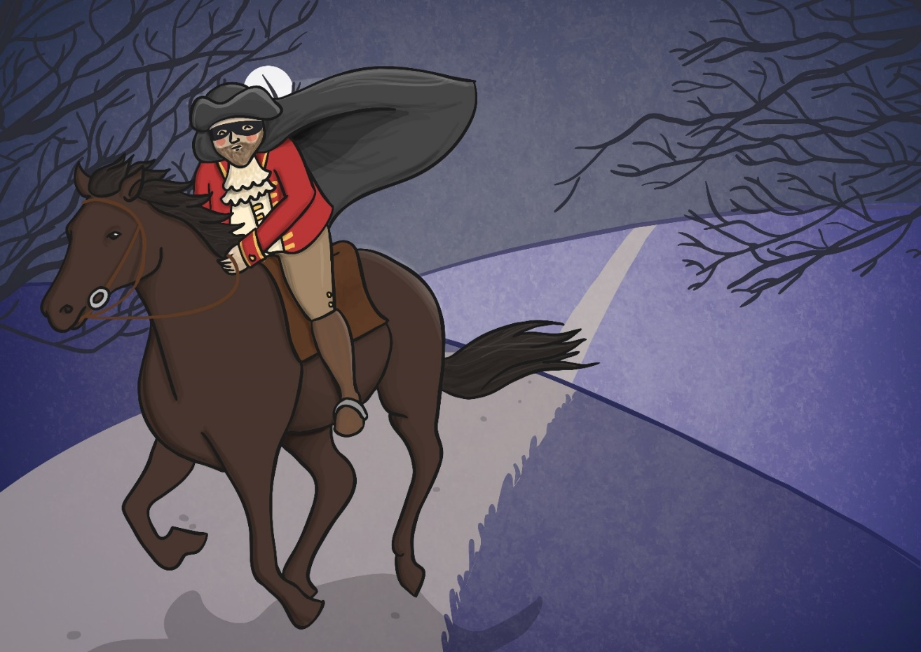

He’d a French cocked-hat on his forehead, a bunch of lace at his chin,
A coat of the claret velvet, and breeches of doe brown skin;
They fitted with never a wrinkle: his boots were up to the thigh!
And he rode with a jewelled twinkle,
His pistol butts a twinkle,
His rapier hilt a-twinkle, under the jewelled sky.

Slide 54
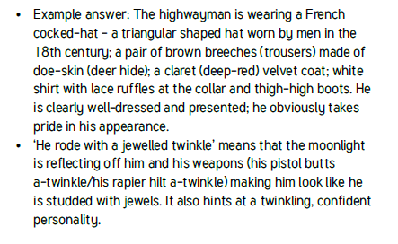
He’d a French cocked-hat on his forehead, a bunch of lace at his chin,
A coat of the claret velvet, and breeches of doe brown skin;
They fitted with never a wrinkle: his boots were up to the thigh!
And he rode with a jewelled twinkle,
His pistol butts a twinkle,
His rapier hilt a-twinkle, under the jewelled sky.

Slide 55
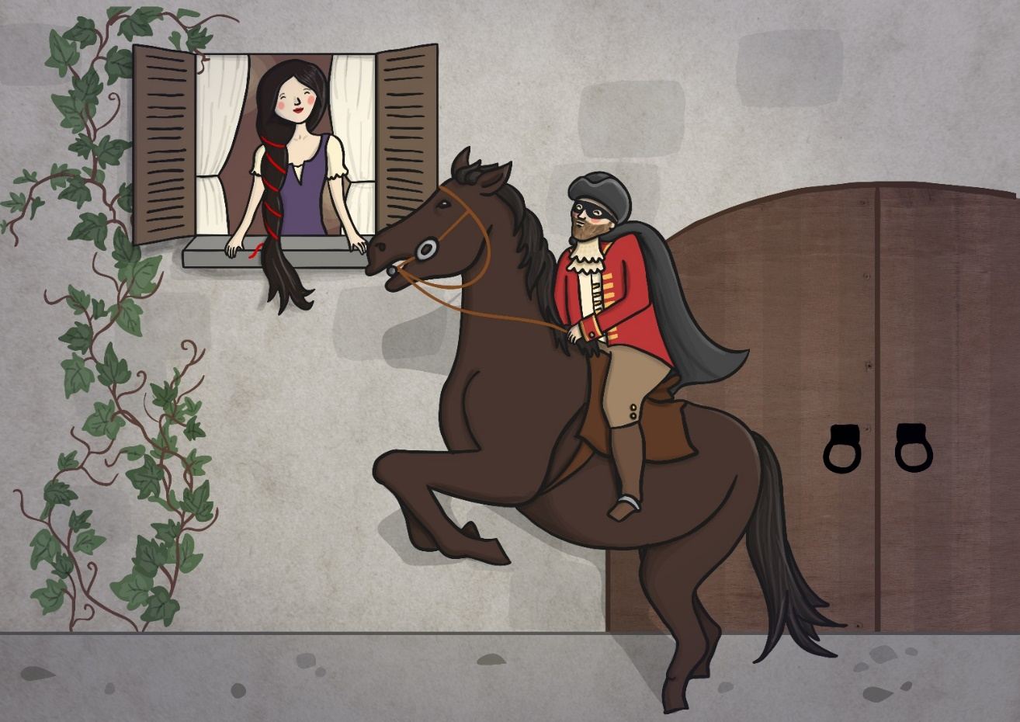

Over the cobbles he clattered and clashed in the dark inn-yard,
And he tapped with his whip on the shutters, but all was locked and barred;
He whistled a tune to the window, and who should be waiting there
But the landlord’s black-eyed daughter,
Bess, the landlord’s daughter,
Plaiting a dark red love-knot into her long black hair.

Slide 56

Over the cobbles he clattered and clashed in the dark inn-yard,
And he tapped with his whip on the shutters, but all was locked and barred;
He whistled a tune to the window, and who should be waiting there
But the landlord’s black-eyed daughter,
Bess, the landlord’s daughter,
Plaiting a dark red love-knot into her long black hair.

Slide 57
LO: To be able to retrieve information from a poem and comment on the author’s use of language
Questions.
In Stanza 1, Which words and phrases tell us what time of day it is?
In Stanza 1, which words and phrases tell us what the weather is like?
In Stanza 2, what is the highwayman wearing?
In Stanza 2, what do his clothes suggest about him?
In Stanza 2, what does ‘he rode with a jewelled twinkle’ mean?
In Stanza 3, who has the highwayman come to see?
In Stanza 3, what do you think a ‘love-knot’ is?
The wind was a torrent of darkness among the gusty trees,
The moon was a ghostly galleon tossed upon cloudy seas,
The road was a ribbon of moonlight over the purple moor,
And the highwayman came riding-
Riding- riding-
The highwayman came riding, up to the old inn door.
He’d a French cocked-hat on his forehead, a bunch of lace at his chin,
A coat of the claret velvet, and breeches of doe brown skin;
They fitted with never a wrinkle: his boots were up to the thigh!
And he rode with a jewelled twinkle,
His pistol butts a twinkle,
His rapier hilt a-twinkle, under the jewelled sky.
Over the cobbles he clattered and clashed in the dark inn-yard,
And he tapped with his whip on the shutters, but all was locked and barred;
He whistled a tune to the window, and who should be waiting there
But the landlord’s black-eyed daughter,
Bess, the landlord’s daughter,
Plaiting a dark red love-knot into her long black hair.

Slide 58

condescendingly

Slide 59
condescendingly
What could it mean?
“That is impossible,” said the Gemini twins condescendingly.

Slide 60
condescendingly
SAY IT AND FEEL THE SYLLABLES
SAY IT TO THE BIN
SAY IT TO SOMEONE ON ANOTHER TABLE
WHISPER IT TO THE FLOOR
SAY IT TO YOUR BOOK
REPEAT IT AFTER ME
SAY IT TO THE WINDOW
WHISPER IT TO A WALL

Slide 61
condescendingly
Adv. in a way that shows that you think you are more important or more intelligent than someone else

Slide 62
condescendingly
He shook his head and smiled condescendingly.
“Alex, honey, I’m on the phone,” she said, condescendingly.
Iain got up and patted her condescendingly on the shoulder.
Stop condescendingly assuming that poor fat people are fat because they eat more junk food.

Slide 63
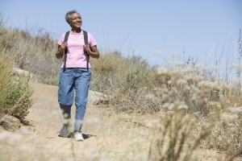
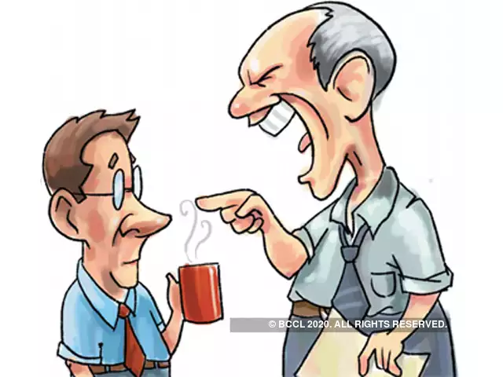
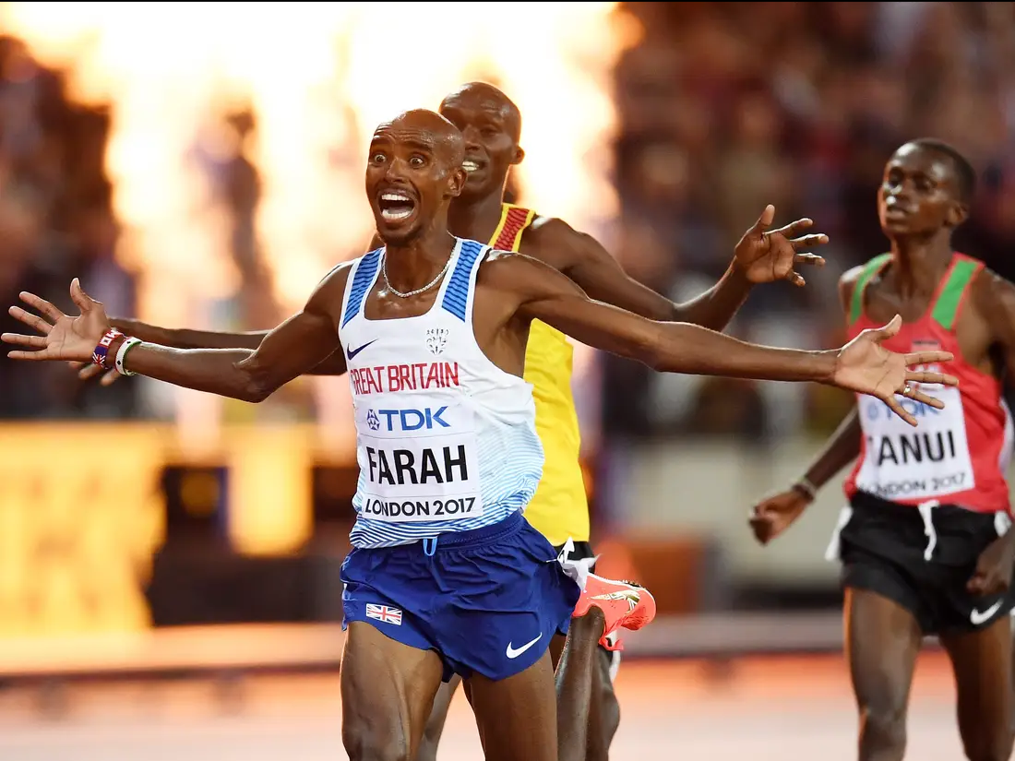


condescendingly
Say condescendingly if you see someone acting as though they are more important or intelligent.

Slide 64
condescendingly
In your books, write the word, the definition and use it in a sentence/draw a picture.

Slide 65
condescendingly
Adv. in a way that shows that you think you are more important or more intelligent than someone else

Slide 66
Lunch

Slide 67
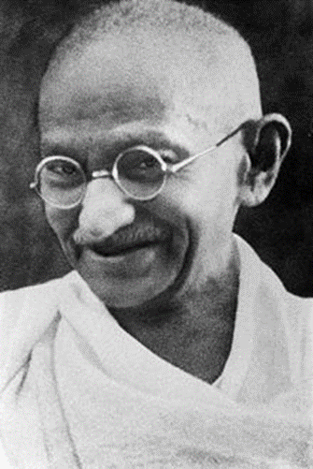
Mahatma Gandhi
Weeks 5 & 6

Slide 68







Religions of the World
Can you name the main religions of the world?
Sikhism
Judaism
Hinduism
Christianity
Buddhism
Islam

Slide 69

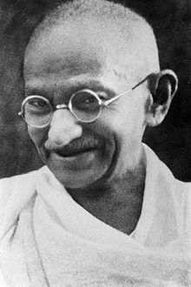
Inspirational Leaders - What can we learn from the great leaders and inspiring examples in today’s world?
Mahatma Gandhi

Slide 70
What can we learn from the great leaders and inspiring examples in today’s world?
Key Questions:
What made this person into a leader?
How did their religion inspire them?
What holy texts explain their lives?
Is this person inspiring just in their religion or to any human?

Slide 71
Family Life
Mohandras Karamchand Gandhi was born on 2nd October 1869. He was born in Porbander in Gujarat, north-west India.
His father was the chief minister of Porbander and his mother was highly religious. She worshipped the god Vishnu, but also believed Jain teachings of mutual tolerance and not causing injury to living things.
Gandhi was born into a privileged caste and therefore received a good education.
Photo courtesy of (@flickr.com) - granted under creative commons licence – attribution

Slide 72
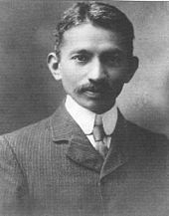
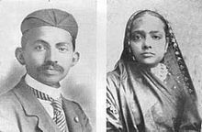
Married Life
At the age of 13, Gandhi had an arranged marriage to a girl who was also 13 called Kasturbai Makhanji.
His first son of four was born in 1888 when Gandhi was 18 years old and a student at Samaldas College.

Slide 73

Studying
Gandhi was not very happy at college, so when he was offered the chance to study law in London, he took it.
He worked hard and began to study all religions. Until this time, he had never really been interested in religion.
When he returned to India, he found it hard to find work, so eventually took a job in South Africa for a year.
Photo courtesy of (@flickr.com) - granted under creative commons licence – attribution

Slide 74

South Africa
Apartheid was in force in South Africa. Gandhi was horrified at the way people who were not white were treated.
On one occasion, Gandhi was removed from a train purely because he was not white.
Another time, he was asked to remove his turban by a European magistrate. He refused and left the courtroom.
Apartheid is an Afrikaans word that means “status of being apart”. In real life terms, it meant that white people were treated a lot better than black or Asian people. There were even shops that “non-whites” weren’t allowed to go into!

Slide 75
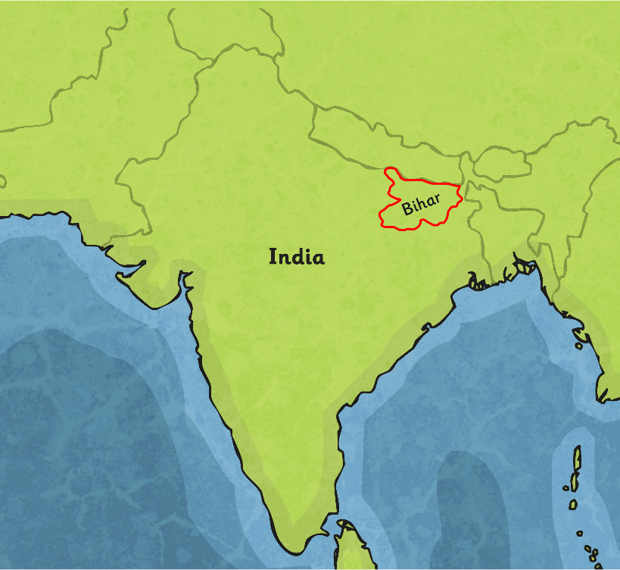
Gandhi and Politics
Gandhi started a political movement called the Natal Indian Congress. He believed in non-violent political protests.
He returned to India in 1916 and was horrified to find how oppressed the Indian people of Bihar were by the white British masters.
He began to encourage people to stand up for themselves and their rights in peaceful protests and strikes.
The people were grateful that somebody was interested in their situation and he became known as Mahatma, meaning ‘Great Soul’.

Slide 76
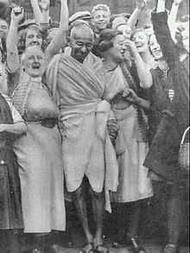
A Famous Leader
Gandhi’s fame began to spread. Indian people saw him as their voice for freedom and fairness. He started a boycott of buying British goods. This meant that he encouraged people not to buy things made in Britain. This led to his first arrest, and on 2nd March 1922, he was put into prison for 2 years. Gandhi went on many hunger strikes to bring attention to the unfair treatment of Indian people at the hands of the British.

Slide 77
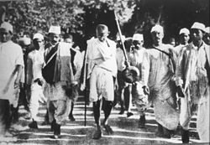
The Salt March
When he was released, he began a campaign to end the British rule over Indian people.
In 1930, the British introduced a tax on salt. This hit the poorest people the most. In protest, Gandhi marched 250 miles to the sea to get his own salt.
Thousands of people joined him on his march and 60,000 people were arrested, including Gandhi.

Slide 78
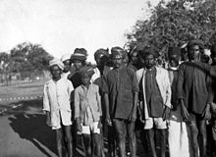
People Power
The British began to realise that Gandhi had many followers and a lot of influence on those people. As a result, they had to:
ease poverty;
grant status and recognition to the people classed as ‘the untouchables’;
give women more rights;
eventually allow India to have political independence from Britain.

Slide 79
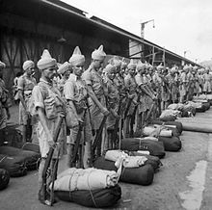
Civil Unrest
When the Second World War broke out, Indian men were fighting for the British. Gandhi did not see why they should when they were being treated so unfairly at home. He was arrested for encouraging people to rise up against Indian men fighting for the British, and spent 2 years in prison at the Aga Khan Palace in Puna.
Sadly, his wife was also held there, but she died in prison not long before Gandhi was released.

Slide 80
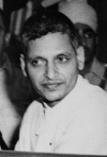
Assassination Attempts
Because Gandhi was so well known, not everyone agreed with his beliefs. There were 6 times when somebody tried to assassinate (kill) him.
One man in particular called Nathurum Godse was a Hindu who didn’t believe the same things as Gandhi, so he tried a number of times to kill him.

Slide 81
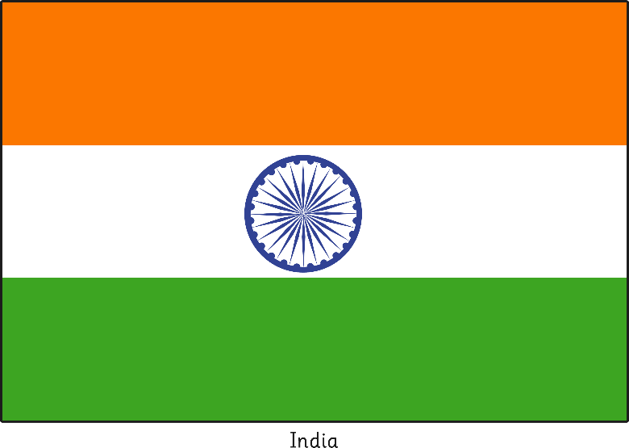

India is Split
The Congress Party decided that it would be better if they split India into two halves, one being Hindu India and other Muslim Pakistan. Gandhi was unhappy about this and worried that the two sides would start a war. He worked tirelessly for peace.

Slide 82
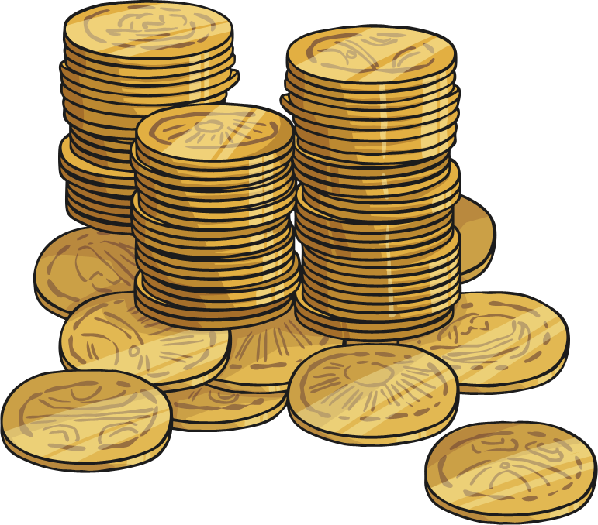
Pay Out
Gandhi believed that Pakistan should receive payment from the government for its lost territories. Other people did not agree and thought Pakistan would use the money to buy weapons and start a war.
Some men tried a fifth time to kill Gandhi.

Slide 83
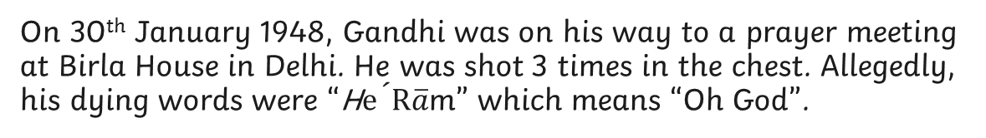
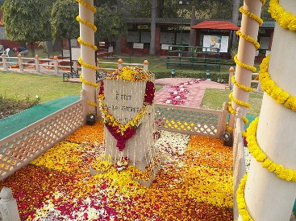
Death of a Good Man
Photo courtesy of Fowler&fowler - granted under creative commons licence – attribution

Slide 84
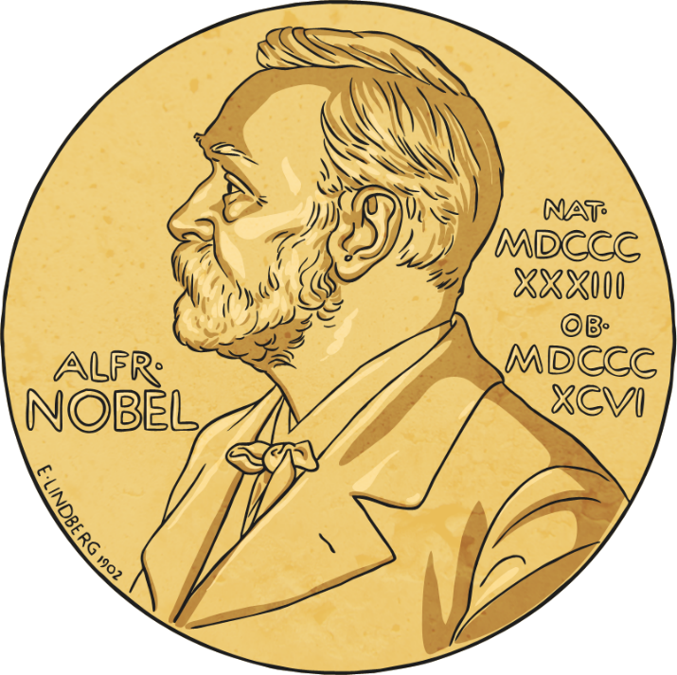
Nobel Peace Prize
Gandhi’s body was cremated and the ashes are kept in the Aga Khan’s Palace in Pune, where he was once kept prisoner.
Gandhi had been nominated 5 times for the Nobel Peace Prize but had never been awarded it. In the year of his death, the prize was not awarded to anyone. The reason given was “there was no suitable living candidate”.
His birthday is now a national holiday in India.

Slide 85
What can we learn from the great leaders and inspiring examples in today’s world?
Key Questions:
What made this person into a leader?
How did their religion inspire them?
What holy texts explain their lives?
Is this person inspiring just in their religion or to any human?

Slide 86
What can we learn from the great leaders and inspiring examples in today’s world?
ACTIVITY
Children to draw a table and write the differences and similarities between Martin Luther King and Mahatma Gandhi

Slide 87
What can we learn from the great leaders and inspiring examples in today’s world?
Activity
Children to research the life of Mahatma Gandhi thinking about:
Born
Died (how)
Beliefs including religion
Why is he famous?
Famous quote/speech
Early Life and Family

Slide 88
REFLECTION - What can we learn from the great leaders and inspiring examples in today’s world?
TP: What have you found out about when he was:
Born
Died (how)
Beliefs including religion
Why is he famous?
Famous quote/speech
Early Life and Family
Key Questions:
What made this person into a leader?
How did their religion inspire them?
What holy texts explain their lives?
Is this person inspiring just in their religion or to any human?

Slide 89
REFLECTION - What can we learn from the great leaders and inspiring examples in today’s world?
What is the Nobel Peace Prize?

Slide 90
REFLECTION - What can we learn from the great leaders and inspiring examples in today’s world?
What is the Nobel Peace Prize?
The Nobel Peace Prize is one of six awards in the memory of Alfred Nobel, the inventor of dynamite. Every year the organization gives out six awards for the people "who best benefit mankind through their actions" in one of the six subjects; peace, literature, physics, chemistry, economics, and medicine.

Slide 91
REFLECTION - What can we learn from the great leaders and inspiring examples in today’s world?
TP: If you were to nominate Mahatma Gandhi for the Nobel Peace Prize, what reasons and examples would you give?

