Slide 1
Good Morning
Thursday 4th February

Slide 2

Theseus and the Minotaur - Part 3
The Minotaur was a monster that was half human and half bull. He lived in the centre of a huge maze on the island of Crete. King Minos loved this horrible monster and liked to give him a treat every now and again. He knew that his people would prefer it if he fed his monster to Athenian children, so King Minos accepted the deal and, in return, agreed to cease the attacks on Athens.
Evidence
Retrieve
Interpret
Choice
Use a thesaurus to find 3 synonyms of horrible.
Where did the Minotaur live?
Would you have liked King Minos as your King? Why/Why not?
What does ‘cease the attacks’ mean?

Slide 3
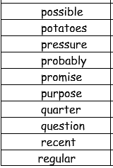
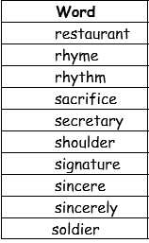
Spellings – Look/Cover/Spell/Check
Lente, Jack, Elliot, Alicia

Slide 4
Maths
Read through the slides and do the activities

Slide 5
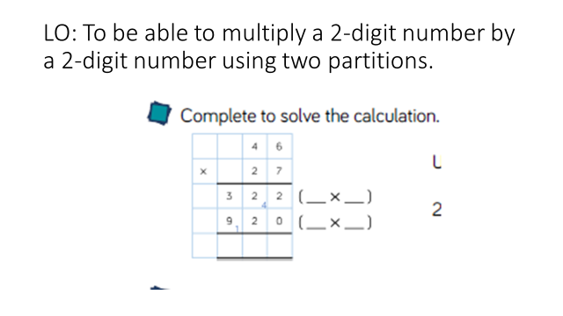
RECALL
TP: What calculations have been done to solve the answer?

Slide 6
LO: To be able to multiply a 2-digit number by a 2-digit number using two partitions.
Top Down | Self Assessment
Some of us will even: I can problem solve and reason when using multiplying two 2-digit numbers
Some of us will: I can solve the calculation by adding the 2 answers together
Most of us will: I can multiply a 2-digit number by a 2-digit number by solving the 2 partitioned calculations
All of us will: I can multiply a 2-digit number by a 2-digit number by creating 2 partitioned calculations

Slide 7
LO: To be able to multiply a 2-digit number by a 2-digit number using two partitions
TP: I want to solve 29 x 19 =
How would I set this calculation out?
What calculation would I do first?
What calculation would I do second?
How would I solve the first calculation?
How would I solve the second calculation?
Why is the 0 so important?

Slide 8
LO: To be able to multiply a 2-digit number by a 2-digit number using two partitions
Solve:
29 x 21 =
29 x 22 =
29 x 33 =

Slide 9
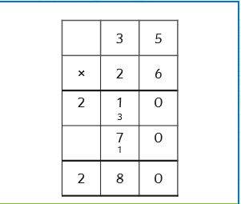
LO: To be able to multiply a 2-digit number by a 2-digit number using two partitions.
Look at this question.
TP: What mistake has Miss Davison made?

Slide 10
LO: To be able to multiply a 2-digit number by a 2-digit number using two partitions

Slide 11
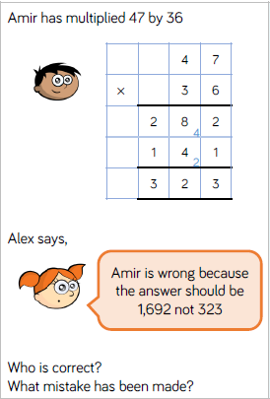
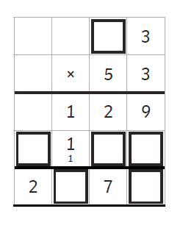
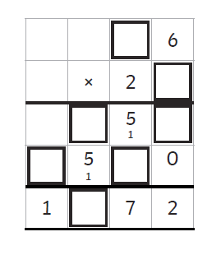
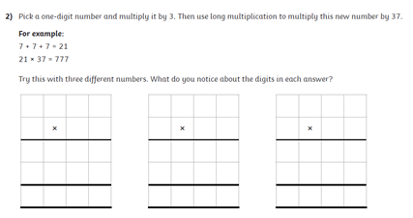
LO: To be able to multiply a 2-digit number by a 2-digit number using two partitions.

Slide 12
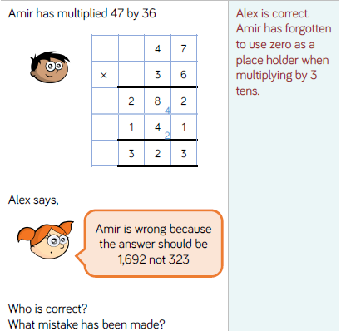
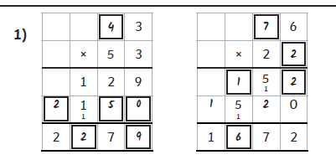

LO: To be able to multiply a 2-digit number by a 2-digit number using two partitions.

Slide 13
LO: To be able to multiply a 2-digit number by a 2-digit number using two partitions.
Top Down | Self Assessment
Some of us will even: I can problem solve and reason when using multiplying two 2-digit numbers
Some of us will: I can solve the calculation by adding the 2 answers together
Most of us will: I can multiply a 2-digit number by a 2-digit number by solving the 2 partitioned calculations
All of us will: I can multiply a 2-digit number by a 2-digit number by creating 2 partitioned calculations

Slide 14
REFLECTION - LO: To be able to multiply a 2-digit number by a 2-digit number using two partitions
SELF ASSESSMENT

Slide 15
Break

Slide 16
English – Poetry - Beowulf
Read through the slides and do the activities

Slide 17
Introduction
We are going to be concentrating on Narrative/Epic Poem that was first told in Anglo-Saxon/Viking times called ‘Beowulf’. We are going to find out what the poem is about, we are going to look at narrative poetry and then have a go at writing our own Narrative Poem about ‘Beowulf’. Finally, we perform our poems. These will be filmed and sent to parents and the school.

Slide 18
Introduction
A narrative poem is a type of poem that tells a story. Narrative poems tend to be quite long. They tell a story like in a novel and also use rhythm and rhyme, like in a poem.
https://www.bbc.co.uk/bitesize/topics/z4mmn39/articles/z3btrwx#:~:text=A%20narrative%20poem%20is%20a,rhyme%2C%20like%20in%20a%20poem.

Slide 19
Introduction
Today, we are going to look at what narrative poems are and plan together our own narrative poems based on the epic story of Beowulf

Slide 20
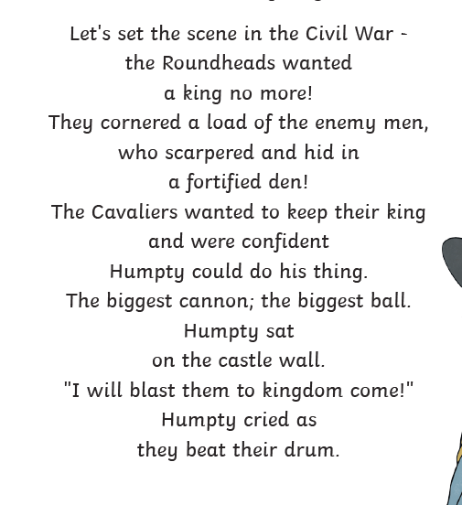
Humpty Dumpty – The Truth
Q: What is this verse about?
Q: How many full sentences could you write from this stanza?
Q: How many lines is each full line broken into?
Q: What is rhyme?
Q: Can you see a rhyming pattern?

Slide 21
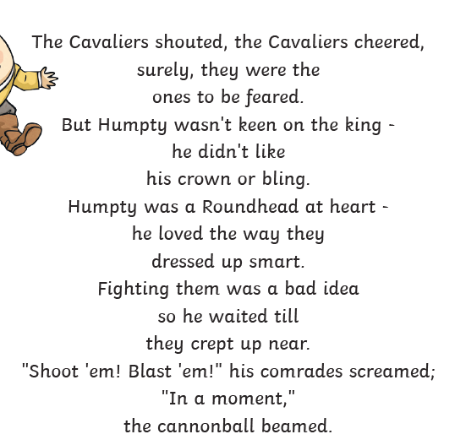
Humpty Dumpty – The Truth
Q: What is this verse about?
Q: How many full sentences could you write from this stanza?
Q: How many lines is each full line broken into?
Q: What is rhyme?
Q: Can you see a rhyming pattern?
Q: Is it the same pattern as the other stanza?

Slide 22
The Highway Man
The wind was a torrent of darkness among the gusty trees,
The moon was a ghostly galleon tossed upon cloudy seas,
The road was a ribbon of moonlight over the purple moor,
And the highwayman came riding-
Riding- riding-
The highwayman came riding, up to the old inn door.
Q: What is this verse about?
Q: Can you see a rhyming pattern?
Q: What descriptive language can you see?
Q: How many lines can you see in the stanza?

Slide 23
The Highway Man
He’d a French cocked-hat on his forehead, a bunch of lace at his chin,
A coat of the claret velvet, and breeches of doe brown skin;
They fitted with never a wrinkle: his boots were up to the thigh!
And he rode with a jewelled twinkle,
His pistol butts a twinkle,
His rapier hilt a-twinkle, under the jewelled sky.
Q: What is this verse about?
Q: Can you see a rhyming pattern?
Q: Is it the same as the first?
Q: What descriptive language can you see?
Q: How many lines can you see in the stanza?

Slide 24
The Highway Man
Over the cobbles he clattered and clashed in the dark inn-yard,
And he tapped with his whip on the shutters, but all was locked and barred;
He whistled a tune to the window, and who should be waiting there
But the landlord’s black-eyed daughter,
Bess, the landlord’s daughter,
Plaiting a dark red love-knot into her long black hair.
Q: What is this verse about?
Q: Can you see a rhyming pattern?
Q: Is it the same as the previous?
Q: What descriptive language can you see?
Q: How many lines can you see in the stanza?

Slide 25
LO: To understand the features of a narrative poem and to be able to plan the Story of Beowulf
Let us remind ourselves of the story of Beowulf.

Slide 26
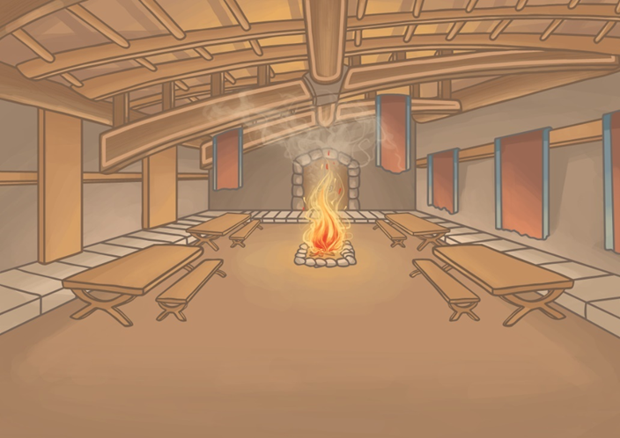
Hrothgar Builds Heorot
The story began when the King of the Danes, Hrothgar, built a mead-hall. He called the hall, Heorot, meaning hart.

Slide 27
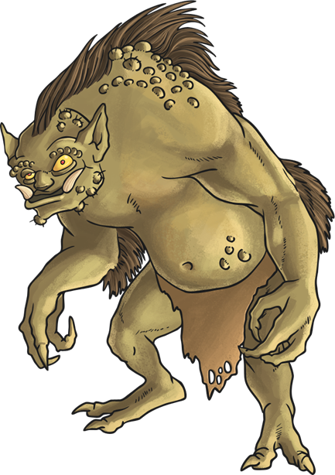
Grendel Attacks
Once Heorot was built, King Hrothgar and his people enjoyed feasts and celebrations there. The hall was filled with the sounds, sights and smells of happy gatherings.
Grendel, a monster who lived nearby, despised the noise from the celebrations. One night, he decided to attack the hall, killing and devouring thirty of Hrothgar’s warriors.

Slide 28

Heorot Lies Silent
After Grendel’s attack, King Hrothgar and the Danes were terrified of Grendel. The celebrations and feasts at Heorot came to an end.
The Danes lived in fear of Grendel for over twelve years! During that time, the people abandoned Heorot and lived quietly in their homes.

Slide 29
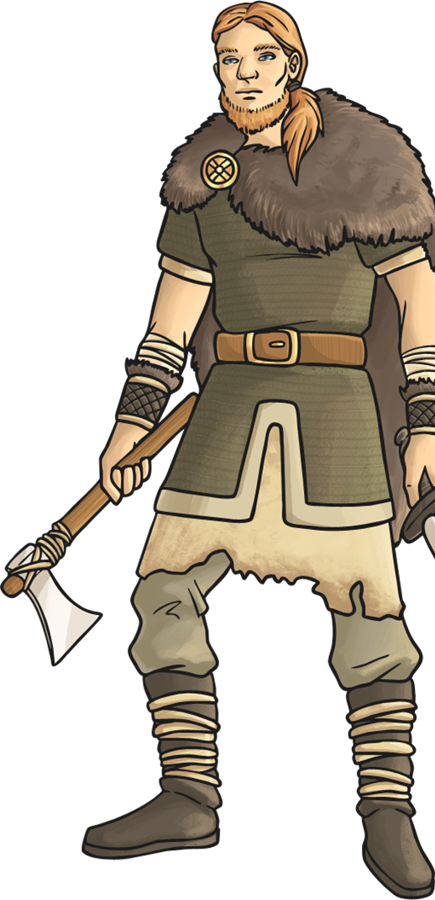
Beowulf Travels to Denmark
Eventually, news travelled over the water to the Geats where the young warrior Beowulf heard of King Hrothgar’s plight. He sailed to Denmark to offer help.
King Hrothgar was grateful for Beowulf’s help and agreed to hold another feast in Heorot. After the feast, Beowulf stayed in the great hall while all the Danes went back to their homes.

Slide 30
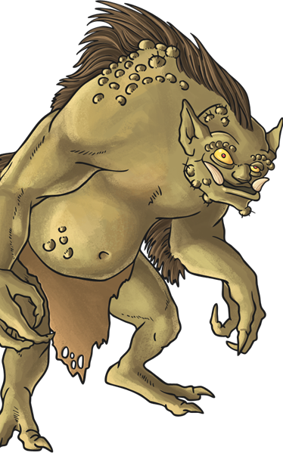
Beowulf’s First Battle
Grendel was furious about the feast and attacked Heorot! Beowulf, pretending to be asleep, leapt up and fought Grendel. His men drew their swords but Grendel’s skin was so tough that they could not pierce it.
After a long battle, Beowulf, using no weapons, finally managed to defeat Grendel by tearing off his arm! Grendel fled to his home in the marshes and died.

Slide 31
LO: To understand the features of a narrative poem and to be able to plan the Story of Beowulf
Thinking of the story to the end of the First Battle. Can you split the story down into different scenes? Sum them up in as few words as possible? What are they?

Slide 32
LO: To understand the features of a narrative poem and to be able to plan the Story of Beowulf
Hrothgar, King of the Danes builds Heorot and they have feasts and celebrations in it.
Grendel does not like the noise and attacks the hall killing Heorot’s warriors
The Danes fear Grendel and live quietly in their homes
Beowulf hears of this problem and sails to Hrothgar and offers his help. They begin a feast.
Grendel is furious and attacks the all again. Beowulf fights Grendel with no weapons, tears Grendel’s arm off and Grendel flees to his home in the marshes.

Slide 33
LO: To understand the features of a narrative poem and to be able to plan the Story of Beowulf
ACTIVITY
Children to plan a flow chart of the events leading to and of the first battle. To split these events into 5 main events

Slide 34
REFLECTION - LO: To understand the features of a narrative poem and to be able to plan the Story of Beowulf
Q: What words rhyme with:
Hrothgar
Hall
Feast
Built
celebrations

Slide 35
Reading Comprehension – The Highwayman
LO: To be able to identify unfamiliar words and work out the meaning of the word by reading the rest of the stanza for context
Read through the slides and answer the questions

Slide 36
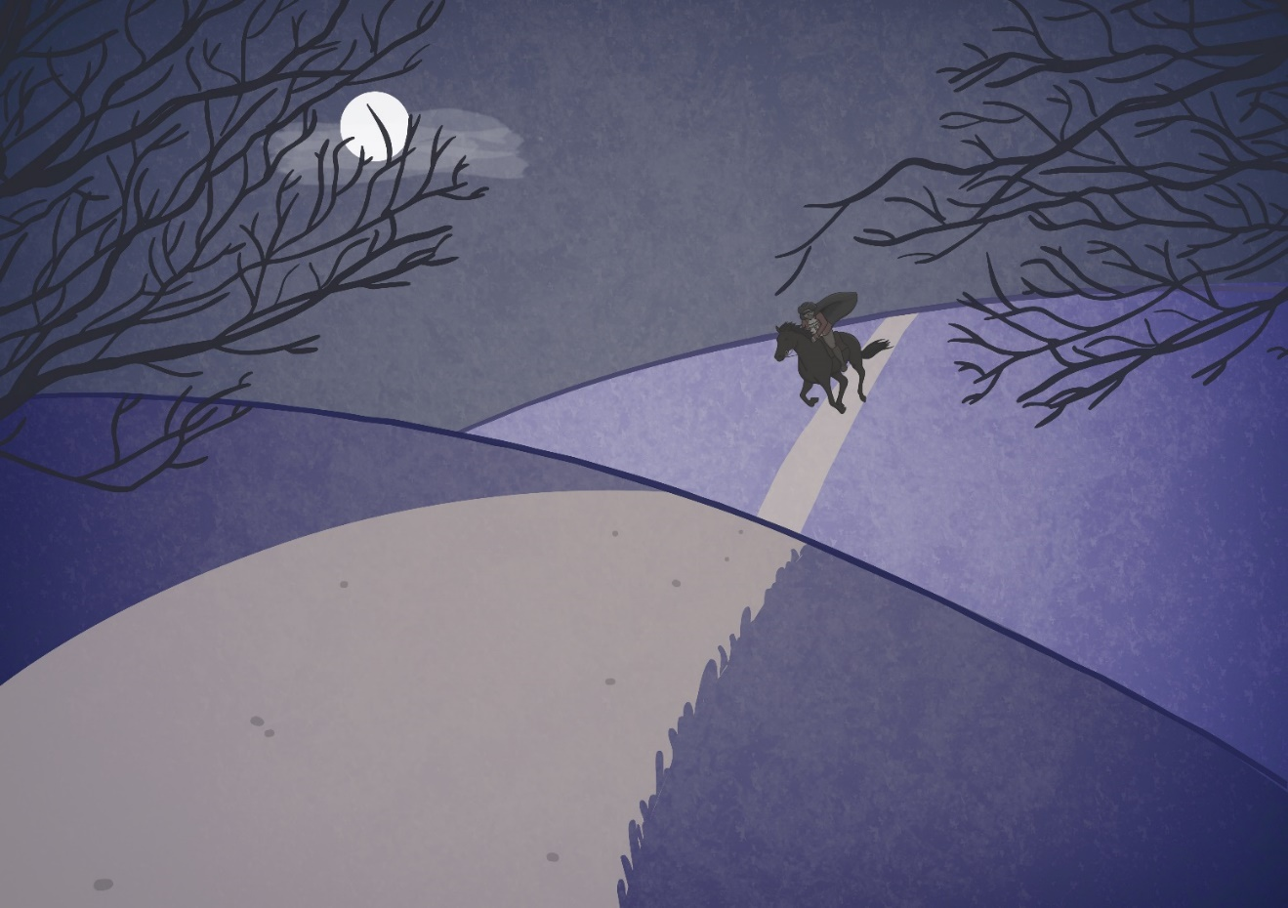
The wind was a torrent of darkness among the gusty trees,
The moon was a ghostly galleon tossed upon cloudy seas,
The road was a ribbon of moonlight over the purple moor,
And the highwayman came riding-
Riding- riding-
The highwayman came riding, up to the old inn door.

Slide 37
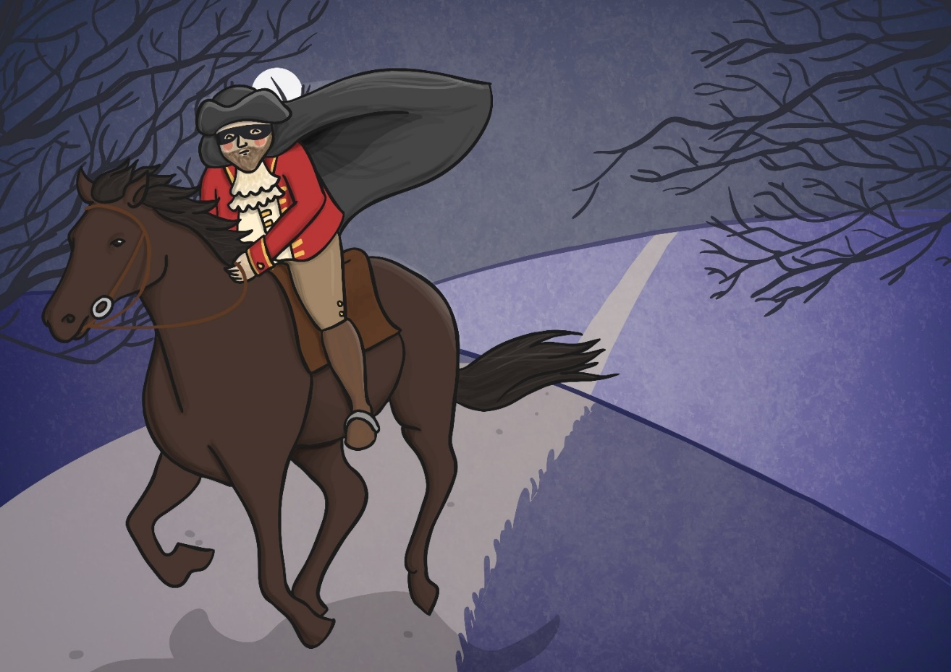
He’d a French cocked-hat on his forehead, a bunch of lace at his chin,
A coat of the claret velvet, and breeches of doe brown skin;
They fitted with never a wrinkle: his boots were up to the thigh!
And he rode with a jewelled twinkle,
His pistol butts a twinkle,
His rapier hilt a-twinkle, under the jewelled sky.

Slide 38
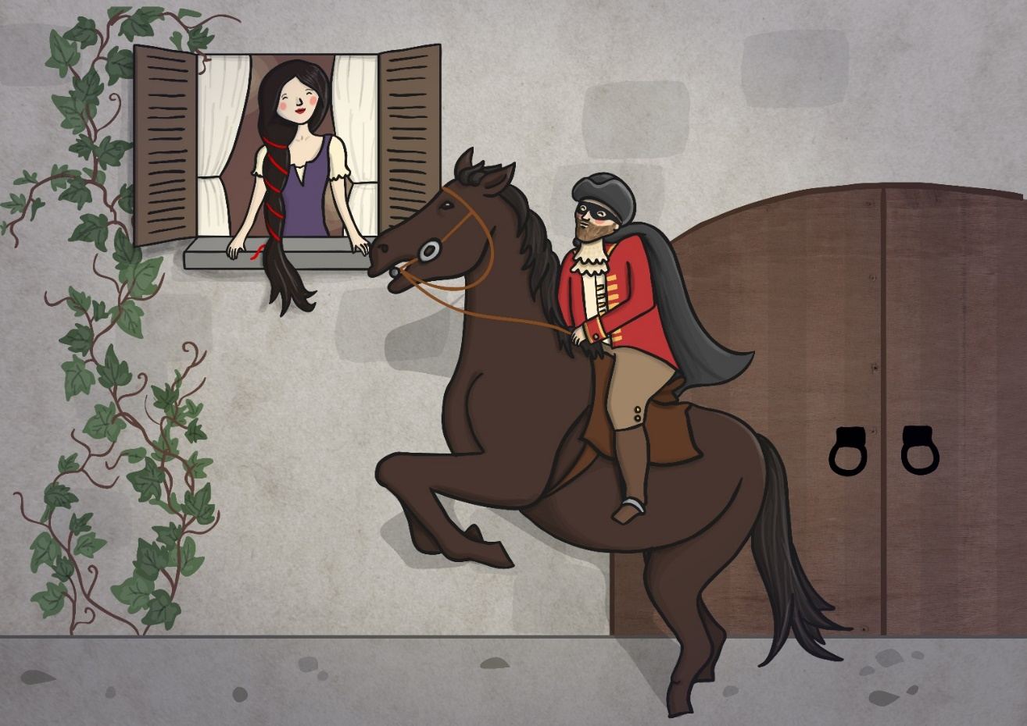
Over the cobbles he clattered and clashed in the dark inn-yard,
And he tapped with his whip on the shutters, but all was locked and barred;
He whistled a tune to the window, and who should be waiting there
But the landlord’s black-eyed daughter,
Bess, the landlord’s daughter,
Plaiting a dark red love-knot into her long black hair.

Slide 39
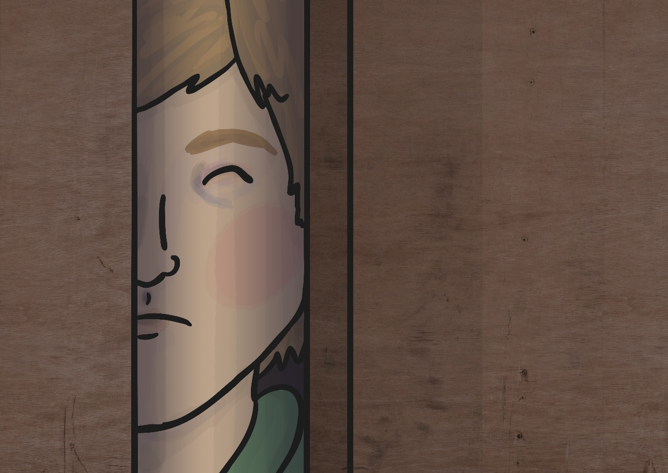
And dark in the old inn-yard a stable-wicket creaked
Where Tim the ostler listened; his face was white and peaked;
His eyes were hollows of madness, his hair like mouldy hay,
But he loved the landlord’s daughter,
The landlord’s red-lipped daughter,
Dumb as a dog he listened, and he heard the robber say.

Slide 40
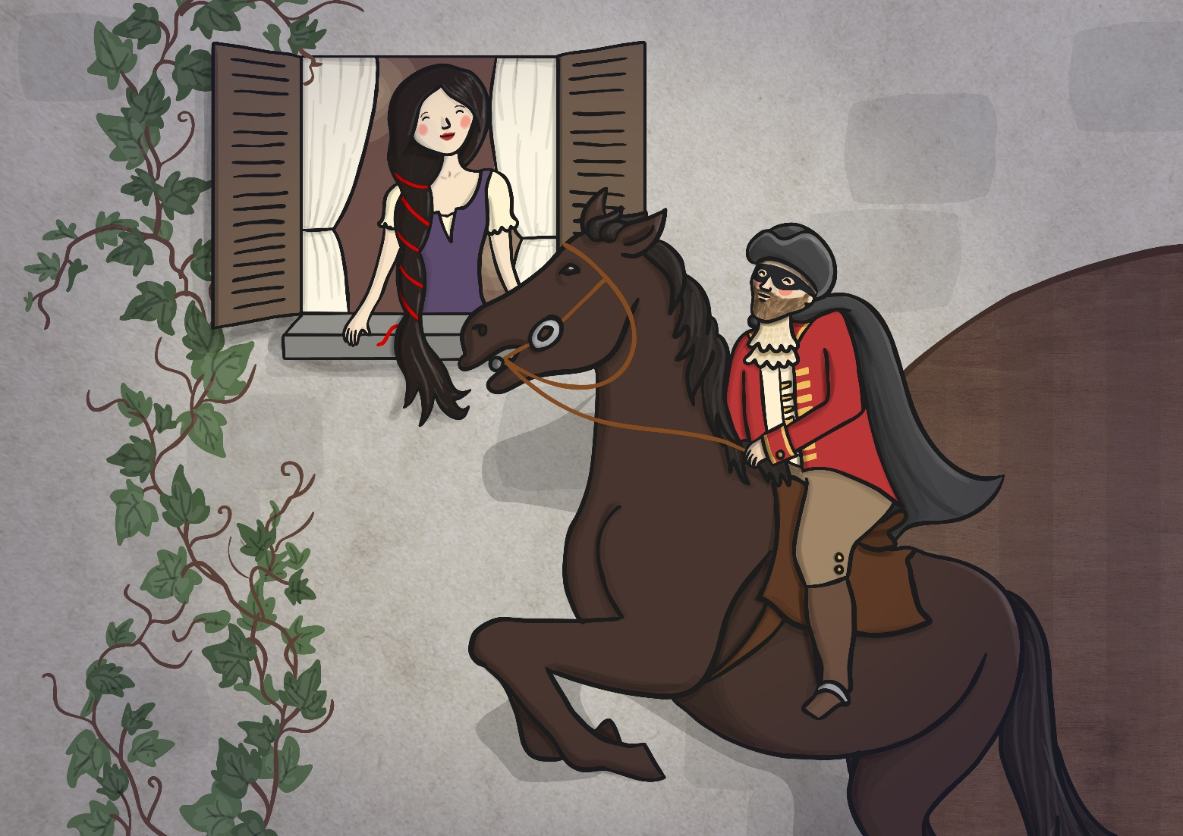
“One kiss, my bonny sweetheart, I’m after a prize to-night,
But I shall be back with the yellow gold before the morning light;
Yet, if they press me sharply, and harry me through the day,
Then look for me by moonlight,
Watch for me by moonlight,
I’ll come to thee by moonlight, though hell should bar the way.”

Slide 41
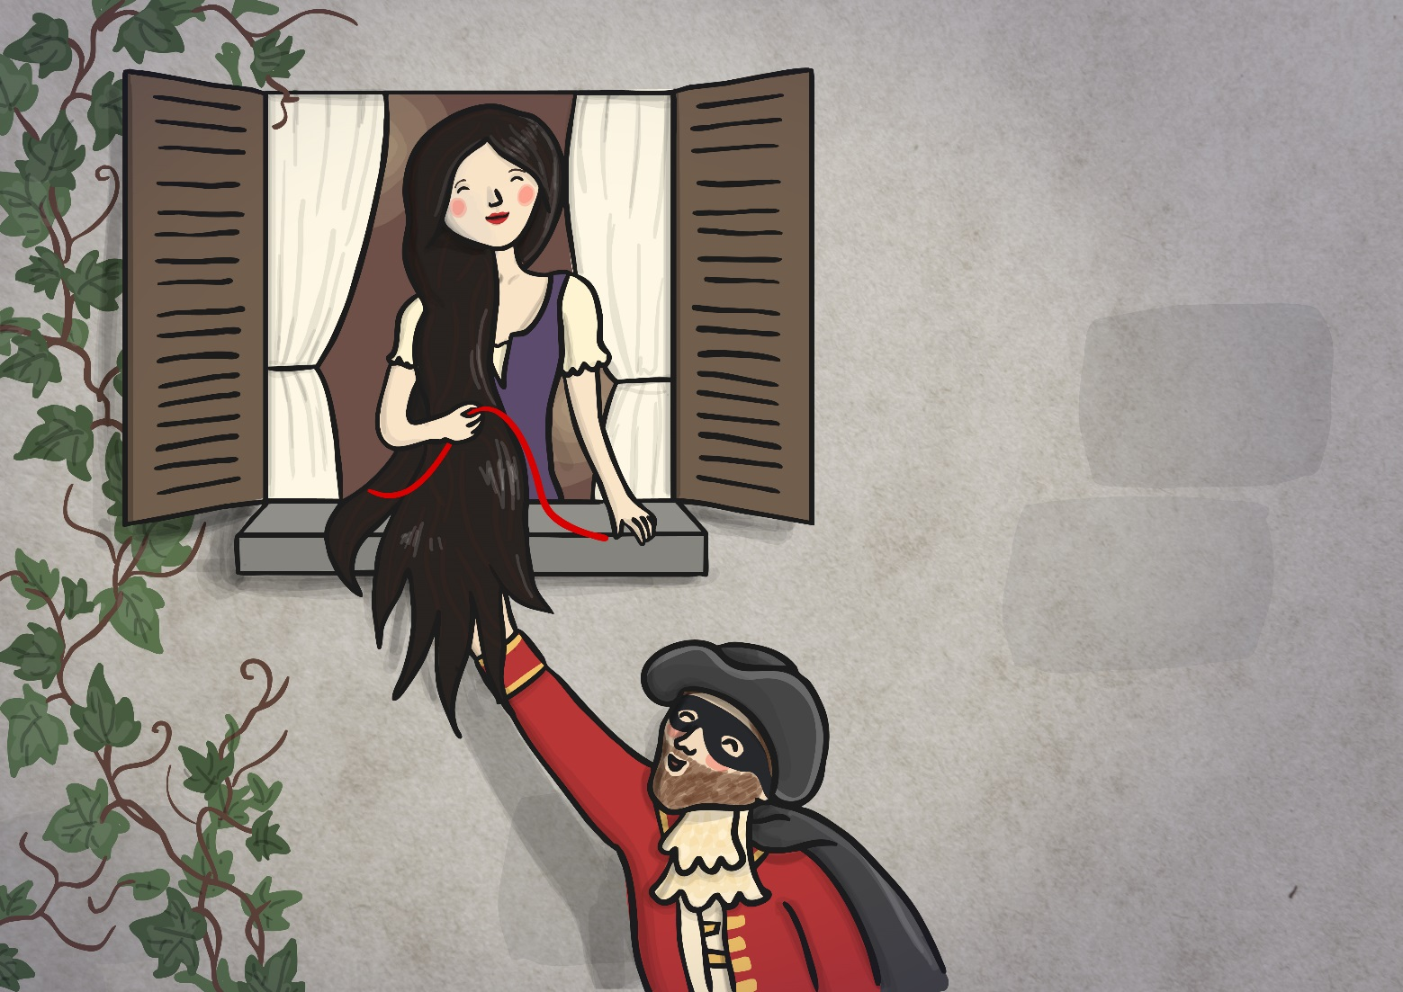
He rose upright in the stirrups; he scarce could reach her hand,
But she loosened her hair i’ the casement! His face burnt like a brand
As the black cascade of perfume came tumbling over his breast;
And he kissed its waves in the moonlight,
(Oh, sweet black waves in the moonlight!)
Then he tugged at his rein in the moonlight, and galloped away to the West.

Slide 42
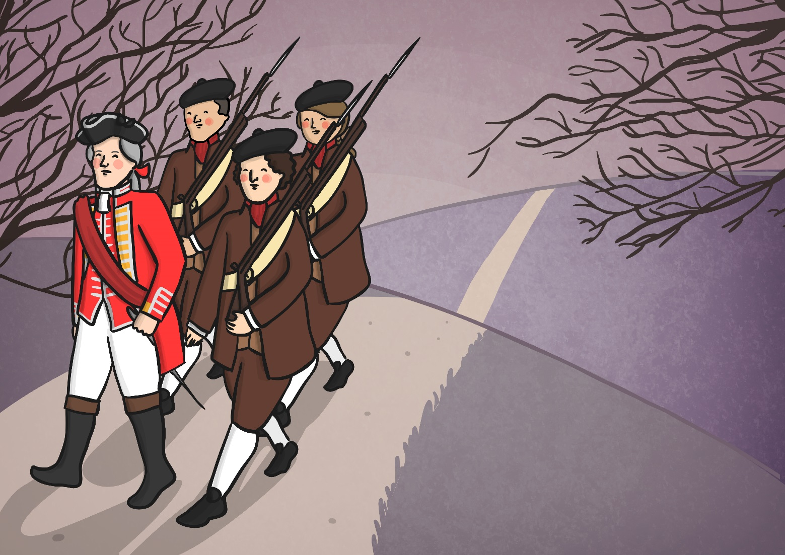
He did not come in the dawning; he did not come at noon;
And out o’ the tawny sunset, before the rise o’ the moon,
When the road was a gypsy’s ribbon, looping the purple moor,
A red-coat troop came marching-
Marching-marching-
King George’s men came marching, up to the old inn-door.

Slide 43
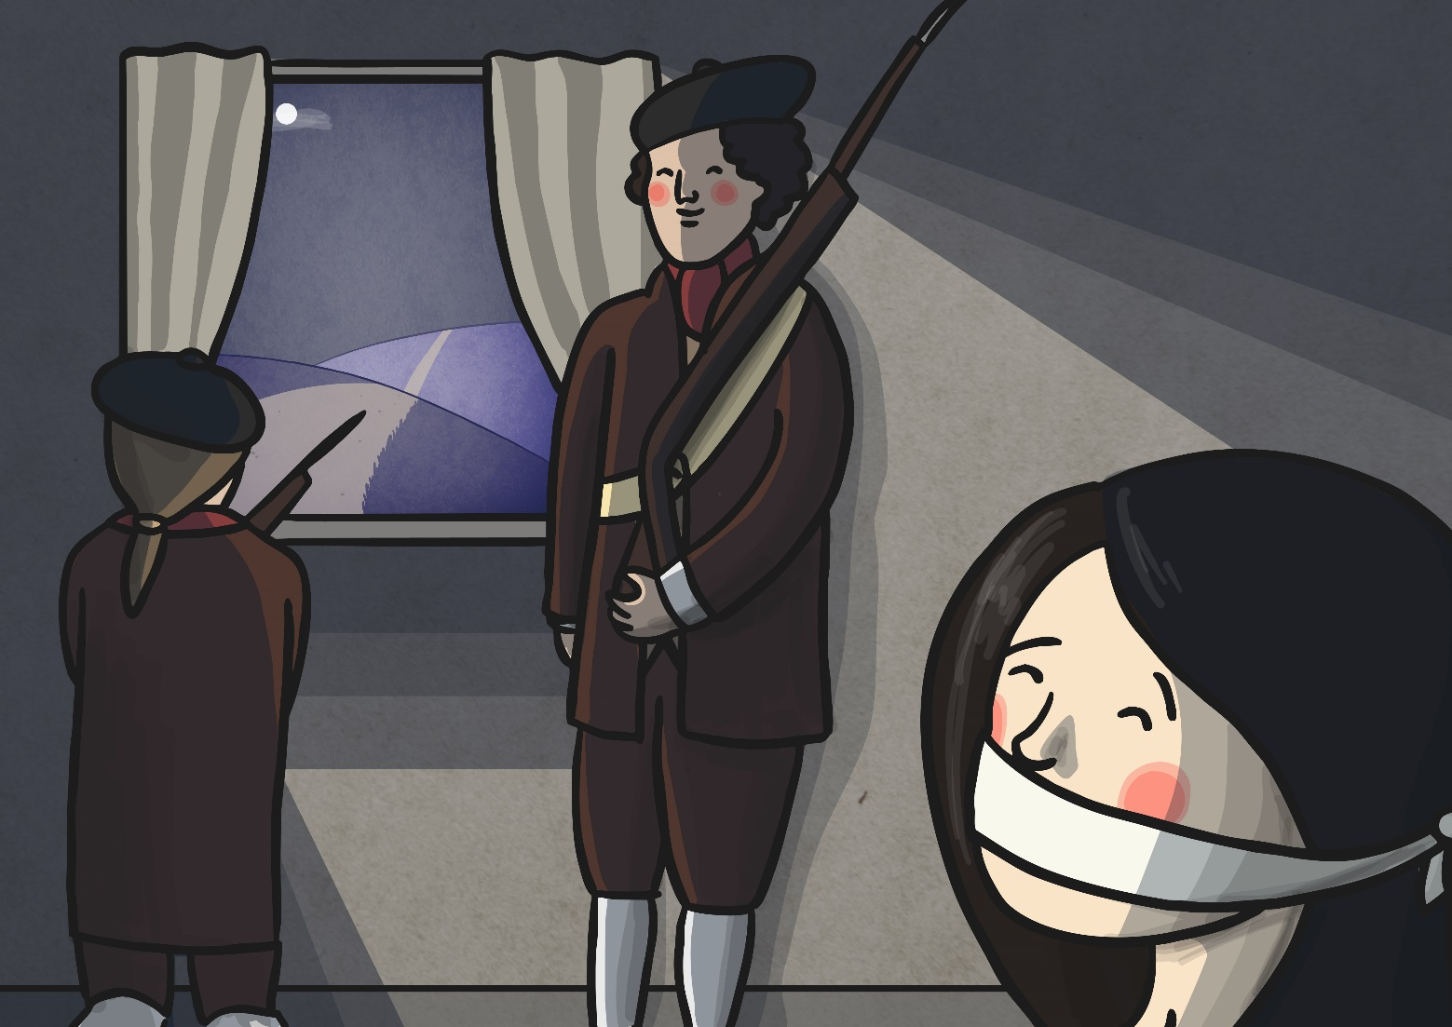
They said no word to the landlord, they drank his ale instead,
But they gagged his daughter and bound her to the foot of the narrow bed;
Two of them knelt at her casement, with muskets at their side!
There was death at every window;
And hell at one dark window;
For Bess could see, through the casement, the road that he would ride.

Slide 44
They had tied her up to attention, with many a sniggering jest;
They bound a musket beside her, with barrel beneath her breast!
“Now keep good watch!” and they kissed her.
She heard the dead man say-
Look for me by moonlight;
Watch for me by moonlight;
I’ll come to thee by moonlight, though hell should bar the way!

Slide 45
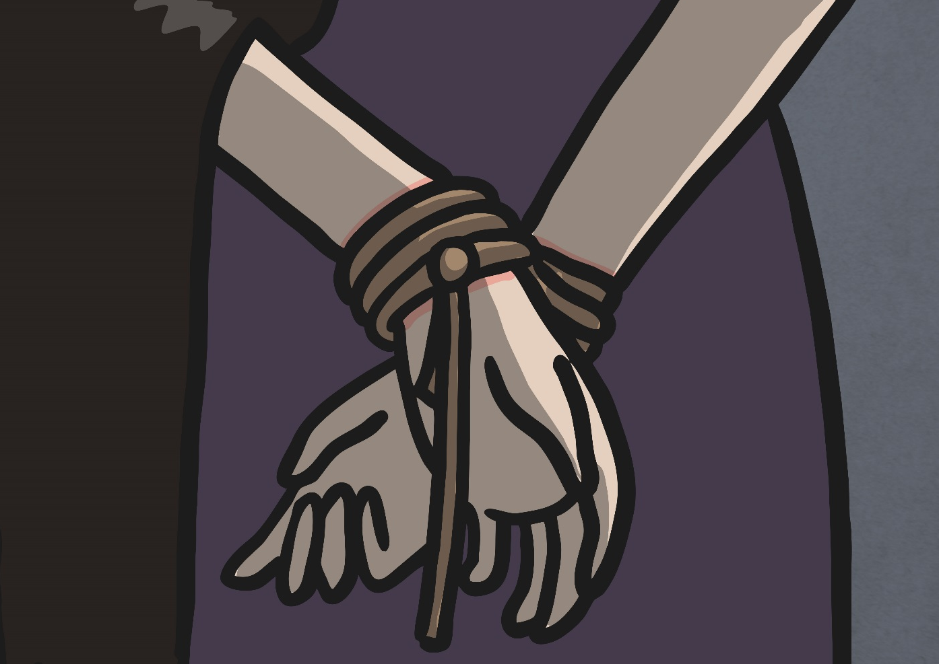
She twisted her hands behind her; but all the knots held good!
She writhed her hands till her fingers were wet with sweat or blood!
They stretched and strained in the darkness, and the hours crawled by like years,
Till, now, on the stroke of midnight,
Cold, on the stroke of midnight,
The tip of one finger touched it! The trigger at least was hers!
For Bess could see, through the casement, the road that he would ride.

Slide 46
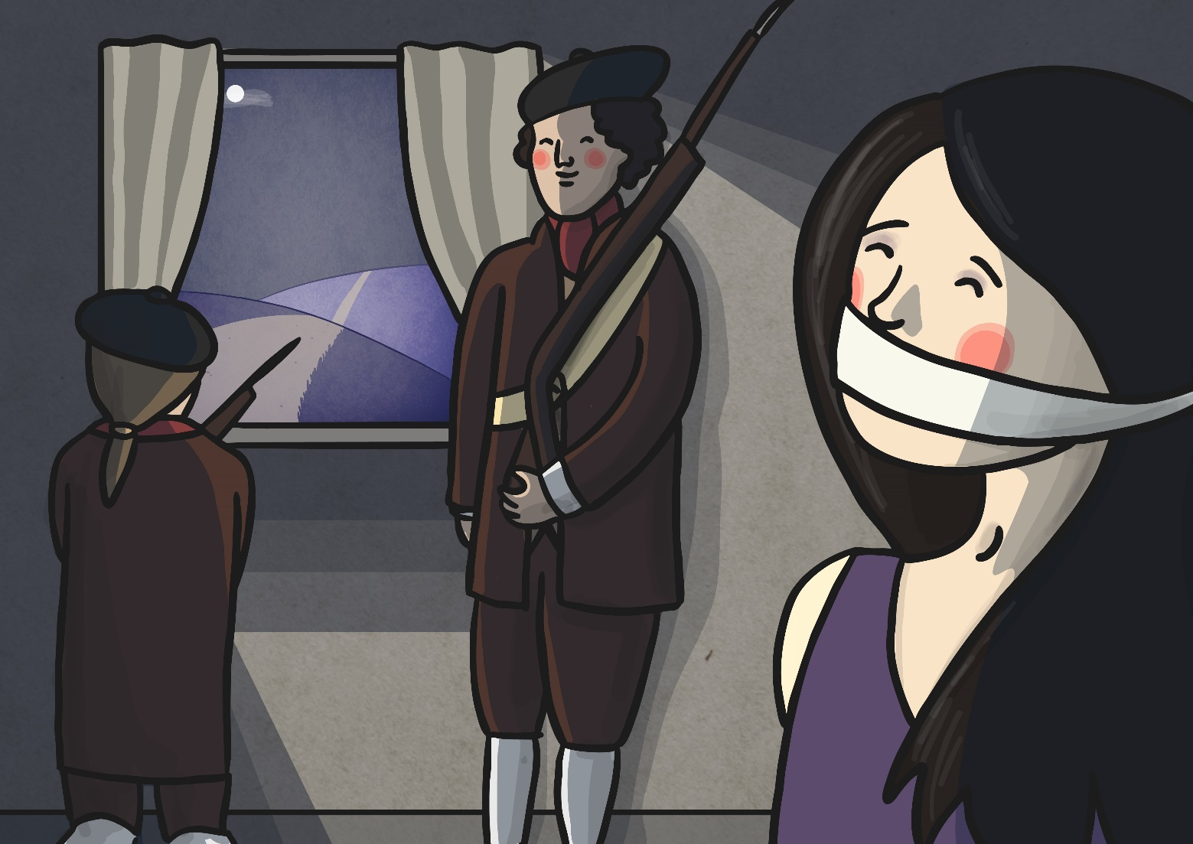
The tip of one finger touched it; she strove no more for the rest!
Up, she stood up to attention, with the barrel beneath her breast,
She would not risk their hearing; she would not strive again;
For the road lay bare in the moonlight;
Blank and bare in the moonlight;
And the blood of her veins in the moonlight throbbed to her love’s refrain.
For Bess could see, through the casement, the road that he would ride.

Slide 47
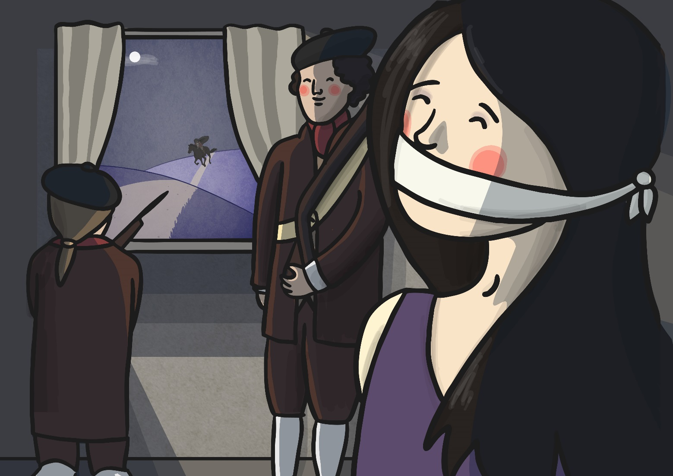
Tlot-tlot; tlot-tlot! Had they heard it? The horse-hoofs ringing clear;
Tlot-tlot, tlot-tlot, in the distance? Were they deaf that they did not hear?
Down the ribbon of moonlight, over the brow of the hill,
The highwayman came riding,
Riding, riding!
The red-coats looked to their priming! She stood up straight and still!

Slide 48
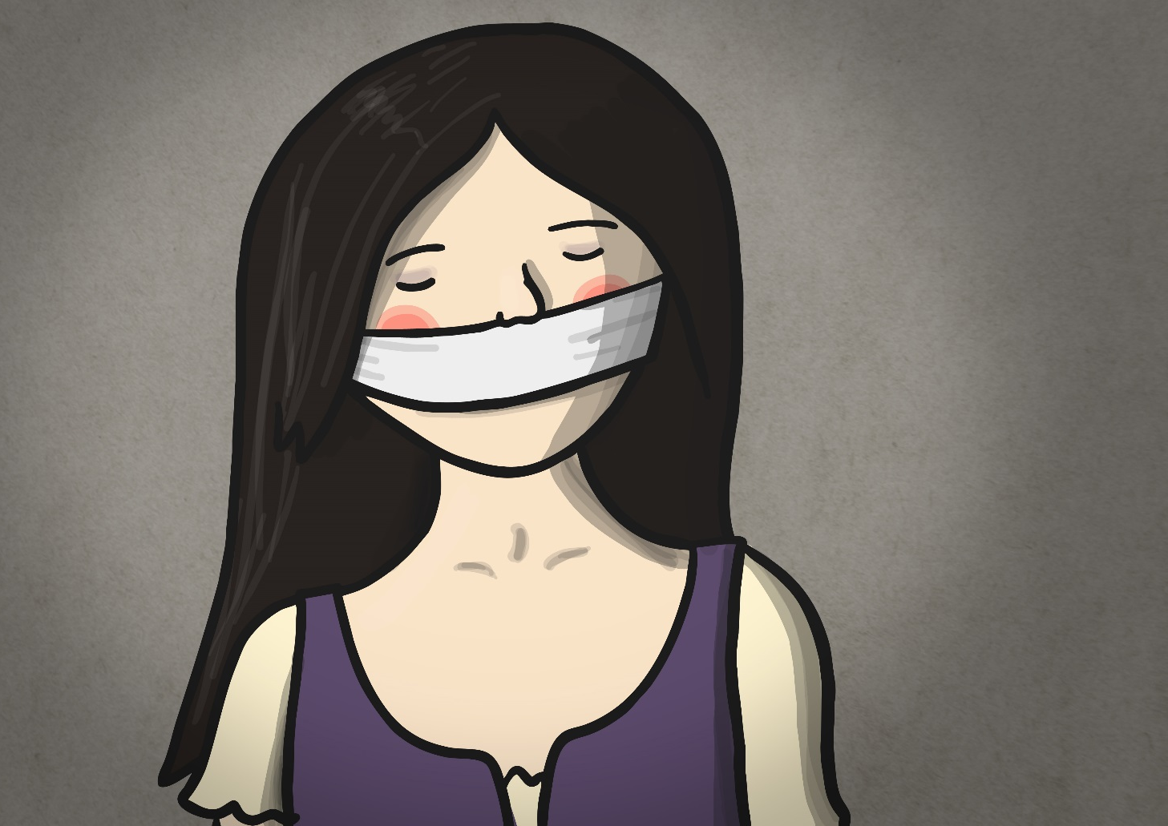
Tlot-tlot in the frosty silence! Tlot-tlot, in the echoing night!
Nearer he came and nearer! Her face was like a light!
Her eyes grew wide for a moment; she drew one last deep breath,
Then her fingers moved in the moonlight,
Her musket shattered the moonlight,
Shattered her breast in the moonlight and warned him with her death.

Slide 49
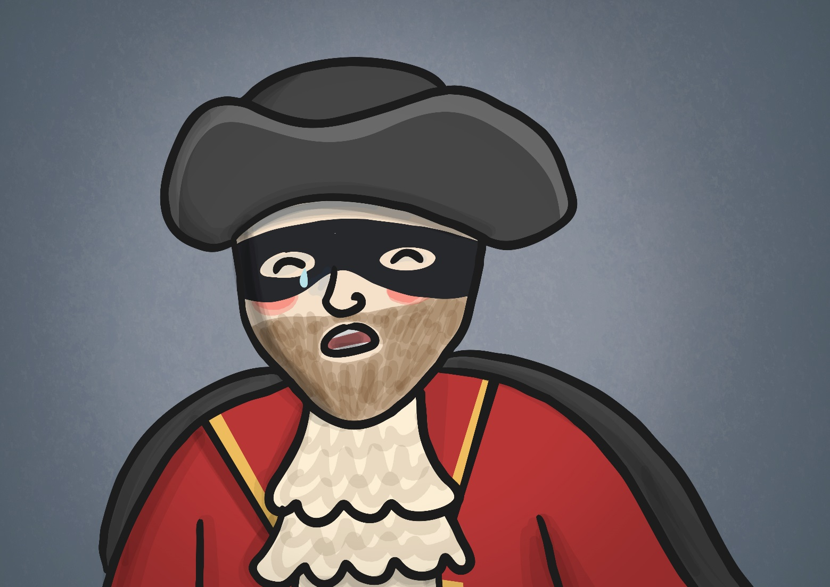
He turned; he spurred to the West; he did not know who stood
Bowed, with her head o’er the musket, drenched with her own red blood!
Not till the dawn he heard it, his face grew grey to hear
How Bess, the landlord’s daughter,
The landlord’s black-eyed daughter,
Had watched for her love in the moonlight, and died in the darkness there.

Slide 50
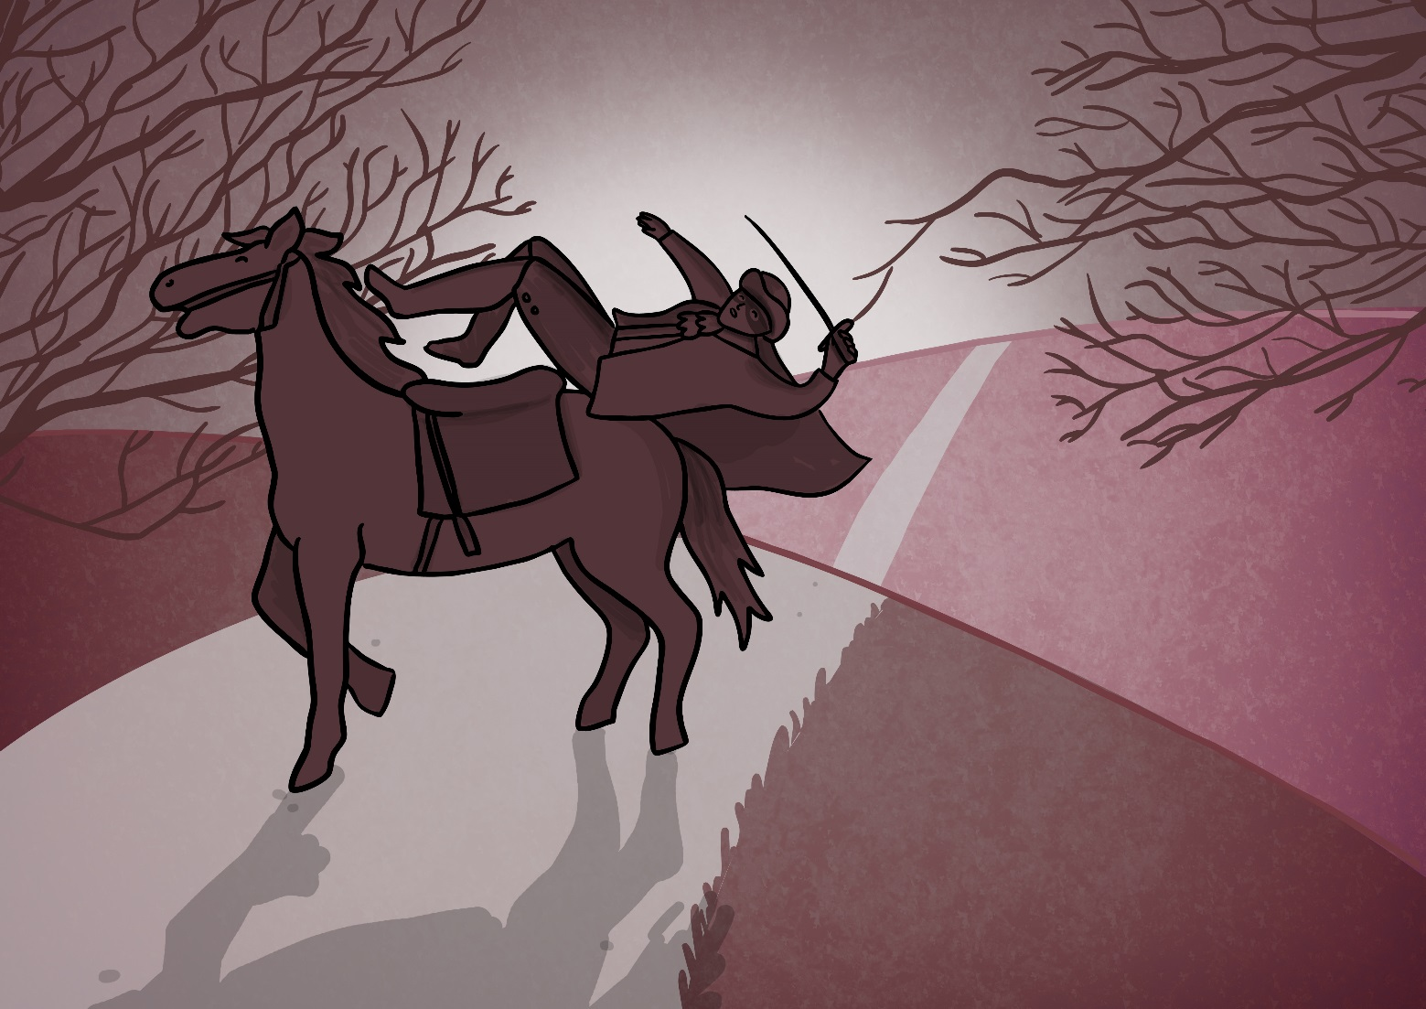
Back, he spurred like a madman, shrieking a curse to the sky,
With the white road smoking behind him and his rapier brandished high!
Blood-red were his spurs i’ the golden noon; wine-red was his velvet coat,
When they shot him down on the highway,
Down like a dog on the highway,
And he lay in his blood on the highway, with the bunch of lace at his throat.

Slide 51
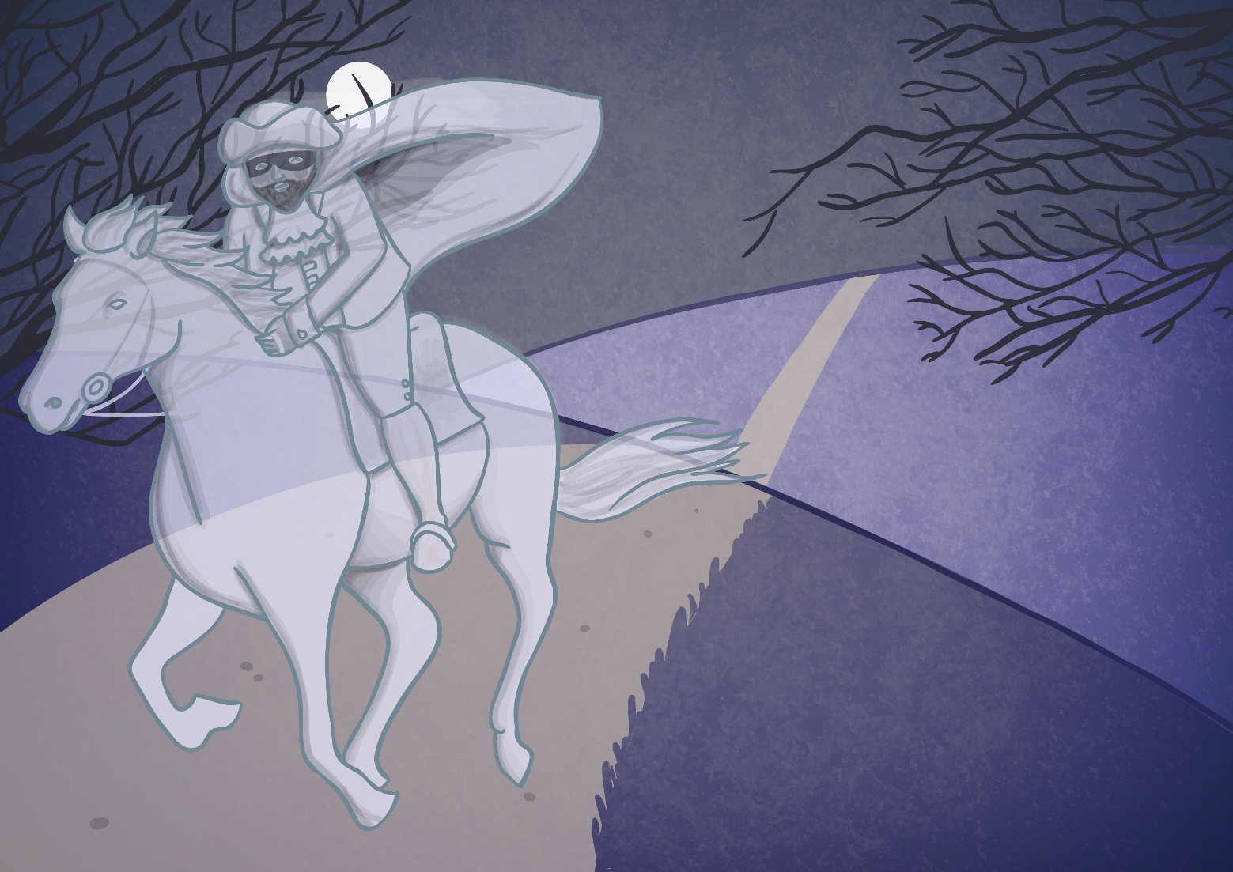
And still of a winters night, they say, when the wind is in the trees,
When the moon is a ghostly galleon tossed upon cloudy seas,
When the road is a ribbon of moonlight over the purple moor,
A highwayman comes riding-
Riding-riding-
A highwayman comes riding, up to the old inn-door.

Slide 52
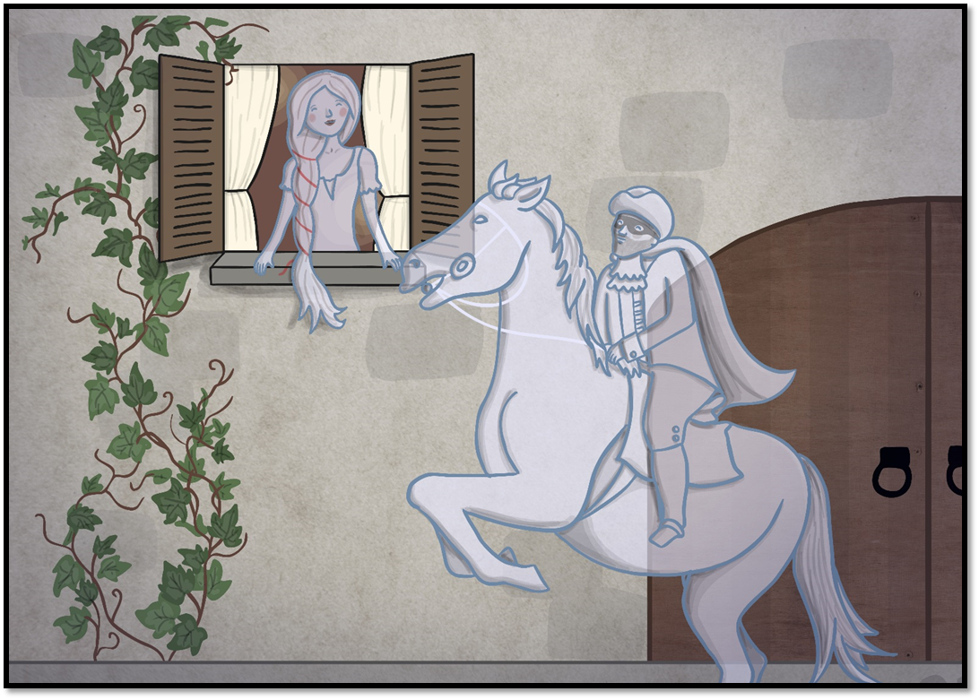
Over the cobbles he clatters and clangs in the dark inn-yard,
And he taps with his whip on the shutters, but all is locked and barred;
He whistles a tune to the window, and who should be waiting there
But the landlord’s black-eyed daughter,
Bess, the landlord’s daughter,
Plaiting a dark red love-knot into her long black hair.

Slide 53
LO: To be able to identify unfamiliar words and work out the meaning of the word by reading the rest of the stanza for context
We shall look through the poem again. Look for words in each verse that are unfamiliar (you are unsure of what they mean)?
Once you identify a word. Read around it. In other words, read the rest of the stanza and see if you can work the meaning of the word out.

Slide 54
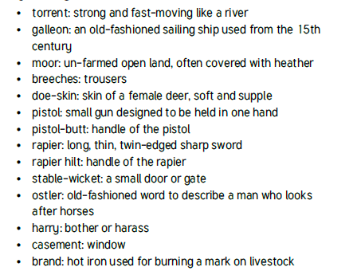
LO: To be able to identify unfamiliar words and work out the meaning of the word by reading the rest of the stanza for context

Slide 55

reprimand

Slide 56
reprimand
What could it mean?
Virgo knew she should leave well enough alone. She had escaped serious reprimand and the whole matter could now be put behind her.

Slide 57
reprimand
SAY IT AND FEEL THE SYLLABLES
SAY IT TO THE BIN
SAY IT TO SOMEONE ON ANOTHER TABLE
WHISPER IT TO THE FLOOR
SAY IT TO YOUR BOOK
REPEAT IT AFTER ME
SAY IT TO THE WINDOW
WHISPER IT TO A WALL

Slide 58
reprimand
Verb. to express to someone your strong official disapproval of them

Slide 59
reprimand
She was reprimanded by her teacher for biting another girl.
His boss gave him a severe reprimand for being late.
I received one written reprimand in three years.

Slide 60
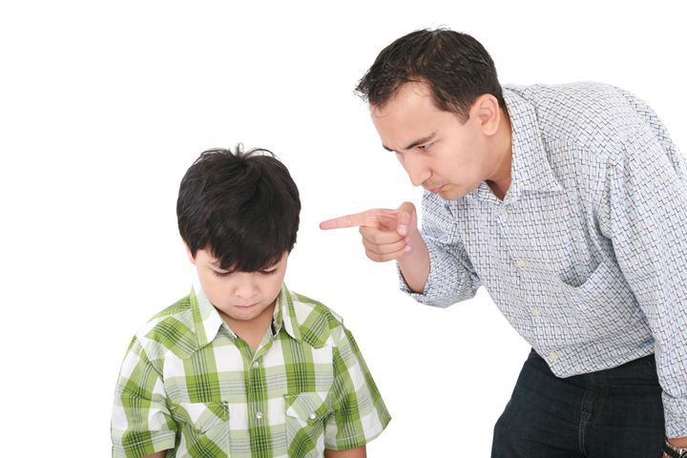
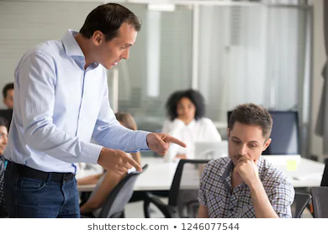

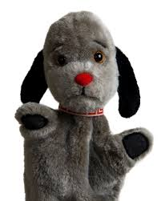
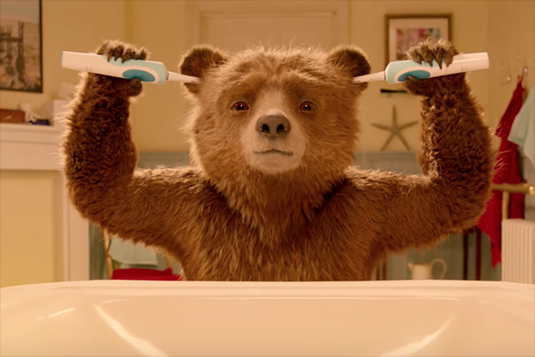
reprimand
Say reprimand if you see someone expressing strong disapproval of someone.

Slide 61
reprimand
In your books, write the word, the definition and write a subordinate clause to complete the complex sentences.

Slide 62
reprimand
Verb. to express to someone your strong official disapproval of them
The teacher reprimanded the boys because
The teacher reprimanded the boys but
The teacher reprimanded the boys so

Slide 63
Lunch

Slide 64

Lesson 5 – What would you do?
LO: To be able to describe and recognise some methods used to encourage people to buy things online.
LO: To be able to give examples of when and why it is important to understand the motive behind online
content.
LO: To be able to use questions to help decide what can and cannot be trusted online

Slide 65
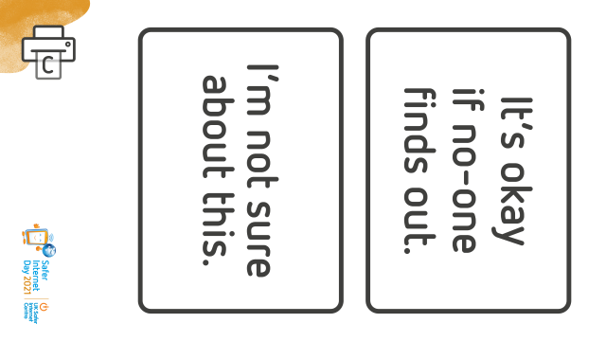
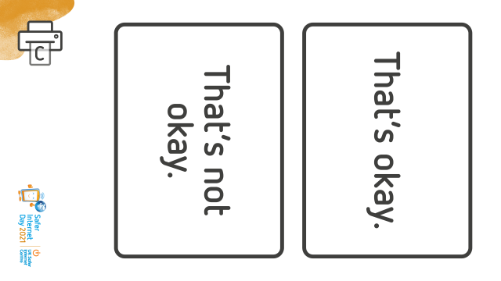
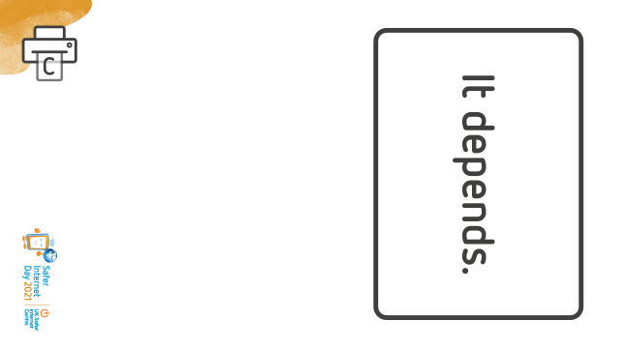
Online Compass Choices

Slide 66
Online Choices Compass
Scenario 1
You share a link with your friends to a website which has information that could upset people or cause offense.
Scenario 2
Someone in your class shares an article that you know is not true. You decide to message them privately and let them know.
Scenario 3
You have been chatting to someone online for a while and they start to ask you personal questions like what school you go to.
Scenario 4
Someone in your class shares something online that you know is not true. You decide to call them out publicly on their post.
Scenario 5
You are playing an online game and a pop up appears. It tells you that you have won lots of money. All you must do is click on it.

Slide 67
Online compass choices
I am going read aloud each scenario and ask you to move to the point which best suits how they feel about it. I will ask you:
TP: What is your reaction to the scenario?
TP: What methods do you already use for questioning what to trust online?
TP: What strategies you use for seeking help?

Slide 68
Lesson 6 – Two Truths and a Lie
LO: To be able to describe and recognise some methods used to encourage people to buy things online.
LO: To be able to give examples of when and why it is important to understand the motive behind online
content.
LO: To be able to use questions to help decide what can and cannot be trusted online

Slide 69
LO: To be able to describe and recognise some methods used to encourage people to buy things online.
LO: To be able to give examples of when and why it is important to understand the motive behind online content.
LO: To be able to use questions to help decide what can and cannot be trusted online
Two truths and a Lie
Think of two truths and a lie about yourselves.
You will take it in turns to say their three statements to the rest of the class, who need to work together to guess which is the false statement.
TP: How did you decide or know which statement was true or false?

Slide 70
LO: To be able to describe and recognise some methods used to encourage people to buy things online.
LO: To be able to give examples of when and why it is important to understand the motive behind online content.
LO: To be able to use questions to help decide what can and cannot be trusted online
Two truths and a Lie
When we’re online, extra clues like facial expressions or tone of voice, aren’t always visible, which can make it more difficult, and more important to stop and check.
We may also see some things online which are true and some which are false, but just like in the game there are things we can do to try and help us decide. E.g. think about what you already know, look out for things that are unrealistic, seem too good to be true, or don’t make sense, etc..
If all else fails - look it up, or ask someone. (This would be cheating in the game, but is a great idea if you’re online!)

