Slide 1
Good Morning
Wednesday 3rd February

Slide 2

Theseus and the Minotaur – Part 2
King Aegeus of Athens wanted to prevent these attacks. He struck a deal with Minos; each year, he would send over seven Athenian boys and seven Athenian girls as an offering to Mino’s bloodthirsty beast – the Minotaur.
Evidence
Retrieve
Interpret
Choice
What does blood-thirsty mean?
How many boys and girls did Athens have to send?
What kind of a King was King Aegeus?
Was King Aegeus right to send the children to Crete? Why/Why not?

Slide 3
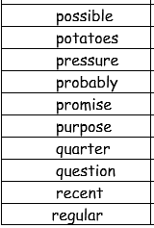
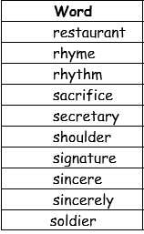
Spellings – Look/Cover/Spell/Check
Lente, Jack, Elliot, Alicia

Slide 4
Maths
Read through the slides and do the activities

Slide 5
RECALL
TP: Use the method from yesterday to solve:
32 x 21 =
33 x 21 =
34 x 21 =
TP: Can you see a pattern in the answers? What is it? Why?

Slide 6
LO: To be able to multiply a 2-digit number by a 2-digit number using two partitions.
Top Down | Self Assessment
Some of us will even: I can problem solve and reason when using multiplying two 2-digit numbers
Some of us will: I can solve the calculation by adding the 2 answers together
Most of us will: I can multiply a 2-digit number by a 2-digit number by solving the 2 partitioned calculations
All of us will: I can multiply a 2-digit number by a 2-digit number by creating 2 partitioned calculations

Slide 7
LO: To be able to multiply a 2-digit number by a 2-digit number using two partitions.
TP: Look at this calculation from yesterday. Can the amount of calculations we do when we partition down to just two?
23
x 14
200 (20 x 10)
40 (20 x 2)
30 ( 3 x 10)
12 ( 3 x 4)
282

Slide 8
LO: To be able to multiply a 2-digit number by a 2-digit number using two partitions.
Yes we can. We can reduce it down to:
23 x 10 =
23 x 4 =
We can just partition the bottom number down.
However, I have started with the smallest digit first.
TP: Solve these calculations. How did you do this? What mathematics did you use that we have looked at in previous lessons?
23
x 14
(23 x 4)
(23 x 10)

Slide 9
LO: To be able to multiply a 2-digit number by a 2-digit number using two partitions.
The knowledge you need was:
Your x table knowledge
X by 10 by moving each digit one place to the left
Short written column method multiplication
Can you see why I have swapped the calculations around?
TP: Why is the zero important?
TP: What do we have to do now to get the answer?
23
x 14
92 (23 x 4)
230 (23 x 10)

Slide 10
LO: To be able to multiply a 2-digit number by a 2-digit number using two partitions.
You still need all that knowledge but you can do this by following the process:
4 x 3 = 12
4 x 20 = 80
10 x 3 = 30
10 x 20 = 200
TP: Why is the zero important?
23
x 14
92 (23 x 4)
230 (23 x 10)

Slide 11
LO: To be able to multiply a 2-digit number by a 2-digit number using two partitions.
We add the answers together
23
x 14
92 (23 x 4)
230 (23 x 10)
3 2 2

Slide 12
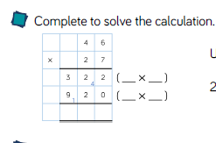
LO: To be able to multiply a 2-digit number by a 2-digit number using two partitions.

Slide 13
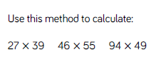
LO: To be able to multiply a 2-digit number by a 2-digit number using two partitions.

Slide 14
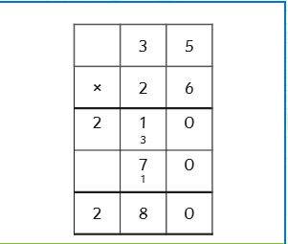
LO: To be able to multiply a 2-digit number by a 2-digit number using two partitions.
Look at this question.
TP: What mistake has Miss Davison made?

Slide 15
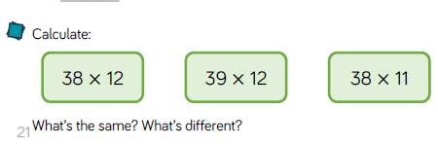
LO: To be able to multiply a 2-digit number by a 2-digit number using two partitions.

Slide 16
LO: To be able to multiply a 2-digit number by a 2-digit number using two partitions.
Chilli Questions
Solve these calculations using the method used during the lesson
45 x 24 =
45 x 25 =
45 x 26 =
45 x 27 =
45 x 28 =
EXT: Can you see the pattern in the answers? What is it?

Slide 17
LO: To be able to multiply a 2-digit number by a 2-digit number using two partitions.
Chilli Questions
Solve these calculations using the method used during the lesson
45 x 24 = 1080
45 x 25 = 1125
45 x 26 = 1170
45 x 27 = 1215
45 x 28 = 1260
EXT: Can you see the pattern in the answers? What is it? It goes up 45 each time.

Slide 18
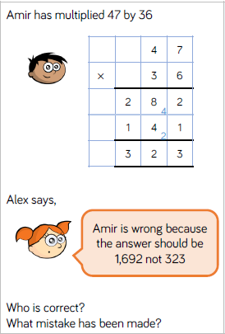
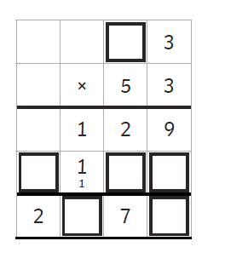
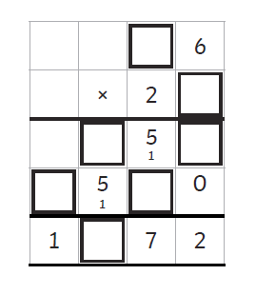
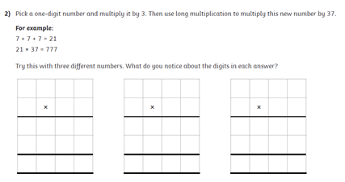
LO: To be able to multiply a 2-digit number by a 2-digit number using two partitions.

Slide 19
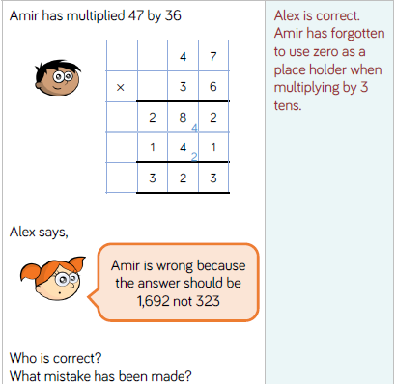
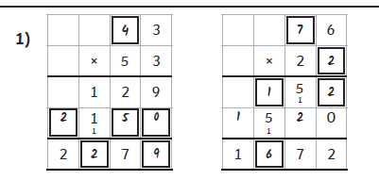

LO: To be able to multiply a 2-digit number by a 2-digit number using two partitions.

Slide 20
LO: To be able to multiply a 2-digit number by a 2-digit number using two partitions.
Top Down | Self Assessment
Some of us will even: I can problem solve and reason when using multiplying two 2-digit numbers
Some of us will: I can solve the calculation by adding the 2 answers together
Most of us will: I can multiply a 2-digit number by a 2-digit number by solving the 2 partitioned calculations
All of us will: I can multiply a 2-digit number by a 2-digit number by creating 2 partitioned calculations

Slide 21
REFLECTION - LO: To be able to multiply a 2-digit number by a 2-digit number using two partitions.
SELF ASSESSMENT

Slide 22
Break

Slide 23
Introduction
We are going to be concentrating on Narrative/Epic Poem that was first told in Anglo-Saxon/Viking times called ‘Beowulf’. We are going to find out what the poem is about, we are going to look at narrative poetry and then have a go at writing our own Narrative Poem about ‘Beowulf’. Finally, we perform our poems. These will be filmed and sent to parents and the school.

Slide 24
Introduction
A narrative poem is a type of poem that tells a story. Narrative poems tend to be quite long. They tell a story like in a novel and also use rhythm and rhyme, like in a poem.
https://www.bbc.co.uk/bitesize/topics/z4mmn39/articles/z3btrwx#:~:text=A%20narrative%20poem%20is%20a,rhyme%2C%20like%20in%20a%20poem.

Slide 25
Introduction
Today, we are going to focus on Beowulf. Let us remind ourselves about Beowulf in the story.

Slide 26
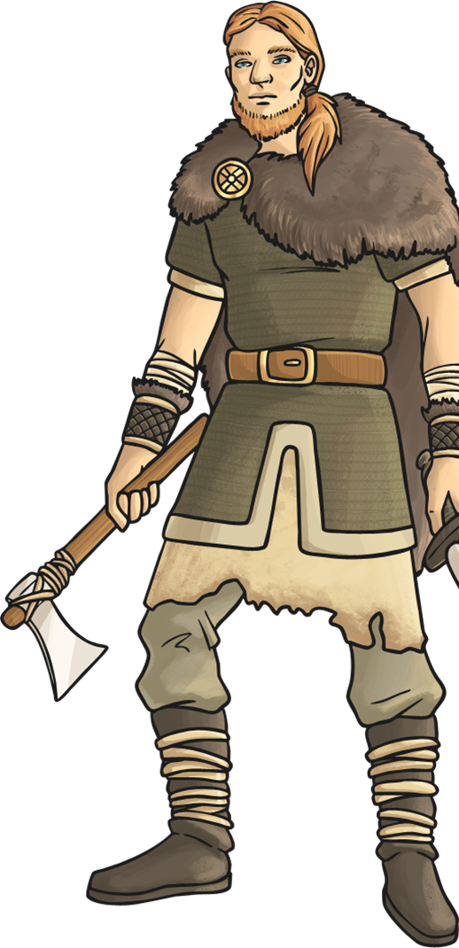
Beowulf Travels to Denmark
Eventually, news travelled over the water to the Geats where the young warrior Beowulf heard of King Hrothgar’s plight. He sailed to Denmark to offer help.
King Hrothgar was grateful for Beowulf’s help and agreed to hold another feast in Heorot. After the feast, Beowulf stayed in the great hall while all the Danes went back to their homes.
Why did it take so long for Beowulf to hear of Grendel’s attack? How would the news have travelled?

Slide 27
Introduction
How should Beowulf be portrayed in the poem?
What kind of things do we associated with a hero?
What questions can you ask about Beowulf that you would like to find out about if we to read a full story of ‘Beowulf’?
What do all questions needs at the end of them?

Slide 28
Introduction
One way to make the reader like and see Beowulf as a hero is describe how he looks, what he does, how he sounds, etc.
A writer does this by choosing carefully what words he uses to describe the character e.g. devour
Today, we are going to write a paragraph about Beowulf that will make the reader like and admire Beowulf

Slide 29
LO: To use a range of descriptive devices to describe a character/hero
Top Down | Self Assessment
Some of us will even: Some of us will even: The language I use creates a vivid image in the reader’s mind and I use a range of techniques to do this e.g. metaphor (Y6)
Some of us will: Some of us will: I am starting to use figurative language e.g. personification and simile to make my writing more interesting (Y4)
Most of us will: I include descriptions of the 5 senses (Y4)
All of us will 2: Most of us will: I use expanded noun phrases in my work using adjectives and prepositional phrases (Y4)
All of us will 1: All of us will: I use expanded noun phrases in my work using adjectives

Slide 30
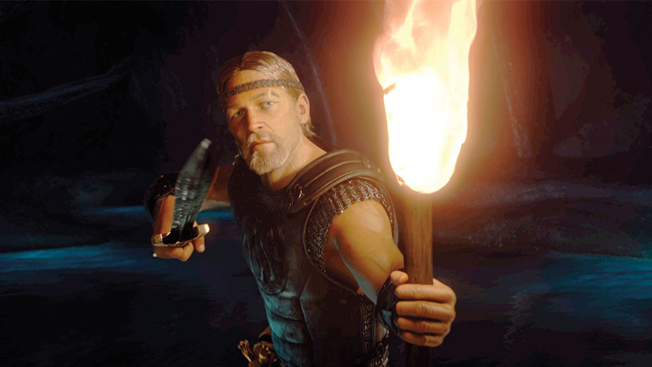
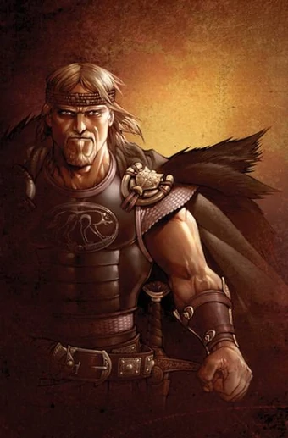
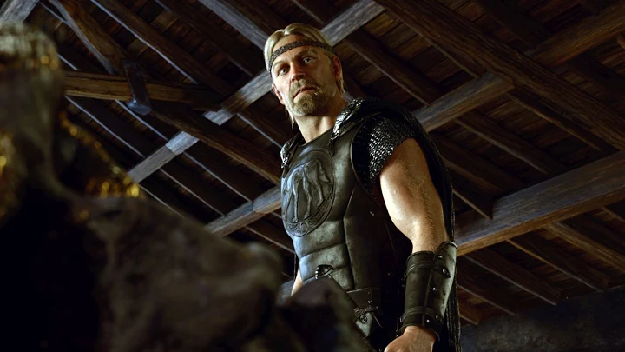
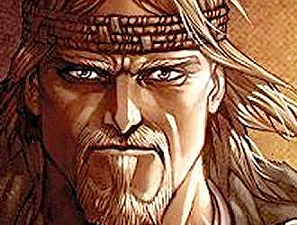
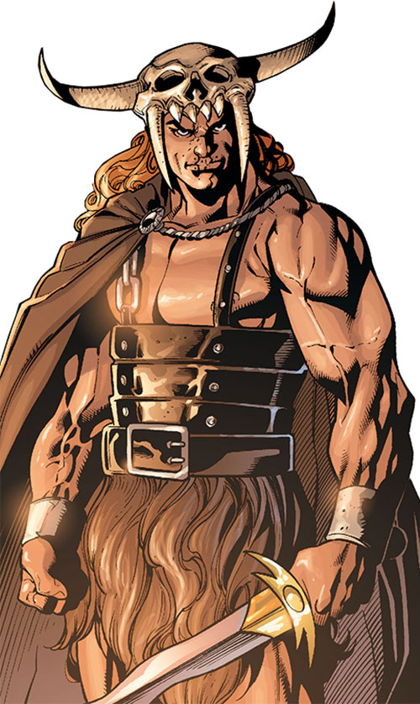
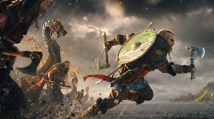
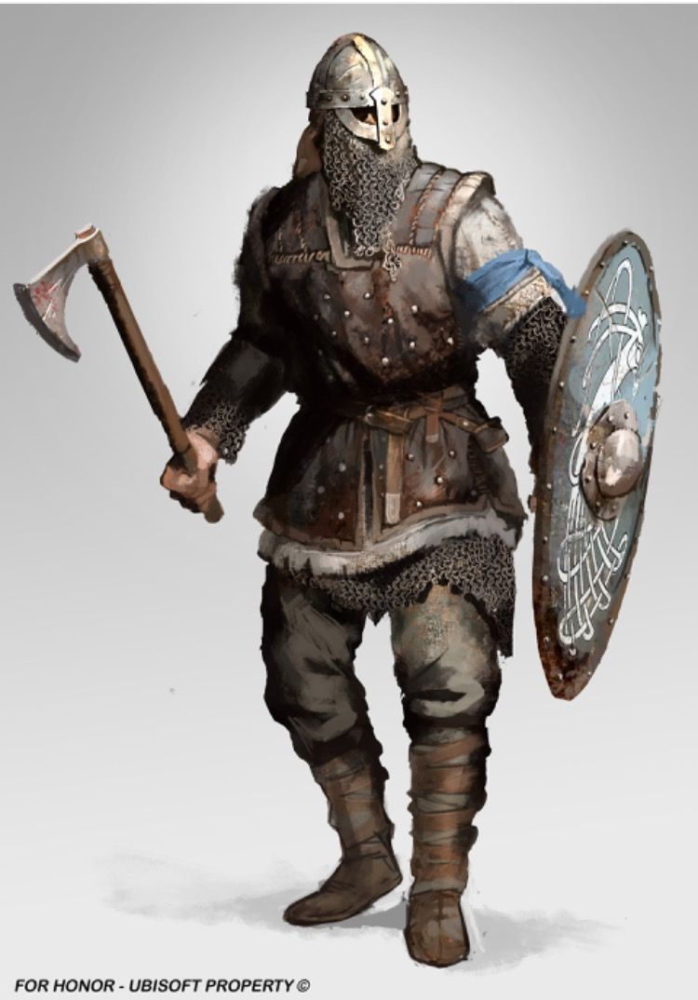
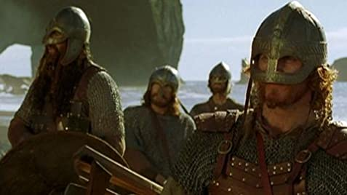
LO: To use a range of descriptive devices to describe a character/hero

Slide 31
LO: To use a range of descriptive devices to describe a character/hero
Q: What is a noun?
Q: Who is our person?
Q: Remember, Beowulf is a Viking/Anglo-Saxon warrior. What would he be wearing? What things would he have with him?

Slide 32
LO: To use a range of descriptive devices to describe a character/hero
Q: What is an adjective?
Q: How many adjectives can you think of that would describe Beowulf? The things he wore/had with him?

Slide 33
LO: To use a range of descriptive devices to describe a character/hero
Q: What is verb?
Q: How might Beowulf move during the course of the story?
Q: What is an adverb?
Q: What adverbs can you think to describe how he moves?

Slide 34
LO: To use a range of descriptive devices to describe a character/hero
Q: What is a preposition?
Q: How many prepositions can you think of?
Q: What is a prepositional phrase?

Slide 35
LO: To use a range of descriptive devices to describe a character/hero
Q: What are the five senses?
Q: What noise will he make?
Q: What smell would he make?
Q: What tastes might there be?
Q: How will he feel?

Slide 36
LO: To use a range of descriptive devices to describe a character/hero
Q: What is a simile?
Q: What similes can you use to describe him?
Q: What is personification?
Q: How could we personify him?
Q: What is a metaphor?
Q: What metaphors can we think of to describe him?

Slide 37
LO: To use a range of descriptive devices to describe a character/hero
Let us build a sentence. Our sentence is going to describe Beowulf at the start of the story.
Write the noun Beowulf
Q: What is an expanded noun phrase?

Slide 38
LO: To use a range of descriptive devices to describe a character/hero
All of us will 1: All of us will: I use expanded noun phrases in my work using adjectives
Now add two adjectives to your sentence to create an expanded noun phrase to describe Bewulf
The fearless and brave Beowulf

Slide 39
LO: To use a range of descriptive devices to describe a character/hero
All of us will 2: Most of us will: I use expanded noun phrases in my work using adjectives and prepositional phrases (Y4)
Add a prepositional phrase to your sentence
The fearless and brave Beowulf sails to Geat .

Slide 40
LO: To use a range of descriptive devices to describe a character/hero
Most of us will: I include descriptions of the 5 senses (Y4)
Can you write a sentence using one of the 5 senses?
The air filled with aroma of roses and hope.

Slide 41
LO: To use a range of descriptive devices to describe a character/hero
Some of us will: Some of us will: I am starting to use figurative language e.g. personification and simile to make my writing more interesting (Y4)
The air danced with aroma of roses and hope as our hero as brave as a lion walked forward

Slide 42
LO: To use a range of descriptive devices to describe a character/hero
Q: Can you use a metaphor in a sentence to describe Beowulf?
The air danced with aroma of roses and hope as our brave lion walked forward.

Slide 43
LO: To use a range of descriptive devices to describe a character/hero
ACTIVITY
Use a range of descriptive language to describe the hero Beowulf so the reader feels positive towards our character and he will be able to defeat the monster

Slide 44
LO: To use a range of descriptive devices to describe a character/hero
Top Down | Self Assessment
Some of us will even: Some of us will even: The language I use creates a vivid image in the reader’s mind and I use a range of techniques to do this e.g. metaphor (Y6)
Some of us will: Some of us will: I am starting to use figurative language e.g. personification and simile to make my writing more interesting (Y4)
Most of us will: I include descriptions of the 5 senses (Y4)
All of us will 2: Most of us will: I use expanded noun phrases in my work using adjectives and prepositional phrases (Y4)
All of us will 1: All of us will: I use expanded noun phrases in my work using adjectives

Slide 45
REFLECTION - LO: To use a range of descriptive devices to describe a character/hero
Read another person’s descriptive passage about Grendel. Which one is your favourite? Why? What descriptive language have they used?

Slide 46
Reading Comprehension
Read through the slides and do the activities

Slide 47
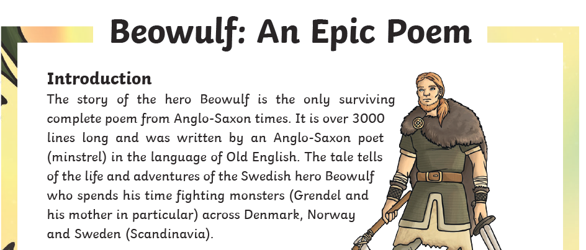
LO: To answer questions about the epic poem ‘Beowulf’

Slide 48
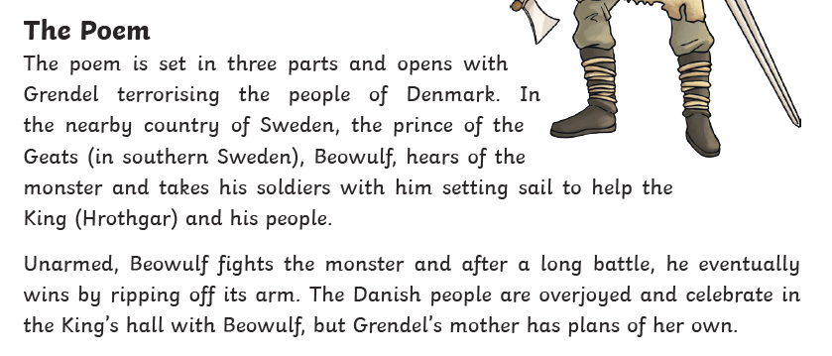
LO: To answer questions about the epic poem ‘Beowulf’

Slide 49
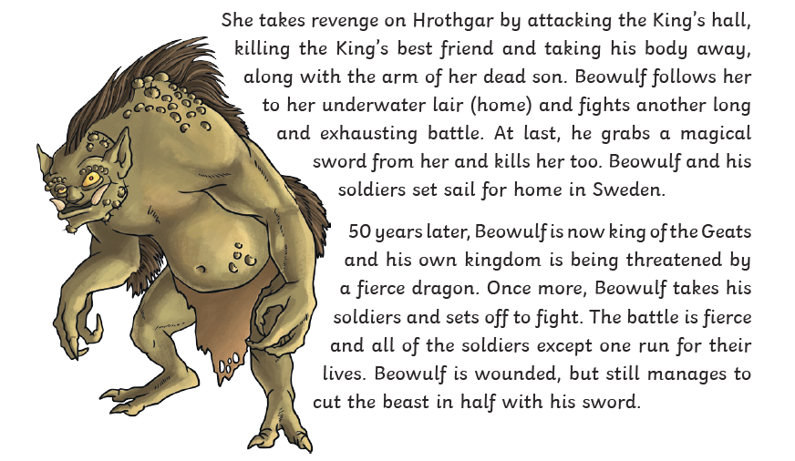
LO: To answer questions about the epic poem ‘Beowulf’

Slide 50
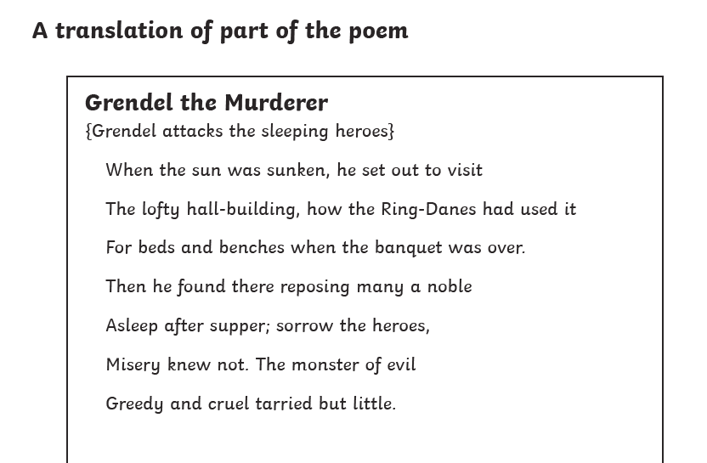
LO: To answer questions about the epic poem ‘Beowulf’

Slide 51
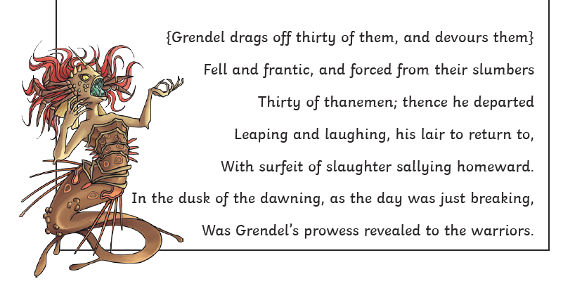
LO: To answer questions about the epic poem ‘Beowulf’

Slide 52
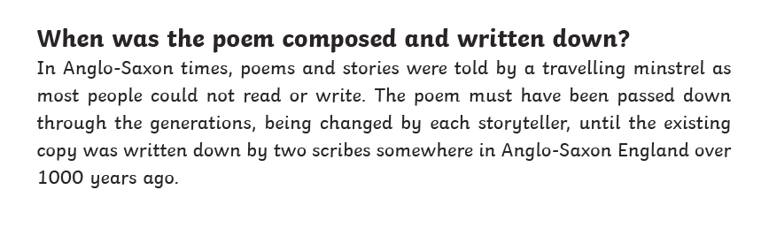
LO: To answer questions about the epic poem ‘Beowulf’

Slide 53
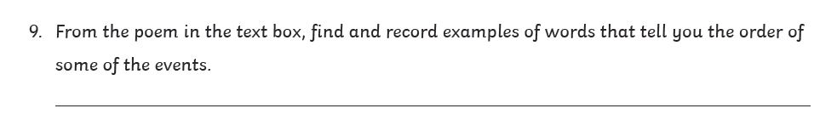
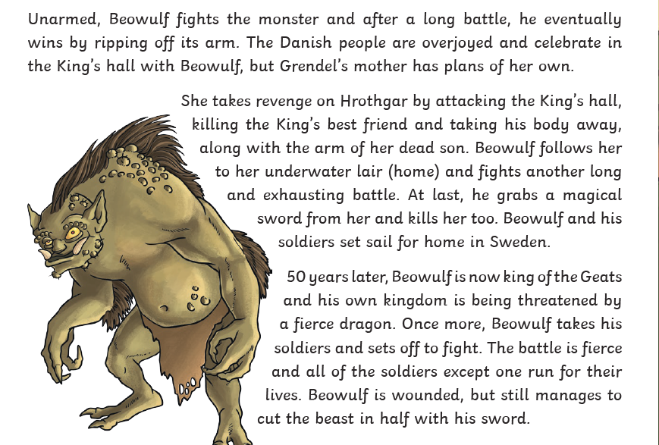
LO: To answer questions about the epic poem ‘Beowulf

Slide 54
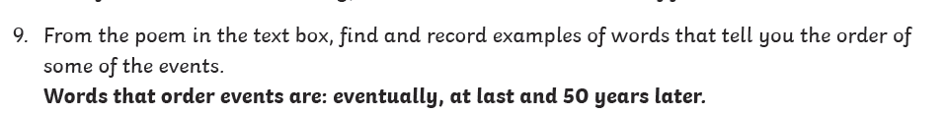
LO: To answer questions about the epic poem ‘Beowulf

Slide 55
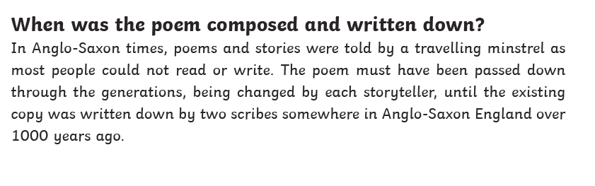
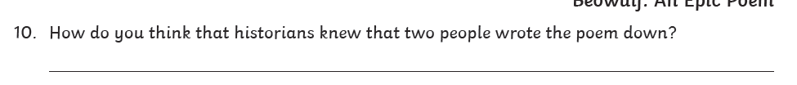
LO: To answer questions about the epic poem ‘Beowulf

Slide 56
LO: To answer questions about the epic poem ‘Beowulf

Slide 57
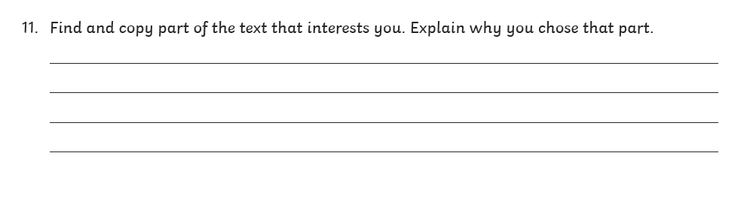
LO: To answer questions about the epic poem ‘Beowulf

Slide 58
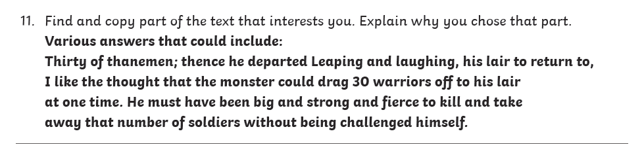
LO: To answer questions about the epic poem ‘Beowulf

Slide 59

protocol

Slide 60
protocol
What could it mean?
“We have to follow protocol.”

Slide 61
protocol
SAY IT AND FEEL THE SYLLABLES
SAY IT TO THE BIN
SAY IT TO SOMEONE ON ANOTHER TABLE
WHISPER IT TO THE FLOOR
SAY IT TO YOUR BOOK
REPEAT IT AFTER ME
SAY IT TO THE WINDOW
WHISPER IT TO A WALL

Slide 62
protocol
Noun. the system of rules and acceptable behaviour used at official ceremonies and occasions

Slide 63
protocol
When you meet the Queen, you have to follow the Royal Protocol.
The Geneva Protocol of 1925 prohibits the use of poisonous gases in war.
Boris Johnston had to follow legal protocol when he won the general election by asking the Queen if he could form a government.

Slide 64
protocol
In your books, write the word, the definition and use it in a sentence/draw a picture.

Slide 65
protocol
Noun. the system of rules and acceptable behaviour used at official ceremonies and occasions

Slide 66
Lunch

Slide 67

Lesson 4 – Spreading the Word
LO: To be able to describe and recognise some methods used to encourage people to buy things online.
LO: To be able to give examples of when and why it is important to understand the motive behind online
content.
LO: To be able to use questions to help decide what can and cannot be trusted online.

Slide 68

Design a Poster
TP: What have you learnt about Internet Safety this week?
Write down as many things as you can think of?
What have your learnt?
You may wish to add some of the things said today to your list

Slide 69
Design a Poster
TASK: Create a poster that could be used to inform the school and wider community about what we have learnt about the key issue this week.
MODEL – Everything is not as it seems online!
Some people have a motive behind what they post.
People could post things for profit.
Look for:

