Slide 1
PSHE
Internet Safety Worksheets

Slide 2
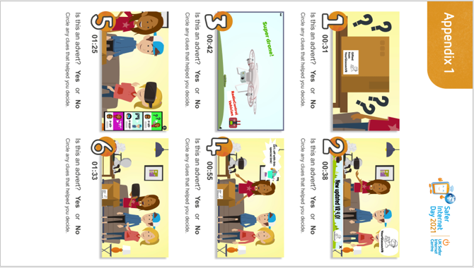

Slide 3


