Slide 1
Good Morning
Monday 1st February

Slide 2
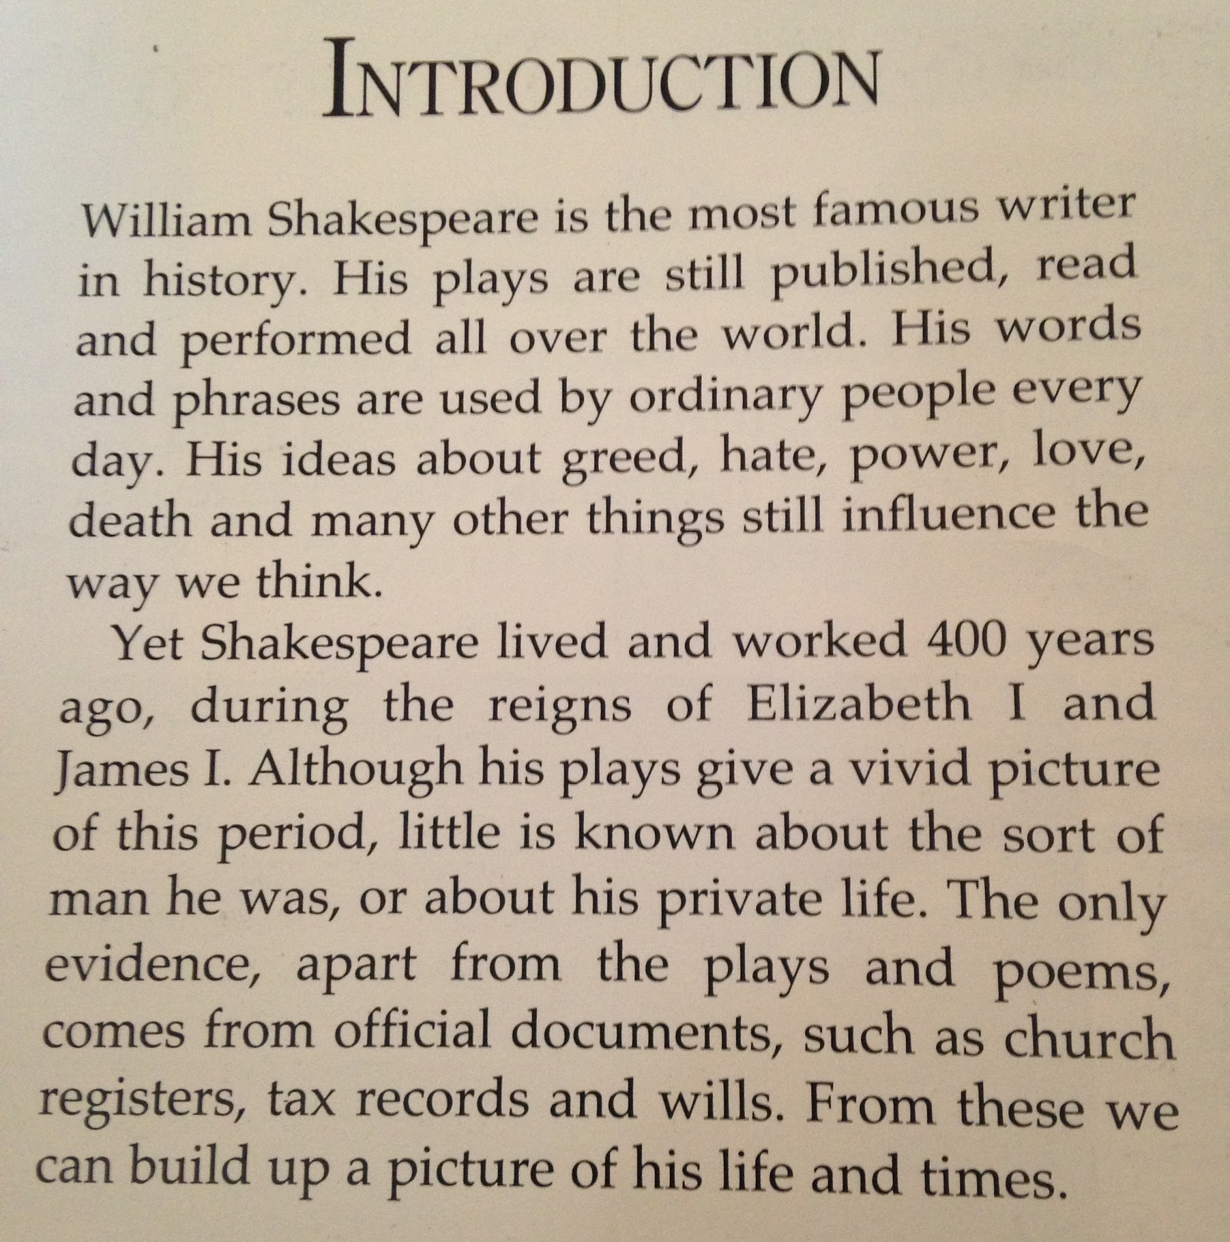
R) Who were the monarchs during Shakespeare’s life?
I) Using this text, how do you know Shakespeare is still important? Remember to use quotes.
C) Why do you think the author chose not to give any specific information about Shakespeare and his life?

Slide 3
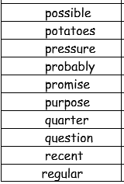
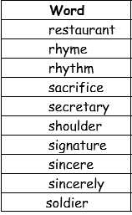
Spellings – Look/Cover/Spell/Check
Lente, Jack, Elliot, Alicia

Slide 4
Maths
Read through the slides and do the activities

Slide 5
RECALL
Use the column method to solve:
2223 x 3 =
2232 x 3 =
2322 x 3 =
4322 x 3 =
4324 x 3 =

Slide 6
LO: To be able to multiply a 2-digit number by a 2-digit number using the grid method.
Top Down | Self Assessment
Some of us will even: I can solve problem solving and reasoning questions that involves multiplying a 2-digit number by a 2-digit number
Some of us will: I can recombine the numbers through addition to find the answer
Most of us will: I can use the grid to help me multiply the partitioned numbers
All of us will: I can partition a calculation and put the numbers into a grid

Slide 7
LO: To be able to multiply a 2-digit number by a 2-digit number using the grid method.
23 x 22 =
Before we look at using the written column method to solve this kind of calculation, we are going to look at partitioning a calculation into separate calculations and recombining them. We are going to start with something called the grid method.

Slide 8
LO: To be able to multiply a 2-digit number by a 2-digit number using the grid method.
23 x 22 =
TP: What is the value of each of these numbers in the calculation?
TP: If I was to partition this calculation into separate calculations, there should be 4 separate calculations. What are these partitioned calculations? Remember the place value of the numbers.

Slide 9
LO: To be able to multiply a 2-digit number by a 2-digit number using the grid method.
23 x 22 =
20 x 20 =
20 x 2 =
3 x 30 =
3 x 2 =
To help us put these into a order we use a grid
x | 20 | 3
20
2

Slide 10
LO: To be able to multiply a 2-digit number by a 2-digit number using the grid method.
23 x 22 =
20 x 20 =
20 x 2 =
3 x 30 =
3 x 2 =
TP: Now we can do the calculations
x | 20 | 3
20
2

Slide 11
LO: To be able to multiply a 2-digit number by a 2-digit number using the grid method.
23 x 22 =
20 x 20 =
20 x 2 =
3 x 30 =
3 x 2 =
TP: Now we can do the calculations
x | 20 | 3
20 | 400 | 60
2 | 40 | 6

Slide 12
LO: To be able to multiply a 2-digit number by a 2-digit number using the grid method.
23 x 22 =
20 x 20 =
20 x 2 =
3 x 30 =
3 x 2 =
TP: What do we now do with these partitioned answers?
x | 20 | 3
20 | 400 | 60
2 | 40 | 6

Slide 13
LO: To be able to multiply a 2-digit number by a 2-digit number using the grid method.
23 x 22 =
20 x 20 =
20 x 2 =
3 x 30 =
3 x 2 =
TP: What is the answer?
400 + 60 + 40 + 6 =
x | 20 | 3
20 | 400 | 60
2 | 40 | 6

Slide 14
LO: To be able to multiply a 2-digit number by a 2-digit number using the grid method.
45 x 42 =
TP: Help me fill in the grid.
x

Slide 15
LO: To be able to multiply a 2-digit number by a 2-digit number using the grid method.
45 x 42 =
TP: Help me fill in the calculations
x | 40 | 5
40
2

Slide 16
LO: To be able to multiply a 2-digit number by a 2-digit number using the grid method.
45 x 42 =
TP: What do I do with all these partitioned answers?
x | 40 | 5
40 | 1600 | 200
2 | 80 | 10

Slide 17
LO: To be able to multiply a 2-digit number by a 2-digit number using the grid method.
45 x 42 =
TP: What is the answer?
x | 40 | 5
40 | 1600 | 200
2 | 80 | 10
1600 + 200 + 80 + 10 =

Slide 18

LO: To be able to multiply a 2-digit number by a 2-digit number using the grid method.
TP: Try these calculations

Slide 19
LO: To be able to multiply a 2-digit number by a 2-digit number using the grid method.
Chilli 1 | Chilli 2 | Chilli 3
Look at these calculations. Partition these calculations into smaller calculations and put them in a grid. 24 x 22 25 x 22 26 x 22 | Now solve the partitioned calculations within the grid | No recombine the answers to find the answer to the calculations
EXT: How would you use the grid method to solve 232 x 22 =

Slide 20
LO: To be able to multiply a 2-digit number by a 2-digit number using the grid method.
EXT: How would you use the grid method to solve 232 x 22 =
Chilli 1 | Chilli 2 | Chilli 3
Look at these calculations. Partition these calculations into smaller calculations and put them in a grid. 24 x 22 25 x 22 26 x 22 | Now solve the partitioned calculations within the grid | No recombine the answers to find the answer to the calculations 400 + 80 + 40 + 8 = 528 400 + 100 + 40 + 10 = 550 400 + 120 + 40 + 12 = 572
x | 20 | 4
20
2
x | 20 | 4
20 | 400 | 80
2 | 40 | 8
x | 20 | 5
20
2
x | 20 | 5
20 | 400 | 100
2 | 40 | 10
x | 20 | 6
20
2
x | 20 | 6
20 | 400 | 120
2 | 40 | 12

Slide 21
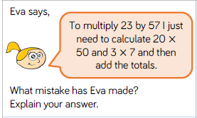
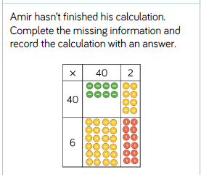
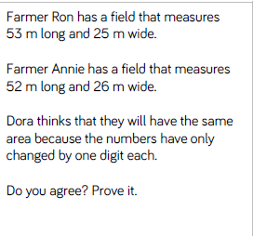
LO: To be able to multiply a 2-digit number by a 2-digit number using the grid method.

Slide 22
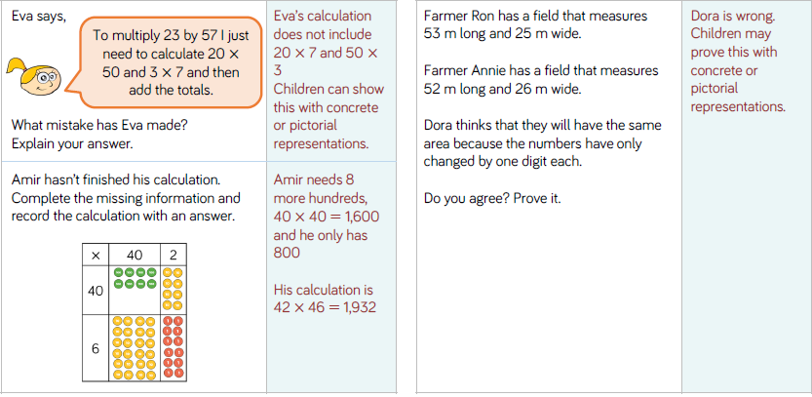
LO: To be able to multiply a 2-digit number by a 2-digit number using the grid method.

Slide 23
LO: To be able to multiply a 2-digit number by a 2-digit number using the grid method.
Top Down | Self Assessment
Some of us will even: I can solve problem solving and reasoning questions that involves multiplying a 2-digit number by a 2-digit number
Some of us will: I can recombine the numbers through addition to find the answer
Most of us will: I can use the grid to help me multiply the partitioned numbers
All of us will: I can partition a calculation and put the numbers into a grid

Slide 24
Assembly and Break

Slide 25
Narrative/Epic Poetry
Read through the slides and do the activities

Slide 26
Introduction
We are going to be concentrating on Narrative/Epic Poem that was first told in Anglo-Saxon/Viking times called ‘Beowulf’. We are going to find out what the poem is about, we are going to look at narrative poetry and then have a go at writing our own Narrative Poem about ‘Beowulf’.

Slide 27
Introduction
A narrative poem is a type of poem that tells a story. Narrative poems tend to be quite long. They tell a story like in a novel and also use rhythm and rhyme, like in a poem.
https://www.bbc.co.uk/bitesize/topics/z4mmn39/articles/z3btrwx#:~:text=A%20narrative%20poem%20is%20a,rhyme%2C%20like%20in%20a%20poem.

Slide 28
LO: To know what the story of ‘Beowulf’ is about and to put it in chronological order
Let us find out about Beowulf

Slide 29
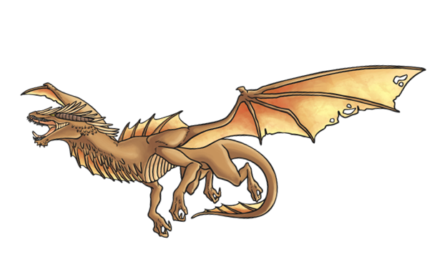
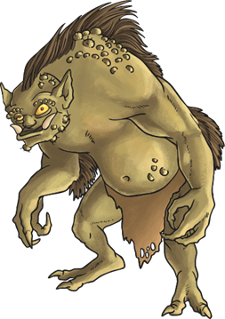
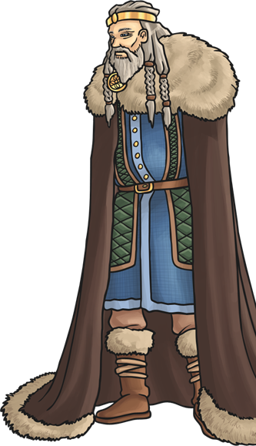
An Epic Poem
Beowulf is a famous epic poem.
‘Epic’ means a very long poem about heroes and warriors.
Beowulf is one of the first recorded stories we have in Britain and it was written in Old English.
Beowulf is the hero of a Scandinavian tribe, the Geats, and the poem tells of his battle with a monster called Grendel.
Other famous epic poems are The Song of Hiawatha, Gilgamesh and the Iliad.

Slide 30
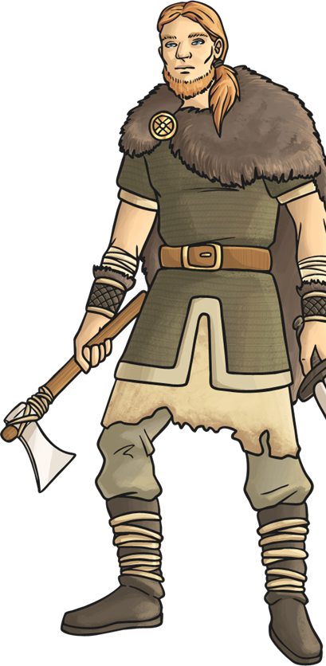


Beowulf
The story of Beowulf, first told around 800AD, tells of events around 200 years before that. It wasn’t written down back then. Instead, the story was passed down orally by storytellers.
There is one surviving manuscript in the British Museum. Experts believe it is around 1000 years old!
Old English, the language spoken by the Anglo-Saxons, was very different to the English we speak today.
Listen to the start of Beowulf in Old English! Can you understand any of it?
Have a look at Beowulf written down. Can you understand any of it?

Slide 31
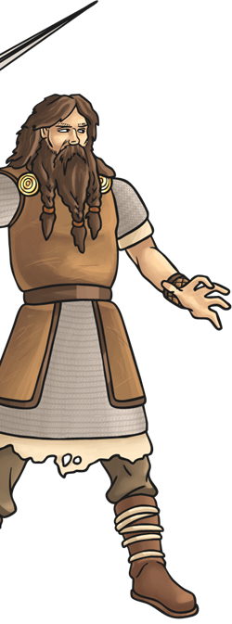

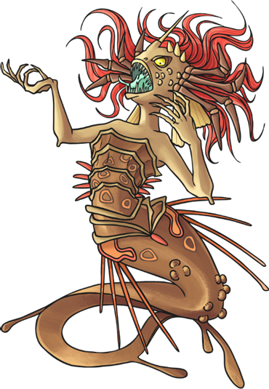
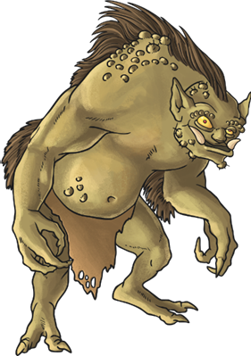
Characters and Places
Beowulf (bay-oh-wolf) | the hero of the story from Geatland
Hrothgar (hroth-gar) | the King of Denmark
Grendel (gren-dell) | a monster believed to be a descendent of Cain
Grendel’s Mother | a hag who lives in a swamp
Wiglaf (wee-lahf) | a young kinsman of Beowulf
Denmark (den-mark) | where the Danes lived
Geatland (gaey-aht-land) | where the Geats lived
Heorot (hay-oh-roht) | Hrothgar’s hall

Slide 32
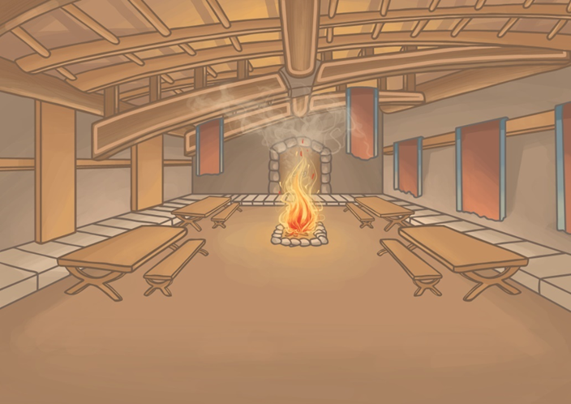

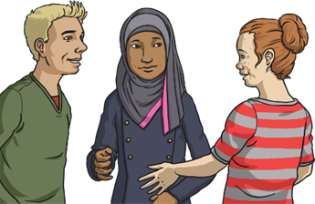
Hrothgar Builds Heorot
The story began when the King of the Danes, Hrothgar, built a mead-hall. He called the hall, Heorot, meaning hart.
Use dictionaries and the Internet to find a modern English word which means ‘hart’.
Why do you think Hrothgar called the mead-hall Heorot? What does the word symbolise?

Slide 33
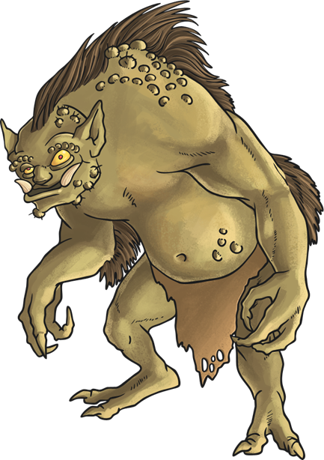
Grendel Attacks
Once Heorot was built, King Hrothgar and his people enjoyed feasts and celebrations there. The hall was filled with the sounds, sights and smells of happy gatherings.
Grendel, a monster who lived nearby, despised the noise from the celebrations. One night, he decided to attack the hall, killing and devouring thirty of Hrothgar’s warriors.
What does the word ‘devouring’ make you think about Grendel?
Why do you think Grendel ‘despised’ the noise from the celebrations?

Slide 34


Heorot Lies Silent
After Grendel’s attack, King Hrothgar and the Danes were terrified of Grendel. The celebrations and feasts at Heorot came to an end.
The Danes lived in fear of Grendel for over twelve years! During that time, the people abandoned Heorot and lived quietly in their homes.
Heorot lay empty for twelve years. What does this tell you about what Hrothgar’s people felt about Grendel?

Slide 35

Beowulf Travels to Denmark
Eventually, news travelled over the water to the Geats where the young warrior Beowulf heard of King Hrothgar’s plight. He sailed to Denmark to offer help.
King Hrothgar was grateful for Beowulf’s help and agreed to hold another feast in Heorot. After the feast, Beowulf stayed in the great hall while all the Danes went back to their homes.
Why did it take so long for Beowulf to hear of Grendel’s attack? How would the news have travelled?

Slide 36
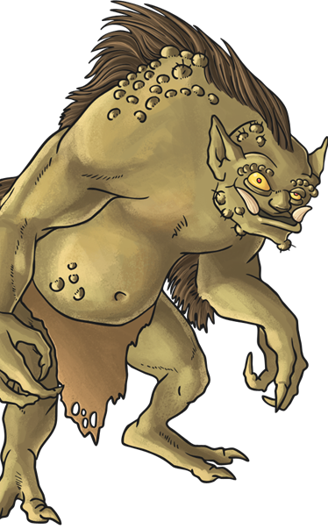
Beowulf’s First Battle
Grendel was furious about the feast and attacked Heorot! Beowulf, pretending to be asleep, leapt up and fought Grendel. His men drew their swords but Grendel’s skin was so tough that they could not pierce it.
After a long battle, Beowulf, using no weapons, finally managed to defeat Grendel by tearing off his arm! Grendel fled to his home in the marshes and died.
Why did Beowulf insist on fighting Grendel without any weapons? What did this prove about him?

Slide 37
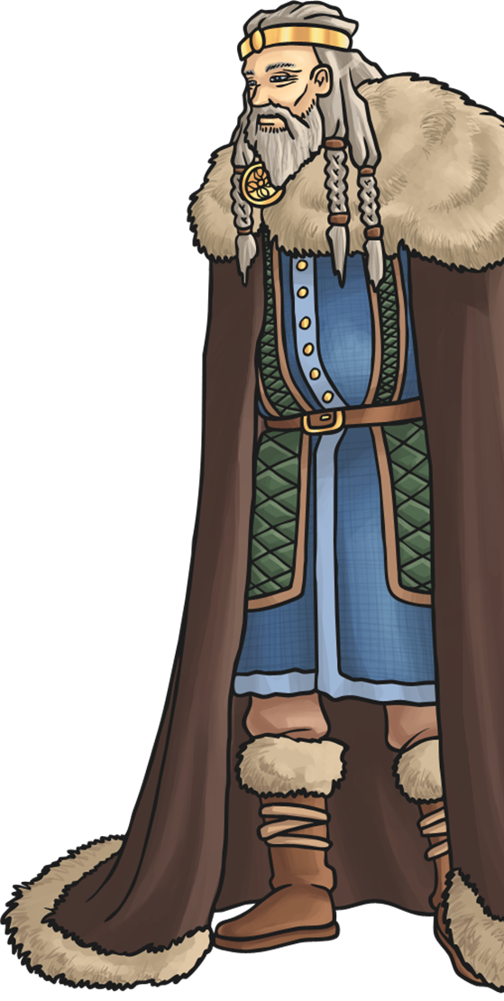
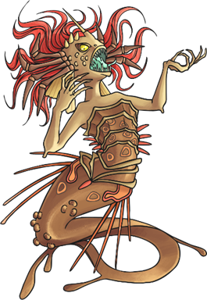
Beowulf’s Second Battle
After hearing that Grendel had been killed, Hrothgar and his thanes returned to Heorot. They ate and slept in the hall once again, finally feeling safe.
However, Grendel’s mother was angry that her son had been killed and attacked Heorot. She killed one of Hrothgar’s best warriors before escaping.
Beowulf and his men tracked her to her lair below a lake. One of his men gave him his sword to fight her but when it was useless. Instead, he took her own sword from her and cut off her head with it. Her poisonous blood dissolved the weapon! Beowulf returned to Heorot triumphant!

Slide 38
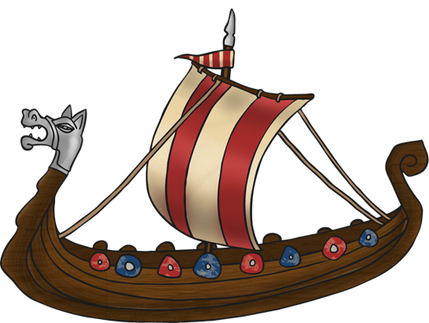
Beowulf Returns Home
Hrothgar was overjoyed when Beowulf returned to Heorot. He declared Beowulf a hero and gave him many gifts including his family’s heirloom sword. He thanked Beowulf for his help and told him they would always be friends.
Before he returned to Geatland, Hrothgar warned Beowulf about the dangers of pride and fame…
Why do you think King Hrothgar gave Beowulf a warning? What does this suggest might happen at the end of the story?

Slide 39

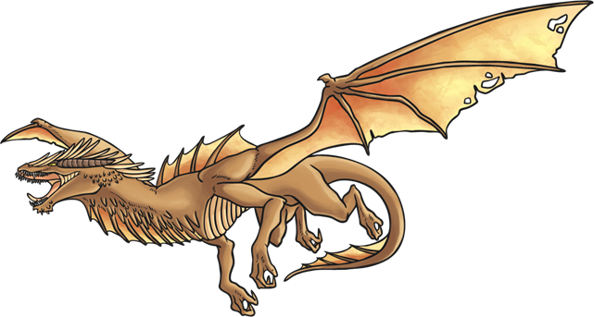
Beowulf King of the Geats
Many years later, Beowulf became the King of his people, the Geats. He reigned for a long time and was well liked by his people because he was a good king.
Fifty years after Beowulf killed Grendel’s mother, one of King Beowulf’s servants stole a golden cup from a dragon’s lair.
The dragon was furious and left its cave, burning everything in its path.

Slide 40
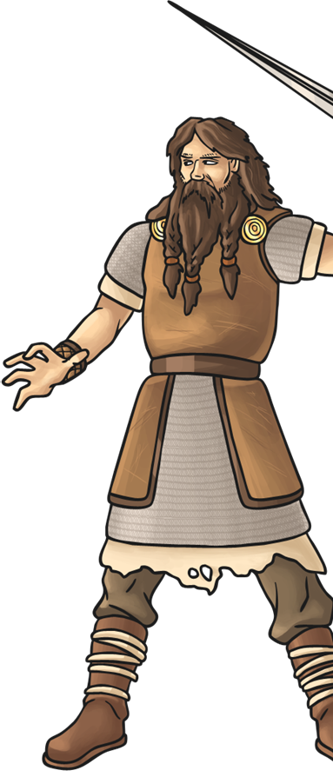
Beowulf’s Third Battle
Beowulf told his warriors that he would fight the dragon alone and they were to wait for him. By now an old man, Beowulf quickly found himself outmatched and overpowered by the dragon.
Frightened, all but one of his warriors ran to hide in the forest nearby. The one who remained was named Wiglaf and he came to Beowulf’s aid. They defeated the dragon together but not before Beowulf was fatally wounded.
Explain how King Hrothgar’s warning relates to Beowulf’s defeat by the dragon.

Slide 41
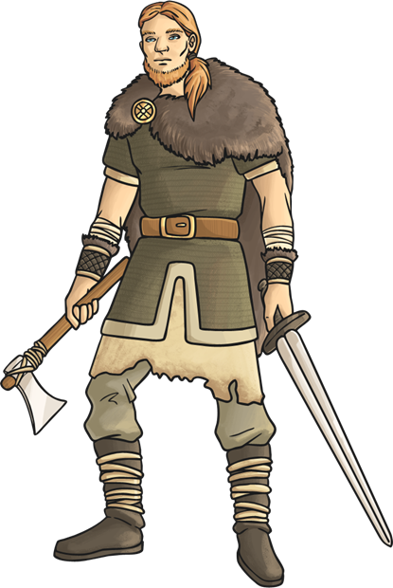
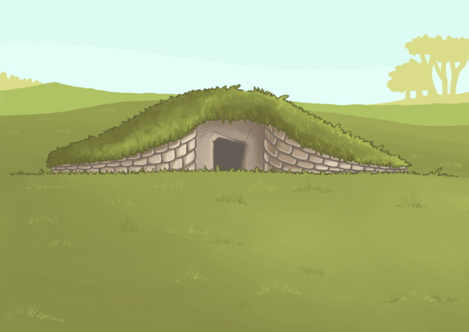
Beowulf’s Funeral
The Geats burned Beowulf on a huge funeral pyre and he was greatly mourned. His people didn’t know who would protect them with Beowulf gone.
To honour their great king, they built a barrow, which could be seen from the sea, in his memory. He was buried with the gold and treasures given to him by Hrothgar.
What was a barrow? Some famous barrows are found at Sutton Hoo. Use the Internet to find out what these are.

Slide 42
Glossary
Barrow | a small hill or tumulus built over a burial chamber
Epic | very long tale about a legendary hero
Despise | to dislike a lot
Devour | to eat something quickly and eagerly
Funeral pyre | a pile of wood for burning the bodies of the dead
Heirloom | an object passed down through the generations of a family
Lair | an underground hiding place
Manuscript | an old handwritten book
Mead hall | a large hall or palace for Scandinavian tribes

Slide 43
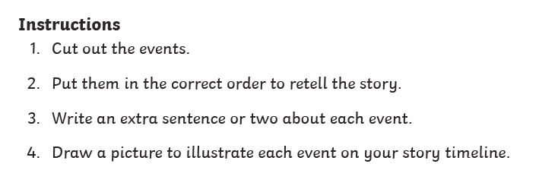
LO: To know what the story of ‘Beowulf’ is about and to put it in chronological order
ACTIVITY
Use the 2 star sheet.

Slide 44
REFLECTION - LO: To know what the story of ‘Beowulf’ is about and to put it in chronological order
Let is go through the events.
What extra information did you put about each event?

Slide 45
Reading Comprehension
LO: To answer questions about the epic poem ‘Beowulf’

Slide 46
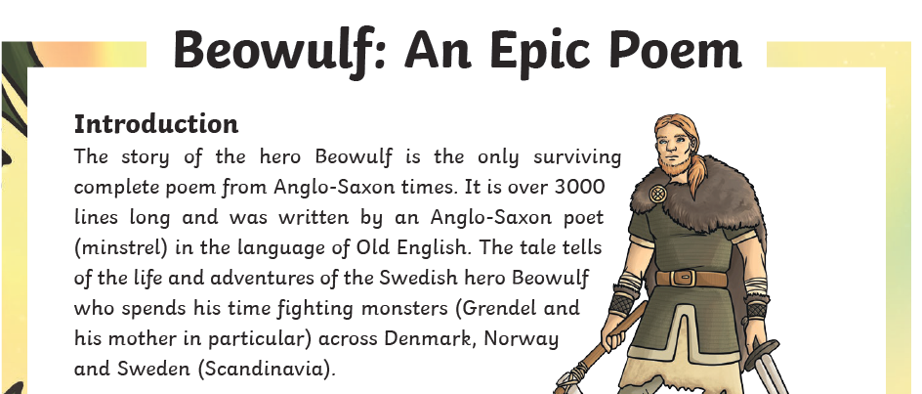
LO: To answer questions about the epic poem ‘Beowulf’

Slide 47
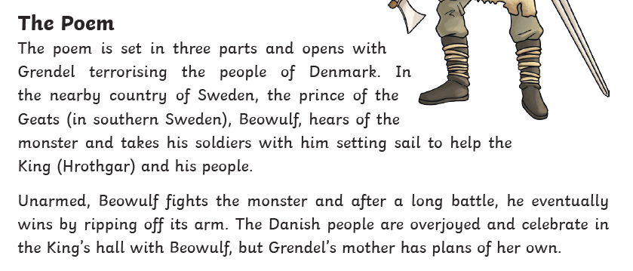
LO: To answer questions about the epic poem ‘Beowulf’

Slide 48
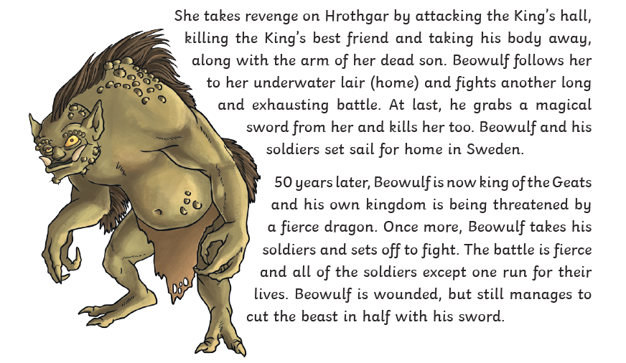
LO: To answer questions about the epic poem ‘Beowulf’

Slide 49
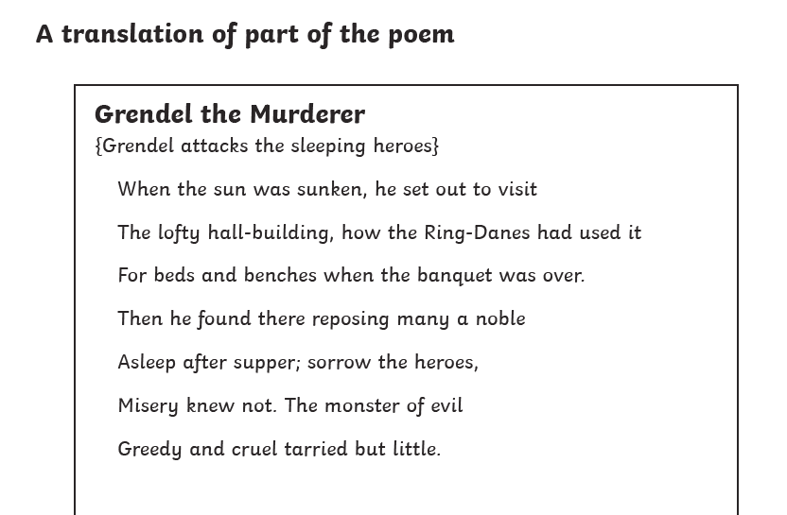
LO: To answer questions about the epic poem ‘Beowulf’

Slide 50
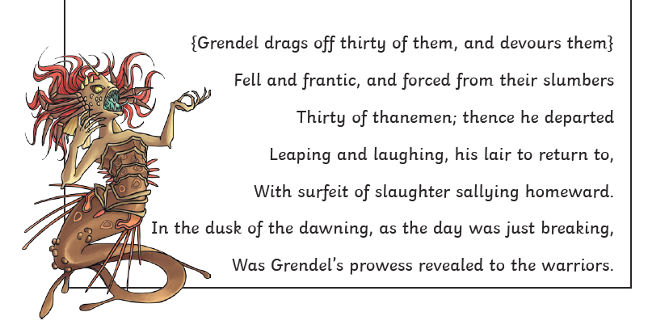
LO: To answer questions about the epic poem ‘Beowulf’

Slide 51
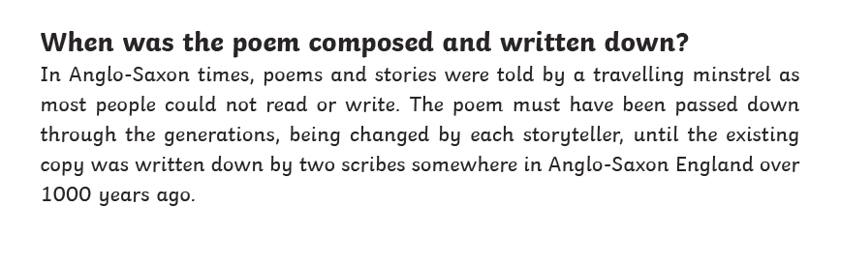
LO: To answer questions about the epic poem ‘Beowulf’

Slide 52
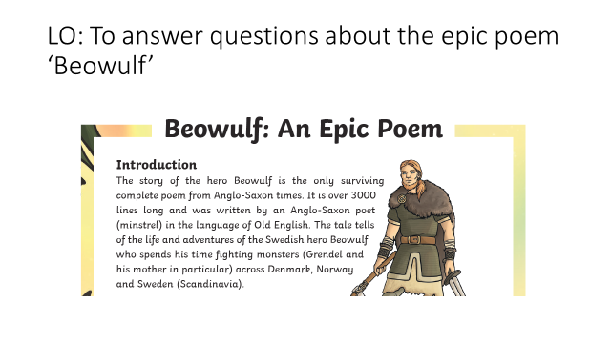
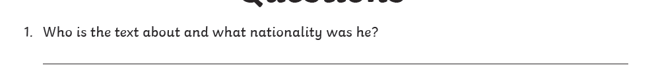
LO: To answer questions about the epic poem ‘Beowulf’

Slide 53
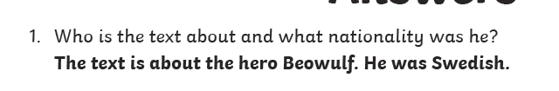
LO: To answer questions about the epic poem ‘Beowulf’

Slide 54

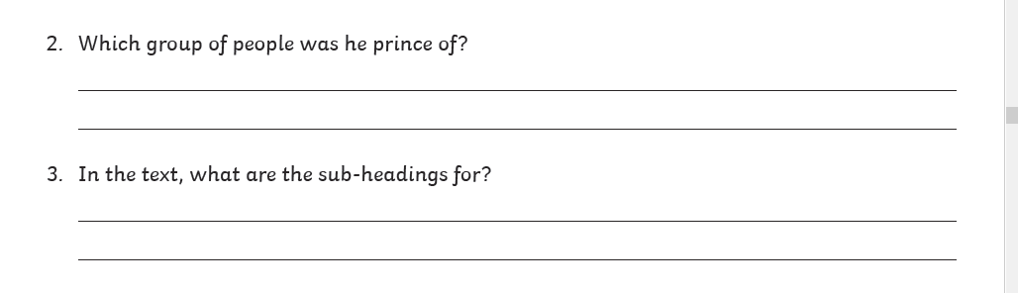
LO: To answer questions about the epic poem ‘Beowulf’

Slide 55
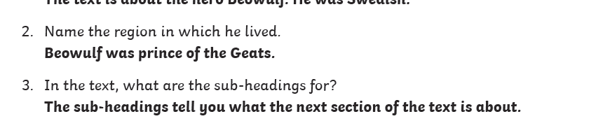
LO: To answer questions about the epic poem ‘Beowulf’

Slide 56
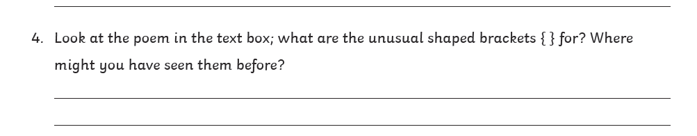

LO: To answer questions about the epic poem ‘Beowulf’

Slide 57
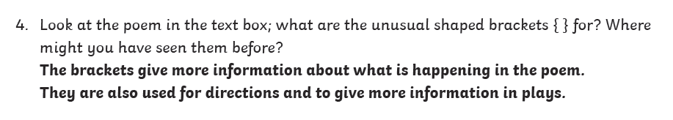
LO: To answer questions about the epic poem ‘Beowulf’

Slide 58

diplomacy

Slide 59
diplomacy
What could it mean?
“I need to handle this delicate situation with my expert tact and diplomacy.”

Slide 60
diplomacy
SAY IT AND FEEL THE SYLLABLES
SAY IT TO THE BIN
SAY IT TO SOMEONE ON ANOTHER TABLE
WHISPER IT TO THE FLOOR
SAY IT TO YOUR BOOK
REPEAT IT AFTER ME
SAY IT TO THE WINDOW
WHISPER IT TO A WALL

Slide 61
diplomacy
Noun. the management of relationships between countries or the skill in dealing with people without offending or upsetting them.

Slide 62
diplomacy
Diplomacy has so far failed to bring an end to the fighting.
It took all her tact and diplomacy to persuade him not to resign.
Diplomacy is not Miss Davison’s strong point.

Slide 63
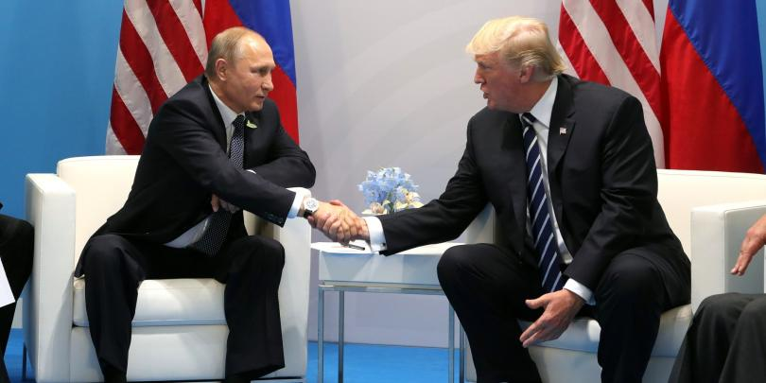

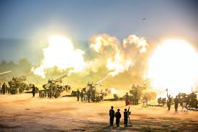
diplomacy
Say diplomacy if you see someone dealing with people without upsetting them or managing relationships between countries.

Slide 64
diplomacy
In your books, write the word, the definition and use it in a sentence/draw a picture.

Slide 65
diplomacy
Noun. the management of relationships between countries or the skill in dealing with people without offending or upsetting them.

Slide 66
Lunch

Slide 67
PSHE
Internet Safety Week

Slide 68

Internet Safety
Spring 1 Week 5

Slide 69
Introduction
Assembly

Slide 70


Slide 71
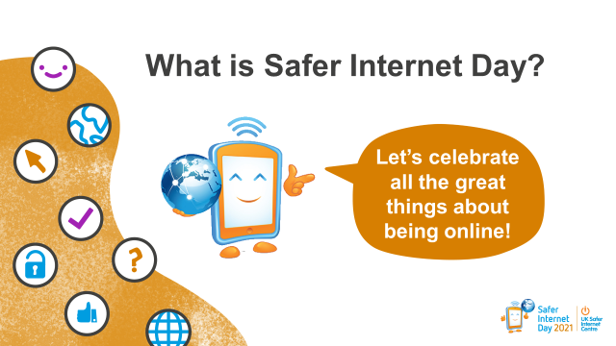
Tuesday 9th February is Safer Internet Day! A day celebrated across the globe in over 170 countries, with thousands of children joining in across the UK.
It’s a day when we celebrate all the great things about being online and remind ourselves how we can stay safe.

Slide 72

Playing games
Chatting to your friends
Video calling friends and family
Learning new things
Listening to music
Watching videos

Slide 73
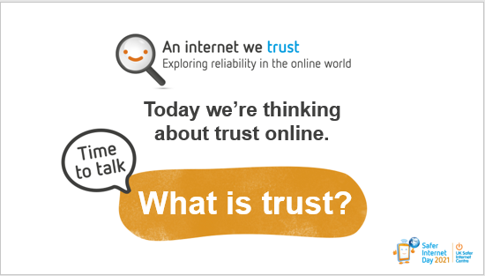
This year for Safer Internet Day we are looking at trust online. Let’s have a think, what is trust?
I’m going to give you 30 seconds to turn and tell the person next to you what you think ‘trust’ is and then we’ll come back together and discuss as a group.

Slide 74
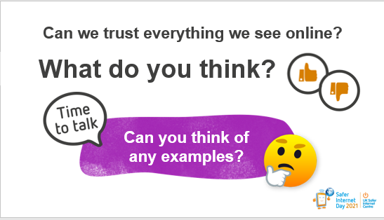
Can we trust everything we see online? Give me a thumbs up if you think we can trust everything we see online, or a thumbs down if you think we can’t trust everything we see online.
I can see lots of thumbs down. Yes – that’s right. Although there is lots of great information online that is useful and trustworthy, it’s important to remember that there is also information online that is not so trustworthy and may even been there to try and confuse or persuade us.
TP: Can you think of any examples of things you’ve seen online that you couldn’t trust?

Slide 75
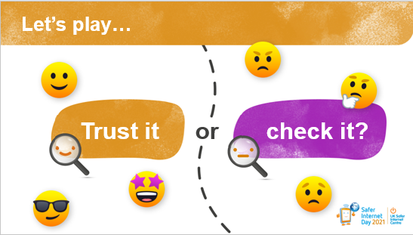
We are now going to play a game called ‘Trust it or Check it?’ I will show you an example of something you might see online. I would like you to have a think about whether you would trust it, or not trust it and check with an adult. I will be asking for your thoughts on each example.
We will also be looking at how seeing each of these examples online might make us feel.

Slide 76
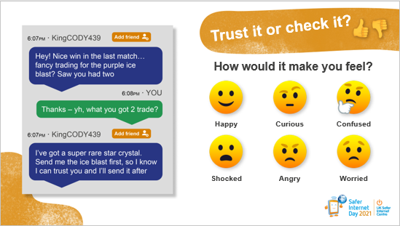
TP: If you saw this trade in an online game would you trust it or check it?

Slide 77
If you saw this trade in an online game would you trust it or check it?
This looks like someone is trying to make an unofficial trade. Agreeing on a trade should always be done using the official trading system in the game - this will make sure it is safe and trustworthy. Make sure that you feel the trade is fair before accepting.
How would seeing something like this make you feel?

Slide 78
This looks like someone is trying to make an unofficial trade. Agreeing on a trade should always be done using the official trading system in the game - this will make sure it is safe and trustworthy. Make sure that you feel the trade is fair before accepting.
TP: How would seeing something like this make you feel?

Slide 79
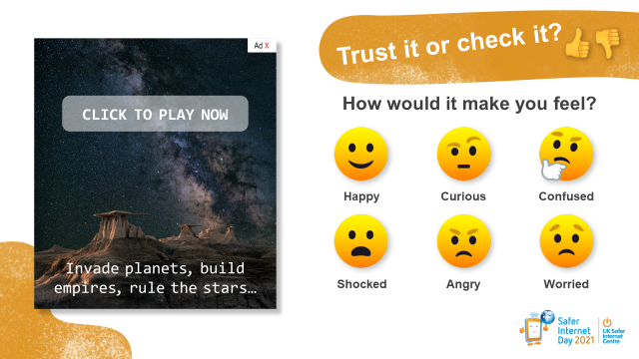
TP: If you saw this advert online would you trust it or check it?

Slide 80
It can be tricky to tell if an online advert is trustworthy or not. It’s always best to check and if you weren’t sure, you could look up the advert separately online and speak to an adult you trust about whether it’s real or not.
TP: How would seeing something like this make you feel?

Slide 81
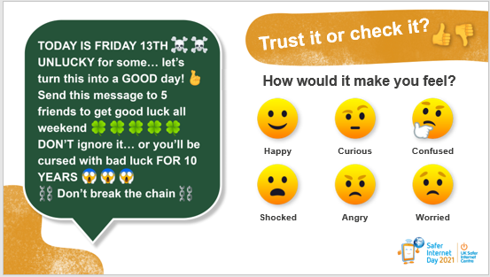
TP: If you saw this chain message online would you trust it or check it?

Slide 82
It can be worrying if you receive a chain message. It’s important to remember that these are not true. However, if you are worried by what you have read or seen it’s always good to talk to an adult you trust. It’s best not to share these on as this might cause more people to worry.
TP: How would seeing something like this make you feel?

Slide 83
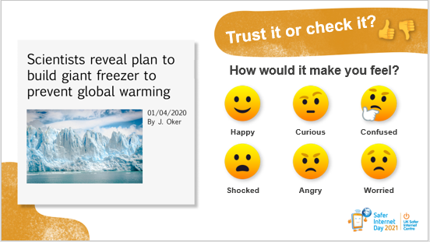
TP: If you saw this news headline online would you trust it or check it?

Slide 84
This example looks like it could be a joke. People usually share jokes to make people laugh. They tend to be very exaggerated, or they can be sarcastic (saying one thing, but meaning the opposite) and might even be trying to make fun of something or someone. It’s important to read past the headline and look at who it is written by.
TP: How do you think seeing something like this would make you feel?

Slide 85
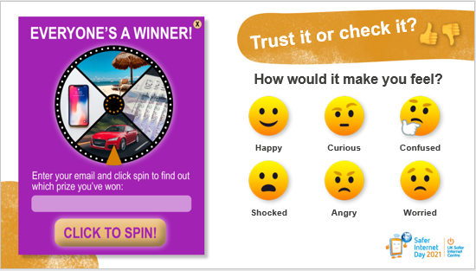
TP: If you saw this competition online would you trust it or check it?

Slide 86
It can be really tempting to enter competitions online and sometimes they are genuine, and you can win some great prizes! It can be helpful to think to yourself that if something seems too good to be true online, it probably isn’t true. This might be an example of ‘phishing.’ It’s probably trying to collect personal information such as usernames and emails to gain access to people’s accounts. Be careful about sharing personal information online and always check with an adult before entering any competitions.
TP: How would seeing something like this make you feel?

Slide 87

TP: If you saw this video online would you trust it or check it?

Slide 88
Remember that just like photos, videos can be edited too. You also might not be given all the correct information. In this example, where it says ‘first time trick shot’, this probably isn’t true and more than likely took a lot of time and effort.
TP: How would seeing something like this make you feel?

Slide 89

TP: If you received this message online would you trust it or check it?

Slide 90
Make sure you always keep your personal information safe online. If a stranger online asks to meet up, for any personal information or for pictures or videos it is really important not to share any of these and to tell an adult you trust straight away. They can help you and make sure the correct action is taken, like blocking the user so they can’t contact you again and making a report.
TP: How would seeing something like this make you feel?

Slide 91

Good job everyone! It was great to hear your thoughts. Hopefully you are now able to answer my next question:
TP: What should we do if we see something and we’re not sure if we can trust it online?

Slide 92

Think of yourself as an internet detective, and actively try to find out more. It’s really important to question things online. Ask yourself: What is it trying to get me to do? What are the risks?
You could ask an adult or look on another website or app - three is a good number to check! You could also look in a book.
Being an internet detective will help you to become more aware and make sensible decisions on whether something is trustworthy online, but remember, just like in the game we played today, we also need to think about how what we see online makes us feel.

Slide 93

Who can put up their hand and tell me what we should we do if we see something online that makes us feel upset, scared, angry, worried or confused?

Slide 94

There are lots of things you can do to help, but most importantly, make sure you talk to an adult you trust for help. This could be an adult at school or at home.
Remember, there is lots of information when you go online, some true, some not. Use the advice from this assembly to help you decide and to make sure you keep yourself and others safe when online.

Slide 95

You’ll be learning more about exploring reliability and trust online later today/this week (if applicable).
Thank you for joining in and sharing your thoughts. I hope everyone has a happy Safer Internet Day this year!

Slide 96
Lesson 1
LO: To be able to describe and recognise some methods used to encourage people to buy things online.
LO: To be able to give examples of when and why it is important to understand the motive behind online
content.
LO: To be able to use questions to help decide what can and cannot be trusted online.

Slide 97
LO: To be able to describe and recognise some methods used to encourage people to buy things online.
LO: To be able to give examples of when and why it is important to understand the motive behind online content.
LO: To be able to use questions to help decide what can and cannot be trusted online.
TP: What do thee words mean?
Advert
Profit
Motive
Unboxing
Giveaway
Merch
Collab
affiliate link

Slide 98
LO: To be able to describe and recognise some methods used to encourage people to buy things online.
LO: To be able to give examples of when and why it is important to understand the motive behind online content.
LO: To be able to use questions to help decide what can and cannot be trusted online.
TP: What do thee words mean?
Advert – an advertisement
Profit - money that is earned in trade or business after paying the costs of producing and selling goods and services OR the good result or advantage that can be achieved by a particular action or activity
Motive – a reason for doing something
Unboxing - the activity of taking new products out of their packaging, especially on videos on the internet
Giveaway - something that tells or shows something secret, often without intending to OR something that is given free to a customer
Merch – informal for merchandise - goods that are bought and sold
Collab - short for collaboration : a situation in which two or more people work together to create, achieve, or promote (= encourage people to buy or use) something
affiliate link - to cause a group to become part of or form a close relationship with another, usually larger, group, or organization

Slide 99

LO: To be able to describe and recognise some methods used to encourage people to buy things online.
LO: To be able to give examples of when and why it is important to understand the motive behind online content.
LO: To be able to use questions to help decide what can and cannot be trusted online.
Teacher chooses a letter or randomly select one to begin.
You must think of answers for each of the four categories beginning with that letter within a set time limit (e.g. 2 minutes).
After the time limit is up, I will take some answers and add up points.
We will play more than one round using different letters.

Slide 100

LO: To be able to describe and recognise some methods used to encourage people to buy things online.
LO: To be able to give examples of when and why it is important to understand the motive behind online content.
LO: To be able to use questions to help decide what can and cannot be trusted online.
Teacher chooses a letter or randomly select one to begin.
You must think of answers for each of the four categories beginning with that letter within a set time limit (e.g. 2 minutes).
After the time limit is up, I will take some answers and add up points.
We will play more than one round using different letters.

Slide 101

LO: To be able to describe and recognise some methods used to encourage people to buy things online.
LO: To be able to give examples of when and why it is important to understand the motive behind online content.
LO: To be able to use questions to help decide what can and cannot be trusted online.
TP: Remind me, what is an advert?
TP: Have you seen an advert before? If so, where?
TP: Was it online or offline?
TP: What did it look like?
TP: If on line, where did you see it? For example, at the side.

Slide 102
LO: To be able to describe and recognise some methods used to encourage people to buy things online.
LO: To be able to give examples of when and why it is important to understand the motive behind online content.
LO: To be able to use questions to help decide what can and cannot be trusted online.
EXPLAIN: We are going to watch a video and your challenge is to spot every time an advert appears. Raise your hand every time you see an advert on screen and I will keep a tally.
https://vimeo.com/481316945

Slide 103

Notes:
The video on this slide is hosted online on Vimeo. You may be given the option to ‘Enable Content’ and will need to click this to allow it to play. Alternatively you can access the video by going to this URL: https://vimeo.com/481316945

Slide 104

LO: To be able to describe and recognise some methods used to encourage people to buy things online.
LO: To be able to give examples of when and why it is important to understand the motive behind online content.
LO: To be able to use questions to help decide what can and cannot be trusted online.
TP: How many adverts did you see and have you seen these types of adverts before and where?
EXPLAIN: We are going to watch the clip again. Each time, I am going to pause at the time stamp shown. Each time, you need to complete the relevant worksheet section
(Sheet Slide 26)

Slide 105
LO: To be able to describe and recognise some methods used to encourage people to buy things online.
LO: To be able to give examples of when and why it is important to understand the motive behind online content.
LO: To be able to use questions to help decide what can and cannot be trusted online.
EXPLAIN: Technically, every section of the worksheet is an
advert. The focus of the activity was on circling the features
shown in the video to help you identify it as such.
TP: How do you feel about online adverts?
TP: Do you prefer to watch or skip adverts?
TP: Have you wanted to buy/download something because they saw an advert for it online?

Slide 106

LO: To be able to describe and recognise some methods used to encourage people to buy things online.
LO: To be able to give examples of when and why it is important to understand the motive behind online content.
LO: To be able to use questions to help decide what can and cannot be trusted online.

Slide 107
PE

