Slide 1
Good Morning
Wednesday 10th February

Slide 2

Protecting Species – Part Two
Each blue whale produced up to 30 tonnes of oil and so quickly became the main target. In 1930, the peak year, 30,000 of these magnificent creatures were killed. Today, it is estimated that there are fewer than 1000 “blues” left in the southern hemisphere against nearly a quarter of a million before large-scale whaling began. Only Japan and Norway still kill whales, mainly fin, sperm and minke, for what they call “scientific” purposes!
Evidence
Retrieve
Interpret
Choice
What does peak year mean?
The least
The most
The average
How many blue whales were killed during the peak year?
What is the author’s opinion about the killing of whales? Use the text to justify your answer.
Do you think the author thinks Norway and Japan are killing whales for “scientific” purposes?

Slide 3
Spellings – Look/Cover/Spell/Check
Lente, Jack, Elliot and Alicia
stomach
sufficient
suggest
symbol
system
temperature
thorough
twelfth
variety
vegetable
vehicle
yacht
Rest of class
reign
remember
sentence
separate
special
straight
strange
strength
suppose
surprise

Slide 4
Maths
Read the slides and do the activities

Slide 5
RECALL
TP: What are all the different ways of saying ÷ ?
Solve these division calculations
4 ÷ 1 =
4 ÷ 4 =
8 ÷ 4 =
12 ÷ 4 =
16 ÷ 4 =
20 ÷ 4 =
TP: How did you solve these?
TP: What does the term divisor mean?

Slide 6
LO: To be able to divide a 4-digit number by a 1-digit number
Top Down | Self Assessment
Some of us will even: I can solve problem solving and reasoning questions when dividing a number by a 1-digit number
Some of us will: I can divide a 4-digit number by a 1-digit number
Most of us will: I can divide a 3-digit number by a 1-digit number
All of us will: I can divide a 2-digit number by a 1-digit number

Slide 7
LO: To be able to divide a 4-digit number by a 1-digit number
First we will look at dividing a 2-digit number by a 1-digit number. To do this we are going to use something called the bus stop method.
Let us look at the calculation 66 ÷ 3 =
First, we use a division bracket that we nickname the bus stop that looks like this.
Next, we put the number that we are dividing into under the bus stop.
6 6
Then, we put the divisor in front of the bus stop
3 6 6

Slide 8
LO: To be able to divide a 4-digit number by a 1-digit number
TP: What is the value of this 6?
We divide the divisor into the largest number 60 first. We say how many groups of 30 are there in 60 (or how many times does 3 divide into 6)
TP: What is the answer?
We then put the answer in the correct place value box above the number
TP: What is the value of this 6?
We divide the divisor into the next lowest number here which is 6. We say how many groups of 3 will divide into 6
TP: What is the answer?
We then put the answer in the correct place value box above the number

Slide 9
LO: To be able to divide a 4-digit number by a 1-digit number
2 2
3 6 6

Slide 10
LO: To be able to divide a 4-digit number by a 1-digit number
TP: How would you solve 88 ÷ 4 using the bus stop method?
Be prepared to talk me through this.

Slide 11
LO: To be able to divide a 4-digit number by a 1-digit number
TP: How would you solve 488 ÷ 4 =?
TP: How would you solve 3699 ÷ 3 = ?

Slide 12
LO: To be able to divide a 4-digit number by a 1-digit number
Chilli 1 | Chilli 2 | Chilli 3
Use the bus stop method to solve: 44 ÷ 2 = 66 ÷ 2 = 88 ÷ 2 = | Use the bus stop method to solve: 333 ÷ 3 = 336 ÷ 3 = 366 ÷ 3 = 636 ÷ 3 = 663 ÷ 3 = | Use the bus stop method to solve: 6666 ÷ 3 = 6669 ÷ 3 = 6696 ÷ 3 = 6966 ÷ 3 = 9666 ÷ 3 =
EXT: How would you solve 387 ÷ 3 = using the bus stop method?

Slide 13
LO: To be able to divide a 4-digit number by a 1-digit number
Chilli 1 | Chilli 2 | Chilli 3
Use the bus stop method to solve: 44 ÷ 2 = 22 66 ÷ 2 = 33 88 ÷ 2 = 44 | Use the bus stop method to solve: 333 ÷ 3 = 111 336 ÷ 3 = 112 366 ÷ 3 = 122 636 ÷ 3 = 212 663 ÷ 3 = 221 | Use the bus stop method to solve: 6666 ÷ 3 = 2222 6669 ÷ 3 = 2223 6696 ÷ 3 = 2232 6966 ÷ 3 = 2322 9666 ÷ 3 = 3222
EXT: How would you solve 387 ÷ 3 = using the bus stop method?

Slide 14
LO: To be able to divide a 4-digit number by a 1-digit number
Q1
Miss Davison asks her children to arrange 500 chairs into rows of 5. How many rows will there be?
Q2
A crate holds 408 bottles. A pack contains 4 bottles. How many packs of bottles can you fit into the crate?
Q3
A photographer takes 8480 pictures. He wants to put them into a photo album. Each page holds 4 pictures. How many pictures will there be?
Q4
Apples are solved in bags of 7. How many bags are needed if there are 7077 apples?

Slide 15
LO: To be able to divide a 4-digit number by a 1-digit number
Q1
Miss Davison asks her children to arrange 500 chairs into rows of 5. How many rows will there be?
100 rows
Q2
A crate holds 408 bottles. A pack contains 4 bottles. How many packs of bottles can you fit into the crate?
102 packs
Q3
A photographer takes 8480 pictures. He wants to put them into a photo album. Each page holds 4 pictures. How many pictures will there be?
2120 pages
Q4
Apples are solved in bags of 7. How many bags are needed if there are 7077 apples? 1011 apples

Slide 16
LO: To be able to divide a 4-digit number by a 1-digit number
Top Down | Self Assessment
Some of us will even: I can solve problem solving and reasoning questions when dividing a number by a 1-digit number
Some of us will: I can divide a 4-digit number by a 1-digit number
Most of us will: I can divide a 3-digit number by a 1-digit number
All of us will: I can divide a 2-digit number by a 1-digit number

Slide 17
REFLECTION - LO: To be able to divide a 4-digit number by a 1-digit number
SELF ASSESSMENT

Slide 18
Break

Slide 19
English - Poetry
Read the slides and do the activities

Slide 20
Introduction
We are going to be concentrating on Narrative/Epic Poem that was first told in Anglo-Saxon/Viking times called ‘Beowulf’. We are going to find out what the poem is about, we are going to look at narrative poetry and then have a go at writing our own Narrative Poem about ‘Beowulf’. Finally, we perform our poems. These will be filmed and sent to parents and the school.

Slide 21
Introduction
A narrative poem is a type of poem that tells a story. Narrative poems tend to be quite long. They tell a story like in a novel and also use rhythm and rhyme, like in a poem.
https://www.bbc.co.uk/bitesize/topics/z4mmn39/articles/z3btrwx#:~:text=A%20narrative%20poem%20is%20a,rhyme%2C%20like%20in%20a%20poem.

Slide 22
Introduction
Today, we are going to look at writing our own fourth stanza of our narrative poems based on the epic story of Beowulf. We will write the same amount of lines to tell the story and try have rhyming words at the end of the line. We will try to keep the same rhyming pattern as the first verse.

Slide 23
LO: To create a narrative poem that choose the appropriate vocabulary to describe setting, characters and atmosphere
Our story begins with Hrothgar, King of the Danes
When he built Heorot, a mead-hall.
Which he wanted things to be celebrated in by all.
Oh how happy those people were
And what magnificent feasts!
But they were unaware of an angry beast.
They awoke Grendel a hideous, ferocious monster
Who lived nearby
Despised the noise and the happy cries.
So he crept, silently to the hall and sprang
Attacking and devouring the once happy warriors
So Hrothgar had no more followers

Slide 24
LO: To create a narrative poem that choose the appropriate vocabulary to describe setting, characters and atmosphere
From that day forth
For over twelve years
Hrothgar’s people lived in fear.
They lived securely and quietly in their homes
Leaving dear once happy Heorot
To fall into disrepair and rot.

Slide 25
LO: To create a narrative poem that choose the appropriate vocabulary to describe setting, characters and atmosphere
Eventually, news travelled over the water to the Geats where the young warrior Beowulf heard of King Hrothgar’s plight. He sailed to Denmark to offer help.
King Hrothgar was grateful for Beowulf’s help and agreed to hold another feast in Heorot. After the feast, Beowulf stayed in the great hall while all the Danes went back to their homes.
Let us have a look at the next part of the story.
To help with rhyming patterns often finding/choosing key words and thinking of words that rhyme can help us
Q: What would you say are the key words in this part of the story
Q: What words can you think of that rhyme with them.
Q: What kind of an atmosphere do we want to create with this stanza?
Q: Which character are we going to describe? Where is he from? How would we describe him?

Slide 26
LO: To create a narrative poem that choose the appropriate vocabulary to describe setting, characters and atmosphere
Eventually, news travelled over the water to the Geats where the young warrior Beowulf heard of King Hrothgar’s plight. He sailed to Denmark to offer help.
King Hrothgar was grateful for Beowulf’s help and agreed to hold another feast in Heorot. After the feast, Beowulf stayed in the great hall while all the Danes went back to their homes.
Can you help me write the next part of the poem?
First LINE
Q: How can we introduce our hero and where he is from and how he hears the news?
Q: Can you write a line?
SECOND STANZA
Q: What does he hear?
Q: I want to finish my line with plight. Can you write the next line?

Slide 27
LO: To create a narrative poem that choose the appropriate vocabulary to describe setting, characters and atmosphere
Eventually, news travelled over the water to the Geats where the young warrior Beowulf heard of King Hrothgar’s plight. He sailed to Denmark to offer help.
King Hrothgar was grateful for Beowulf’s help and agreed to hold another feast in Heorot. After the feast, Beowulf stayed in the great hall while all the Danes went back to their homes.
THIRD STANZA
Q: What rhymes with plight?
Q: What does Beowulf do?
Q: How does he do this?
Q: Can you write the next line?
FOURTH STANZA
Q: What does Hrothgar do? Write a line.
FIFTH STANZA
Q: Who is left in the hall? Can you write me a line that ends in hall.
SIXTH STANZA
Q: What rhymes with hall?
Q: How do you think Grendel will react?
Q: Can you write the last line?

Slide 28
LO: To create a narrative poem that choose the appropriate vocabulary to describe setting, characters and atmosphere
Eventually, news travelled over the water to the Geats where the young warrior Beowulf heard of King Hrothgar’s plight. He sailed to Denmark to offer help.
King Hrothgar was grateful for Beowulf’s help and agreed to hold another feast in Heorot. After the feast, Beowulf stayed in the great hall while all the Danes went back to their homes.
2nd and 3rd
5th and 6th
Until, news travelled to Geat for our fearless hero, Beowulf, to hear
Of Hrothgar’s unfortunate plight.
Encouraging Beowulf to bravely offer to take up the fight.
King Hrothgar held a long awaited Heorot feast
Then, leaving heroic Beowulf in the hall
To stay bravely until he heard the gruesome call.

Slide 29
LO: To create a narrative poem that choose the appropriate vocabulary to describe setting, characters and atmosphere
ACTIVITY
Children to write their fourth stanza about Beowulf, introducing him using the same amount of lines and rhyming pattern as the other stanzas

Slide 30
REFLECTION - LO: To create a narrative poem that choose the appropriate vocabulary to describe setting, characters and atmosphere
Let us read some of our ideas. Can we identify the rhyming pattern?

Slide 31
Reading Comprehension
Read the slides and do the activities

Slide 32
LO: To be able to identify and explain how meaning is enhanced through choice of words and phrases (2g)
Q: What is figurative language?
Q: Why do you think figurative language is a common feature in poetry writing?

Slide 33
LO: To be able to identify and explain how meaning is enhanced through choice of words and phrases (2g)
Q: What is figurative language?
Figurative language uses words and meanings which do not have their literal meaning.
Q: Why do you think figurative language is a common feature in poetry writing?
Figurative language us commonly used in poetry writing because it allows the poet to create powerful descriptions and comparisons in fewer words but with maximum impact.

Slide 34
LO: To be able to identify and explain how meaning is enhanced through choice of words and phrases (2g)
EXPLAIN: We will read through the poem again. While we are doing this, I want you to look for examples of metaphors used by the poet in the poem. When we have read this, I am going to ask you to read through the poem again and identify and underline the metaphors and think about what effect they create.
Q: What is a metaphor? Can you give me examples?

Slide 35
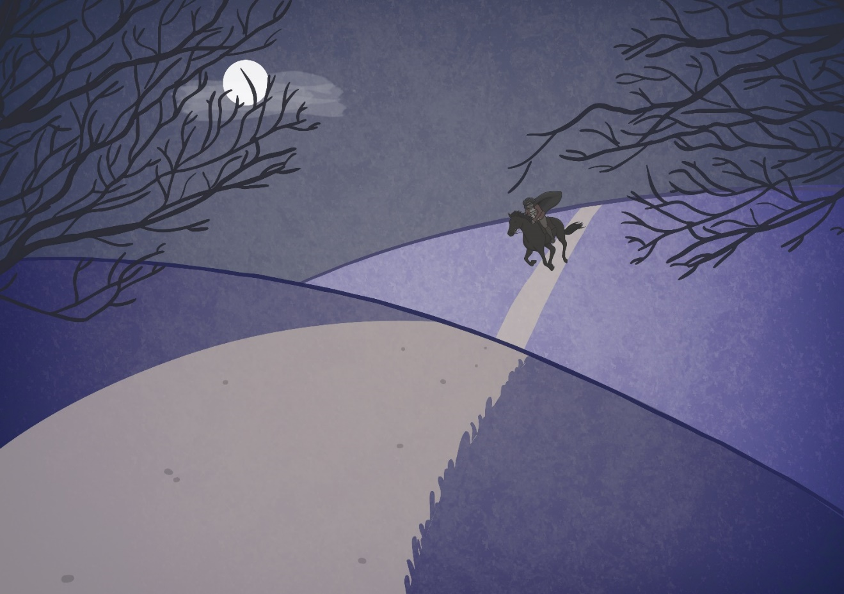
The wind was a torrent of darkness among the gusty trees,
The moon was a ghostly galleon tossed upon cloudy seas,
The road was a ribbon of moonlight over the purple moor,
And the highwayman came riding-
Riding- riding-
The highwayman came riding, up to the old inn door.

Slide 36
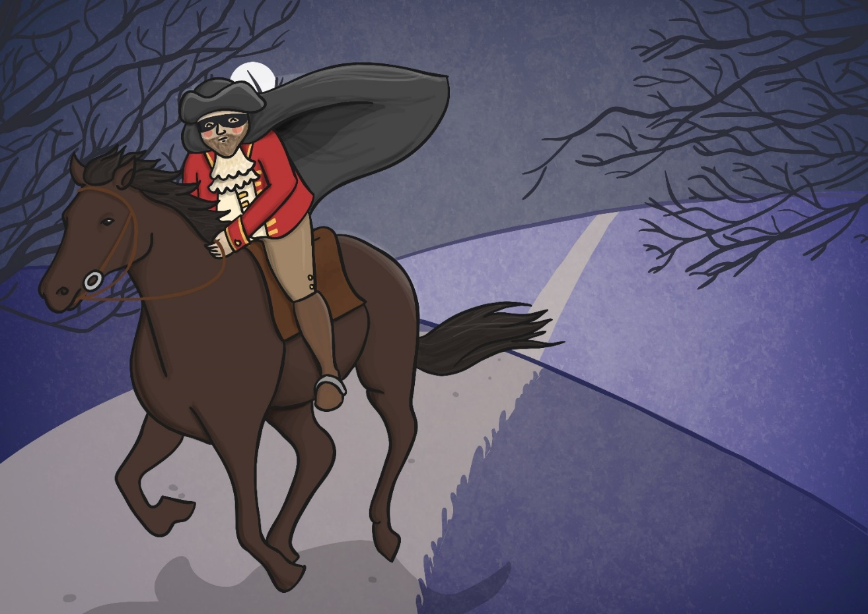
He’d a French cocked-hat on his forehead, a bunch of lace at his chin,
A coat of the claret velvet, and breeches of doe brown skin;
They fitted with never a wrinkle: his boots were up to the thigh!
And he rode with a jewelled twinkle,
His pistol butts a twinkle,
His rapier hilt a-twinkle, under the jewelled sky.

Slide 37
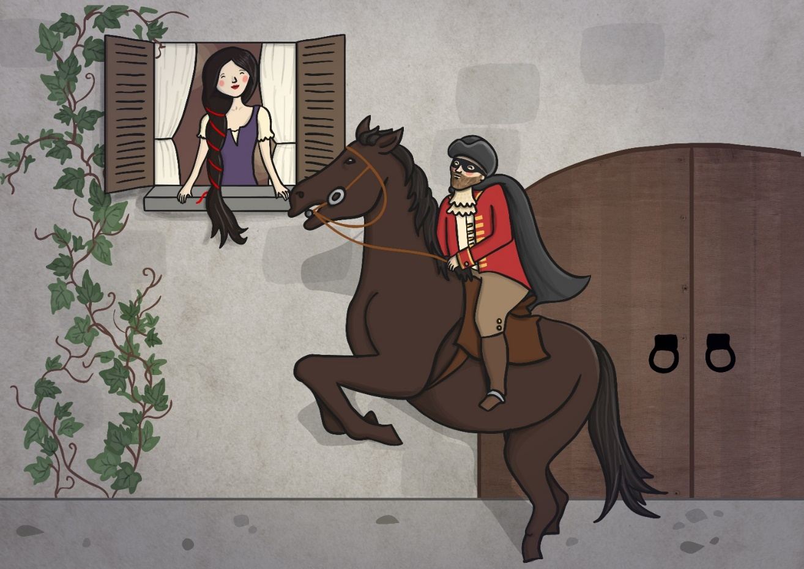
Over the cobbles he clattered and clashed in the dark inn-yard,
And he tapped with his whip on the shutters, but all was locked and barred;
He whistled a tune to the window, and who should be waiting there
But the landlord’s black-eyed daughter,
Bess, the landlord’s daughter,
Plaiting a dark red love-knot into her long black hair.

Slide 38
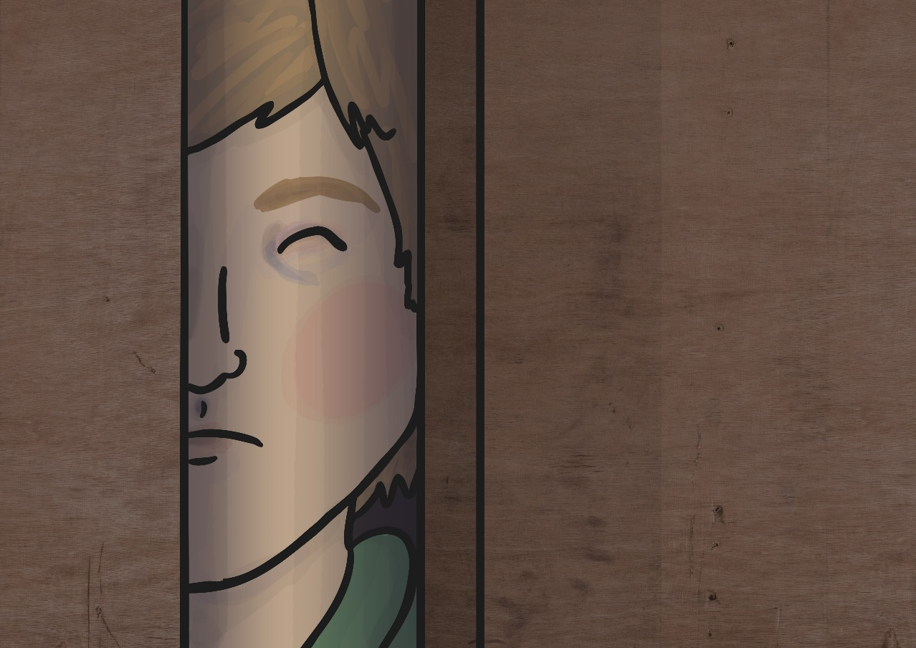
And dark in the old inn-yard a stable-wicket creaked
Where Tim the ostler listened; his face was white and peaked;
His eyes were hollows of madness, his hair like mouldy hay,
But he loved the landlord’s daughter,
The landlord’s red-lipped daughter,
Dumb as a dog he listened, and he heard the robber say.

Slide 39
LO: To be able to identify and explain how meaning is enhanced through choice of words and phrases (2g)
ACTIVITY
Look through the poem again and identify the metaphors in the poem. What effects do they create?

Slide 40
LO: To be able to identify and explain how meaning is enhanced through choice of words and phrases (2g)
Stanza 1
The wind was a torrent of darkness among the gusty trees,
The moon was a ghostly galleon tossed upon cloudy seas,
The road was a ribbon of moonlight over the purple moor,
And the highwayman came riding-
Riding- riding-
The highwayman came riding, up to the old inn door.
Q: What effect do these create?

Slide 41
LO: To be able to identify and explain how meaning is enhanced through choice of words and phrases (2g)
Stanza 1
The wind was a torrent of darkness among the gusty trees,
The moon was a ghostly galleon tossed upon cloudy seas,
The road was a ribbon of moonlight over the purple moor,
And the highwayman came riding-
Riding- riding-
The highwayman came riding, up to the old inn door.
Q: What effect do these create?
The wind was a torrent of darkness among the gusty trees. This metaphor compares the wind to a torrent of darkness creating the image of a fast-flowing dark void swirling and blustering through the trees
The moon was a ghostly galleon tossed upon cloudy seas. This metaphor compares the moon to a galleon suggesting it is like a large majestic ship which is being jostled around the sea. The sea in this case is the clouds which are being blown about in the wind across the moon.
The road was a ribbon of moonlight over the purple moor. This metaphor compares the road to a ribbon which suggests it is floaty and winding up and down and around the hills illuminating the moonlight.

Slide 42
LO: To be able to identify and explain how meaning is enhanced through choice of words and phrases (2g)
Stanza 4
And dark in the old inn-yard a stable-wicket creaked
Where Tim the ostler listened; his face was white and peaked;
His eyes were hollows of madness, his hair like mouldy hay,
But he loved the landlord’s daughter,
The landlord’s red-lipped daughter,
Dumb as a dog he listened, and he heard the robber say.
Q: What effect do these create?

Slide 43
LO: To be able to identify and explain how meaning is enhanced through choice of words and phrases (2g)
Stanza 4
And dark in the old inn-yard a stable-wicket creaked
Where Tim the ostler listened; his face was white and peaked;
His eyes were hollows of madness, his hair like mouldy hay,
But he loved the landlord’s daughter,
The landlord’s red-lipped daughter,
Dumb as a dog he listened, and he heard the robber say.
Q: What effect do these create?
This metaphor creates the effect of Tim’s eyes being deep, dark voids detached from reality and focused only on crazy, wild thoughts.

Slide 44
Word of the Day Challenge
Reverberated - Verb. If a loud, deep sound reverberates, it continues to be heard around an area, so that the area seems to shake or to continue to be heard; to echo repeatedly.
Clamour - Noun. loud noise, especially made by people's voices
Crescendo - Noun. a gradual increase in loudness, or the moment when a noise or piece of music is at its loudest.
Deftly - Adv. in a skilful, clever, or quick way
Seethed - Verb. to feel very angry
Adversaries - Noun. An enemy
Obliterated - Verb. to remove all signs of something, either by destroying it or by covering it so that it cannot be seen
Repugnant - Adj. very unpleasant, causing a feeling of disgust
Poverty - Noun. the condition of being extremely poor
Affliction - Noun. something that makes you suffer
Ghastly - Adj. unpleasant and shocking or to look very ill
Deluded - Adj. believing things that are not real or true.
Cherished - Adj. bringing the pleasure of love or caring about someone or something that is important to you
Memento - Noun. an object that you keep to remember a person, place, or event
Ushering - Verb. to show someone where they should go, or to make someone go where you want them to go

Slide 45
Word of the Day Challenge
Laden - Adj. carrying or holding a lot of something
Flawless - Adj. perfect or without mistakes
Defiantly - Adv. in a way that proudly refuses to obey authority or shows you are not willing to accept criticism or disapproval
Diplomacy - Noun. the management of relationships between countries or the skill in dealing with people without offending or upsetting them.
Contingency - Noun. something that might possibly happen in the future, usually causing problems or making further arrangements necessary
Protocol - Noun. the system of rules and acceptable behaviour used at official ceremonies and occasions
Reprimand - Verb. to express to someone your strong official disapproval of them
Condescendingly - Adv. in a way that shows that you think you are more important or more intelligent than someone else

Slide 46
Word of the Day Challenge
Can you come up with a game that you can play with other children that practices remembering the meaning of these words?

Slide 47
Lunch

Slide 48
LO: To investigate the effects of air resistance.
Science Quiz
TP: Ask the questions you created about forces and gravity.
TP: Can you create questions about air resistance?

Slide 49
LO: To investigate the effects of air resistance.
You have learnt that gravity pulls objects towards the centre of the Earth.
But do you think all objects are pulled as fast as each other?
These two balls are the same size, but one has a much greater mass.
Do you think they will hit the ground at the same time when dropped from a height?

Slide 50
LO: To investigate the effects of air resistance.
Galileo Galilei (1564-1642) was an Italian scientist and mathematician who wondered about this.
In 1590, he decided to carry out an investigation to find the answer.
He climbed to the top of the Leaning Tower of Pisa with two balls of similar shape and size, but with different masses.
He dropped both of the balls from the top of the tower at the same time. Both balls hit the ground at the same time.

Slide 51
LO: To investigate the effects of air resistance.
Galileo's experiment proved that all objects fall at the same rate, no matter what their mass is.
But this can seem hard to believe!
TP: Think about a feather and a hammer. If you dropped both objects at the same time, would they hit the ground at the same time?

Slide 52
LO: To investigate the effects of air resistance.
TP: What do you think happened when astronauts stood on the Moon and dropped these two items at the same time?

Slide 53
LO: To investigate the effects of air resistance.
The feather and the hammer hit the surface of the Moon at the same time!
This proves that Galileo’s findings are correct.
TP: Can you think why the two objects might fall at the same speed on the Moon but the feather falls so much more slowly on Earth?
TP: What is different about the Moon and the Earth that could cause this to happen?

Slide 54
LO: To investigate the effects of air resistance.
There is no air on the Moon.
Air pushes against any object moving through it. This is known as air resistance.
On Earth, air resistance acts on both objects. The feather has a large surface area in comparison to its mass. The hammer has a small surface area in comparison to its mass. Air resistance therefore has a greater upwards force on the feather.
Since there is no air on the Moon, there is no air resistance to push against the feather, so the two objects fall at the same speed.

Slide 55
LO: To investigate the effects of air resistance.

Slide 56
LO: To investigate the effects of air resistance
Watch to 1.02
https://www.bbc.co.uk/bitesize/topics/zsxxsbk/articles/zxw6gdm

Slide 57

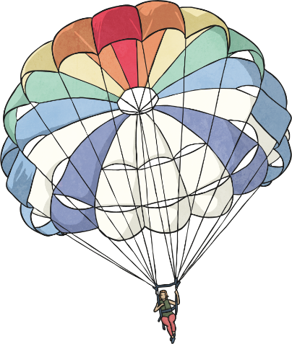
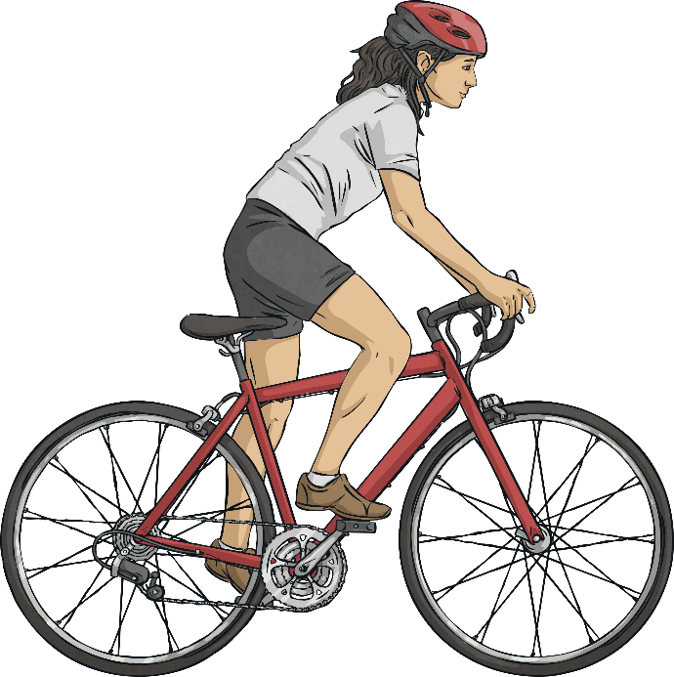
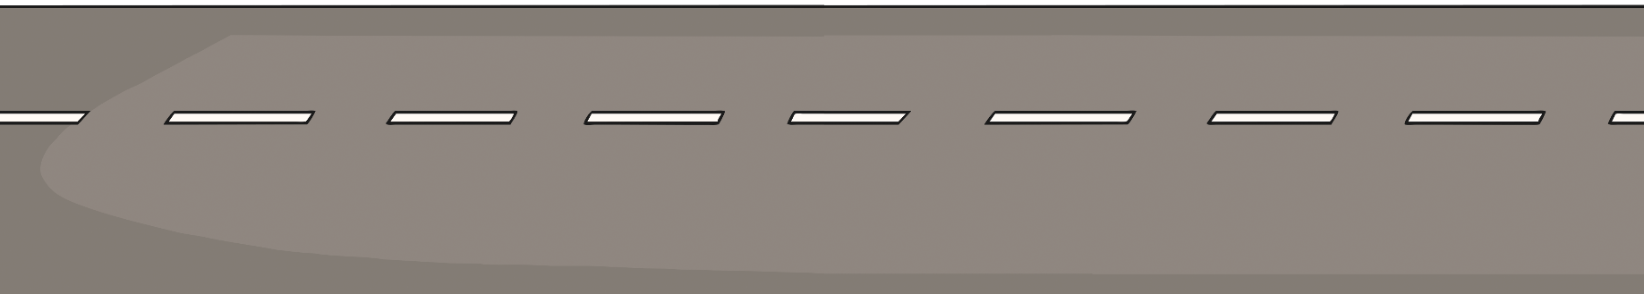
Air Resistance
gravity
Air resistance can be a useful force, but it can also be unhelpful in certain situations.
air resistance
air resistance
TP: Look at the two diagrams below. Which one shows a useful effect of air resistance, and which one shows an unhelpful effect of air resistance?
driving force

Slide 58







Air Resistance
Air resistance pushes up on the parachute, opposing the force of gravity and making the parachute and the person fall more slowly. This is a useful effect.
gravity
air resistance
air resistance
But air resistance pushes the cyclist back, opposing the cyclist’s force from them pedalling the bicycle and making the bicycle travel more slowly. This is an unhelpful effect.
driving force

Slide 59
Sky Diving Company
The Super Skydiving Company are redesigning the parachute they use to allow people to perform skydives from aeroplanes. They want to make sure that the parachute they use allows their customers to fall from the aeroplane as slowly and safely as possible.
You are going to investigate a helpful effect of air resistance by finding the best design for their new parachute.
The perfect parachute will be the one that makes a person fall the slowest. It will cause air resistance to push it up with the biggest force.

Slide 60
Task
You will make three parachutes and drop them from a height. Each of the three parachutes should be slightly different.
You will observe which of your parachutes falls the most slowly. This parachute will have the most air resistance pushing it up.
Construct your parachutes using a sheet of plastic or card. Tie or tape string to the corners, and tie or tape the four pieces of string to an object such as a toy figure, paper clip or piece of modelling clay

Slide 61
LO: To investigate the effects of air resistance
TP: What does variable mean?

Slide 62
LO: To investigate the effects of air resistance
TP: What does variable mean?
A variable is a factor in an experiment that can be changed.
TP: In order to make ‘The perfect parachute’ which variables could you try changing to see which one will be the one that makes a person fall the slowest?

Slide 63
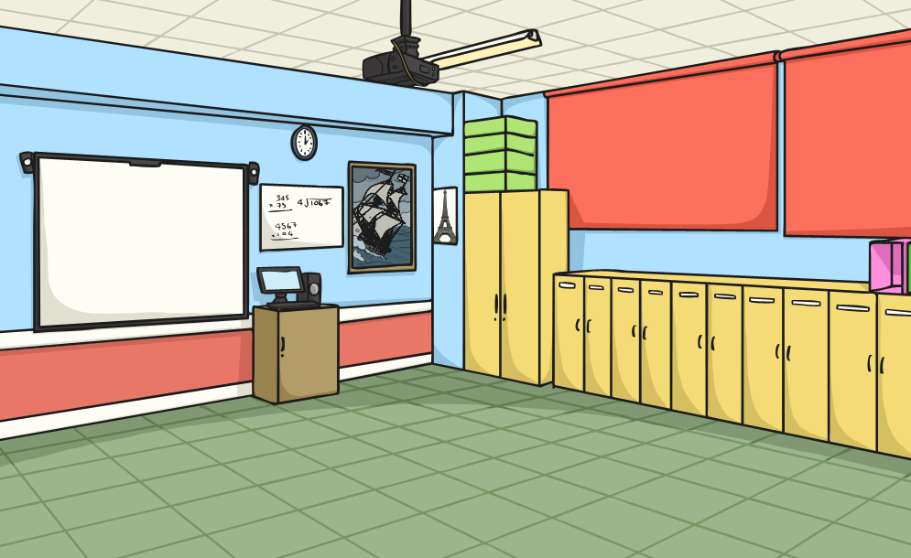
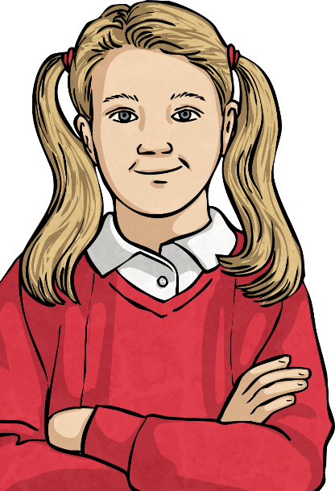
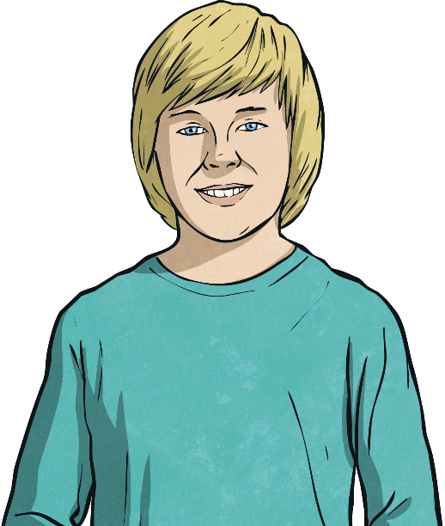
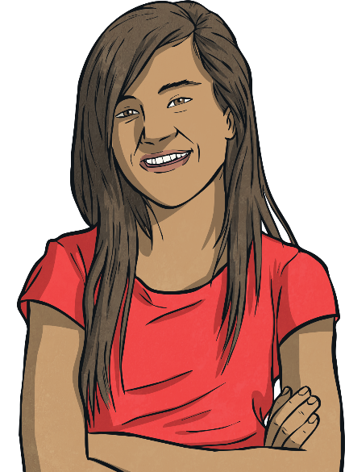
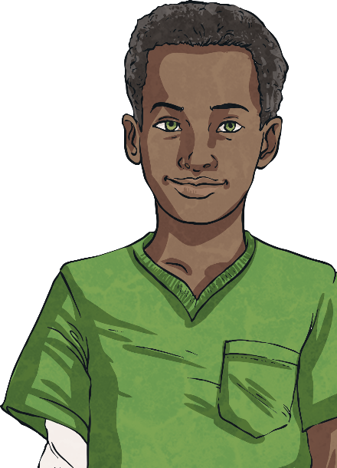
The Perfect Parachute
How many variables did you think of? Did you come up with any of these?
Variables are the things that can change in an investigation.
Which variables could we change in this investigation?
Object attached to the parachute
Length of string to attach the object
Shape of parachute
Size of parachute
Height of drop

Slide 64
LO: To investigate the effects of air resistance
A variable is a factor in an experiment that can be changed.
TP: Which variable will you change and why?
TP: Why will you change only one variable?

Slide 65
LO: To investigate the effects of air resistance
TP: What does a fair test mean?

Slide 66
LO: To investigate the effects of air resistance
TP: What does a fair test mean?
A fair test is a test which controls all but one variable when attempting to answer a scientific question. Only changing one variable allows the person conducting the test to know that no other variable has affected the results of the test

Slide 67
LO: To investigate the effects of air resistance
TP: Now we have sorted the variable we will change, what will we keep the same and what will we measure?

Slide 68
LO: To investigate the effects of air resistance
Activity
Children to decide on the variable they will change and why and which they will keep the same and why. They then need to make their parachutes and record how long it takes them to reach the floor. Finally, they will conclude their results through writing a report explaining the effects of air resistance on them and why.
1 Star – All children

Slide 69
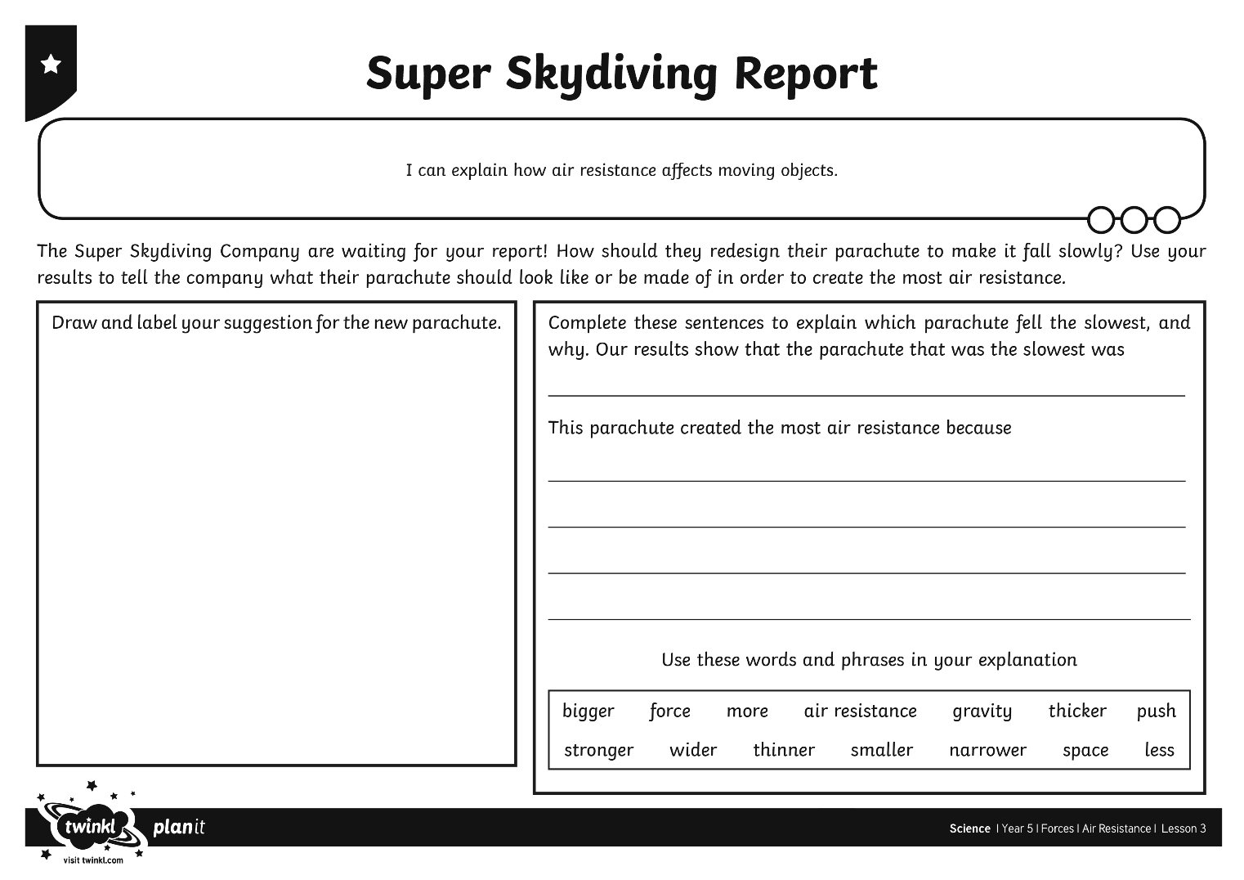
Super Skydiving Company
You now need to explain your findings to the Super Skydiving Company.
Let them know the best design for their new parachute and explain why it works well.
In your answer, make sure to explain how air resistance affects moving objects.

