Slide 1
Good Morning
Tuesday 9th February

Slide 2

Protecting Species
All species rely on other species to survive. If just one species dies then many others may suffer.
Whales have been hunted for food and other products, for thousands if years. But is wasn’t until the 1870s that the mass slaughter of whales began eventually threatening their existence. The invention of the grenade harpoon and the introduction of fast catcher boats, armed with bow-mounted cannons, meant whalers had much more efficient “killing machines”. Now, even the giant blue whale, weighing up to 180 tonnes and 31m long, fell victim.
Evidence
Retrieve
Interpret
Choice
What does slaughter mean?
Keep alive
Kill
Pat an animal
The introduction of which 2 things made it easier for whalers to kill whales?
Why will other species suffer if one species dies?
What does the author mean when he says whalers had much more efficient “killing machines”?

Slide 3
Spellings – Look/Cover/Spell/Check
Lente, Jack, Elliot and Alicia
stomach
sufficient
suggest
symbol
system
temperature
thorough
twelfth
variety
vegetable
vehicle
yacht
Rest of class
reign
remember
sentence
separate
special
straight
strange
strength
suppose
surprise

Slide 4
Maths
Read through the slides and do the activities

Slide 5
RECALL
25 x 33 =
26 x 33 =

Slide 6
LO: To be able to multiply a 4-digit number by a 2-digit number
Top Down | Self Assessment
Some of us will even: I can problem solve and reason when multiplying by a 2-digit number
Some of us will: I can multiply a 4-digit number by a 2-digit number
Most of us will: I can multiply a 3-digit number by a 2-digit number
All of us will: I can multiply a 2-digit number by a 2-digit number

Slide 7
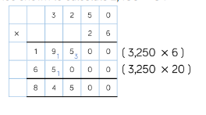
LO: To be able to multiply a 4-digit number by a 2-digit number
TP: Explain the steps followed to solve this calculation.

Slide 8
LO: To be able to multiply a 4-digit number by a 2-digit number
TP: How would we organise this calculation? What calculations do we need to put at the side?
2456 x 34 =
TP: Solve it

Slide 9
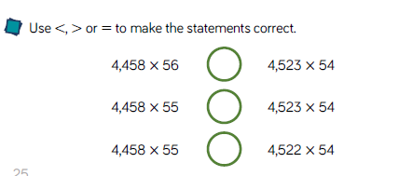
LO: To be able to multiply a 4-digit number by a 2-digit number
TP: How would you solve these questions?

Slide 10
LO: To be able to multiply a 4-digit number by a 2-digit number
Chilli 1 | Chilli 2 | Chilli 3
38 x 24 = 38 x 25 = 38 x 26 = | 234 x 24 = 234 x 25 = 234 x 26 = | 4234 x 24 = 4234 x 25 = 4234 x 26 = 4234 x 27 = 4234 x 28 =
EXT: Look at Chilli 3. What is the pattern within the answers that you can see?

Slide 11
LO: To be able to multiply a 4-digit number by a 2-digit number
Chilli 1 | Chilli 2 | Chilli 3
38 x 24 = 912 38 x 25 = 950 38 x 26 = 988 | 234 x 24 = 5616 234 x 25 = 5820 234 x 26 = 6084 | 4234 x 24 = 101,616 4234 x 25 = 105,850 4234 x 26 = 110,084 4234 x 27 = 114,318 4234 x 28 = 118,552
EXT: Look at Chilli 3. What is the pattern within the answers that you can see? The pattern is that it does up 4234 each time.

Slide 12
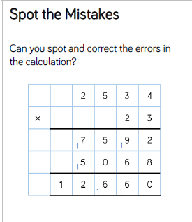
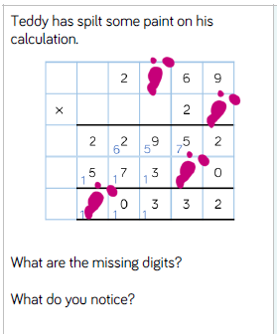
LO: To be able to multiply a 4-digit number by a 2-digit number

Slide 13
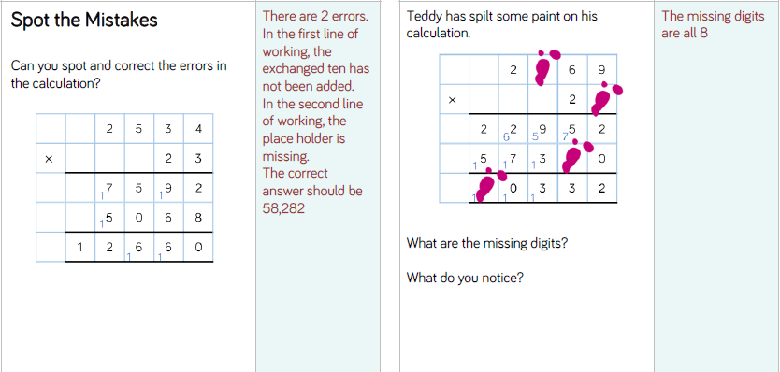
LO: To be able to multiply a 4-digit number by a 2-digit number

Slide 14
LO: To be able to multiply a 4-digit number by a 2-digit number
Top Down | Self Assessment
Some of us will even: I can problem solve and reason when multiplying by a 2-digit number
Some of us will: I can multiply a 4-digit number by a 2-digit number
Most of us will: I can multiply a 3-digit number by a 2-digit number
All of us will: I can multiply a 2-digit number by a 2-digit number

Slide 15
REFLECTION - LO: To be able to multiply a 4-digit number by a 2-digit number
SELF ASSESSMENT

Slide 16
Break

Slide 17
English
Read through the slides and do the activities

Slide 18
Introduction
We are going to be concentrating on Narrative/Epic Poem that was first told in Anglo-Saxon/Viking times called ‘Beowulf’. We are going to find out what the poem is about, we are going to look at narrative poetry and then have a go at writing our own Narrative Poem about ‘Beowulf’. Finally, we perform our poems. These will be filmed and sent to parents and the school.

Slide 19
Introduction
A narrative poem is a type of poem that tells a story. Narrative poems tend to be quite long. They tell a story like in a novel and also use rhythm and rhyme, like in a poem.
https://www.bbc.co.uk/bitesize/topics/z4mmn39/articles/z3btrwx#:~:text=A%20narrative%20poem%20is%20a,rhyme%2C%20like%20in%20a%20poem.

Slide 20
Introduction
Today, we are going to look at writing our own second stanza of our narrative poems based on the epic story of Beowulf. We will write the same amount of lines to tell the story and try have rhyming words at the end of the line. We will try to keep the same rhyming pattern as the first verse.

Slide 21
LO: To create a narrative poem that choose the appropriate vocabulary to describe setting, characters and atmosphere
Our story begins with Hrothgar, King of the Danes
When he built Heorot, a mead-hall.
Which he wanted things to be celebrated in by all.
Oh how happy those people were
And what magnificent feasts!
But they were unaware of an angry beast.
They awoke Grendel a hideous, ferocious monster
Who lived nearby
Despised the noise and the happy cries.
So he crept, silently to the hall and sprang
Attacking and devouring the once happy warriors
So Hrothgar had no more followers

Slide 22
LO: To create a narrative poem that choose the appropriate vocabulary to describe setting, characters and atmosphere
The Danes lived in fear of Grendel for over twelve years! During that time, the people abandoned Heorot and lived quietly in their homes.
Let us look at the next part
To help with rhyming patterns often finding/choosing key words and thinking of words that rhyme can help us
Q: What would you say are the key words in this part of the story
Q: What words can you think of that rhyme with them.
Q: What kind of an atmosphere do we want to create with this stanza?

Slide 23
LO: To create a narrative poem that choose the appropriate vocabulary to describe setting, characters and atmosphere
The Danes lived in fear of Grendel for over twelve years! During that time, the people abandoned Heorot and lived quietly in their homes
Can you help me write the third stanza.
FIRST LINE
I came up with:
From that day forth
SECOND LINE
Q: How long did they live in fear?
Q: Can you come up with a line that tells us how long?
THIRD LINE
Q: How did Hrothgar’s people live for that time?
Q: Can you come up with a sentence that rhymes with ______

Slide 24
LO: To create a narrative poem that choose the appropriate vocabulary to describe setting, characters and atmosphere
The Danes lived in fear of Grendel for over twelve years! During that time, the people abandoned Heorot and lived quietly in their homes
FOURTH LINE
Q: Where did they live during that time?
Q: Can you write me a line telling me that?
FIFTH LINE
Q: What had they left to live in their homes?
Q: Can you write a line telling me this that ends with Herot.
SIXTH LINE
Q: What words words rhyme with Heorot?
Q: What would happen to Heorot during this time?
Q: Can you tell me this with a line ending in rot?

Slide 25
LO: To create a narrative poem that choose the appropriate vocabulary to describe setting, characters and atmosphere
The Danes lived in fear of Grendel for over twelve years! During that time, the people abandoned Heorot and lived quietly in their homes.
2nd and 3rd
5th and 6th
From that day forth
For over twelve years
Hrothgar’s people lived in fear.
They lived seceurely and quietly in their homes
Leaving dear once happy Heorot
To fall into disrepair and rot.

Slide 26
LO: To create a narrative poem that choose the appropriate vocabulary to describe setting, characters and atmosphere
ACTIVITY
Children to write the 3rd part of the Beowulf epic story using the same amount of lines and rhyming pattern as the previous stanzas?

Slide 27
REFLECTION - LO: To create a narrative poem that choose the appropriate vocabulary to describe setting, characters and atmosphere
Let us read some of our ideas. Can we identify the rhyming pattern?

Slide 28
Reading Comprehension
The Highway Man
Comprehension

Slide 29
LO: To be able to identify and explain how meaning is enhanced through choice of words and phrases (2g)
Q: What is figurative language?
Q: Why do you think figurative language is a common feature in poetry writing?

Slide 30
LO: To be able to identify and explain how meaning is enhanced through choice of words and phrases (2g)
Q: What is figurative language?
Figurative language uses words and meanings which do not have their literal meaning.
Q: Why do you think figurative language is a common feature in poetry writing?
Figurative language us commonly used in poetry writing because it allows the poet to create powerful descriptions and comparisons in fewer words but with maximum impact.

Slide 31
LO: To be able to identify and explain how meaning is enhanced through choice of words and phrases (2g)
EXPLAIN: We will read through the poem again. While we are doing this, I want you to look for examples of similes used by the poet in the poem. When we have read this, I am going to ask you to read through the poem again and identify and underline the similes and think about what effect they create.
Q: What is a simile? Can you give me examples?
You will need to get the Highwayman Poem for this

Slide 32
LO: To be able to identify and explain how meaning is enhanced through choice of words and phrases (2g)
ACTIVITY
Look through the poem again and identify the similes in the poem. What effects do they create?

Slide 33
LO: To be able to identify and explain how meaning is enhanced through choice of words and phrases (2g)
Stanza 4
And dark in the old inn-yard a stable-wicket creaked
Where Tim the ostler listened; his face was white and peaked;
His eyes were hollows of madness, his hair like mouldy hay,
But he loved the landlord’s daughter,
The landlord’s red-lipped daughter,
Dumb as a dog he listened, and he heard the robber say.
Q: What effect do these create?

Slide 34
LO: To be able to identify and explain how meaning is enhanced through choice of words and phrases (2g)
Stanza 4
And dark in the old inn-yard a stable-wicket creaked
Where Tim the ostler listened; his face was white and peaked;
His eyes were hollows of madness, his hair like mouldy hay,
But he loved the landlord’s daughter,
The landlord’s red-lipped daughter,
Dumb as a dog he listened, and he heard the robber say.
Q: What effect does this create?
This simile compares Tim’s hair to mouldy hay suggesting that it is wild, wiry and dirty
Q: What effect does this create?
This simile compares Tim’s silence to that of a dog that incapable of speech.

Slide 35
LO: To be able to identify and explain how meaning is enhanced through choice of words and phrases (2g)
Stanza 6
He rose upright in the stirrups; he scarce could reach her hand,
But she loosened her hair i’ the casement! His face burnt like a brand
As the black cascade of perfume came tumbling over his breast;
And he kissed its waves in the moonlight,
(Oh, sweet black waves in the moonlight!)
Then he tugged at his rein in the moonlight, and galloped away to the West.
Q: What effect does this create?

Slide 36
LO: To be able to identify and explain how meaning is enhanced through choice of words and phrases (2g)
Stanza 6
He rose upright in the stirrups; he scarce could reach her hand,
But she loosened her hair i’ the casement! His face burnt like a brand
As the black cascade of perfume came tumbling over his breast;
And he kissed its waves in the moonlight,
(Oh, sweet black waves in the moonlight!)
Then he tugged at his rein in the moonlight, and galloped away to the West.
Q: What effect does this create?
This simile compares the highwayman’s face to a red-hot iron brand. This suggests he is blushing red as a result of Bess’s affections.

Slide 37
LO: To be able to identify and explain how meaning is enhanced through choice of words and phrases (2g)
Stanza 10
She twisted her hands behind her; but all the knots held good!
She writhed her hands till her fingers were wet with sweat or blood!
They stretched and strained in the darkness, and the hours crawled by like years,
Till, now, on the stroke of midnight,
Cold, on the stroke of midnight,
The tip of one finger touched it! The trigger at least was hers!
For Bess could see, through the casement, the road that he would ride.
Q: What effect does this create?

Slide 38
LO: To be able to identify and explain how meaning is enhanced through choice of words and phrases (2g)
Stanza 10
She twisted her hands behind her; but all the knots held good!
She writhed her hands till her fingers were wet with sweat or blood!
They stretched and strained in the darkness, and the hours crawled by like years,
Till, now, on the stroke of midnight,
Cold, on the stroke of midnight,
The tip of one finger touched it! The trigger at least was hers!
For Bess could see, through the casement, the road that he would ride.
Q: What effect does this create?
This simile compares the lengths of time. To Bess it feels like she has stood for years awaiting her fate but in reality she knows it is actually been hours.

Slide 39
LO: To be able to identify and explain how meaning is enhanced through choice of words and phrases (2g)
Stanza 13
Tlot-tlot in the frosty silence! Tlot-tlot, in the echoing night!
Nearer he came and nearer! Her face was like a light!
Her eyes grew wide for a moment; she drew one last deep breath,
Then her fingers moved in the moonlight,
Her musket shattered the moonlight,
Shattered her breast in the moonlight and warned him with her death.
Q: What effect does this create?

Slide 40
LO: To be able to identify and explain how meaning is enhanced through choice of words and phrases (2g)
Stanza 13
Tlot-tlot in the frosty silence! Tlot-tlot, in the echoing night!
Nearer he came and nearer! Her face was like a light!
Her eyes grew wide for a moment; she drew one last deep breath,
Then her fingers moved in the moonlight,
Her musket shattered the moonlight,
Shattered her breast in the moonlight and warned him with her death.
Q: What effect does this create?
This simile creates and image of Bess’s face like a beacon of light shining out in the darkness.

Slide 41
LO: To be able to identify and explain how meaning is enhanced through choice of words and phrases (2g)
Stanza 15
Back, he spurred like a madman, shrieking a curse to the sky,
With the white road smoking behind him and his rapier brandished high!
Blood-red were his spurs i’ the golden noon; wine-red was his velvet coat,
When they shot him down on the highway,
Down like a dog on the highway,
And he lay in his blood on the highway, with the bunch of lace at his throat.
Q: What effect does this create?

Slide 42
LO: To be able to identify and explain how meaning is enhanced through choice of words and phrases (2g)
Stanza 15
Back, he spurred like a madman, shrieking a curse to the sky,
With the white road smoking behind him and his rapier brandished high!
Blood-red were his spurs i’ the golden noon; wine-red was his velvet coat,
When they shot him down on the highway,
Down like a dog on the highway,
And he lay in his blood on the highway, with the bunch of lace at his throat.
Q: What effect does this create?
This simile directly compares the highwayman to man who is crazy and out of control
This simile compares the way the highwayman is shot down to the way a dog might be treated. He is afforded no humanity and there is not dignity in death.

Slide 43
Word of the Day Challenge
Reverberated - Verb. If a loud, deep sound reverberates, it continues to be heard around an area, so that the area seems to shake or to continue to be heard; to echo repeatedly.
Clamour - Noun. loud noise, especially made by people's voices
Crescendo - Noun. a gradual increase in loudness, or the moment when a noise or piece of music is at its loudest.
Deftly - Adv. in a skilful, clever, or quick way
Seethed - Verb. to feel very angry
Adversaries - Noun. An enemy
Obliterated - Verb. to remove all signs of something, either by destroying it or by covering it so that it cannot be seen
Repugnant - Adj. very unpleasant, causing a feeling of disgust
Poverty - Noun. the condition of being extremely poor
Affliction - Noun. something that makes you suffer
Ghastly - Adj. unpleasant and shocking or to look very ill
Deluded - Adj. believing things that are not real or true.
Cherished - Adj. bringing the pleasure of love or caring about someone or something that is important to you
Memento - Noun. an object that you keep to remember a person, place, or event
Ushering - Verb. to show someone where they should go, or to make someone go where you want them to go

Slide 44
Word of the Day Challenge
Laden - Adj. carrying or holding a lot of something
Flawless - Adj. perfect or without mistakes
Defiantly - Adv. in a way that proudly refuses to obey authority or shows you are not willing to accept criticism or disapproval
Diplomacy - Noun. the management of relationships between countries or the skill in dealing with people without offending or upsetting them.
Contingency - Noun. something that might possibly happen in the future, usually causing problems or making further arrangements necessary
Protocol - Noun. the system of rules and acceptable behaviour used at official ceremonies and occasions
Reprimand - Verb. to express to someone your strong official disapproval of them
Condescendingly - Adv. in a way that shows that you think you are more important or more intelligent than someone else

Slide 45
Word of the Day Challenge
Can you come up with a game that you can play with other children that practices remembering the meaning of these words?

Slide 46
Lunch

Slide 47
PSHE – Drugs - Lesson 4 – Running Your Life
LO: To have healthy aspirations

Slide 48
LO: To have healthy aspirations
TP: What does aspirations mean?

Slide 49
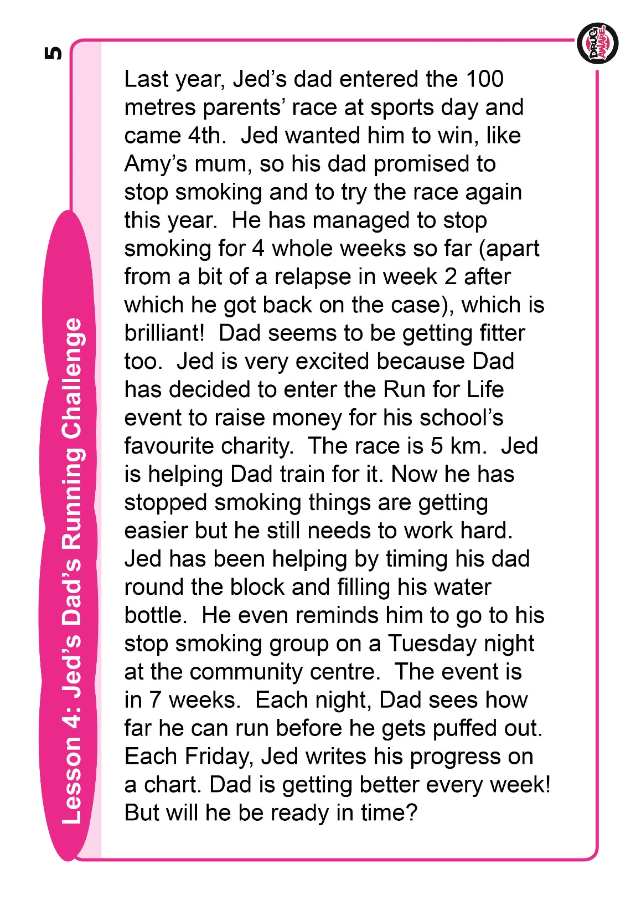
A
LO: To have healthy aspirations

Slide 50
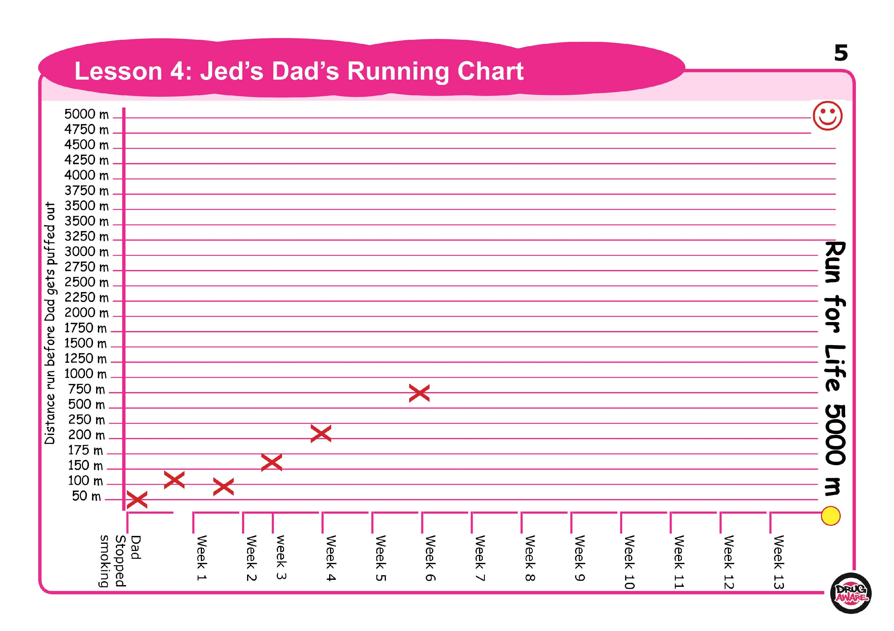
A

Slide 51
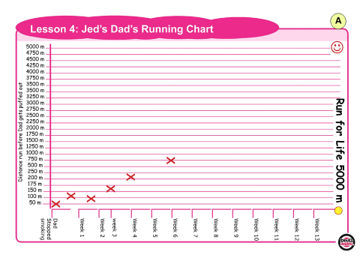
LO: To have healthy aspirations
TP: What is 5km in metres?
TP: What distance does Dad need to aim for by week 9 to be on track for the Run for Life? You can plot a line to the 5000m mark and read off the targets or calculate based on previous increases over time depending on ability

Slide 52
LO: To have healthy aspirations
TP: What happened to his running times in week 2?
TP: Why was this? (Dad’s relapse)
TP: Why do you think Dad can run further now he doesn’t smoke?

Slide 53
LO: To have healthy aspirations
TASK: Plot their own chart to include milestones towards a goal - it would be great if this was a health-related, aspirational goal
Some suggestions are:
Drink 4 glasses of water per day, building up slowly
Eat 5 portions of fruit and vegetables a day
Work up to doing 60 minutes of activity per day that puffs you out, such as bunny hops or running on the spot
In each case make sure the children set realistic safe starting points, goals and milestones over a period of time

Slide 54
LO: To have healthy aspirations
ACTIVITY
Plot their own chart to include milestones towards a goal - it would be great if this was a health-related, aspirational goal

Slide 55
REFLECTION - LO: To have healthy aspirations
TP: What could the impact of negative health choices on your goal be? What could the negative health choices be that stop you achieving this?
TP: Imagine your future, when you are grown up, and what you could achieve longer term if they keep going on their goals
TP: How might smoking or alcohol / drugs affect those achievements?

Slide 56
Science – Forces Lesson 2
Read the slides and do the activities

Slide 57
LO: To explore the effect that gravity has on objects and how the first theory of gravity was developed.
Science Quiz
Forces Fact Sheet
TP: Look at what a force is, gravity and air resistance. Using the facts, can you ask questions that will require the facts as an answer?
You will need the Gravity presentation for this

Slide 58
LO: To explore the effect that gravity has on objects and how the first theory of gravity was developed.
Activity
Children to predict if they think there will be a link between mass and weight when they measure the mass and weight of an object. They will then need to measure and record the mass and weight of objects. Conclusions of link will be discussed and then they will record their conclusions.
Do the 1 star sheet.
Children working from home. Fill in the passage with the missing words.

Slide 59
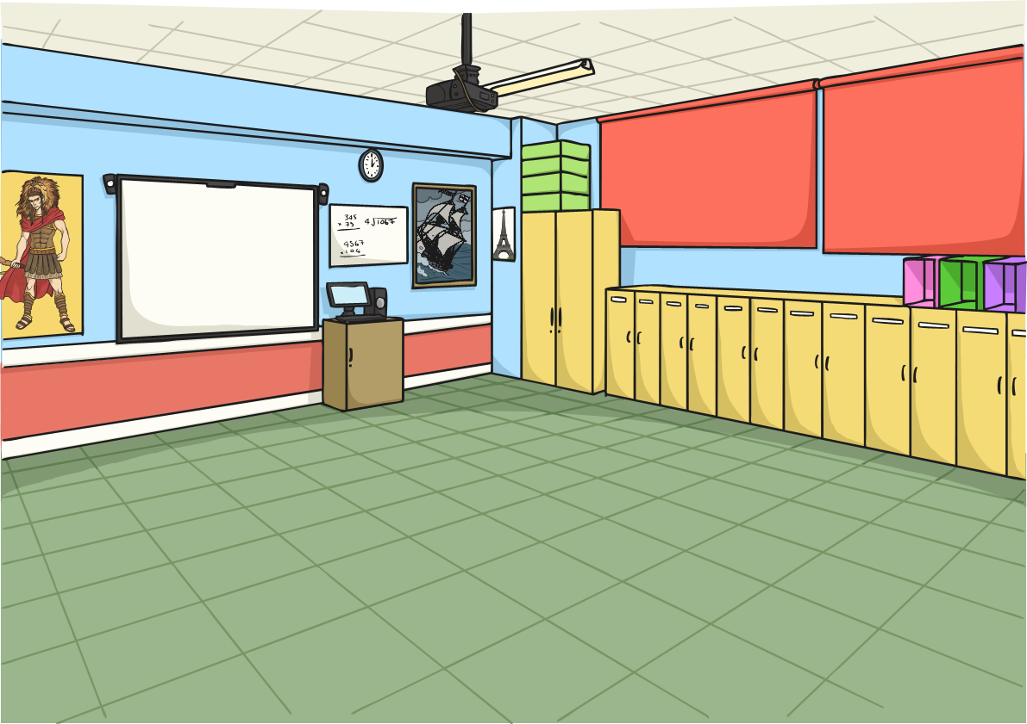







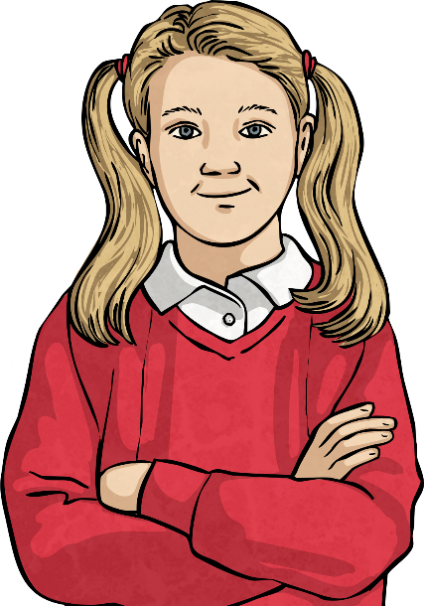
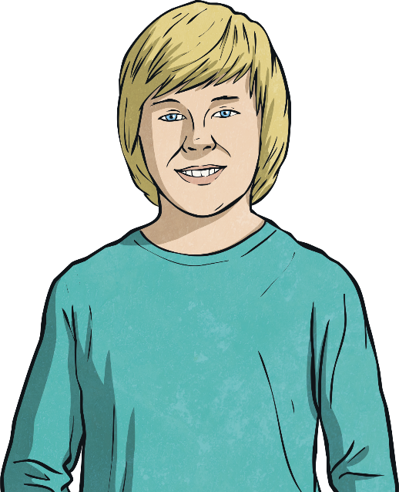
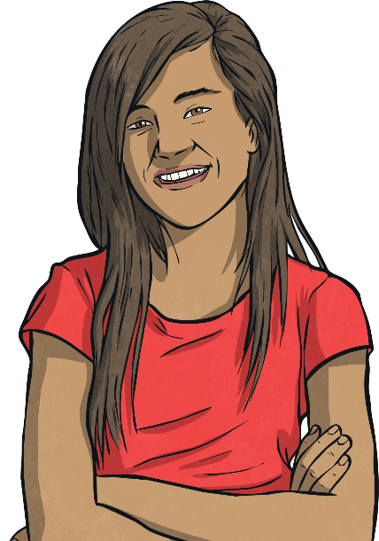
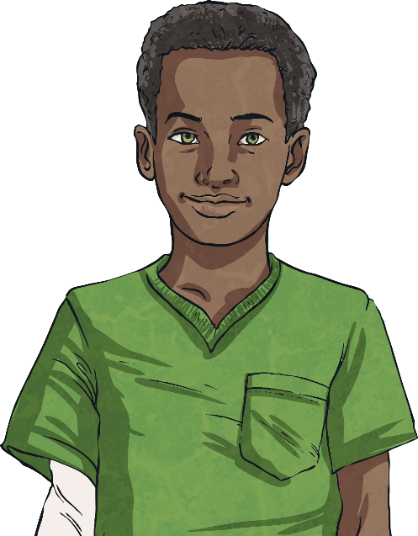
Finding a Link
Did you notice a link between each object’s weight and its mass?
Talk to a partner about the link you spotted.
Did they see a similar link?
Can you explain any results that don’t follow this link?

Slide 60

Finding a Link
You should have discovered that gravity pulls objects down with a force of approximately 1N for every 100g.
If an object weighs 1kg, gravity will pull it down with a force of 10N.
Have another look at your results. Do they follow this pattern?
So if an object weighs 200g, gravity will pull it down with a force of 2N.

Slide 61
REFLECTION - LO: To explore the effect that gravity has on objects and how the first theory of gravity was developed.
https://www.bbc.co.uk/bitesize/topics/zf66fg8/articles/zqbm3k7
Science quiz

