Slide 1
Good Morning
Monday 8th February

Slide 2

Theseus and the Minotaur – Part 5
As Minos led the children to the palace to be cleaned and prepared, Ariadne pulled Theseus to one side. She told him that she was a beautiful princess and that she was desperate to escape from the world that her father had built, she offered to aid him in his quest in exchange for safe passage to Athens. Ariadne took Theseus to meet Daedalus, the inventor of the labyrinth which held the Minotaur.
Evidence
Retrieve
Interpret
Choice
What is a synonym for quest?
Mission
Rest
Sleep
Who invented the labyrinth?
Why do you think Ariadne took Theseus to meet Daedalus?
Why do you think Ariadne told Theseus she was a beautiful princess?

Slide 3
Spellings – Look/Cover/Spell/Check
Lente, Jack, Elliot and Alicia
stomach
sufficient
suggest
symbol
system
temperature
thorough
twelfth
variety
vegetable
vehicle
yacht
Rest of class
reign
remember
sentence
separate
special
straight
strange
strength
suppose
surprise

Slide 4
Maths
Read through the slides and do the activities

Slide 5
RECALL
TP: Solve:
41 x 24 =
42 x 25 =
43 x 26 =
TP: What is the pattern?

Slide 6
LO: To multiply a 3-digit number by a 2-digit number
Top Down | Self Assessment
Some of us will even: I can solve problem solving and reasoning questions involving multiplying a 3-digit number by a 2-digit number
Some of us will: I can multiply any 3-digit number by any 2-digit number
Most of us will: I can multiply a 3-digit number by a 2-digit number when involving 10
All of us will: I can multiply a 2-digit number by a 2-digit number

Slide 7
LO: To multiply a 3-digit number by a 2-digit number
TP: What partitioned calculations have I calculated to get these answers
1 3 2
X 1 4
5 2 8 ( )
1 3 2 0 ( )

Slide 8
LO: To multiply a 3-digit number by a 2-digit number
TP: How did I solve these calculations?
TP: What is the answer?
1 3 2
X 1 4
5 2 8 (132 x 4)
1 3 2 0 (132 x 10)

Slide 9
LO: To multiply a 3-digit number by a 2-digit number
TP: What is wrong with this calculation?
2 6 4
x 1 4
(264 x 4)
(264 x 1)

Slide 10
LO: To multiply a 3-digit number by a 2-digit number
TP: Can you solve it?
TP: Why is the zero important?
2 6 4
x 1 4
(264 x 4)
(264 x 10)

Slide 11
LO: To multiply a 3-digit number by a 2-digit number
TP: Can you solve it?
TP: Why is the zero so important?
2 6 4
X 1 8

Slide 12
LO: To multiply a 3-digit number by a 2-digit number
TP: With your partner, work through this calculation step-by-step and be prepared to talk me through it.
3 2 3
X 7 8

Slide 13
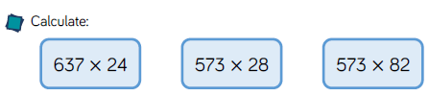
LO: To multiply a 3-digit number by a 2-digit number

Slide 14
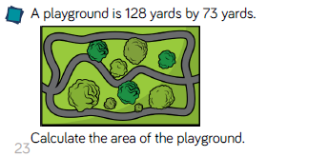
LO: To multiply a 3-digit number by a 2-digit number

Slide 15
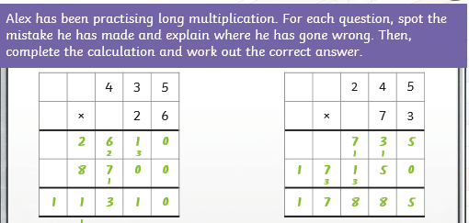
LO: To multiply a 3-digit number by a 2-digit number

Slide 16
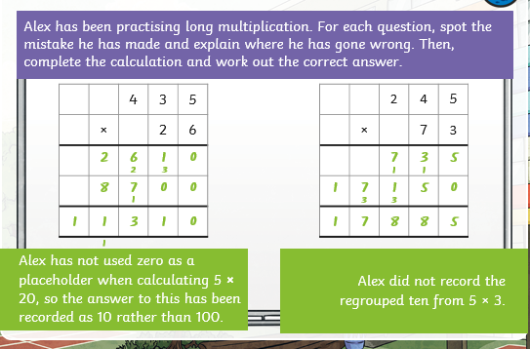
LO: To multiply a 3-digit number by a 2-digit number

Slide 17
LO: To multiply a 3-digit number by a 2-digit number
Chilli 1 | Chilli 2 | Chilli 3
125 x 33 = 126 x 33 = 127 x 33 = 128 x 33 = 129 x 33 = | 245 x 15 = 245 x 16 = 245 x 17 = 245 x 18 = 245 x 19 = | 265 x 51 = 265 x 52 = 265 x 53 = 265 x 54 = 265 x 55 =
EXT: What are the patterns for each chilli? Make sure you give examples in you answer.

Slide 18
LO: To multiply a 3-digit number by a 2-digit number
Chilli 1 | Chilli 2 | Chilli 3
125 x 33 = 4125 126 x 33 = 4158 127 x 33 = 4191 128 x 33 = 4224 129 x 33 = 4257 | 245 x 15 = 3675 245 x 16 = 3920 245 x 17 = 4165 245 x 18 = 4410 245 x 19 = 4655 | 365 x 51 = 18615 365 x 52 = 18980 365 x 53 = 19345 365 x 54 = 19710 365 x 55 = 20275
EXT: What are the patterns for each chilli? Make sure you give examples in you answer. Chilli 1 goes up 33 each time
Chilli 2 goes up 245 each time
Chilli 3 goes up 365 each time

Slide 19
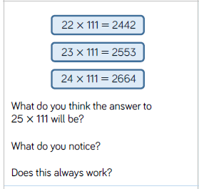
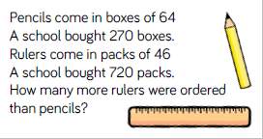
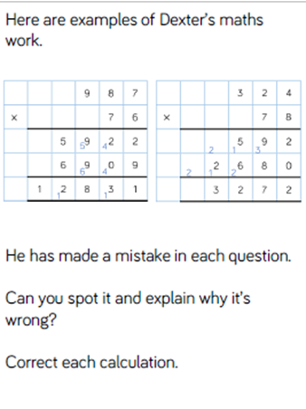
LO: To multiply a 3-digit number by a 2-digit number

Slide 20
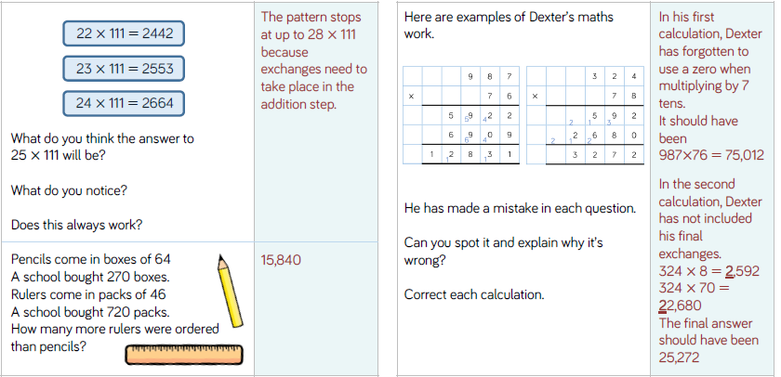
LO: To multiply a 3-digit number by a 2-digit number

Slide 21
LO: To multiply a 3-digit number by a 2-digit number
Top Down | Self Assessment
Some of us will even: I can solve problem solving and reasoning questions involving multiplying a 3-digit number by a 2-digit number
Some of us will: I can multiply any 3-digit number by any 2-digit number
Most of us will: I can multiply a 3-digit number by a 2-digit number when involving 10
All of us will: I can multiply a 2-digit number by a 2-digit number

Slide 22
Assembly and Break

Slide 23
English - Poetry
Read the slides and do the activities

Slide 24
Introduction
We are going to be concentrating on Narrative/Epic Poem that was first told in Anglo-Saxon/Viking times called ‘Beowulf’. We are going to find out what the poem is about, we are going to look at narrative poetry and then have a go at writing our own Narrative Poem about ‘Beowulf’. Finally, we perform our poems. These will be filmed and sent to parents and the school.

Slide 25
Introduction
A narrative poem is a type of poem that tells a story. Narrative poems tend to be quite long. They tell a story like in a novel and also use rhythm and rhyme, like in a poem.
https://www.bbc.co.uk/bitesize/topics/z4mmn39/articles/z3btrwx#:~:text=A%20narrative%20poem%20is%20a,rhyme%2C%20like%20in%20a%20poem.

Slide 26
Introduction
Today, we are going to look at writing our own second stanza of our narrative poems based on the epic story of Beowulf. We will write the same amount of lines to tell the story and try have rhyming words at the end of the line. We will try to keep the same rhyming pattern as the first verse.

Slide 27
LO: To create a narrative poem that choose the appropriate vocabulary to describe setting, characters and atmosphere
First, let us look at the stanza I wrote yesterday, which opens the story up and sets the scene.
Q: What do I hint at the end of the stanza?
Q: How many lines has my first stanza?
Q: What rhyming pattern do I have?
Our story begins with Hrothgar, King of the Danes
When he built Heorot, a mead-hall.
Which he wanted things to be celebrated in by all.
Oh how happy those people were
And what magnificent feasts!
But they were unaware of an angry beast.

Slide 28
LO: To create a narrative poem that choose the appropriate vocabulary to describe setting, characters and atmosphere
Grendel, a monster who lived nearby, despised the noise from the celebrations. One night, he decided to attack the hall, killing and devouring thirty of Hrothgar’s warriors
Let us look at the second part of the epic story to Beowulf that is on your plans
To help with rhyming patterns often finding/choosing key words and thinking of words that rhyme can help us
Q: What would you say are the key words in this part of the story
Q: What words can you think of that rhyme with them.
Q: Which character am I going to describe?
Q: What atmosphere do I want to create?

Slide 29
LO: To create a narrative poem that choose the appropriate vocabulary to describe setting, characters and atmosphere
Grendel, a monster who lived nearby, despised the noise from the celebrations. One night, he decided to attack the hall, killing and devouring thirty of Hrothgar’s warriors
Can you help me write the second verse/stanza?
FIRST LINE
Q: What did all the feasting and celebrations do? What kind of monster was he?
Can you write a first line for me that puts this information in as few words as possible?

Slide 30
LO: To create a narrative poem that choose the appropriate vocabulary to describe setting, characters and atmosphere
Grendel, a monster who lived nearby, despised the noise from the celebrations. One night, he decided to attack the hall, killing and devouring thirty of Hrothgar’s warriors
SECOND LINE
Q: Where did he live?
THIRD LINE
Q: What rhymes with by?
Q: What did he despise? Think about the rhyming
Q: Can you write me a third line that rhymes with the second line?

Slide 31
LO: To create a narrative poem that choose the appropriate vocabulary to describe setting, characters and atmosphere
Grendel, a monster who lived nearby, despised the noise from the celebrations. One night, he decided to attack the hall, killing and devouring thirty of Hrothgar’s warriors
FOURTH LINE
Q: What did he do? How did he do this? What could be a word that shows that he moved so he caught them unaware?
FIFTH LINE
Q: What did he do?
Q: Can you write me a line telling me this?
SIXTH LINE
Q: What rhymes with the last word?
Q: What had Hrothgar got at then end?
Q: Can you write me a line telling me this?

Slide 32
LO: To create a narrative poem that choose the appropriate vocabulary to describe setting, characters and atmosphere
Take a look at what I wrote
They awoke Grendel a hideous, ferocious monster
Who lived nearby
Despised the noise and the happy cries.
So he crept, silently to the hall and sprang
Attacking and devouring the once happy warriors
So Hrothgar had no more followers.

Slide 33
LO: To create a narrative poem that choose the appropriate vocabulary to describe setting, characters and atmosphere
ACTIVITY
Children to write the second part of the story of Beowulf where Grendel strikes. To have the same amount of lines in the stanza and try to follow the same rhyming pattern as the first stanza.

Slide 34
REFLECTION - LO: To create a narrative poem that choose the appropriate vocabulary to describe setting, characters and atmosphere
Let us hear some of your stanzas. Can we identify the rhyming pattern?

Slide 35
Reading Comprehension - Poetry
LO: To be able to retrieve, infer and comment on the poet’s language choices

Slide 36
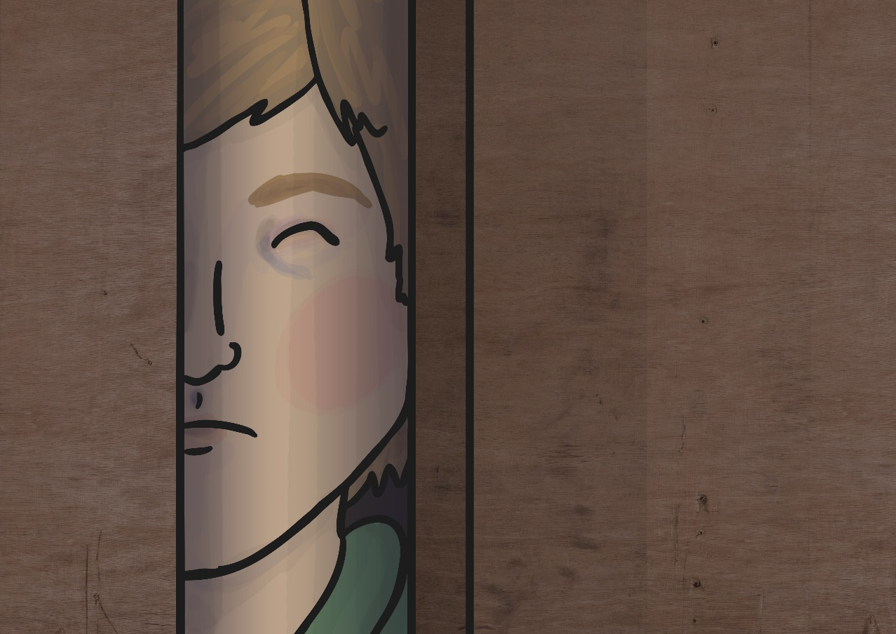

And dark in the old inn-yard a stable-wicket creaked
Where Tim the ostler listened; his face was white and peaked;
His eyes were hollows of madness, his hair like mouldy hay,
But he loved the landlord’s daughter,
The landlord’s red-lipped daughter,
Dumb as a dog he listened, and he heard the robber say.

Slide 37
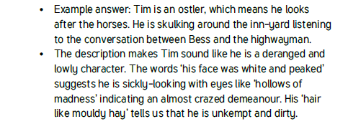
And dark in the old inn-yard a stable-wicket creaked
Where Tim the ostler listened; his face was white and peaked;
His eyes were hollows of madness, his hair like mouldy hay,
But he loved the landlord’s daughter,
The landlord’s red-lipped daughter,
Dumb as a dog he listened, and he heard the robber say.

Slide 38
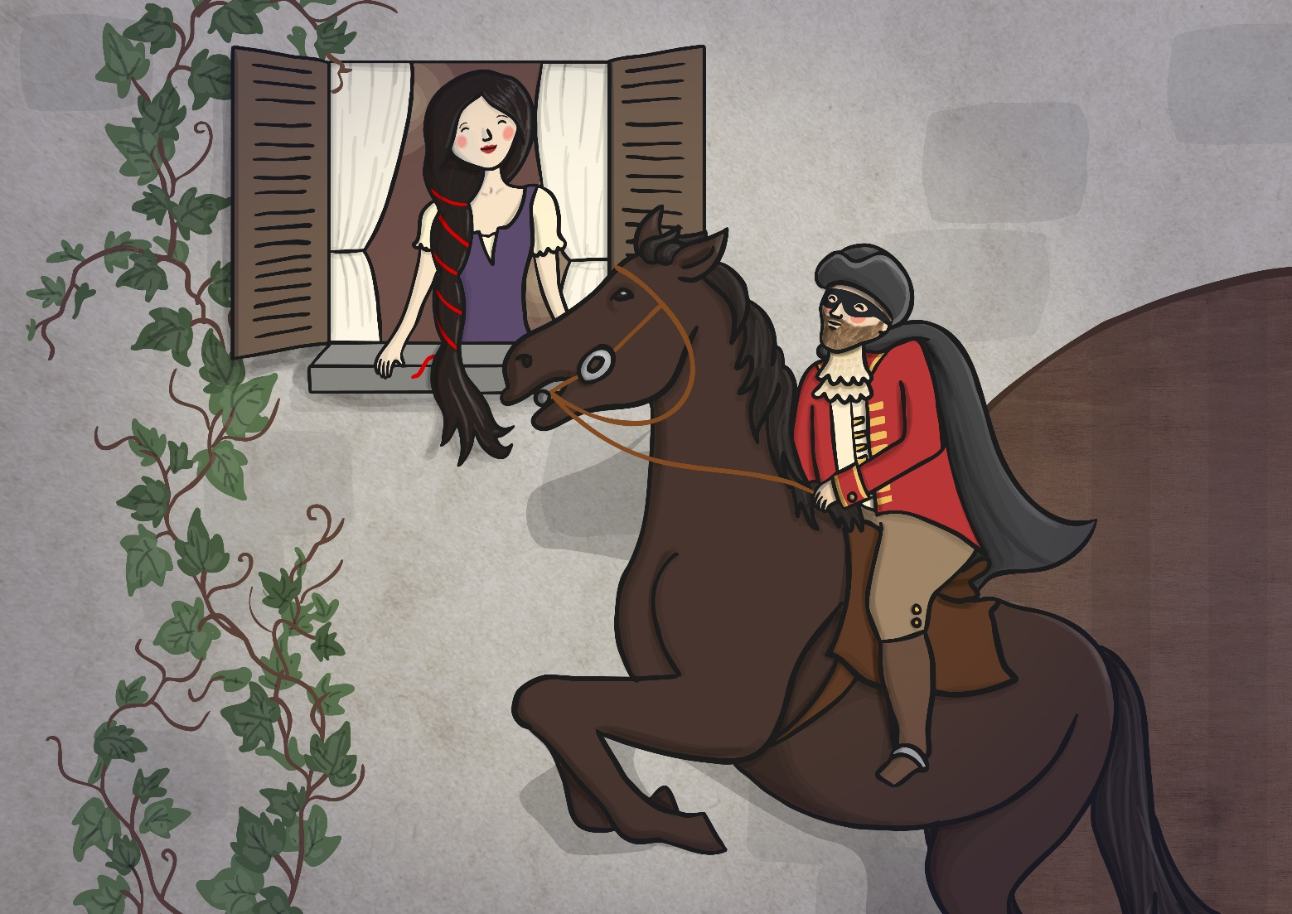

“One kiss, my bonny sweetheart, I’m after a prize to-night,
But I shall be back with the yellow gold before the morning light;
Yet, if they press me sharply, and harry me through the day,
Then look for me by moonlight,
Watch for me by moonlight,
I’ll come to thee by moonlight, though hell should bar the way.”

Slide 39
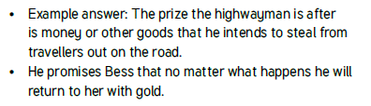
“One kiss, my bonny sweetheart, I’m after a prize to-night,
But I shall be back with the yellow gold before the morning light;
Yet, if they press me sharply, and harry me through the day,
Then look for me by moonlight,
Watch for me by moonlight,
I’ll come to thee by moonlight, though hell should bar the way.”

Slide 40
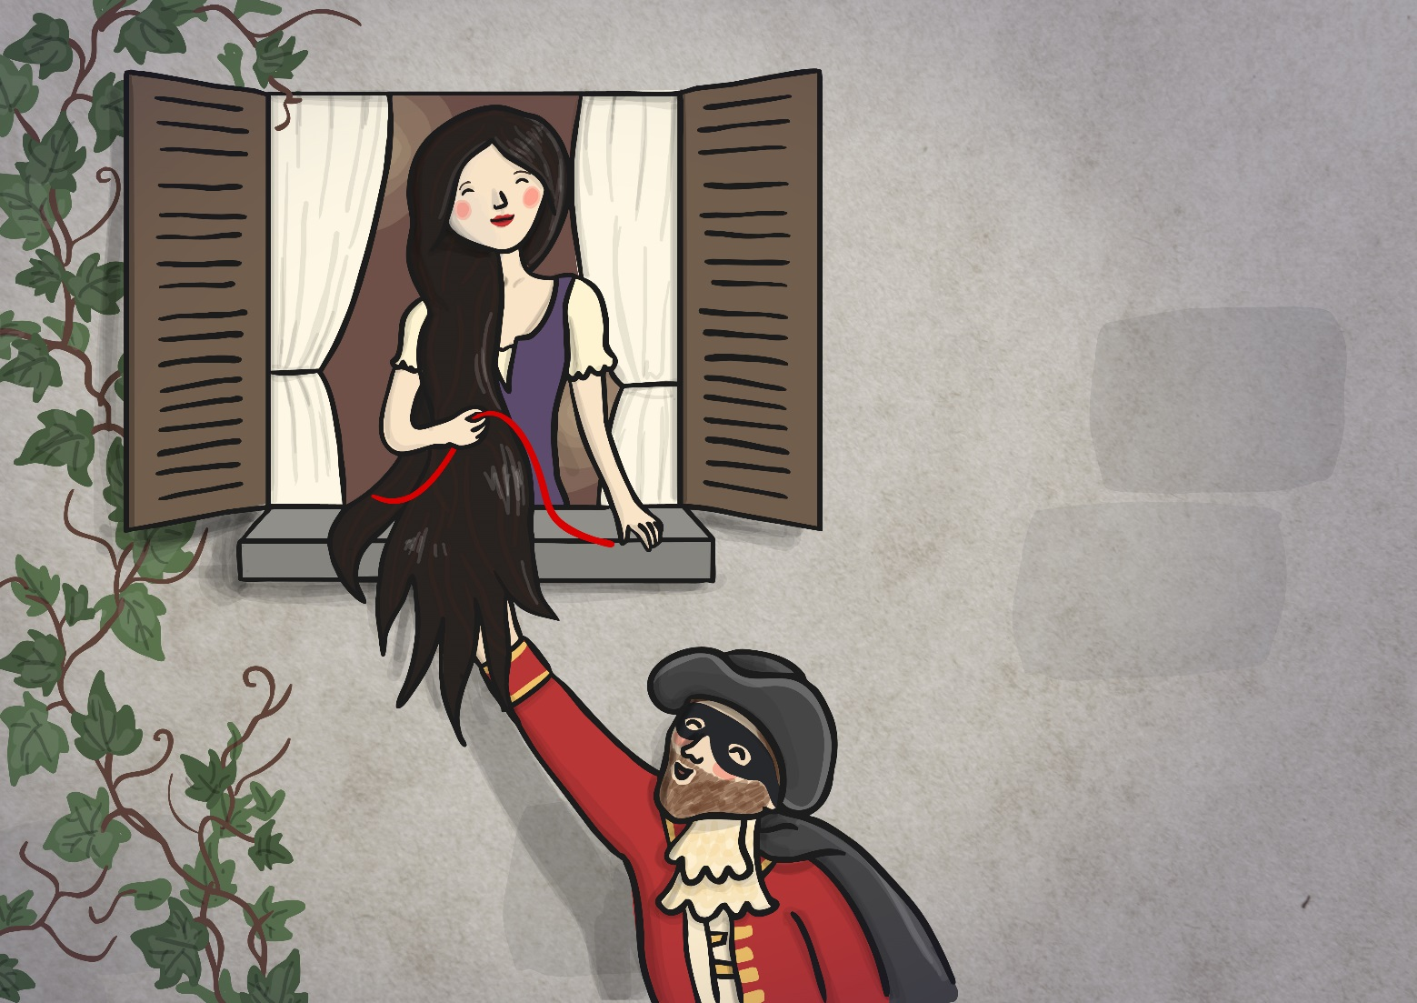

He rose upright in the stirrups; he scarce could reach her hand,
But she loosened her hair i’ the casement! His face burnt like a brand
As the black cascade of perfume came tumbling over his breast;
And he kissed its waves in the moonlight,
(Oh, sweet black waves in the moonlight!)
Then he tugged at his rein in the moonlight, and galloped away to the West.

Slide 41

He rose upright in the stirrups; he scarce could reach her hand,
But she loosened her hair i’ the casement! His face burnt like a brand
As the black cascade of perfume came tumbling over his breast;
And he kissed its waves in the moonlight,
(Oh, sweet black waves in the moonlight!)
Then he tugged at his rein in the moonlight, and galloped away to the West.

Slide 42
LO: To be able to retrieve, infer and comment on the poet’s language choices
And dark in the old inn-yard a stable-wicket creaked
Where Tim the ostler listened; his face was white and peaked;
His eyes were hollows of madness, his hair like mouldy hay,
But he loved the landlord’s daughter,
The landlord’s red-lipped daughter,
Dumb as a dog he listened, and he heard the robber say.
“One kiss, my bonny sweetheart, I’m after a prize to-night,
But I shall be back with the yellow gold before the morning light;
Yet, if they press me sharply, and harry me through the day,
Then look for me by moonlight,
Watch for me by moonlight,
I’ll come to thee by moonlight, though hell should bar the way.”
He rose upright in the stirrups; he scarce could reach her hand,
But she loosened her hair i’ the casement! His face burnt like a brand
As the black cascade of perfume came tumbling over his breast;
And he kissed its waves in the moonlight,
(Oh, sweet black waves in the moonlight!)
Then he tugged at his rein in the moonlight, and galloped away to the West.
Questions
Who is Tim?
What is he doing and why?
What does the description tell us about him?
What does the highwayman mean when he says he is ‘after a prize to-night’?
What does he promise Bess?
What do you think ‘His face burnt like a brand’ Means?
What are the ‘sweet, black waves’’?

Slide 43
Word of the Day Challenge
Reverberated - Verb. If a loud, deep sound reverberates, it continues to be heard around an area, so that the area seems to shake or to continue to be heard; to echo repeatedly.
Clamour - Noun. loud noise, especially made by people's voices
Crescendo - Noun. a gradual increase in loudness, or the moment when a noise or piece of music is at its loudest.
Deftly - Adv. in a skilful, clever, or quick way
Seethed - Verb. to feel very angry
Adversaries - Noun. An enemy
Obliterated - Verb. to remove all signs of something, either by destroying it or by covering it so that it cannot be seen
Repugnant - Adj. very unpleasant, causing a feeling of disgust
Poverty - Noun. the condition of being extremely poor
Affliction - Noun. something that makes you suffer
Ghastly - Adj. unpleasant and shocking or to look very ill
Deluded - Adj. believing things that are not real or true.
Cherished - Adj. bringing the pleasure of love or caring about someone or something that is important to you
Memento - Noun. an object that you keep to remember a person, place, or event
Ushering - Verb. to show someone where they should go, or to make someone go where you want them to go

Slide 44
Word of the Day Challenge
Laden - Adj. carrying or holding a lot of something
Flawless - Adj. perfect or without mistakes
Defiantly - Adv. in a way that proudly refuses to obey authority or shows you are not willing to accept criticism or disapproval
Diplomacy - Noun. the management of relationships between countries or the skill in dealing with people without offending or upsetting them.
Contingency - Noun. something that might possibly happen in the future, usually causing problems or making further arrangements necessary
Protocol - Noun. the system of rules and acceptable behaviour used at official ceremonies and occasions
Reprimand - Verb. to express to someone your strong official disapproval of them
Condescendingly - Adv. in a way that shows that you think you are more important or more intelligent than someone else

Slide 45
Word of the Day Challenge
Can you come up with a game that you can play with other children that practices remembering the meaning of these words?

Slide 46
Lunch

Slide 47
Lesson 1
LO: To be able to identify the different forces acting on objects

Slide 48







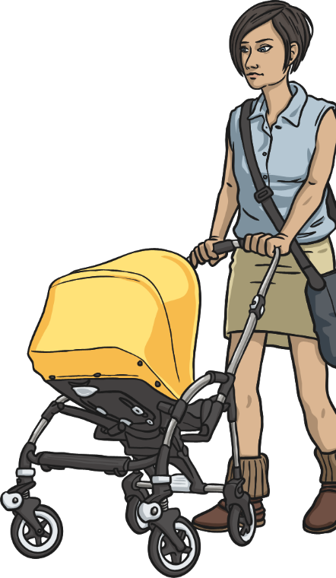
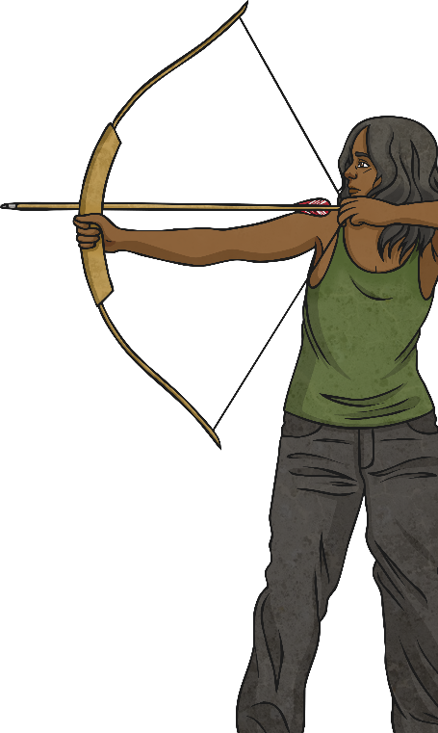
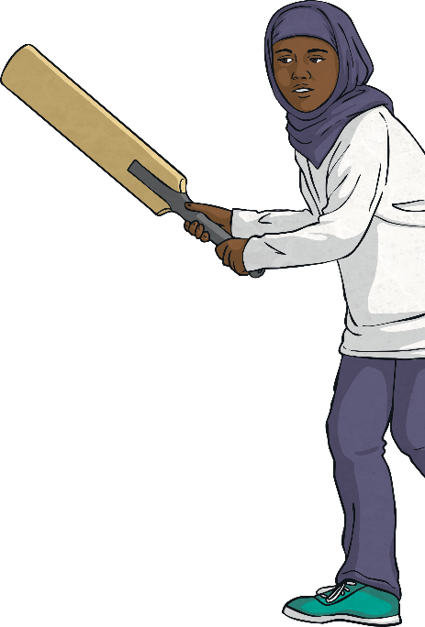
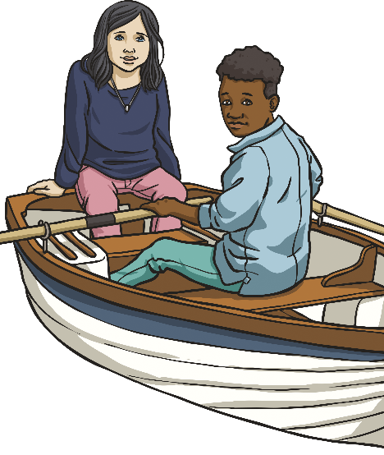

What Are Forces?
Forces are often referred to as pushes and pulls.
Look at the pictures below and talk to your partner about whether each picture shows an example of a pushing or pulling force.

Slide 49




LO: To be able to identify the different forces acting on objects
Forces are just pushes and pulls in a particular direction.
Forces are shown by arrows in diagrams. The direction of the arrow shows the direction in which the force is acting. The bigger the arrow, the bigger the force

Slide 50

LO: To be able to identify the different forces acting on objects
Balanced forces
If two forces are balanced, it means the forces are the same size but are acting in opposite directions.
If two balanced forces are acting on an object, that object will not change its motion. If it is still, the object will stay still or if it is moving, it will continue moving in the same direction and at the same speed.

Slide 51

LO: To be able to identify the different forces acting on objects
Unbalanced forces
When two forces acting on an object are not equal in size, we say that they are unbalanced forces. Unbalanced forces do change the way something is moving.
They can make objects start to move, speed up, slow down or change direction

Slide 52
LO: To be able to identify the different forces acting on objects
https://www.bbc.co.uk/bitesize/topics/zvpp34j/articles/zywcrdm
Quiz 1
Quiz 2

Slide 53

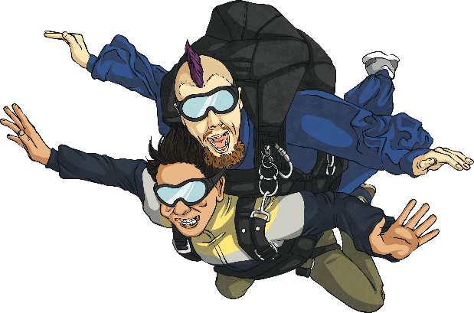
What Are Forces?
Forces affect the movement or shape of an object. They can make an object start to move, stop moving, move faster or move more slowly. They could also make an object change its shape or cause a moving object to change direction.
TP: What is the name of the force pulling the skydivers down?

Slide 54
What Are Forces?
Gravity is a pulling force exerted by the Earth. The gravitational force from the Earth pulls in a direction towards the centre of the Earth.
Gravity is pulling the skydivers towards the Earth.
gravity

Slide 55
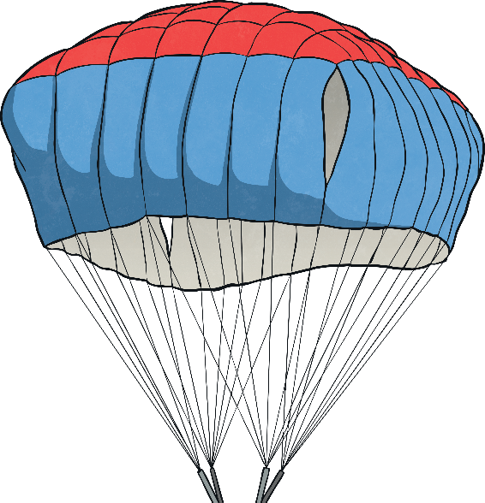

What Are Forces?
Air resistance is the name of the force that is pushing up against the parachute.
Gravity is pulling the skydivers towards the ground. However, they are slowed down because a force (air resistance) pushes against the inside of the parachute and they descend more slowly.
Gravity and air resistance are opposing forces in this situation.
air resistance
gravity

Slide 56
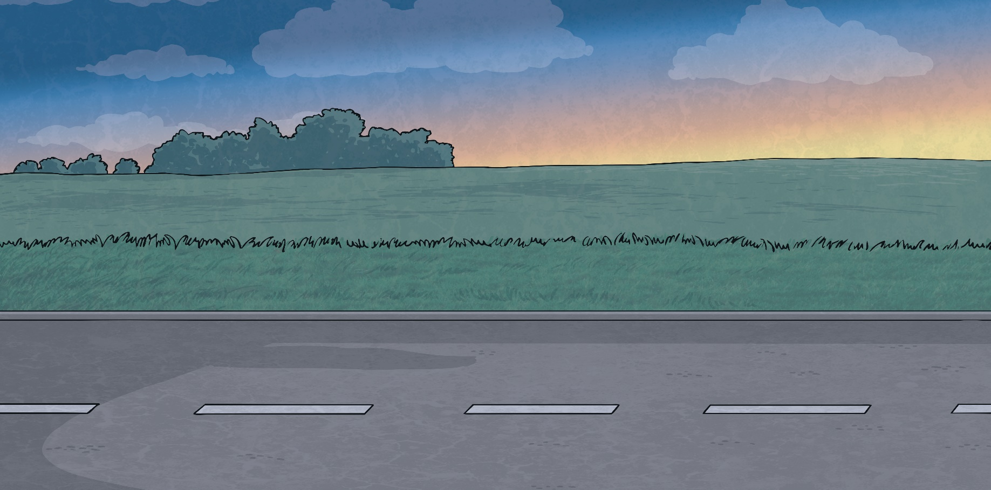
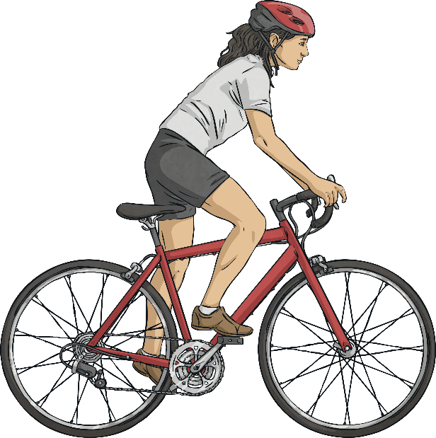
What Are Forces?
As well as gravity and air resistance, there are other forces that can act on objects.
TP: What forces do you think might be represented by the arrows in this image?
cyclist’s driving force
friction

Slide 57
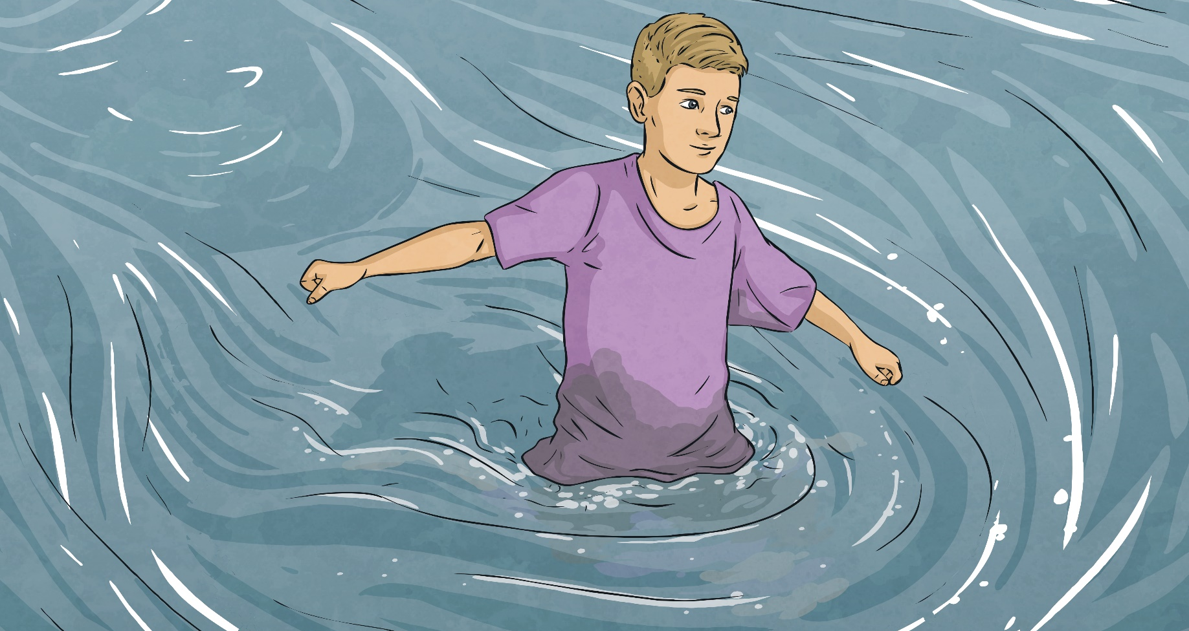
What Are Forces?
TP: What forces do you think might be represented by the arrows in this image?
man’s pushing force
water resistance

Slide 58

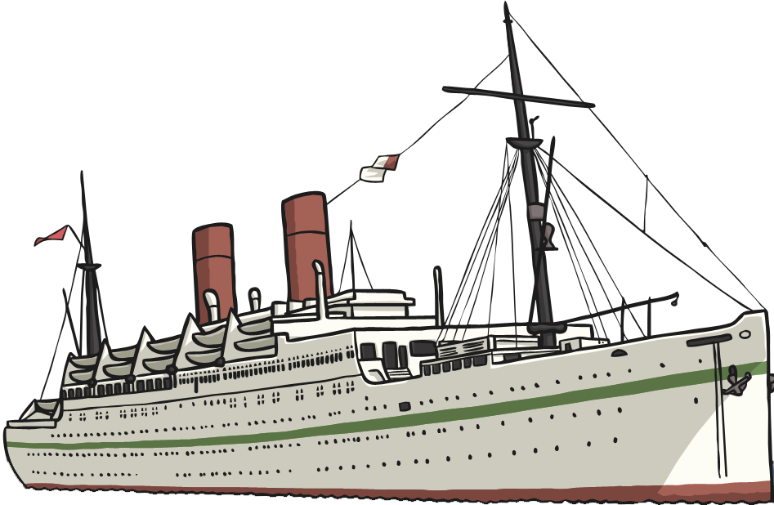
What Are Forces?
TP: What forces do you think might be represented by the arrows in this image?
gravity
In this example, the boat doesn’t sink because there is a buoyant force (upthrust) created by the volume of water. It is the balance of the gravity and the buoyancy that keeps the boat floating.
buoyancy

Slide 59
LO: To be able to identify the different forces acting on objects
Activity
Children to be given pictures with force arrows acting on different objects. To label which forces are acting on the objects.
1 Star – To have beginning letter of force.
TH, JLJ, LT, BB, RA, LT, JB, LL, RC, LN, GS (11)
2 Star – To have one force and to identify missing force.
EW, AB, HP, CW, SC, EMA, CM, AM, EB, KB, CH, AW, LS, LP, DRL, LW (16)
3 Star – To identify both forces acting on object.
NP, JM, LW, EB, DW (5)
EXT – Draw your own pictures of forces in action. Label them with force arrows and the forces that are acting on them.

Slide 60
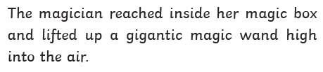

REFLECTION - LO: To be able to identify the different forces acting on objects
Story Time.
We are going to read a story. After each section, you are going to discuss what forces are in the story and tell me which ones are being used. For example, the first part of the story is…..
The forces in action are…..

Slide 61
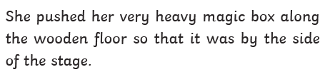
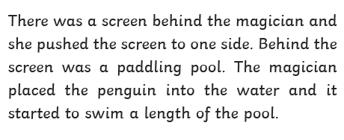
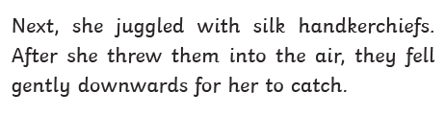
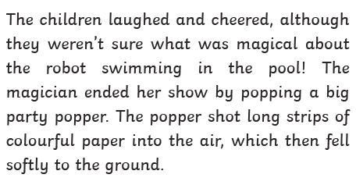

REFLECTION - LO: To be able to identify the different forces acting on objects

Slide 62
REFLECTION - LO: To be able to identify the different forces acting on objects
Mini Test

