Slide 1
Good Morning
Friday 29th January

Slide 2
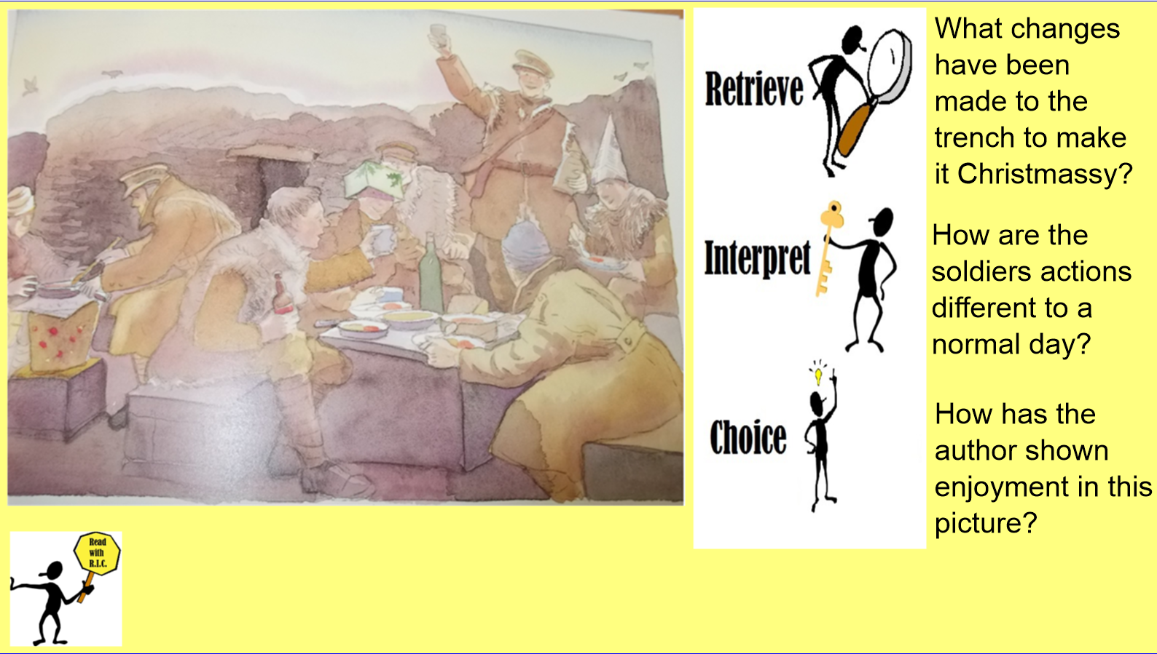
From the book War Game by Michael Foreman

Slide 3
Spelling Test

Slide 4
Spellings – Look/Cover/Spell/Check
Alicia, Elliot, Lente, Jack
Rest
column
concentration
conclusion
consequence
continuous
accompany
according
achieve
aggressive
amateur
accompany
according
achieve
aggressive
amateur
accident
accidentally
actual
actually
address

Slide 5
Maths – Year 4 Catch Up
Read through the slides and do the activities

Slide 6
RECALL
You will need your place value mats.
TP: What do we do with a number when we divide by 10?
TP: Does the digit change?
1 ÷ 10 =
2 ÷ 10 =
3 ÷ 10 =
4 ÷ 10 =
5 ÷ 10 =

Slide 7
LO: To be able to divide 2-digits by 10
Top Down | Self Assessment
Some of us will even: I can problem solve and reason about dividing 2-digit numbers by 10
Some of us will: I can say what 2-digit number has been divided by 10 when I am given the answer
Most of us will: I can divide a 2-digit number by 10 even when the equals sign is in a different place
All of us will: I can divide a 2-digit number by 10

Slide 8

LO: To be able to divide 2-digits by 10
TP: What is the value of the number on the place value grid?
TP: Divide that number by 10. What answer do you get?
TP: What do you notice about the digit in the answer?

Slide 9

LO: To be able to divide 2-digits by 10
TP: Solve:

Slide 10
LO: To be able to divide 2-digits by 10
TP: How would I solve:
3.2 = ? ÷ 10

Slide 11
LO: To be able to divide 2-digits by 10
Q: There are 2 boxes. Each box has 10 books in them.
Box A weighs 12kg.
Box B weighs 14kg.
TP: How heavy is a book in Box A?
TP: How heavy is a book in Box B?

Slide 12
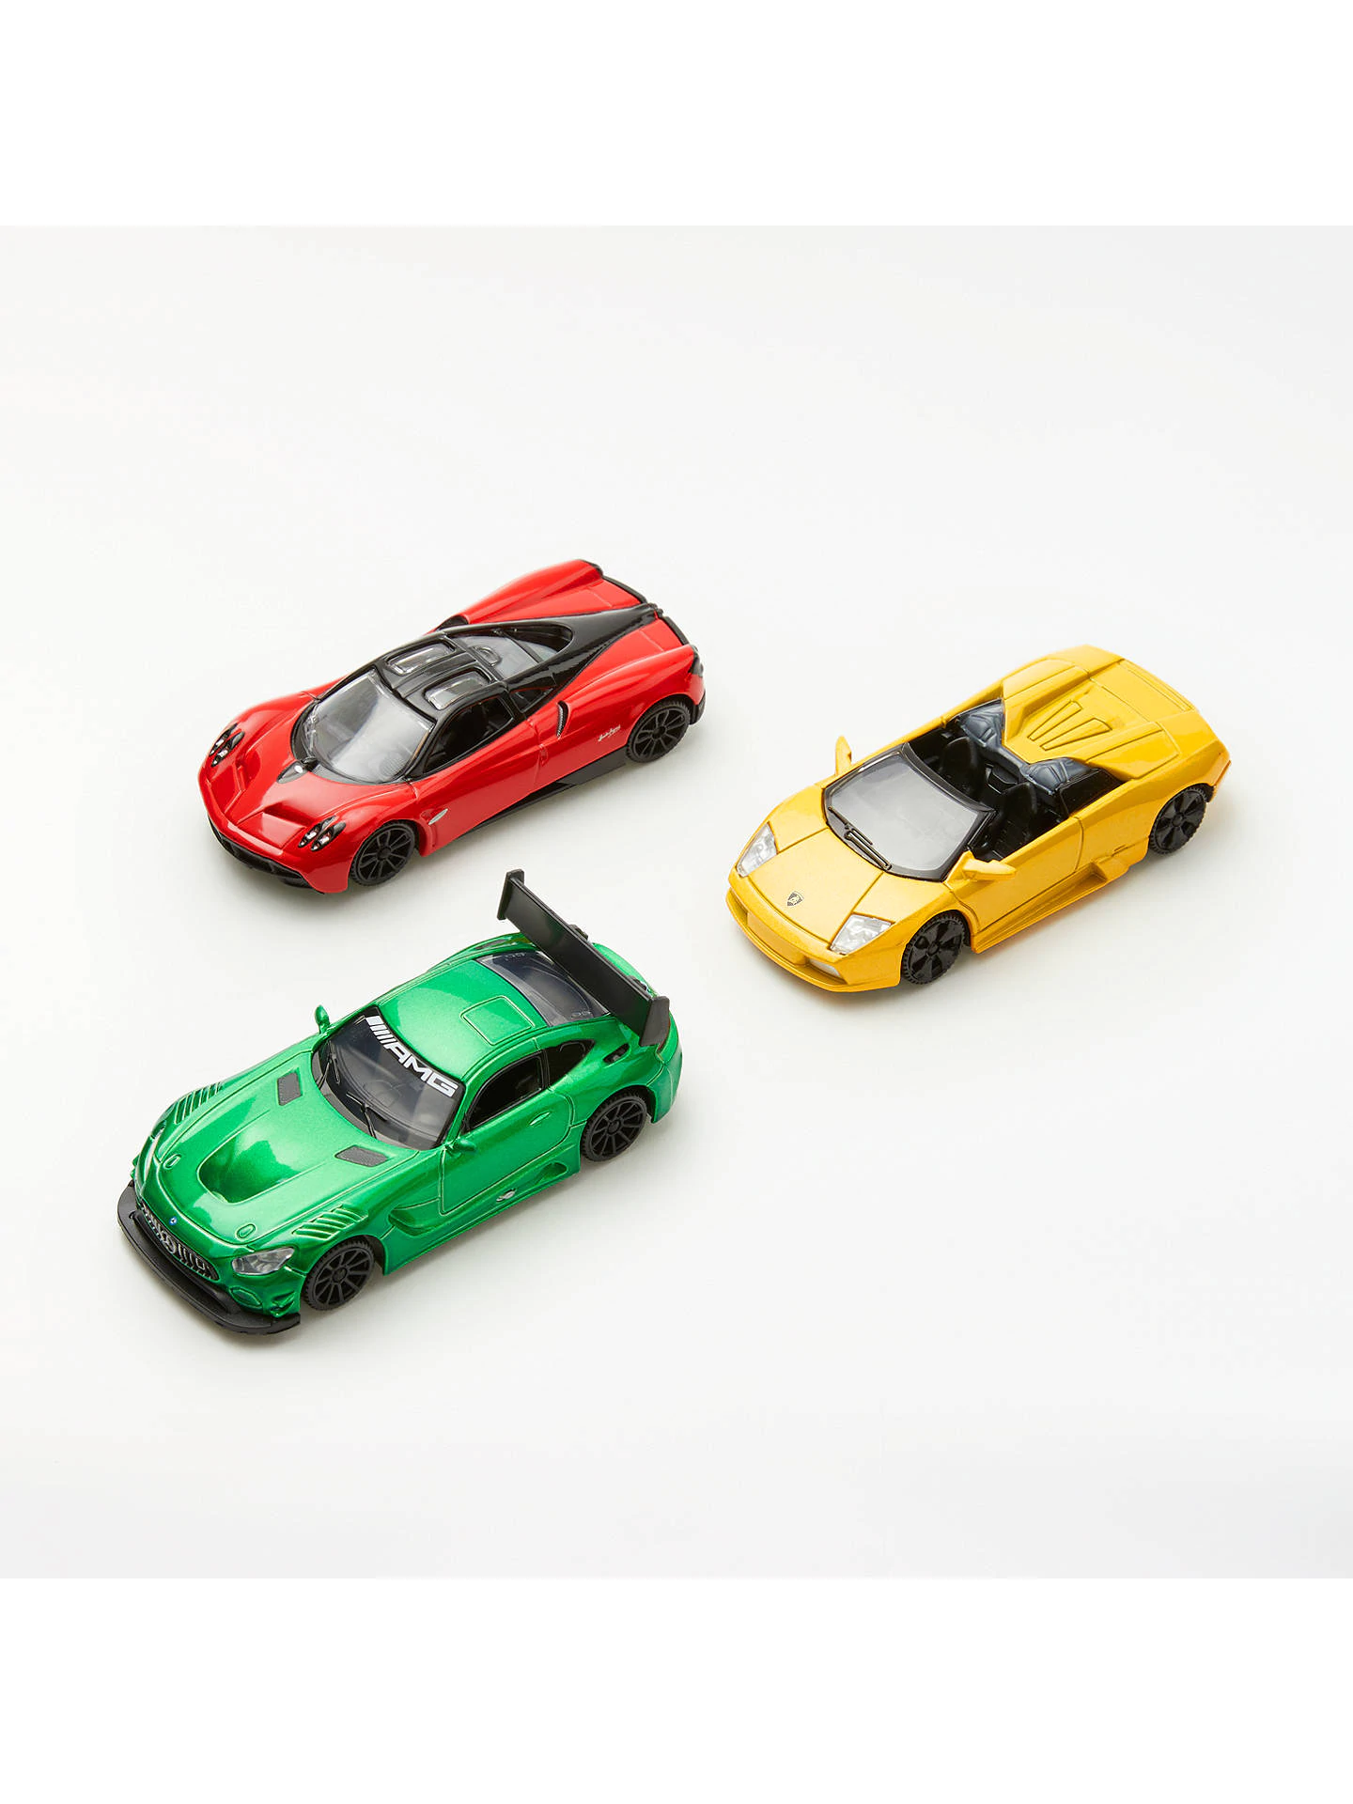
LO: To be able to divide 2-digits by 10
TP: A box of 10 identical toy cars has a mass of 23kg. What is the mass of each car?

Slide 13
LO: To be able to divide 2-digits by 10
Q: What are the largest and the smallest answers for Number B that can be made in the number sentence below? Use two of the digits to represent A and B.
Digits = 1 5 4
Number A ÷ 10 = Number B

Slide 14
LO: To be able to divide 2-digits by 10
Chilli 1 | Chilli 2 | Chilli 3
31 ÷ 10 = 32 ÷ 10 = 33 ÷ 10 = 34 ÷ 10 = 35 ÷ 10 = | ? = 41 ÷ 10 ? = 42 ÷ 10 ? = 43 ÷ 10 ? = 44 ÷ 10 ? = 45 ÷ 10 | ? ÷ 10 = 5.1 ? ÷ 10 = 5.2 ? ÷ 10 = 5.3 ? ÷ 10 = 5.4 ? ÷ 10 = 5.5
Extension – Describe what happens to each digit when you divide 47 by10

Slide 15
LO: To be able to divide 2-digits by 10
Chilli 1 | Chilli 2 | Chilli 3
31 ÷ 10 = 3.1 32 ÷ 10 = 3.2 33 ÷ 10 = 3.3 34 ÷ 10 = 3.4 35 ÷ 10 = 3.5 | 4.1 = 41 ÷ 10 4.2 = 42 ÷ 10 4.3 = 43 ÷ 10 4.4 = 44 ÷ 10 4.5 = 45 ÷ 10 | 51 ÷ 10 = 5.1 52 ÷ 10 = 5.2 53 ÷ 10 = 5.3 54 ÷ 10 = 5.4 55 ÷ 10 = 5.5
Extension – Describe what happens to each digit when you divide 47 by10 – Each digit moves one place to the right. The 4 moves from the tens to the ones column and the 7 moves from the ones column to the tenths column.

Slide 16
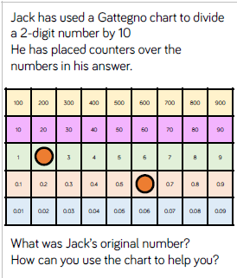
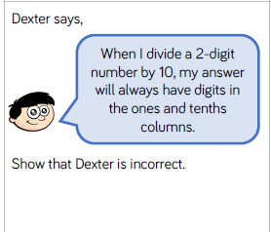
LO: To be able to divide 2-digits by 10
Q1
Are the following calculations true or false? Write true or false next to them.
43 ÷ 10 = 3.4
10 ÷ 43 = 4.3
43 ÷ 10 = 4.3
4.3 = 43 ÷ 10
Q2
Is the following statement always, sometimes or never true?
‘A 2-digit number divided by 10 will always have an answer with a digit in the tenths column.’

Slide 17
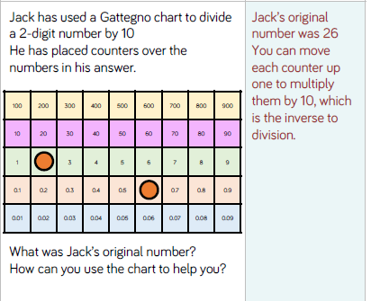
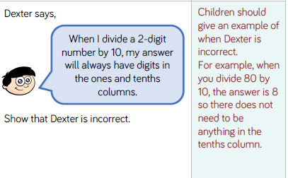
ANSWERS - LO: To be able to divide 2-digits by 10
Q1
Are the following calculations true or false? Write true or false next to them.
43 ÷ 10 = 3.4 False
10 ÷ 43 = 4.3 False
43 ÷ 10 = 4.3 True
4.3 = 43 ÷ 10 True
Q2
Is the following statement always, sometimes or never true?
‘A 2-digit number divided by 10 will always have an answer with a digit in the tenths column.’
It is sometimes true depending on the number you are dividing by 10. For example 32 ÷ 10 = 3.2 BUT 320 ÷ 10 = 32. You don’t have to put the 0 as a place holder in the tenth column because the number is greater than 1

Slide 18
LO: To be able to divide 2-digits by 10
Top Down | Self Assessment
Some of us will even: I can problem solve and reason about dividing 2-digit numbers by 10
Some of us will: I can say what 2-digit number has been divided by 10 when I am given the answer
Most of us will: I can divide a 2-digit number by 10 even when the equals sign is in a different place
All of us will: I can divide a 2-digit number by 10

Slide 19
Assembly and Break

Slide 20
English - Myth
Read through the slides and do the activities

Slide 21
LO: To be able to edit our work through making changes to vocabulary, grammar and punctuation to enhance effects and clarify meaning and proof-reading for spelling and punctuation errors
Top Down | Self Assessment
Some of us will even: I can use a dictionary to check my work for spelling errors and correct them
Some of us will: I edit my work as I write making improvements without input from a peer or teacher (Y5)
Most of us will: I can give and take advice from a friend to improve our work (Y3)
All of us will: I can give and take advice from the teacher to improve my work (Y3)

Slide 22
Check List
Used Inverted commas when a character is speaking.
Use the correct punctuation when a character is speaking.
Started a new line when a new character speaks.
Used expanded noun phrases using adjectives
Used expanded noun phrases using prepositional phrases
Used similes
Used metaphors
Used the 5 senses – see, hear, touch, smell, taste
Used fronted adverbials
Used a comma after a fronted adverbial.
Used the Power of 3
Used short sentences
Use first word, last word sentences
Used empty words
Used capital letters and full sentences to make a sentence
Used punctuation correctly
Used a rhetorical question

Slide 23
LO: To be able to edit our work through making changes to vocabulary, grammar and punctuation to enhance effects and clarify meaning and proof-reading for spelling and punctuation errors
ACTIVITY
Use your check list to:
Look at the advice given by the teacher to improve your work at do it.
Work with a partner. Listen to your partners advice on how to improve it and do it.
Look through your work on your own and improve it.
Look at the spelling of words, check they are right and if they are not, change the spelling.

Slide 24
LO: To be able to edit our work through making changes to vocabulary, grammar and punctuation to enhance effects and clarify meaning and proof-reading for spelling and punctuation errors
Top Down | Self Assessment
Some of us will even: I can use a dictionary to check my work for spelling errors and correct them
Some of us will: I edit my work as I write making improvements without input from a peer or teacher (Y5)
Most of us will: I can give and take advice from a friend to improve our work (Y3)
All of us will: I can give and take advice from the teacher to improve my work (Y3)

Slide 25
Reading Comprehension
LO: 2f: To be able to identify/explain how information content is related and contributes to meaning as a whole.
2h: To be able to make comparisons within the text.

Slide 26
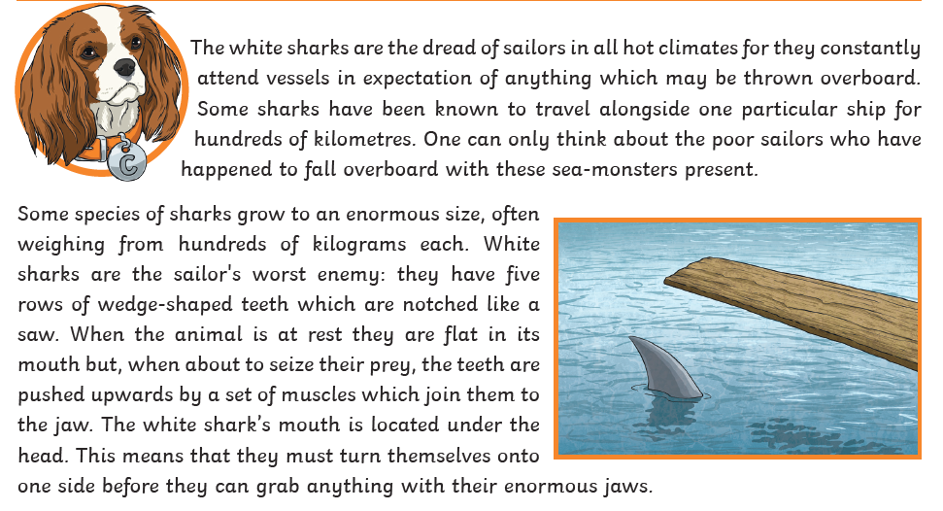
LO: 2f: To be able to identify/explain how information content is related and contributes to meaning as a whole.
2h: To be able to make comparisons within the text.

Slide 27
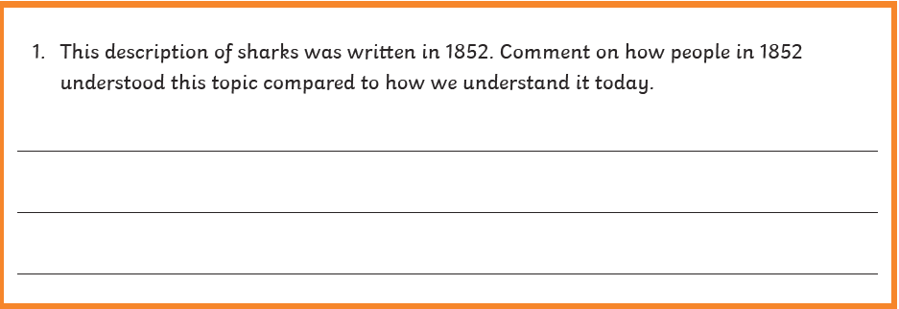
LO: 2f: To be able to identify/explain how information content is related and contributes to meaning as a whole.
2h: To be able to make comparisons within the text.
The main message question

Slide 28
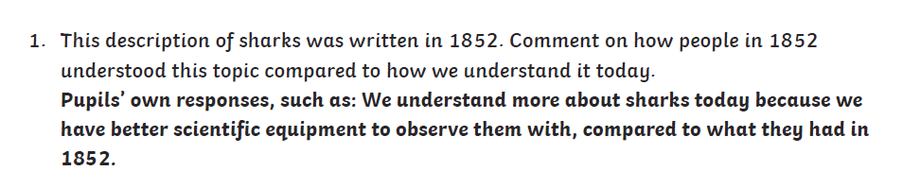
LO: 2f: To be able to identify/explain how information content is related and contributes to meaning as a whole.
2h: To be able to make comparisons within the text.

Slide 29
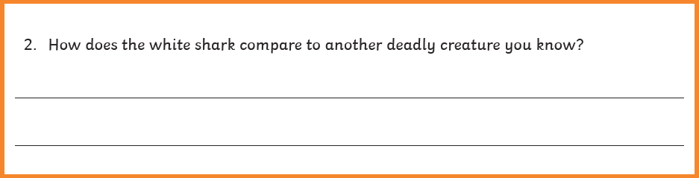
LO: 2f: To be able to identify/explain how information content is related and contributes to meaning as a whole.
2h: To be able to make comparisons within the text.

Slide 30
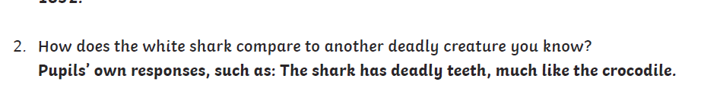
LO: 2f: To be able to identify/explain how information content is related and contributes to meaning as a whole.
2h: To be able to make comparisons within the text.

Slide 31
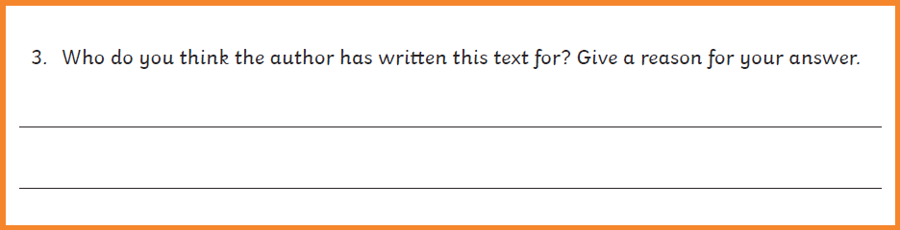
LO: 2f: To be able to identify/explain how information content is related and contributes to meaning as a whole.
2h: To be able to make comparisons within the text.

Slide 32
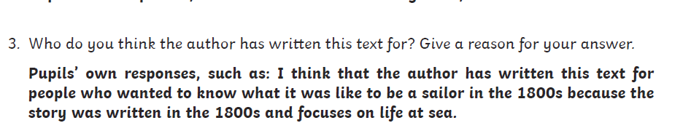
LO: 2f: To be able to identify/explain how information content is related and contributes to meaning as a whole.
2h: To be able to make comparisons within the text.

Slide 33
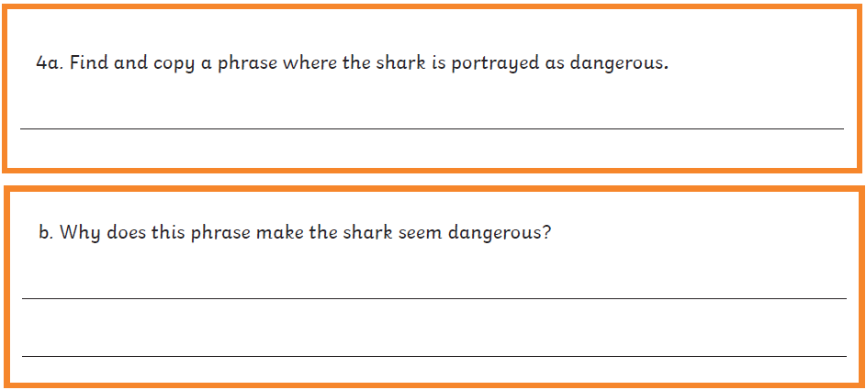
LO: 2f: To be able to identify/explain how information content is related and contributes to meaning as a whole.
2h: To be able to make comparisons within the text.

Slide 34
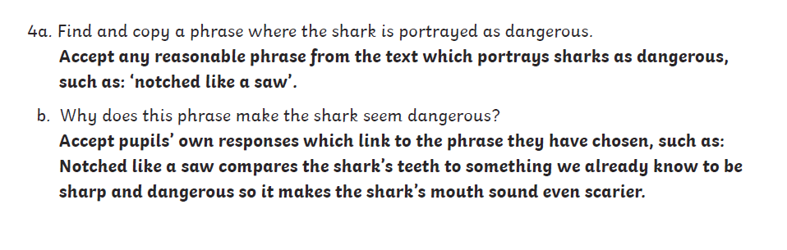
LO: 2f: To be able to identify/explain how information content is related and contributes to meaning as a whole.
2h: To be able to make comparisons within the text.

Slide 35

defiantly

Slide 36
defiantly
What could it mean?
“You can’t tell me what to do,” said Elliot defiantly.

Slide 37
defiantly
SAY IT AND FEEL THE SYLLABLES
SAY IT TO THE BIN
SAY IT TO SOMEONE ON ANOTHER TABLE
WHISPER IT TO THE FLOOR
SAY IT TO YOUR BOOK
REPEAT IT AFTER ME
SAY IT TO THE WINDOW
WHISPER IT TO A WALL

Slide 38
defiantly
Adv. in a way that proudly refuses to obey authority or shows you are not willing to accept criticism or disapproval

Slide 39
ambled
A group of prisoners stood on the roof, defiantly waving banners.
They defiantly refused to identify themselves in court.
He defiantly denies having done anything wrong.
She defiantly declared her innocence and claimed that prosecutors are trying to destroy her.

Slide 40
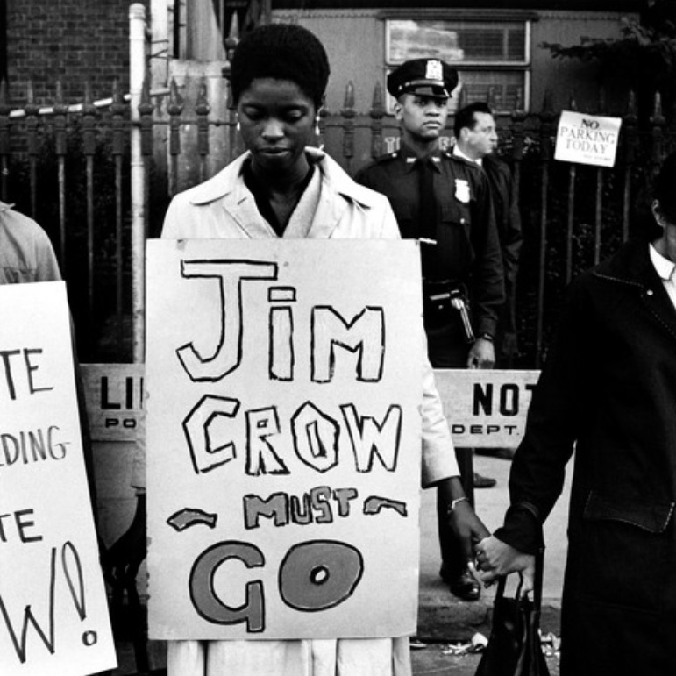
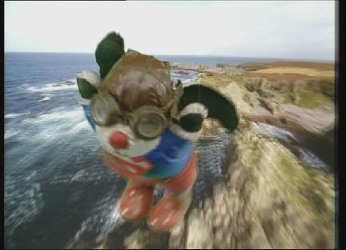
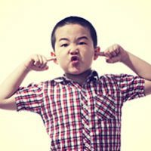
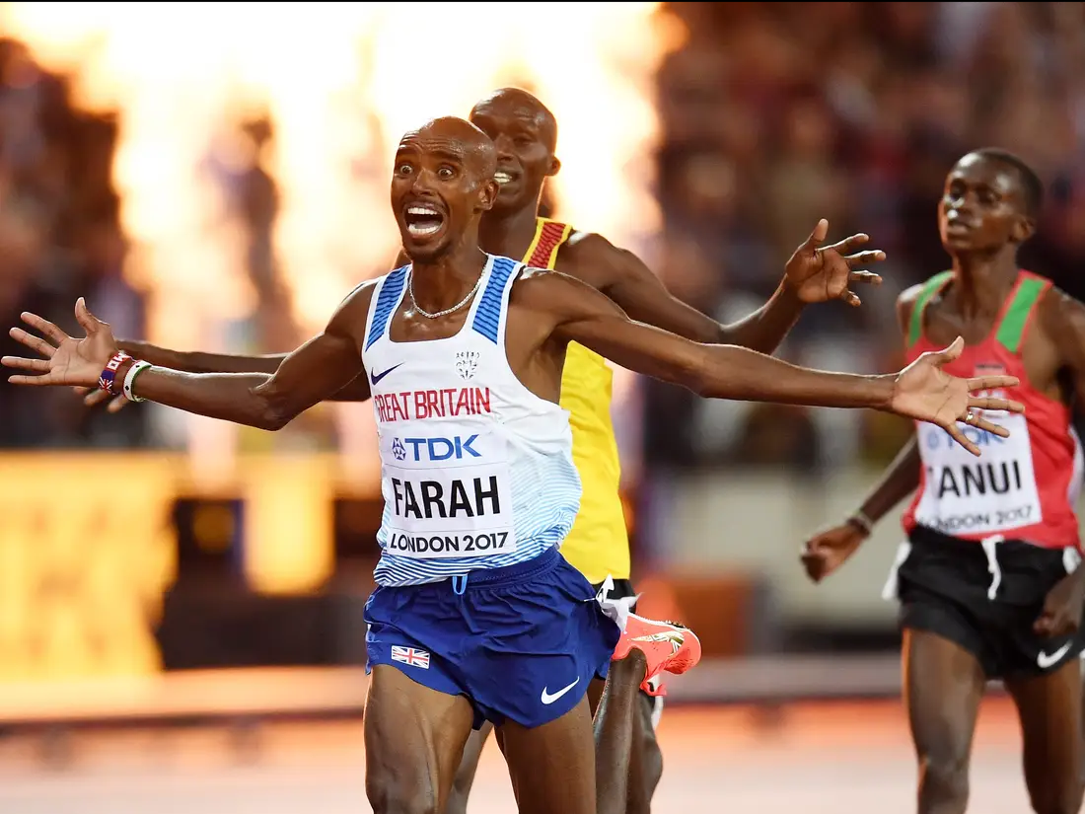


defiantly
Write/Say defiantly if you see someone acting refusing to obey authority or criticism.

Slide 41
defiantly
In your books, write the word, the definition and use it in a sentence/draw a picture.

Slide 42
defiantly
Adv. in a way that proudly refuses to obey authority or shows you are not willing to accept criticism or disapproval

Slide 43
Lunch

Slide 44
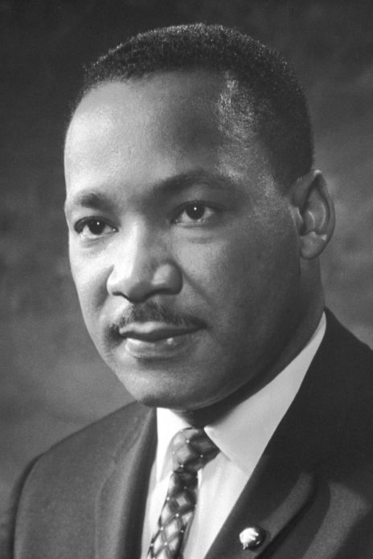
Martin Luther King
Week 3 & 4

Slide 45
What can we learn from the great leaders and inspiring examples in today’s world?
Can you answer these?
Born
Died (how)
Beliefs including religion
Why is he famous?
Things that he did/Middle Life
Famous quote/speech
Early Life and Family
Key Questions:
What made this person into a leader?
How did their religion inspire them?
What holy texts explain their lives?
Is this person inspiring just in their religion or to any human?

Slide 46
What can we learn from the great leaders and inspiring examples in today’s world?
Task 1
You are a media reporter whose main job is to tell the world about key people in the world. Your Editor (boss) has told you that you will be interviewing Martin Luther King. The interview:
Purpose – To find out about Martin Luther King’s life, beliefs and actions
Audience – People who want to know about Martin Luther King’s life, beliefs and actions.
TP: What questions would you ask him that would meet the requirements of your purpose and audience?

Slide 47
What can we learn from the great leaders and inspiring examples in today’s world?
Task 2
Pretend you are Martin Luther King. From you research on him, what would his answers be?

Slide 48
What can we learn from the great leaders and inspiring examples in today’s world?
Task 3
Write up the interview

Slide 49
REFLECTION - What can we learn from the great leaders and inspiring examples in today’s world?
TP: What did Martin Luther King do that inspired people?
TP: What can we learn about Martin Luther King?

Slide 50
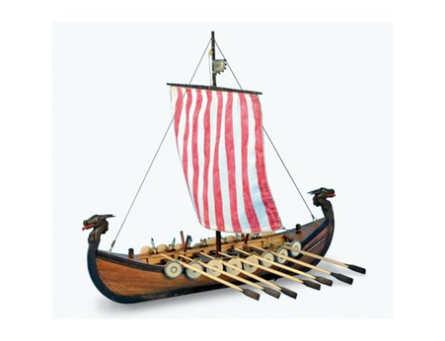
Final Lesson
LO: To be able to evaluate their ideas and products against their own design criteria and consider the views of others to improve their work

Slide 51
LO: To be able to evaluate their ideas and products against their own design criteria and consider the views of others to improve their work
What are the strengths of your boats?/What went well?
If you made a boat again in the future, what improvements would you make?
Did you meet the design brief?
Did you change anything from your original plan?
Are you pleased with your final product?
Name of ship

