Slide 1
Good Morning
Thursday 28th January

Slide 2
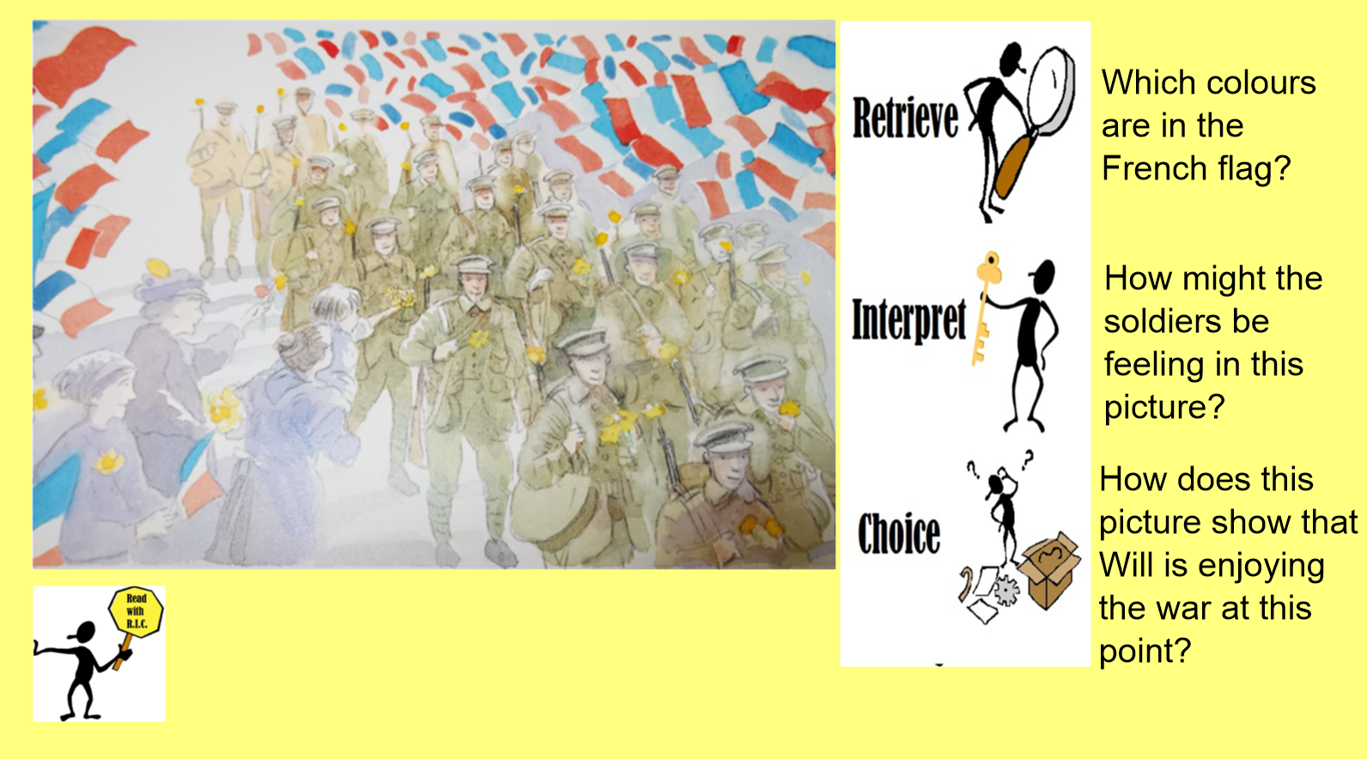
From the book War Game by Michael Foreman

Slide 3
Spellings – Look/Cover/Spell/Check
Alicia, Elliot, Lente, Jack
Rest
column
concentration
conclusion
consequence
continuous
accompany
according
achieve
aggressive
amateur
accompany
according
achieve
aggressive
amateur
accident
accidentally
actual
actually
address

Slide 4
Maths
Read through the slides and do the activities

Slide 5
RECALL
TP: How would I write this calculation as column multiplication?
233 x 3 =
TP: How would I solve it?
TP: How would I solve 234 x 3 =
TP: How would I solve 244 x 3 =

Slide 6
To be able to multiply 4-digits by 1-digit
Top Down | Self Assessment
Some of us will even: I can solve problem solving and reasoning questions involving multiplying 4-digit numbers by a 1-digit number
Some of us will: I can multiply a 4-digit number by a 1-digit number with more than one exchange
Most of us will: I can multiply a 4-digit number by a 1-digit number with one exchange
All of us will: I can multiply a 4-digit number by a 1-digit number with no exchanges

Slide 7
To be able to multiply 4-digits by 1-digit
TP: Solve as column multiplication:
1231 x 3 =
TP: Why is it important that we set the calculation out in columns?
TP: Using the place value grid, the 1000 counters, 100 counters, 10 counters and ones counters, what would our answer look like?

Slide 8

Multiply 4 Digits by 1 Digit
Diving
Thousands | Hundreds | Tens | Ones
Write the multiplication calculation which is represented by the place value counters.
 | 1 | 2 | 3 | 1
× |  |  |  | 3
 | 3 | 6 | 9 | 3

Slide 9
To be able to multiply 4-digits by 1-digit
TP: Solve column multiplication:
2324 x 3 =
2342 x 3 =
2422 x 3 =
2444 x 3 =

Slide 10
To be able to multiply 4-digits by 1-digit
Q: Ikjot earns £1325 per week. How much will she earn in 4 weeks?
TP: What calculation will you have to do? Solve it.

Slide 11
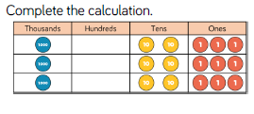
To be able to multiply 4-digits by 1-digit
TP: Alfie did a column multiplication calculation and he got this answer. What could the question have been?
TP: What must have gone in the hundreds column?

Slide 12
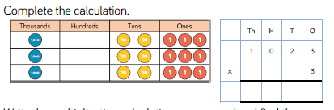
To be able to multiply 4-digits by 1-digit
ANSWER

Slide 13
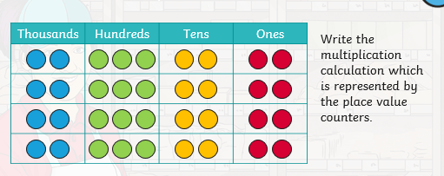
To be able to multiply 4-digits by 1-digit
TP: Look at this answer to a multiplication calculation. What do you notice about the hundreds column?
TP: What numbers (factors) have an answer of 1200 or 12?
TP: When we multiply the hundred column therefore, what must be exchanged?
TP: What is the actual answer we will get when we use column multiplication?

Slide 14
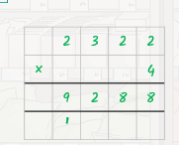
To be able to multiply 4-digits by 1-digit
ANSWER

Slide 15
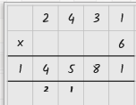
To be able to multiply 4-digits by 1-digit
Ellie has done this calculation. She has had this calculation marked as incorrect. Can you help her? What mistake has she made?
TP: How would you go about solving this problem. Solve it?

Slide 16
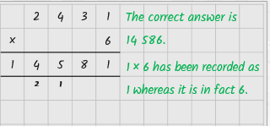
To be able to multiply 4-digits by 1-digit
ANSWER

Slide 17
To be able to multiply 4-digits by 1-digit
TP: Can you identify the missing digits in this calculation?
3 __ 1 4
x 3
_ 6 _ 2

Slide 18
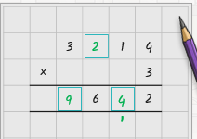
To be able to multiply 4-digits by 1-digit
ANSWER

Slide 19
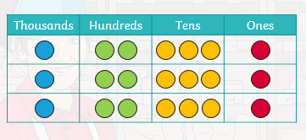
To be able to multiply 4-digits by 1-digit
Chilli 1 | Chilli 2 | Chilli 3
3222 x 3 = 3223 x 3 = 3233 x 3 = 3333 x 3 = | 2223 x 4 = 2232 x 4 = 2322 x 4 = 3222 x 4 = | 2424 x 3 = 2234 x 3 = 2334 x 3 = 3334 x 3 =
EXT: Write the multiplication calculation which is represented by the place value counters.

Slide 20
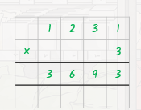
To be able to multiply 4-digits by 1-digit
Chilli 1 | Chilli 2 | Chilli 3
3222 x 3 = 9666 3223 x 3 = 9669 3233 x 3 = 9699 3333 x 3 = 9999 | 2223 x 4 = 8892 2232 x 4 = 8928 2322 x 4 = 9288 3222 x 4 = 12888 | 2424 x 3 = 7272 2234 x 3 = 6702 2334 x 3 = 7002 3334 x 3 = 10002
EXT: Write the multiplication calculation which is represented by the place value counters.

Slide 21
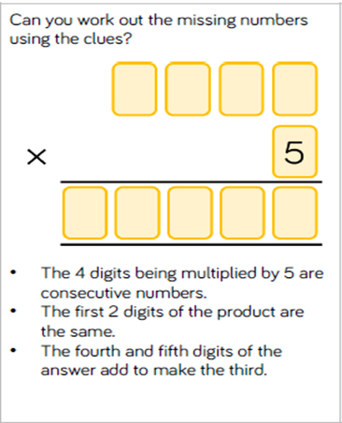
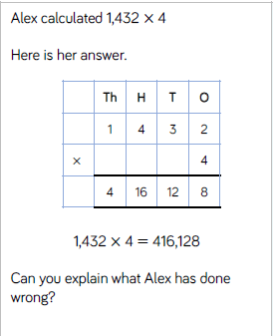
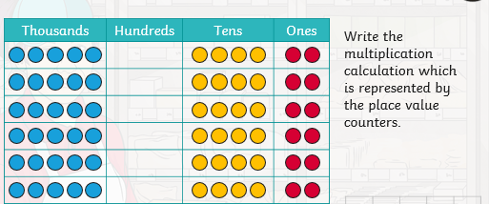
To be able to multiply 4-digits by 1-digit
Q2
Can you find the missing digits in this calculation?
__ __ 2 4
X 5
2 5 1 __ 0

Slide 22
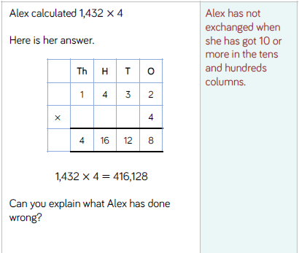
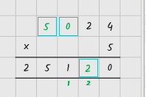
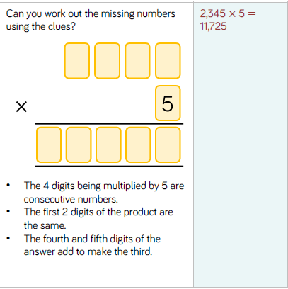
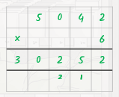
To be able to multiply 4-digits by 1-digit

Slide 23
To be able to multiply 4-digits by 1-digit
Top Down | Self Assessment
Some of us will even: I can solve problem solving and reasoning questions involving multiplying 4-digit numbers by a 1-digit number
Some of us will: I can multiply a 4-digit number by a 1-digit number with more than one exchange
Most of us will: I can multiply a 4-digit number by a 1-digit number with one exchange
All of us will: I can multiply a 4-digit number by a 1-digit number with no exchanges

Slide 24
Break

Slide 25
English - Myths
Read through the slides and do the activities

Slide 26
Introduction
Myths are part of the oral tradition of story-telling. They were told long ago and written down later. They are based in religions of ancient times. They can tell of gods and goddesses often explain how or why things are as they are e.g. creation, weather.
Features:
Basic story structure – Introduction, build-up, problem, action, conclusion
Gods and goddesses
Kings and queens
Heroes and villains
Witches and wizards
Fairies and ‘little people’
Monster, ogres and giants
Talking Animals

Slide 27
Introduction
We are looking at an Ancient Greek myth called Theseus and the Minotaur. Let us re-read it to remind ourselves of the story.
For the next 5 lessons, you are going to rewrite the myth of Theseus and the Minotaur using all the grammatical features we have been rehearsing and inverted commas.
Today, we are going to concentrate on the action and ending.

Slide 28
LO: To be able to rewrite a myth that describes settings, characters and atmosphere and integrates dialogue to convey character and advance the action
Top Down | Self Assessment
Some of us will even: I am able to sustain a dialogue between two or more characters without losing the flow of the story (Y6)
Some of us will: I can create and maintain an appropriate atmosphere throughout the whole piece (Y6)
Most of us will: I make links in fiction between the opening and ending of a story (Y5)
All of us will: I make sure my writing does not jump from one idea to another and I try to build on ideas through the piece of work, making connections between paragraphs (Y4)

Slide 29
LO: To be able to rewrite a myth that describes settings, characters and atmosphere and integrates dialogue to convey character and advance the action
Paragraphs
A paragraph is a group of sentences about the same thing/subject.
Fiction – You change a paragraph when the time, place, action or place changes
Look at our plan of the story from Theseus and the Minotaur. How many paragraphs could our action and ending have?

Slide 30
LO: To be able to rewrite a myth that describes settings, characters and atmosphere and integrates dialogue to convey character and advance the action
The Minotaur charged at Theseus but he raised the sword that Princess Ariadne had given him and killed the horrible monster. Prince Theseus began to make his way back to the gate, following the string he had unravelled along his way.
How can I improve this action?

Slide 31
LO: To be able to rewrite a myth that describes settings, characters and atmosphere and integrates dialogue to convey character and advance the action
Princess Ariadne was waiting for Theseus at the gate. Theseus and Ariadne gathered the children and ran to their ship and sailed away quietly without anyone noticing. On the way back, they stopped off at a small island called Naxos for supplies.
However, Princess Ariadne insisted on coming ashore to rest. There was nothing to do on the island and she soon fell asleep. Theseus gathered all the children and quietly sailed away from the island towards Athens, leaving Princess Ariadne asleep on Naxos. After all, he did keep his word.
Theseus’ ship arrived safely back at Athens although he had forgotten the promise he had made to his father to change the ship’s sails to white, making King Aegeus believe that his son had been defeated by the Minotaur.
How does the ending relate to the beginning?

Slide 32
LO: To be able to rewrite a myth that describes settings, characters and atmosphere and integrates dialogue to convey character and advance the action
ACTIVITY
Children to use their plans to write their action and ending to the story.

Slide 33
LO: To be able to rewrite a myth that describes settings, characters and atmosphere and integrates dialogue to convey character and advance the action
Top Down | Self Assessment
Some of us will even: I am able to sustain a dialogue between two or more characters without losing the flow of the story (Y6)
Some of us will: I can create and maintain an appropriate atmosphere throughout the whole piece (Y6)
Most of us will: I make links in fiction between the opening and ending of a story (Y5)
All of us will: I make sure my writing does not jump from one idea to another and I try to build on ideas through the piece of work, making connections between paragraphs (Y4)

Slide 34
Reading Comprehension
Read through the slides and do the activities

Slide 36

What Does Cassie the Commentator Do?
Cassie the Commentator helps with content domains 2f and 2h:
2f: Identify/explain how information/narrative content is related and contributes to meaning as a whole.
2h: Make comparisons within the text.
This means that she is there to help you to do two things:
Explain how certain parts of a text build or change
an overall message or meaning.
Say how characters or events within the story are similar to or different from each other or how a single character changes over the course of a story.

Slide 37
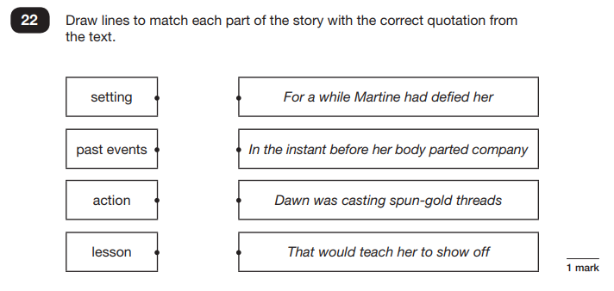
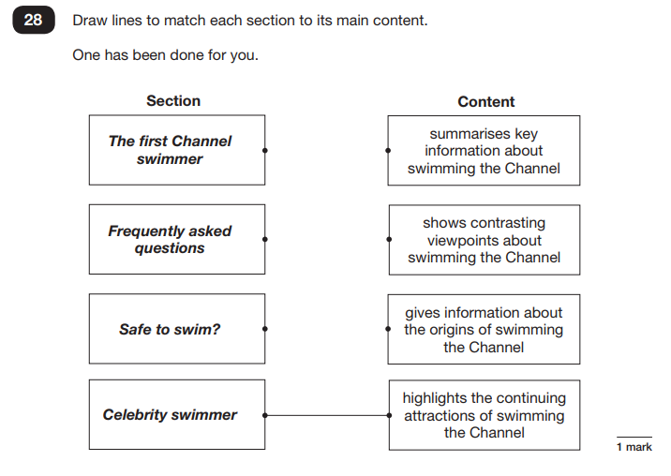
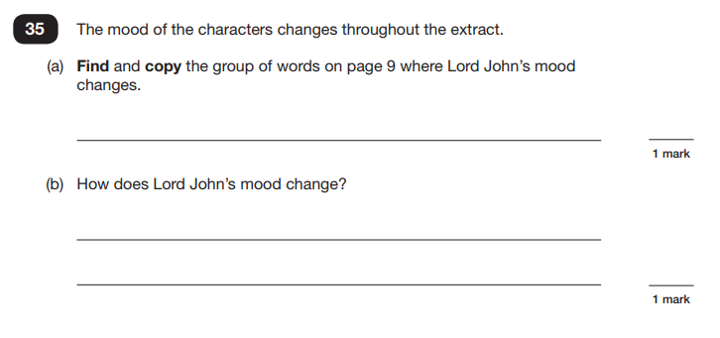
When Have We Seen
Cassie the Commentator?
Here are example questions that Cassie the Commentator can help you with. Here are those examples:

Slide 38
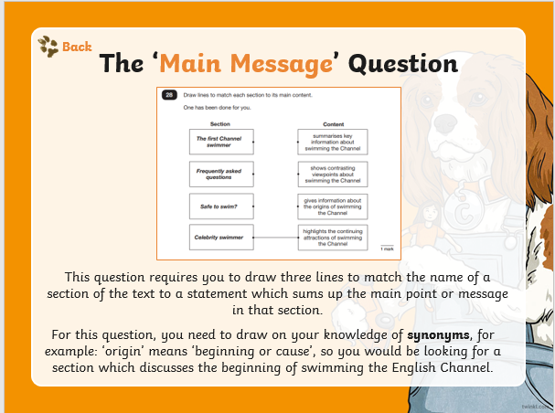
2f: Identify/explain how information/narrative content is related and contributes to meaning as a whole.
2h: Make comparisons within the text.

Slide 39
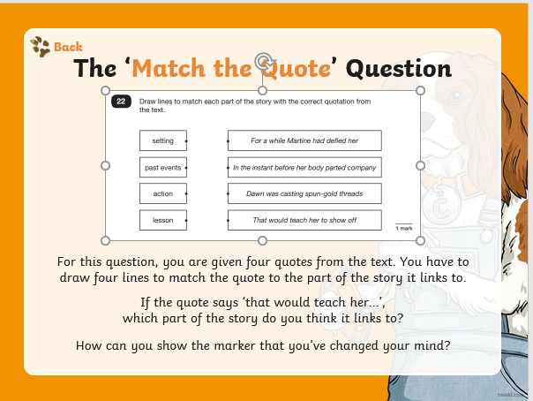
2f: Identify/explain how information/narrative content is related and contributes to meaning as a whole.
2h: Make comparisons within the text.

Slide 40
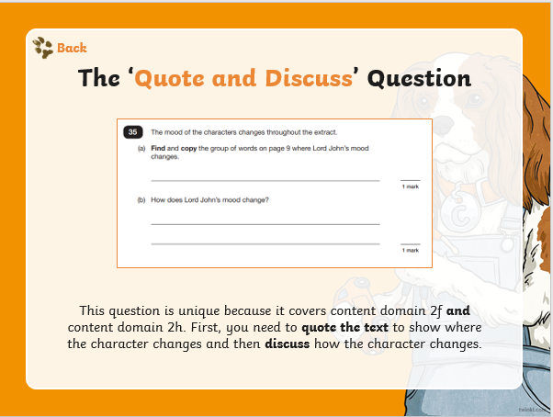
2f: Identify/explain how information/narrative content is related and contributes to meaning as a whole.
2h: Make comparisons within the text.

Slide 41
What Might Cassie the Commentator Ask?
Cassie the Commentator might ask questions like these:
Compare one character to another. How are they different or similar?
How are the settings within the story similar or different?
Who has the author written this text for? Why?
How has this character changed during the text?
Compare how the characters react to this situation.
Who deals with it best?
What is the most thought-provoking moment of the story?

Slide 42

Let’s Explore Cassie the Commentator Questions Together
.

Slide 43
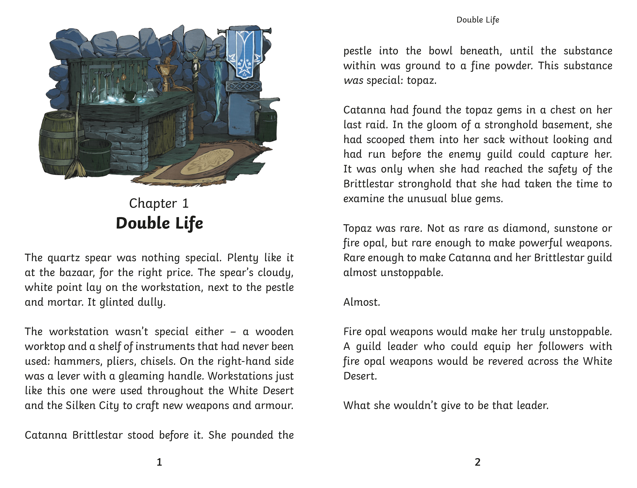

Back

Slide 44
2f: Identify/explain how information/narrative content is related and contributes to meaning as a whole.
2h: Make comparisons within the text.
Read the extract from Raider’s Peril and answer the questions as a class.
Look at the front cover of this book. What sort of content do you expect to find inside?
Who do you think the author has written this text for?
How does the character of Catanna remind you of another character or person you know?
Draw lines to match each part of the story with the correct quotation from the text.
props |  | She pounded the pestle into the bowl beneath…
past events |  | She has scooped them into her sack…
action |  | What she wouldn’t give to be that leader.
intention |  | The workstation wasn’t special either…

Slide 45

flawless

Slide 46
flawless
What could it mean?
In the distance one way, Elliot could make out a flawless glass pyramid that sparkled.

Slide 47
flawless
SAY IT AND FEEL THE SYLLABLES
SAY IT TO THE BIN
SAY IT TO SOMEONE ON ANOTHER TABLE
WHISPER IT TO THE FLOOR
SAY IT TO YOUR BOOK
REPEAT IT AFTER ME
SAY IT TO THE WINDOW
WHISPER IT TO A WALL

Slide 48
flawless
Adj. perfect or without mistakes

Slide 49
flawless
The woman had a flawless complexion.
Torvill and Dean gave a flawless performance when skating to. the Bolero.
Miss Davison always executes flawless lessons.
The diamonds were perfect. They were flawless and would fetch millions of pounds.

Slide 50

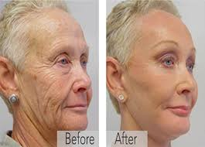
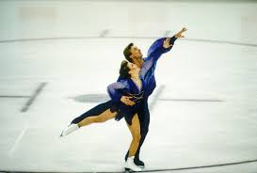
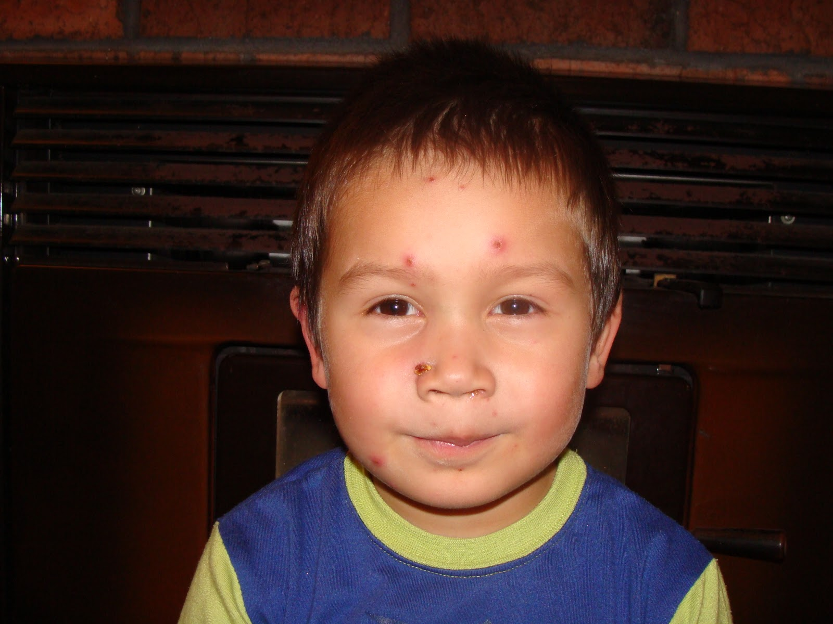
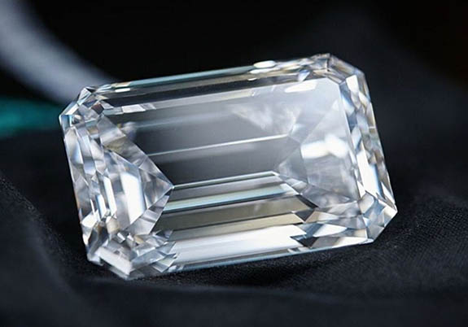
flawless
Say/Write flawless if you see someone or something that is perfect and without mistakes.

Slide 51
flawless
In your books, write the word, the definition and write a statement, command, question and exclamation using the word flawless

Slide 52
flawless
Adj. perfect or without mistakes
Write a statement, command, question and exclamation using the word flawless

Slide 53
Lunch

Slide 54
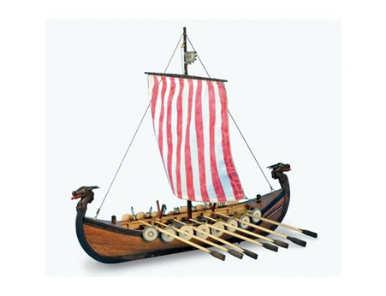
Lesson 9
LO: To make a Viking Longboat using design brief

Slide 55
LO: To make a Viking Longboat using design brief
Make your Viking Longboat
Did you have to amend your plans?

