Slide 1
Good Morning
Wednesday 27th January

Slide 2

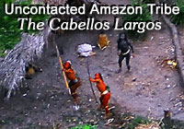


Who are these people?
What are they doing?
How are they feeling?
How do you know?
How can we tell that they are an isolated tribe?
Choose interesting words to describe this scene.

Slide 3
Spellings – Look/Cover/Spell/Check
Alicia, Elliot, Lente, Jack
Rest
column
concentration
conclusion
consequence
continuous
accompany
according
achieve
aggressive
amateur
accompany
according
achieve
aggressive
amateur
accident
accidentally
actual
actually
address

Slide 4
Maths
Read the slides and do the activities

Slide 5
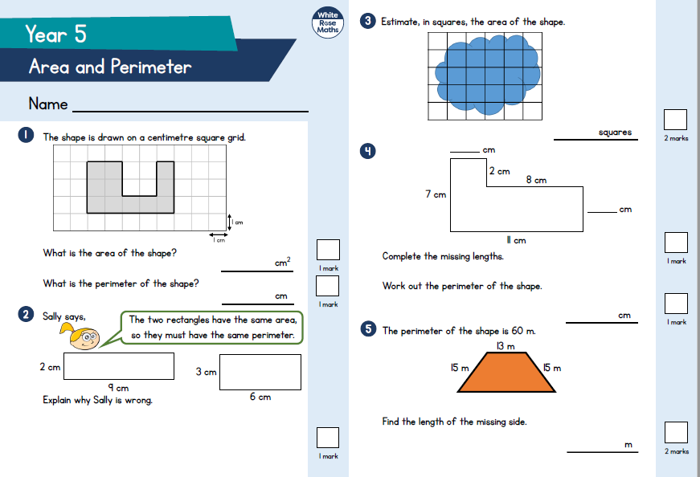
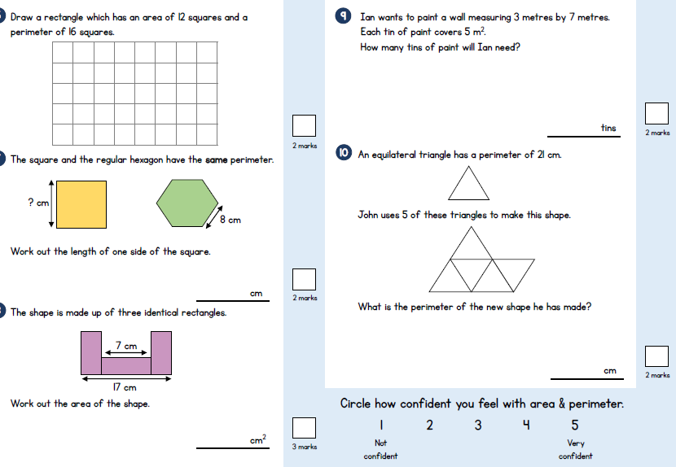
Area and Perimeter Assessment

Slide 6
Break

Slide 7
English - Myths
Read through the slides and do the activities

Slide 8
Introduction
Myths are part of the oral tradition of story-telling. They were told long ago and written down later. They are based in religions of ancient times. They can tell of gods and goddesses often explain how or why things are as they are e.g. creation, weather.
Features:
Basic story structure – Introduction, build-up, problem, action, conclusion
Gods and goddesses
Kings and queens
Heroes and villains
Witches and wizards
Fairies and ‘little people’
Monster, ogres and giants
Talking Animals

Slide 9
Introduction
We are looking at an Ancient Greek myth called Theseus and the Minotaur. Let us re-read it to remind ourselves of the story.
For the next 5 lessons, you are going to rewrite the myth of Theseus and the Minotaur using all the grammatical features we have been rehearsing and inverted commas.
Today, we are going to concentrate on the dilemma.

Slide 10
LO: To be able to rewrite a myth that describes settings, characters and atmosphere and integrates dialogue to convey character and advance the action
Top Down | Self Assessment
Some of us will even: I am able to sustain a dialogue between two or more characters without losing the flow of the story (Y6)
Some of us will: I can create and maintain an appropriate atmosphere throughout the whole piece (Y6)
Most of us will: I make links in fiction between the opening and ending of a story (Y5)
All of us will: I make sure my writing does not jump from one idea to another and I try to build on ideas through the piece of work, making connections between paragraphs (Y4)

Slide 11
LO: To be able to rewrite a myth that describes settings, characters and atmosphere and integrates dialogue to convey character and advance the action
Paragraphs
A paragraph is a group of sentences about the same thing/subject.
Fiction – You change a paragraph when the time, place, action or place changes
Look at our plan of the story from Theseus and the Minotaur. How many paragraphs could our dilemma have?

Slide 12
LO: To be able to rewrite a myth that describes settings, characters and atmosphere and integrates dialogue to convey character and advance the action
With that, Theseus entered the labyrinth and the door slammed shut behind him. Following Daedalus’ instructions, Theseus tied one end of the string to the door and set off to search the many passages of the labyrinth with it trailing behind him.
To build atmosphere, suspense and tension, how can I create another paragraph that describes how Theseus moves around the labyrinth?

Slide 13
LO: To be able to rewrite a myth that describes settings, characters and atmosphere and integrates dialogue to convey character and advance the action
With fear and dread, Theseus crept cautiously down the dark, damp tunnel, shuffling cautiously and stopping at times to listen all the time remembering to unwind his string as he crept down the tunnel as dark as a cloudless night. His hands were his eyes, nervously seeking the way by tracing the slime covered granite walls. Though he strained to hear and see, there was nothing…..nothing but the sounds of his own strained breathing and the soft pad of his sandals.
Suddenly, an evil odour invaded his nostrils, like the rotting filth of a thousand corpses. Corpses left from the Minotaur’s last seven Athenian boys and seven Athenian girl victims. He stopped, heart pounding. Was something there in the dreaded darkness?
Silence, heavy and still, surrounded him. Reassured, he began to step forward……Out of the black depths came a sudden blood-curdling shriek as the great beast leapt towards him. There, he finally saw it…..

Slide 14
LO: To be able to rewrite a myth that describes settings, characters and atmosphere and integrates dialogue to convey character and advance the action
ACTIVITY
Children to use their plan to write the dilemma section of the story using all the grammatical and sentence devices used during the previous lessons to create suspense, tension and atmosphere.

Slide 15
LO: To be able to rewrite a myth that describes settings, characters and atmosphere and integrates dialogue to convey character and advance the action
Top Down | Self Assessment
Some of us will even: I am able to sustain a dialogue between two or more characters without losing the flow of the story (Y6)
Some of us will: I can create and maintain an appropriate atmosphere throughout the whole piece (Y6)
Most of us will: I make links in fiction between the opening and ending of a story (Y5)
All of us will: I make sure my writing does not jump from one idea to another and I try to build on ideas through the piece of work, making connections between paragraphs (Y4)

Slide 16
Reading Comprehension
Non-Fiction – Cold Review

Slide 17
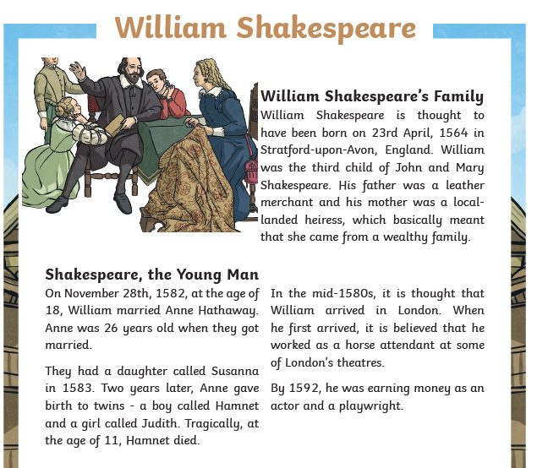
LO: To answer questions about a non-fiction text - Cold

Slide 18
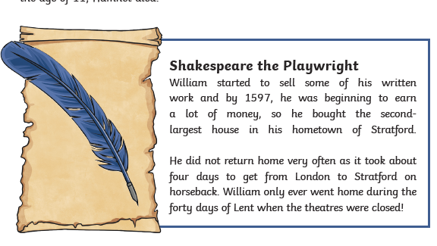
LO: To answer questions about a non-fiction text - Cold

Slide 19
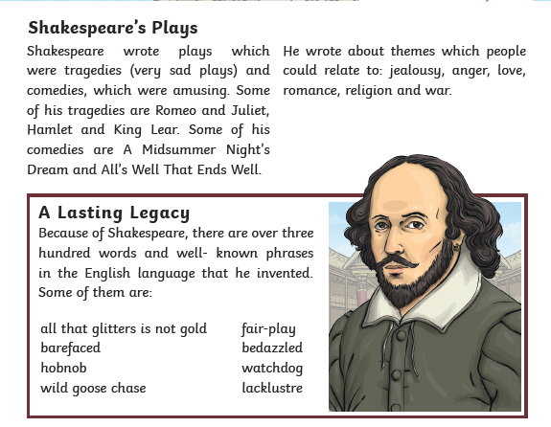
LO: To answer questions about a non-fiction text - Cold

Slide 20
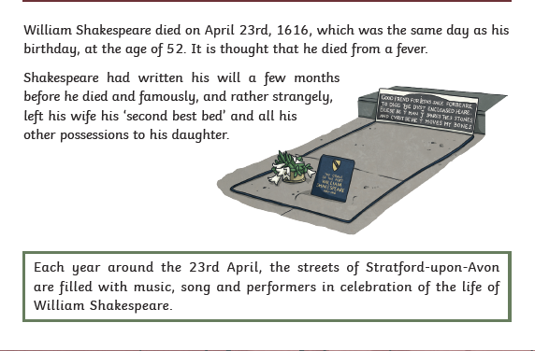
LO: To answer questions about a non-fiction text - Cold

Slide 21
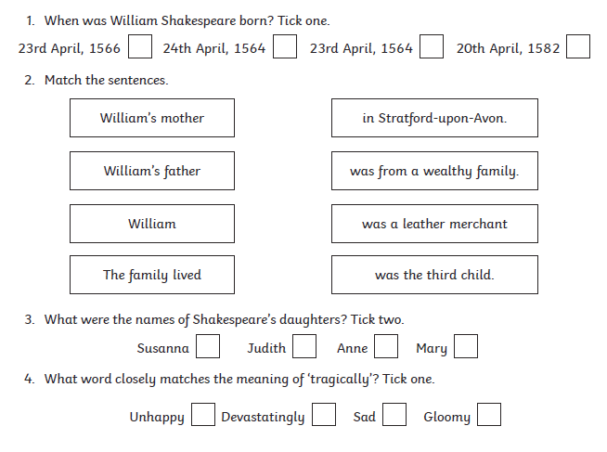

LO: To answer questions about a non-fiction text - Cold

Slide 22
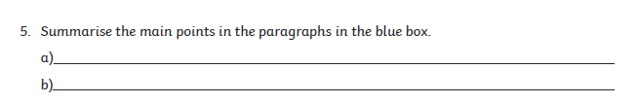

LO: To answer questions about a non-fiction text - Cold

Slide 23
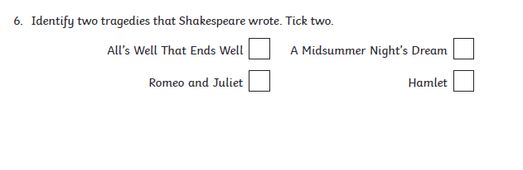

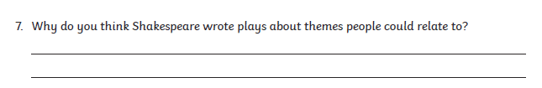
LO: To answer questions about a non-fiction text - Cold

Slide 24
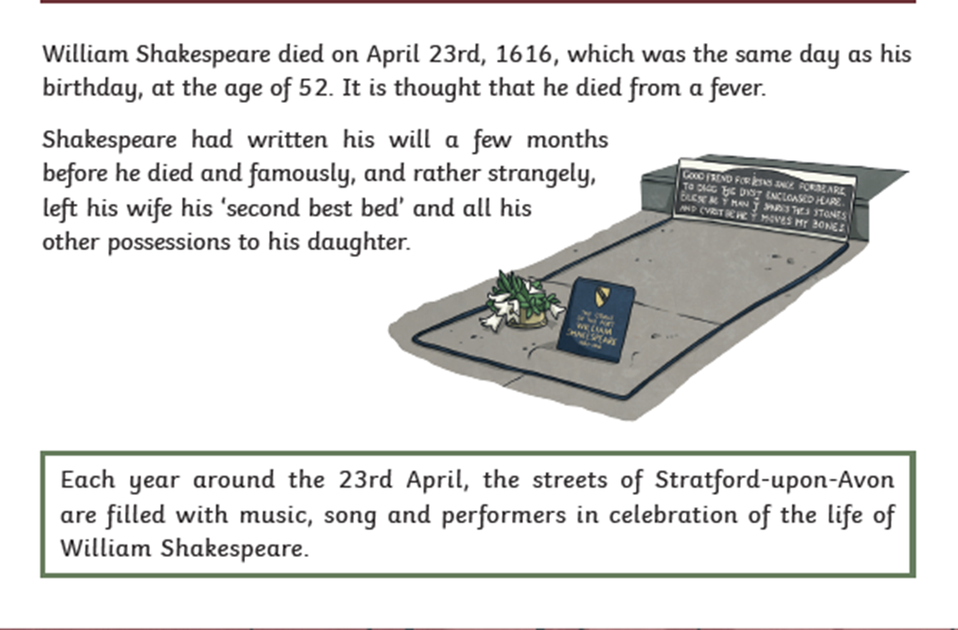
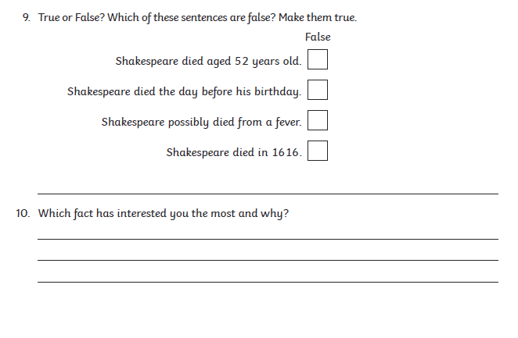
LO: To answer questions about a non-fiction text - Cold

Slide 25

laden

Slide 26
laden
What could it mean?
Fruit trees straining under laden branches.

Slide 27
laden
SAY IT AND FEEL THE SYLLABLES
SAY IT TO THE BIN
SAY IT TO SOMEONE ON ANOTHER TABLE
WHISPER IT TO THE FLOOR
SAY IT TO YOUR BOOK
REPEAT IT AFTER ME
SAY IT TO THE WINDOW
WHISPER IT TO A WALL

Slide 28
laden
Adj. carrying or holding a lot of something

Slide 29
laden
He always comes back from France laden with presents for everyone.
The table, as always, was laden with food.
The way to Miss Davison’s heart – a table laden with cola bottles.

Slide 30
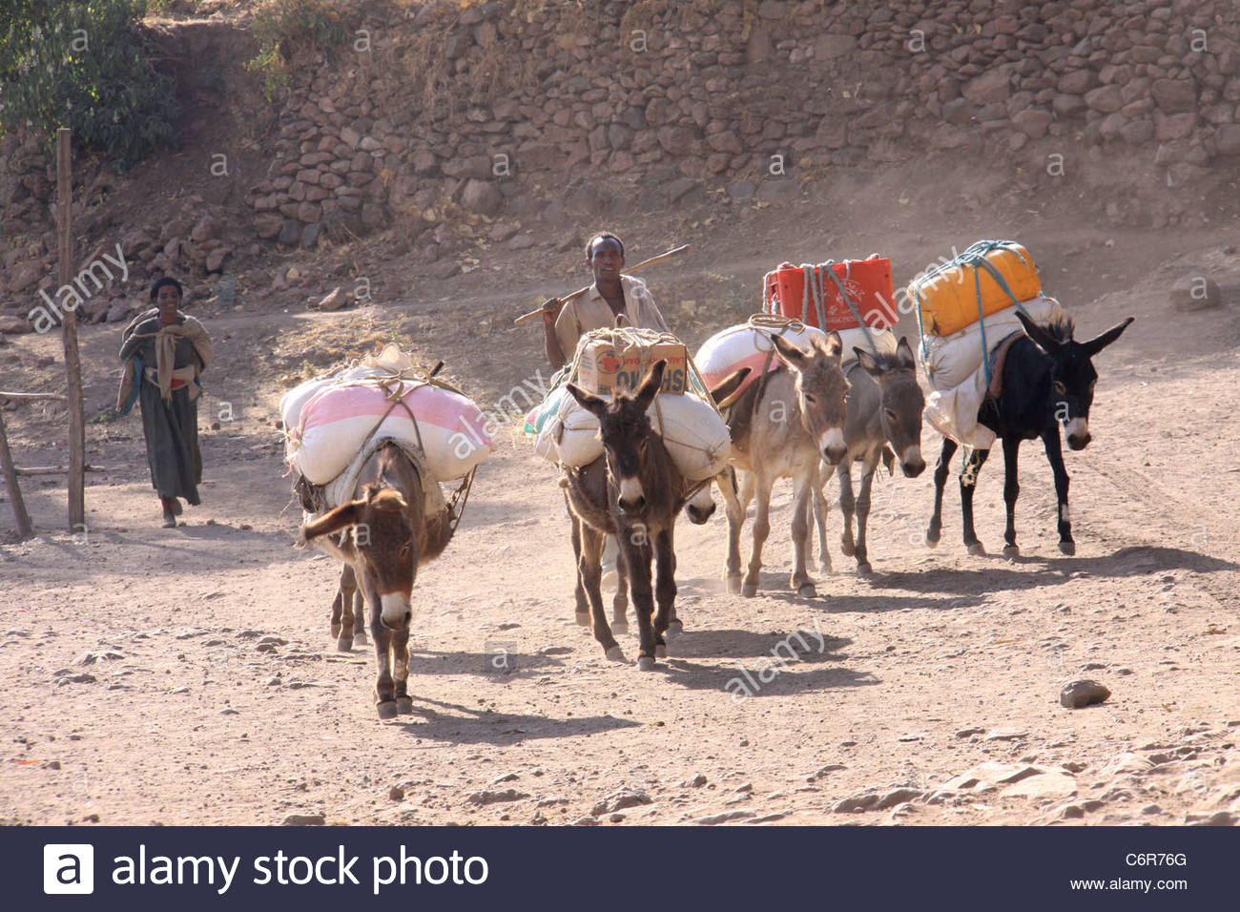
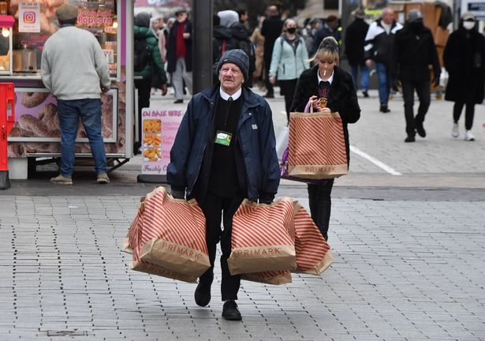
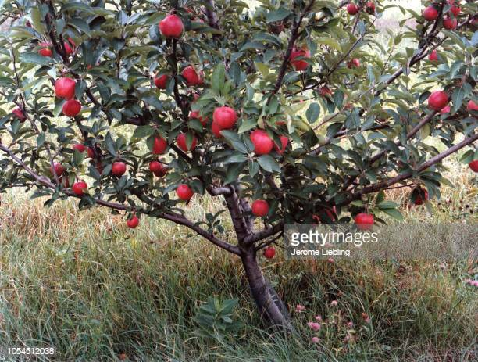
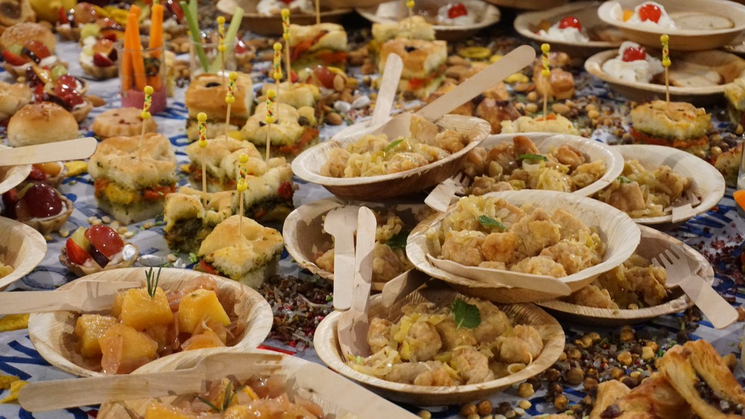
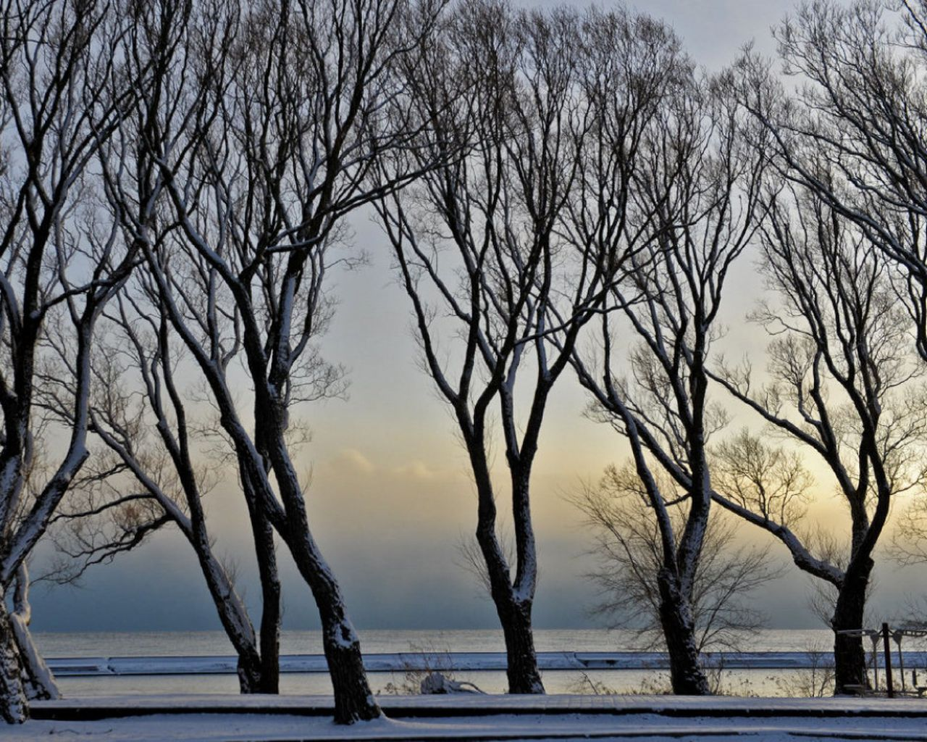
laden
Say laden if you see someone or something carrying or holding a lot of something.

Slide 31
laden
In your books, write the word, the definition and then write a statement, question, exclamation and command using the word laden

Slide 32
laden
Adj. carrying or holding a lot of something
Write a statement, question, exclamation and command using the word laden. Use the pictures to help.

Slide 33
Lunch

Slide 34
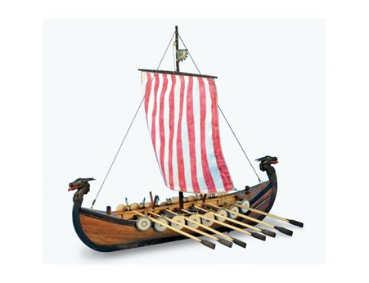
Lesson 8
LO: To make a Viking Longboat using design brief

Slide 35
LO: To make a Viking Longboat using design brief
Make your Viking Longboat
Did you have to amend your plans?

