Slide 1
Good Morning
Tuesday 26th January

Slide 2

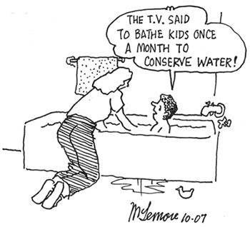


What room are these people in?
How are these people related?
Why is the duck on the floor?
How often does this child take a bath? How do you know?
What language choices has the illustrator made?

Slide 3
Spellings – Look/Cover/Spell/Check
Alicia, Elliot, Lente, Jack
Rest
column
concentration
conclusion
consequence
continuous
accompany
according
achieve
aggressive
amateur
accompany
according
achieve
aggressive
amateur
accident
accidentally
actual
actually
address

Slide 4
Maths
Read the slides and do the activities

Slide 5
LO: To be able to calculate the area of a shape by counting squares
TP: What is area?
TP: What unit of measurement do we use when calculating the area of a shape?
TP: What symbol do we use to show this?
TP: How do we find the area of a rectangle/square?

Slide 6
RECALL
Find the area of these rectangles
Length 9cm Width 3cm
Length 9cm Width 4cm
Length 9cm Width 5cm
Length 9cm Width 6cm
Length 9cm Width 7cm
What is the width?
Area 27cm² Length 9cm
Area 36cm² Length 9cm
Area 45cm² Length 9cm

Slide 7
LO: To be able to find the area of compound shapes
Top Down | Self Assessment
Some of us will even: I can problem solve and reason about compound shapes
Some of us will: I can draw a compound shape when given an area
Most of us will: I can find the area of a compound shape by deciding where to split the shape into rectangles
All of us will: I can find the area of a compound shape when it is already split into rectangles

Slide 8
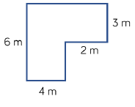
LO: To be able to find the area of compound shapes
TP: How could you find the area of this compound shape?
TP: Can you see any rectangles in the compound shape?
TP: How could you split the shape?
TP: Is there more than one way?

Slide 9
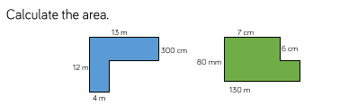
LO: To be able to find the area of compound shapes
TP: What is the problem? What do we need to do first?

Slide 10


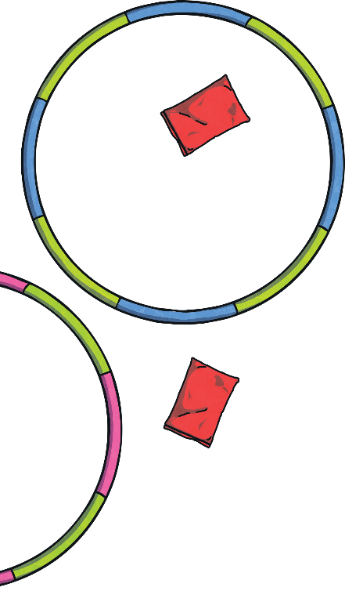
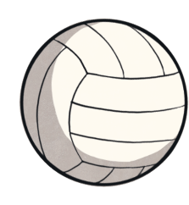

Area of Compound Shapes
Diving
13m
\
7m
\
13m × 13m = 169m²
13m × 7m = 91m²
187m²
3m
\
\
13m
6m × 3m = 18m²
6m
16m × 6m = 96m²
\
Is there another way you could split this shape to work out its area?
Calculate the area of this shape:

Slide 11
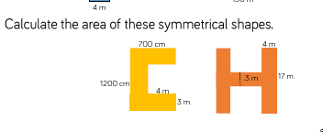
LO: To be able to find the area of compound shapes
TP: How would I find the area of these symmetrical shapes?

Slide 12
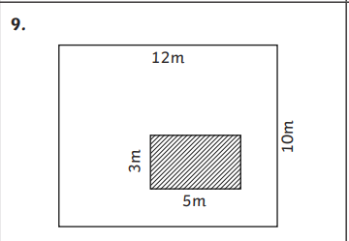
LO: To be able to find the area of compound shapes
TP: How would I find the area of the area shaded white?

Slide 13



Area of Compound Shapes
Deeper
I could cut this shape
into two rectangles,
using either the green or the yellow dotted line.
16m
7m
Discuss with a partner how the purple dotted lines could also help you find the area.
3m
6m
19m × 13m = 247m²
7m × 3m = 21m²
247m² – 21m² = 226m²

Slide 14
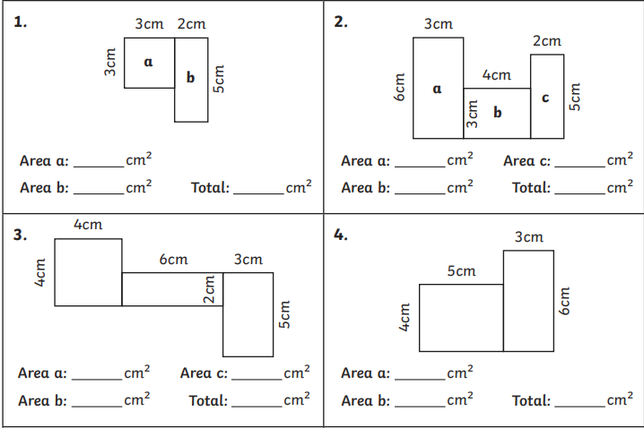
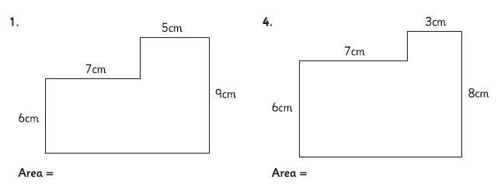
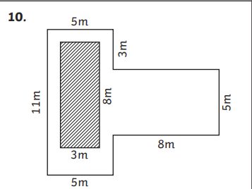
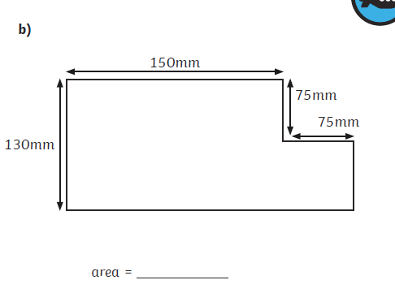
LO: To be able to find the area of compound shapes
Chilli 1 | Chilli 2 | Chilli 3
 |  | Draw 3 different compound shapes, each with an area of 45cm².
EXT:

Slide 15
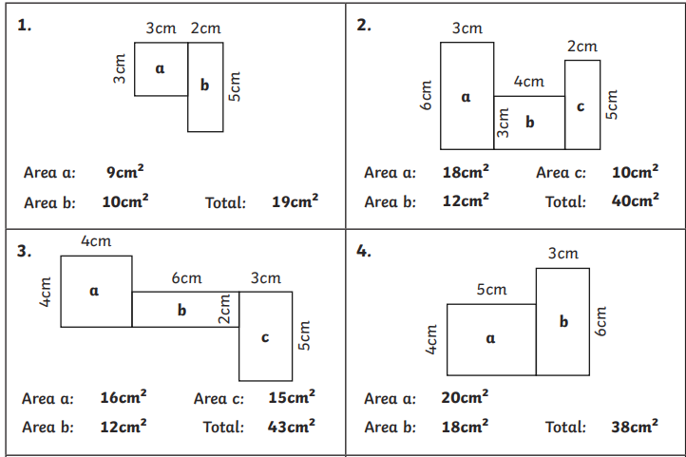
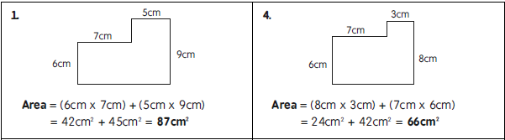
LO: To be able to find the area of compound shapes
Chilli 1 | Chilli 2 | Chilli 3
 |  | Draw 3 different compound shapes, each with an area of 45cm².
EXT: 71m²
23 625mm² or 236.25cm²

Slide 16
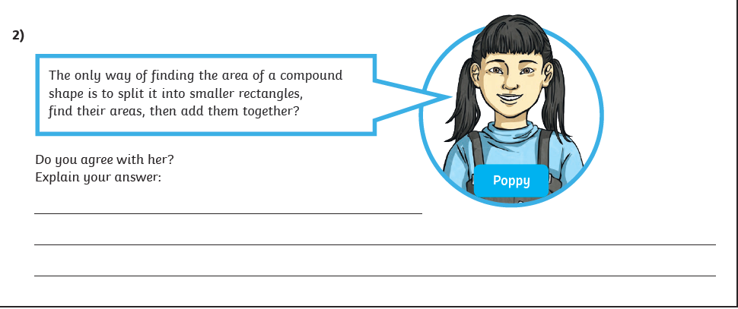
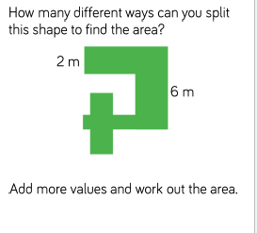
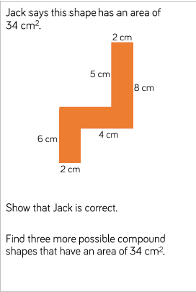
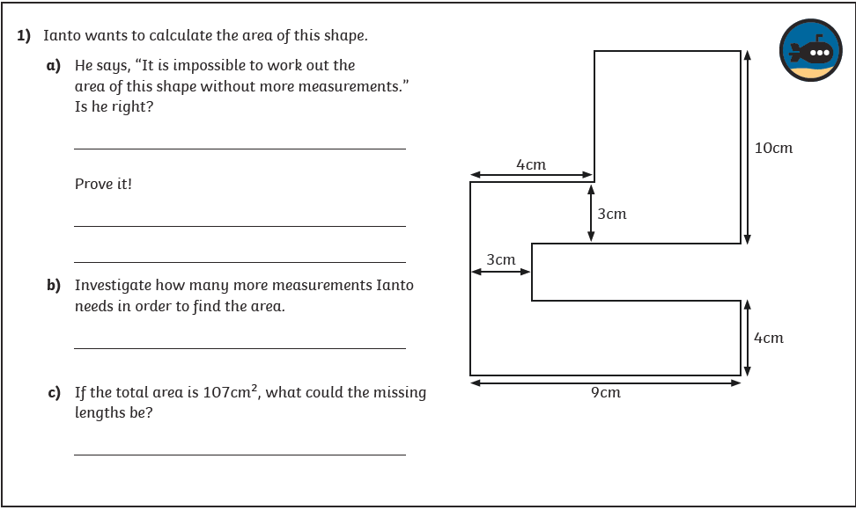
LO: To be able to find the area of compound shapes

Slide 17


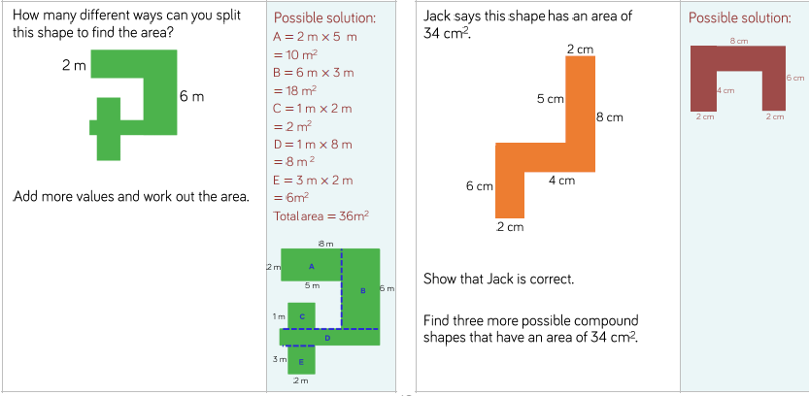
LO: To be able to find the area of compound shapes

Slide 18
LO: To be able to find the area of compound shapes
Top Down | Self Assessment
Some of us will even: I can problem solve and reason about compound shapes
Some of us will: I can draw a compound shape when given an area
Most of us will: I can find the area of a compound shape by deciding where to split the shape into rectangles
All of us will: I can find the area of a compound shape when it is already split into rectangles

Slide 19
Break

Slide 20
Introduction
Myths are part of the oral tradition of story-telling. They were told long ago and written down later. They are based in religions of ancient times. They can tell of gods and goddesses often explain how or why things are as they are e.g. creation, weather.
Features:
Basic story structure – Introduction, build-up, problem, action, conclusion
Gods and goddesses
Kings and queens
Heroes and villains
Witches and wizards
Fairies and ‘little people’
Monster, ogres and giants
Talking Animals

Slide 21
Introduction
We are looking at an Ancient Greek myth called Theseus and the Minotaur. Let us re-read it to remind ourselves of the story.
For the next 5 lessons, you are going to rewrite the myth of Theseus and the Minotaur using all the grammatical features we have been rehearsing and inverted commas.
Today, we are going to concentrate on the build up.

Slide 22
LO: To be able to rewrite a myth that describes settings, characters and atmosphere and integrates dialogue to convey character and advance the action
Top Down | Self Assessment
Some of us will even: I am able to sustain a dialogue between two or more characters without losing the flow of the story (Y6)
Some of us will: I can create and maintain an appropriate atmosphere throughout the whole piece (Y6)
Most of us will: I make links in fiction between the opening and ending of a story (Y5)
All of us will: I make sure my writing does not jump from one idea to another and I try to build on ideas through the piece of work, making connections between paragraphs (Y4)

Slide 23
LO: To be able to rewrite a myth that describes settings, characters and atmosphere and integrates dialogue to convey character and advance the action
Paragraphs
A paragraph is a group of sentences about the same thing/subject.
Fiction – You change a paragraph when the time, place, action or place changes
Look at our plan of the story from Theseus and the Minotaur. How many paragraphs could our build up have? Dilemma have?

Slide 24
LO: To be able to rewrite a myth that describes settings, characters and atmosphere and integrates dialogue to convey character and advance the action
Prince Theseus, son of King Aegeus, knew the importance of keeping his word. However, he also knew what his father was doing was wrong so he went to his father with an idea.
“Father, I know it is important to keep your word when you say you will do something but many of the people of Athens are extremely upset that their children are being sent to be brutally devoured by a monster,” said Theseus with sincerity.
“I know, it is a horrible thing to do but what else can I do?” replied his father sadly.
“ I have an idea,” Theseus responded boldly. “I shall go to Crete as the seventh boy and when I am put in the labyrinth, I shall kill the monster and end the terror of the citizens of Athens,” King Aegeus pondered this idea for a few moments and soon replied,
“No son, I shall not risk losing my only son to that terrible monster. It is out of the question.” But Theseus told him he was going to go with or without his consent and repeated this again and again. Eventually, the King relented and told his son,
“Fine. You can go. Only on one condition. When you return, you must replace the black sail of your ship with white sails.” To this Theseus agreed.
What have I used for this part of the build up to tell the story but to keep the action moving?

Slide 25
LO: To be able to rewrite a myth that describes settings, characters and atmosphere and integrates dialogue to convey character and advance the action
The prince took his place alongside the other six boys and seven girls and sailed towards Crete.
To improve this story further, and to convey an atmosphere of fear, I need to describe how the other boys and girls on the boat are behaving.
Can you write sentences that will help to do this?

Slide 26
LO: To be able to rewrite a myth that describes settings, characters and atmosphere and integrates dialogue to convey character and advance the action
When the prince and the children arrived on the island of Crete, King Minos and his daughter, Princess Ariadne, came to greet them and welcomed them into their palace. The king told the children they would not be eaten until the next day and in the meantime, they should enjoy themselves in the palace.
What could I had to this sentence to show that the children were not happy about the situation that they found themselves in and continue to create the atmosphere of fear?
Could I use description?
Could I use a rhetorical question?

Slide 27
LO: To be able to rewrite a myth that describes settings, characters and atmosphere and integrates dialogue to convey character and advance the action
As Minos led the children to the palace to be cleaned and prepared, Ariadne pulled Theseus to one side. Desperate to escape from the world that her father had built, she offered to aid him in his quest in exchange for safe passage to Athens.
Ariadne took Theseus to meet Daedalus, the inventor of the labyrinth which held the minotaur.
Could you use a conversation here to move the story forward? Think about what you have already done in the lessons

Slide 28
LO: To be able to rewrite a myth that describes settings, characters and atmosphere and integrates dialogue to convey character and advance the action
At the entrance to the labyrinth, Daedalus gave Theseus some string and told the prince to trail it behind him as he entered so he could find his way back out once he had defeated the Minotaur.
Ariadne then gave Theseus a fine sword. Theseus thanked her for her kindness.
“But don’t forget,” the princess warned, “you must take me with you when you leave.”

Slide 29
LO: To be able to rewrite a myth that describes settings, characters and atmosphere and integrates dialogue to convey character and advance the action
ACTIVITY
Children to use their plans to write the build up of the story. To use conversation to move the story forward where appropriate and to use descriptive devices to convey characters feelings.

Slide 30
LO: To be able to rewrite a myth that describes settings, characters and atmosphere and integrates dialogue to convey character and advance the action
Top Down | Self Assessment
Some of us will even: I am able to sustain a dialogue between two or more characters without losing the flow of the story (Y6)
Some of us will: I can create and maintain an appropriate atmosphere throughout the whole piece (Y6)
Most of us will: I make links in fiction between the opening and ending of a story (Y5)
All of us will: I make sure my writing does not jump from one idea to another and I try to build on ideas through the piece of work, making connections between paragraphs (Y4)

Slide 31
Reading Comprehension
LO: To answer questions about a non-fiction text - Cold

Slide 32
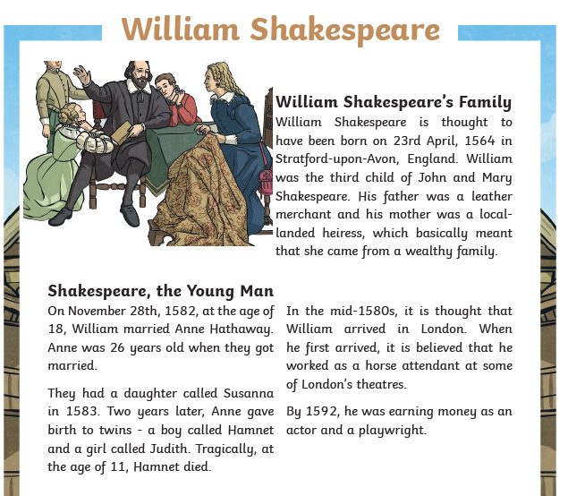
LO: To answer questions about a non-fiction text - Cold

Slide 33
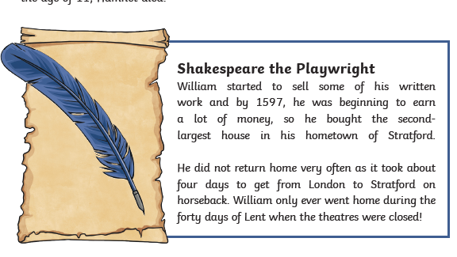
LO: To answer questions about a non-fiction text - Cold

Slide 34
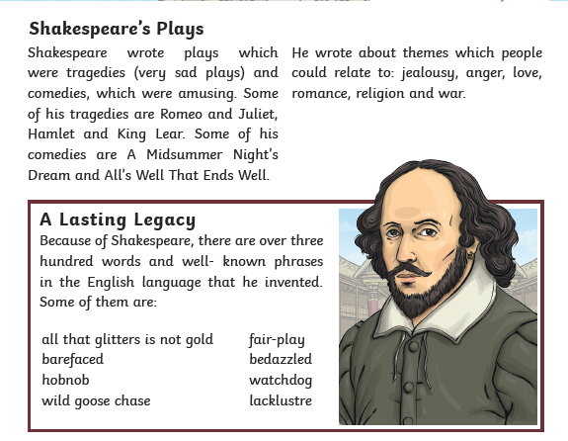
LO: To answer questions about a non-fiction text - Cold

Slide 35
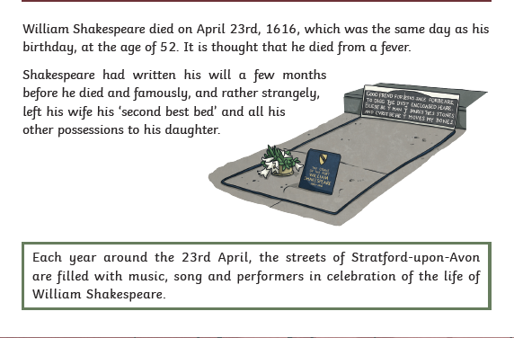
LO: To answer questions about a non-fiction text - Cold

Slide 36
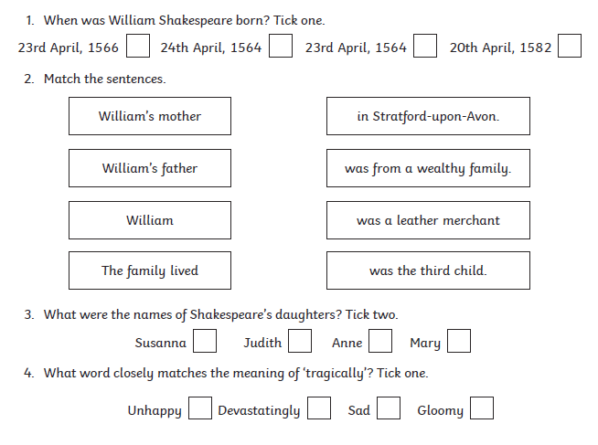

LO: To answer questions about a non-fiction text - Cold

Slide 37
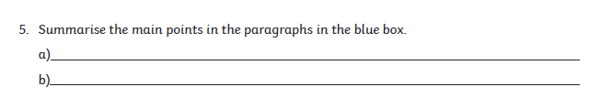

LO: To answer questions about a non-fiction text - Cold

Slide 38
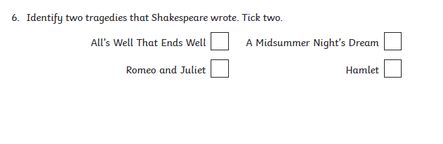

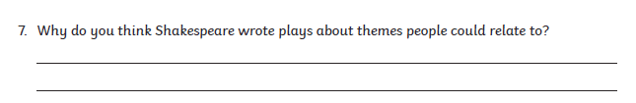
LO: To answer questions about a non-fiction text - Cold

Slide 39
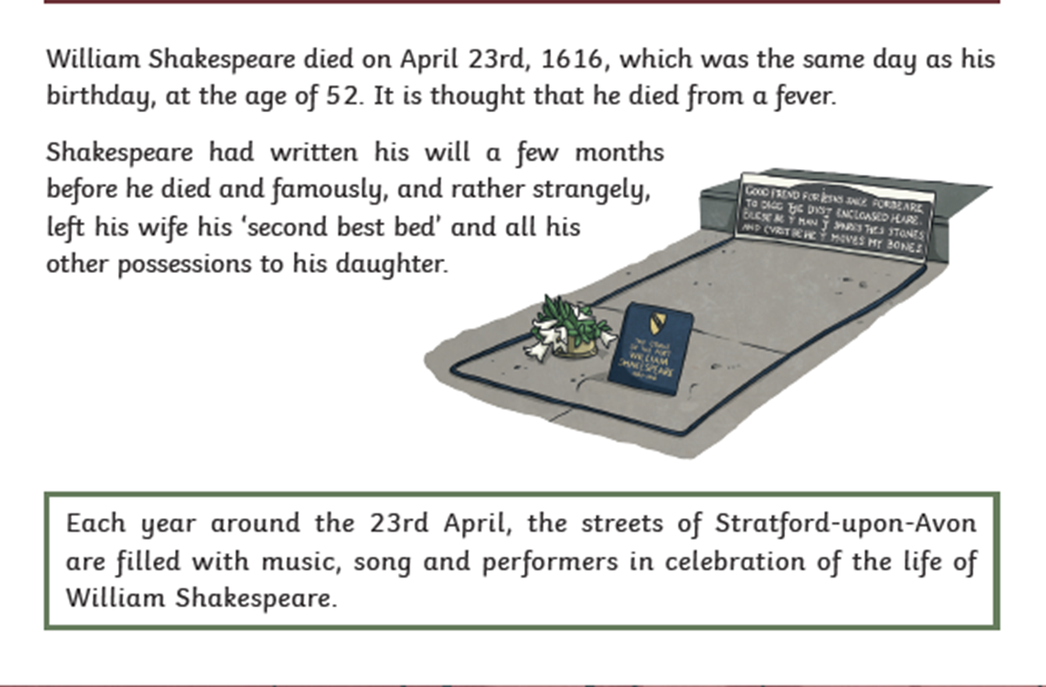
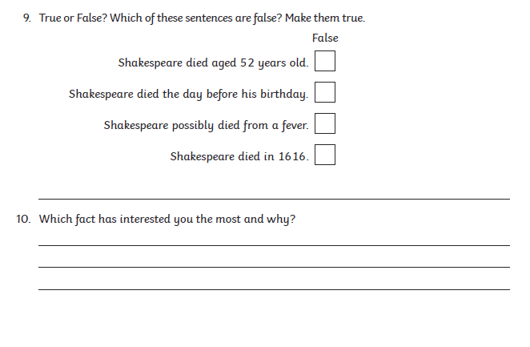
LO: To answer questions about a non-fiction text - Cold

Slide 40

ushering

Slide 41
ushering
What could it mean?
“Can I get you some tea?” Josie asked kindly ushering her guest through to the kitchen.

Slide 42
ushering
SAY IT AND FEEL THE SYLLABLES
SAY IT TO THE BIN
SAY IT TO SOMEONE ON ANOTHER TABLE
WHISPER IT TO THE FLOOR
SAY IT TO YOUR BOOK
REPEAT IT AFTER ME
SAY IT TO THE WINDOW
WHISPER IT TO A WALL

Slide 43
ushering
Verb. to show someone where they should go, or to make someone go where you want them to go

Slide 44
ushering
She ushered us into her office and offered us coffee.
Officials quickly ushered the protesters out of the hall.
The bride’s nephew ushered people to their seats in the church.

Slide 45
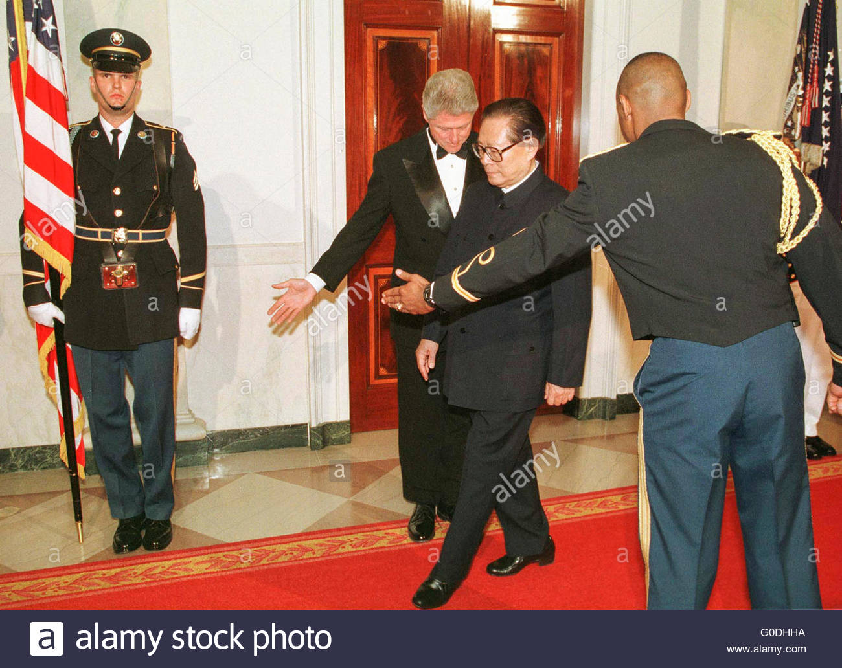
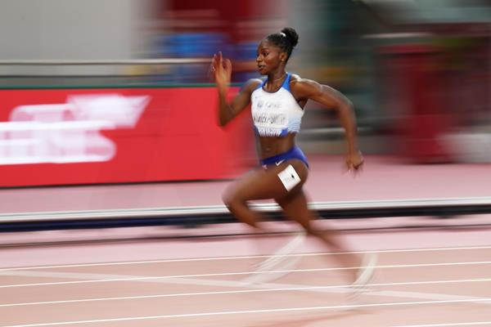
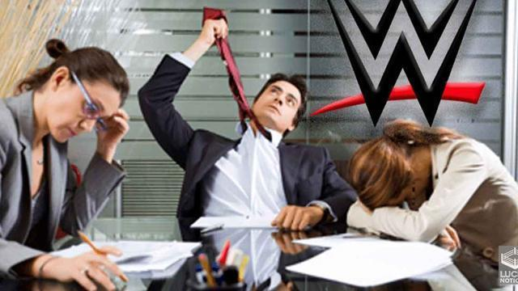
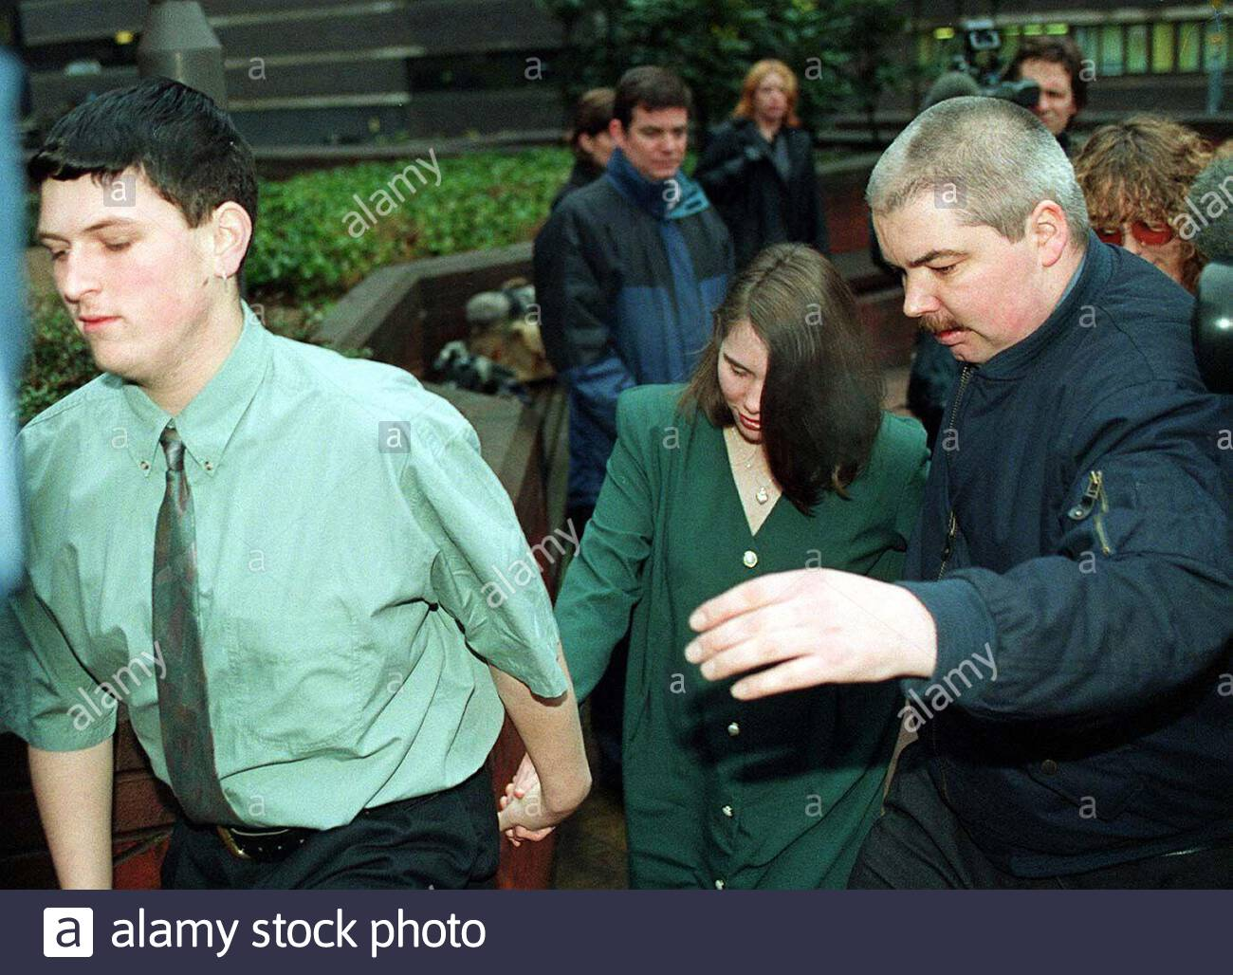
ushering
Say ushering if you see someone showing someone where to go.

Slide 46
ushering
In your books, write the word, the definition and use it in a sentence/draw a picture.

Slide 47
ushering
Verb. to show someone where they should go, or to make someone go where you want them to go

Slide 48
Lunch

Slide 49
Lesson 3 – Why I choose not to use!
LO: To know what the positive benefits of a drug-free life are

Slide 50
LO: To know what the positive benefits of a drug-free life are
Jed has started to realise that making choices is not just about what you choose to do, it’s also about what you choose not to do. “My body is like my most amazing possession - it belongs to me, it’s my job to take care of it!” said Jed to Ted that night. “If only more people knew how great healthy felt,” he thought.
Then Jed had an idea! He decided to start a Healthy Me / Boss of Me campaign as part of the school’s Drug Aware lessons. Next day he told the class and everybody thought it was an amazing idea and so did the teacher. His friends all wanted to take part – even the Trouble Twins didn’t want to be left out!

Slide 51
LO: To know what the positive benefits of a drug-free life are
Activity 1: Choosing your campaign focus
In groups, choose a positive choice health campaign based on one of the following:
smoking, alcohol, medication or caffeine
Using the drug information sheets, research the effects and statistics provided

Slide 52
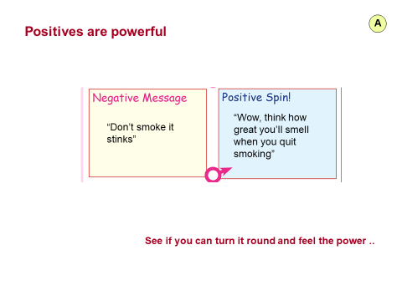
LO: To know what the positive benefits of a drug-free life are
Activity 1: Choosing your campaign focus
Using the Positive Spin sheet ask them to reframe the information into a range of positive messages
Choose key positive messages to use in the campaign

Slide 53
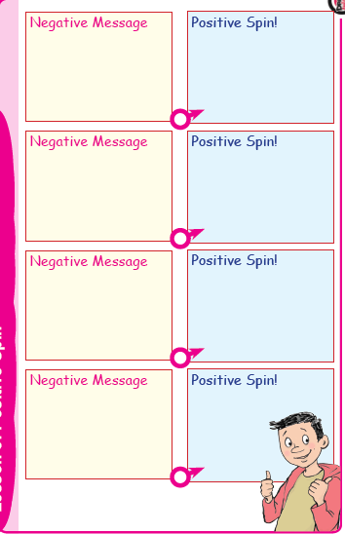
LO: To know what the positive benefits of a drug-free life are
Activity 1: Choosing your campaign focus
Using the Positive Spin sheet ask them to reframe the information into a range of positive messages
Choose key positive messages to use in the campaign

Slide 54
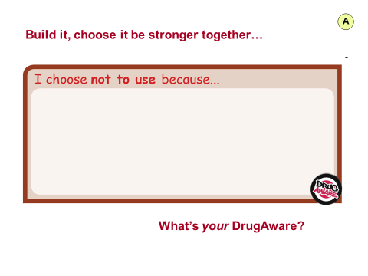
LO: To know what the positive benefits of a drug-free life are
Activity 2: Choosing your key messages
Use the graffiti wall brick to collect and think of key messages to use in the campaign
We will build the bricks into an ‘inspiration wall’ in the classroom or even hall or foyer of the school.

Slide 55
LO: To know what the positive benefits of a drug-free life are
Activity 3: Creating your materials
Design the materials - poster, t-shirt, leaflet,
REMEMBER it must be a positive message

Slide 56
LO: To know what the positive benefits of a drug-free life are
Activity 4: Make a plan to roll out the campaign/s to the school or local community
Some ideas are:
• Hold a poster competition judged as part of a special assembly
• Display work at a special themed assembly
• Make signs for the school
• Put it on your school newsletter, website or cable channel

Slide 57
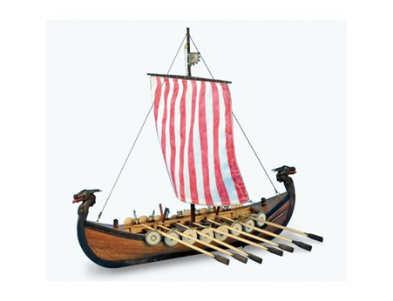
Lesson 7
LO: To make a Viking Longboat using design brief

Slide 58
LO: To make a Viking Longboat using design brief
Make your Viking Longboat
Did you have to amend your plans?

