Slide 1
Good Morning
Monday 25th January

Slide 2
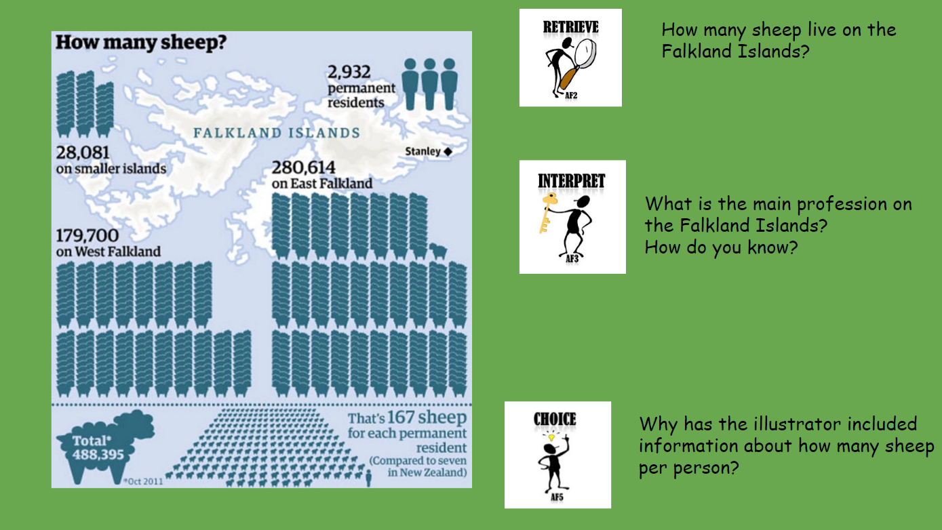

Slide 3
Spellings – Look/Cover/Spell/Check
Alicia, Elliot, Lente, Jack
Rest
column
concentration
conclusion
consequence
continuous
accompany
according
achieve
aggressive
amateur
accompany
according
achieve
aggressive
amateur
accident
accidentally
actual
actually
address

Slide 4
Maths
Read the slides and do the activities

Slide 5
LO: To be able to calculate the area of a shape by counting squares
The area of a shape is the name we give to the space it takes up.
In a 2D shape it is the space inside the lines.
The larger the shape the larger the area
We measure it in square units called square centimetres (cm²) and square metres (m²)
Square & Rectangle – a = l x w

Slide 6
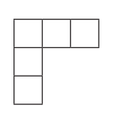
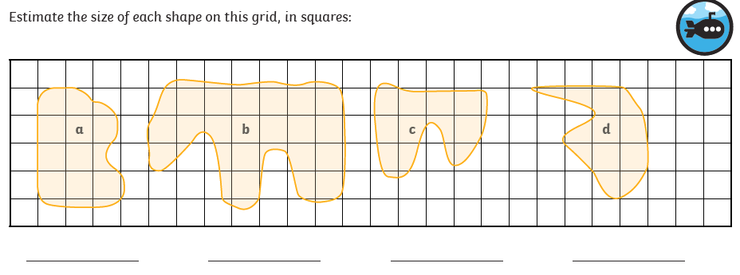
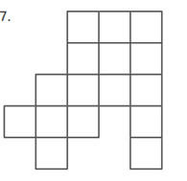
RECALL
TP: Find the area of these shapes
TP: Find the area of these shapes.

Slide 7
LO: To be able to find the area of a rectangle
Top Down | Self Assessment
Some of us will even: I can solve problem solving and reasoning questions involving area
Some of us will: I can work out the width when the area and length are known
Most of us will: I can draw all the different rectangles that have a given area
All of us will: I can calculate the area of a rectangle using the length and width

Slide 8
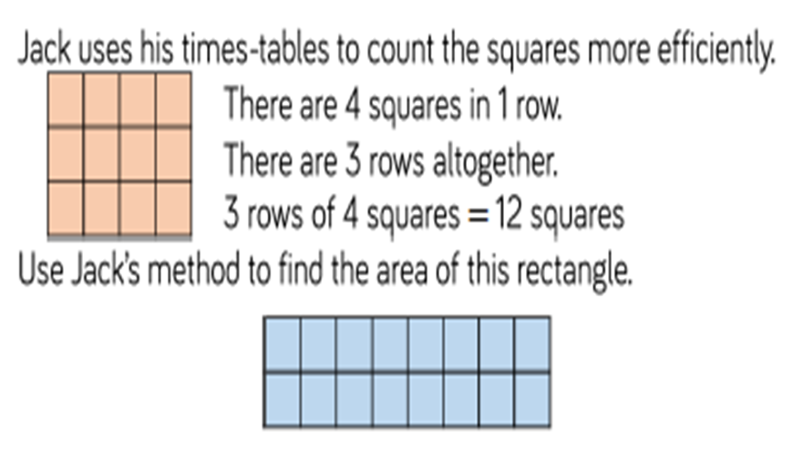
LO: To be able to find the area of a rectangle
There is a quicker way to find the area of a rectangle or square. It is based on what Jack did. What is the equation for finding the area of a rectangle/square?
Using this method, what is the area of the blue rectangle?

Slide 9
LO: To be able to find the area of a rectangle
How many different rectangles can you make that have the area of 24cm²?
What mathematical knowledge do you have that will help you work this out? – Factor Pairs

Slide 10
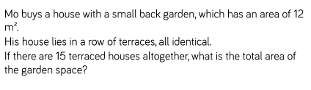
LO: To be able to find the area of a rectangle

Slide 11
LO: To be able to find the area of a rectangle
Q: A rectangle has an area of 50cm². It has a length of 10cm. What is its width?
What mathematical knowledge do you have that you need to use?

Slide 12
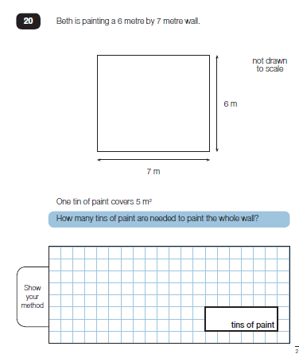
LO: To be able to find the area of a rectangle
TP: How would you complete this question?

Slide 13
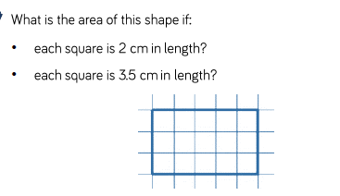
LO: To be able to find the area of a rectangle
Chilli 1 | Chilli 2 | Chilli 3
Find the area of these rectangles: Length 9cm Width 3cm Length 9cm Width 4cm Length 9cm Width 5cm Length 9cm Width 6cm Length 9cm Width 7cm | Draw all the rectangles that have an area of: 12cm² 18cm² 28cm² | What is the width of thee shapes if: Area 27cm² Length 9cm Area 36cm² Length 9cm Area 45cm² Length 9cm
EXT

Slide 14
LO: To be able to find the area of a rectangle
Chilli 1 | Chilli 2 | Chilli 3
Find the area of these rectangles: Length 9cm Width 3cm 27cm² Length 9cm Width 4cm 36cm² Length 9cm Width 5cm 45cm² Length 9cm Width 6cm 54cm² Length 9cm Width 7cm 63cm² | Draw all the rectangles that have an area of: 12cm² 1 x12, 2x 6, 3 x 4 18cm² 1 x 18, 2 x 9, 3 x 6 28cm² 1 x 28, 2 x 14, 4 x 7 | What is the width of thee shapes if: Area 27cm² Length 9cm width = 3cm Area 36cm² Length 9cm width – 4cm Area 45cm² Length 9cm width = 5cm
EXT
30cm²
52.5cm²

Slide 15
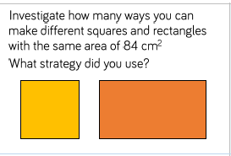
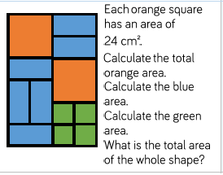
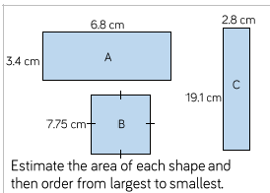
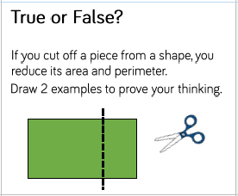
LO: To be able to find the area of a rectangle

Slide 16
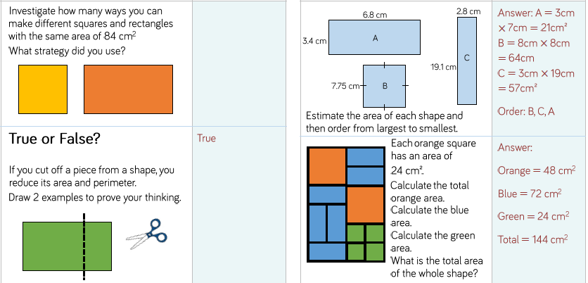
LO: To be able to find the area of a rectangle

Slide 17
LO: To be able to find the area of a rectangle
Top Down | Self Assessment
Some of us will even: I can solve problem solving and reasoning questions involving area
Some of us will: I can work out the width when the area and length are known
Most of us will: I can draw all the different rectangles that have a given area
All of us will: I can calculate the area of a rectangle using the length and width

Slide 18
Assembly and Break

Slide 19
English
Read the slides and do the activities

Slide 20
Introduction
Myths are part of the oral tradition of story-telling. They were told long ago and written down later. They are based in religions of ancient times. They can tell of gods and goddesses often explain how or why things are as they are e.g. creation, weather.
Features:
Basic story structure – Introduction, build-up, problem, action, conclusion
Gods and goddesses
Kings and queens
Heroes and villains
Witches and wizards
Fairies and ‘little people’
Monster, ogres and giants
Talking Animals

Slide 21
Introduction
We are looking at an Ancient Greek myth called Theseus and the Minotaur. Let us re-read it to remind ourselves of the story.
For the next 5 lessons, you are going to rewrite the myth of Theseus and the Minotaur using all the grammatical features we have been rehearsing and inverted commas.
Today, we are going to concentrate on the beginning of the story.

Slide 22
LO: To be able to rewrite a myth that describes settings, characters and atmosphere and integrates dialogue to convey character and advance the action
Top Down | Self Assessment
Some of us will even: I am able to sustain a dialogue between two or more characters without losing the flow of the story (Y6)
Some of us will: I can create and maintain an appropriate atmosphere throughout the whole piece (Y6)
Most of us will: I make links in fiction between the opening and ending of a story (Y5)
All of us will: I make sure my writing does not jump from one idea to another and I try to build on ideas through the piece of work, making connections between paragraphs (Y4)

Slide 23
LO: To be able to rewrite a myth that describes settings, characters and atmosphere and integrates dialogue to convey character and advance the action
Paragraphs
A paragraph is a group of sentences about the same thing/subject.
Fiction – You change a paragraph when the time, place, action or place changes
Look at our plan of the story from Theseus and the Minotaur. How many paragraphs could our beginning have? Why?

Slide 24
LO: To be able to rewrite a myth that describes settings, characters and atmosphere and integrates dialogue to convey character and advance the action
A long time ago, on an island called Crete, there lived a king named Minos. After the loss of his son, Minos waged war against Athens. Every now and then, he would send his large, powerful army to storm the city and wreak havoc.
King Aegeus of Athens wanted to prevent these attacks. He struck a deal with Minos; each year, he would send over seven Athenian boys and seven Athenian girls as an offering to Minos’ bloodthirsty beast - the Minotaur.
The Minotaur was a monster that was half human and half bull. He lived in the centre of a huge maze on the island of Crete. King Minos loved this horrible monster and liked to give it a treat every now and again. He knew that his people would prefer it if he fed his monster Athenian children, so King Minos accepted the deal and, in return, agreed to cease his attacks on Athens.
Nine years passed very quickly. It was just about time for Athens to send seven boys and seven girls to Crete to be eaten by the Minotaur. Seven girls and six boys had taken their place to go to Crete. Everyone in Athens was upset.

Slide 25
LO: To be able to rewrite a myth that describes settings, characters and atmosphere and integrates dialogue to convey character and advance the action
The Minotaur was a monster that was half human and half bull. He lived in the centre of a huge maze on the island of Crete. King Minos loved this horrible monster and liked to give it a treat every now and again. He knew that his people would prefer it if he fed his monster Athenian children, so King Minos accepted the deal and, in return, agreed to cease his attacks on Athens.
ABC
A = Thinking about all the different grammatical and descriptive features we can put into a story, what is good about it?
B = What else is good about it?
C = How can we improve it?

Slide 26
LO: To be able to rewrite a myth that describes settings, characters and atmosphere and integrates dialogue to convey character and advance the action
The Minotaur was a monster that was half human and half bull.
We can improve this paragraph for the reader by painting a vivid picture of the Minotaur. We need to describe what the Minotaur is like in detail to make him truly frightening.
What could we write?

Slide 27
LO: To be able to rewrite a myth that describes settings, characters and atmosphere and integrates dialogue to convey character and advance the action
ACTIVITY
Children to use their plans to write the beginning of the story. Their beginning should have more than one paragraph and describe the Minotaur so that it creates and atmosphere of fear and describes this character in detail creating a vivid picture in the mind of the reader as to what the minotaur looks like and is like.

Slide 28
LO: To be able to rewrite a myth that describes settings, characters and atmosphere and integrates dialogue to convey character and advance the action
Top Down | Self Assessment
Some of us will even: I am able to sustain a dialogue between two or more characters without losing the flow of the story (Y6)
Some of us will: I can create and maintain an appropriate atmosphere throughout the whole piece (Y6)
Most of us will: I make links in fiction between the opening and ending of a story (Y5)
All of us will: I make sure my writing does not jump from one idea to another and I try to build on ideas through the piece of work, making connections between paragraphs (Y4)

Slide 29
Reading Comprehension – Non-Fiction
Read the ‘The Man Who Moved a Mountain’ and answer Q5-8

Slide 30
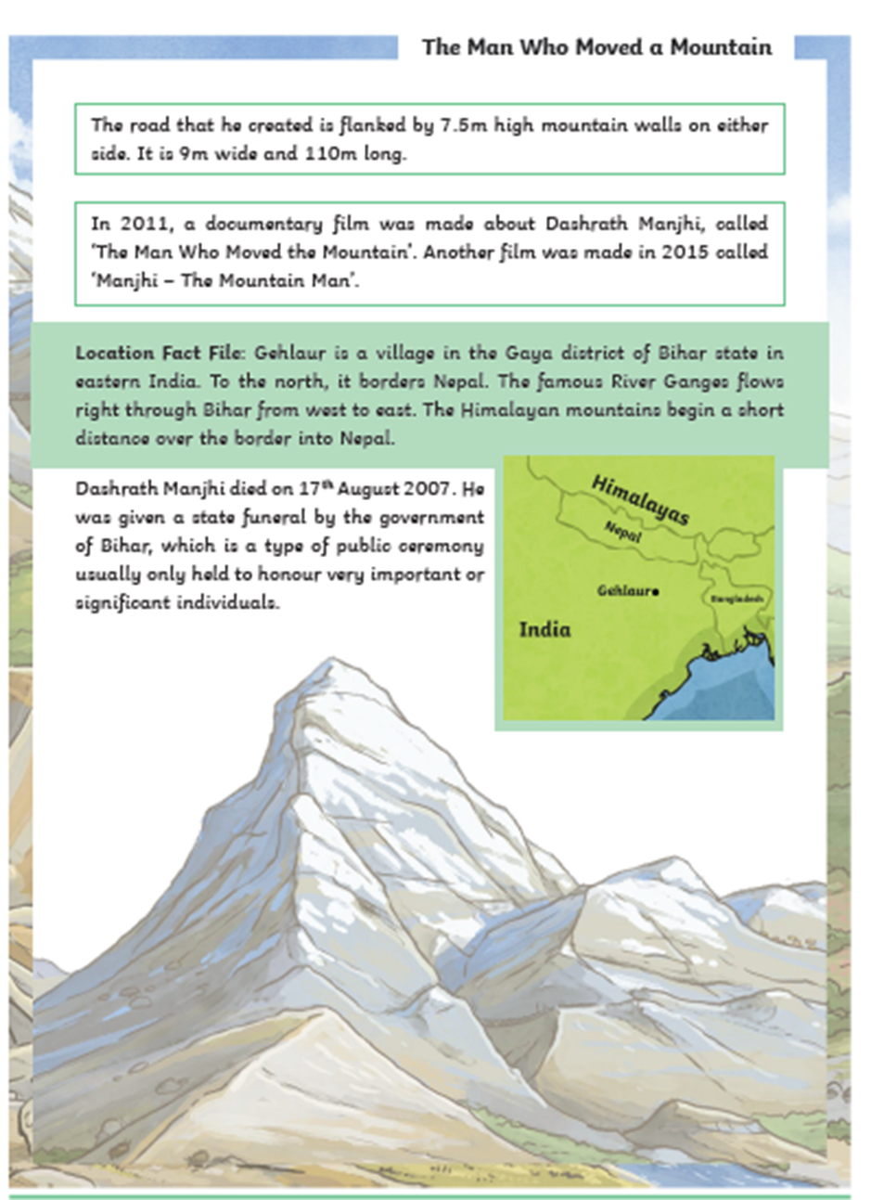
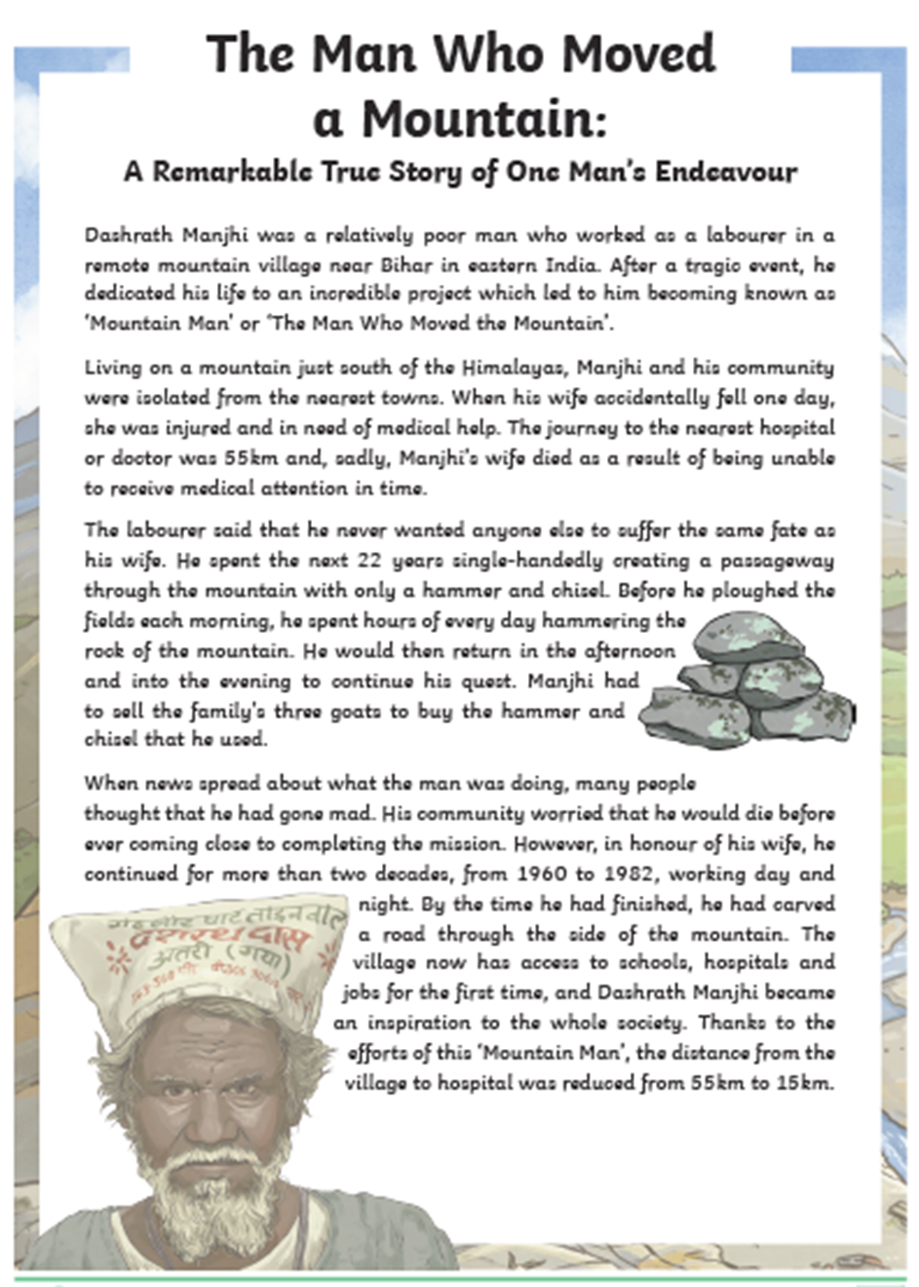
Non-Fiction - ‘The Man Who Moved a Mountain’

Slide 31
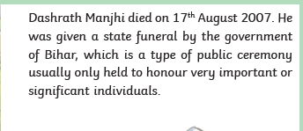
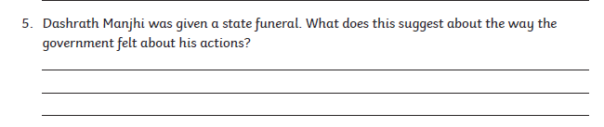
Non-Fiction - ‘The Man Who Moved a Mountain’

Slide 32
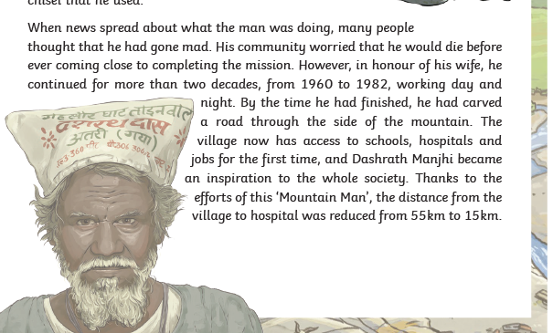

Non-Fiction - ‘The Man Who Moved a Mountain’

Slide 33
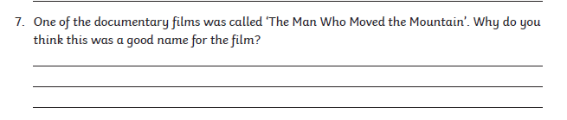
Non-Fiction - ‘The Man Who Moved a Mountain’

Slide 34
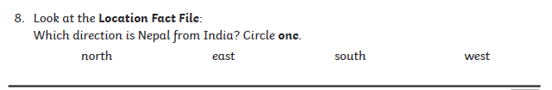
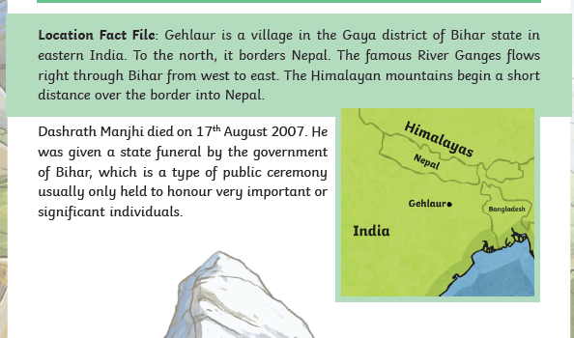
Non-Fiction - ‘The Man Who Moved a Mountain’

Slide 35

memento

Slide 36
memento
What could it mean?
As she looked around the cherished home, stuffed with joyful mementos of all the Hoopers who had lived there, she happily pictured the day her bulldozers would flatten it to the ground.

Slide 37
memento
SAY IT AND FEEL THE SYLLABLES
SAY IT TO THE BIN
SAY IT TO SOMEONE ON ANOTHER TABLE
WHISPER IT TO THE FLOOR
SAY IT TO YOUR BOOK
REPEAT IT AFTER ME
SAY IT TO THE WINDOW
WHISPER IT TO A WALL

Slide 38
memento
Noun. an object that you keep to remember a person, place, or event

Slide 39
memento
I kept a seashell as a memento of our holiday.
The bracelet is a memento from her college sweetheart.

Slide 40
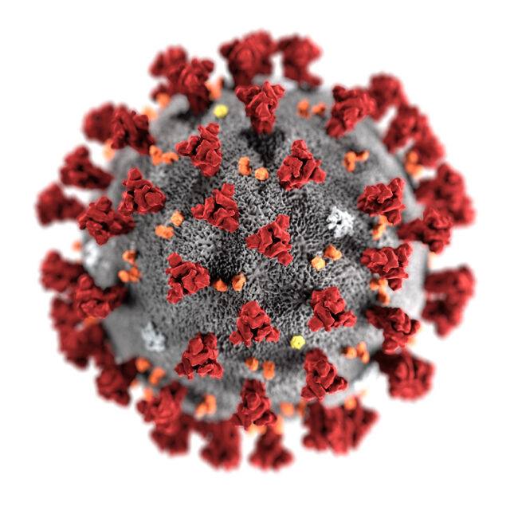
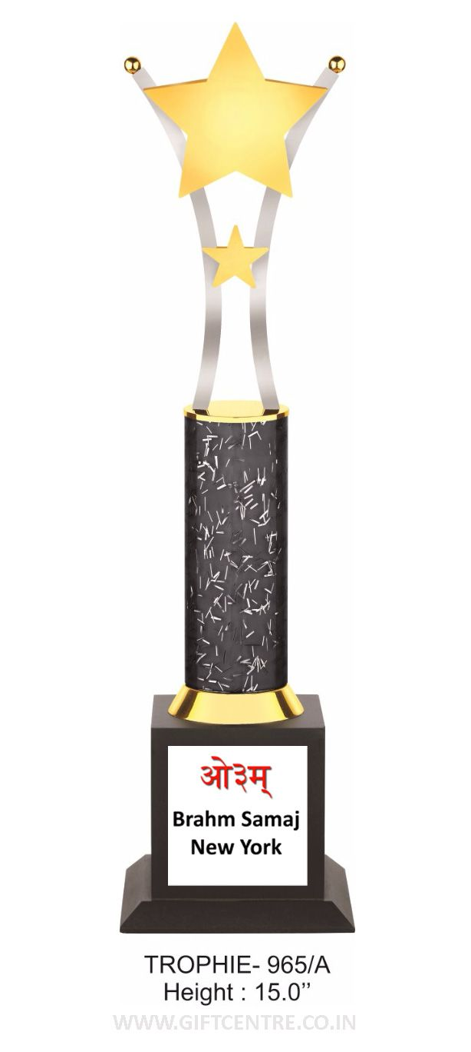
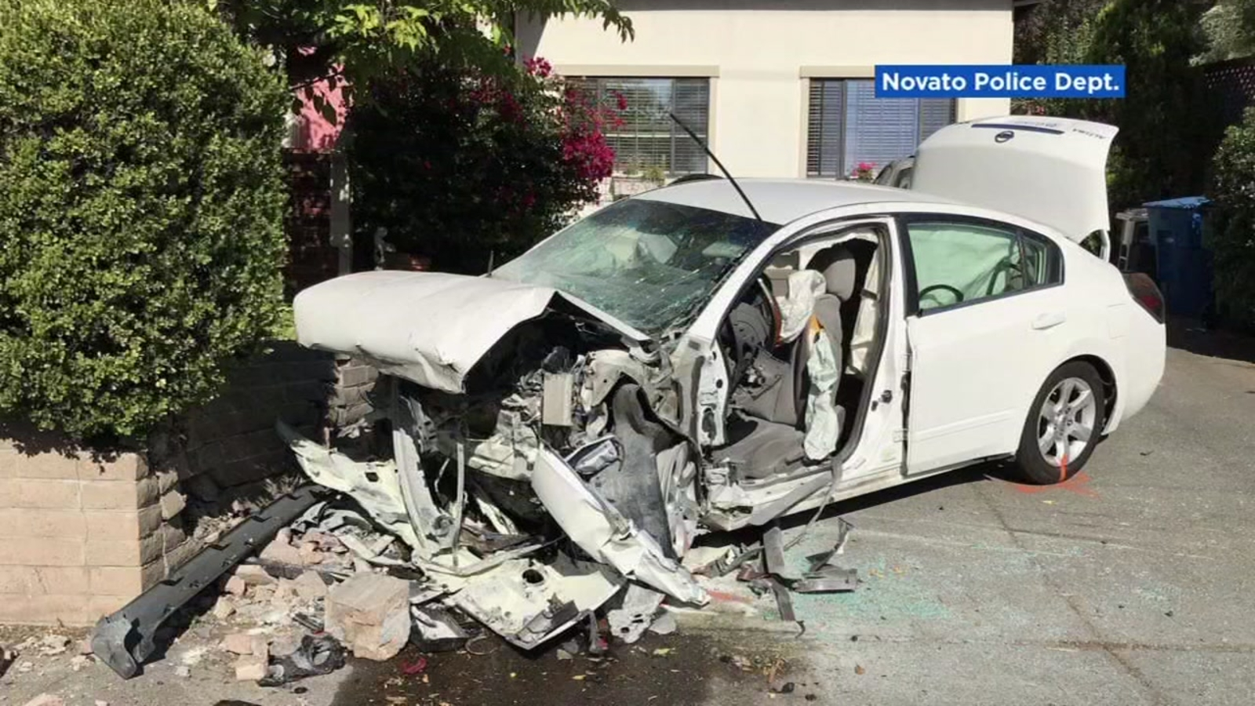
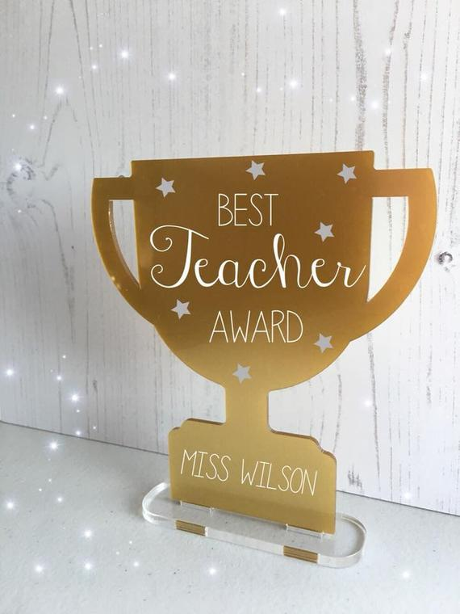
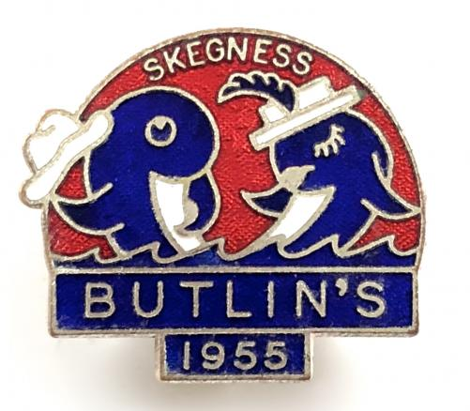
memento
Write/Say memento if you see an object that someone might keep to remember something.

Slide 41
memento
In your books, write the word, the definition and can you turn these fragments of a sentence into a full sentence using the work momento?

Slide 42
memento
Noun. an object that you keep to remember a person, place, or event
My trophies are
Kept by Jack.

Slide 43
Lunch

Slide 44
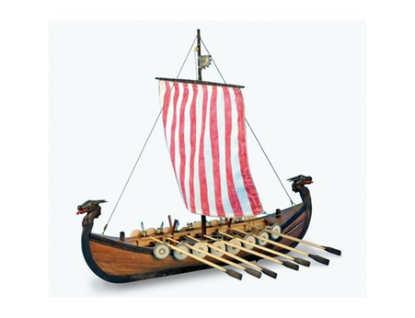
Lesson 6
LO: To make a Viking Longboat using design brief

Slide 45
LO: To make a Viking Longboat using design brief
Make your Viking Longboat
Did you have to amend your plans?

